Slide 1
AQA GCSE English Language
Paper 1 50%
Paper 2 50%
Section A:
Reading
1 unseen literary fiction text
Section B:
Writing
Descriptive or narrative writing
Section A:
Reading
1 non-fiction and 1 literary non-fiction text
Section B:
Writing
Writing to present a viewpoint
Total exam time:
1 hour and 45 minutes
Total exam time:
1 hour and 45 minutes
All exams will be at the end of Year 11. You will also sit an English Literature GCSE.

Slide 2
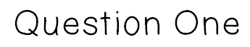

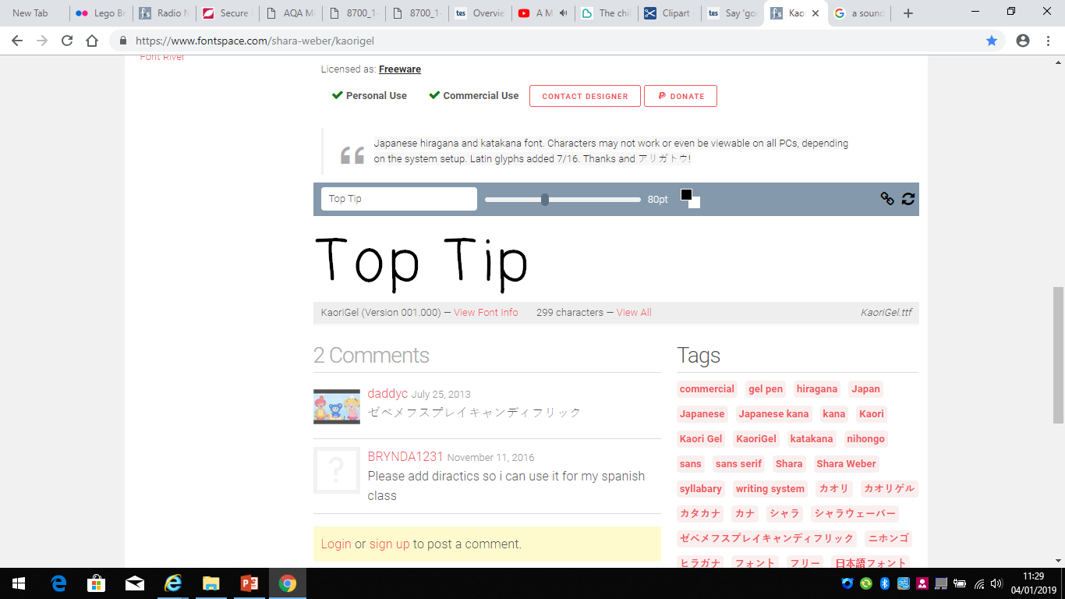
AO1
4 Marks
5 Minutes
Read again the first part of the Source from lines 1 to 6.
List four things about the classroom from this part of the source.
A ___________________________________________________________________
_____________________________________________________________________
B____________________________________________________________________
_____________________________________________________________________
C____________________________________________________________________
_____________________________________________________________________
D____________________________________________________________________
_____________________________________________________________________
Highlight section of text the question asks you to look at.
Read it thoroughly – DO NOT SKIM READ!
Take your answers from what is explicitly written.
Do not make assumptions or look for inferred meaning.
5 MINUTES

Slide 3
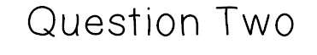

AO2
8 Marks
10 Minutes
Look in detail at this extract, from lines 7 – 15 of the source:
How does the writer use language here to describe the teacher?
You could include the writer’s choice of:
words and phrases
language features and techniques
sentence forms.
1) Use your topic sentence to make a point relevant to the question.
2) Select evidence from the text – pick out a key quotation.
Highlight 2/3 quotations that you can write about in detail.
Explode the quotations, linking your interpretation back to the question to evidence your understanding.
Offer multiple interpretations of the same quote.
3) Explain the evidence – this should be the longest part of the paragraph.
4) Finish the paragraph by establishing a link back to the question.

Slide 4
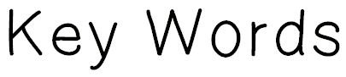
Character
Narrative voice | The perspective from which the story is told.
Archetype | A familiar/traditional character used seen in many stories across different cultures e.g. the villain.
Protagonist | The main character.
Setting
Pathetic fallacy | When the weather reflects the actions/mood of the story.
Structure
Declarative sentence | A statement e.g. The sky is blue.
Imperative sentence | A command e.g. Stop running.
Interrogative sentence | A question.
Exclamative sentence | A sentence ending with a !
Linear narrative | Narrative that follows a straight line e.g. beginning – middle – end.
Non-linear narrative | Often starts in the middle of the story and then goes back to the beginning may involve flashbacks.
Cyclical narrative | A story that ends where it begins.
Motif | Reoccurring ideas and themes throughout the story.
Asyndetic list | A list without conjunctions or connectives.
Climax | The point of greatest tension in the story.
Foreshadowing | Hints of what is to come in the story.
Imagery and Language
Alliteration | Words in a sentence/passage that begin with the same letter or sound.
Plosive alliteration | Repetition of the B or P sound at the beginning of words.
Sibilance | Repetition of the S or SH sound at the beginning of words.
Metaphor | Comparing one thing to another by saying it is something else e.g. the tree was a mountain.
Simile | Comparing one thing to another using like or as e.g. the tree was like a mountain.
Personification | Giving an inanimate object human qualities.
Onomatopoeia | Words that sound like what they are e.g. bang/crash/drip.
Repetition | Repeating a word or idea more than once.
Adjective | A describing word.
Verb (dynamic/modal) | A doing word.
Noun (abstract/concrete) | A naming word.
Pronoun | I/You/He/She/They etc.
Adverb | Describes a verb, usually ends in –ly.
Connotation | The associated meanings of a word e.g. the connotations of red might be love/danger/anger etc.
Colloquial language | Informal or slang language.
Semantic field | A group of words suggesting a theme/topic e.g. a semantic field of war – guns/bullets/army/soldier
These are the main techniques that you need to learn and remember for Paper 1, Section A.

Slide 5
Need some help?
Step by Step Sentence Starters
The writer uses…
In the text the writer…
The writer uses language to create a …………. Atmosphere
Language is used effectively in the text to convey….
For example, ….
This is illustrated in the quotation…
We can see this when…
This is evident in the quotation…
This metaphor/simile/personification is used to show...
The clever use of this adverb/verb/adjective/image represents...
The writer is trying to symbolise...
This image is effective because...
The use of the adjective/noun/verb evokes a sense of…
Thus we can see that…
So this is important because…
This is significant because…

Slide 6
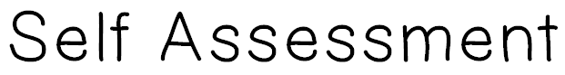
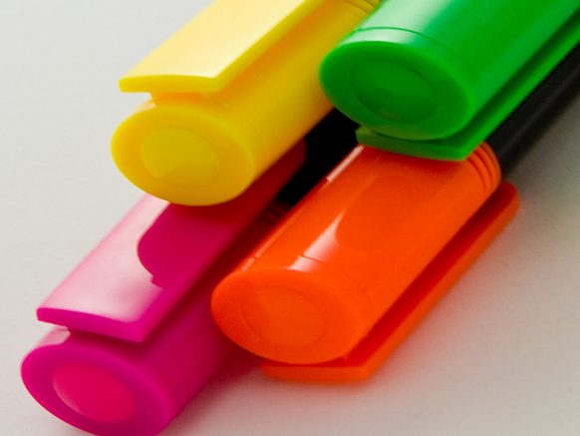
AO2
Q2 AO2 Explain & analyse language
Level 4 | 7-8 | Shows detailed, perceptive understanding of language features Analyses the effects of the writer’s choice of language features Selects a judicious range of examples . Uses a range of subject terminology appropriately
Level 3 | 5-6 | Shows clear understanding of language features Clearly explains the effects of the writer’s choice of language features Selects a range of relevant examples . Uses subject terminology accurately
Level 2 | 3-4 | Shows some understanding of language features Attempts to comment on the effect of language features Selects some relevant examples Uses some subject terminology, not always appropriately
Level 1 | `1-2 | Shows simple awareness of language Offers simple comment on the effect of language Simple references or examples Simple mention of subject terminology
Have you made a range of clear points about the language techniques used?
Have you included a range of quotations?
Have you explained the effect of the language techniques on the reader?
Have you tried to develop a range of interpretations of the language?
TARGET BANK:
Q2 Language: make sure you select relevant quotations to support your ideas. Try to use short, precise quotations and write in detail about the effect of the words/phrases within the quotation. | Q2 Language: make sophisticated comments about the language used. For example, how does the writer use a semantic field of horror to build tension and suspense?

Slide 7
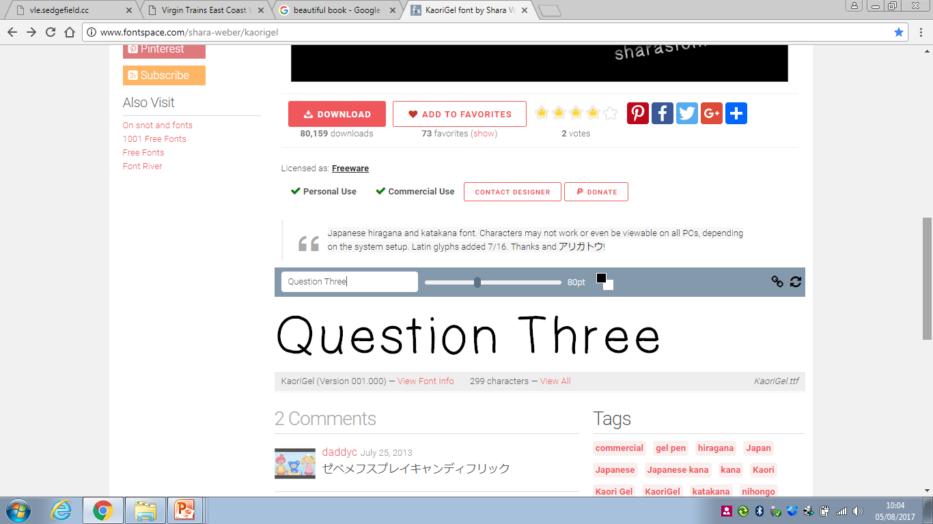
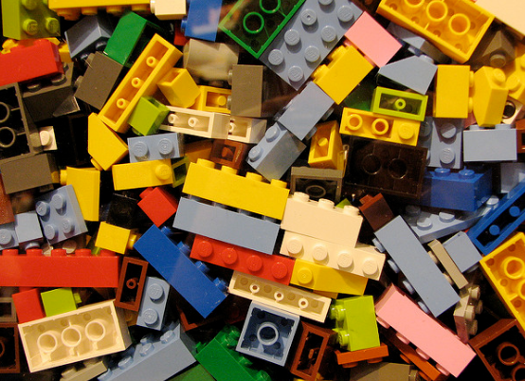
AO2
8 Marks
10 Minutes
This text is taken from a section towards the end of the novel.
How has the writer structured the text to interest you as a reader?
You could write about:
what the writer focuses your attention on at the beginning
how and why the writer changes the focus as the source develops
any other structural features that interest you.
Ideas:
What is the are you made to focus on at the beginning, middle and end?
Perspective?
Setting?
Time?
Flashback?

Slide 8
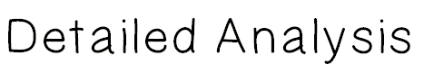
 | What happens? | Why is it Interesting? | Quotations
Overview:
Beginning
Middle
End
Look at the text as a whole in order to give an overview statement: ‘the text is structured as a journey/memory/in two parts’ etc.

Slide 9

Support Sheet
Key Phrases
At first
Then
At this point
Changes the scene to
Shifts away from
Now
The author then introduces
Narrows down
Focuses in
Wide view
Eventually
The author goes back to
The writer has made this part of the story interesting because….
Finally
Notes:
Useful phrases to help answer question 3

Slide 10
AO2
Q3 AO2 Explain & analyse structure
Level 4 | 7-8 | Shows detailed, perceptive understanding of language features Analyses the effects of the writer’s choice of language features Selects a judicious range of examples . Uses a range of subject terminology appropriately
Level 3 | 5-6 | Shows clear understanding of language features Clearly explains the effects of the writer’s choice of language features Selects a range of relevant examples . Uses subject terminology accurately
Level 2 | 3-4 | Shows some understanding of language features Attempts to comment on the effect of language features Selects some relevant examples Uses some subject terminology, not always appropriately
Level 1 | `1-2 | Shows simple awareness of language Offers simple comment on the effect of language Simple references or examples Simple mention of subject terminology
Have you made a range of clear points about the structural techniques used?
Have you included a range of quotations?
Have you explained the effect of the structural techniques on the reader?
Have you tried to develop a range of interpretations of the techniques?
TARGET BANK:
Q3 Structure: write a paragraph about the beginning/middle/end of the extract. What does the writer show to us at these points and why? | Q3 Structure: consider more sophisticated structural techniques. What is the impact of the difference in perspective on the reader?

Slide 11
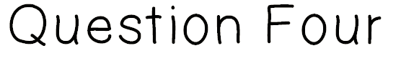
AO4
20 Marks
20 Minutes
Focus this part of your answer on the second half of the Source from line 20 to the end.
A student said, ‘‘The new boy is clearly very different from the rest of the students and the writer suggests that everything about him is better than everybody else.’’
In your response, you could:
• consider your impressions of the new boy
• evaluate how the writer presents the new boy as better than everybody else
• support your response with references to the text.
You MUST do all of these bullet points!
Marks | What’s Written | How It’s Written
16-20 Level 4 | In-depth, personal response to the statement, detailed analysis of writer’s choices. | Opinions are convincingly explained and fully supported with relevant, useful quotations.
11=15 Level 3 | Clearly explained response to the statement that discusses the effects of the writer’s choices. | Opinions are clearly expressed and mostly supported with apt quotations.

Slide 12

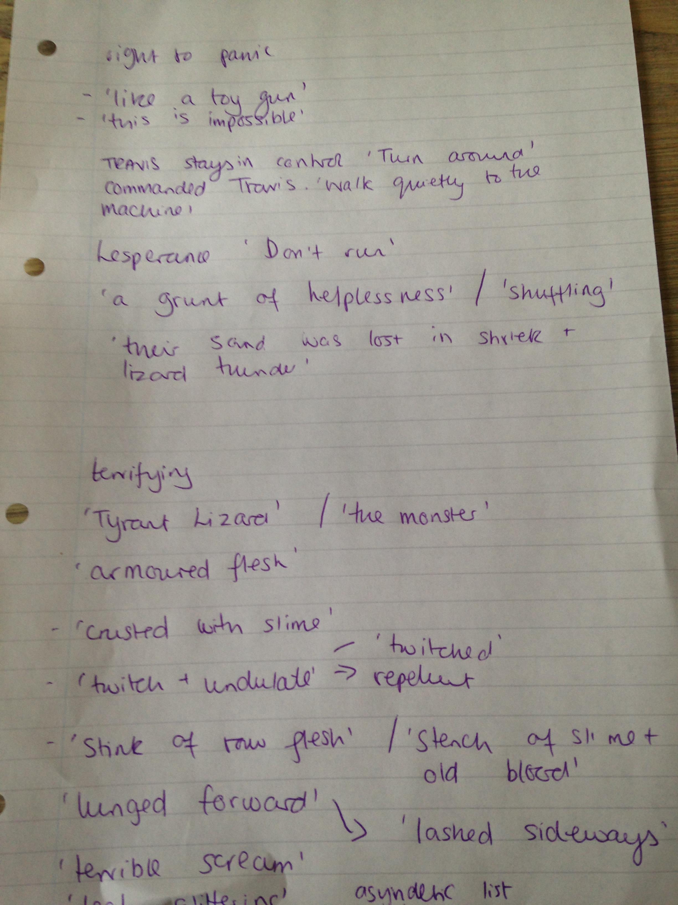
AO4
20 Marks
20 Minutes
An example of my very messy planning as I prepared to write my answer!
Continually embed your evidence throughout your evaluation, always answering the questions: Why has the writer chosen this language? how does this evidence my argument? How does this impact the reader?
Separate the different elements of the statement and then re-read the source to look for relevant evidence.
I have two sections
Re-read the source and jot down your quotations as you go. This will become the structure of your argument.

Slide 13
Need some help?
Step by Step Sentence Starters
The writer uses…
In the text the writer…
The writer uses language to create a …………. Atmosphere
Language is used effectively in the text to convey….
For example, ….
This is illustrated in the quotation…
We can see this when…
This is evident in the quotation…
This metaphor/simile/personification is used to show...
The clever use of this adverb/verb/adjective/image represents...
The writer is trying to symbolise...
This image is effective because...
The use of the adjective/noun/verb evokes a sense of…
Thus we can see that…
So this is important because…
This is significant because…

Slide 14
AO4
Q4 AO4 Evaluate texts critically
Level 4 | 16-17-18-19-20 | Critically evaluates the text in a detailed way Offers examples to explain views convincingly Analyses effects of a range of writer’s choices Selects a range of relevant quotations
Level 3 | 11-12-13-14-15 | Clearly evaluates the text Offers examples from the text to explain views clearly Clearly explains the effect of writer’s choices Selects some relevant quotations
Level 2 | 6-7-8-9-10 | Attempts evaluative comment on the text Offers an example from the text to explain view(s) Attempts to comment on writer’s methods Selects some quotations
Level 1 | `1-2-3-4-5 | Simple evaluative comment on the text Offers simple example from the text which may explain view Simple mention of writer’s methods Simple references or textual details
Have you agreed/disagreed with the statement?
Have you included a range of quotations?
Have you explained the effect of techniques/individual words?
Have you used evaluative language?
TARGET BANK:
Q4 Evaluate: make sure you have made a clear point about what happens in the struggle. Use a range of relevant quotations to support your ideas. | Q4 Evaluate: analyse the full range of techniques that the writer uses to make you feel sorry for White Fang.

