Slide 1
GCSE Summer Homework
You can choose ONE of the following THREE tasks (or complete more than one!)
1. Reading Task – Read Blood Brothers and make clear character notes (complete the attached sheets)
2. Watching task - Watch Blood Brothers or Billy Elliot Live
Blood Brothers Part 1 – YouTube
Billy Elliot Live is available to rent or buy on Amazon
3. Writing task (Y9 into 10) – Write a three page (min) script starting with the line: “I can’t believe they did it”
Writing task (Y10 into 11) – Complete all three sections of your Devising Log Books
Evidence of competition must be discussed/shared/demonstrated in the first lesson back after the summer. The student who completes the best work for each subject will win 30 house points.

Slide 2
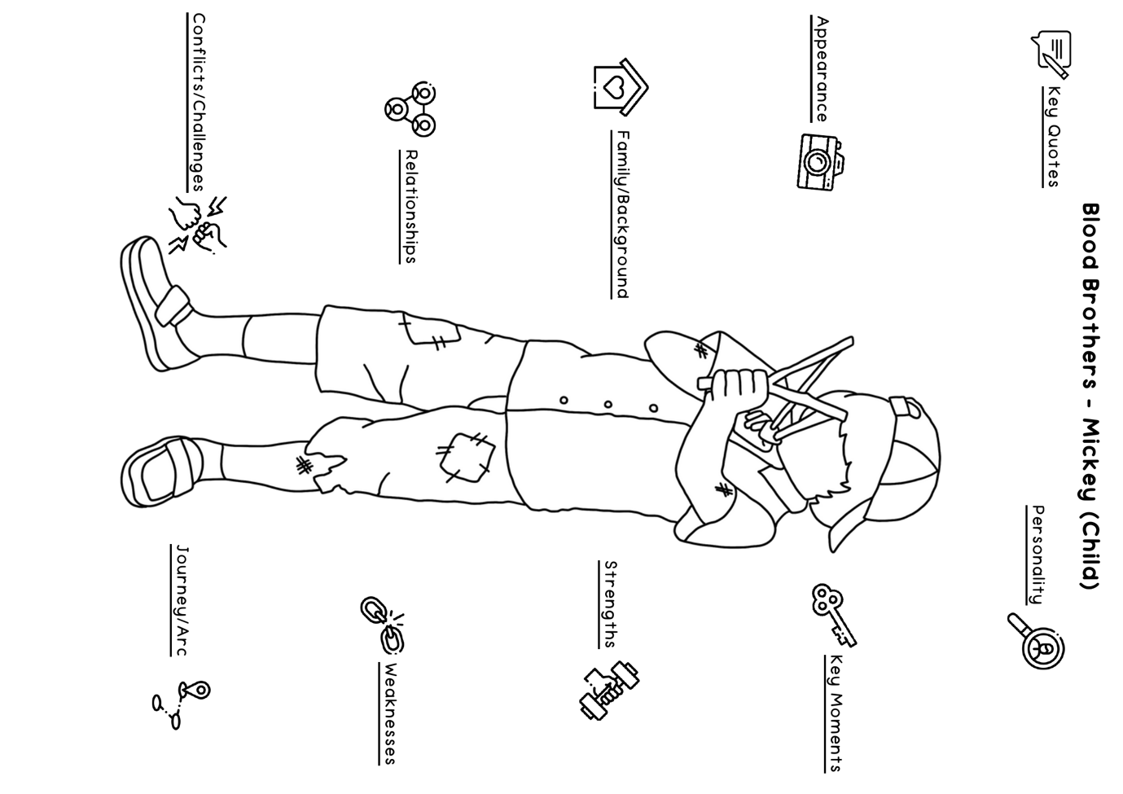

Slide 3
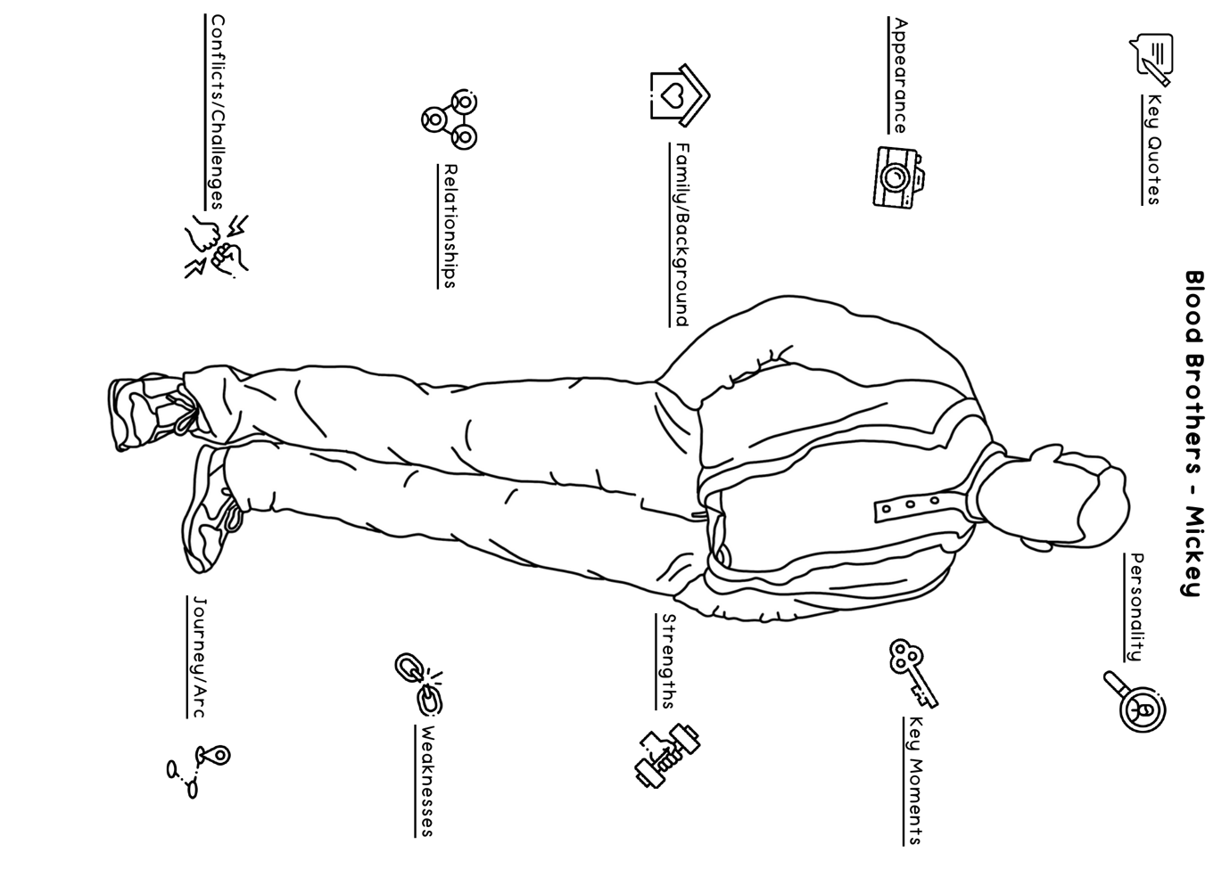

Slide 4
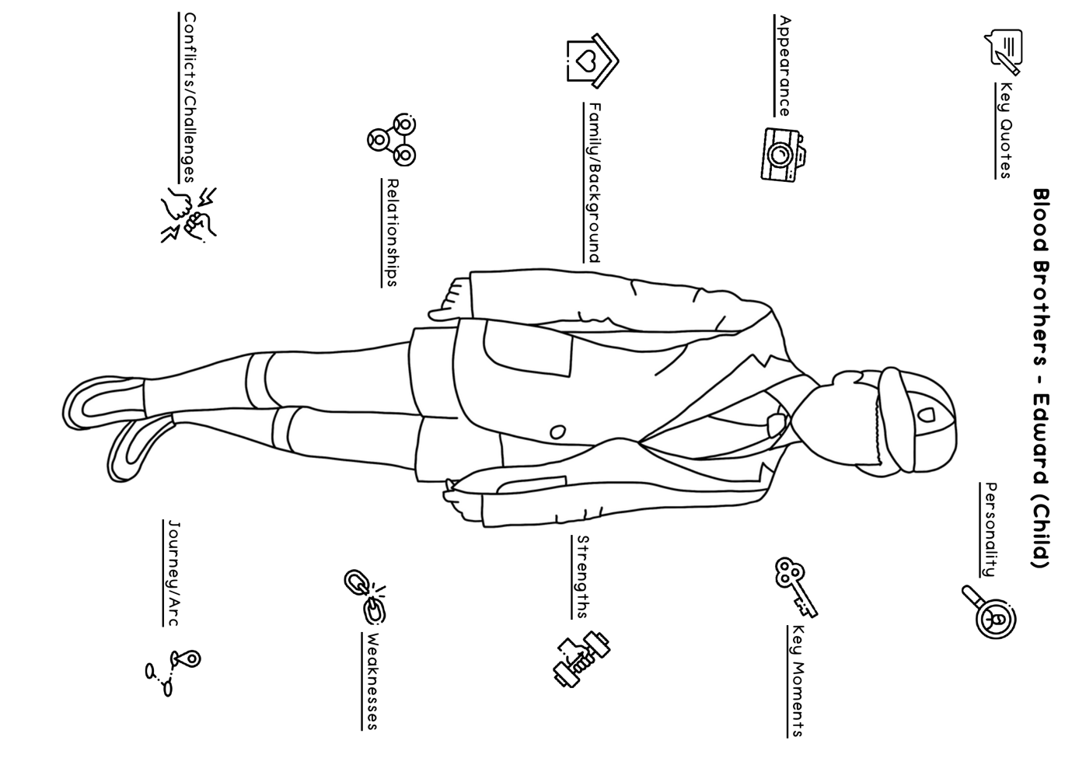

Slide 5
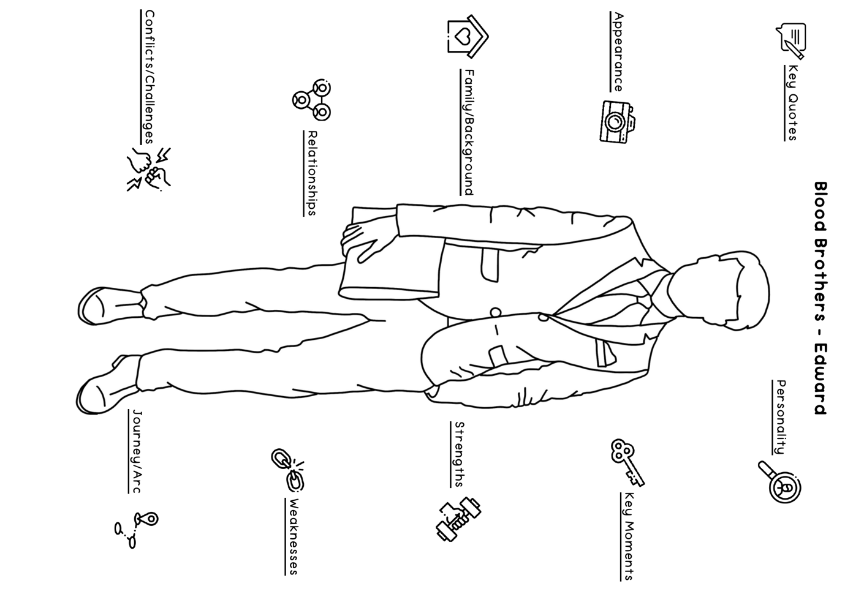

Slide 6
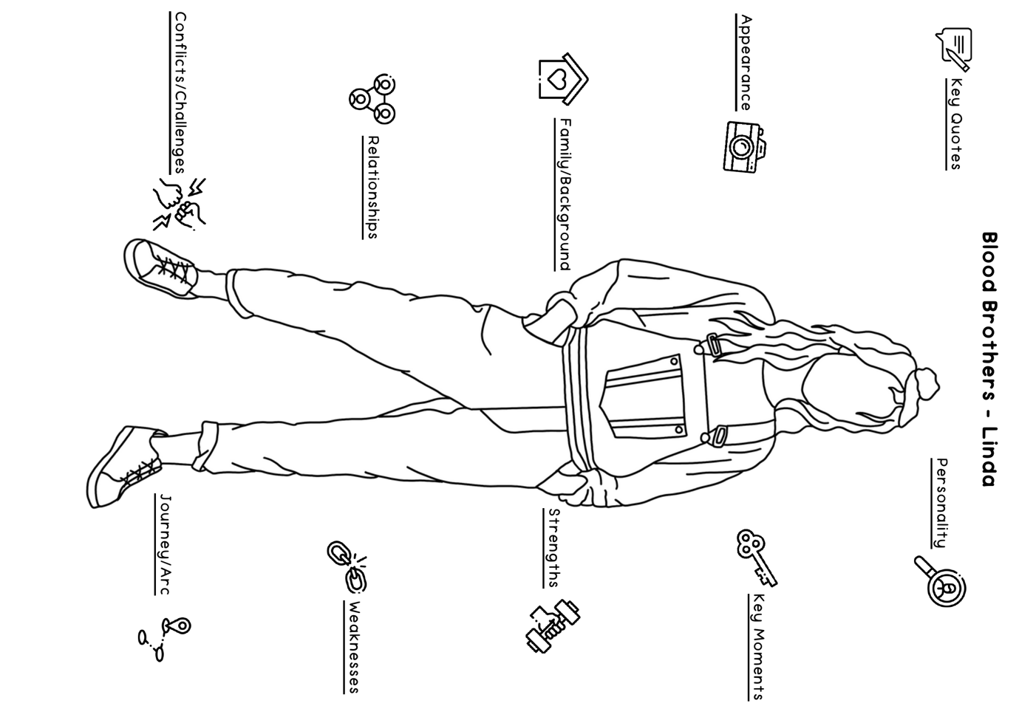

Slide 7
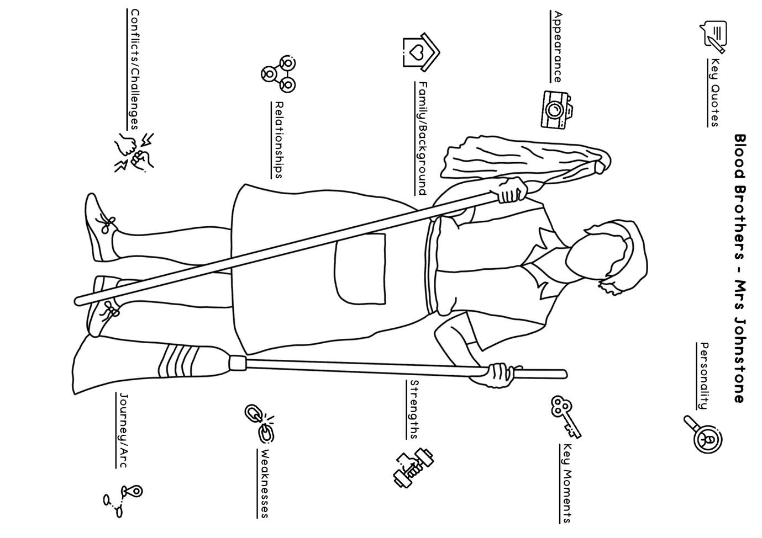

Slide 8
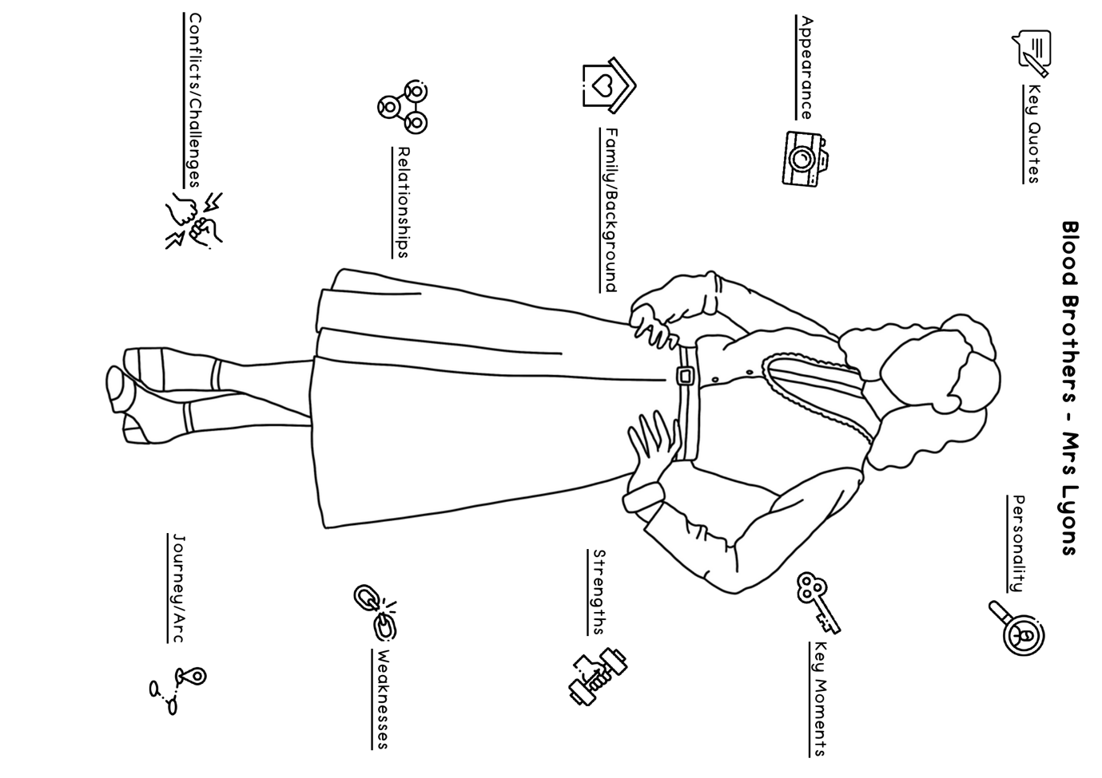

Slide 9
