Slide 1

Welcome to Film Studies!
The following slides are your Summer Prep tasks to be completed.​
All tasks must be complete by your first Film lesson.​
You must complete all tasks

Slide 2

Task – Intro to Film: Part 1
Create a mind-map of all of the cinematography elements there are.
Sketch each shot to help you remember.
Create a small list of all mise en scene elements.
Have a go at sketching your dream holiday destination and label it with all elements of mise en scene.

Slide 3

Task – Intro to Film: Part 2
Create a mini glossary of all sound devices used in film.
What would the soundtrack to your life be? Create a track-list of 10 songs to summarise your upbringing to present day.
Create a poster of all of the editing techniques used in film.
Research 1 film that has won Best Editing at the Oscars. In no more than 2 sentences summarise the reasons why it won Best Editing. You may have to use your iPad to help you research.

Slide 4
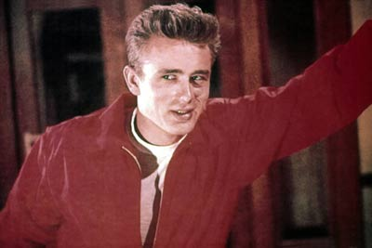
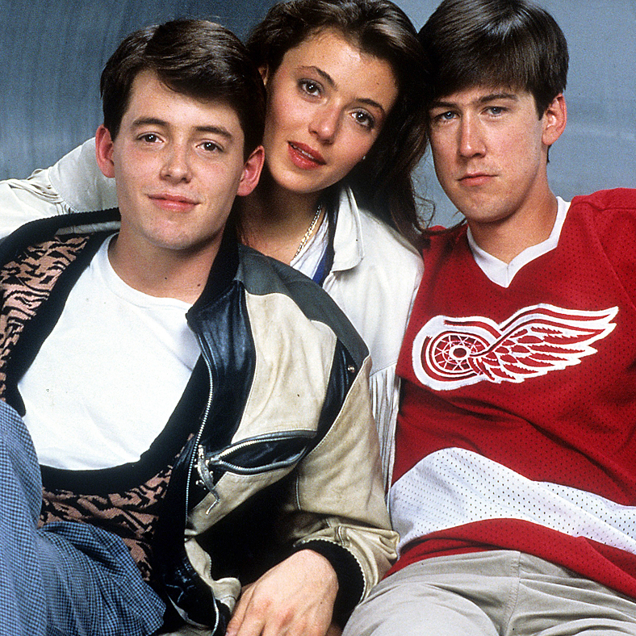
Task – Old Hollywood vs. New Hollywood
Viewings and note-taking:
Watch Rebel Without a Cause (Ray, 1955) and Ferris Bueller’s Day Off (Hughes, 1986).
Pick two key scenes from the films.
Create a small 2x2 grid on A4 and for each section write in Cinematography, Mise en Scene, Sound, Editing and Performance.
Watch the scenes and make notes on each element of film form.

Slide 5
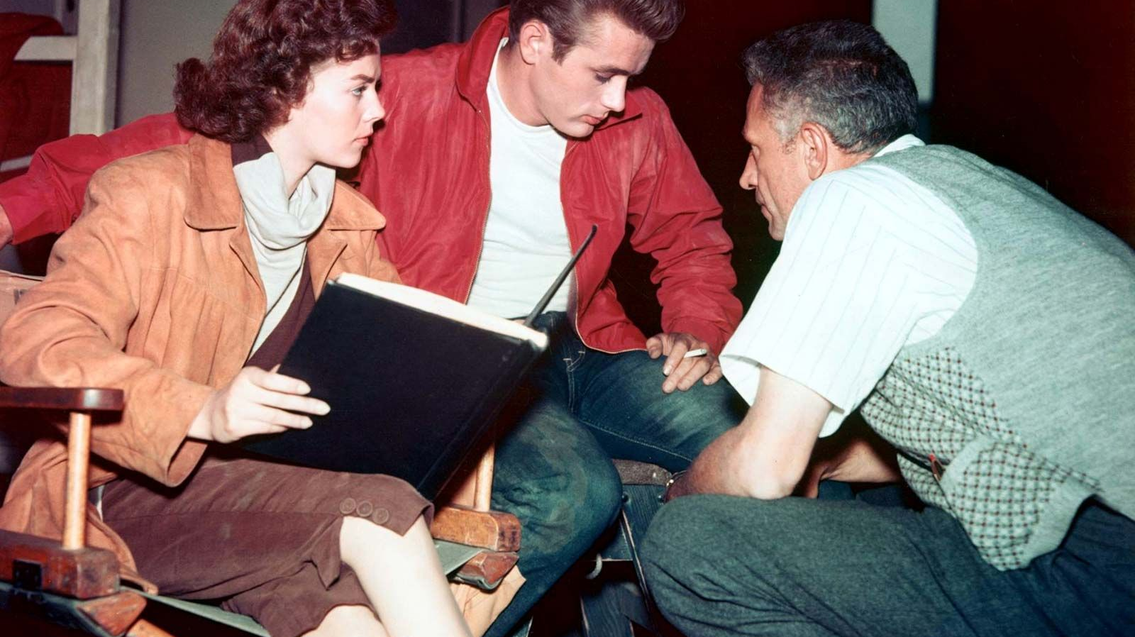
Task – Nicholas Ray
Research the life and works of Nicholas Ray (Director of Rebel Without a Cause). Create a set of detailed notes in the form of a fact file on the director you will study.

Slide 6
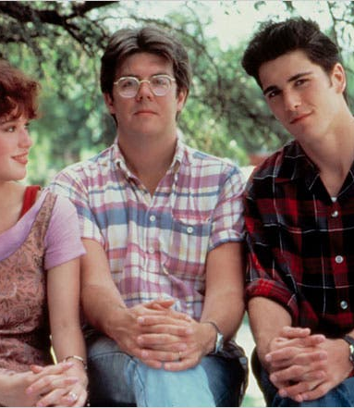
Task – John Hughes
Research the life and works of John Hughes (Director of Ferris Bueller’s Day Off). Create a set of detailed notes in the form of a fact file on the director you will study.

Slide 7


Task – Film Diary
Create a film diary and keep track of all the films you watch over Summer.
Rate them out of 5 stars and write a one sentence review.
Be ready to share your film knowledge in September!

