Slide 1


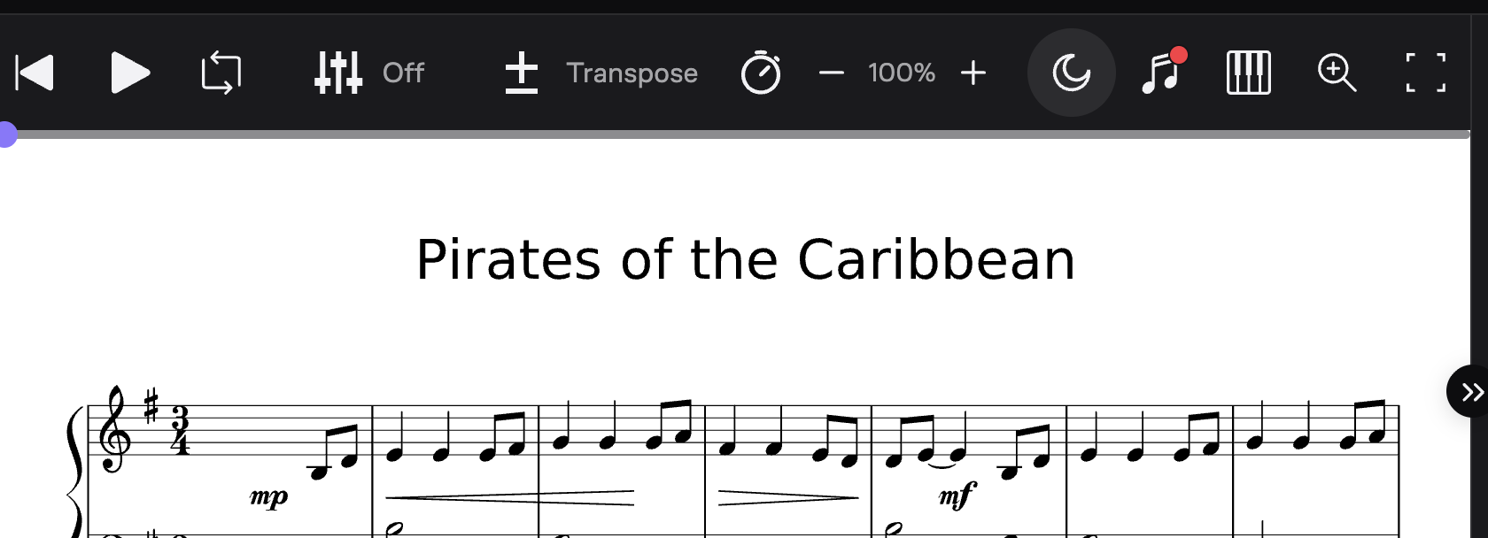
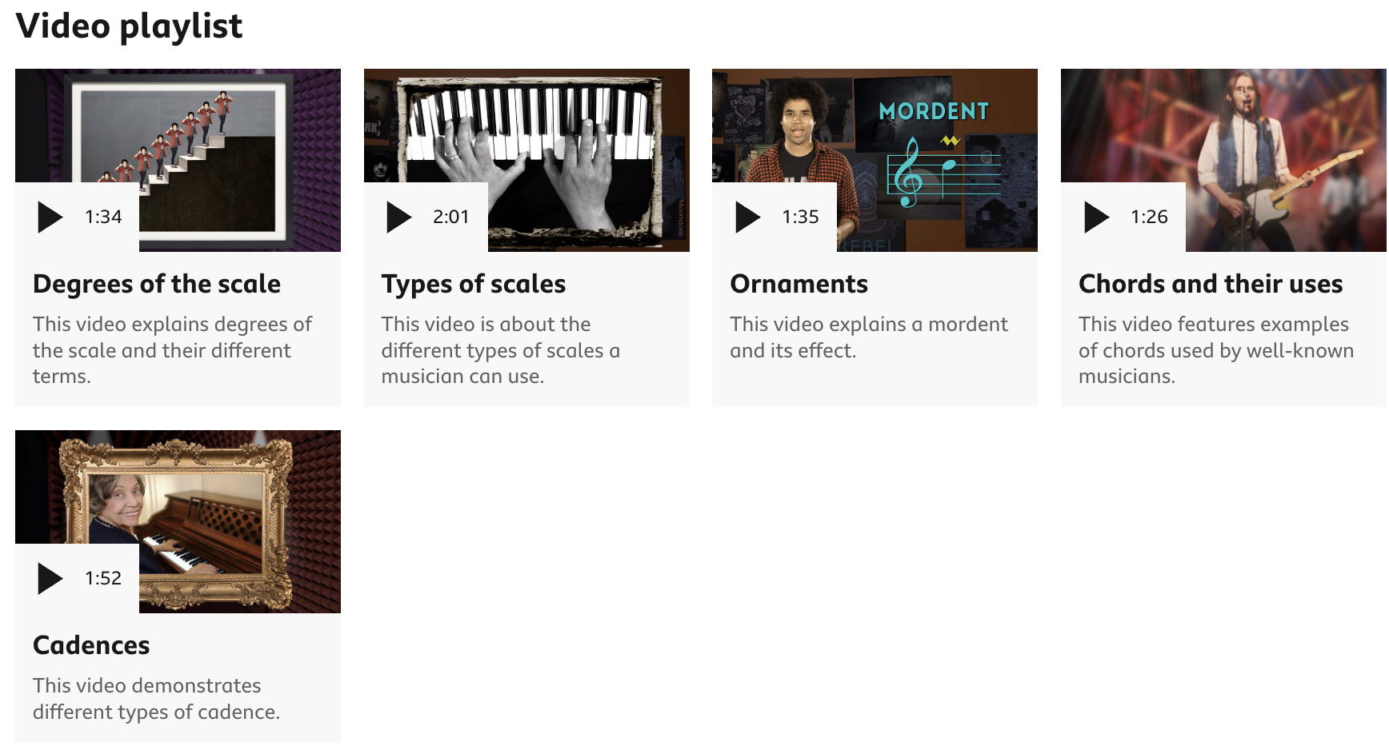
Music Year 9 into 10 Summer Homework
Task: Complete one of the following activities over the summer holidays.
Record yourself playing a piece of music you have learned or are currently learning Record the piece (for example,video, screen recording or Voice Memo) Submit the piece via email psaul@dma.tela.org.uk Resources: Search online for ‘magic piano videos’ Piano/other instruments: https://musescore.com/ Ukulele https://www.songsterr.com/ Guitar https://ukebuddy.com/ | Watch these 5 videos: https://www.bbc.co.uk/bitesize/topics/zvx37v4 Degrees of the scale Types of Scales Ornaments Chords and their uses Cadences Create a poster/guide/information sheet based around those 5 aspects of music Send via email to: psaul@dma.tela.org.uk | Use GarageBand to create a new piece of music in Binary Form. There should two main contrasting sections: Alternatively, think of them like a Verse and a Chorus Avoid using the built-in loops. Input your own original ideas using the virtual instruments. Alternatively, use record your own instrument playing your compositions Send a video, audio or screen recording Send via email to: psaul@dma.tela.org.uk

