Slide 1

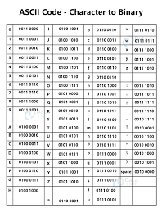

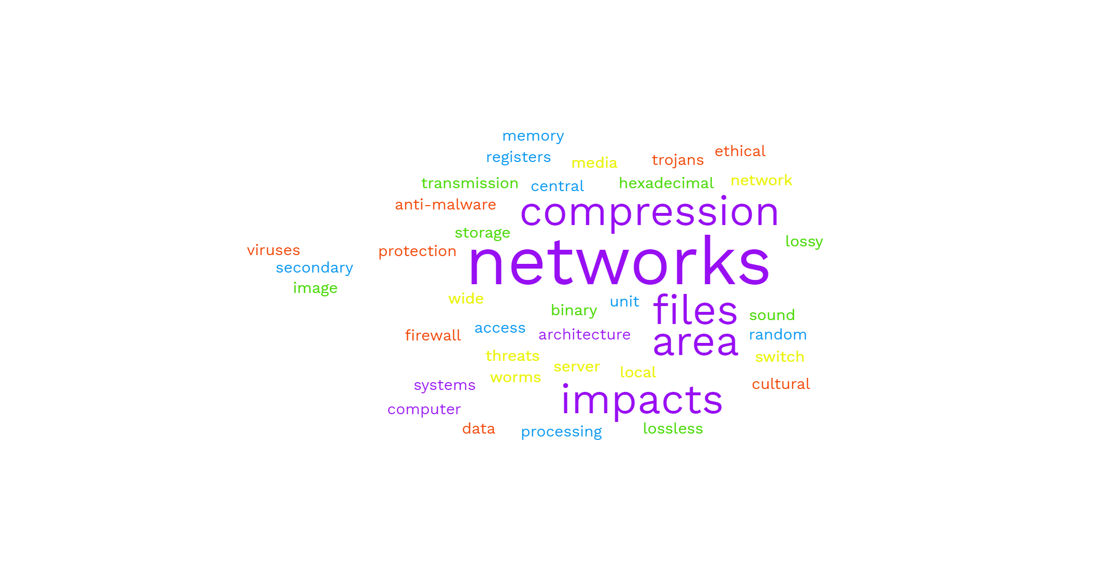
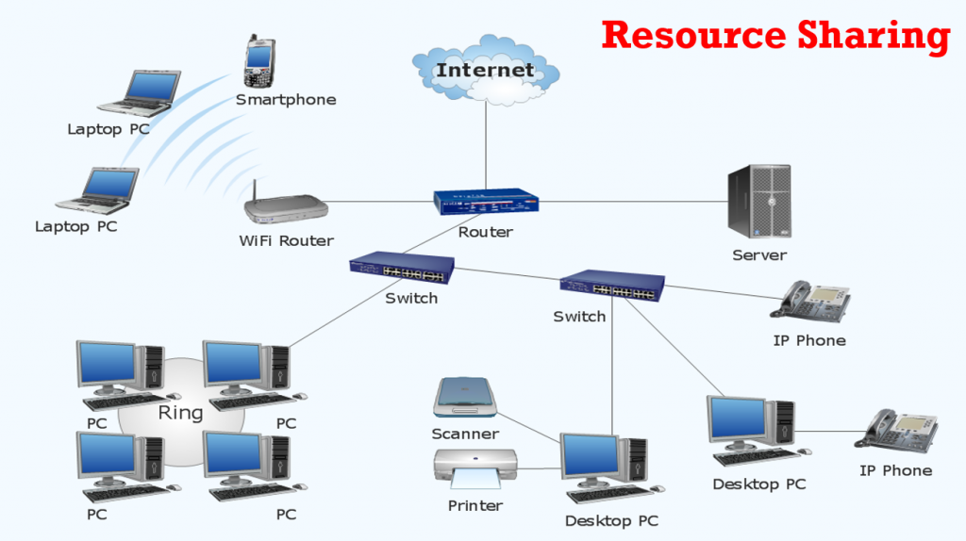

Getting ready for Year 10
COMPUTER SCIENCE

Slide 2

Getting ready for Year 10 Computer Science
To do;
Over the summer you need to complete the following 3 Tasks and email them to Mr Wilson.
You can complete these tasks on paper and screenshot, you can complete on IPad and send, you can complete on a computer and send.
awilson@dma.tela.org.uk

Slide 3
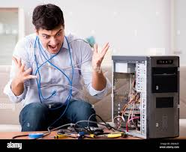

Task 1- Inside the Computer
You have been asked to fix your neighbour’s computer. You need to look inside and identify the components so you can tell them what the problem might be. You will create a poster to outline the key internal components and explanations of their purposes.
YOU MUST INCLUDE:
Images and explanations of Motherboard, CPU, RAM, ROM, Graphics Card, Hard Drive/SSD.
Use www.teach-ict.com to help

Slide 4
Task 2 – I don’t speak English just ASCII!
YOU NEED TO CRACK THIS MESSAGE BY CONVERTING FROM ASCII CODE TO ENGLISH.
IT IS A 4 WORD SENTENCE – HINT USE AN ASCII TABLE:
67 111 109 112 117 116 101 114 32 83 99 105 101 110 99 101 32 105 115 32 71 114 101 97 116 33

Slide 5
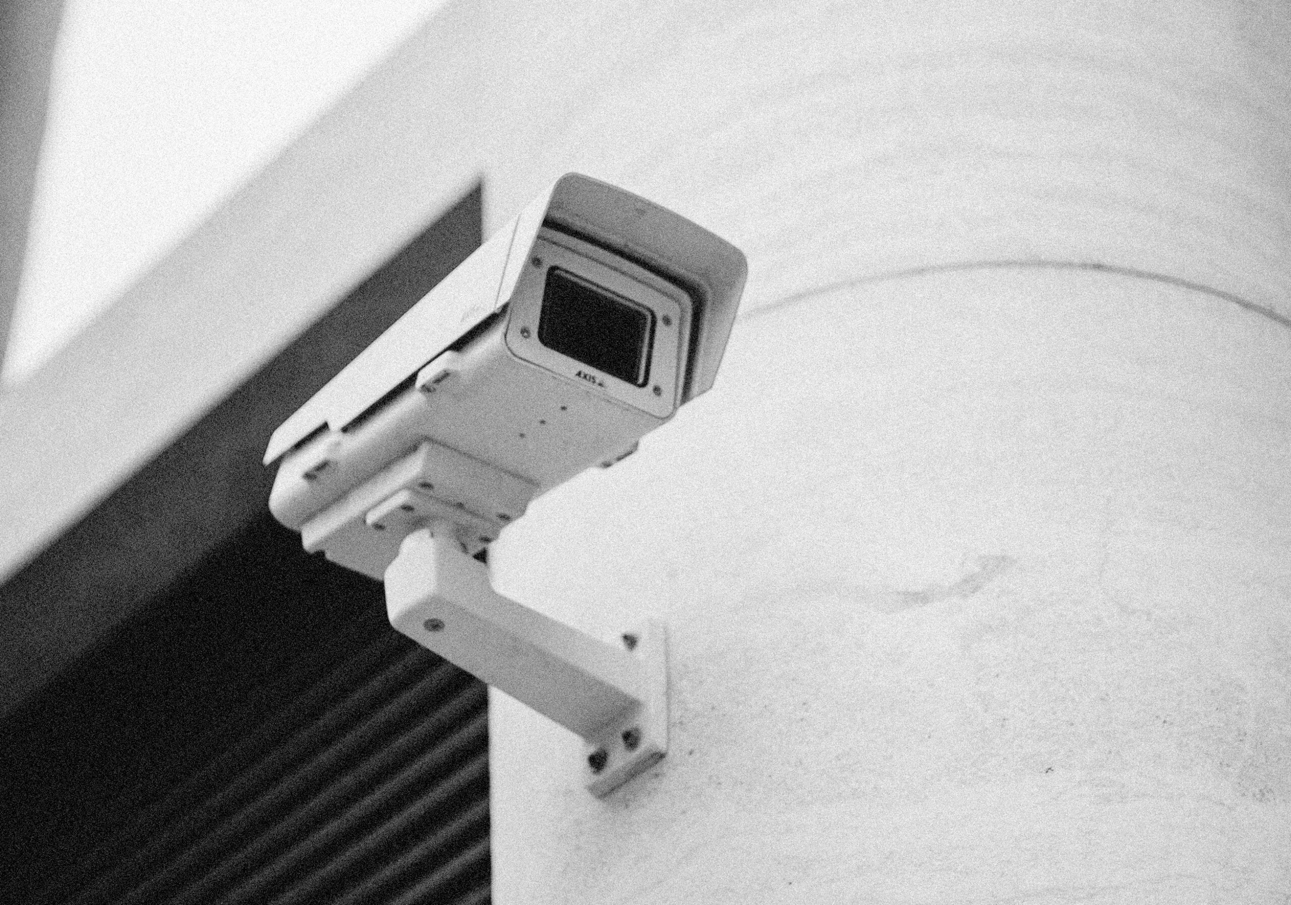
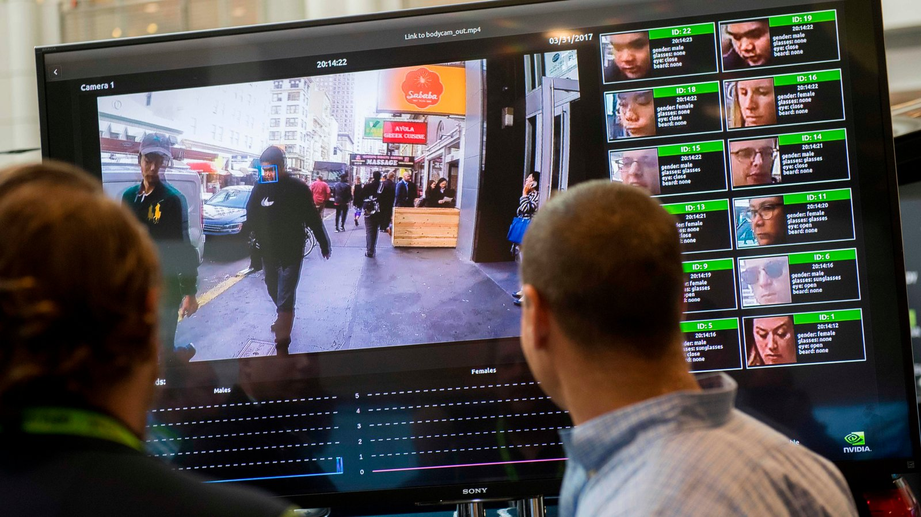
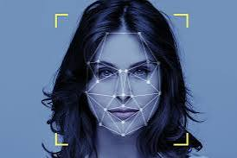
Task 3 – “Facial recognition used by police to monitor Downham Market - Market Place by 2024”. Good or bad?
➢TASK: you have been asked to give your expert opinion on the use of facial recognition by the police.
➢YOU MUST Explain 3 reasons why this would be good for the public and
3 reasons why it might be bad for the local community.
Carry out some internet research to help with your arguments for or against.

