Slide 1
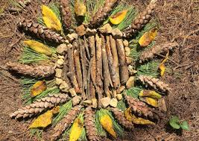
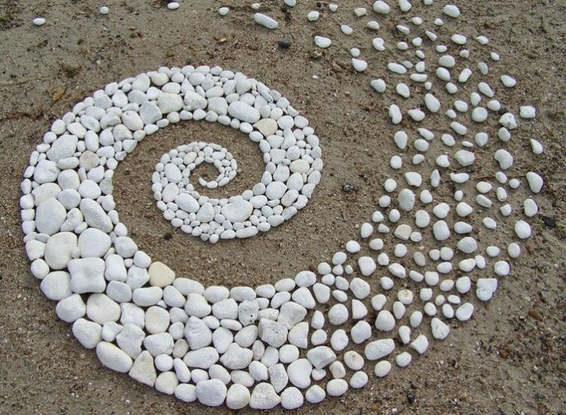
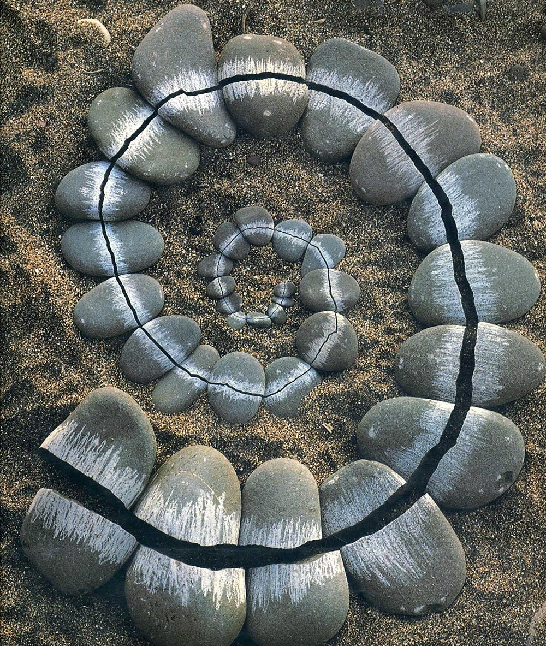
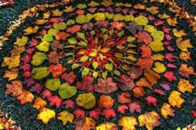
Year 8 Art Summer Competition
Andy Goldsworthy is a sculptor, environmentalist, and photographer. He is best known for land art made entirely from natural materials found on-site, including twigs, stone, leaves, ice, and clay. The art department would like you to choose one of the tasks below to enhance your knowledge about the artist or photography and drawing skills
Option 1: Produce a page of research about Andy Goldsworthy, include images of the artist’s work, give your opinion about his work and talk about how he uses, colour, line, tone and pattern in his work.
Option 2: Take your own photographs in the style of the artist. Arrange stones, shells or anything else from nature in a pattern. You could edit your images to make the colours like the artist’s and the shadows and highlights bolder.
Option 3: Produce your own piece of work that is inspired by Andy Goldsworthy. Arrange stones, shells or anything else from nature in a pattern and then draw/paint them.

