Slide 1
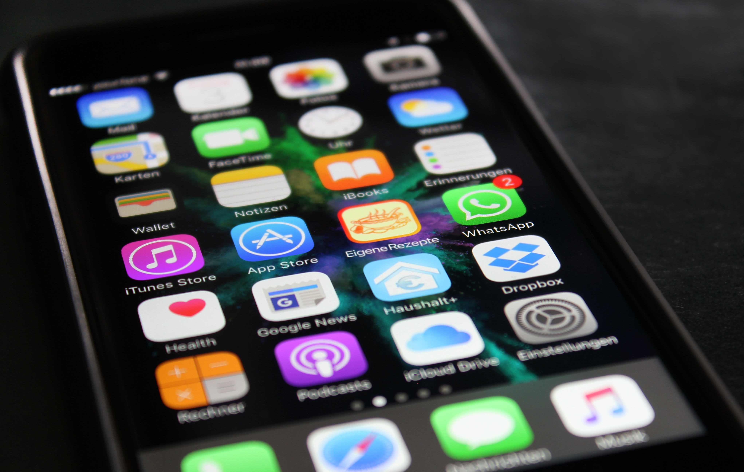
YEAR 8 INTO 9 COMPUTING HOMEWORK
TASK:
Design a new APP for an Ipad or Smart Phone. You need to design the layout, buttons, logo. You need to describe what it does and how it would work. What will be the inputs and outputs of the app?
How will the user interact with the app?

