Slide 1

RS Summer Challenge - Yr 8 – option 1
Create a Travel Guide
Pretend you are a travel writer visiting famous religious sites:
Mecca
Vatican City
Golden Temple
Western Wall
Describe:Why people visit
What they would see
Why the site is important

Slide 2
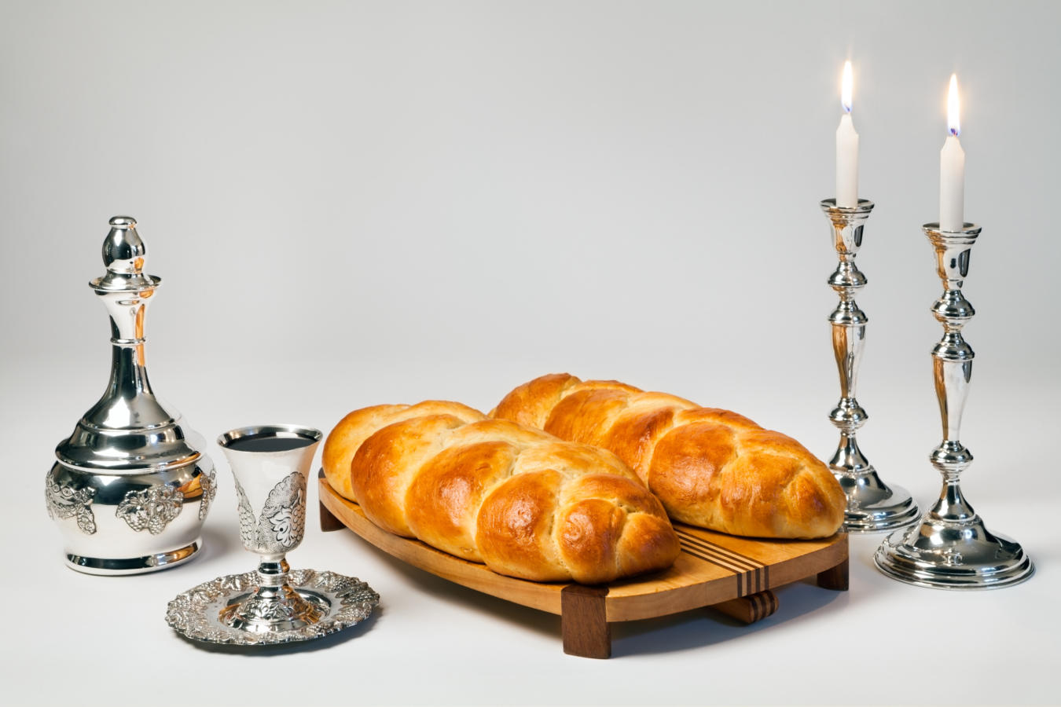
RS Summer Challenge - Yr 8 – option 2
Make Challah bread & take a photo
Whip up a beautiful braided challah using just Self-Raising Flour, Greek Yogurt, and an Egg. This three-ingredient "magic" dough requires no yeast, no waiting for the bread to rise, and zero kneading time while still producing a soft, slightly sweet, and fluffy loaf.
Ingredients
Self-Raising Flour: 2 cups (plus a little extra for shaping)
Full-Fat Greek Yogurt: 1.5 cups
Eggs: 1 whole egg + 1 egg yolk (whisked together for the egg wash)
Note: You can add 1 tablespoon of sugar to the yogurt if you want it to taste sweet, or a pinch of salt if you prefer it savory.
Instructions
Mix the Dough: In a large mixing bowl, combine the self-raising flour and the Greek yogurt. Stir until it starts to clump together, then use your hands to bring it into a shaggy, cohesive dough ball.
Shape and Braid: Turn the dough onto a lightly floured surface. Cut it into 3 equal pieces. Roll each piece into a rope (about 12 inches long). Pinch the 3 ropes together at the top, braid them like hair, and pinch the bottom ends together to secure them.
Add the Wash: Place the braided loaf on a baking sheet lined with parchment paper. Brush the top generously with your whisked egg-and-yolk mixture—this gives challah its signature shiny, golden crust.
Bake: Preheat your oven to 180°C (160°C Fan / Gas Mark 4). Bake the loaf for 25 to 30 minutes, or until it is deeply golden brown and sounds hollow when you tap the bottom.
Cool: Transfer to a wire rack and let it cool before slicing!

Slide 3
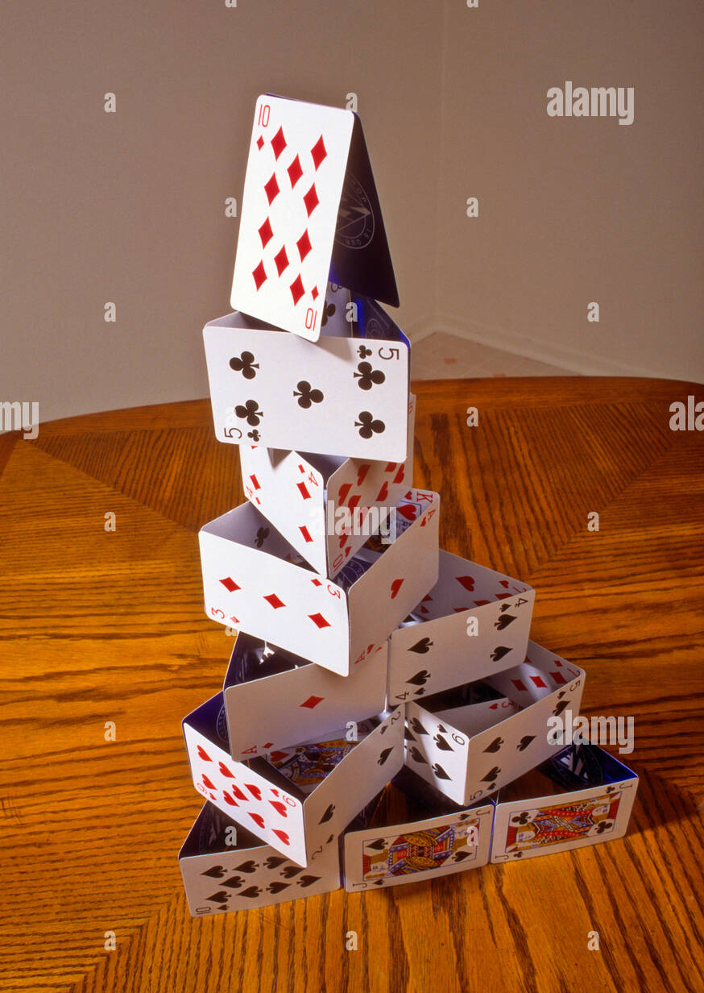
RS Summer Challenge – Option 3
Take a photo of the highest stack of cards you can make (5 high at least). This represents Hindu beliefs about Vishnu
Teaching and Devotion: In 17th-century India, playing cards called Ganjifa were adapted into sets known as the Dashavatara. The cards depicted the ten avatars of Lord Vishnu. People would sing chants and mantras while dealing these cards, turning a game into an educational, spiritual practice.

