Slide 1
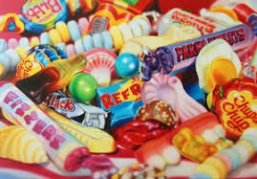
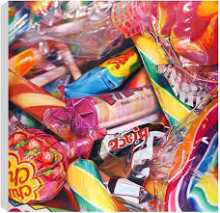
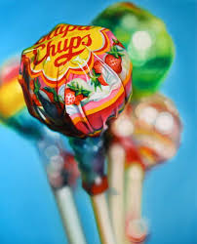
Year 7 Art Summer Competition
Sarah Graham is an artist known for creating hyperrealist paintings of sweets and toys. The art department would like you to choose one of the tasks below to enhance your knowledge about the artist or photography and drawing skills
Option 1: Produce a page of research about Sarah Graham, include images of the artist’s work, give your opinion about her work and talk about how she uses, colour, line, tone in her work.
Option 2: Take your own photographs in the style of the artist. Arrange sweets or toys in an interesting arrangement and then photograph. You could edit your images to make the colours brighter and bolder like the artist’s.
Option 3: Produce your own piece of work that is inspired by Sarah Graham. Arrange sweets or toys in front of you and draw/paint them.

