Slide 1
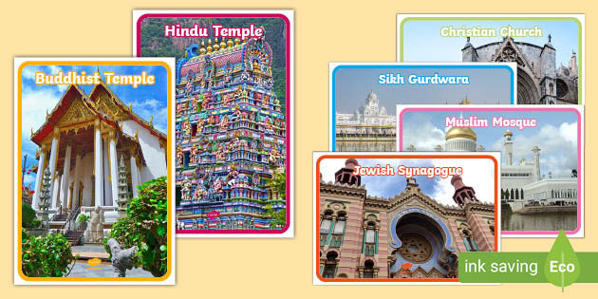
RS Summer Challenge – Y7 – option 1
Religious Buildings Photo Challenge
Find or take pictures of different places of worship:
Church
Mosque
Synagogue
Temple
Gurdwara
For each one, write: Which religion it belongs to Two facts about it
What people do there

Slide 2
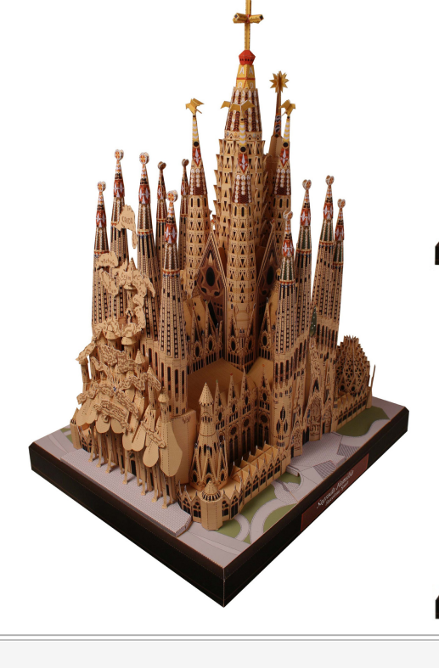
RS Summer Challenge – Y7 – option 2
Make the Sagrada familia
Use the template from the following link
https://www.educart.it/wp-content/uploads/Papercraft/Sagrada-Familia-Set1.pdf
Form into the Sagrada Familia and take a photo or bring in the results.
If you do not have a printer, you may use your own resources such as card, lollipop sticks etc.

Slide 3
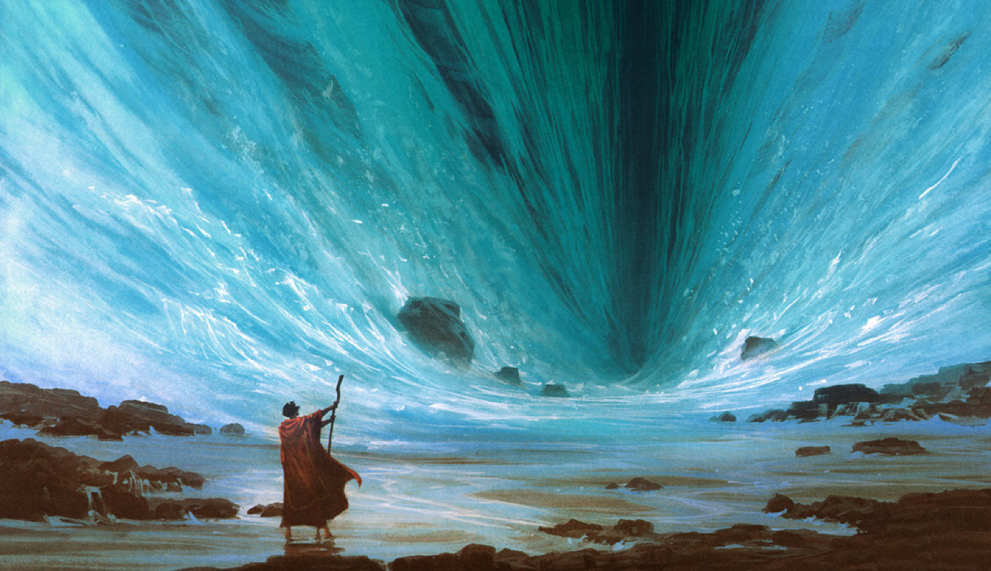
RS Summer Challenge – Y7 – option 3
Watch this short film
Write a film clip
Moses Splits the Red Sea | The Prince of Egypt
What happens?
What characters are there?
How many stars?
What was best about it?
Would you recommend it?
Include a photo and ensure it is one A4 side in font 12pt

