Slide 1

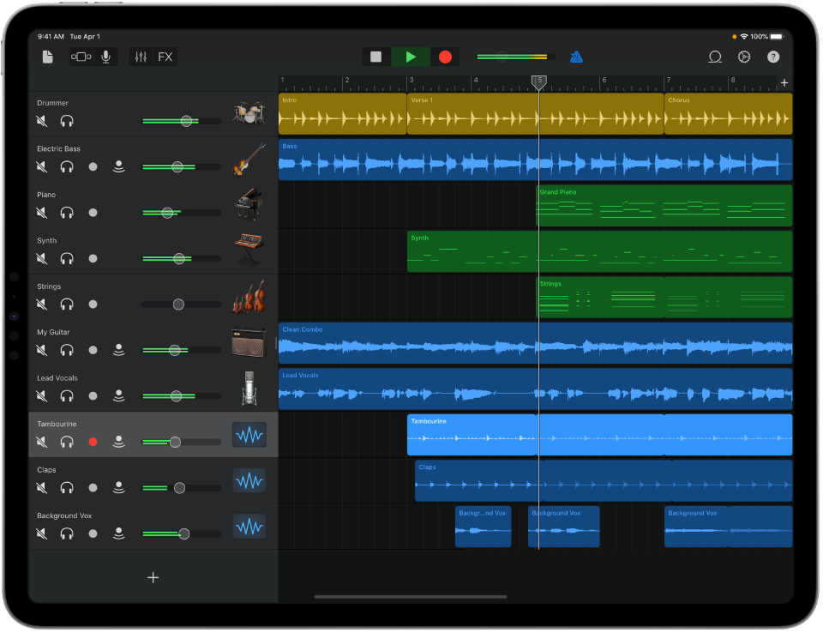
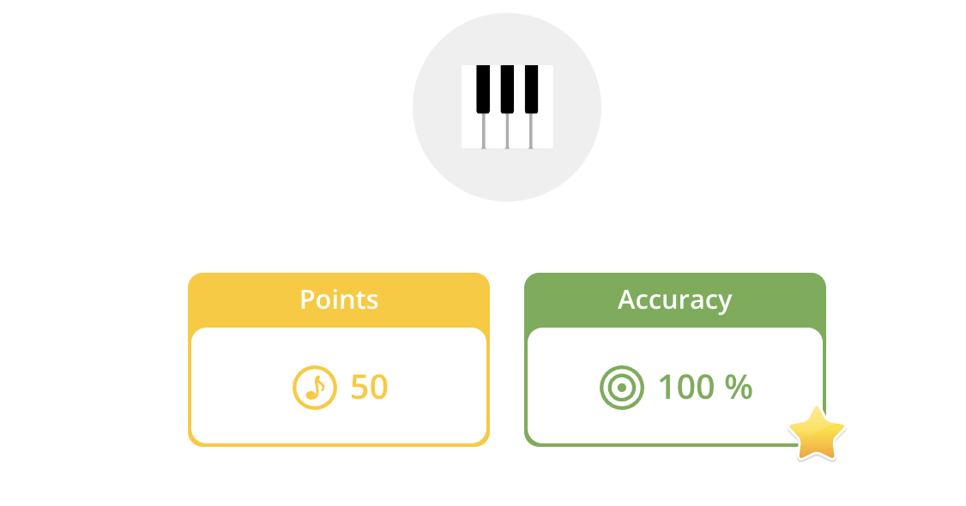
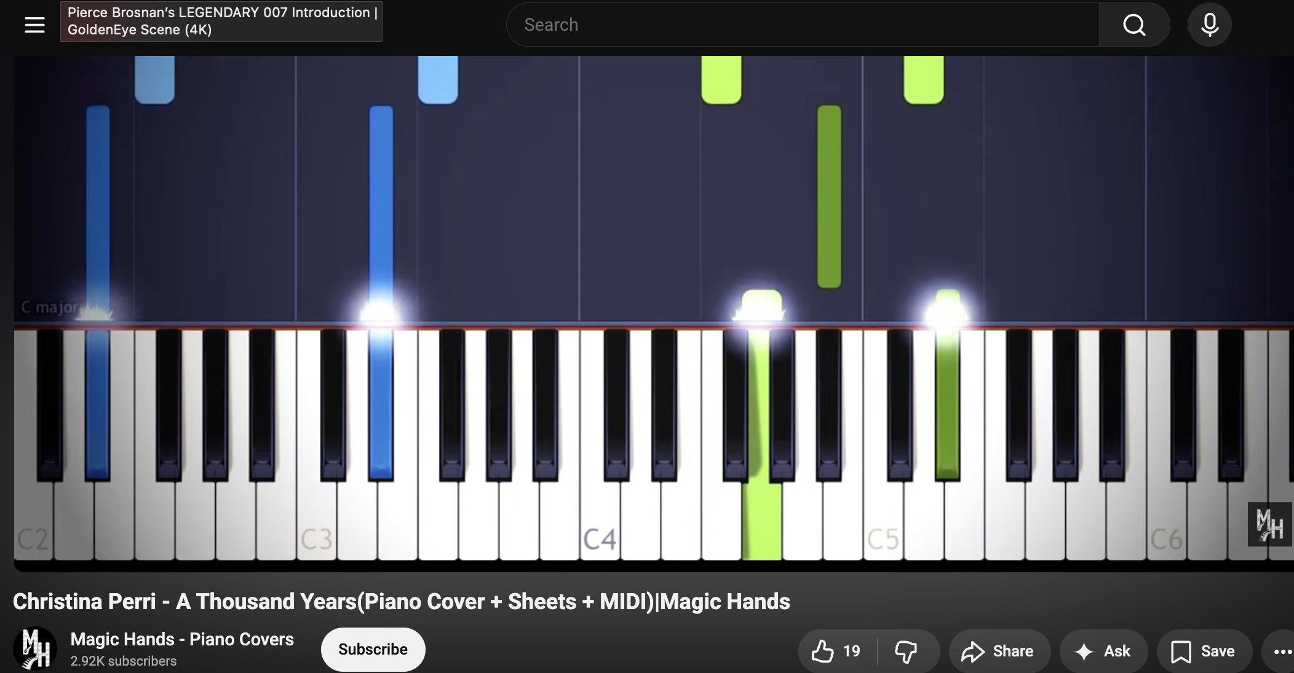
Music Y7 Summer Homework
Task: Complete one of the following activities over the summer holidays.
Use an instrument to learn any piece of music If you do not have an instrument, try recording it using the virtual piano in GarageBand Practice the piece Record the piece (video, screen recording or Voice Memo) Submit the piece via email psaul@dma.tela.org.uk Resources: Search online for ‘magic piano videos’ Piano/other instruments: https://musescore.com/ Ukulele https://www.songsterr.com/ Guitar https://ukebuddy.com/ | Use Musicca to improve your skills at reading notes or rhythms https://www.musicca.com/exercises/ Choose a variety of exercises (minimum 10) Screenshot your scores Add your screenshots to a document (e.g. Word or PowerPoint. Each activity needs a title Send the document via email psaul@dma.tela.org.uk e.g. Accidentals | Create a new composition using GarageBand Load GarageBand. Start a new project Use any combination of loops or virtual instruments Consider your structure (A-B = Binary Form) Optional: Consider whether you would like to turn it into a song. Try recording your voice Create a screen recording of your piece Send your piece via email to psaul@dma.tela.org.uk

