Slide 1
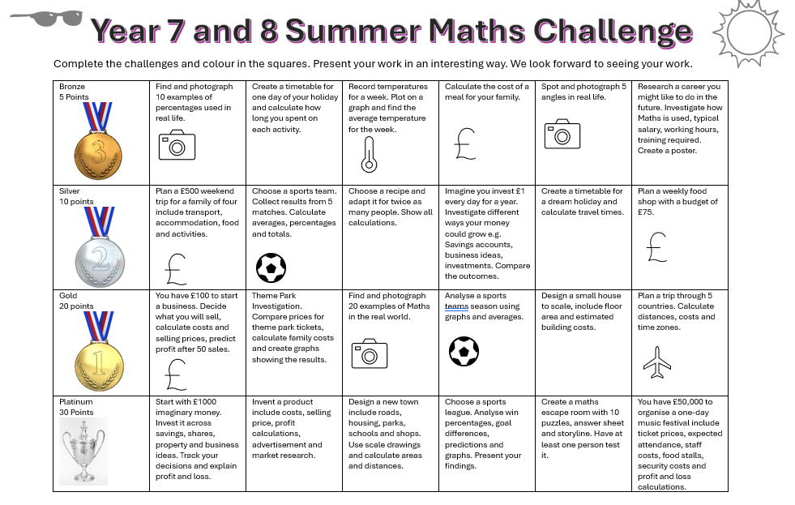
Summer Challenge Y7&Y8

