Slide 1
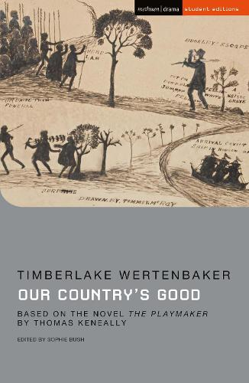
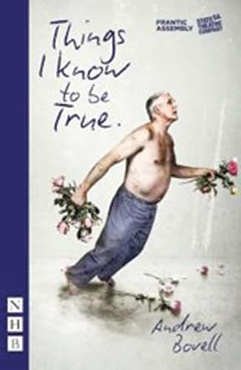
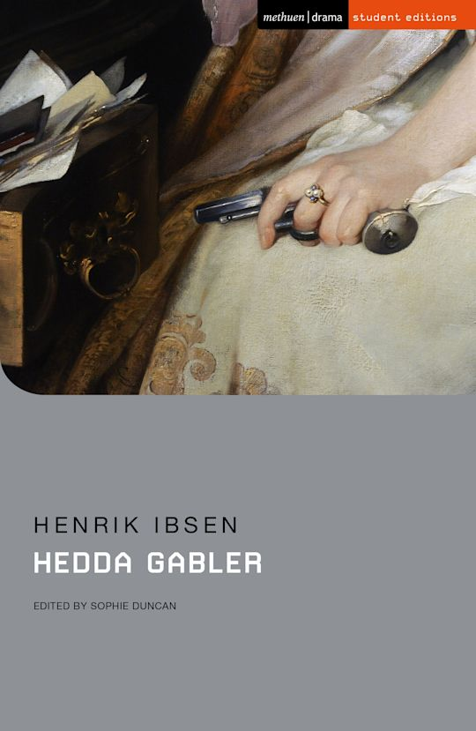
Year 11 into 12 Summer Transition
Our set texts will be:
'Our Country’s Good' by Timberlake Wertenbaker
'Hedda Gabler' by Henrik Ibsen
'Things I Know to be True' by Frantic Assembly (Live Theatre)
1. Read as much as you can!
2. You can also watch the following versions:
Hedda Gabler (1981) FULL MOVIE | Diana Rigg, Denis Lill, Philip Bond
Our Country's Good Weymouth College

