Slide 1
YEAR 11 into 12 CTEC Sport
Task
Unit 8 TASK 1: Plan Your Sports Event
Some ideas to get you started:
🧱 Staff vs Students Match
🧠 Sports Quiz Afternoon
🥅 Penalty Shootout or Free Throw Competition
⚽ Inter-Tutor Group or Inter-House Tournament
🏃 Fitness Challenge
🧗 Obstacle Course Challenge
🤾Target Sports Challenge
🎮 E-Sports or Virtual Sports Tournament
🧘 Wellbeing and Activity Morning
🚴 Spin-a-thon or Bike Challenge
Decide on the type of sports event (e.g., tournament, fun run, charity match, skills competition).
Choose the sport(s) involved.
Define the target audience (age group, skill level, community, etc.).
Select the date, time, and venue for your event.
Identify the purpose of the event (competition, fundraising, community engagement, etc.).

Slide 2
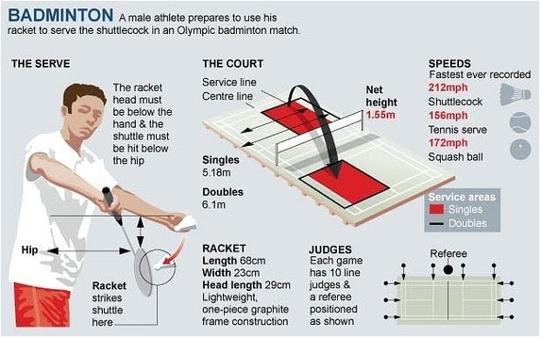
YEAR 11 into 12 CTEC Sport
Task
Unit 18 Task 1: Practical Skills in Sport and Physical Activities
Choose a Sport:
Select a sport you are confident in or interested in refereeing (e.g., football, basketball, netball, rugby, volleyball).
Rules and Regulations:
Research and summarise the key rules and regulations relevant to refereeing that sport.
Highlight any specific signals, fouls, or penalties the referee must know.

Slide 3
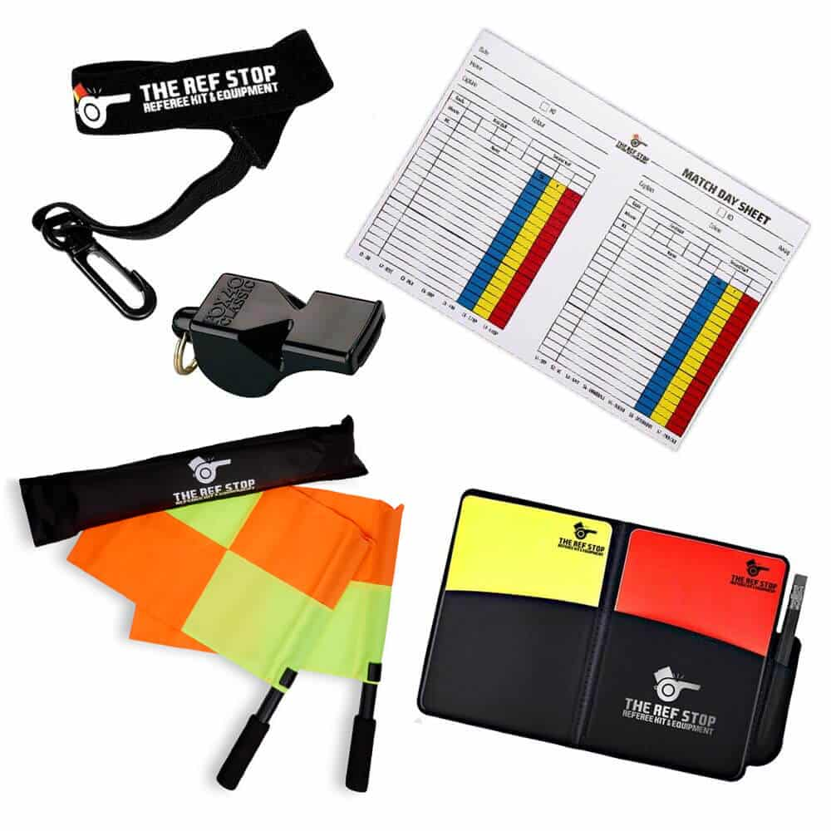
YEAR 11 into 12 CTEC Sport
Task
Unit 18 Task 2: Practical Skills in Sport and Physical Activities
Pre-Match Preparation:
Prepare a checklist of referee duties before the match (e.g., equipment check, briefing players, checking the pitch/court, safety considerations).

