Slide 1
History
Summer work – Year 10 into Year 11

Slide 2
Task 1: Interpretations of Appeasement
Learn the following schools of thought that provide different interpretations of Appeasement:
Popular Majority
Popular Political
Orthodox
Revisionist
Counter-Revisionist
For each school of thought, you must be able to state:
Title; dates; key message; context (what influenced their writing at the time?)
Stretch yourself: Which schools of thoughts have areas of agreement or similarity? What about areas of disagreement or difference? Why might this be?

Slide 3
Task 2: Impact of Empire
This was your year group’s weakest section of the mock – let’s fix that now!
Complete at least two of the following activities in the blue boxes.
Create a timeline of the Impact of Empire course. Utilise the textbook and revision guide – don’t Google it, it won’t make sense…
Extension:
Review the specification on the next slide – make notes on each section using the revision guide and textbook.
Create a series of flashcards for each of the following topics:
England and Ireland
England and Scotland
England’s economy
Social and political developments in Britain
The plantations and the slave trade
Use the MIGRATION textbook for this task (not the revision guide). Read the chapter summaries and use them to create mind maps or notes about the Impact of Empire course.
p. 149; p. 159; p. 162; p. 178; p. 185; p. 190; p. 203

Slide 4
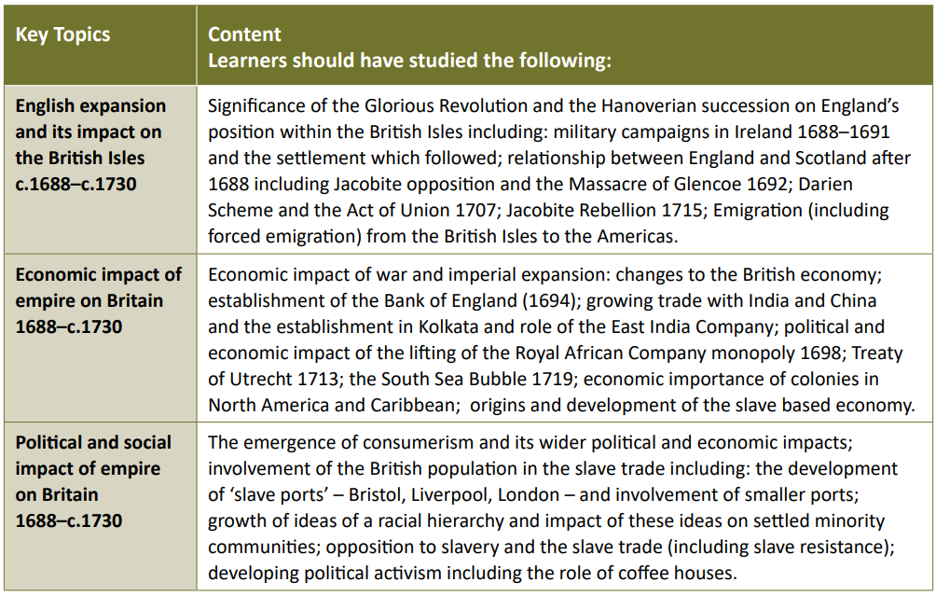

Slide 5
Task 3 Practice Question
Complete the following practice question to be marked in class your first lesson back.
Q3. Study Interpretation A. Do you think this interpretation is a fair comment on the British policy of appeasement? Use other interpretations of the events of 1937–1939 and your knowledge to support your answer. (25 marks)
Interpretation A
THE MAN THE WORLD LOOKS UP TO. How well our faith in Mr Chamberlain has been justified! His firmness of spirit and gentleness of heart have been successful. Refusing to give in, refusing to be discouraged or give way to opposition and insults, he went tirelessly on until he stopped the armies of Britain and Germany from going to war.
An extract from the front page of ‘The Daily Sketch’, a popular British newspaper in the 1930s. This extract was published on 29 September 1938.

Slide 6
Interpretations questions made simple
Question 3: ‘Is this a fair comment?’
FIRST: Summarise the extract: what is it saying about Appeasement? Was Chamberlain to blame? Did he have any choice? Were other factors more important? Choose a quote to support your view.
SECOND: Decide on one school of thought who would find the interpretation fair. Describe what they said, and explain why they would say this is fair.
THIRD: Decide on one school of thought who would find the interpretation unfair. Describe what they said, and explain why they would say this is unfair.
This is all you need to do to get a decent mark!
The extras below will make your answer even stronger…
Name the schools of thought
Mention the context: why did they have that view at that time?
Refer to one more school who would find this fair or unfair.
Learning intention: To utilise interpretations regarding Appeasement.

Slide 7
Paragraph structure Q3:
You can use the following structure:
A __[name of school]__ historian from ________________ [what years?] would find the interpretation fair/unfair. In particular, they would agree/disagree with “____________________________” [quote the interpretation], because a _________ historian thinks that…[what does this school of thought think about Chamberlain and Appeasement/who is to blame for the Cold War?]
They think this because…. [Discuss the context either historical or of the interpretation].
Therefore, ______________[school of thought, e.g. Orthodox] historians like _______________ [name a historian] would consider this fair/unfair.
Learning Intention: To effectively utilise historical interpretations for Paper 1

Slide 8
Optional extras
Want to improve your grade, or keep your brain active over summer?
Excellent!
There are lots of practice questions in the textbooks and revision guide that you can practice.
Don’t forget about Migration and Spitalfields – review your knowledge using mind maps, flashcards, practice questions and quizzes.
Listen to podcasts from providers like:
Dan Snow’s History Hit
The Rest is History
History Extra
In Our Time
You’re Dead to Me (Radio edits – the non-radio edits contain some rude words!)

