Slide 1
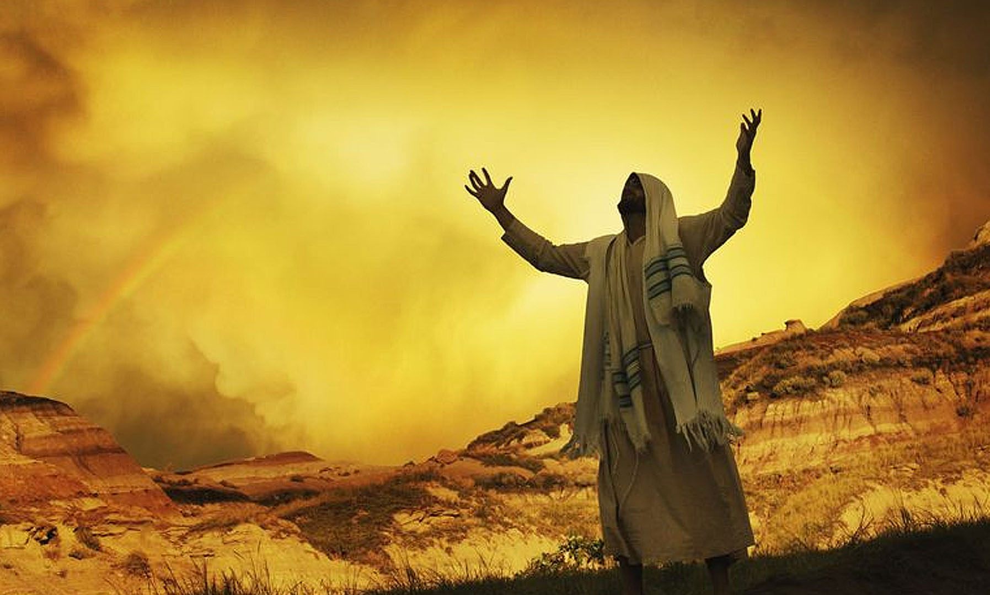
GCSE Summer Homework – Year 10
Creative Project – Covenant with God
The idea of a covenant (special agreement) between God and the Jewish people is central to Judaism.
Create ONE of the following:
A comic strip
A storyboard
An illustrated timeline
A short story from the perspective of Abraham, Moses, or a Jewish believer today
Your project should explain:
What the Covenant is?
Why it is important in Judaism? How it influences Jewish life today? Evidence: Listen to a podcast?
Evidence of competition must be discussed/shared/demonstrated in the first lesson back after the summer. The student who completes the best work for each subject will win 30 house points.

