Slide 1

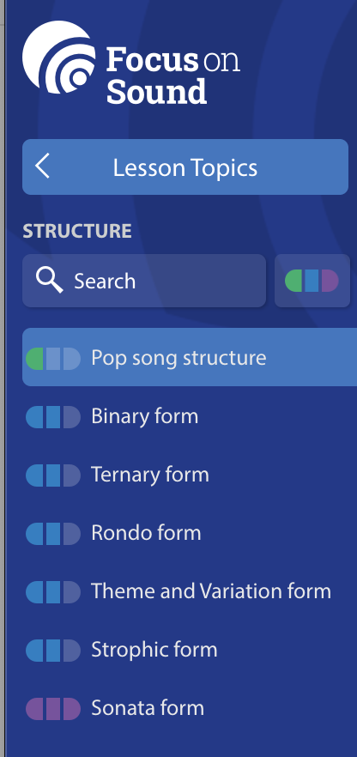
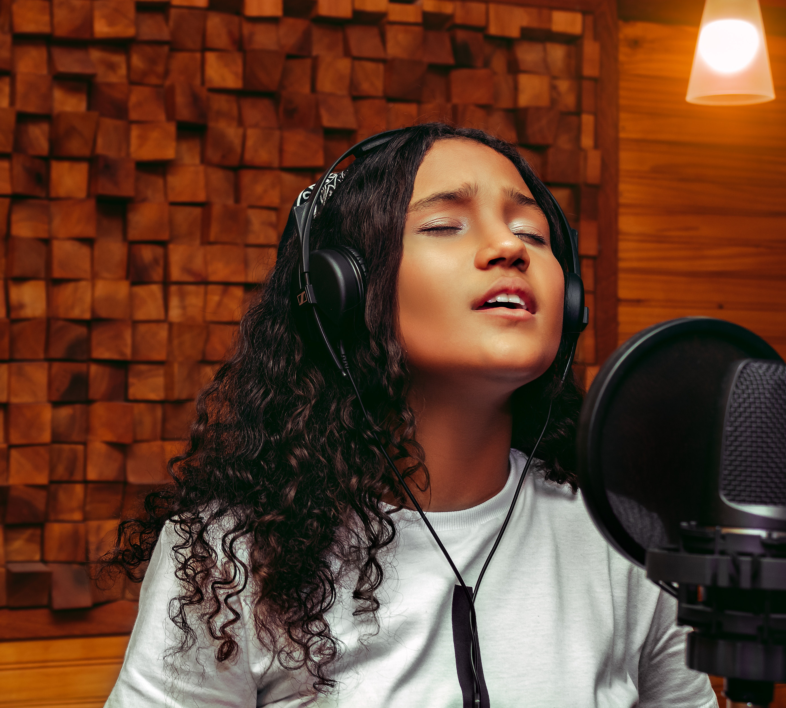
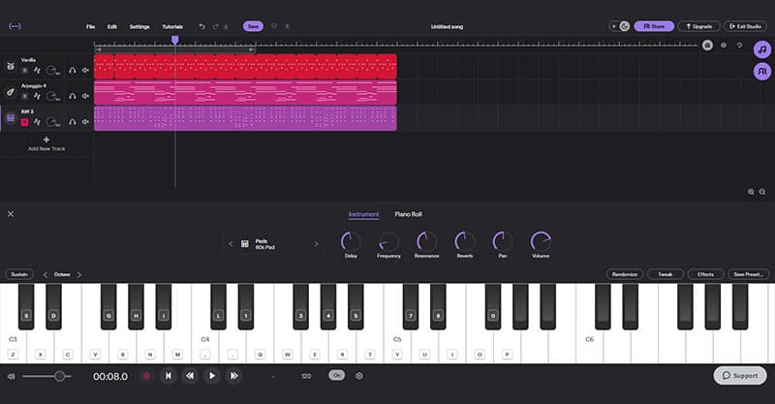
Music Year 10 into 11 Summer Homework
Task: Complete two of the following activities over the summer holidays.
Rehearse and make improvements to your Solo piece Send a video of improvements made via email to: psaul@dma.tela.org.uk Alternatively, you can upload it to your Private Teams Channel | Please complete all sections on Structure, using Focus On Sound https://fosuk.server1.apps.focusonsound.com/lessons/structure | Compose a section of music for at least four instruments that explores the use of syncopation Use either; Flat I/O Soundtrap GarageBand All ideas must be your own. Do not use pre-recorded loops

