Slide 1






French Summer Task 2025

Slide 2

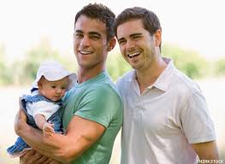
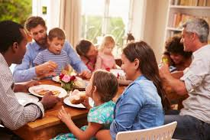
Task 1 : Watch the YouTube clip and make notes (in English) about how the structure of families has changed in France over the last 40 years.
https://www.youtube.com/watch?v=58T8RCG_Lmc

Slide 3
Task 2 : Translate the passage about family into English.
Je vis avec mon petit frère, ma mère, son conjoint et sa fille. Nous nous entendons assez bien mais nous nous disputons au sujet des tâches ménagères. Ma mère dit qu’elle a besoin d’aide mais mon beau-père répond qu’il est fatigué le soir. Sa fille et moi avons des devoirs le soir et ne voulons pas toujours aider. Qui va étendre le linge ou faire la vaisselle ?

Slide 4
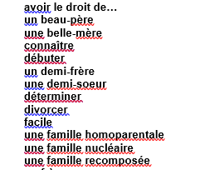
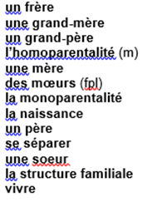

Task 3 : Translate the vocab into English and write a paragraph in French, using as much of it as possible!

Slide 5
Task 4 : Write approx. 150 words in French covering the 2 bullet points. Use a variety of complex grammar structures from GCSE
Theme 1 – Identity and culture
Vous écrivez un blog sur les rapports familiaux.
Décrivez :
• l’importance d’avoir de bons rapports avec votre famille
• une célébration récente en famille.
Ecrivez environ 150 mots en français. Répondez aux deux aspects de la question.

Slide 6
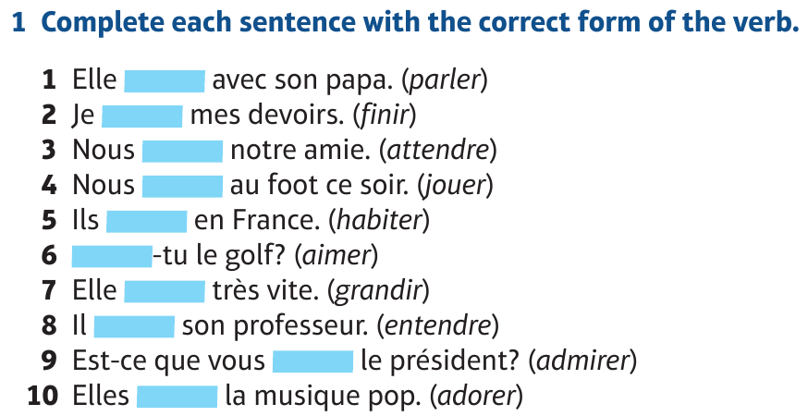
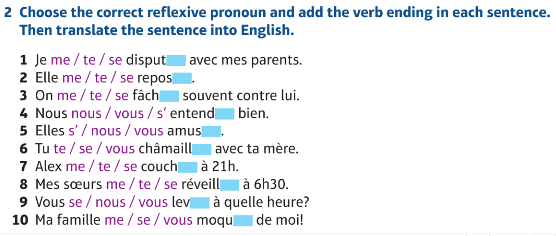
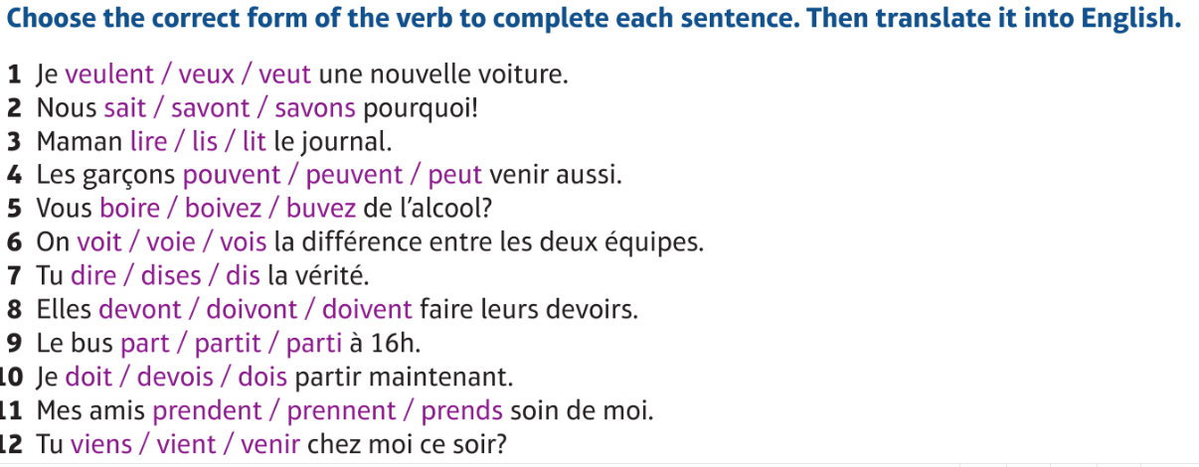
Task 5 : Complete the grammar activities below

Slide 7

Task 6 : Research the novel “Un sac de billes” around the following points:
A - Character:
•Who are the main characters?
•Who are the secondary characters?
•What traits/personalities do they have?
•What relationships do the characters have?
B - Theme:
•What are the main themes in the piece of literature? (Come up with more than one!)
C - Styles and techniques:
•Use of language, slang, is the narrator a child or adult?
D - Social and Historical Context:
•What time period is the piece set in?
•Why is this relevant to the story?
•What key events were going on at the time?

Slide 8

Task 7 : Watch the blog about the film “Les intouchables” and make notes in English
https://www.commeunefrancaise.com/blog/intouchables

