Slide 1
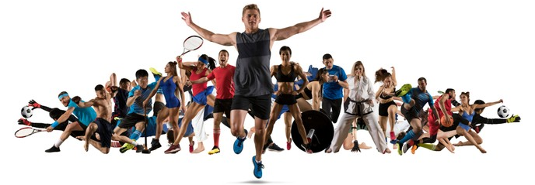
Level 3 CTEC Sport PE
Summer Homework 2025

Slide 2
Unit 8 TASK 1: Plan Your Sports Event
Decide on the type of sports event (e.g., tournament, fun run, charity match, skills competition).
Choose the sport(s) involved.
Define the target audience (age group, skill level, community, etc.).
Select the date, time, and venue for your event.
Identify the purpose of the event (competition, fundraising, community engagement, etc.).
Some ideas to get you started:
🧱 Staff vs Students Match
🧠 Sports Quiz Afternoon
🥅 Penalty Shootout or Free Throw Competition
⚽ Inter-Tutor Group or Inter-House Tournament
🏃 Fitness Challenge
🧗 Obstacle Course Challenge
🤾Target Sports Challenge
🎮 E-Sports or Virtual Sports Tournament
🧘 Wellbeing and Activity Morning
🚴 Spin-a-thon or Bike Challenge

Slide 3

Unit 8 TASK 2: Plan Your Sports Event
Part 2: Create Promotional Posters
Design at least one poster to promote your event.
Posters must include:
Event name and logo (if applicable).
Date, time, and venue.
Key highlights or attractions.
Contact information or how to register.
Eye-catching visuals and clear layout.
You may use digital tools (e.g., Canva, Photoshop) or hand-draw your posters.
Consider different formats: one could be for social media and the other for physical display.

Slide 4
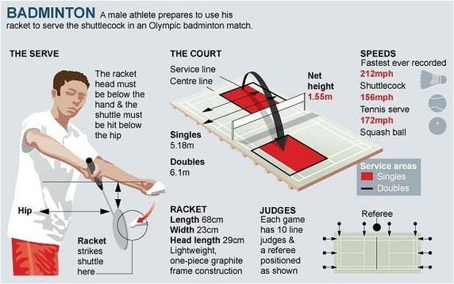
Unit 18 Task 1: Practical Skills in Sport and Physical Activities
Choose a Sport:
Select a sport you are confident in or interested in refereeing (e.g., football, basketball, netball, rugby, volleyball).
Rules and Regulations:
Research and summarise the key rules and regulations relevant to refereeing that sport.
Highlight any specific signals, fouls, or penalties the referee must know.

Slide 5
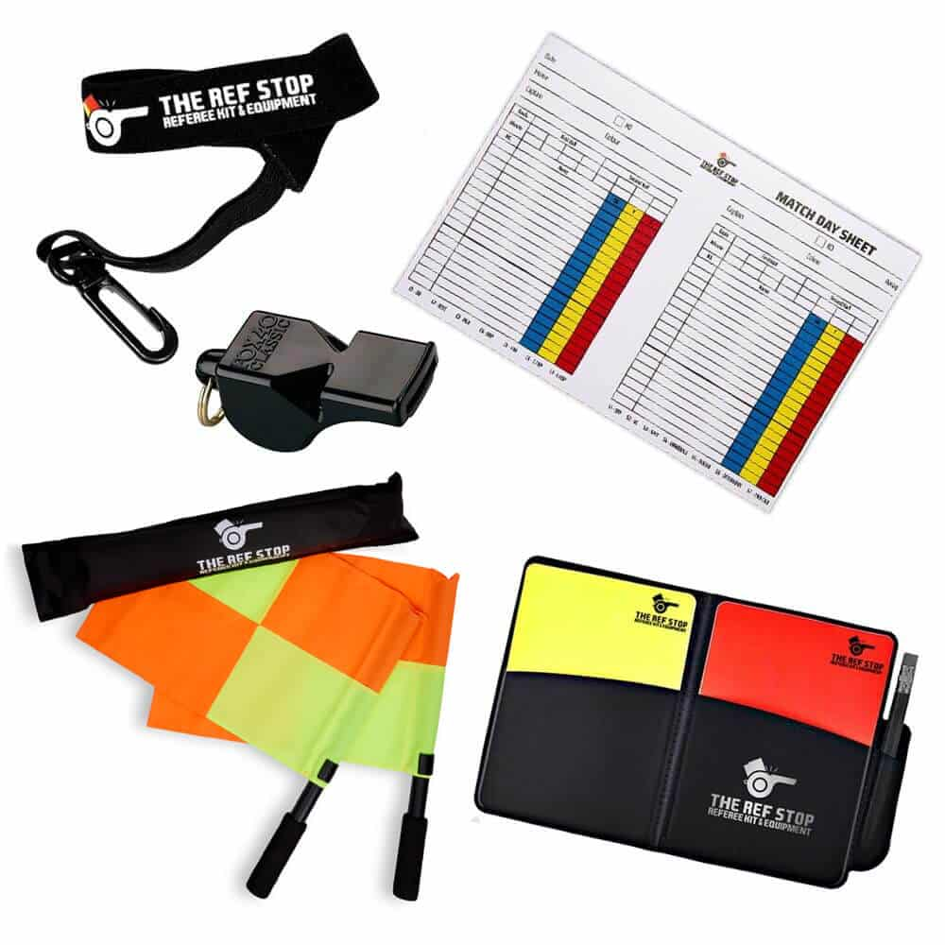
Unit 18 Task 2: Practical Skills in Sport and Physical Activities
Pre-Match Preparation:
Prepare a checklist of referee duties before the match (e.g., equipment check, briefing players, checking the pitch/court, safety considerations).

