Slide 1
GCSE ART: WEEKLY PLAN
Week | Date | Focus | Prep due
1 | 05.01.26 | Launch of Unit 2 Exam paper theme. Initial mind map and statement. Selecting first Artist/Contextual reference. | New set of exceptional photographs
2 | 12.01.26 | First artist: Pastiche and in-depth written analysis. Content, context and meaning. Use the ‘AO1 Grade 9 response tick list’ for support.
3 | 19.01.26 | Your own photographs, annotated to explain how they link to the theme. Visual recording lesson from one of your photographs: A diverse range of drawings presented with supporting annotation. One drawing should be sustained. | Mind map in response to the theme of ‘Found’ and typed up Statement of Interest/Intent. Printed out and clipped onto the first page of your unit 2 book.
4 | 26.01.26 | Using the above artist with your own imagery. Experimentation and developments
5 | 02.02.26 | Printmaking: Mono-printing and collage work presented with supporting annotation. Etching design. Etchings and developments fully presented | Exceptional sustained drawing (s) from new photographs.
6 | 09.02.26 | A new artist. This can be one you have independently found or one recommended by us.
7 | 16.02.26 | Half Term
8 | 23.02.26 | Mastery of artists, combining with own imagery. | Fully documented artist to support your monoprint/etching developments.
9 | 02.03.26 | Mock exam planning: Thumb nail sketches of composition ideas.
10 | 09.03.26 | Digital planning and refinements. | Composition planning
11 | 16.03.26 | Mocks: 18 and 19th March
12 | 23.03.26 | Refinements: Taking strengths from mocks to refine, adapt and develop. | Planning and refinements.
13 | 30.03.26 | Easter Holiday
13 | 06.04.26
14 | 13.04.26 | Individual targets based on mock exam outcome. Experimentation and mastery. | Planning and refinements
15 | 20.04.26 | Individual targets based on mock exam outcome. Experimentation and mastery.
16 | 27.04.26 | Individual targets based on mock exam outcome. Experimentation and mastery. | Planning and refinements
17 | 04.05.26 | GCSE ART UNIT 2 EXAM
18 | 11.05.26 | Labelling. Unit 1 amendments.

Slide 2
What does the word 'Found' mean to you? What images/themes/concepts did you initially think of in response to the theme of ‘Found’? What words are linked/associated?
What area of specialism do you wish to focus on and why? (people/human form, objects, architecture, organic forms, the environment etc) What main topics or themes do you wish to explore within the ‘Found’ title? Include topics that are unusual, challenging, controversial, gritty or inspiring: those that fill you with passion. Why is this topic important to you? Why do you want to communicate this in your artwork?
What artists and designers inspire you and why? (is it their themes, messages, techniques, media, processes etc) Out of the artists/contexts we have covered in class so far, which ones do you love? Are there any other artists/designers that you are also intrigued by and would like to take inspiration from?
What material's and techniques covered so far in lessons do you feel are your areas of strength?
Which materials and techniques would you like to refine and develop further?

Slide 3
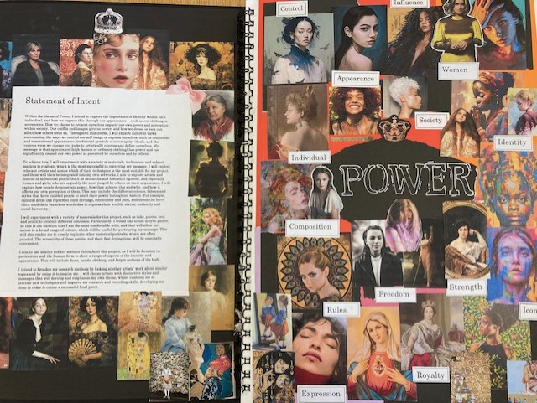
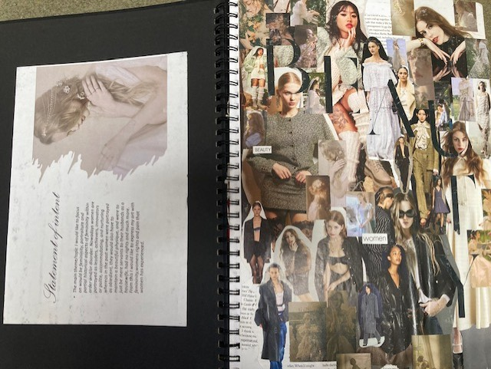
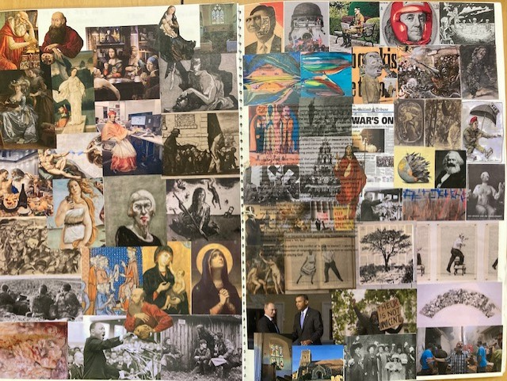

Slide 4
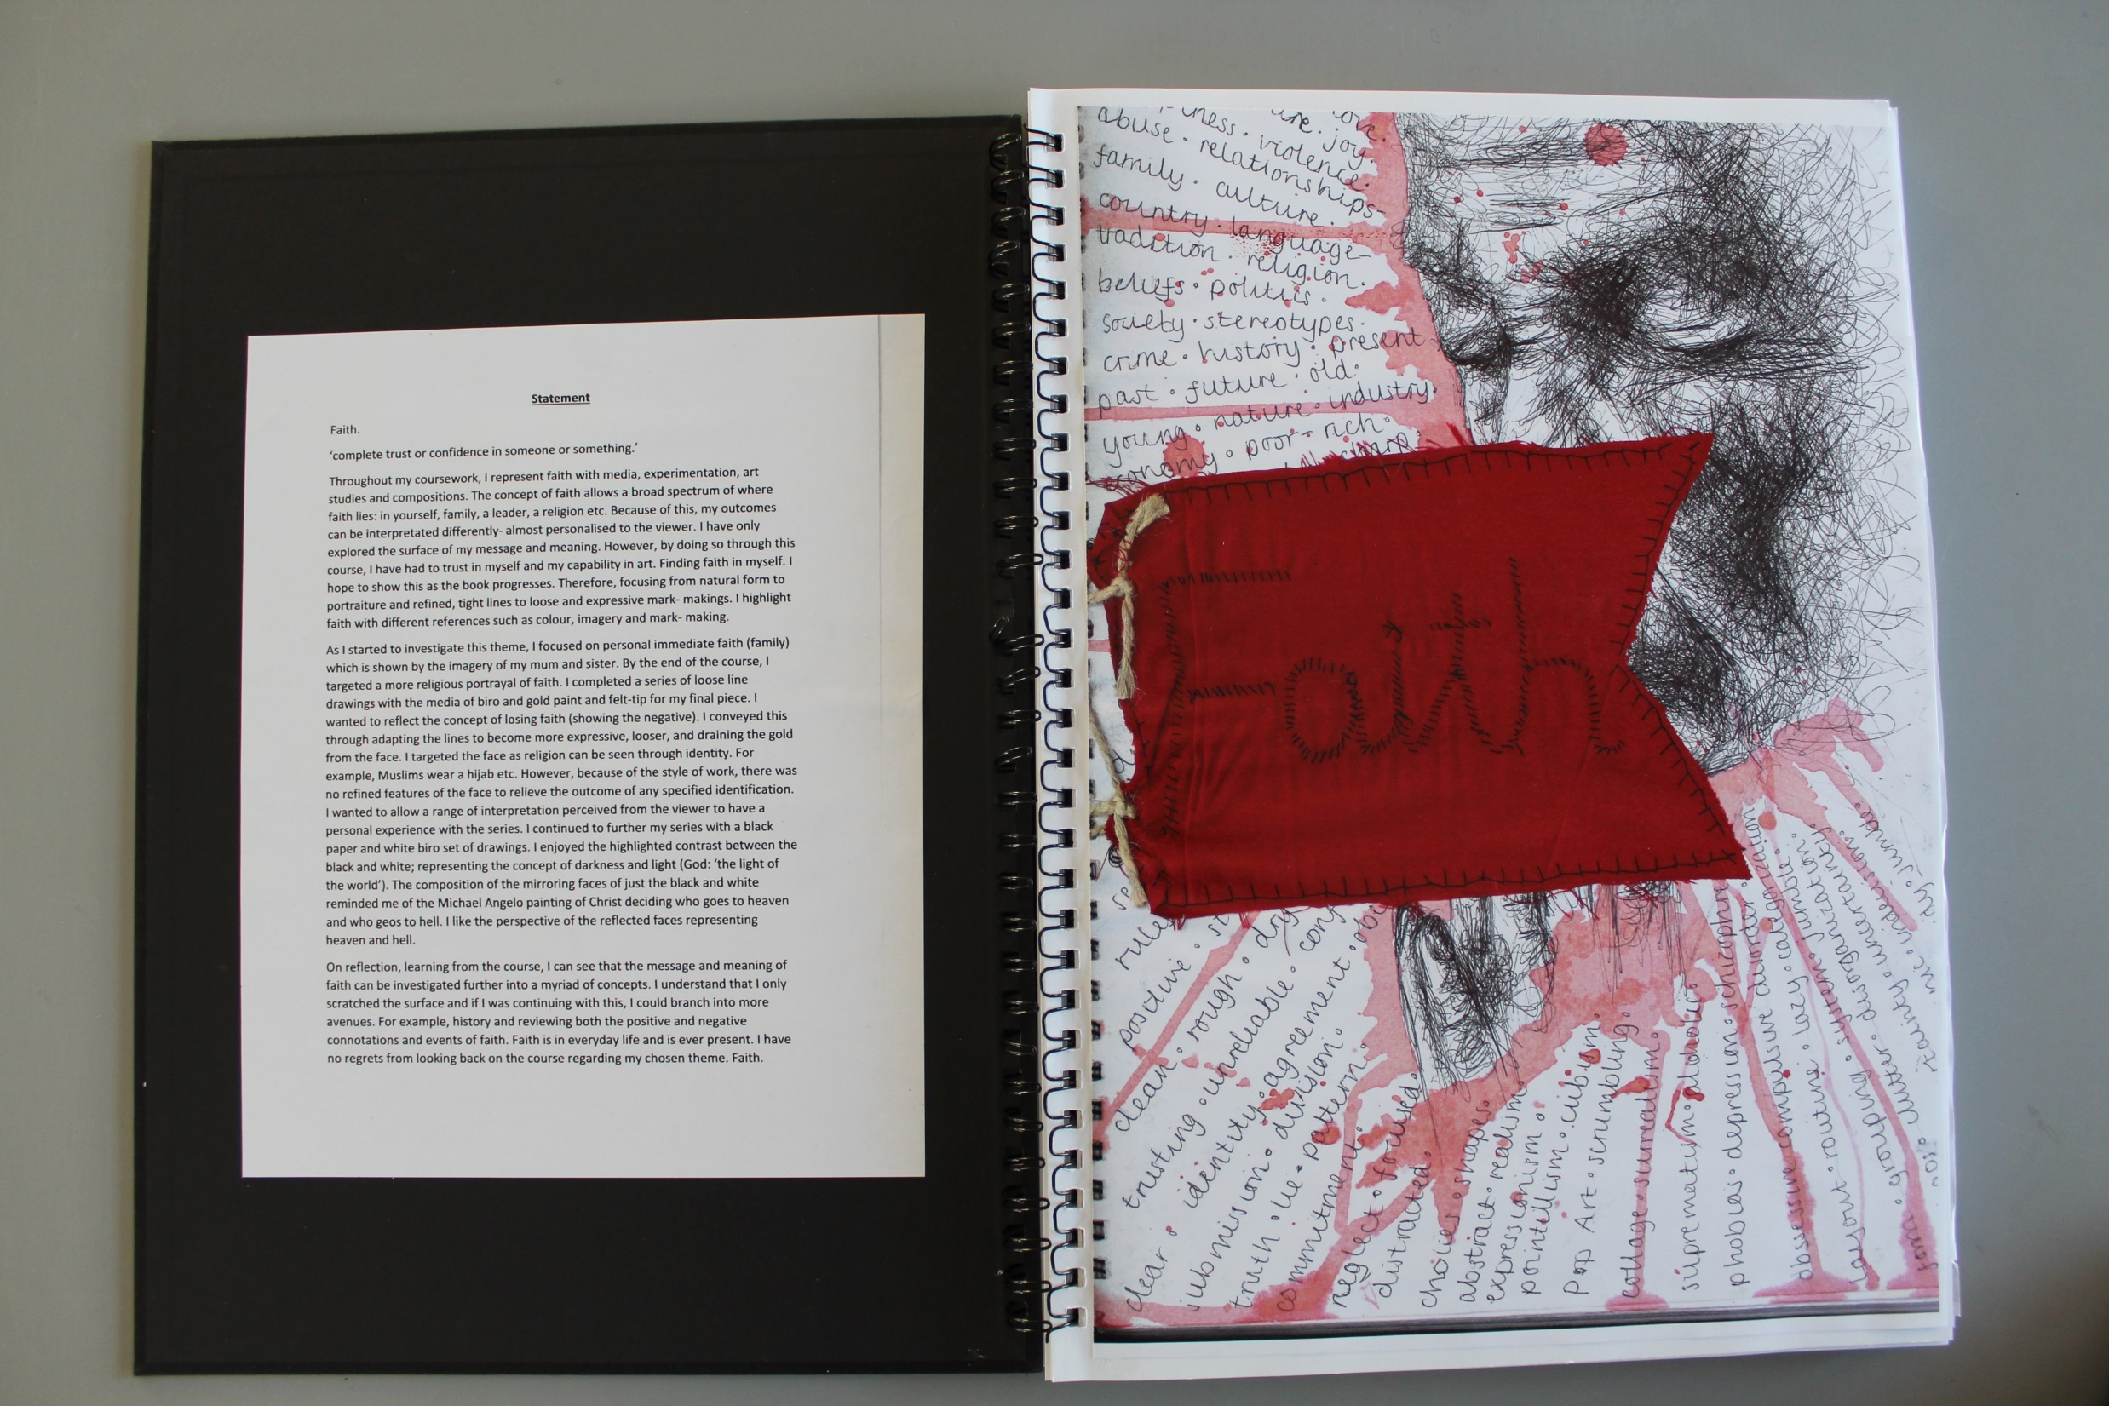

Slide 5
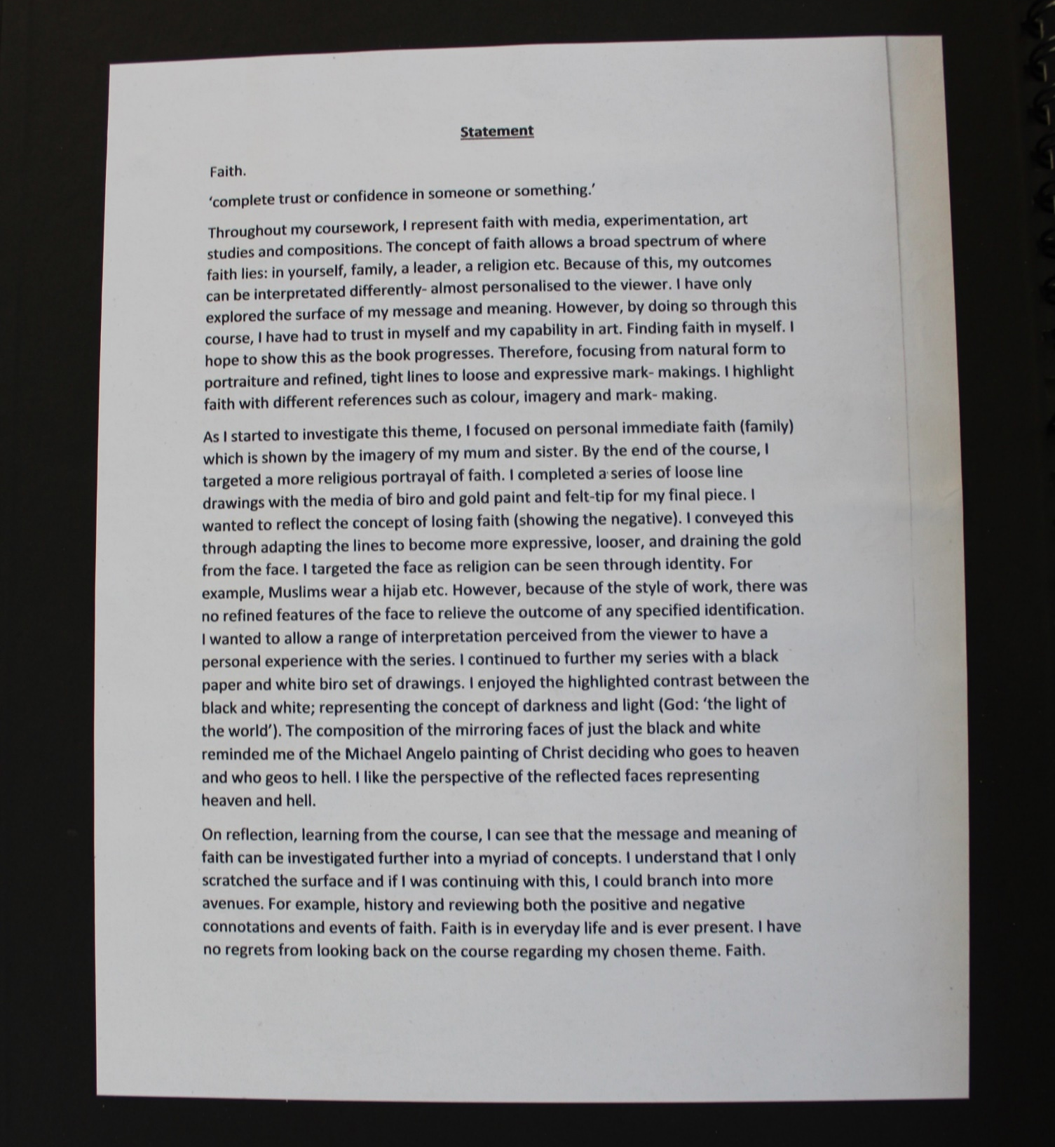

Slide 6
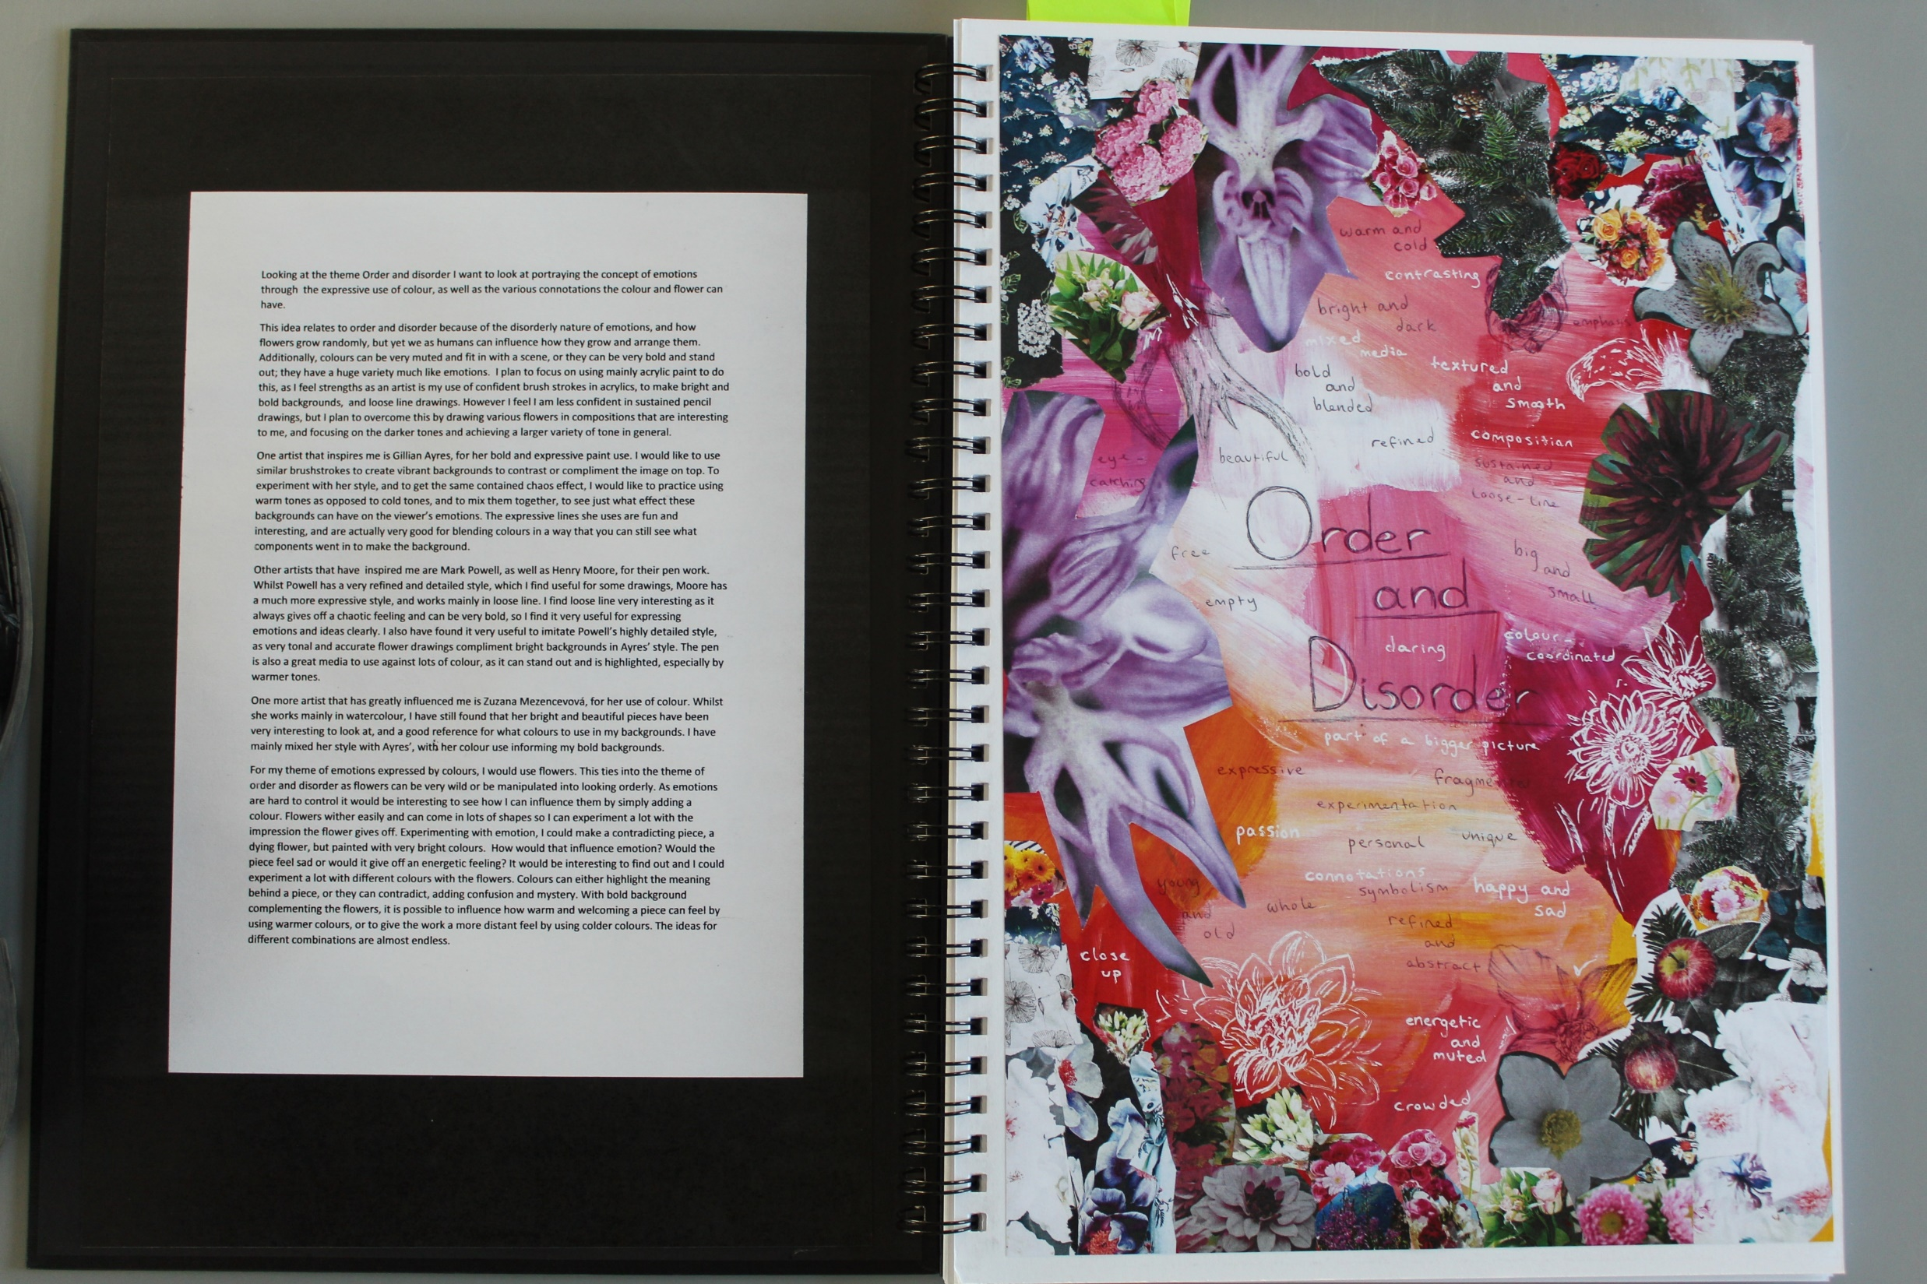

Slide 7
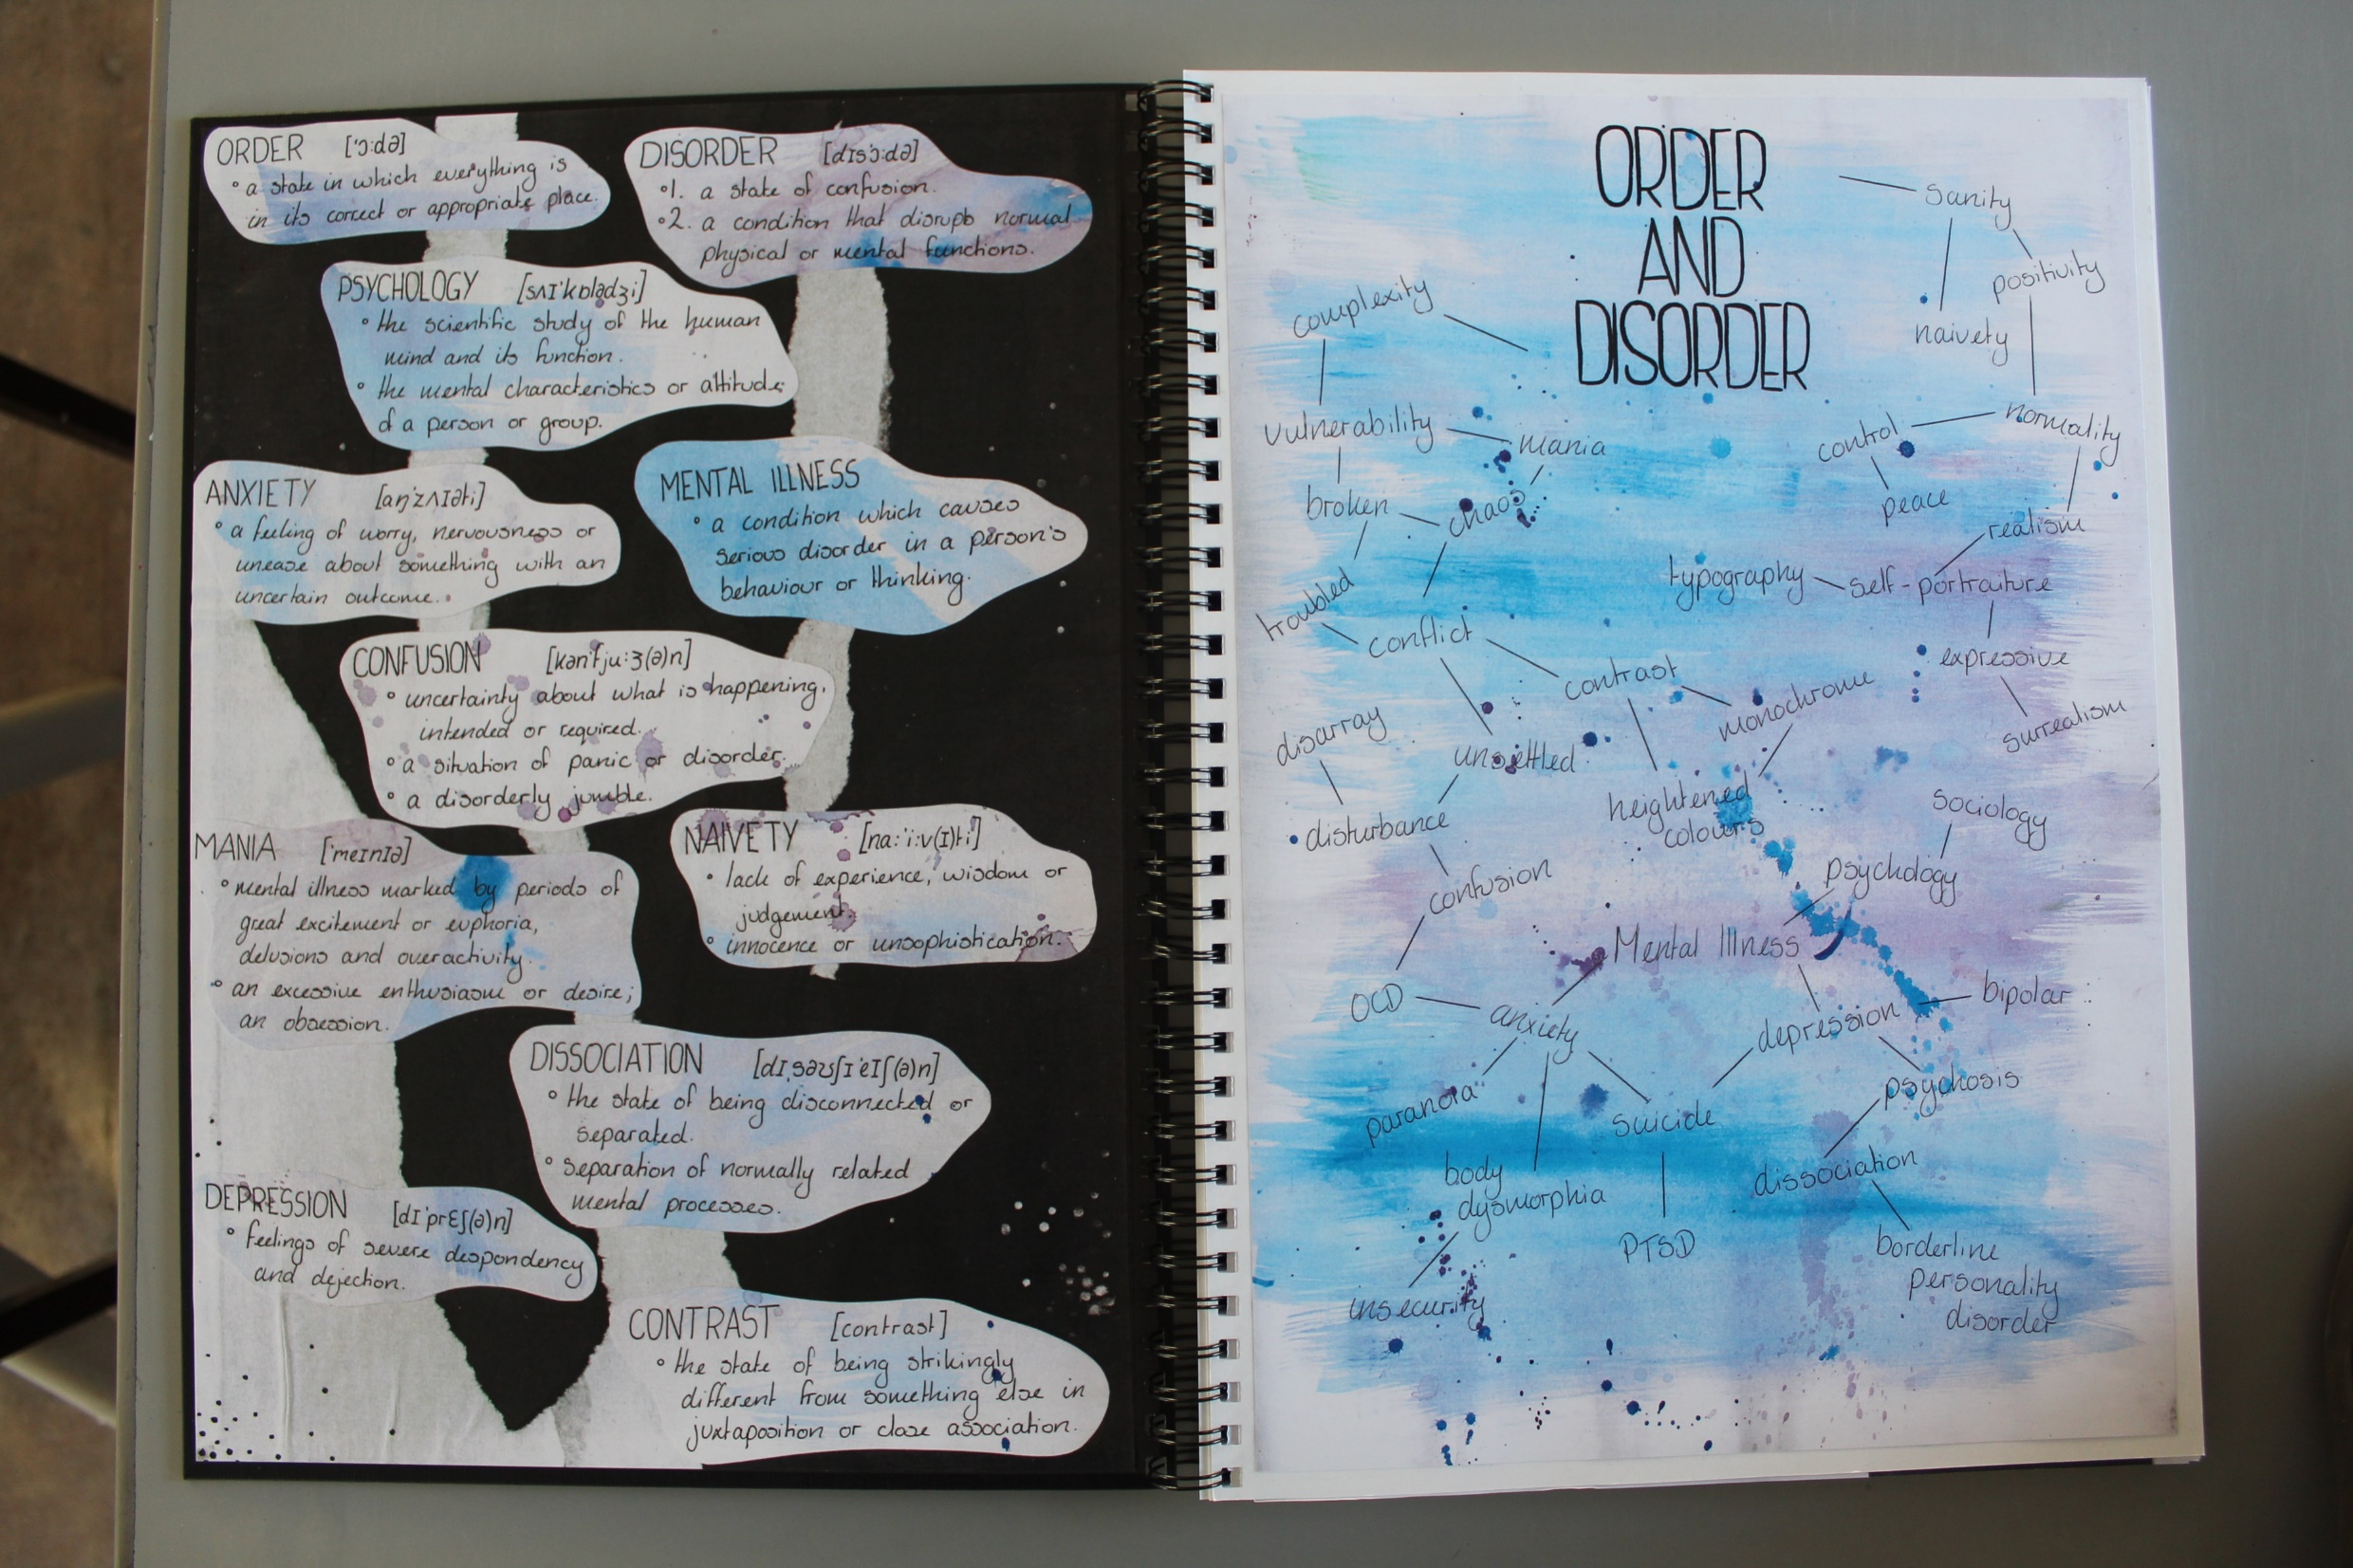

Slide 8
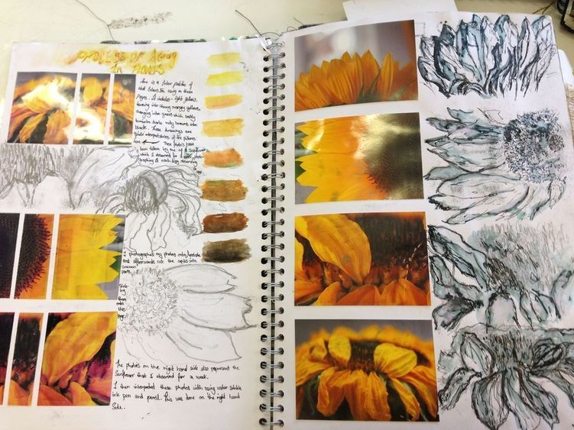
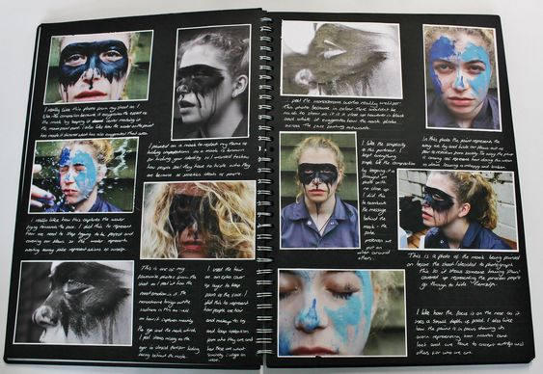
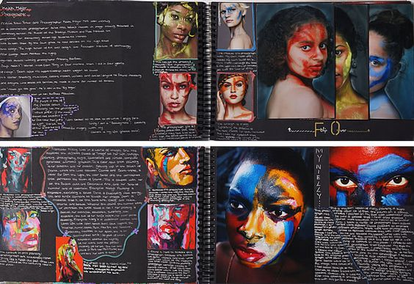
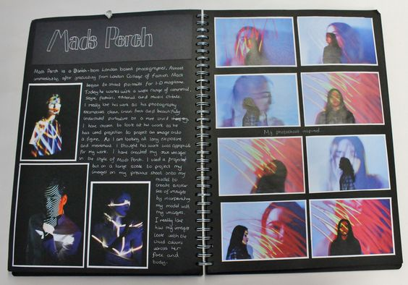
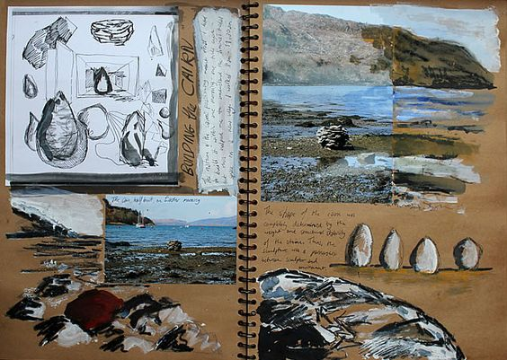
Your Unit 2 starting point will heavily rely on
a new set of ‘exceptional’ photographs.
These will provide you with vital reference
Materials for drawings and developments.
Consider carefully how you wish to respond
to the Unit 2 theme.
People - Portraits, the Human Form.
Man Made – Objects, tools, machinery
Environment – Architecture, landscapes
Natural world – Organic forms
Natural
Staged
Posed
Black and white
Colour
Filtered
Manipulated
Repeated

Slide 9
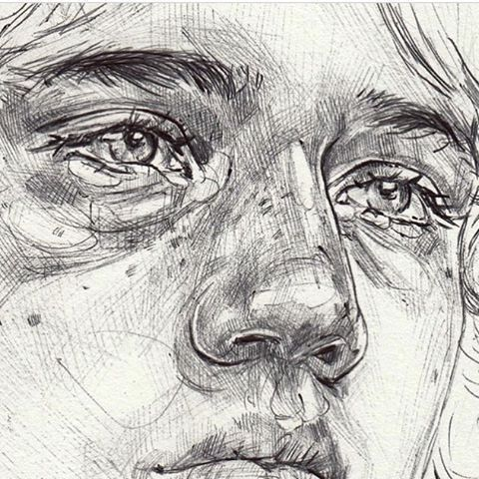
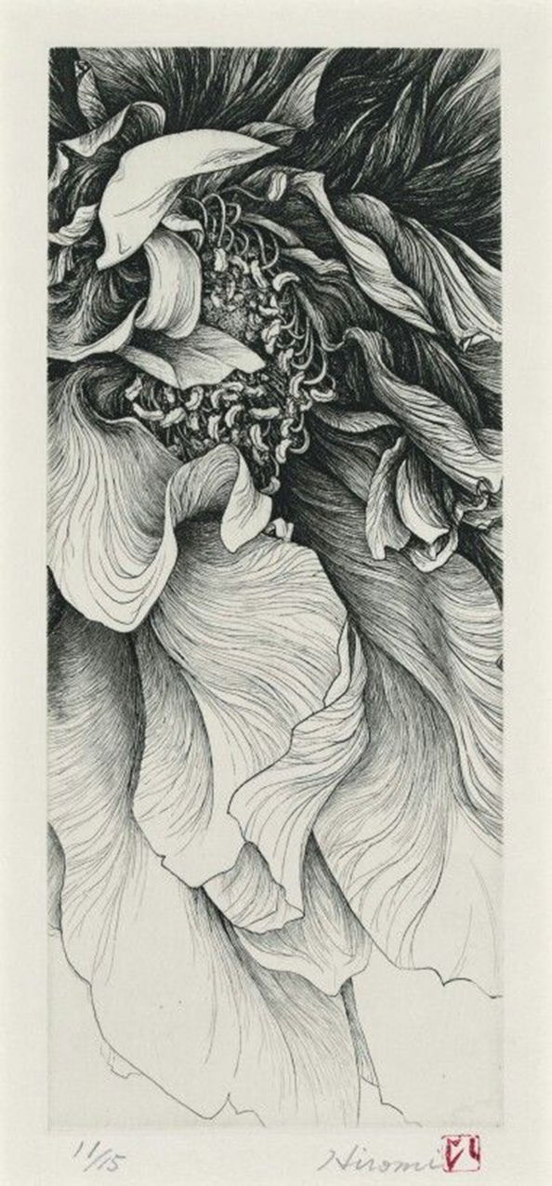
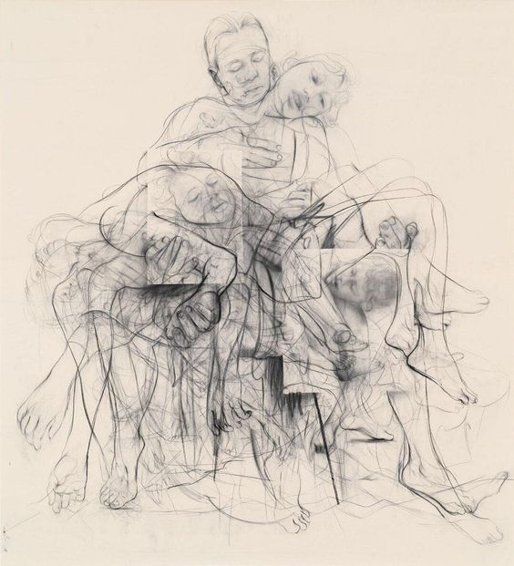
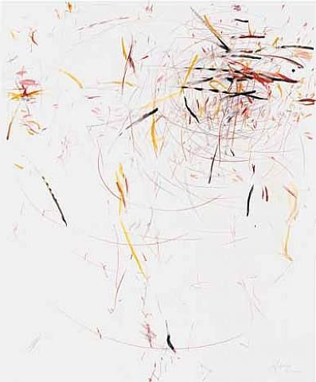
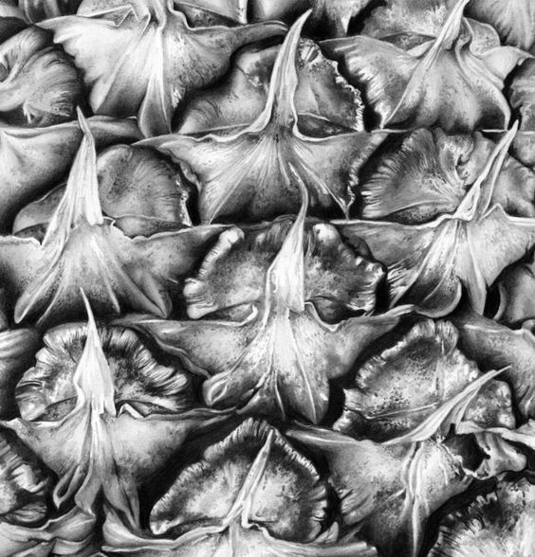

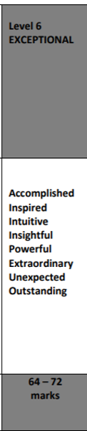
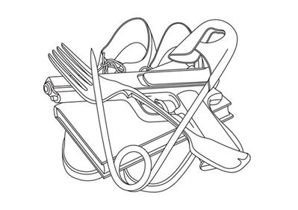
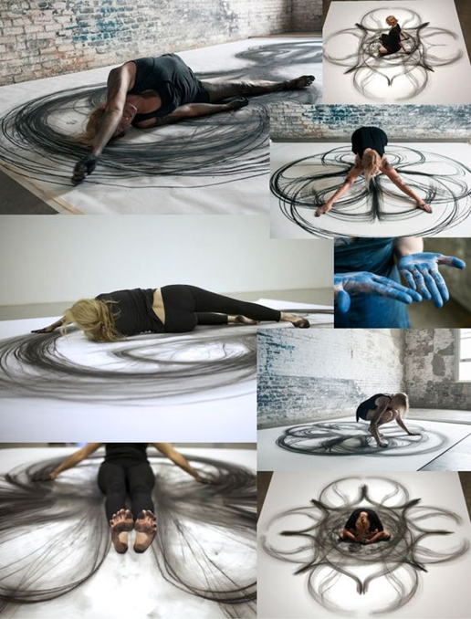
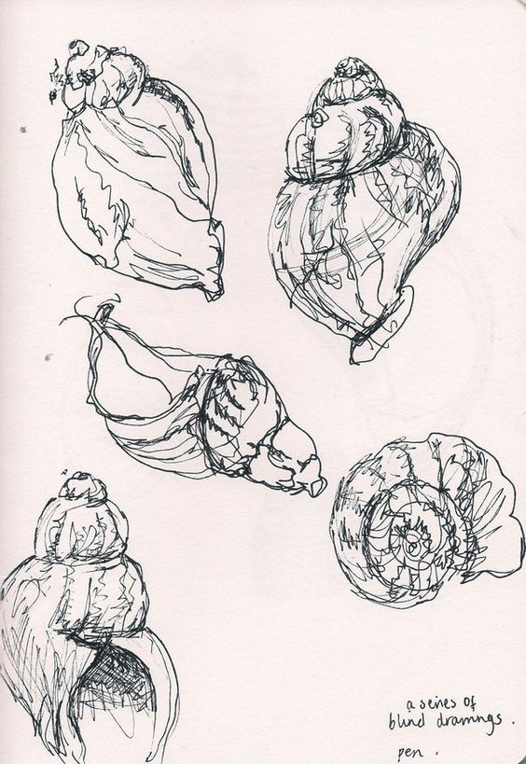
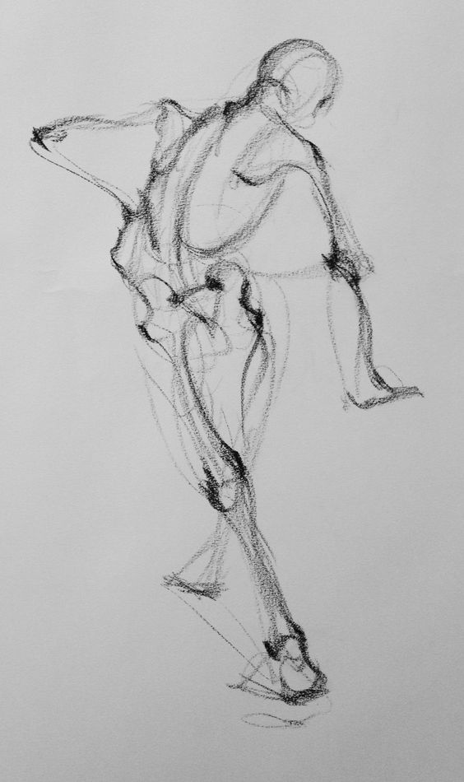
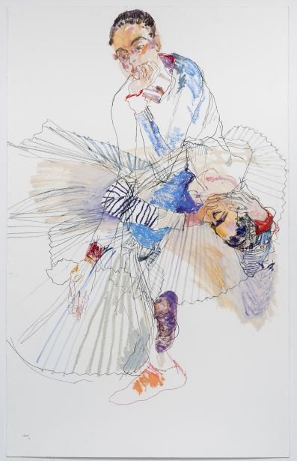
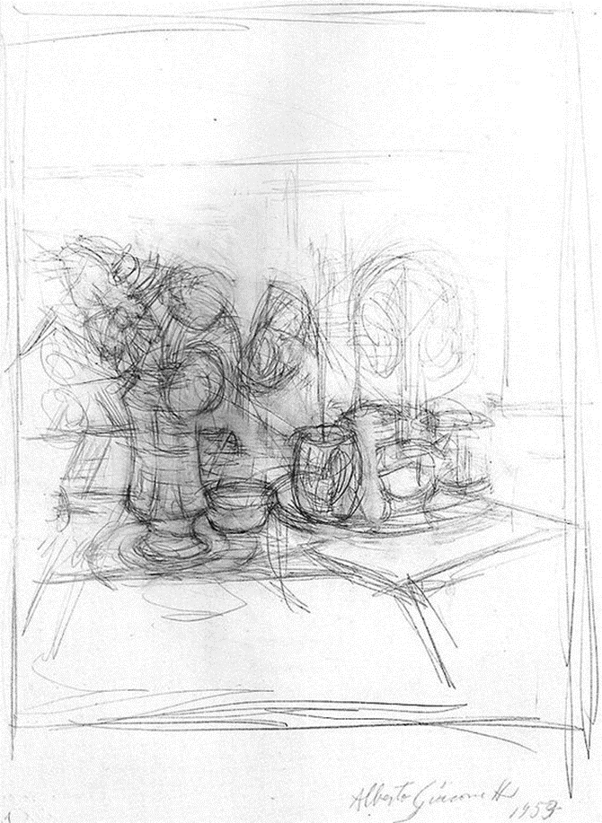
What is ‘Exceptional’ Visual Recording?

Slide 10
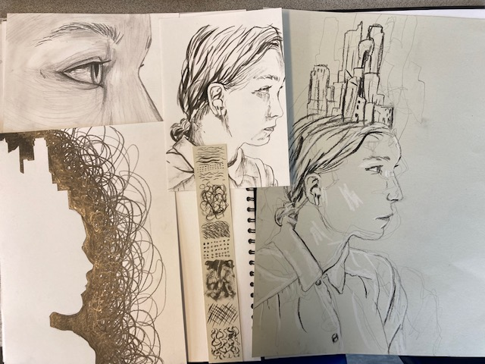
What is ‘Exceptional’ Visual Recording?
Your challenge this morning is to practice and master the recording of your image.
Drawing exercises:
Bind continuous line
Gesture
Highlights
Positive/negative space
Linear ink with mark-making.
Cropped tonal
Graphite
Willow charcoal
White chalk
4B pencil
Indian ink

Slide 11
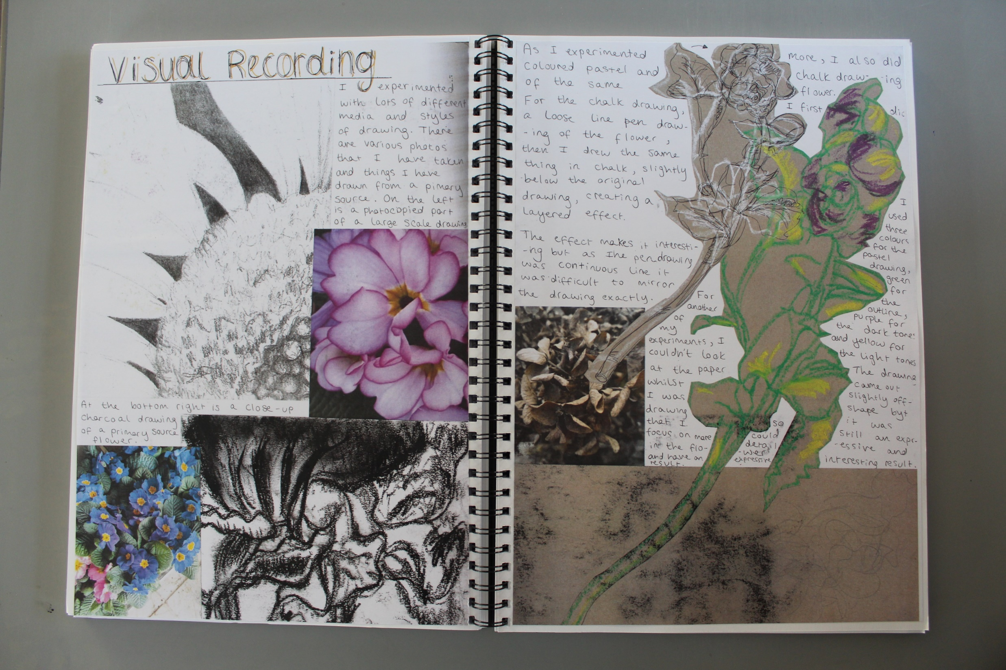

Slide 12
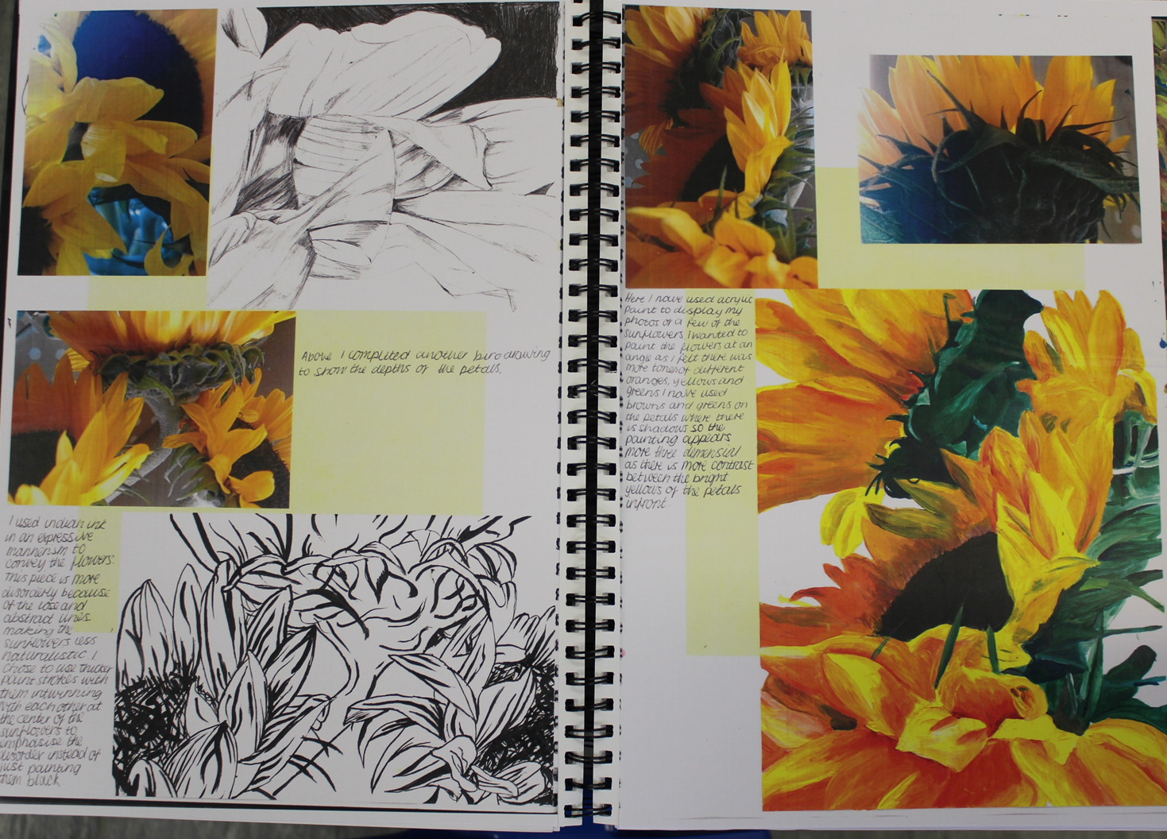

Slide 13
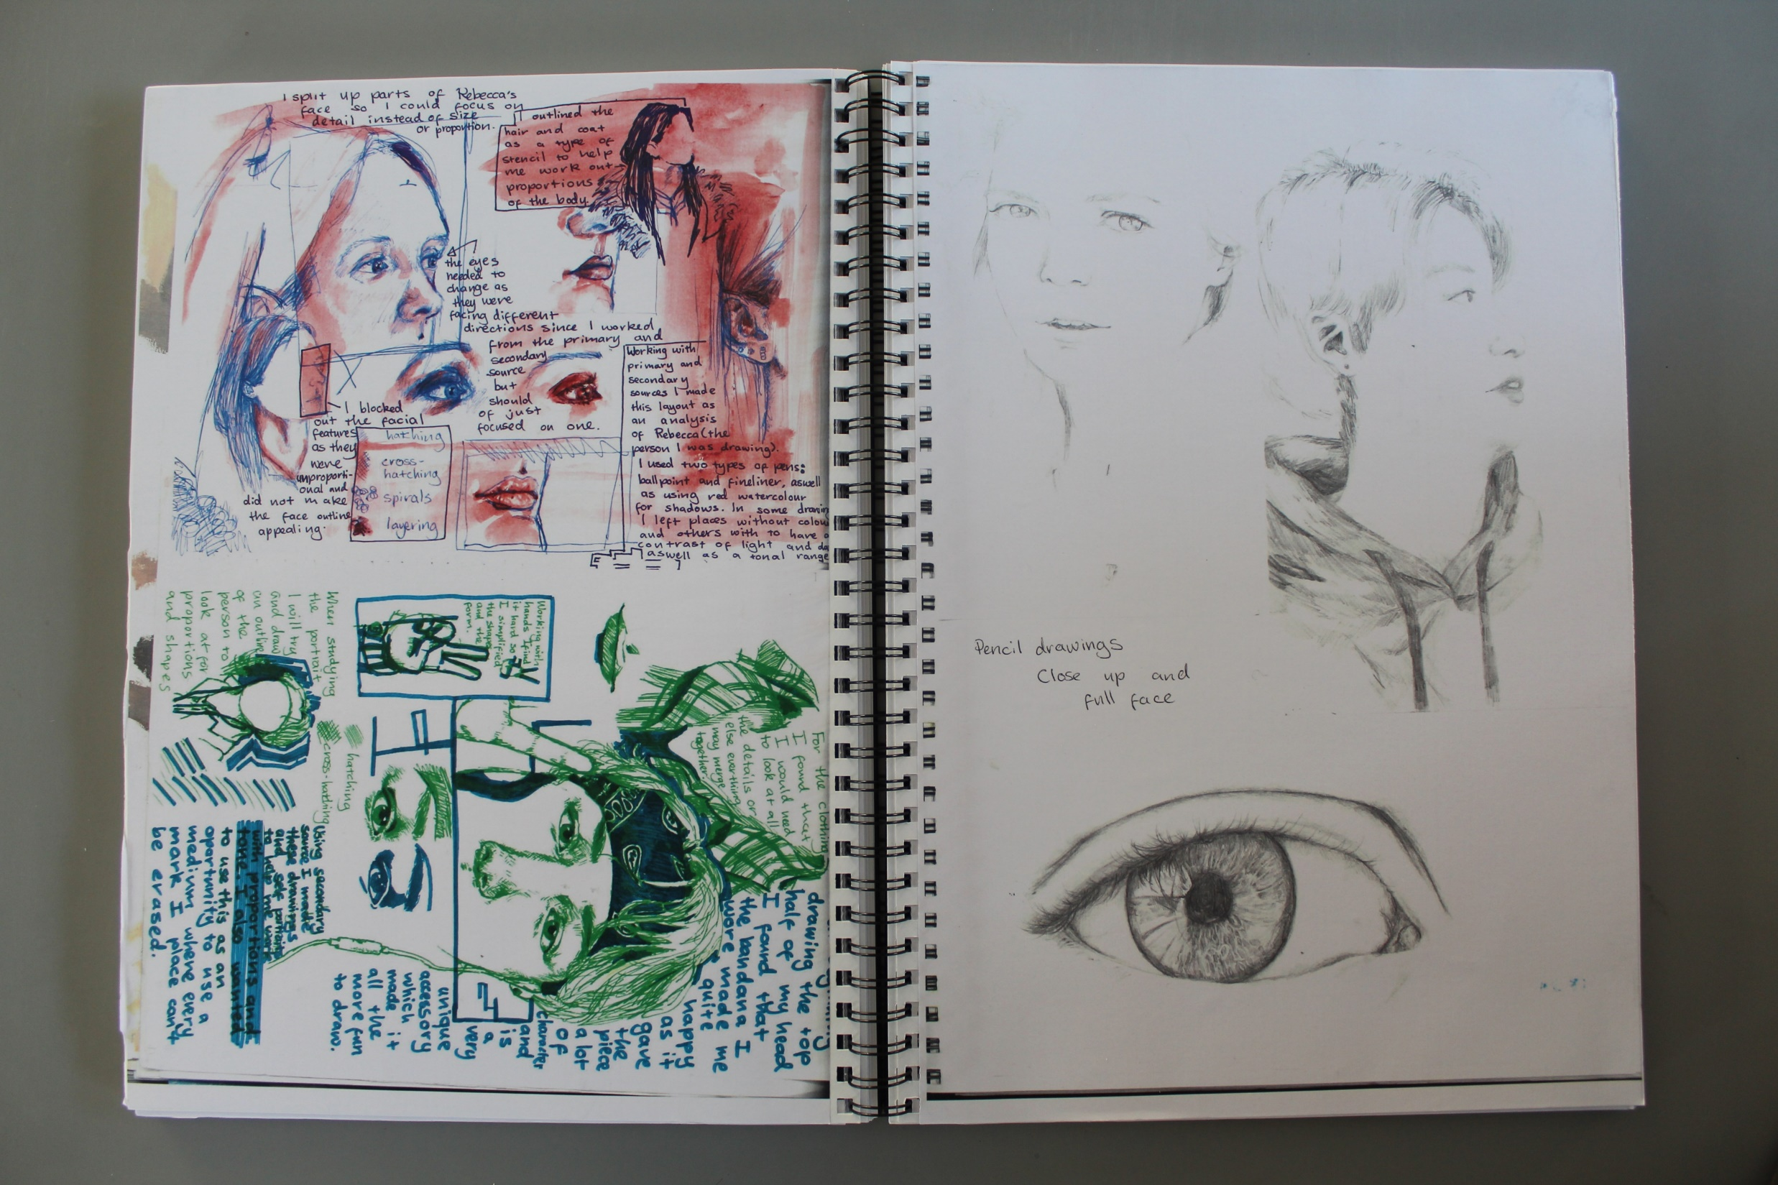

Slide 14
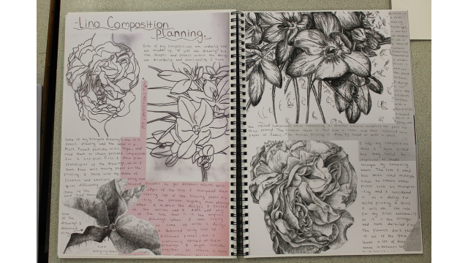

Slide 15

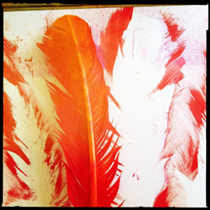
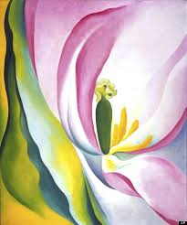

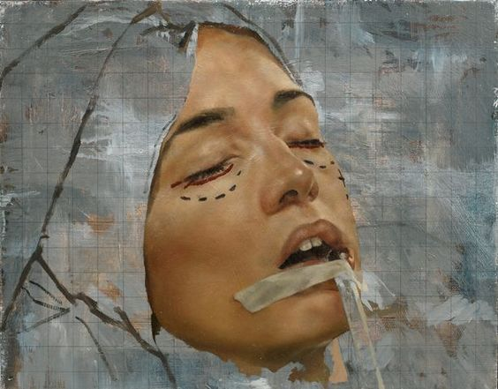
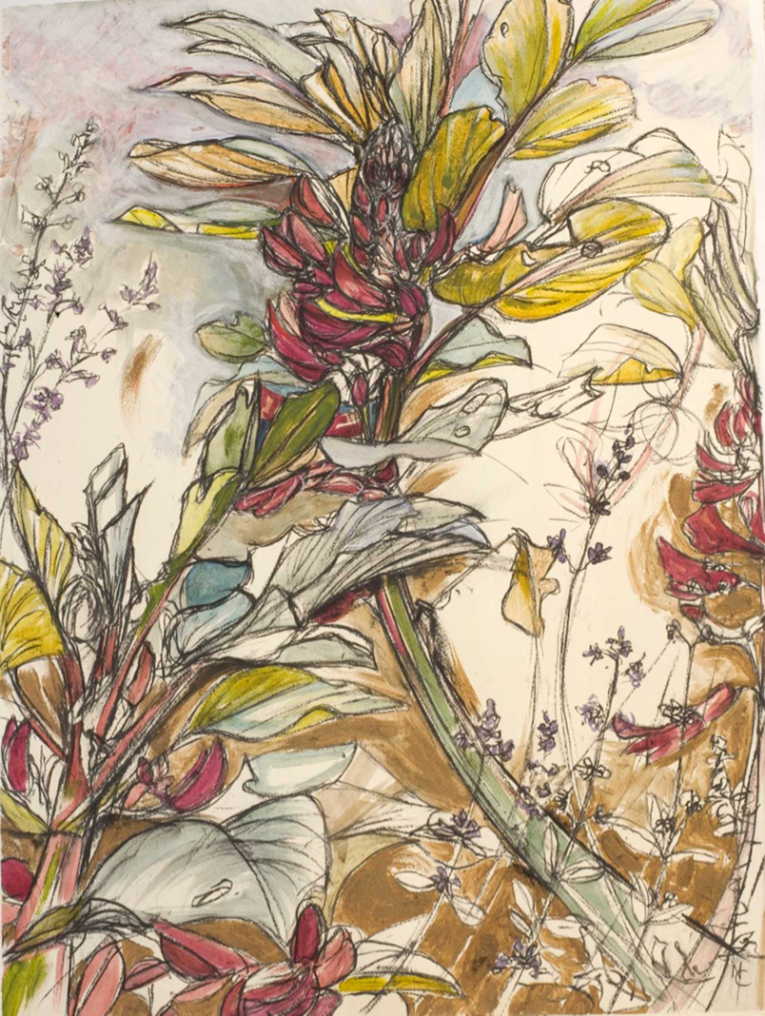
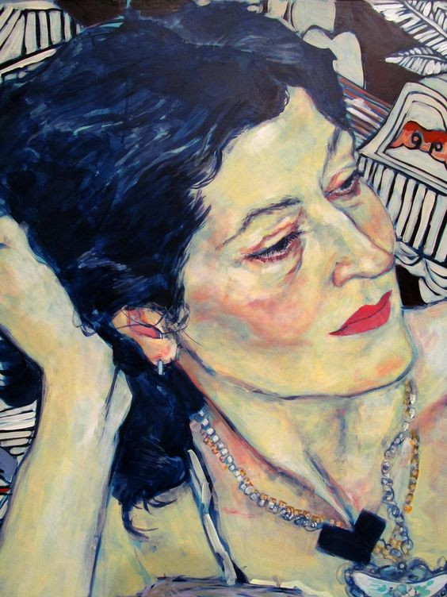
Georgia O’Keeffe
Cropping and enlarging
Often a photo will lack impact because the main subject is so small it becomes lost among the clutter of its surroundings. By cropping tight around the subject you eliminate the background "noise", ensuring the subject gets the viewer's undivided attention.

Slide 16
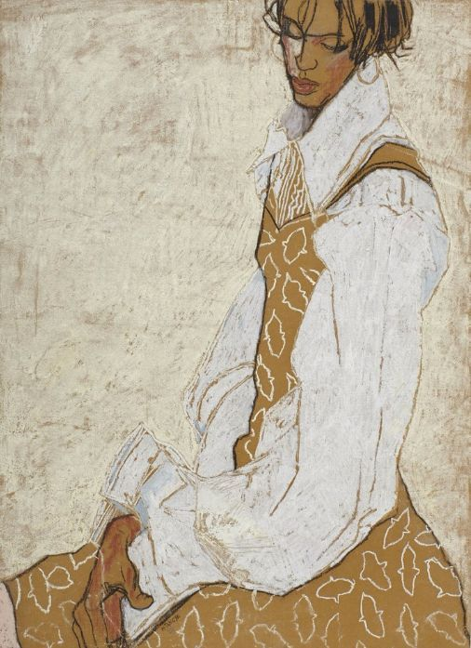
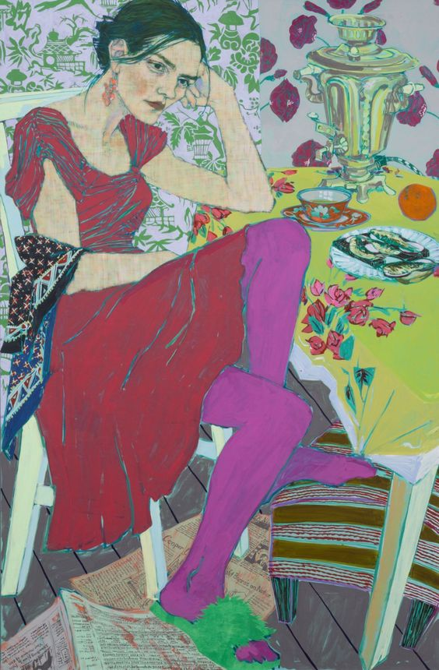
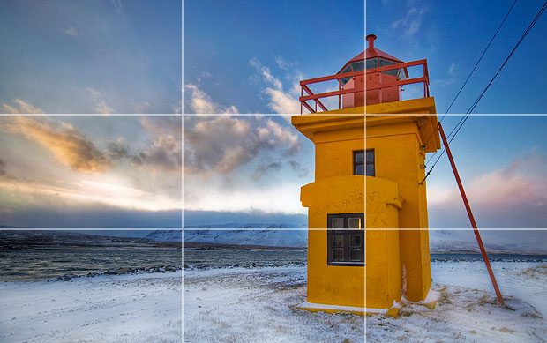
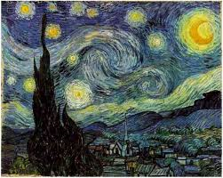

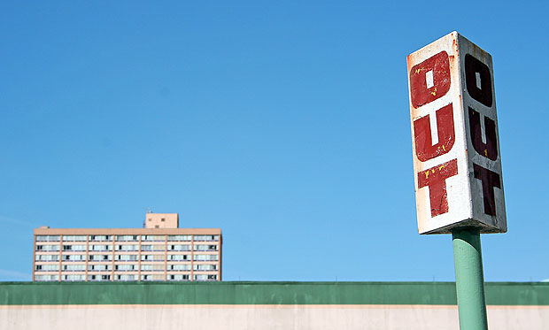
Rule of Thirds
The most interesting component along one of these 3rds!
This will automatically add balance and interest.
Placing the object off centre
Balancing the weight of the subject matter is key. Other wise it can feel empty
Vincent Van Gogh

Slide 17

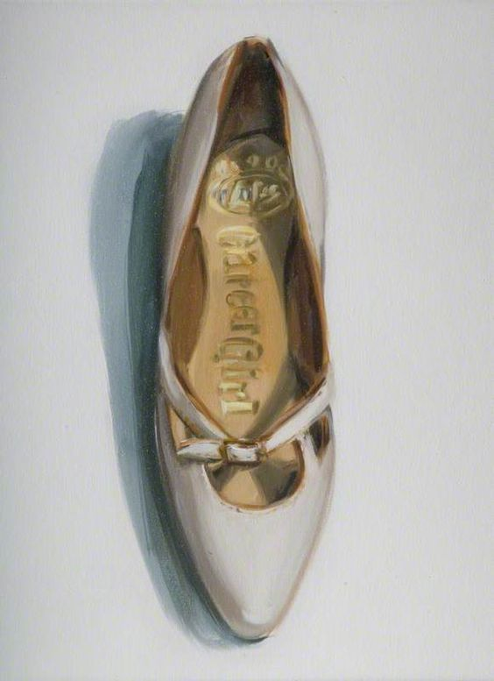
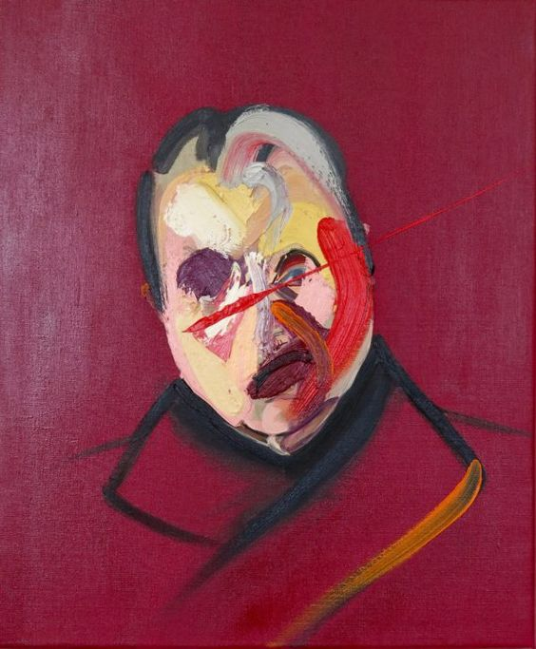
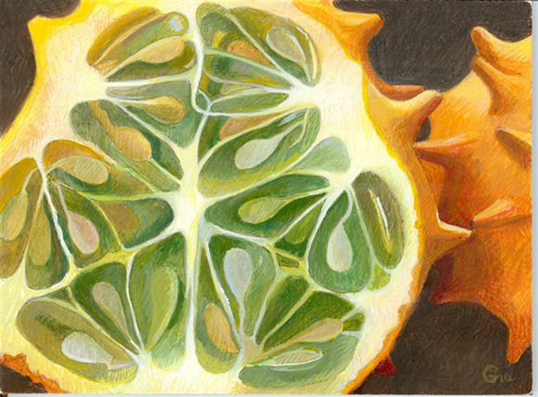
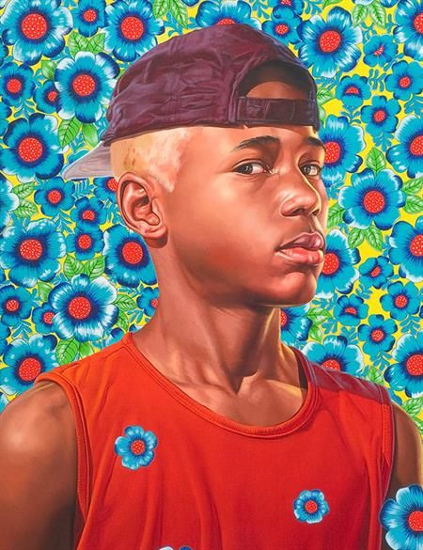
Background: A composition can be made or ruined by a busy and obtrusive back ground.
You will need to think carefully about how a background can enhance your message and meaning.

Slide 18
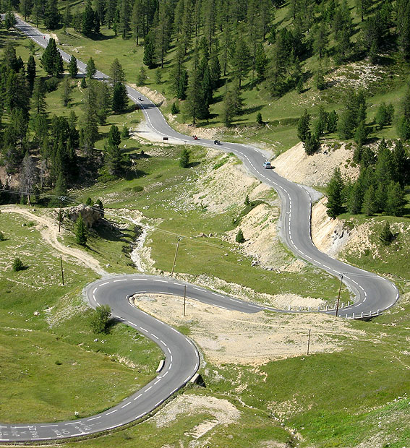
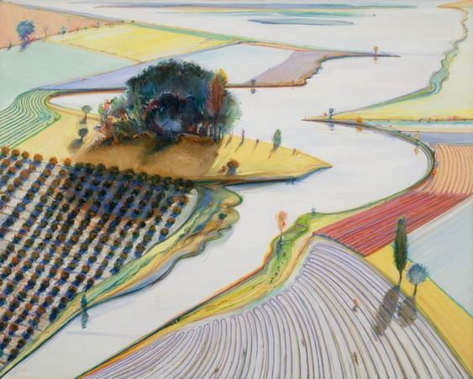
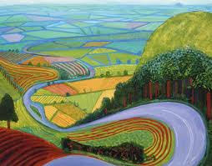
Leading lines
You can affect the way we view the image, pulling us into the picture, towards the subject, or on a journey "through" the scene. There are many different types of line - straight, diagonal, curvy, zigzag, radial etc - and each can be used to enhance our photo's composition.
David Hockney

Slide 19
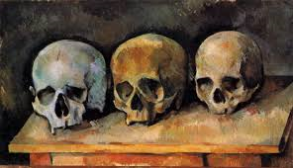
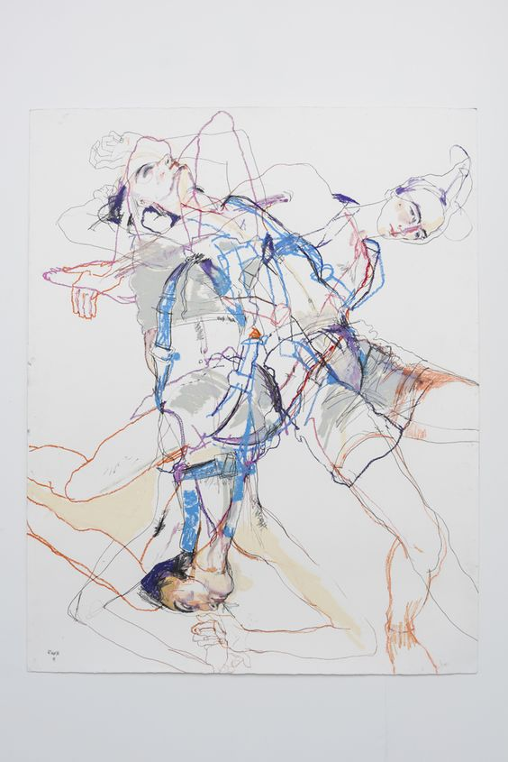
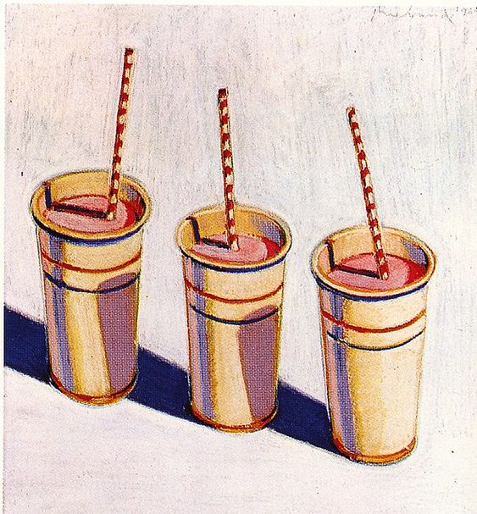
Rule of Odds Having an odd number of objects to make the composition more visually dynamic.
Paul Cezanne

Slide 20
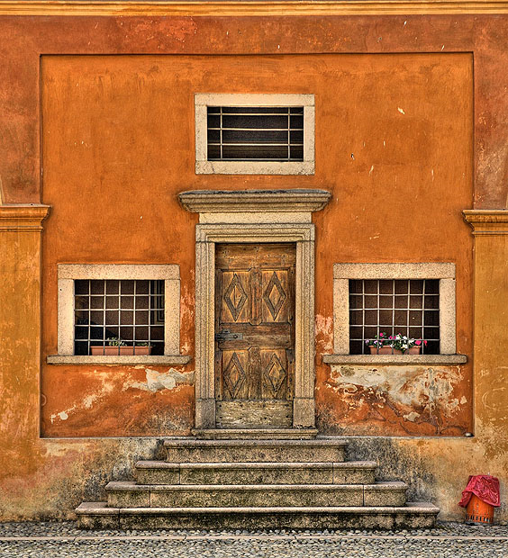




Symmetry and Pattern
We are surrounded by symmetry and patterns, both natural and man-made., They can make for very eye-catching compositions, particularly in situations where they are not expected. Another great way to use them is to break the symmetry or pattern in some way, introducing tension and a focal point to the scene.

Slide 21




Q: What makes a ‘strong’, interesting, visually dynamic composition?
Composition is the placement or arrangement of visual elements or ingredients in a work of art.
Documenting composition:
Complete a series of thumb nail sketches of your chosen photograph (s)
Try:
Crop and enlarge
Rule of Thirds
Rule of Odds
Symmetry and Pattern
Key words:
Cropping, enlarge, movement, centre, foreground, background, visual, eye, balance, isolation, overlapping, layered, repetition, pattern, abstract.

Slide 22


What are the features of Exceptional Planning for A04 final piece?
Success Criteria:
It must be purposeful and relevant.
You need to be certain on the images you will use for your final outcome. ( should be primarily primary ) Is the imagery challenging, visually exciting, original?
Show that you are CONFIDENT to visually record that image. You should demonstrate your skills in drawing and painting to test out a range of compositional styles. (crop and enlarge, rule of thirds, rule of odds, background consideration, pattern and symmetry, leading lines)
You need to critically reflect on the alternative compositions you use to justify your final choices.
You can demonstrate experimentation in different media and on different surfaces to help make your decisions for the final piece.
It should include references to your artists skills and techniques inspiration.
It should be comprehensive – taking several pages in your sketchbook.

Slide 23



How do you plan for a FLUENT A04 outcome?
Decide on a suitable image (s) for the final piece. Is it challenging, visually exciting, original?
Show that you are CONFIDENT to visually record that image…..draw/paint it over and over…different viewpoints, scales. These should be quality, sustained drawings. Not thumb nail sketches.
Don’t settle on the first composition that you try out. Test out a wide range of compositional styles.
.
Then start to combine A02 experimentation with your drawings. Show clear links to the artists skills and techniques you have studied.
This planning should show a high level of skill

Slide 24


Examples of high level composition planning.
You have chosen your final image (s):
Now test out different compositions/viewpoints.
These should not be thumb nail sketches but detailed, skilled and sustained pieces.
Vary the scale you work on.

Slide 25



You can combine your compositional studies with experimentation if you want or keep it simple by restricting it to pencil/charcoal/coloured pencil.
Photographs should be used to enhance this planning.

Slide 26



Exercise to plan for media and artist technique:
Split your chosen image (from your own photographs) into sections and test out different media/technique/process in each one.
Several of these sections should reflect the skills and techniques of the artists you have studied in your sketchbook.
Evaluate as you go, commenting on the strengths and limitations of the media and processes you have used.
Consider which ones show the greatest skill/reflect your artists techniques and are practical to apply in the 10 hour exam.
Media: Pencil, coloured pencil, Indian ink, Brusso ink, watercolours, acrylic, biro, collage, charcoal, chalk, oil pastel, graphite.

