Slide 1
Year 11 GCSE PE
20 Week Revision Plan
Mr Walker

Slide 2
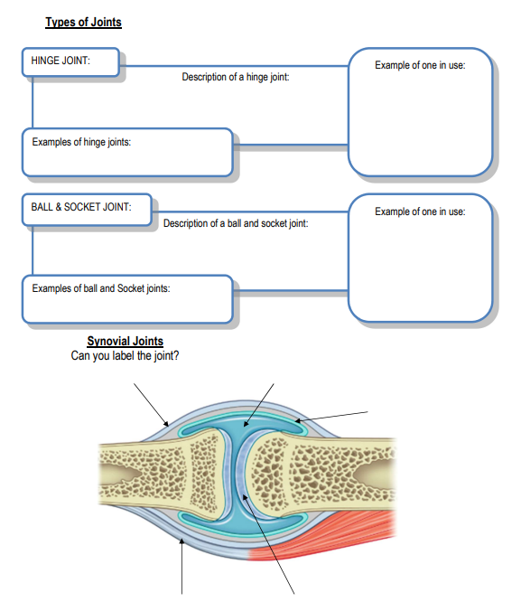
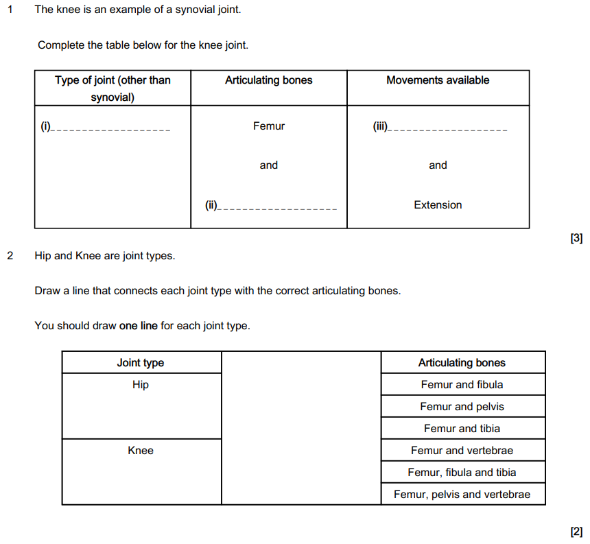
Week 1 – 12th Jan
Paper 1: Types of Synovial Joints

Slide 3
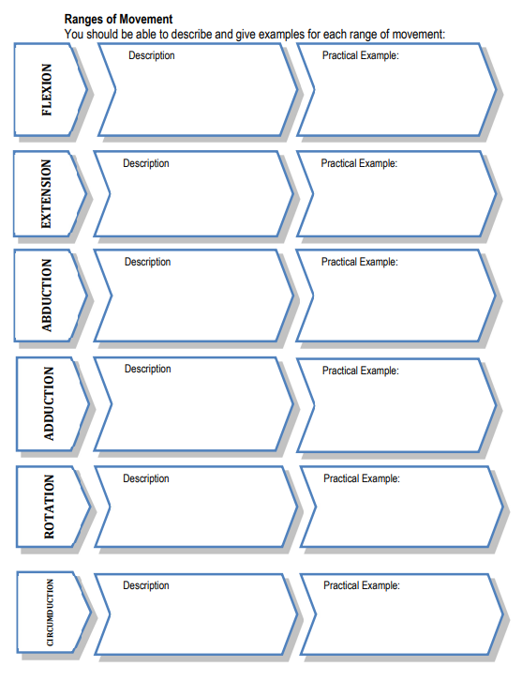
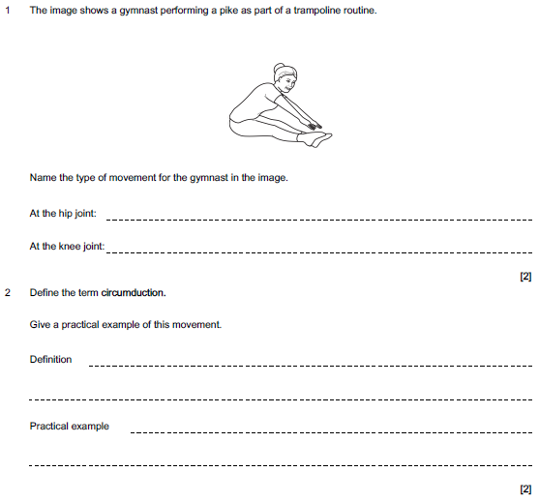
Week 2 – 19th Jan
Paper 1: Types of Movement

Slide 4
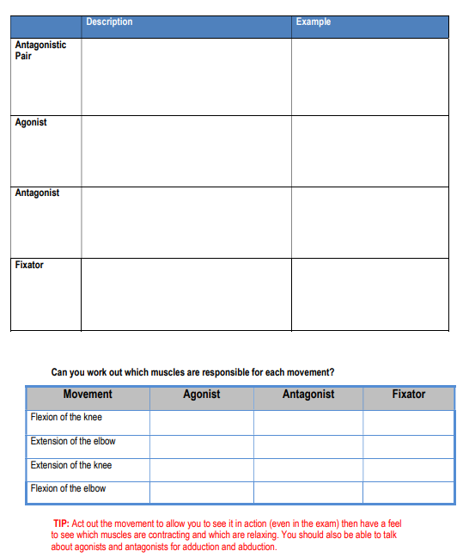
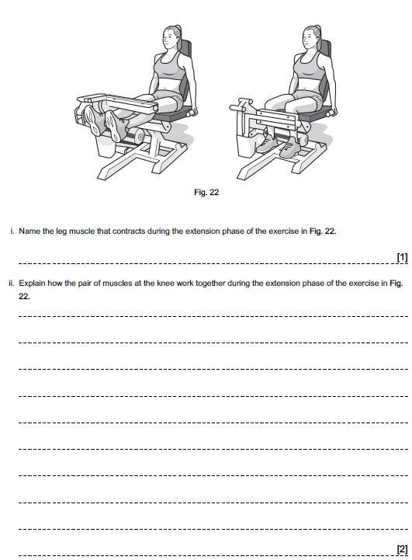
Week 3 – 26th Jan
Paper 1: Antagonistic Muscle Pairs

Slide 5
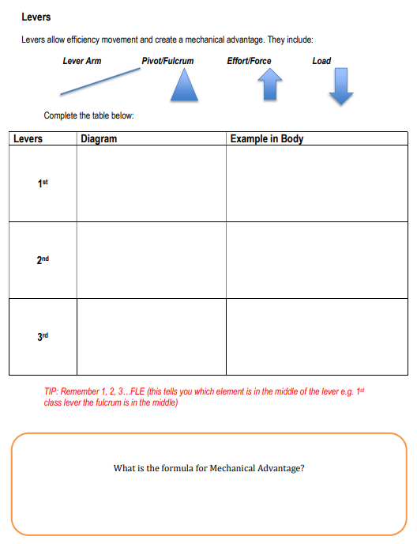
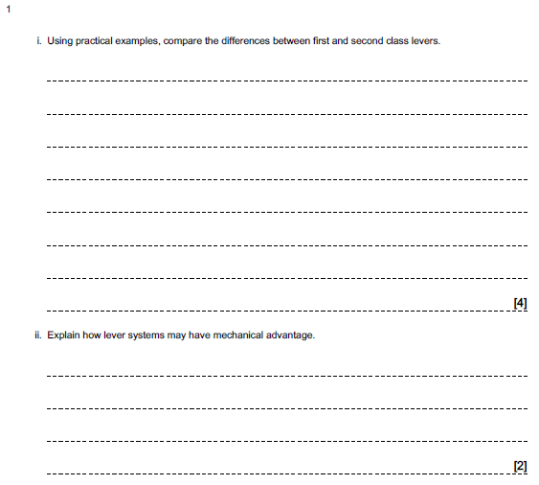
Week 4 – 2nd Feb
Paper 1: Levers

Slide 6
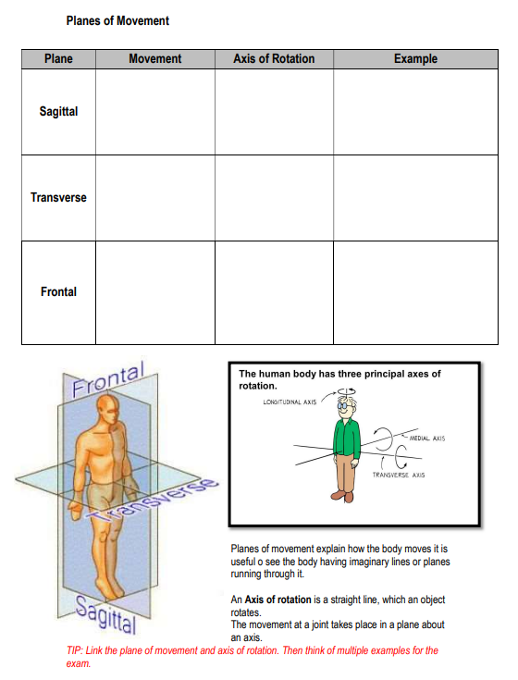
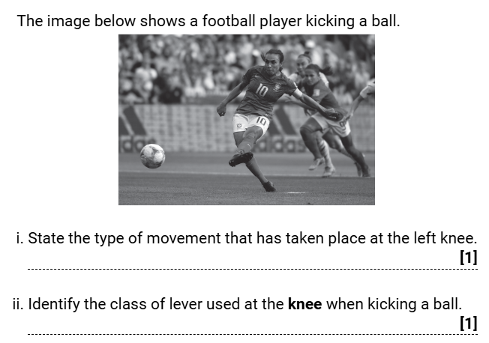
Week 5 – 9th Feb
Paper 1: Planes of Movement & Axes of Rotation

Slide 7
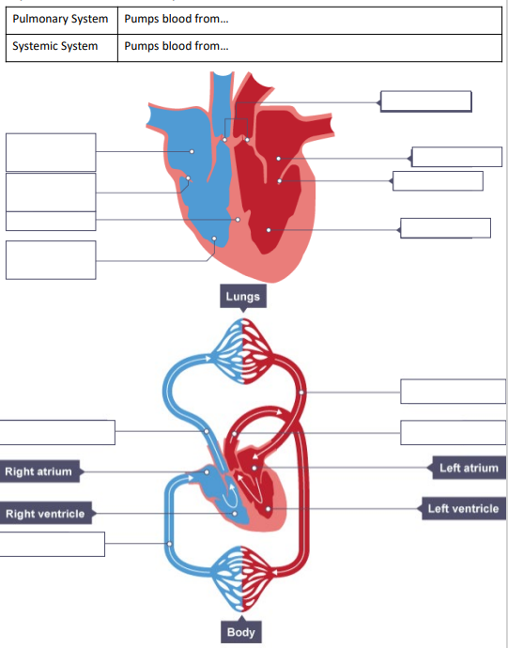
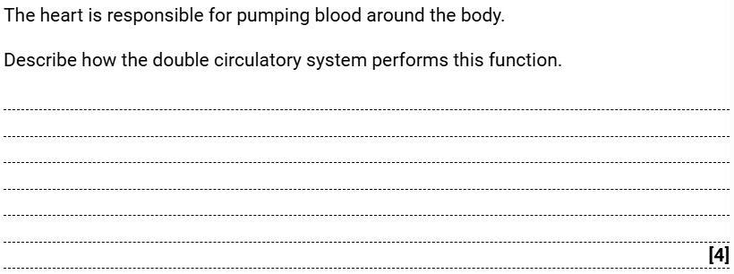
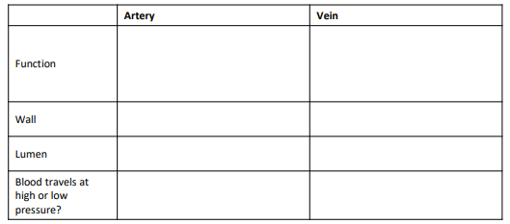
Week 6 – 16th Feb
Paper 1: Structure and Function of the CV System

Slide 8
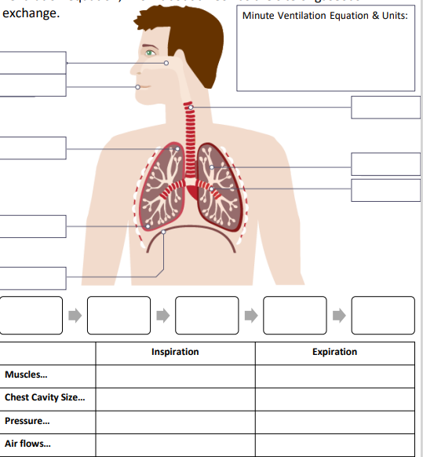
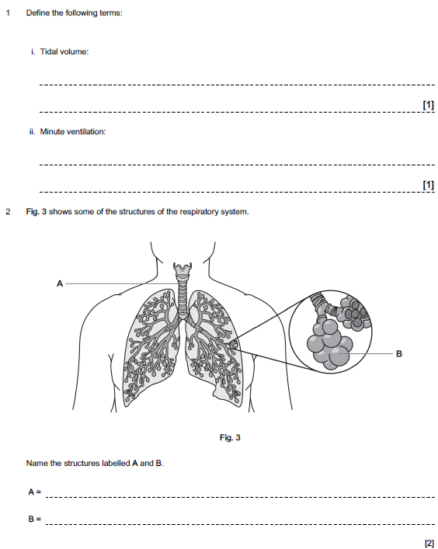
Week 7 – 23rd Feb
Paper 1: Structure and Function of the Respiratory System

Slide 9
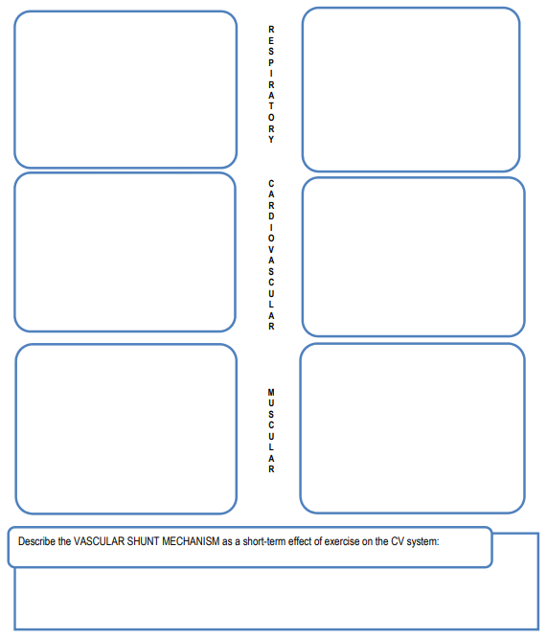
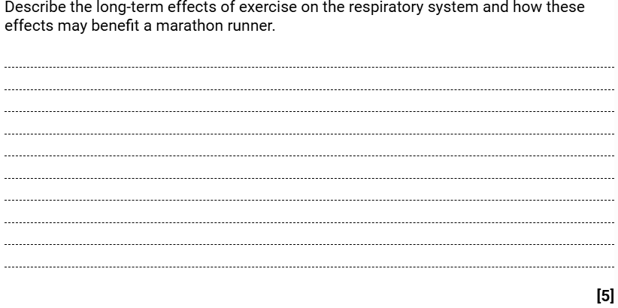
Week 8 – 2nd Mar
Paper 1: Short and Long Term Effects of Exercise

Slide 10
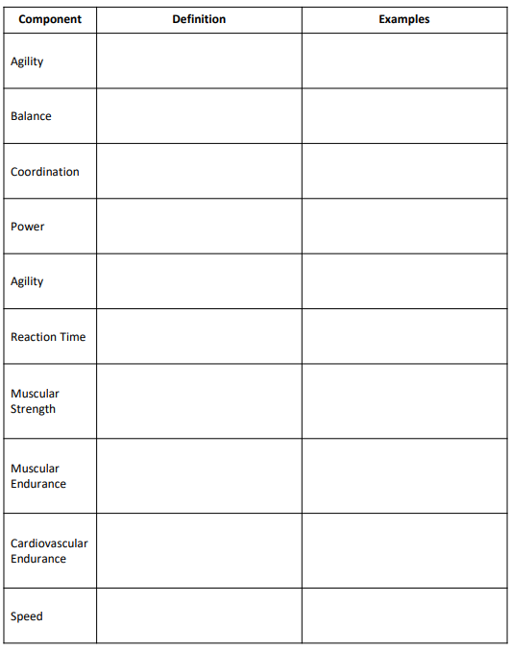
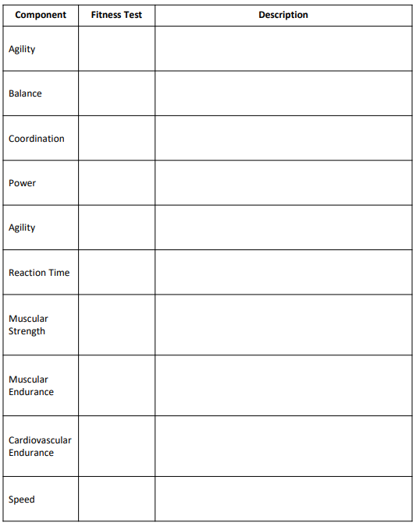
Week 9 – 9th Mar
Paper 1: Components of Fitness

Slide 11
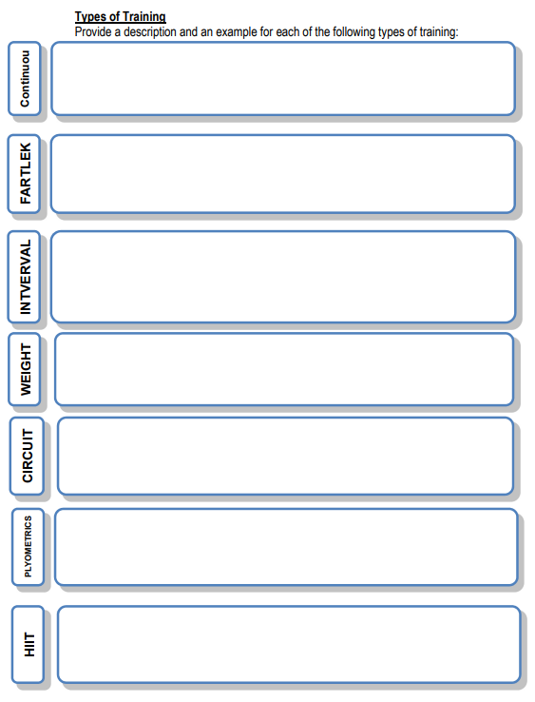
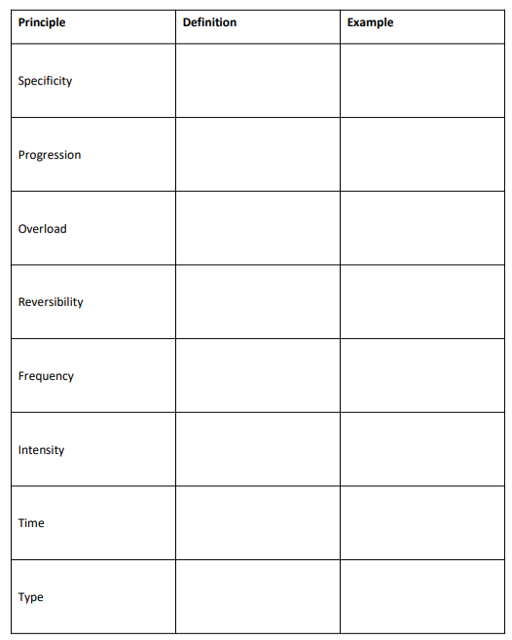
Week 10 – 16th Mar
Paper 1: Types of Training

Slide 12
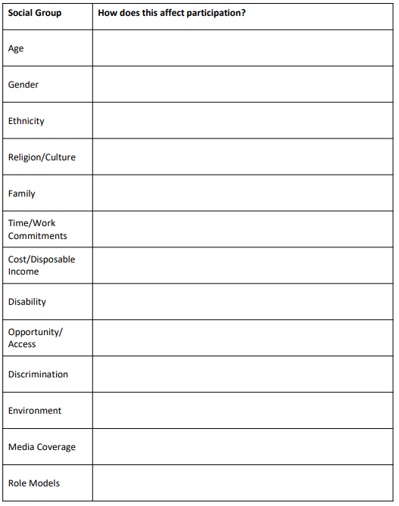
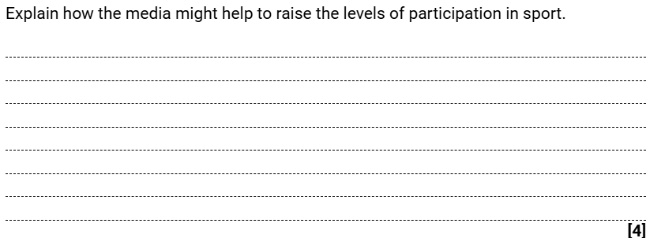
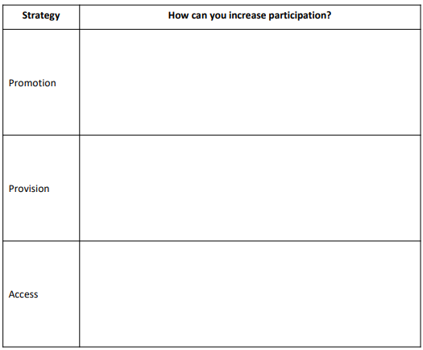
Week 11 – 23rd Mar
Paper 2: Participation in Sport

Slide 13
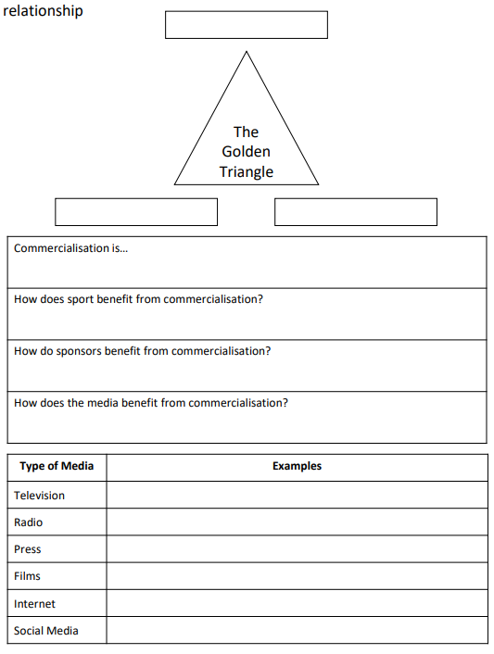
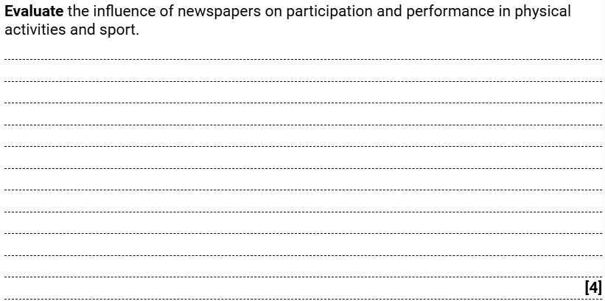
Week 12 – 30th Mar
Paper 2: Commercialisation of Sport

Slide 14
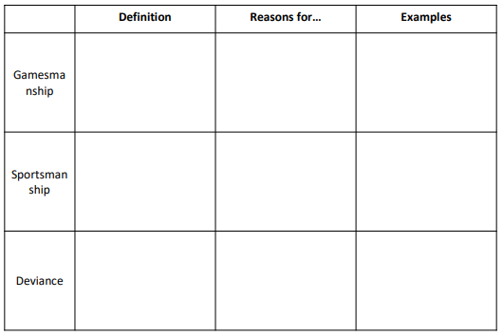
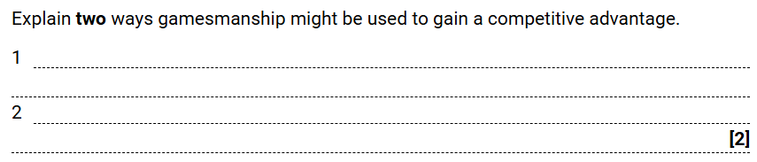
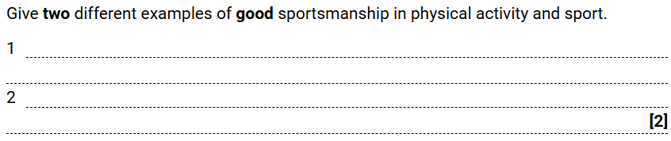
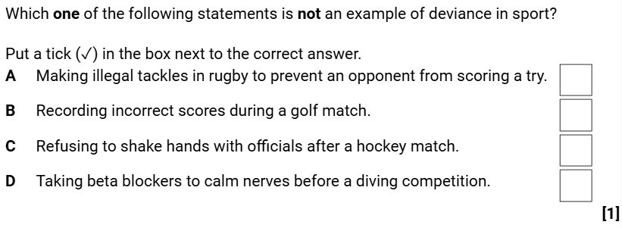
Week 13 – 6th Apr
Paper 2: Ethics in Sport

Slide 15
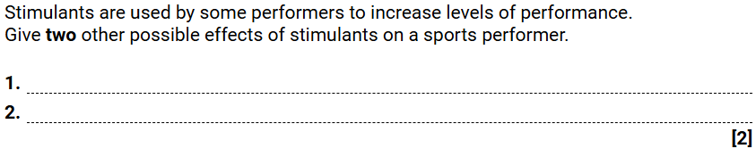
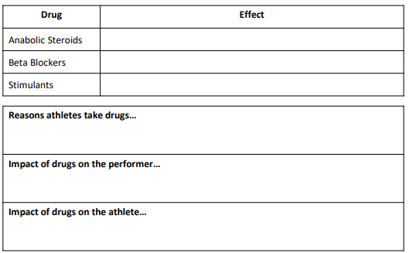
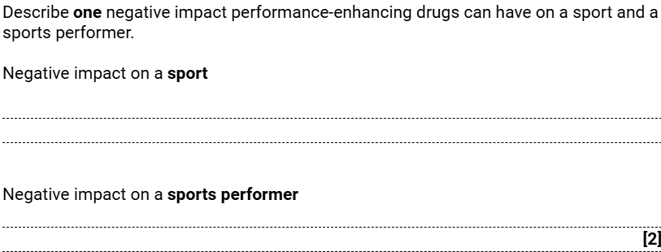

Week 14 – 13th Apr
Paper 2: Drugs in Sport

Slide 16
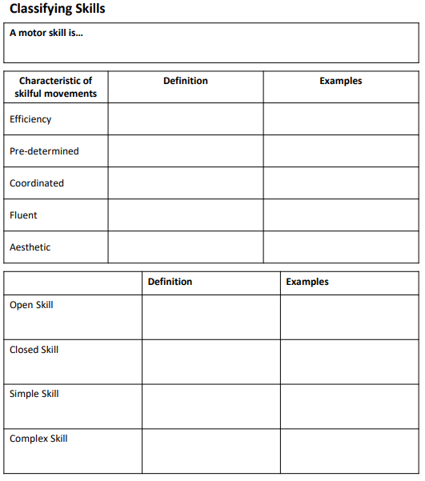
Week 15 – 20th Apr
Paper 2: Skills Classification

Slide 17
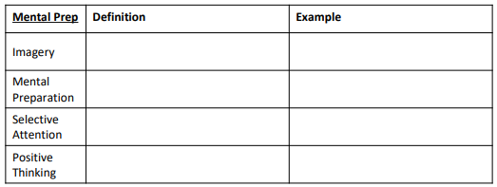
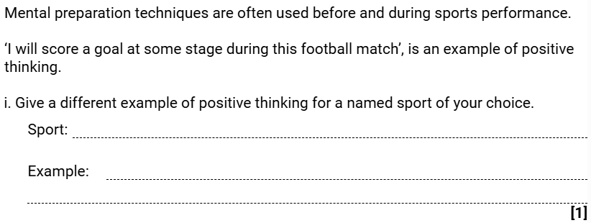
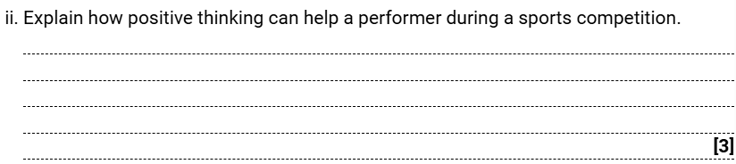
Week 16 – 27th Apr
Paper 2: Mental Preparation

Slide 18
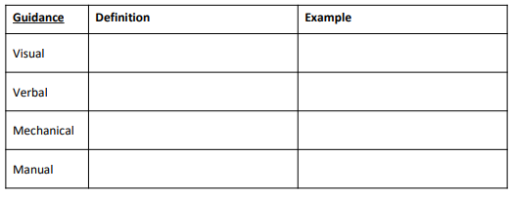
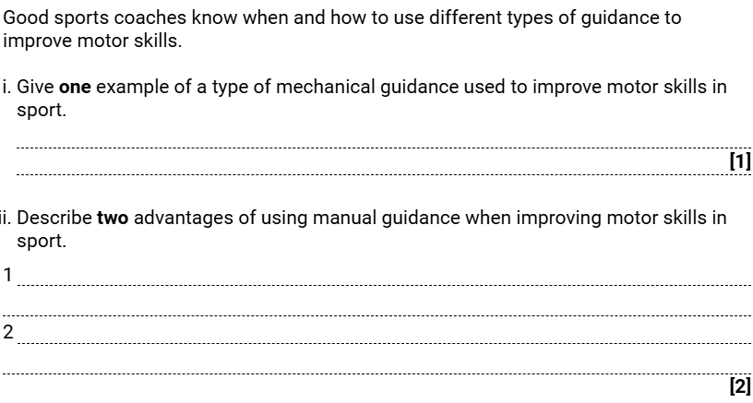
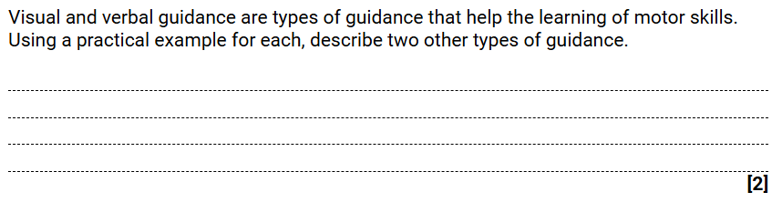
Week 17 – 4th May
Paper 2: Guidance

Slide 19
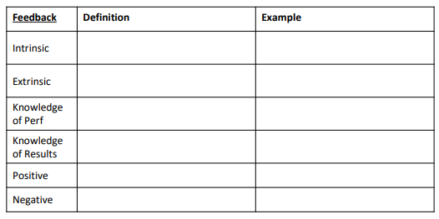
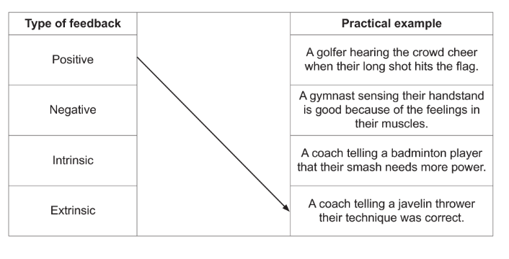
Week 18 – 11th May
Paper 2: Feedback

Slide 20
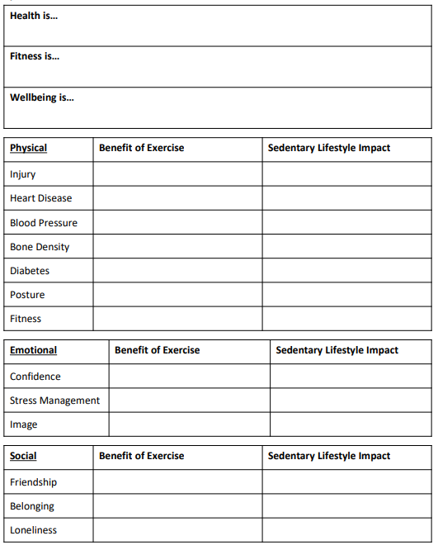
Week 19 – 18th May
Paper 2: Health, Fitness and Well-Being

Slide 21
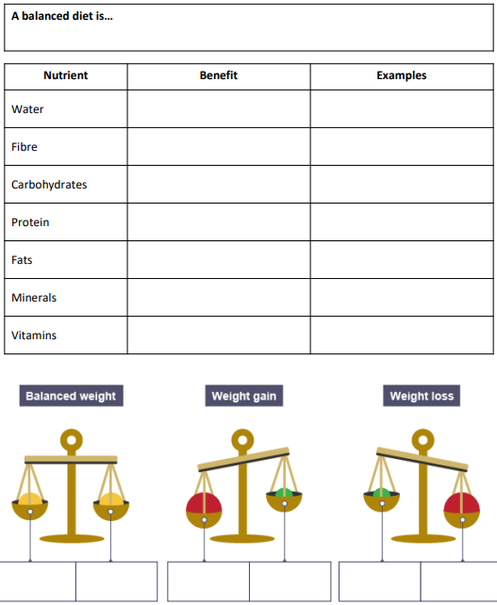
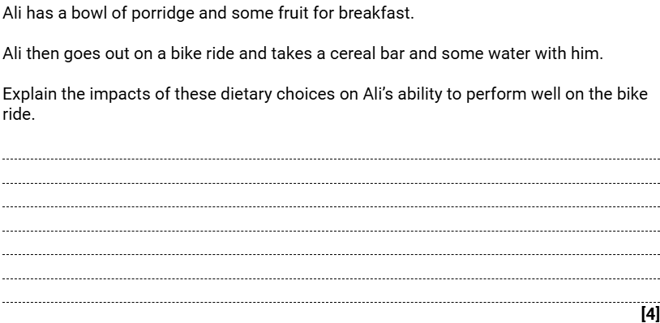
Week 20 – 25th May
Paper 2: Diet and Nutrition

