Slide 1

Year 11 French
20 week revision plan
Exams dates :
Speaking –20th to 24th April
Listening & Reading – 20th May
Writing – 4th June

Slide 2
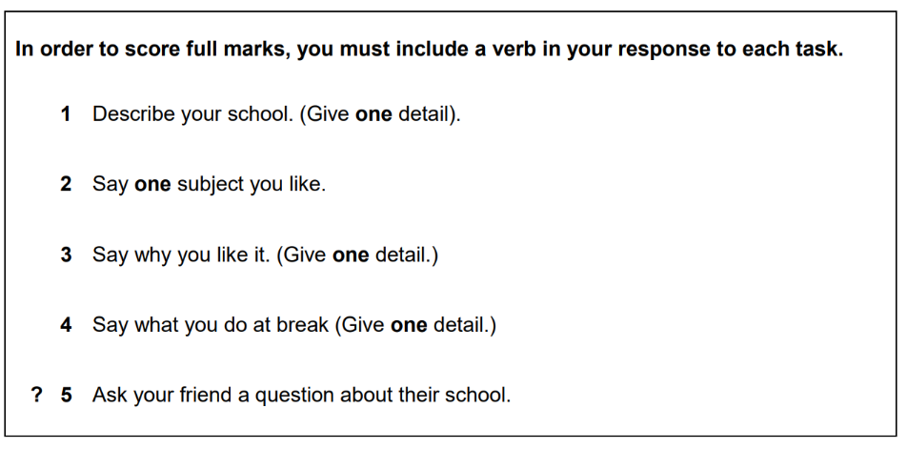
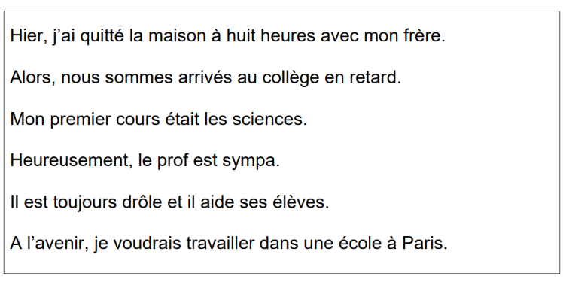
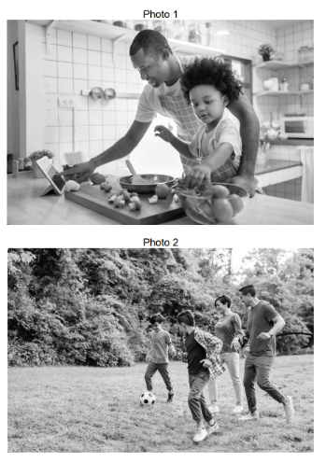
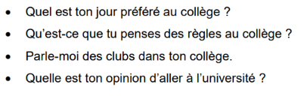
Week 1 – 12/01/26
1 –plan + record the role play
2 – annotate + record the read aloud task
3 –describe the photos
4 – answer the questions
5 –conjugate the verb ; jouer
Foundation : past, present + future
Higher : past, present, future,
Imperfect, conditional

Slide 3
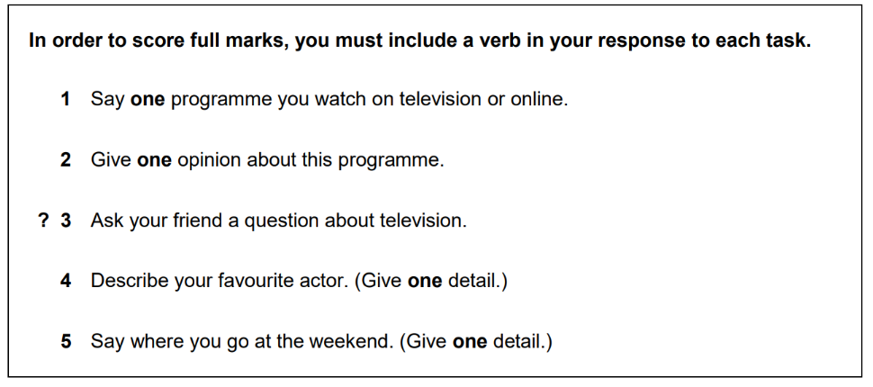
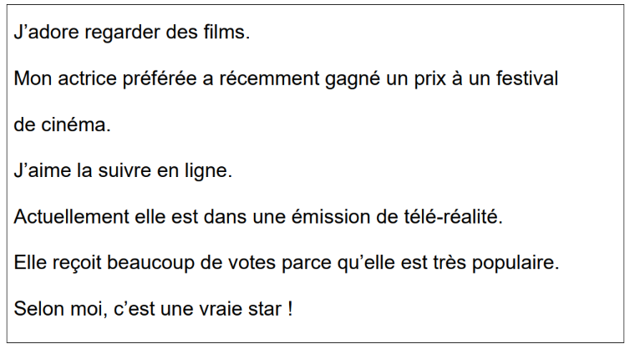
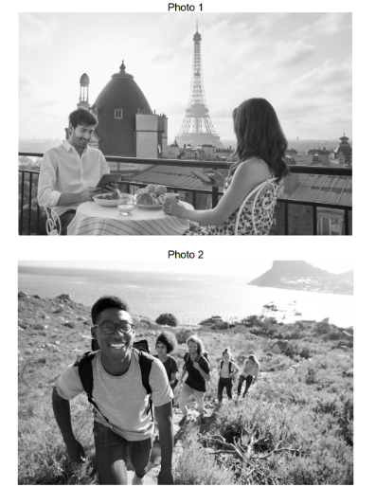
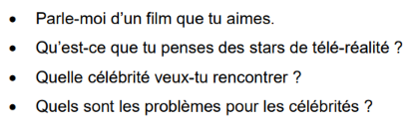
Week 2 – 19/01/26
1 –plan + record the role play
2 – annotate + record the read aloud task
3 –describe the photos
4 – answer the questions
5 –conjugate the verb ; regarder
Foundation : past, present + future
Higher : past, present, future,
Imperfect, conditional

Slide 4
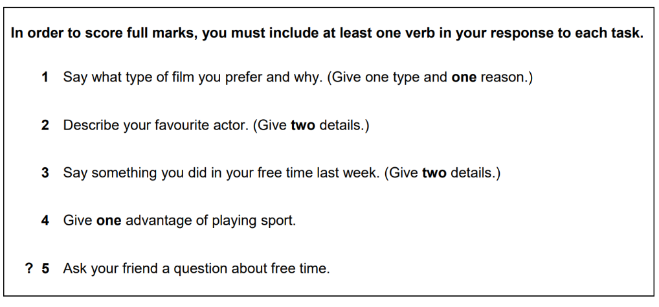
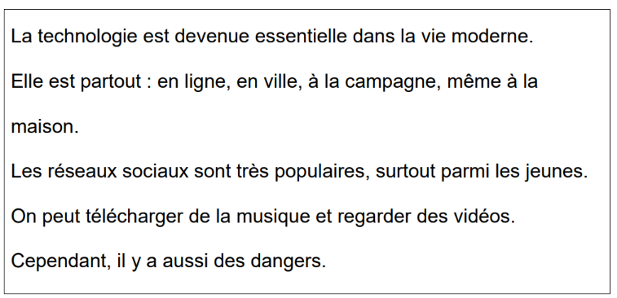
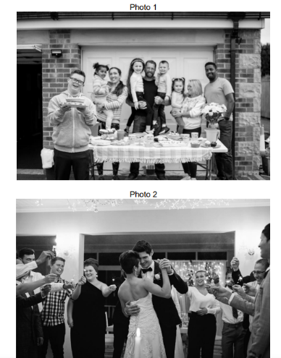
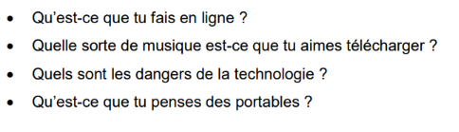
Week 3 – 26/01/26
1 –plan + record the role play
2 – annotate + record the read aloud task
3 –describe the photos
4 – answer the questions
5 –conjugate the verb ; manger
Foundation : past, present + future
Higher : past, present, future,
Imperfect, conditional

Slide 5
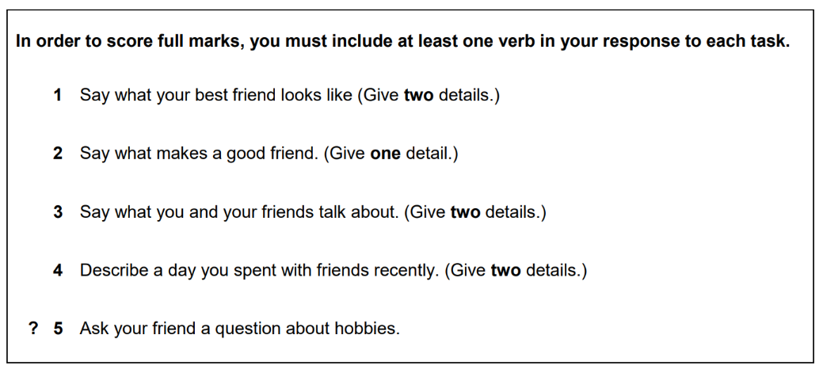
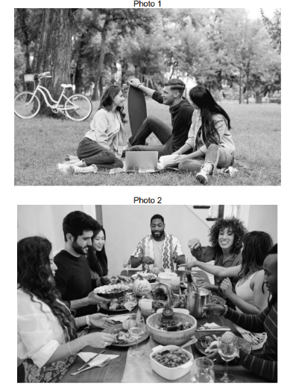
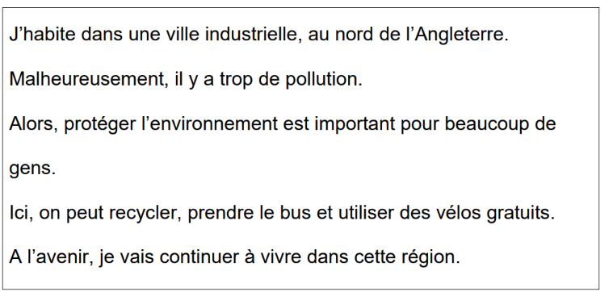
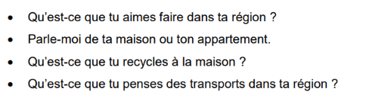
Week 4 – 02/02/26
1 –plan + record the role play
2 – annotate + record the read aloud task
3 –describe the photos
4 – answer the questions
5 –conjugate the verb ; aller
Foundation : past, present + future
Higher : past, present, future,
Imperfect, conditional

Slide 6
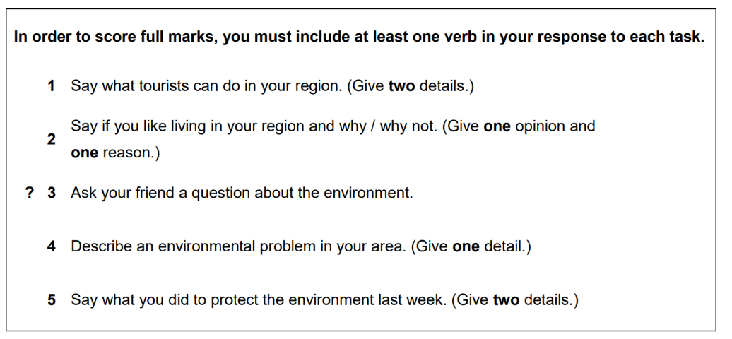
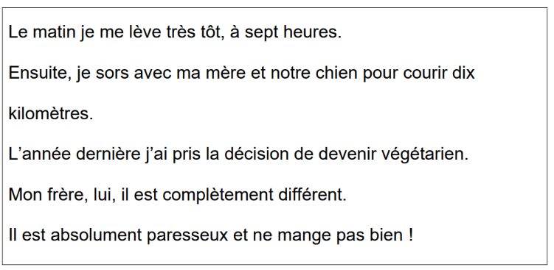
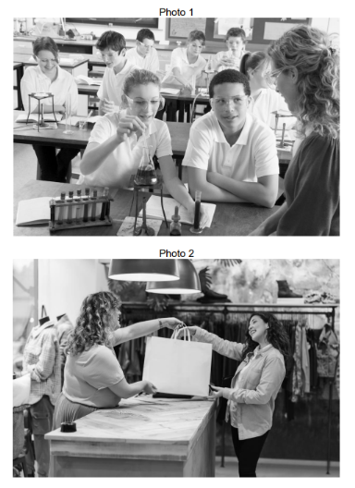
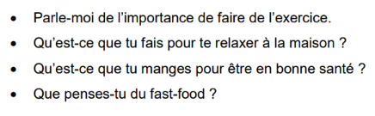
Week 5 – 09/02/26
1 –plan + record the role play
2 – annotate + record the read aloud task
3 –describe the photos
4 – answer the questions
5 –conjugate the verb ; faire
Foundation : past, present + future
Higher : past, present, future,
Imperfect, conditional

Slide 7
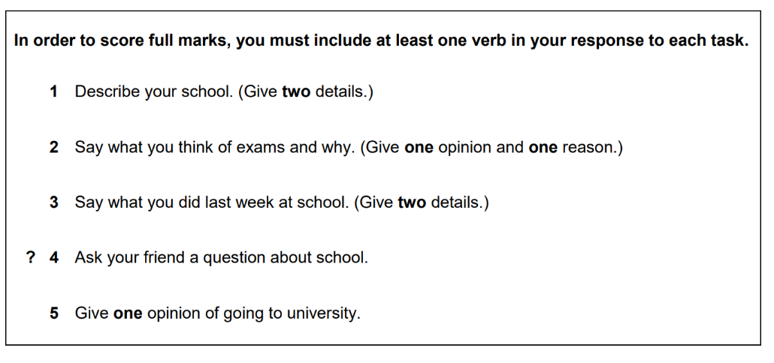
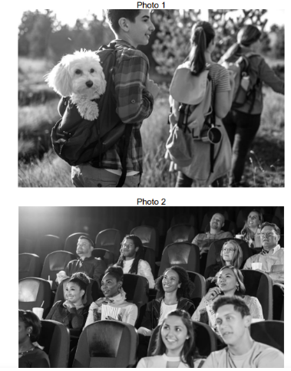
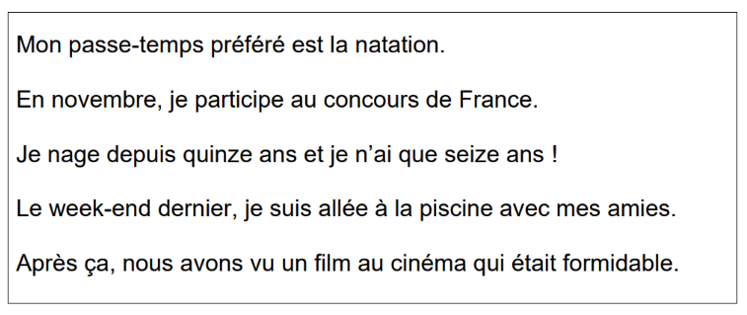
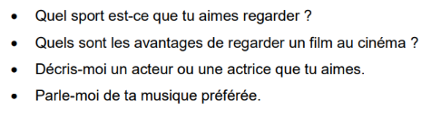
Week 6 – 16/02/26
1 –plan + record the role play
2 – annotate + record the read aloud task
3 –describe the photos
4 – answer the questions
5 –conjugate the verb ; finir
Foundation : past, present + future
Higher : past, present, future,
Imperfect, conditional

Slide 8
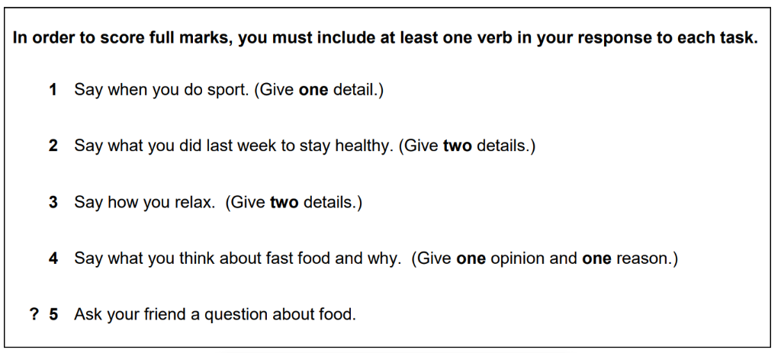
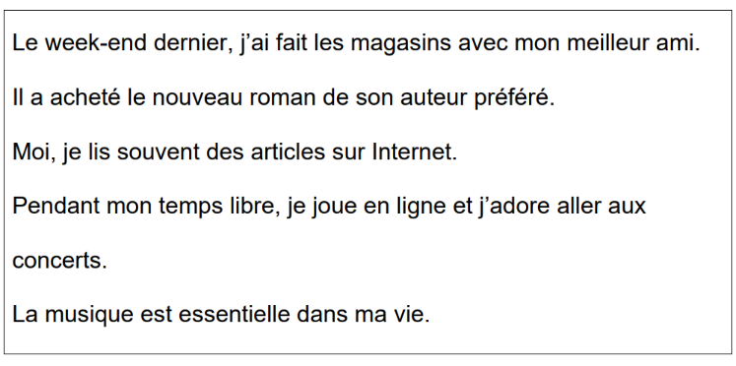
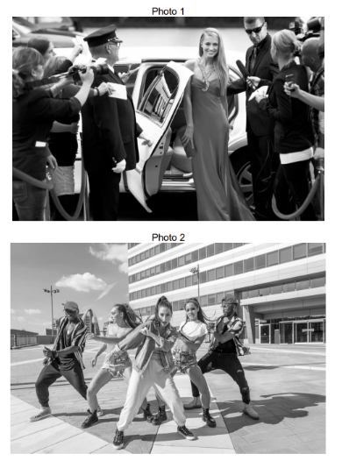
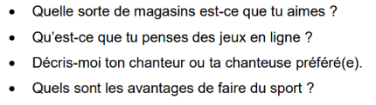
Week 7 – 23/02/26
1 –plan + record the role play
2 – annotate + record the read aloud task
3 –describe the photos
4 – answer the questions
5 –conjugate the verb ; étudier
Foundation : past, present + future
Higher : past, present, future,
Imperfect, conditional

Slide 9
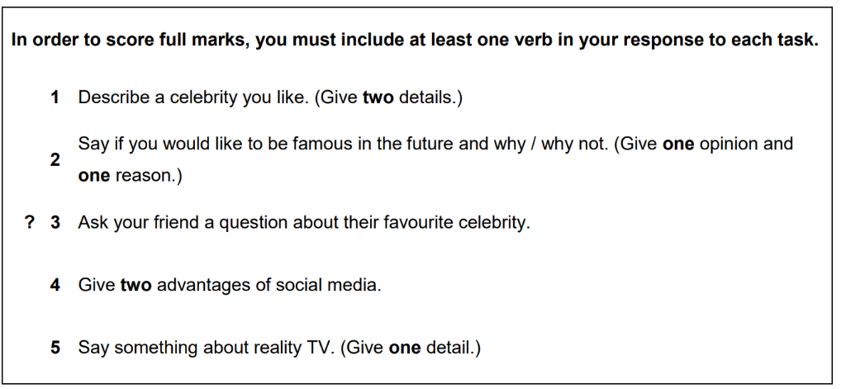
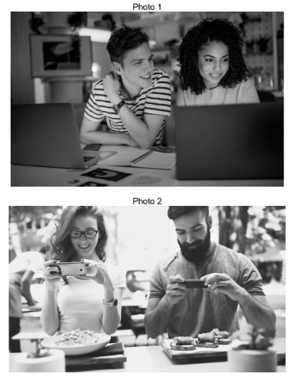
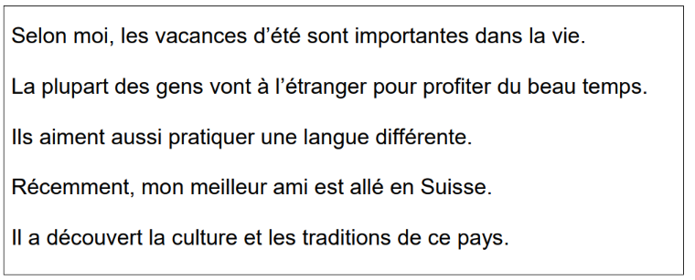
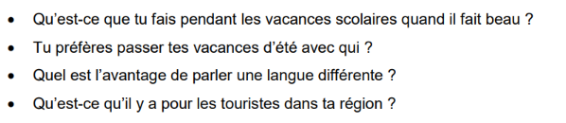
Week 8 – 02/03/26
1 –plan + record the role play
2 – annotate + record the read aloud task
3 –describe the photos
4 – answer the questions
5 –conjugate the verb ; passer
Foundation : past, present + future
Higher : past, present, future,
Imperfect, conditional

Slide 10
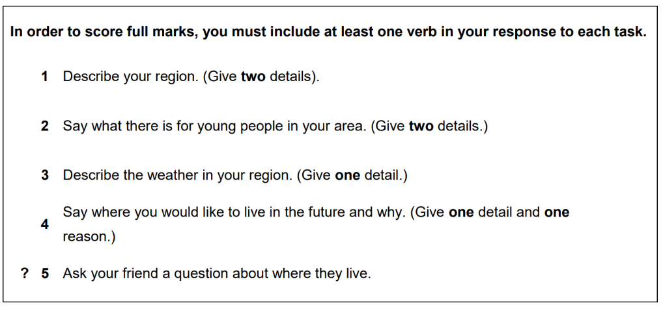
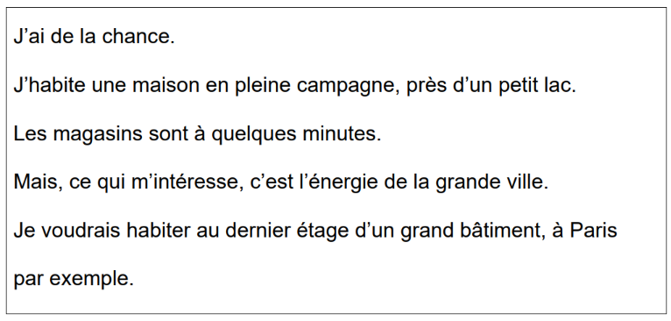
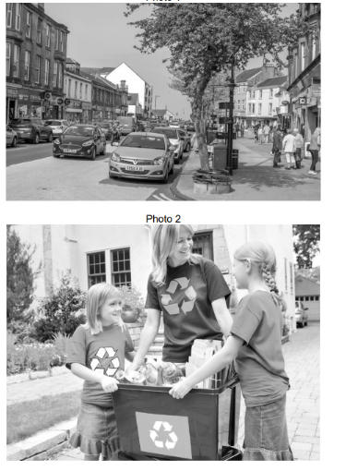
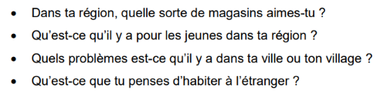
Week 9 – 09/03/26
1 –plan + record the role play
2 – annotate + record the read aloud task
3 –describe the photos
4 – answer the questions
5 –conjugate the verb ; écouter
Foundation : past, present + future
Higher : past, present, future,
Imperfect, conditional

Slide 11
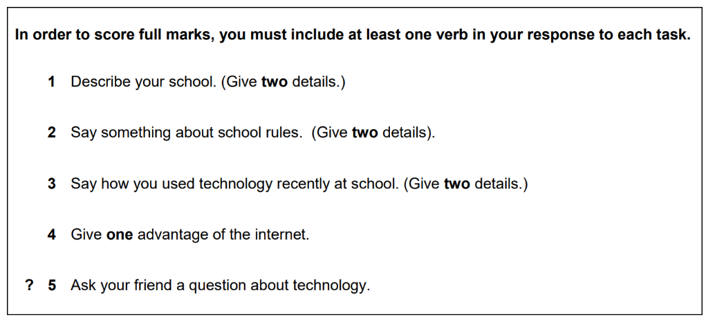
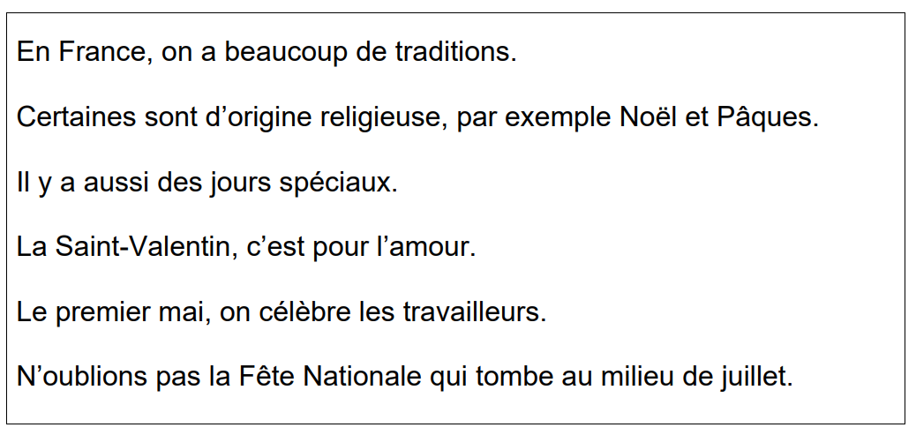
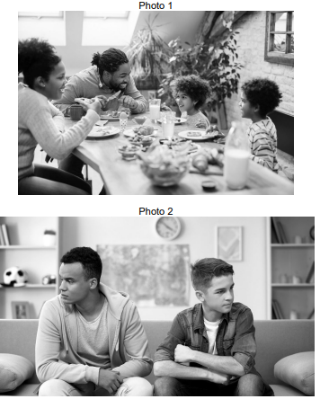
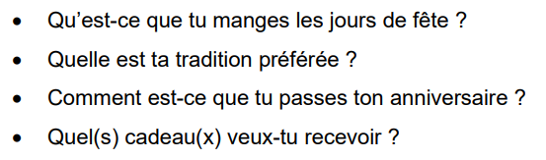
Week 10 – 16/03/26
1 –plan + record the role play
2 – annotate + record the read aloud task
3 –describe the photos
4 – answer the questions
5 –conjugate the verb ; visiter
Foundation : past, present + future
Higher : past, present, future,
Imperfect, conditional

Slide 12
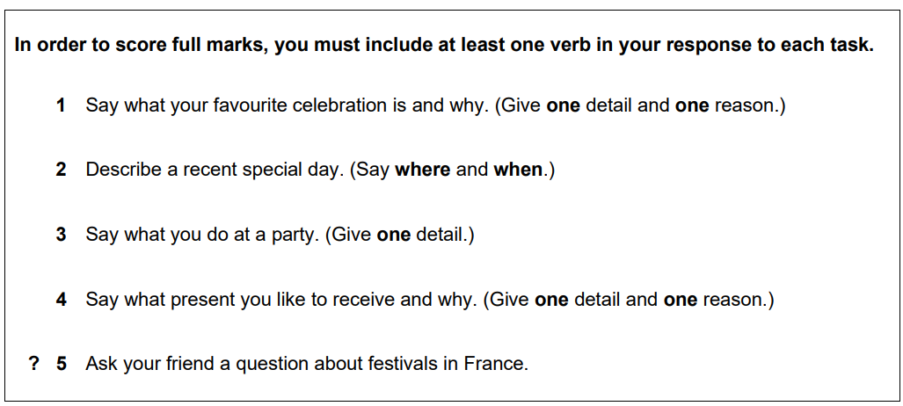
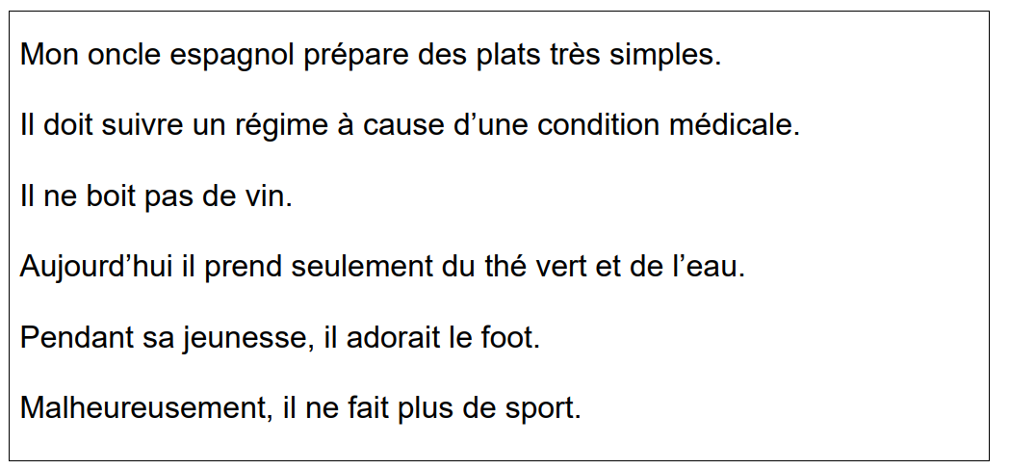
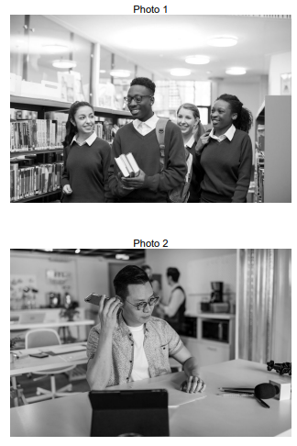
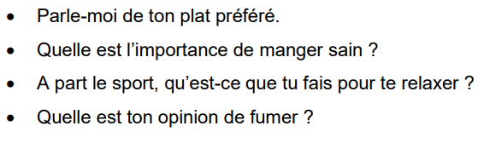
Week 11 – 23/03/26
1 –plan + record the role play
2 – annotate + record the read aloud task
3 –describe the photos
4 – answer the questions
5 –conjugate the verb ; fumer
Foundation : past, present + future
Higher : past, present, future,
Imperfect, conditional

Slide 13
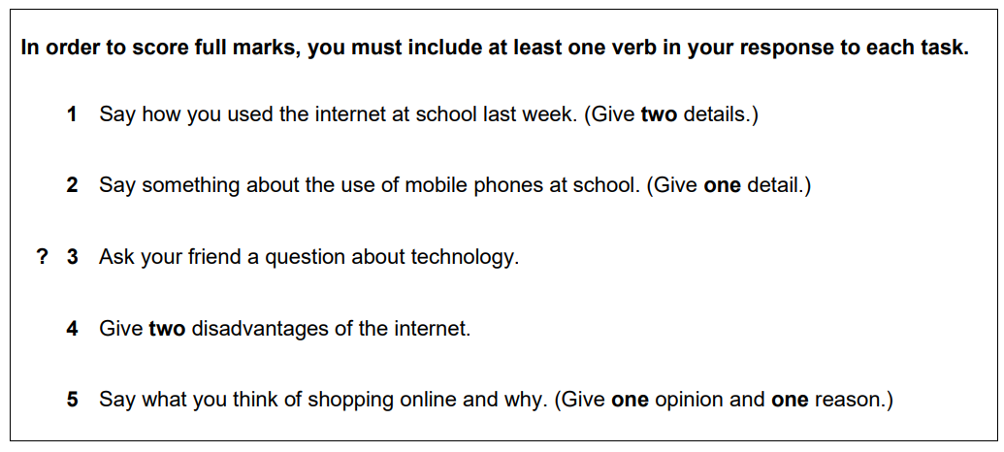
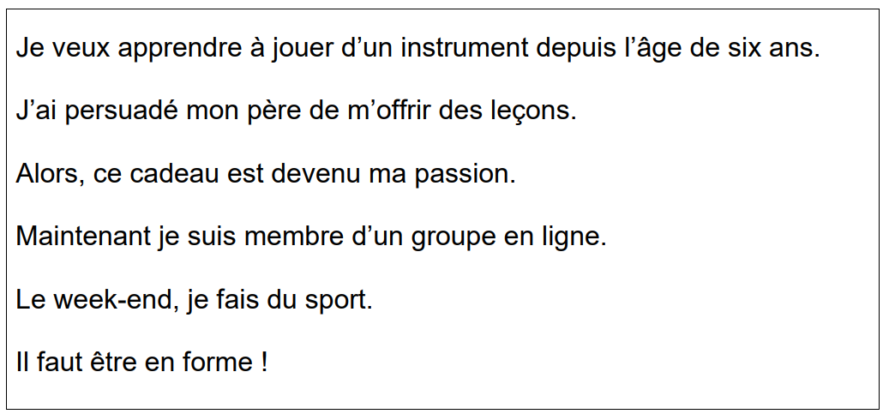
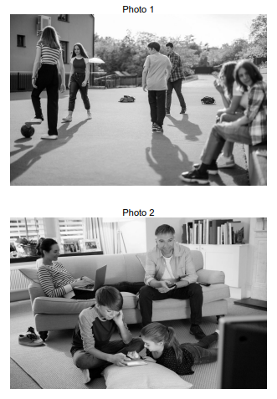
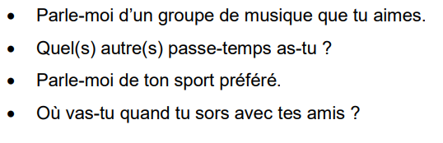
Week 12 – 30/03/26
1 –plan + record the role play
2 – annotate + record the read aloud task
3 –describe the photos
4 – answer the questions
5 –conjugate the verb ; fêter
Foundation : past, present + future
Higher : past, present, future,
Imperfect, conditional

Slide 14
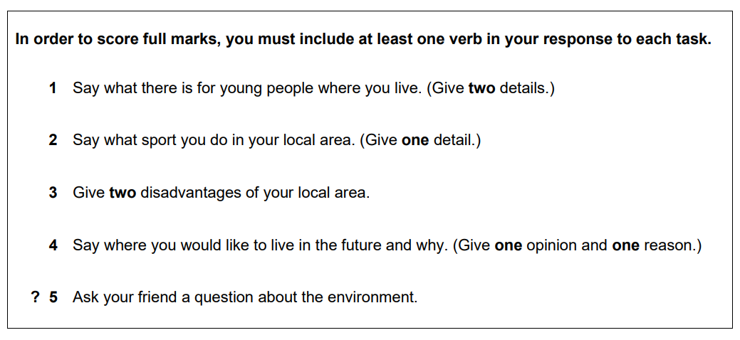
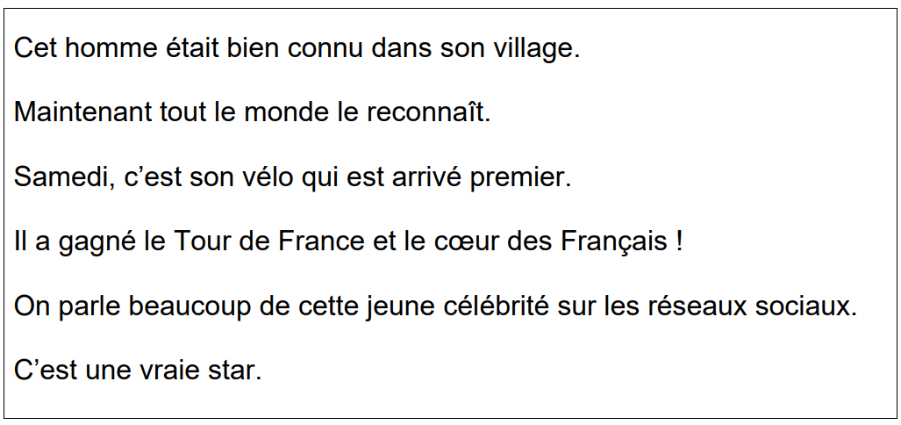


Week 13 – 06/04/26
1 –plan + record the role play
2 – annotate + record the read aloud task
3 –describe the photos
4 – answer the questions
5 –conjugate the verb ; boire
Foundation : past, present + future
Higher : past, present, future,
Imperfect, conditional

Slide 15




Week 14 – 13/04/26
1 –plan + record the role play
2 – annotate + record the read aloud task
3 –describe the photos
4 – answer the questions
5 –conjugate the verb ; voir
Foundation : past, present + future
Higher : past, present, future,
Imperfect, conditional

Slide 16




Week 15 – 20/04/26
1 –plan + record the role play
2 – annotate + record the read aloud task
3 –describe the photos
4 – answer the questions
5 –conjugate the verb ; utiliser
Foundation : past, present + future
Higher : past, present, future,
Imperfect, conditional

Slide 17


Week 16 – 27/04/26
1 –complete the reading question
2 – complete writing question
3 – revise your 150 word mat

Slide 18


Week 17 – 05/05/26
1 –complete the reading question
2 – complete writing question
3 –revise + learn phrases from
your 150 word mat

Slide 19


Week 18 – 11/05/26
1 –complete the reading question
2 – complete writing question
3 – create flashcards for phrases
from your 150 word mat

Slide 20


Week 19 – 19/05/26
1 –complete the reading question
2 – complete writing question
3 –test yourself on your 150
word mat phrases

Slide 21


Week 20 – 25/05/26
1 –complete the reading question
2 – complete writing question
3 – from memory, write all the complex
150 word mat phrases you can
remember

