Slide 1
Revising with flashcards

Slide 2
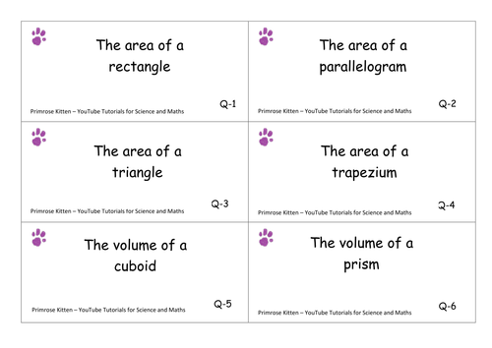
What are flash cards?
The key term or question goes on one side of the card whilst the answer or description goes on the back.
This allows you to both learn and keep a check on how much information you can remember.
What would be on the back of each of these cards?
Notes:
Rectangle = base x height
Triangle = ½ x base x height
Parallelogram = base x height
Trapezium = (a+b)/2 x height
Prism = cross sectional area x length
Cuboid = length x width x height

Slide 3
How to make flash cards (1/2)
Buy a fresh set of blank flash cards or create your own by cutting up card.
Write a list of what you want to use on your cards.
Go through your class notes and write down every fact that you plan to use on your flashcards in the most concise language possible. Include information such as dates of important events, names of important figures and what they accomplished, and names and brief definitions of important theories.

Slide 4
How to make flash cards (2/2)
On one side of the card write a key term or question and on the other side write the definition for that key term, or an answer to the question. Stick to one idea or concept per flash card.
Don’t fill the card with a long complex answer. Keep them as simple as possible. You should split bigger answers into smaller sets of questions if necessary. Don’t worry if this means using more cards.

Slide 5
How to use flash cards
Read the question or key term from the front of the card.
Try to remember the definition or answer without looking.
Check your answer by looking at the back of the card.
Don’t spend hours wading through flash cards!
Review them for only a small amount of time, but repeat this often within your revision timetable.

Slide 6
Using the Leitner method to test yourself – easy version
As you work through your flash cards, separate them into different piles:
I know this
I’m not sure about this
I don’t know this at all
Prioritise the cards you can’t remember and revisit these the most often.
Make sure you revisit every card at some point, even those you are confident about, in order to keep the information fresh in your mind.

Slide 7
Using the Leitner method to test yourself – harder version
Notes:
Please talk through the diagram

Slide 8
Why should I use flash cards?
Flash cards are a quick way to check what you know.
Flash cards are a great tool to revise vocabulary, keywords and facts.
Using the Leitner method helps you to prioritise remembering things you are not yet confident about.

Slide 9
Testing vocabulary with Quizlet
Teachers have tagged their Quizlet sets #chestertoncc
If you see #chestertoncc you know quality is guaranteed!
We will add a list of approved Quizlets to the website over half term.

Slide 10
Make a commitment!
Plan to make a set of flashcards over half term.
Take a slip of paper.
Write down your name and the topic of the flashcards you will make over half term.
Give the slip of paper to your Head of House.
Bring your flashcards to the next HoH revision session.

