Slide 1
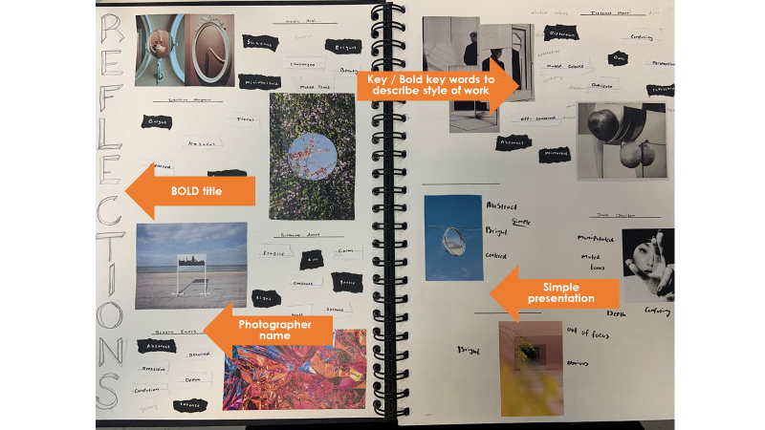
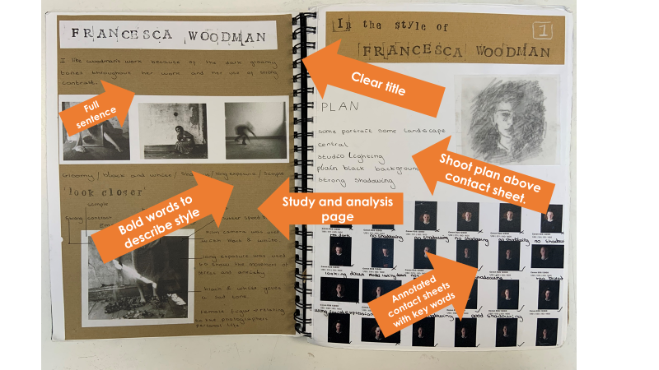
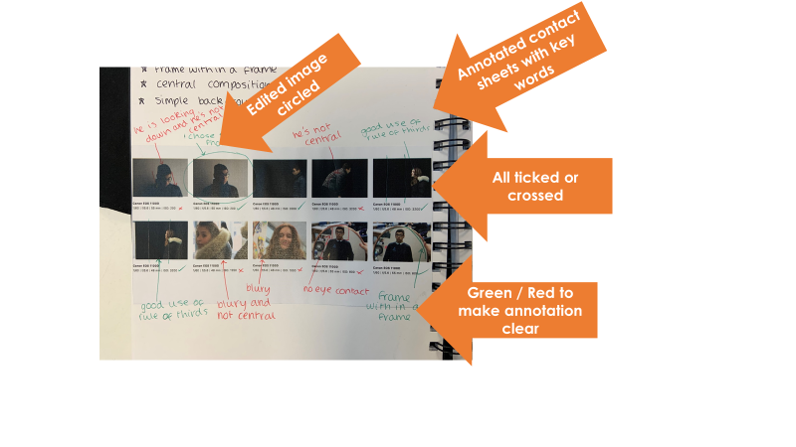
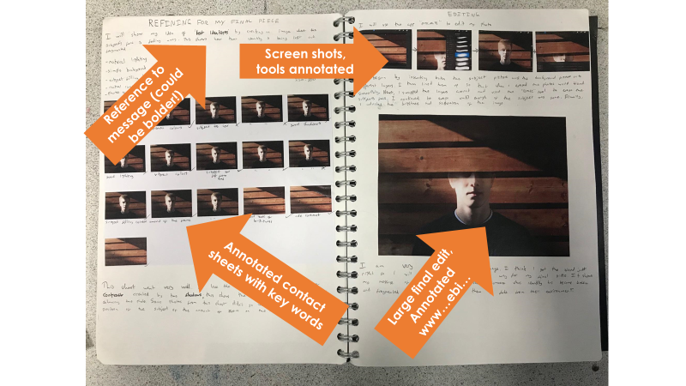
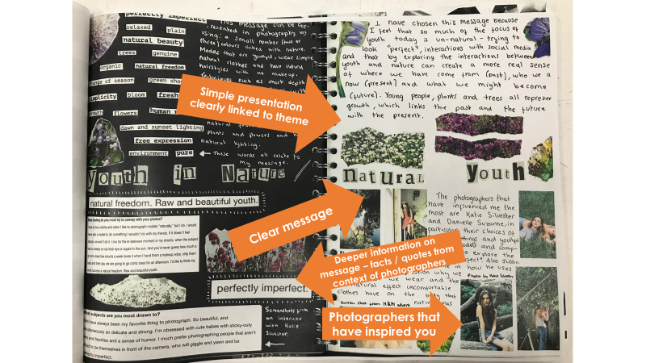
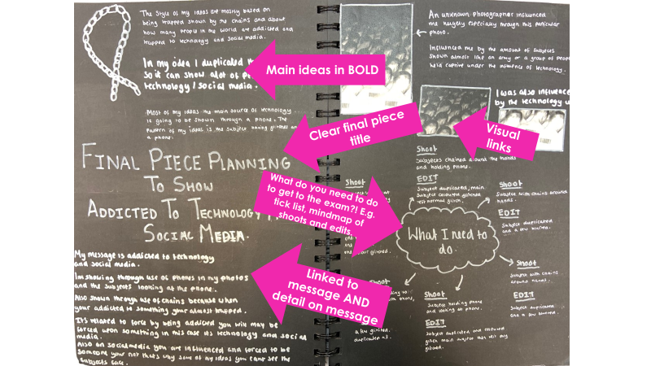
How to prepare for your PHOTOGRAPHY 10 hour practical exam
No need to revise! BUT you will still need to plan Photography into your revision schedule as it is vital you are prepared for your 10 hour session. The good news is that your teacher is here to guide you through this. Your main focus should be on completing all your lesson work and homework as directed by your class teacher. IF YOUCOMPLETE ALL OF THIS YOU WILL BE READY!
You can check you are ready by using the visual sketch book guide to make sure you have met all the assessment objectives and that each sketch book page shows evidence of your skill level.
Check with your teacher, they will be happy to post-it note your sketch book with direct feedback on how to improve.
ASSESSMENT OBJECTIVES
Develop
Refine
Record
Present

