Slide 1
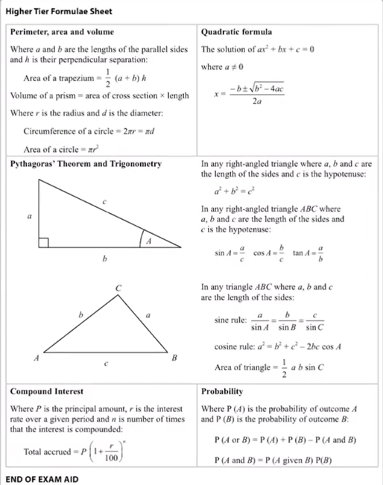
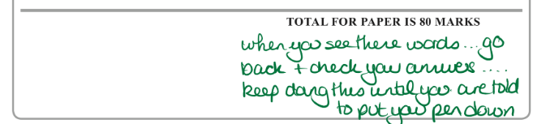
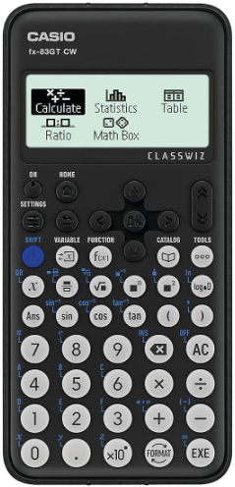
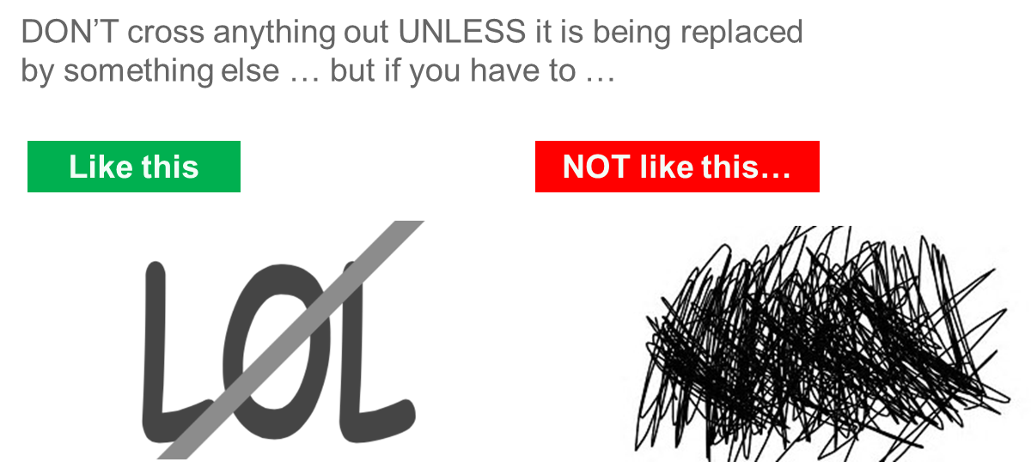
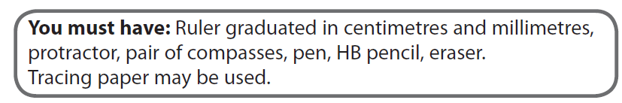
Maths Mock 2025:
Paper 1 Non-Calculator (90 minutes)
Paper 2 Calculator (90 minutes)
Paper 3 Calculator (90 minutes)
Exam board: Edexcel
Most topics will come up either in paper 1, 2 or 3. If a topic hasn’t come up in paper 1, it is likely to come up in paper 2 or 3.
See attached for a list of all topics.
See this website for the percentage appearance of a particular topic each year.
GCSE Maths Topic Appearance % | 1st Class Maths
Higher – Grades 3 - 9
Foundation – Grades 1 - 5
During the exam…
Don’t panic .. You can do this! Read the question carefully!
Use the exam aid for specific formulas!
Keep an eye on the time – think about using 1 minute per mark. Where you are faster than this, the extra time can be used for trickier questions and to check your answers. The questions generally go up in difficulty, so the hardest questions are at the end of the paper.
Check your answers! Show all your working out! Ensure your working is clear.
ALWAYS check the back page and the end of the paper will say :
Be prepared …
& a scientific calculator

