Slide 1
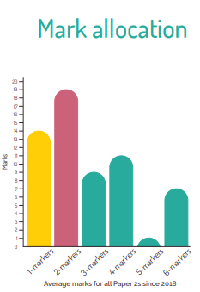
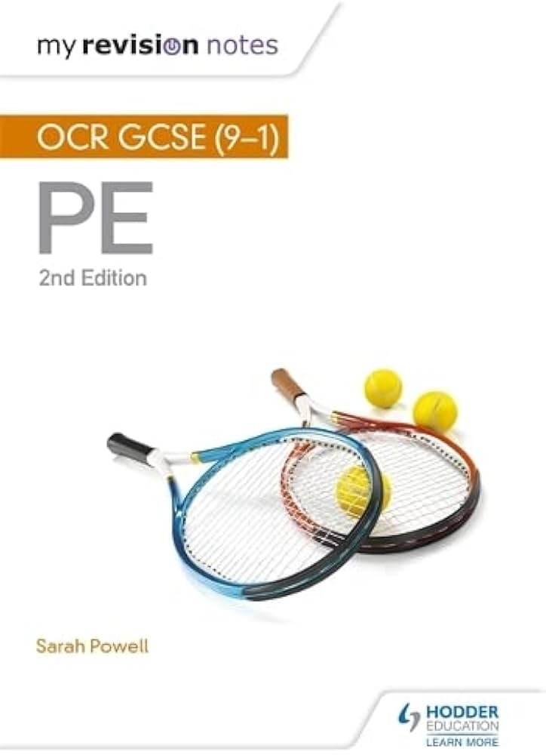
OCR GCSE Physical Education Paper 2 Mock Exam
Structure of the exam Total marks: 50 minutes Time available: 50 minutes Answer ALL questions. Topics being assessed: Participation in Sport Trends in Sport Governing bodies Factors affecting participation Strategies to increase participation Commercialisation in Sport Golden Triangle Types of Media Sponsorship Ethics in Sport Gamesmanship Sportsmanship Deviance Characteristics of Skillful Movement |  | Commands Give / Identify / State – recall a basic answer. Explain – Give reasons for your answer or view. Describe – write about the characteristics (‘say what you see’). Analyse – Gives both sides to the answer. Discuss / Evaluate / Assess – write about the strengths and weaknesses. Top Revision tips: 1.) Blurting – select a topic to the left, Write down everything you can remember about this. 2.) Use TheEverLearner 3.) Complete past papers 4.) Use the OCR Knowledge organiser
 | Style of questions Multiple choice questions 1 mark - Choose one answer only. State or Identify Questions 1 or 2 marks One mark for each correct and relevant point. Explain or Describe Questions 3 or 4 marks Various points or reasons needed – sometimes you may need to support your answer with a sporting example Analyse or Compare Question 6 marks

