Slide 1
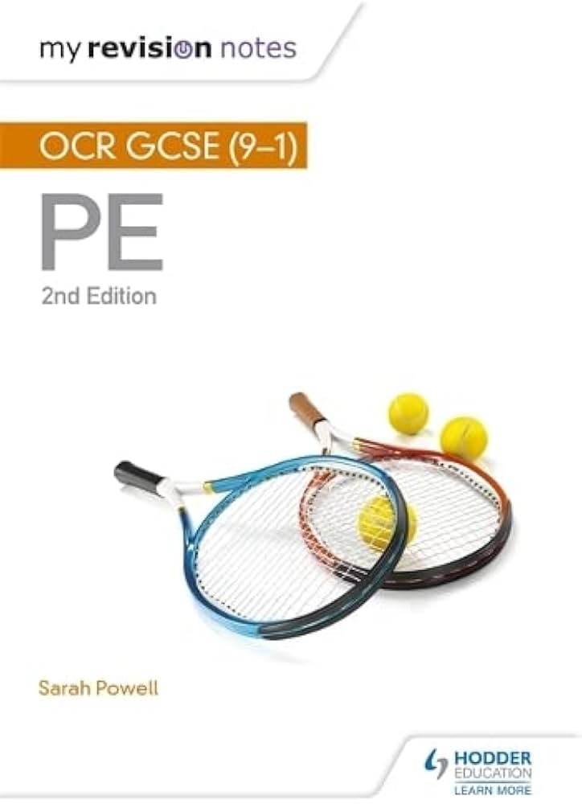
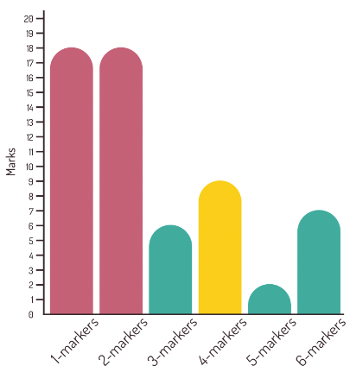
OCR GCSE Physical Education Paper 1 Mock Exam
Structure of the exam Total marks: 60 minutes Time available:60 minutes. Answer ALL questions. Topics being assessed: Physical Training Components of Fitness Methods of Training Fitness Testing Principles of Training Skeletal System Location of major bones Functions of the skeleton Joints Components of Joints Movement Muscles in movement Types of movement Levers Planes and Axes Respiratory System Pathway of air Mechanics of breathing | Cardiovascular System Types of vessels Cardiac equation Pathway of blood through the heart Short-and long-term effects of exercise Cardiovascular Respiratory Muscular Skeletal | Commands Give / Identify / State – recall a basic answer. Explain – Give reasons for your answer or view. Describe – write about the characteristics (‘say what you see’). Analyse – Gives both sides to the answer. Discuss / Evaluate / Assess – write about the strengths and weaknesses. Top Revision tips: 1.) Blurting – select a topic to the left, Write down everything you can remember about this. 2.) Use TheEverLearner 3.) Complete past papers 4.) Use Knowledge organiser
 | Style of questions Multiple choice questions 1 mark - Choose one answer only. State or Identify Questions 1 or 2 marks One mark for each correct and relevant point. Explain or Describe Questions 3 or 4 marks Various points or reasons needed – sometimes you may need to support your answer with a sporting example Analyse or Compare Question 6 marks

