Slide 1
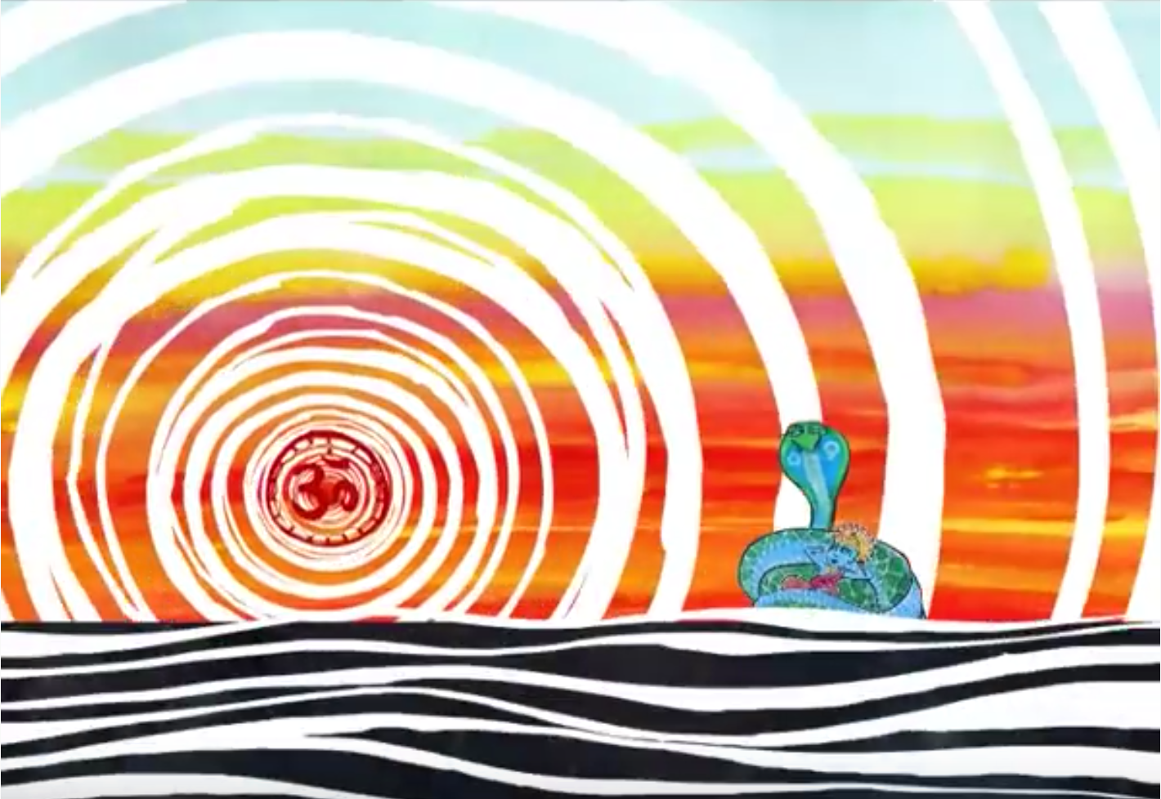
Year 8 Creation stories
Hinduism
You are expected to know all of the information in this booklet.
You will be assessed on this knowledge.
Before time began there was no heaven, no earth and no space between. A vast dark ocean washed upon the shores of nothingness and licked the edges of night. A giant cobra floated on the waters. The mighty serpent watched over the Lord Vishnu, who lay asleep within its endless coils. Everything was so peaceful and silent that Vishnu slept undisturbed by dreams or movement. From the depths a humming sound began to tremble. The first word was created: Om. It grew and spread, filling the emptiness and throbbing with energy. The night had ended. Vishnu awoke. As the dawn began to break, from Vishnu’s navel grew a magnificent lotus flower. In the middle of the blossom sat Vishnu’s servant, a God with four faces, named Brahma. He awaited the Lord’s command. Vishnu spoke to his servant: ‘It is time to begin.’ Brahma bowed, and Vishnu commanded: ‘Create the world.’ A wind swept up the waters. Vishnu and the cobra vanished. Brahma remained in the lotus flower, floating and tossing on the sea. He lifted up his arms and calmed the wind and the ocean. Then Brahma split the lotus flower into three. He stretched one part into the heavens. He made another part into the earth. With the third part of the flower he created the skies. The earth was bare. Brahma set to work creating grass, flowers, trees and plants of all kinds. To these he gave feeling. Next he created the animals and the insects to live on the land. He made birds to fly in the air and many fish to swim in the sea. To all these creatures, he gave the senses of touch and smell. He gave them power to see, hear and move. The world was soon bristling with life and the air was filled with the sounds of Brahma’s creation.

Slide 2
Year 8 Creation stories
Christianity
You are expected to know all of the information in this booklet.
You will be assessed on this knowledge.
Genesis 1 ¹ In the beginning God created the heavens and the earth. ² Now the earth was formless and empty, darkness was over the surface of the deep, and the Spirit of God was hovering over the waters. ³ And God said, “Let there be light,” and there was light. God the Father and God the Holy Spirit were present at creation. God’s word created the universe and life. | Genesis 1 repeatedly states that ‘God saw that it was good’. Most Christians believe that this means that the world was created to be good.
John 1 ¹ In the beginning was the Word, and the Word was with God, and the Word was God. ² He was with God in the beginning. ³ Through him all things were made; without him nothing was made that has been made. God the Father and God the Son (The Word) were present at creation.

Slide 3
Year 8 Science and Religion key facts
The Big Bang and Evolution
You are expected to know all of the information in this booklet.
You will be assessed on this knowledge.
Summary of the Big Bang theory The theory states that about 13.7 billion years ago all the matter in the Universe was concentrated into a single incredibly tiny point. It began to enlarge rapidly in a hot explosion, and it is still expanding today.
Evidence in support of the Big Bang theory All other galaxies are moving away from us. The further away a galaxy is, the faster it is moving away. These two features are found in explosions - the fastest moving objects end up furthest away from the explosion. Scientists have detected cosmic microwave background radiation. This is received from all parts of the Universe and is thought to be the heat left over from the original explosion.
Summary of evolution Darwin observed that although individuals in a species shared similarities, they were not exact copies of each other. He also noticed that everything in the natural world was in competition. The winners were those that had characteristics which made them better adapted for survival. These living things were more likely to reproduce and pass on their useful characteristics to their offspring. Individuals that were poorly adapted were less likely to survive and their characteristics were not as likely to be inherited. Given enough time, these small changes can add up to the extent that a new species altogether can evolve.
Evidence in support of the theory of evolution Fossil remains have been found in rocks of all ages. Fossils of the simplest organisms are found in the oldest rocks, and fossils of more complex organisms in the newest rocks. There are also fossil remains in peat bogs and ice. Animals that have not adapted well to their environment are less likely to survive and reproduce than those that are well adapted. The animals that have not adapted to their environment may become extinct.

Slide 4
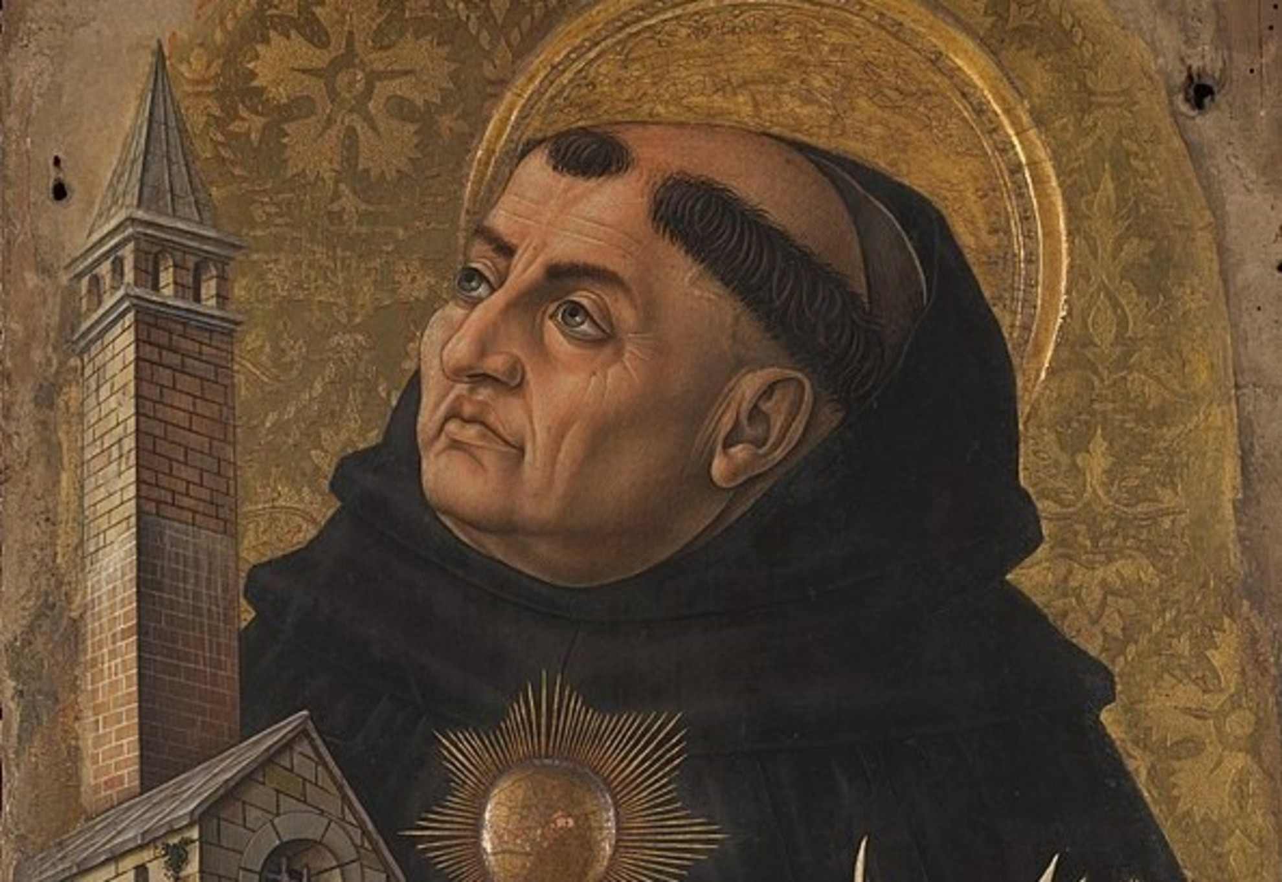
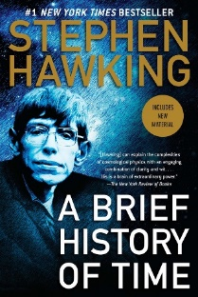
Year 8 Science and Religion key facts
Cosmological and teleological arguments
You are expected to know all of the information in this booklet.
You will be assessed on this knowledge.
Summary of the cosmological argument The cosmos is everything that is in existence. The cosmological argument explains that the cosmos has been created by a Supreme Being (God). God (the creator) is the First Cause or Prime Mover that created everything. God created out of Love and for a reason. Everything was created by God ex nihilo. This means ‘out of nothing’.
The cosmological argument and causation God is the First Cause. God sets everything off like a domino effect. Everything that exists leads back to the Supreme Being (God). God set off the Big Bang and evolution. Philosopher Thomas Aquinas developed the Prime Mover argument.
Summary of the teleological argument Some Theists argue that the cosmological argument shows that the world was created by God through intelligent design. Theists believe God is omniscient (all-knowing), so it would make sense that His creation was an Intelligent Design. Theists would look at evidence such as the incredible complexity of an eye and how unlikely it is that such a thing could exist randomly. Everything is planned and designed by God. Each and every change that takes place is the direct working of God in creation. Theologian William Paley developed the divine watchmaker argument. He pointed out that if you found a watch on a heath you’d naturally assume it had a designer. The human eye was like a sophisticated piece of machinery: so just as you’d know any watch must have had a designer, so, Paley argued, you ought to recognise that the human eye, a brilliant piece of biological machinery, must have had one too
 | What does Stephen Hawking add to the arguments in support of the cosmological and teleological arguments? “It would be very difficult to explain why the universe should have begun in just this way, except as the act of a God who intended to create beings like us.” “In fact, if one considers the possible constants and laws that could have emerged, the odds against a universe that has produced life like ours are immense.” | What does Stephen Hawking add to the arguments against the cosmological and teleological arguments? “Because there is a law such as gravity, the universe can and will create itself from nothing….Spontaneous creation is the reason there is something rather than nothing, why the universe exists, why we exist.” “It is not necessary to invoke God to light the blue touch paper and set the universe going.”

Slide 5
Year 8 Science and Religion key facts
Christian Creationism
You are expected to know all of the information in this booklet.
You will be assessed on this knowledge.
Summary of creationism Literal Christians believe that every word written in the Bible is true. Liberal Christians believe that the Bible is a poetic way to teach people about the nature of God and creation. It is not true word-for-word. Creationists believe that all the forms of life existing today were created by the actions of God. The organisms created by God can't produce new forms of organism - only God can do this.
Young Earth creationism teaches that: The Book of Genesis is literally true. The Earth and all forms of life were created by God in 6 days, around 10,000 years ago. Scientists are almost unanimous in saying that the Young Earth theory is false. | Old Earth creationism teaches that: The Earth is as old as scientists say (around 4 billion years). The universe, Earth, and life were created by processes in which God played an active part. There have been countless divine acts of creation throughout history. God acts both by direct creation and by guiding the processes He created. Humans were created directly created by God. | Gap creationism adds a new idea: There were two creations - one before Adam, and a second one, which included Adam and Eve, after a long gap. Most scientists say that the geological evidence shows that this theory is false. | Progressive creationism accepts the scientific timetable of creation, and gives evolution a small part to play. God created the various species of plants and animals one after another - according to the timetable shown by fossils. God created each kind of organism as we find it. Different forms of organism are separate creations, not the result of evolution from an earlier form. Some created organisms do become extinct. | Theistic evolution In Theistic Evolution, God creates the original universe and the forces that operate in it but doesn’t play an active part beyond this.
 |  |  |  | Intelligent design teaches that Everything is planned and designed by God. Each and every change that takes place is the direct working of God in creation.
 |  | Day-Age creationism teaches that: Each 'day' in the Biblical '6 days' of creation wasn't really a day, but a period of millions of years.

