Slide 1
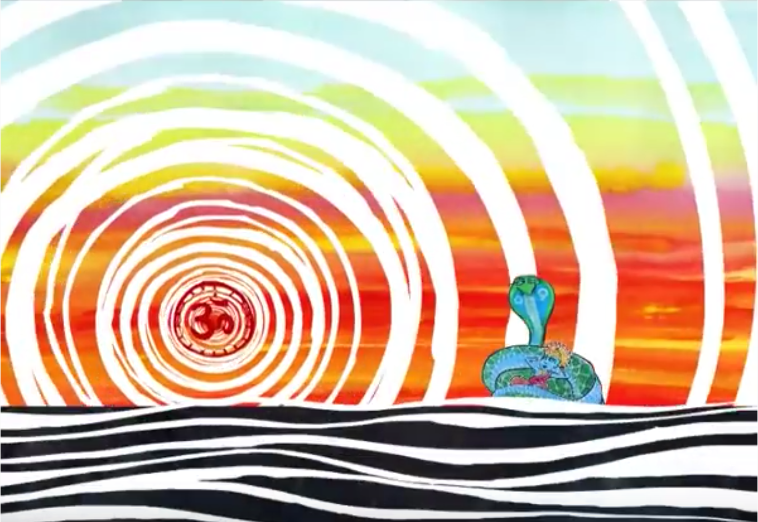
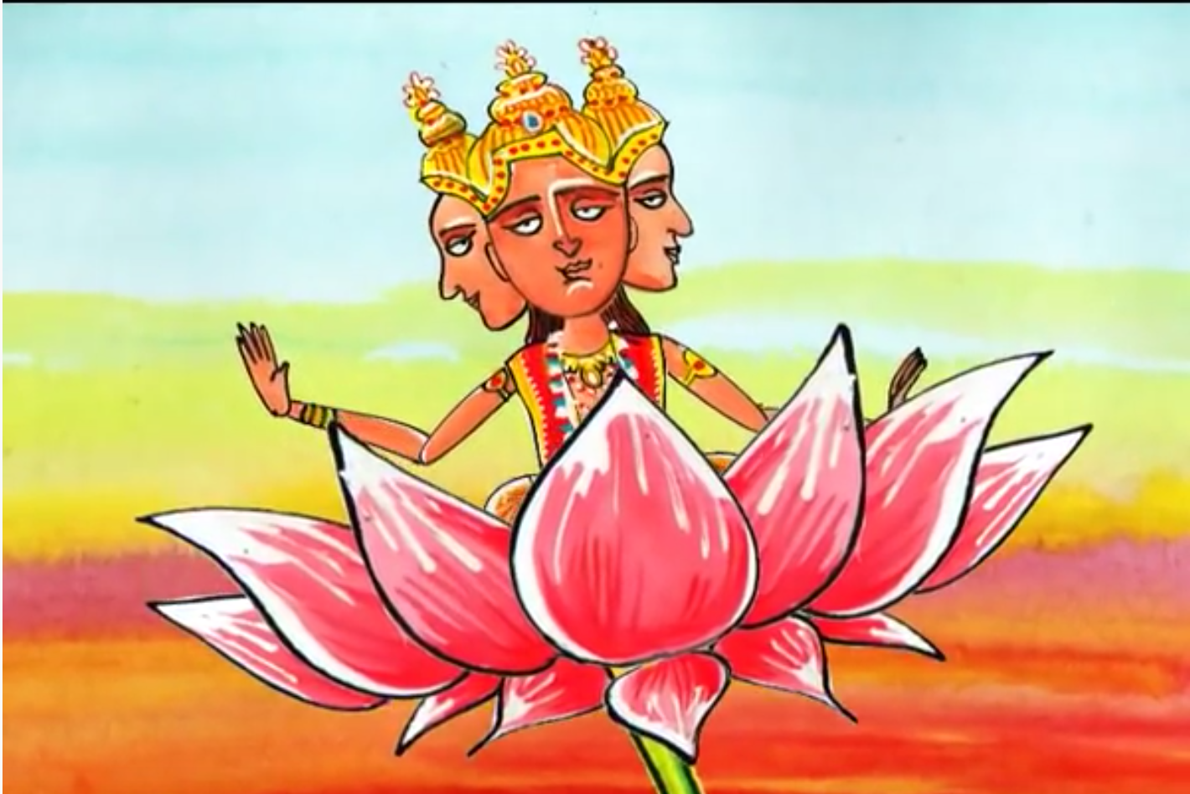
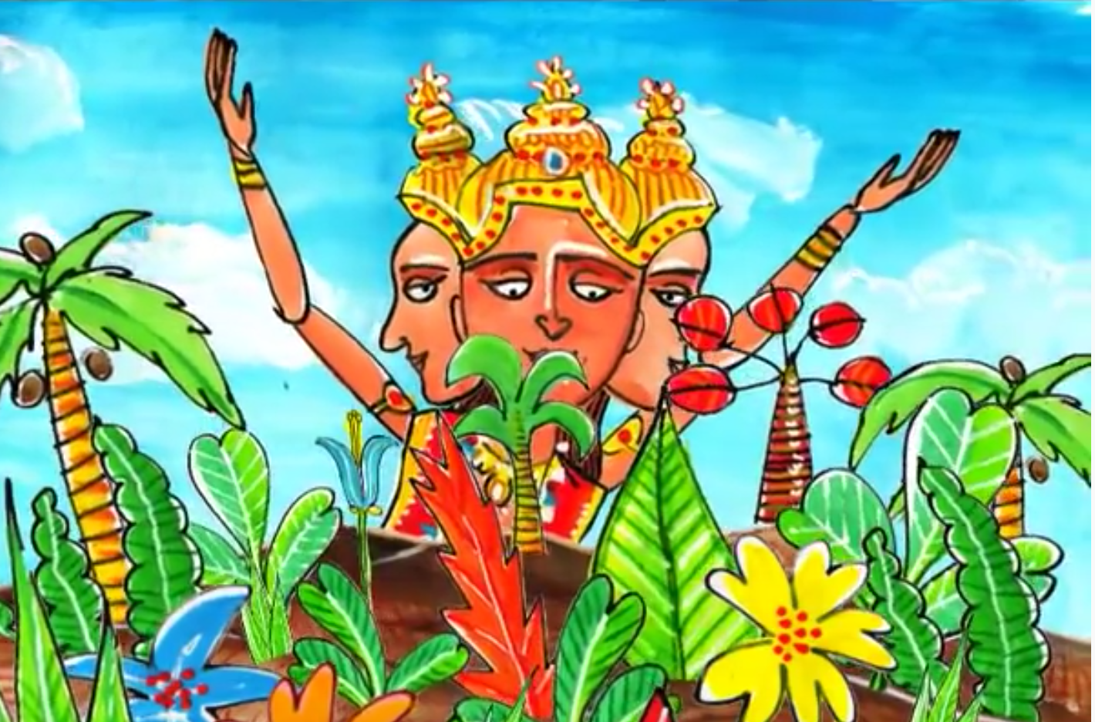
Year 8 Creation stories
Hinduism
You are expected to know all of the information in this booklet.
You will be assessed on this knowledge.
Before time began there was no heaven, no earth and no space between. A vast dark ocean washed upon the shores of nothingness and licked the edges of night. A giant cobra floated on the waters. The mighty serpent watched over the Lord Vishnu, who lay asleep within its endless coils. Everything was so peaceful and silent that Vishnu slept undisturbed by dreams or movement. From the depths a humming sound began to tremble. The first word was created: Om. It grew and spread, filling the emptiness and throbbing with energy. The night had ended. Vishnu awoke. As the dawn began to break, from Vishnu’s navel grew a magnificent lotus flower. In the middle of the blossom sat Vishnu’s servant, a God with four faces, named Brahma. He awaited the Lord’s command. Vishnu spoke to his servant: ‘It is time to begin.’ Brahma bowed, and Vishnu commanded: ‘Create the world.’ A wind swept up the waters. Vishnu and the cobra vanished. Brahma remained in the lotus flower, floating and tossing on the sea. He lifted up his arms and calmed the wind and the ocean. Then Brahma split the lotus flower into three. He stretched one part into the heavens. He made another part into the earth. With the third part of the flower he created the skies. The earth was bare. Brahma set to work creating grass, flowers, trees and plants of all kinds. To these he gave feeling. Next he created the animals and the insects to live on the land. He made birds to fly in the air and many fish to swim in the sea. To all these creatures, he gave the senses of touch and smell. He gave them power to see, hear and move. The world was soon bristling with life and the air was filled with the sounds of Brahma’s creation.

Slide 2
Year 8 Creation stories
Christianity
You are expected to know all of the information in this booklet.
You will be assessed on this knowledge.
Genesis 1 ¹ In the beginning God created the heavens and the earth. ² Now the earth was formless and empty, darkness was over the surface of the deep, and the Spirit of God was hovering over the waters. ³ And God said, “Let there be light,” and there was light. God the Father and God the Holy Spirit were present at creation. God’s word created the universe and life. | Genesis 1 repeatedly states that ‘God saw that it was good’. Most Christians believe that this means that the world was created to be good.
John 1 ¹ In the beginning was the Word, and the Word was with God, and the Word was God. ² He was with God in the beginning. ³ Through him all things were made; without him nothing was made that has been made. God the Father and God the Son (The Word) were present at creation.

Slide 3
Year 8 Science and Religion key facts
Evolution and Christian Creationism
You are expected to know all of the information in this booklet.
You will be assessed on this knowledge.
Summary of the Big Bang theory The theory states that about 13.7 billion years ago all the matter in the Universe was concentrated into a single incredibly tiny point. It began to enlarge rapidly in a hot explosion, and it is still expanding today.
Summary of evolution Darwin observed that although individuals in a species shared similarities, they were not exact copies of each other. He also noticed that everything in the natural world was in competition. The winners were those that had characteristics which made them better adapted for survival. These living things were more likely to reproduce and pass on their useful characteristics to their offspring. Individuals that were poorly adapted were less likely to survive and their characteristics were not as likely to be inherited. Given enough time, these small changes can add up to the extent that a new species altogether can evolve.
Summary of creationism Creationists believe that all the forms of life existing today were created by the actions of God. The organisms created by God can't produce new forms of organism - only God can do this.
Young Earth creationism teaches that: The Book of Genesis is literally true. The Earth and all forms of life were created by God in 6 days, around 10,000 years ago. Scientists are almost unanimous in saying that the Young Earth theory is false. | Old Earth creationism teaches that: The Earth is as old as scientists say (around 4 billion years). The universe, Earth, and life were created by processes in which God played an active part. There have been countless divine acts of creation throughout history. God acts both by direct creation and by guiding the processes He created. Humans were created directly created by God. | Gap creationism adds a new idea: There were two creations - one before Adam, and a second one, which included Adam and Eve, after a long gap. Most scientists say that the geological evidence shows that this theory is false. | Progressive creationism accepts the scientific timetable of creation, and gives evolution a small part to play. God created the various species of plants and animals one after another - according to the timetable shown by fossils. God created each kind of organism as we find it. Different forms of organism are separate creations, not the result of evolution from an earlier form. Some created organisms do become extinct. | Theistic evolution In Theistic Evolution, God creates the original universe and the forces that operate in it but doesn’t play an active part beyond this.
 |  |  |  | Intelligent design teaches that Everything is planned and designed by God. Each and every change that takes place is the direct working of God in creation.
 |  | Day-Age creationism teaches that: Each 'day' in the Biblical '6 days' of creation wasn't really a day, but a period of millions of years.

Slide 4
Year 8 Religion and care of the world
You are expected to know all of the information in this booklet.
You will be assessed on this knowledge.
Stewardship and dominion Dominion means humanity's right to control and have power over the land and all other living beings. Stewardship refers to the responsibilities to the land that come with the right and power.
Christians and Jews believe that God instructed Adam and Eve to be his stewards, a story told in the Book of Genesis. God also gave them dominion, which means that they have authority over the other creatures that God created. Most Christians and Jews believe that this means humans have a huge responsibility, and it does not mean that God gives humans the right to treat the planet however they would like. | The Qur’an also tells Muslims that they have the duty of guardianship, which is known as khalifah. Muslims believe that they will be held accountable for their actions affecting the planet on the Day of Judgement. | Hindus believe that the world was created by Brahman, which makes it sacred. They also believe that Brahman is present in everything, so doing harm to the world is doing harm to Brahman as well. Hindus live by the principle of ahimsa which means non-harm to other living creatures. For this reason, many Hindus are vegetarian or vegan, which many people acknowledge has less of an impact on the environment than raising animals and killing them to eat meat. | Many Sikhs also believe that God (Waheguru) created the world and is present in it, and this also motivates them to care for the planet. Sikhs believe that caring for the planet and doing their best to avoid damaging it is an important part of the duty of sewa, meaning service, by which they live their lives. | Buddhists believe that if a person has a right mind, the actions they perform will be beneficial not just to themselves but to the whole world and also to the environment. Buddhists believe that our actions affect the planet in a harmful way because we are selfish and we crave things. These actions result in more suffering in the future. The effects of karma will continue to work in a person's rebirth, so by being compassionate, we will improve our own future and that of the environment.

Slide 5
Judaism | Christianity | Islam | Sikhism | Hinduism | Buddhism
“The Lord God took the man and put him in the Garden of Eden to work it and take care of it.” Genesis 2:15 The Jewish festival of Tu B'Shevat, in January or February, is also known as the New Year of the Trees. Many Jews plant trees, donate to environmental charities and take part in environmental action, such as cleaning litter from rivers. Tu B'Shevat reminds Jews to thank God for the Earth, and to take care of it. | “Christianity is first and foremost a concern for the whole of the created order — biodiversity and business; politics and pollution; rivers, religion and rainforests...If Christians believe in Jesus, they must recognise that concern for climate change is not an optional extra but a core matter of faith.” Anglican Communion Environmental Network | Muslims believe that the world belongs to God, not to humans, and that people will have to answer to God for how well they have cared for the planet: “It is He who has appointed you viceroys in the earth … that He may try you in what He has given you.” Qur’an * A viceroy is someone appointed to rule on behalf of a leader. | Guru Nanak the founder of Sikhism, said “Air is the Guru, Water the Father, and the Earth is the Great Mother’.” This shows that Sikhs believe that the natural world nurtures and helps us grow. This makes Sikhs want to preserve the world. | ‘Everything (animate or inanimate) that is in the universe is dwelt in by God. Enjoy it with the spirit of renunciation. Do not covet what belongs to others.’ Upanishad | “As people alive today, we must consider future generations: a clean environment is a human right like any other. It is part of our responsibility toward others to ensure that the world we pass on is as healthy, if not healthier, than we found it.” Dalai Lama, speaking at the Global Environmental Forum for the Next Generation in Tokyo, 2015
 |  |  |  | There are lots of examples of non-religious people who are environmental activists. These activists strive to take personal responsibility for the environment, as well as encouraging others to do so. Atheists do not believe the world was created by a god and do not believe that the world is sacred.

Slide 6
Year 8 Festivals key facts
Islam - Id ul-Fitr
You are expected to know all of the information in this booklet.
You will be assessed on this knowledge.
Ramadan and Id ul-Fitr Ramadan is a month of fasting – not eating or drinking during daylight hours. During the month of Ramadan, Muslims celebrate Muhammad receiving his first revelation from the angel Jibril on the Night of Power. Ramadan ends with a celebration known as Id ul-Fitr. ‘Id ul-Fitr’ means ‘the festival of breaking the fast’’. The Id ul-Fitr festival begins at the first sight of the new moon in the sky. Muslims are forbidden from fasting on Id ul-Fitr. | Before Id ul-Fitr begins A few days before Id ul-Ftr begins, each Muslim family makes a donation known as sadaqah ul-fitr (charity of fast-breaking). Sadaqah ul-fitr is a donation of food like rice and dates given to less fortunate families so that they can feast and celebrate on the holiday. Muslim families will buy new clothes ready to wear at Id ul-Fitr. Muslims will clean their houses ready for the celebrations. Many Muslims will buy gifts and cards ready to give to friends and family when Id ul-Fitr arrives.
What happens at Id ul-Fitr? Id ul-Fitr is a time of prayer and celebration. There is a special salah (prayer) for Id ul-Fitr and it can only be performed in congregation (with other people). This often happens in an open field or a large hall. Muslims will wear their best clothes to this prayer. After Id prayers, a specially prepared sweet dish is eaten and the rest of the day is spent celebrating with friends and family. Muslims will often decorate their houses, eat feasts together and give each other gifts and cards. They will also give to charity. There will be a special sermon (khutbah) at the mosque to remind people how to pay zakah. On the first day of Id ul-Fitr, Muslim families usually go to the mosque to thank God that their fast is complete and for His support over the previous month in helping them to practice self-control. They are reminded by the imam that Muhammad promised that those who complete the fast will receive pleasure on earth and a reward from God on the Day of Judgement.

Slide 7
Year 8 Festivals key facts
Hinduism - Diwali
Diwali is also celebrated by Sikhs
You are expected to know all of the information in this booklet.
You will be assessed on this knowledge.
What happens at Diwali? Diwali is known as the festival of lights. To celebrate, houses are cleaned and then decorated with candles and colourful lights. Clay lamps, known as diyas, are lit. Houses will often be decorated with Rangoli artworks – patterns created on the floor using coloured rice or powder. Huge firework displays are held. During Diwali, Hindus often wear new clothes. Families and friends share sweets and gifts and there is also a strong belief in giving food and goods to those in need. Diwali coincides with the Hindu new year. Hindus will celebrate new beginnings and the triumph of good over evil and light over darkness. | What is the meaning of Diwali? Diwali has different meanings for different Hindus. For some Hindus, the glow of lights at Diwali symbolises the sun’s nourishing energy, and is a reminder of their dependence on the Supreme Deity who created this world, sustains it and will eventually destroy it. Some Hindus light lamps at Diwali to help Lakshmi, the goddess of wealth, enter their homes and bring them good fortune. Other Hindus remember the events of the Ramayana at Diwali. For them, the lights are a reminder of Rama and Sita returning home after defeating the demon Ravana. They arrived on a moonless night. In order to guide the couple home and welcome them, the people of the city lit lamps. The large firework displays remember the celebrations which, according to the legend, took place upon Rama’s return as locals set off their own version of fireworks.

Slide 8
Year 8 Festivals key facts
Judaism - Passover (Pesach)
You are expected to know all of the information in this booklet.
You will be assessed on this knowledge.
What do Jews remember at Passover? At Pesach (Passover), Jews remember the night when the angel of death passed over Egypt, killing the firstborn sons of the Egyptians but sparing the Israelite boys. After this plague, the Pharaoh agreed to let the Israelites go, and Moses led them out of Egypt. This story reminds Jews of God’s power and their covenant with Him. | The Seder meal All the food at this meal has a symbolic meaning and helps Jews remember the difficulties of their ancestors.
What do Jews do to prepare for Passover? Before Pesach begins, Jews remove any products containing yeast or leaven (the substance that makes bread rise) from their homes. This is because the slaves who rushed to escape Egypt did not have time to collect any yeast to make their bread rise, so they escaped with flat bread. All firstborn males fast on the day before Passover begins. This is to celebrate their escape from the Plague of the First Born. | Bitter herbs represent the bitterness of slavery. A green vegetable dipped in salt water symbolises the tears of the slaves. Charoset is eaten to symbolise the cement that the slaves were forced to make for the Egyptians. This could be a mixture of nuts, apples, dates and sweet wine. There is also a roasted lamb shank bone, which is not eaten. This bone represents the lambs that were sacrificed in the Temple before it was destroyed. An egg is roasted as a symbol of new life, but this is also not eaten. Four glasses of wine are drunk during the meal to remember God’s four promises to Moses: “Say therefore to the people of Israel, ‘I am the Lord and I will bring you out from captivity; I will welcome you with an outstretched arm; I will make you my people and I will be your God.” A fifth cup is poured and left for the prophet Elijah, who some Jews believe will return to announce the arrival of the Messiah at Passover. An empty chair will also be left for Elijah at the dinner table.
Celebrating Passover The Torah says to celebrate Passover for 7 days. On the first two nights of Passover, friends and family gather together for a seder meal. Seder means order – a ritual is followed. The only type of bread that Jews will eat during Passover is a flat bread called matzot.

Slide 9
Year 8 Festivals key facts
Buddhism - Wesak
You are expected to know all of the information in this booklet.
You will be assessed on this knowledge.
What do Buddhists remember at Wesak? Wesak is the most important festival for many Buddhists. In Western countries it is often called ‘Buddha Day’. The festival is a time to remember the Buddha’s birth, his enlightenment (nirvana) and his death (parinirvana). There is no fixed date for Wesak and it is celebrated at different times in different countries.
What do Buddhists do at Wesak? Many Buddhists will clean and decorate their homes. In many countries, Buddhists visit their nearest temple or monastery for services and teaching. Monks give talks and lead the chanting of mantras, including the Three Jewels. The laity bring gifts of flowers, rice, candles and incense, which are placed by statues of the Buddha. This is to show respect and gratitude to the Buddha for his life and teachings, Some Buddhists also pour water over a statue of the Buddha. This is called ‘The Bathing of the Buddha’. The Bathing of the Buddha symbolises the washing away of one’s past misdeeds and is a reminder to Buddhists to purify their own minds from greed, hate and ignorance. In some countries, Buddhists will release caged birds. This represents letting go of troubles and wishing that all beings are well and happy. In Thailand and Indonesia, special Wesak lanterns are made from paper and wood. Many Buddhists will donate to charity or give free food and drink to those in need.

Slide 10
Year 8 life after death key facts
Christianity
You are expected to know all of the information in this booklet.
You will be assessed on this knowledge.
Christian Funeral The coffin is carried slowly to the front of the Church. Prayers of welcome are said for the mourners. A Bible reading and hymns that are about life after death is recited. A eulogy is said of the life of the person who has died. The commendation - the soul of the deceased is given to God's protection. The committal - the body is given to God either by burial or through the curtain for cremation. Final prayers of blessing is recited for those present to be comforted in the time of loss. A gathering or wake is organised for mourners to share memories and celebrate the life of the deceased. | Stages of Afterlife Death - at the time of death, the soul separates from the body. Personal Judgement (Catholics only) - straight after death, every individual is judged. Purgatory (Catholics only) - an intermediate state where souls are cleansed in order to enter heaven. The Second Coming - the prophesied return of Christ to Earth for the Last Judgement. Resurrection - the body is resurrected and unites with soul. The Final/Last Judgement - will take place after the resurrection of the dead and the Second Coming. After this judgement, people will either go heaven or hell for eternity. Heaven - believing souls will enter Heaven and all sins will be cleansed. Hell - unbelieving souls will go to Hell.
“I am the resurrection and the life. The one who believes in me will live, even though they die.” John 11:25 Christians strongly believe that death is not the end. Instead, they believe that after death they will come back to life to live for eternity, just like Jesus. Christians believe in the immortality of the soul, that the soul lives on after the death of the body. Christians believe that after the crucifixion, Jesus’ body was put in a cave and three days later, on Easter Sunday, he resurrected. Over the next 40 days, Jesus appeared to his disciples and continued to inform them about how they can also be with him after death if they follow his teachings. He then ascended to the heavens to go and sit on the right hand side of the Father. Not all Christians have exactly the same belief about life after death. | Resurrection: (difference of opinion) Some Christians say the heavenly bodies will possess flesh that is of a different variety than the earthly ones; imperishable and eternal bodies. Some Christians believe that it is only the soul that will live on because of what St Paul said, ’Flesh and blood cannot inherit the kingdom of God’. Judgement: (difference of opinion) Most Christians believe that they will be judged on faith and actions as taught in the Parable of the Sheep and Goats. Some believe that people will be judged only on faith or only on actions. Some say everyone will go heaven because God is Omnibenevolent. Heaven and Hell: (difference of opinion) Some Christians believe that heaven and hell are physical places. Heaven is a reward with many beautiful things. Hell is a place of fire, torment and suffering. Some Christians believe that heaven and hell are spiritual states. Heaven is a place quite literally being WITH God. This is the ultimate ‘heaven’ and hell is being WITHOUT God, the ultimate ‘loss and pain’.

Slide 11
Year 8 life after death key facts
Islam
You are expected to know all of the information in this booklet.
You will be assessed on this knowledge.
Muslim Funeral Time of Death - The Shahadah is recited near death as it summaries the core beliefs of Muslims and a means to enter heaven. Washing & Shrouding - Bodies are very gently washed and then wrapped in sheets of white unsewn cloth signifying the belief in the equality of all humans, regardless of wealth, gender, race or colour. Funeral – The Muslim community get together and pray Salat-ul Janazah (funeral prayer) and ask forgiveness to God on their behalf. Burial - The deceased is buried in a cemetery. Muslims believe everyone was created from earth so therefore must be returned to earth after death. Cremation is forbidden in Islam. Mourning - Mourning should last no more than 3 days as death is not considered to be the end and so, Muslims place their faith in God and trust in him to take care of the dead. | After Burial Soon after the burial, Muslims believe that the soul enters a realm between this world and the Akhirah (Hereafter) called the Barzakh. Barzakh means a veil or barrier. The first thing that happens in the life of Barzakh, is that two angels, called Munkar and Nakir, approach the soul and ask three questions about Islam. ‘Who is your Lord? What is your religion? Who is the final prophet?’ The heart will answer. Thereafter, the soul remains in this realm according to their deeds until the world comes to an end. If the person is destined for heaven, then the wait in the grave will be pleasant and beautiful. Otherwise, it will be a place of torment and pain. This will continue till everyone is resurrected.
Stages of Hereafter 1. The Last Hour Muslims believe that everyone in the world will die one day. The Angel of Death takes the soul of every person. Muslims believe that this world is temporary and will end one day. The eternal life is the Akhirah (Hereafter) which is life after death. The entire universe will perish along with everyone in it by the impact of the sound of the Soor (a special trumpet) which will be blown by an angel called, Israfil. This is known as ‘The Last Hour’. None knows when this will happen except Allah. However, there are minor and major signs to signal it’s nearness. 2. Resurrection After a period where only Allah exists, He will bring back to life angel Israfil and order him to blow the Soor again, (for the second time) which will bring every living being back to life. Everyone’s soul will unite with their bodies. Everyone will resurrect and proceed towards Judgement Day. | 3. Judgement Day Angels will give everyone their book of deeds in either their right hand, which will be a sign that Allah is pleased with them, or left hand, a sign of Allah’s displeasure. Allah will then judge everyone on their faith and actions. Allah will be absolutely fair and just during this judgement. All deeds of humans will be weighed on a scale called Al-Mizan. The results from the weighing will give an indication of whether a person will be sent to heaven or hell. However, ultimately, the final call is from Allah. He will forgive whoever he wants on this day and those entering heaven will only be because of His absolute mercy. 4. Heaven & Hell Muslims believe both heaven and hell are physical places. Heaven is known as Jannah and hell is known as Jahannam. Jannah is a reward to those who lived their life according to the Qur’an and Sunnah and Jahannam is for those who did not.

Slide 12
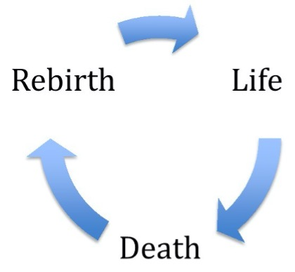
Year 8 life after death key facts
Hinduism, Sikhism, Buddhism
and non-religious beliefs
You are expected to know all of the information in this booklet.
You will be assessed on this knowledge.
Most non-religious people do not believe there is any life after death. Some say that nothing happens after death. There is no life, or resurrection or reincarnation after one passes away. Some might say that the only thing that lives on after death is a person’s legacy and remembrance as a memory of others. Immortality as a legacy is the belief that there is no actual life after death and that we will only exist in what we leave behind. Immortality as a memory of others is the belief that there is no actual life after death and that we will only exist in the memories of family and friends. | Some non-religious people might believe that there is life after death because of the following reasons: Near-death experiences (NDE). People claim to have near-death experiences when they are classed as clinically dead for a short period then revived or it happens during a medical operation. They often describe feelings of peace; out of body experiences; seeing a bright light; and even meeting deceased relatives. Paranormal activities. Beliefs in ghosts and Ouija boards give some people reasons to believe that the spirits, or souls, of the dead live on. Some believe in Mediums who claim evidence for life after death by contacting people’s dead relatives and telling them things only their relatives could know.
Reincarnation Reincarnation is usually associated with Hinduism, Sikhism and Buddhism but some non-religious people have also adopted the idea. Reincarnation is the belief that existence is a cycle of birth, life, death and rebirth. Rebirth is decided by a person’s karma and how a person lived and performed actions in their previous life. Hindus, Sikhs and Buddhists say the actions you do in this life will determine what you come as in your next life in this world. Good karma can be accumulated by the following: Hindus: Following the Vedas and completing your dharma. Sikhs: Following the teachings of the gurus and carrying out the three types of sewa. Buddhists: Following the Eightfold Path and accepting the Four Noble Truths. If a person’s karma is really good, then instead of reincarnation or rebirth, the following will happen: Hindus: the soul (atman) breaks free from the cycle and attains Moksha (soul absorbs with Brahman). Sikhs: the soul breaks free from the cycle and attains Mukti (soul connects with Waheguru). Buddhists: The energy of a person breaks free from the cycle and attains Nirvana (enlightenment), an indescribable state of joy, happiness and the end of eternal suffering. Hindus, Sikhs and Buddhists believe the best method of disposing the deceased is by burning the body in a funeral ceremony known as cremation. The ashes is then thrown into a holy river or any sea water. Some Buddhist might bury the ashes with the bones that remain.

Slide 13
Year 8 Pilgrimage key facts
Islam - Hajj
You are expected to know all of the information in this booklet.
You will be assessed on this knowledge.
Hajj is a pilgrimage that every Muslim tries to make at least once in their lifetime. Pilgrims travel to Makkah, in Saudi Arabia. When approaching Makkah, pilgrims must enter into a spiritual state of holiness or purity known as ihram. This involves performing ritual washing, praying and putting on ihram clothing. Men dress in two sheets of white cloth and women wear a single colour. While in this state, pilgrims are not allowed to do various things, including smoke, shave, wear perfume or jewellery, or cut their nails. It is a time to focus wholly on God. On arriving in Makkah, pilgrims head towards the Grand Mosque, which is home to the Ka’aba. Pilgrims walk around the Ka’aba seven times in an anticlockwise direction. After circling the Ka’aba, pilgrims walk or run back and forth between two hills, Safa and Marwah. Muslims believe that Ibrahim’s wife rushed between these two hills in search of water for her dehydrated son, Ismail.
During hajj, pilgrims stand on or near Mount Arafat from noon to sunset, praying for forgiveness from God. This is a significant location, because it is believed to be where God forgave Adam and Hawwa (Eve) after they disobeyed him by eating fruit from a tree that was forbidden to them, and also where Muhammad delivered his final sermon. After Mount Arafat, pilgrims collect stones and head to Mina to throw the stones at three pillars (jamarat), which represent Satan. This is done to remember the willingness of the prophet Ibrahim to sacrifice his son, Ismail, despite Satan telling him not to. It also symbolises Muslims’ own rejection of evil. The stoning of Satan is often followed by the open-air sacrifice of an animal such as a goat or sheep. The meat can be eaten in Mina, but is often frozen and sent to poor Muslims in other countries. At the end of hajj, pilgrims leave the state of ihram, and men will join a queue outside one of Makkah’s many barber shops to have their heads shaved. Women usually just have one lock of their hair removed. Finally, pilgrims complete their pilgrimage by returning to the Ka’aba and circling it seven more times.

Slide 14
Year 8 Pilgrimage key facts
Hinduism - Kumbh Mela
You are expected to know all of the information in this booklet.
You will be assessed on this knowledge.
The Kumbh Mela is a Hindu festival that takes place once every three years. The Kumbh Mela is one of the largest gatherings in the world. Up to 30 million pilgrims might attend every day. The location of the Kumbh Mela rotates between four different venues in India. According to medieval Hinduism, the gods spilled drops of Amrita (the drink of immortality) at four places, while transporting it in a kumbh (pot) to take it away from the demons. These four places are the present-day sites of the Kumbh Mela. In the Kumbh Mela pilgrimage, people bathe in the sacred rivers of India to get rid of bad karma. The River Ganges is the holiest river for Hindus as it is considered to be an extension of Lord Shiva. The Kumbh Mela is famous for attracting many ascetics, or sadhus, who often make the pilgrimage in large groups. For ordinary Hindus, the chance of seeing the sadhus is an important reason to make the pilgrimage. The sight of a holy man or woman is darshan: it is considered a blessing to have the chance to see such people.

Slide 15
Year 8 Worship key facts
Hinduism - Puja
You are expected to know all of the information in this booklet.
You will be assessed on this knowledge.
Most Hindu homes have a shrine in them and Hindus perform puja, or worship, at home. The shrines usually contain an image of the god or gods that are most important to that particular family. The image of a deity found at a Hindu shrine is called a murti, which means form or image. The murti is a sacred object but it is not a god. It is just an image of a deity. Hindus believe that if it is produced and installed in the right way then the murti has a special connection to the deity. Puja is a daily routine for Hindus. It is a simple form of worship using mantras (prayers) and making offerings. It is made at least once a day, usually in the morning. Offerings of water, flowers, fruit and incense are placed in front of the images. Then the image of the god is ‘awakened’ by the lighting of a flame, the sound of a prayer (mantra), the playing of music (raga) or the ringing of a bell. Arti is then performed. Arti is an act of worship and of adoration. An arti lamp has five wicks – each one represents one of the five elements: earth, air, fire, water and space. The sacred word ‘Aum’ (a sound symbol for Brahman) is chanted over and over again during worship. At the end of puja, the food that has been offered to the deities might be eaten. This is called prashad. Some Hindus believe that the prashad contains a blessing from their god. Many of the objects of worship used during Puja at the shrine appeal to the five senses of sight, hearing, smell, taste and touch. This is to involve the whole person in the worship.
 | Most puja trays include: Murti – to help the person focus on their god Incense – to purify and cleanse the air and create a holy atmosphere Bell – to wake up the gods because it is unreasonable to expect something as a great as a god to be sat around waiting for humans to worship them Light – the light is moved around the shrine symbolising the presence of the god. Hindus pass their hands over the flame then over their head to symbolise being covered with the presence of god Offerings – these are a show of love Water – this is used for purification and worshippers will take three sips before saying their prayer (mantra) Kum kum powder – worshippers make a paste from this powder and use it to mark their forehead to show their devotion and the blessings and protection of their god

Slide 16
Year 8 Worship key facts
Judaism - Standing Prayer
You are expected to know all of the information in this booklet.
You will be assessed on this knowledge.
Jews are obliged to pray three times a day. This is in the Talmud. By reciting the Amidah (Standing Prayer), Jews can fulfil their obligation to pray. There are19 blessings in the Amidah. On special days, such as Shabbat and High Holy Days, the blessings are slightly different.
Jews stand with their feet together while reciting the Amidah as a sign of respect for G-d. Jews should face the direction of Israel when praying the Amidah. This shows respect for the Temples and reminds them that the synagogues were established to try to fill the gap in Jewish life left by the Temples’ destruction. In many synagogues in the west, the ark is on the eastern wall to face Jerusalem. It is the holiest place in the synagogue. | The Amidah is a Jew’s opportunity to approach G-d in private prayer and it should therefore be said quietly. Only a grave emergency justifies interrupting the Amidah since it is considered a conversation with G-d.
Before a Jew begins the Amidah, they take three small steps forward as if they were approaching a king. If there isn’t much space, they take several tiny steps back before taking the three symbolic steps forward. Jews bends their knees and bows at both the beginning and the end of the first blessing. Jews will stand straight up when they say G-d’s name (‘Adonai’). In the sixth blessing, for forgiveness, when saying ‘hatanu’ (we have sinned) most Jews will lightly beat their chest with their right hand. This symbolises that the heart is the source of temptation to sin. At the end of the eighteenth blessing, for thanksgiving, Jews will bow again. At the end of the Amidah, Jews will meditate before saying ‘Oseh shalom bimromav’ (this means ‘He who makes peace in his heights’). While saying that line, they bow three times – to the left, to the right, then forwards. This is symbolic of leaving a king.

Slide 17
Year 8 Worship key facts
Christianity - Holy Communion
You are expected to know all of the information in this booklet.
You will be assessed on this knowledge.
Holy Communion is also known as Eucharist or Mass. Holy Communion is a sacrament. This means that it is an outward sign of an inward grace. Another way of describing this is that a sacrament is an action made holy or special because of its believed ability to demonstrate a truth about God. Christians don't say that they 'do' or 'carry out' the Eucharist; they celebrate it. In some churches, the person who takes the leading role in the ceremony is called the celebrant.
Christians often have Holy Communion services at church. Holy Communion is a re-enactment of the Last Supper, the final meal that Jesus shared with his disciples before his arrest and crucifixion. At the Last Supper, Jesus ate bread and drank wine and told his disciples to do the same in memory of him. Jesus gave his disciples bread and wine and told them that they were symbols for his body and his blood that would be sacrificed on the cross for them. Luke 22:19 says "And He took bread, gave thanks and broke it, and gave it to them saying, 'This is my body given for you; do this in remembrance of me.’” Catholics believe that when the priest repeats Jesus’ words from the Last Supper, the bread and wine actually turn into the body and blood of Jesus, even though they look the same on the outside. This is called transubstantiation. Other Christian denominations think that the bread and wine symbolise Jesus’ body and blood but that they are not transformed. This is called consubstantiation. Protestants believe that Jesus made his sacrifice on the cross and simply follow the tradition of the sacrament in memory of the event, recalling its symbolic importance in the life of Jesus. |  | The Religious Society of Friends (Quakers) do not celebrate Holy Communion because they do not recognise the sacraments. They don't regard some activities as more sacred than others, nor do they believe that any particular ritual is needed to get in touch with God.
The Holy Communion symbolises the new covenant (promise) given by God to His followers. The old covenant was the one given by God to Israel when He freed His people from slavery in Egypt. The new sacrament symbolises freedom from the slavery of sin and the promise of eternal life. Celebrating Holy Communion helps individuals to become closer to God and strengthen their faith. They receive God’s grace by joining in the sacrifice of Jesus. Holy Communion also has benefits for communities because it brings the community of believers together in unity by sharing the bread and the wine. This can provide support and encouragement for people who are going through a difficult time.

Slide 18
Year 8 Worship key facts
Sikhism - Kirtan and Langar
You are expected to know all of the information in this booklet.
You will be assessed on this knowledge.
Kirtan Devotional singing of the Guru Granth Sahib is called kirtan. Kirtan means ‘singing the praises of God’. Kirtan usually takes place during the service on a Sunday. It also often happens during festivals to honour the Gurus. Generally in the Gurdwara the musicians either sing alone or request the Sangat (congregation) to repeat the lines of the hymn after them in chorus. This is known as congregational hymn singing.
Langar Langar means free kitchen. It is a shared eating area in a Gurdwara. The langar is open to everyone – it doesn’t matter what gender, ethnicity or religion they are. Men and women sit side by side in the langar. All the food that is served in a langar is vegetarian. Everyone receives the same food. Sikhs are expected to volunteer at the langar by donating, cooking and serving food as well as washing up and cleaning. This is a part of the sewa (service to others). Traditionally, people sit on the floor to eat so that everyone is at the same level with nobody in a higher position. Nowadays, some people sit on benches.
In October each year, Sikhs in the UK and around the world have International Langar Week. During this time they try to: Introduce a friend to the langar Set up a langar in a public place Join a local street langar team that gives food to the poor

