Slide 1
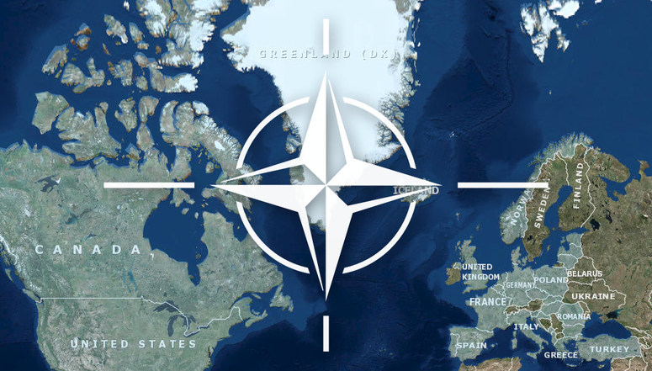
Why do people seek refuge in the UK?
The UK has a good record on human rights
English is spoken widely across the world (why is this?)
People may have cultural or ethnic ties to communities already in the UK?
The UK is a wealthy country that can afford to support asylum seekers?
Jobs are available in the UK. Many of these are unskilled, so they don’t necessarily require high levels of English
People in the UK have a right to;
Housing
Healthcare
Education
North Atlantic treaty organisation (NATO)
Commonwealth
NATO
Council of Europe
World Trade organisation
Pros and Cons of interventions

Slide 2
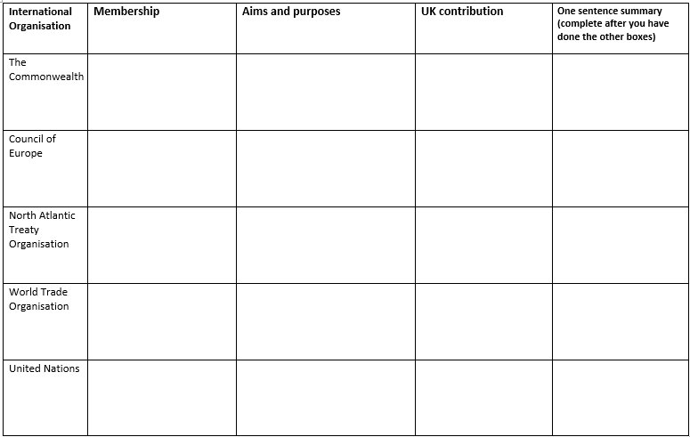
54 countries including; Australia, Jamaica and Canada
To maintain relations between the UK and former colonies and promoting human rights and economic prosperity
UK makes one of the largest financial contributions to less wealthy members.
46 including; UK France, Spain Italy and Belgium
To enforce European convention on human rights safe guard democracy and the rule of law
UK has a permanent representative ( even post Brexit)
30 including; UK, USA, Finland and Turkey
UK was a founding member and contributes 2% of its GDP to defence and is the 2nd largest contributor of personnel and weapons
Military alliance to protect any members if they are attacked
164 countries
UK makes financial contribution towards WTO development projects
Promote free trade and settle disputes fairly
To help ensure international issues and conflicts are resolved peacefully, protect human rights and combat climate change
UK is a member of both the UN and the security council responsible for helping settle disputes by mediating or imposing sanctions
193 countries

