Slide 1
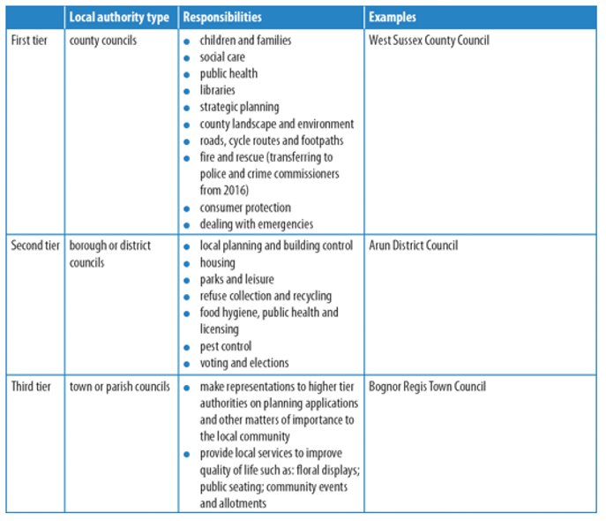
Scotland | Wales | Northern Ireland
Scottish Parliament | National Assembly | Northern Ireland Assembly
129 elected Members of Scottish Parliament (MSPs) | 60 elected Assembly Members (AMs) | 108 elected Members of the Legislative Assembly (MLAs)
Holyrood, Edinburgh | Senedd, Cardiff Bay | Stormont, Belfast
First Minister (Nicola Sturgeon) | First Minister (Mark Drakeford) | First Minster (Sir Jeffery Donaldson) and Deputy First Minister (Michelle o’ Neill)
1998 Scotland Act | 1998 Government of Wales Act | 1998 Northern Ireland Act
1998: agriculture, forestry & fishing Education, environment Health & social work Local government Courts, Justice, Policing & fire Economic Development Transport, roads & Tourism 2012: Stamp Duty, land tax, landfill tax, Scottish Income tax rate, borrowing, drinking, drugs & driving 2016: Air Passenger Duty, half of VAT revenues, Income Tax, Crown Estate, election franchise, oil and gas licensing, Abortion law, Employment programmes, Gaming Machine licensing powers, further transport & welfare powers | 1998: agriculture, forestry & fishing Education, environment Health & social welfare Local government Fire Economic development Transport 2011: law-making powers over devolved areas 2014: tax-raising powers including stamp duty & landfill tax | 1998: agriculture Education, environment Health & social services Local government Justice & Policing Trade & enterprise Transport Pensions & Child Support Culture & Sport 2017: air passenger duty & corporation tax
Pros and Cons to Devolution
Advantages​ | Disadvantages​
Local decision makers understand culture/needs of community better​ Local decision makers live in the area so can better scrutinise spending & services​ Local decision makers are easier to contact and hold to account for local residents ​ Residents can develop a stronger sense of identity and increase participation in the political process ​ | Some government responsibilities cannot be devolved e.g. economic policy, national defence​ Centralisation enables decision makers to consider interests of the whole country ​ Centralisation achieves coordinated approach at national level – easier to organise ​
How national government is chosen

