Slide 1
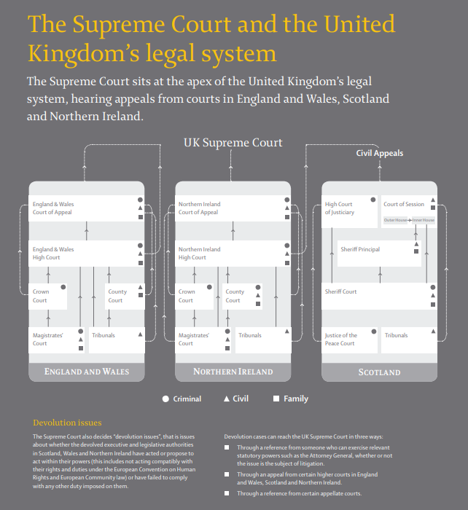
Civil Law cases​ | Criminal Law cases​
Inheritance​ Divorce, separation and custody​ Negligence​ Copyright and patents​ Land and property ownership​ Accident and injury​ Employment and other contracts​ Unfair treatment at work​ ​ | Robbery​ Tax evasion​ Fraud​ Smuggling​ Joint enterprise​ Burglary​ Rape​ Currency forgery​ ​
The Equality Act also says that employers (and schools etc) have a legal duty to make ‘reasonable adjustments’ to remove or reduce any substantial disadvantage faced by disabled workers which would not be faced by a non-disabled person. ​
Sources of law
Characteristics protected under the equality act:
age
disability
gender reassignment
marriage or civil partnership (in employment only)
pregnancy and maternity
race
religion or belief
sex/gender
sexual orientation
Incohate offences are where no harm has actually come about but there was intention to cause harm. (Conspiracy or attempt)
Causing disruption in a public place or to other people (rioting or abusive behaviour)

