Slide 1

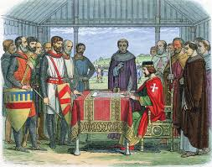
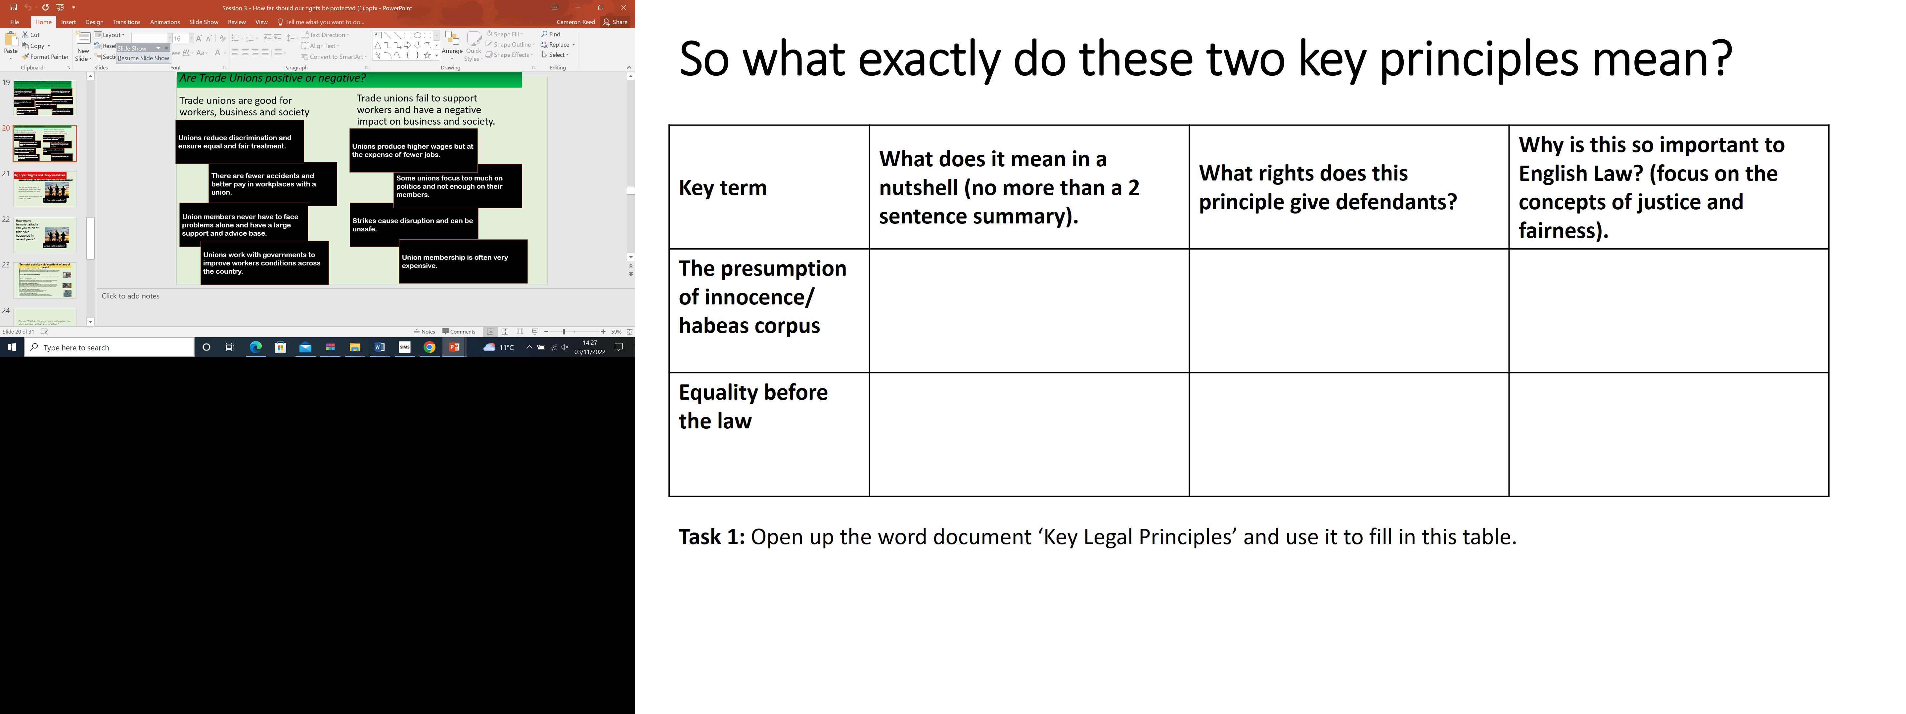

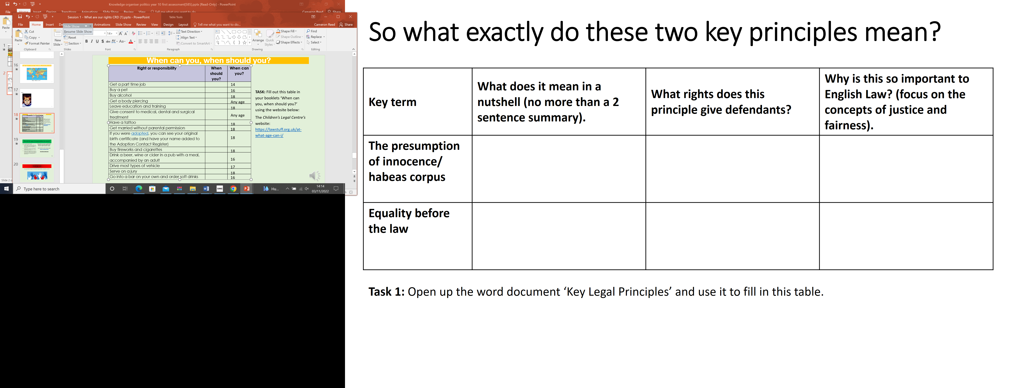
Knowledge organiser: Rights and Responsibilities
Moral Right
What is a an employee association?:
Employers' associations are the owners' and managers' version of trade unions. These groups often represent employers during any negotiation with the unions.
Moral Responsibilities | Legal Responsibilities
To ring a hotel you have reserved a room in to tell them you are no longer coming to stay. | A teacher informing the police of a serious incident regarding a student they teach
Someone telling their best friend their fiancé has been unfaithful | Students not carrying in their bags or pockets any harmful weapons or substances
Learners behaving well in class and completing the work. | Parents ensuring their child receives an education
Getting a refund if an item is faulty. | Businesses selling goods which are legal /approved.
What we expect from others in particular situations. This is not a legal right but we expect it to happen.
For example, parents expect to be contacted by teachers if their son or daughter misbehaves.
What is a Trade Union:
Trade unions were set up by groups of employees to protect their rights, and to campaign for fair wages and safe working conditions.
Magna carta
Placed limits on royal authority by establishing law as a power in itself.
No subject/citizen may be imprisoned without cause shown.
Right to be tried by a jury of their peers
Legal right
Expectations in law and where there will be legal action if they are not followed.
For example there are laws whereby children and teenagers are expected to be educated
The Universal Declaration of Human Rights:
- All equal before the law
- Right to education eight to freedom of expression
Pro’s and cons of anti terror laws for human rights
The United Nations Convention on the Rights of the Child:
- Right to life
- Right to good health and good quality care
The Government Counter-Terrorism and Security Act (2015) allows for people to be excluded from the UK and for the government to track and store data on people’s conversations, contacts and movements. This goes against our right to privacy.
Age of criminal responsibility:
England :10
Scotland : 12
Terrorism threatens our human rights and so must be stopped. This makes counter-terrorism measures essential for human rights law.

