Slide 1
 | Circus Maximus | Colosseum | Large Theatre at Pompeii | Central Baths at Herculaneum
Location | Rome | Rome | Pompeii | Herculaneum
Constructed | First built 6th century BC. Rebuilt a number of times, notably in 2nd century AD | Constructed in 70s AD. Opened in 80 AD | 2nd century BC. Renovated in late 1st century BC | Late 1st century BC
No. of seats | 250,000 (by 1st century AD). The largest sporting arena in recorded history. | Around 50,000 | Around 4000 | N/A
Materials | Originally wood. Later rebuilt with brick-faced concrete and marble. Lower tier of seating made of marble, the upper stone. Imperial box built from marble. | Outer wall made of travertine rock Arches made of brick and concrete Stucco (plaster which is easy to paint over) possibly used throughout the building for decoration. Definitely used on two arches which marked VIP entrances. First three storeys of seating made of marble. Top storey made of wood. Metal fence around the arena Sand covered arena | Main seating area made of marble Stage made of wood Front wall made of stone | Variety of materials in different rooms, including marble and stucco
Purpose | Hosted chariot racing | Gladiator fighting Public executions Beast hunts Performances by trained animals Some other extraordinary events, such as sea battles in a flooded arena | Hosted comedies, mimes and pantomimes | People might go to the baths to: Get washed Exercise To be seen and show off their power and status if they were rich men To meet rich and powerful people and try to get dinner invitations Meet friends and relax Hold business meetings Buy snacks and drinks
Important features | Size of track: 600m long, 150m wide Dividing bank down the middle called the spina (spine) Turning points at either end decorated with bronze posts covered with gold called metae 13th century BC red granite obelisk (tall stone monument) on the spina, brought from Egypt by Augustus. Symbols of the gods along the spina Seven large wooden eggs on spina, used to count laps. Later replaced by seven bronze dolphins. Carceres (Starting cages) constructed to stagger the racers as certain starting positions were better than others Three tiers of seating: Lowest: VIPs, state priests, senators and wealthy equites Middle: Anyone, including men, women and children. Top: Possibly standing only Imperial box on one side | Constructed around four concentric circles and a series of archways Four pathways from outer wall to arena with toilets and drinking fountains, Vomitoria: staircases allowing fast exit Eighty entrances with four ornate ones (possibly for VIPs), two of which are decorated (see above) Awning which could be pulled over spectators in event of heat Seating by social class: Ground floor: imperial box, special seats for Vestal Virgins, seating for senators First tier: equites Second tier: ordinary citizens Third tier: women, slaves and the poor Archers stood by arena to shoot animals which threatened spectators Network of tunnels, cages and lifts under the arena. Animals held in these and sent out through trapdoors Underground area linked to a point outside the stadium so that spectators would be surprised by the animals | Renovated by Holconii family with crypt, boxes (above main seating) and theatre seating All seating (except upper section) built into hill in Greek fashion. Seating tiered: Lower tier made of marble: VIPs Second tier: other free citizens Third tier: freedmen, slaves and women Awning to shade spectators Orchestra in front of stage in Greek fashion. Probably used for VIP seating unless a Greek play was happening. Elaborate scaena frons (front scene) behind stage Stage raised on pillars, leaving space below it to move stage machinery and props | Separate areas for both men and women (women’s area was smaller with smaller rooms). Men and women could visit at the same time (baths without both sections would require women to visit in the morning and men in the afternoon). Men and women each had: An entrance An apodyterium (changing room- slaves were probably available to watch people’s possessions) A tepidarium (warm room like a modern saunda) A caldarium (hot room where people would get washed with hot water, have dirt scraped off them with olive oil and strigils and get massaged) The following were only found in the men’s area: A palaestra (exercise ground. Women might have exercised in a corridor next to their apodyterium) A frigidarium (cold room with a plunge pool, used to cool down after caldarium) A man might have visited their rooms in this order: entrance -> apodyterium -> palaestra -> tepidarium -> caldarium -> frigidarium Women would have followed same path, maybe exercising in the corridor next to the apodyterium, though without visiting a frigidarium. Hypocaust system of underground heating used to heat warm rooms.

Slide 2
Circus Maximus | Circus Maximus
Location | Rome
Constructed | First built 6th century BC. Rebuilt a number of times, notably in 2nd century AD
No. of seats | 250,000 (by 1st century AD). The largest sporting arena in recorded history.
Materials | Originally wood. Later rebuilt with brick-faced concrete and marble. Lower tier of seating made of marble, the upper stone. Imperial box built from marble.
Purpose | Hosted chariot racing
Important features | Size of track: 600m long, 150m wide Dividing bank down the middle called the spina (spine) Turning points at either end decorated with bronze posts covered with gold called metae 13th century BC red granite obelisk (tall stone monument) on the spina, brought from Egypt by Augustus. Symbols of the gods along the spina Seven large wooden eggs on spina, used to count laps. Later replaced by seven bronze dolphins. Carceres (Starting cages) constructed to stagger the racers as certain starting positions were better than others Three tiers of seating: Lowest: VIPs, state priests, senators and wealthy equites Middle: Anyone, including men, women and children. Top: Possibly standing only Imperial box on one side

Slide 3
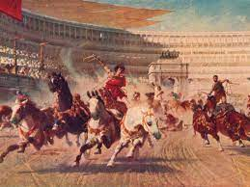
What happened at chariot races?
The races were paid for by the emperor or a senior politician.
There was a parade before the race, led by the sponsor. Behind him came the charioteers and the horses, as well as musicians and soldiers carrying images of the gods and goddesses thought to be present at the races. These were placed in a shrine in the imperial box.
Each races lasted about 10-15 minutes. Each one consisted of seven laps of the track in an anti-clockwise direction.
Normally there were 24 races in a single day.
Chariots normally pulled by 4 horses (though more was possible).
Chariot race started by sponsor dropping a white cloth.
Most accidents happened around the metae (the turning points).
The winner of a race was given a palm branch by the sponsor. Money was given to him and his team at the end of the day.

Slide 4
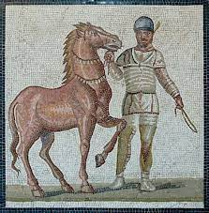
Who were the charioteers?
Usually freedmen or slaves who would hope to buy their freedom with prize money.
Divided into four teams: red, blue, green and white. Each team had an owner who oversaw the team’s stables and staff.
Each wore a tunic (in their team’s colours), a leather helmet, a whip and a knife to cut himself out of the reins wrapped around his wrists in the event of a crash.
Charioteers could be extremely wealthy. Gaius Appuleius Diocles was a chariot racer who would have been a multi-millionaire (perhaps even a billionaire) by today’s standards.

Slide 5
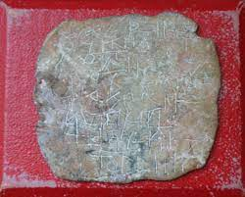
Who were the supporters?
A supporter might have followed a particular team, racer or even a horse. For instance, a successful horse like Victor, who we know won 429 races, might have had a lot of supporters.
It was common for supporters to wear their team’s colours to the races and to bet heavily in favour of them.
Some supporters took chariot racing extremely seriously. We have curse tablets (normally sheets of lead on which were written prayers asking for a curse to put on an enemy- one is shown to the right) which begged the gods to torture and kill rival teams’ racers and horses.
There is one very extreme example of a Red team supporter jumping onto a Red charioteer’s funeral pyre out of grief.

Slide 6
Colosseum | Colosseum
Location | Rome
Constructed | Constructed in 70s AD. Opened in 80 AD
No. of seats | Around 50,000
Materials | Outer wall made of travertine rock Arches made of brick and concrete Stucco (plaster which is easy to paint over) possibly used throughout the building for decoration. Definitely used on two arches which marked VIP entrances. First three storeys of seating made of marble. Top storey made of wood. Metal fence around the arena Sand covered arena
Purpose | Gladiator fighting Public executions Beast hunts Performances by trained animals Some other extraordinary events, such as sea battles in a flooded arena
Important features | Constructed around four concentric circles and a series of archways Four pathways from outer wall to arena with toilets and drinking fountains, Vomitoria: staircases allowing fast exit Eighty entrances with four ornate ones (possibly for VIPs), two of which are decorated (see above) Awning which could be pulled over spectators in event of heat Seating by social class: Ground floor: imperial box, special seats for Vestal Virgins, seating for senators First tier: equites Second tier: ordinary citizens Third tier: women, slaves and the poor Archers stood by arena to shoot animals which threatened spectators Network of tunnels, cages and lifts under the arena. Animals held in these and sent out through trapdoors Underground area linked to a point outside the stadium so that spectators would be surprised by the animals

Slide 7
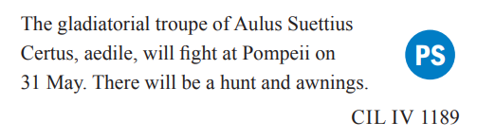
How were the games at an amphitheatre funded?
Emperors and other wealthy men sponsored games in amphitheatres as a way to win support from the general public (politicians, especially before the reign of Augustus, would promise spectacular games as a way of persuading people to vote for them). Over time the emperors passed laws so to stop anyone other than themselves putting in particularly extraordinary shows in Rome.
Outside of Rome, wealthy politicians continued to use the promise of great spectacles in games in order to persuade people to vote for them.
Prescribed source
In cities outside of Rome, the two most powerful politicians were the aediles. This message was painted on the outside wall of a building in the forum at Pompeii. The forum was the central marketplace of a Roman town which many people would probably have visited on almost a daily basis. Aulus clearly wanted his message to be seen by as many people as possible in order to gain their support in future elections.

Slide 8
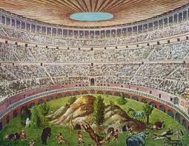
Wild animal shows
When they happened
Probably in the morning.
What they involved
Animals might perform tricks, like panthers who pulled chariots or elephants bowing to the emperor. The animals might be made to fight each other, or a bestiarius (a trained animal fighter) might fight a vicious animal or hunt them through a recreation of the wilderness (similar to the scene to the right).
What the point of them was
By bringing into the Colosseum animals taken from far away places, the size (and therefore the power) of the Roman Empire could be shown off. These included elephants, crocodiles, giraffes and hippos. Most spectators would never see such animals outside of the games. The shows were also meant to give the spectators the idea that the empire (and therefore the Emperor) had control over both humans and nature.

Slide 9
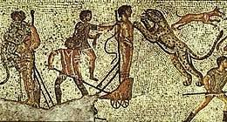
Executions
When they happened
Probably in midday.
What they involved
Criminals were killed in brutal or disgustingly creative ways. They were usually killed by wild animals, either after being tied to a stake or being made to fight them. Criminals were also made to fight to the death in a mock gladiator fight. In addition, we hear of crucifixions and people even being burned alive. Some of the more creative methods of execution might involve a criminal being forced to play the role of a mythological character in a recreation of their death scene.
What the point of them was
These were probably meant to be a warning against going against the emperor’s laws. The presence of the wild animals would have had an effect similar to that of the wild animal shows.

Slide 10
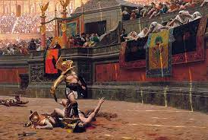
Gladiatorial fights
When they happened
Probably in the afternoon.
What they involved
A procession, accompanied by music, would have started the gladiator fights, followed by an inspection of the gladiator’s weapons. Most bouts involved two gladiators, but some could involve more. A bout lasted about 15-20 minutes, and ended when one fighter surrendered by lifting up his finger. At this point, the emperor, after listening to the crowd’s response, use his thumb to give the order to either spare or kill the defeated gladiator (we do not have records about what his signal looked like). Usually gladiators were not killed, but those who were would be trained to not flinch or beg for mercy. After his death, a gladiator’s head would be hit by a mallet from an attendant, whilst another dressed as Mercury would prod the corpse with a hot rod. The body was then removed, the man’s throat cut and the sand rake over to hide the blood. Some gladiatorial fights involved marginalised groups, such as women or dwarfs, as gladiators.
What the point of them was
Not only were these entertaining, but gladiator fights allowed the emperor to not only be seen as paying attention to the will of the crowd when he voted on whether to kill or spare a defeated gladiator, but it also allowed him to present himself as somebody who had power over life and death. The appearance of an attendant dressed as Mercury represented the spirit of the gladiator being taken down into the underworld.
The usage of marginalised people would have provided the audience with variety, but would have also been a cruel way of mocking these people.

Slide 11
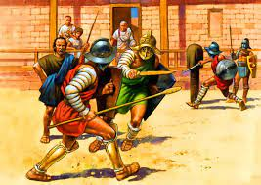
Overview
Gladiators might be slaves, prisoners of war, criminals being forced into becoming gladiators as a punishment or free men who signed up to escape poverty.
Gladiators trained in a gladiator school, each of which was run by a trainer. The trainer would hire out the gladiators to the sponsors of the games.
Gladiators trained for hours a day with blunt wooden weapons and were trained not to appear scared of death.
Training a gladiator was very expensive, as they would have had access to high-level medical care and a high-energy diet. This was probably one of the main reasons why gladiator deaths in the arena were so rare, in addition to the fact that many gladiators had fans and supporters who would be very upset at seeing their favourite killed.
Gladiators were infamis, meaning that they held very low legal status. Their trainers had power over their lives and deaths.

Slide 12
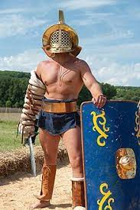
Murmillo
Armed like a legionary soldier
Helmet with a metal crest in the shape of a fish (‘murmillo’ means something like ‘fish-man’) and a visor
Short greaves
Curved shield of a Roman legionary
A legionary’s short sword

Slide 13
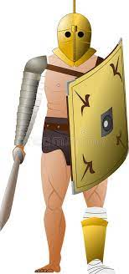
Secutor
Visor with two eye-holes (protecting face from trident thrusts)
Greave on left leg
Arm guard
Legionary-style shield
Short sword
Usually fought against retiarius

Slide 14
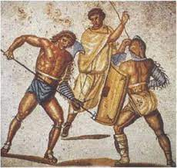
Retiarius
Net (the name means something like ‘net-man’)
Trident
Arm guard
Shoulder guard
Dagger
Usually fought a secutor

Slide 15
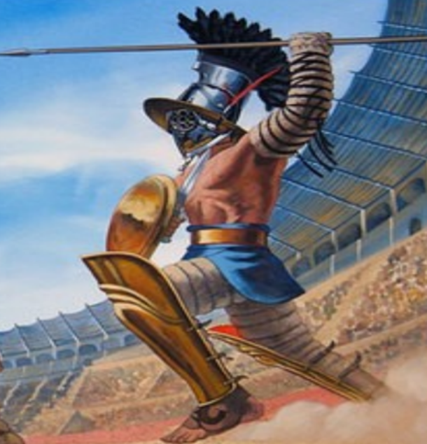
Hoplomachos
Armed like a Greek hoplite (heavily-armed infantryman)
Large crested helmet with visor
Thigh-length greave on left leg
Spear
Round shield

Slide 16
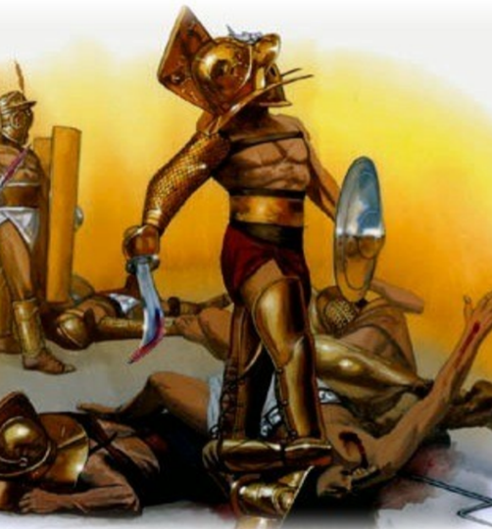
Thracian
Crested, broad-brimmed helmet with a visor
Greaves on both legs
Protector on sword arm and shoulder
Small round shield
Short sword designed to slash

Slide 17
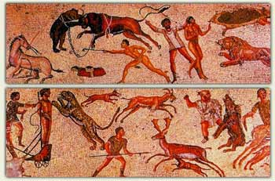
Bestiarius
Usually no armour
Might have carried:
  A whip
  A spear
  A bow
  A lance
  Technically not a gladiator (gladiator = someone who fights with a sword)

Slide 18
Large Theatre at Pompeii | Colosseum
Location | Pompeii
Constructed | 2nd century BC. Renovated in late 1st century BC
No. of seats | Around 4000
Materials | Main seating area made of marble Stage made of wood Front wall made of stone
Purpose | Hosted comedies, mimes and pantomimes
Important features | Renovated by Holconii family with crypt, boxes (above main seating) and theatre seating All seating (except upper section) built into hill in Greek fashion. Seating tiered: Lower tier made of marble: VIPs Second tier: other free citizens Third tier: freedmen, slaves and women Awning to shade spectators Orchestra in front of stage in Greek fashion. Probably used for VIP seating unless a Greek play was happening. Elaborate scaena frons (front scene) behind stage Stage raised on pillars, leaving space below it to move stage machinery and props

Slide 19
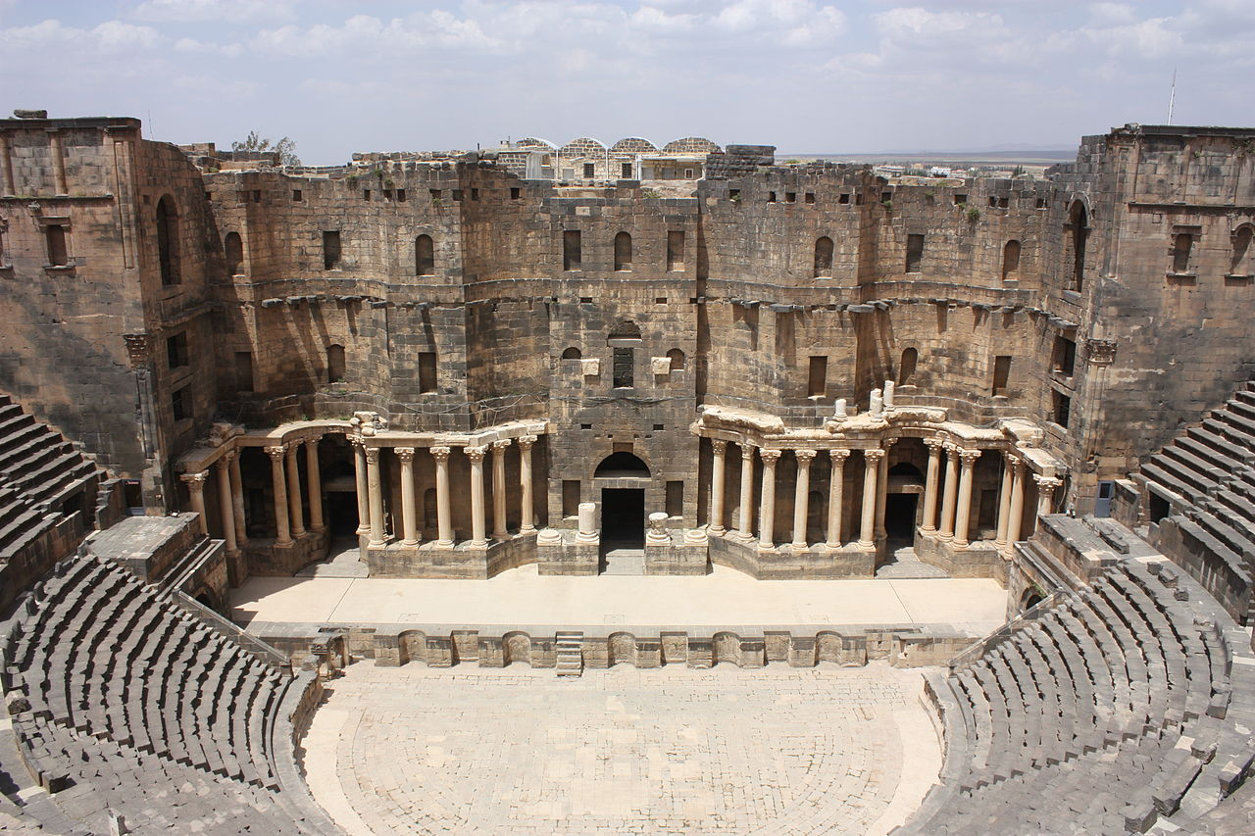
awning
Slave Seating
Scaenae frons
vomitoria
Pillars
Orchestra
Double doors
VIP seating
Stage

Slide 20
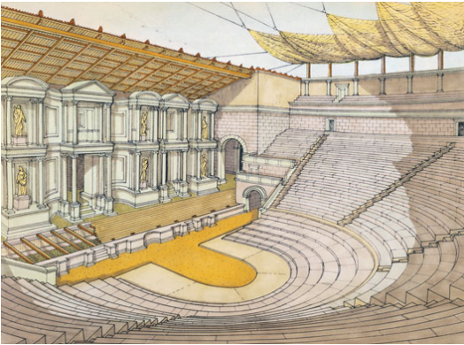
Overview
Roman drama developed from Greek drama
Like the Greeks, Romans often put on plays during religious festivals
Plays were usually paid for partly out of public funds and partly by politicians who ran the festivals, hoping that this would get them support in elections
Wealthy people would also pay for theatres to be built or renovated (i.e. the Holconii in Pompeii)
A theatre might have had a semi-circular seating area and a semi-circular space in the centre called the orchestra. This was probably only used for Greek plays and otherwise likely used for VIP seating.

Slide 21
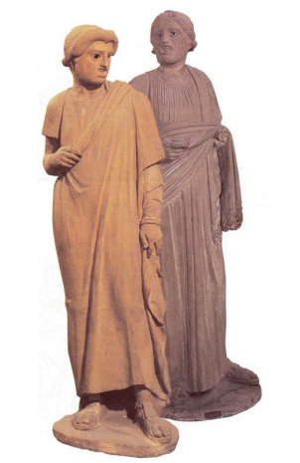
Roman actors
Considered infamis (few legal rights)
Tended to be slaves or people with little money to begin with.
To be an actor, a person needed to be able to sing and play a vast number of roles.
Could become very rich due to having huge numbers of passionate fans
Groups of actors formed troupes, each under the leadership of a troupe leader.
Competition was fierce between troupes, as prizes were awarded to troupes or individual actors at the end of festivals. Troupes might have supporters placed in the audience in order to clap or cheer at the right moments.

Slide 22
Costumes, props and masks
For male roles, a cloak and tunic would be worn,
For female roles, a dress and a cloak would be worn for female roles
Props would be use to tell an audience about a character’s role in the play- an old man might carry a walking stick, a cook might hold a knife and a slave dealer usually held a money-bag. These sorts of costumes all originated in Greek theatre.
The theatrical mask originated in Greek theatre and allowed a single actor to play multiple roles with each one designed to indicate a specific kind of character. For instance, masks made for female characters would have pale skin, whilst masks made for male characters would have brown skin. They were made out of linen and plaster, making them very light.

Slide 23
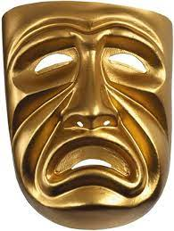
Tragedy
Roman tragedy developed from Greek tragedy, but we have little evidence of it.
By the 1st century BC, tragedy had lot a lot of popularity, which probably explains the small amount of evidence.
Greek (and therefore probably Roman) tragedy told serious stories about often mythical figures (though some historical tragedies were written). Although we now call them tragedies, these did not always have unhappy endings (our word ‘tragedy’ originally comes from the Greek word tragoidia, which doesn’t have quite the same meaning).

Slide 24
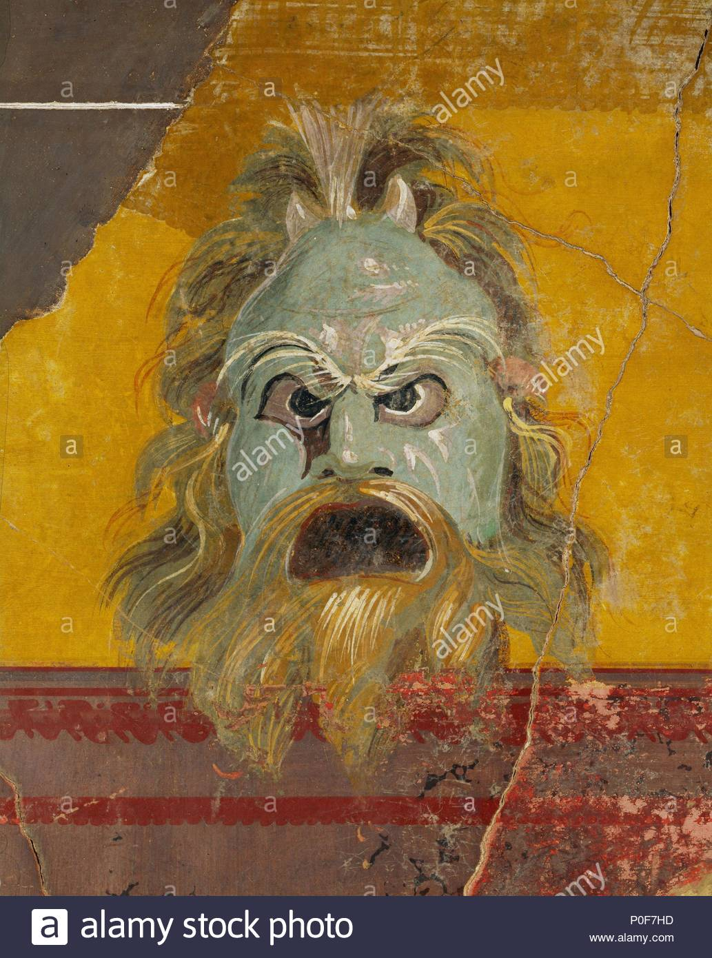
Comedy
Roman comedy developed from Greek tragedy.
Two main comic playwrights are Plautus and Terence, who based their plays on the work of the Greek comic Menander.
Plots based around events such as confusions of identity, conflicts between fathers and sons or clever slaves outwitting their masters.
Roman comedy made use of stock characters (characters easily recognisable from how they behaved) such as the flatterer or the boastful soldier.

Slide 25
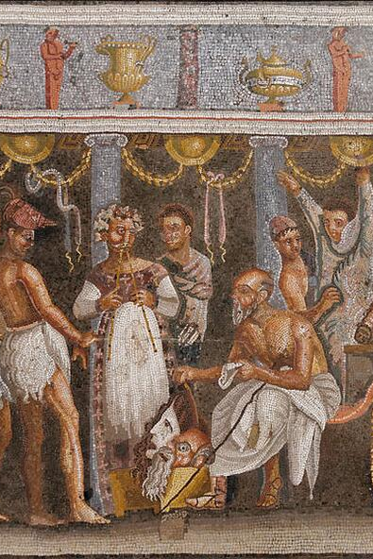
Mime
Originated in Greece
Roman mime would include speaking
A variety performance which included acrobatics, singing, dancing, jokes and conjuring based around a simple plot.
The subject matter was often very rude and provided a parody of town or city life.
Some mimes were political, whilst others presented scenes from every day life.
A mime could be performed as a standalone play, but mimes were sometimes used to fill the gap between two other plays, or as part of another form of public or private entertainment.

Slide 26
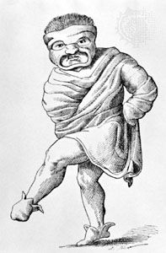
Pantomime
A Roman pantomime involved a single actor and normally concerned a tragic subject.
The pantomime actor would not speak or sing throughout the play, but would be accompanied by music or singing.
It usually took the form of a scene from a Greek tragedy.
A pantomime actor had to be highly skilled, as he was required to play every role in the play.
Pantomime was incredibly popular in Rome and famous pantomime actors attracted huge fanbases.

Slide 27
Central Baths at Herculaneum | Colosseum
Location | Herculaneum
Constructed | Late 1st century BC
No. of seats | N/A
Materials | Variety of materials in different rooms, including marble and stucco
Purpose | People might go to the baths to: Get washed Exercise To be seen and show off their power and status if they were rich men To meet rich and powerful people and try to get dinner invitations Meet friends and relax Hold business meetings Buy snacks and drinks
Important features | Separate areas for both men and women (women’s area was smaller with smaller rooms). Men and women could visit at the same time (baths without both sections would require women to visit in the morning and men in the afternoon). Men and women each had: An entrance An apodyterium (changing room- slaves were probably available to watch people’s possessions) A tepidarium (warm room like a modern saunda) A caldarium (hot room where people would get washed with hot water, have dirt scraped off them with olive oil and strigils and get massaged) The following were only found in the men’s area: A palaestra (exercise ground. Women might have exercised in a corridor next to their apodyterium) A frigidarium (cold room with a plunge pool, used to cool down after caldarium) A man might have visited their rooms in this order: entrance -> apodyterium -> palaestra -> tepidarium -> caldarium -> frigidarium Women would have followed same path, maybe exercising in the corridor next to the apodyterium, though without visiting a frigidarium. Hypocaust system of underground heating used to heat warm rooms.

Slide 28
 | Insula (tower block, literally ‘island’) | Domus (house)
Who would have lived here? | The very poorest in society as well as those who had enough money to rent a flat. | Wealthy people and their slaves
What sort of rooms were there? | Often thermopylia (hot food shops) on the ground floor with space above for the shop workers to sleep (mezzanines). A range of different living spaces. Some single rooms. Some large rooms for multiple people to live in at once. Some flats divided into multiple rooms for better-off families. A few small number had very large flats in them for wealthier people. Communal kitchens and toilet facilities were found in some insulae. | Shops somewhere along the outside, either run by family or rented out. Atrium- main room in which visitors were met. In the centre was an impluvium (rectangular pool to collect rainwater) with a compluvium (an opening to let rainwater fall into the house) in the roof above it. Might contain a lararium (shrine to household gods) and wax masks of ancestors were sometimes kept in Tablinum- a study for the master of the house, usually located between the atrium and the peristyle. Peristyle- A garden with a colonnade running around it. Normally found in an open-air part of the house’s centre. Triclinium- Dining room with three couches for guests to recline on. Bedroom- Normally only big enough for a bed and a chair Kitchen- Small and cramped with a hearth for cooking. Slaves who were cooks may have slept here. Recess- A small room with one side open
How might these be decorated? | Wall decorations quite common. We have evidence for murals (wall paintings) as well as blocks of colour painted onto walls (reds, yellows and browns seem to have been very popular). The outside would have been made of brick-faced concrete, roofs made out of wooden beams covered with terracotta tiles. Some windows may have been glazed. | Wall decorations quite common. Blocks of colours often painted on walls. The most popular colours were reds, oranges, blue-greens. Yellows, purples and black were also popular colours for walls. Atrium might be very well decorated to show off the family’s wealth. Tablinum possibly well-decorated for the same reason. Peristyle would have included flowers and shrubs, possibly an ornate (fancy-looking) fountain and statues. Other rooms likely had murals (wall paintings) appropriate to the room i.e. food on the walls of the tricilinium. Other murals might include scenes of the countryside of scenes from mythology. Slave areas probably not well decorated. The house as a whole probably would have had a lot of furniture in it.
What was life like for people living here? | Varied depending on which part of the building you were living in. Multi-room flats probably not terrible to live in with a decent amount of space. Smaller rooms were probably cramped, especially if multiple people were staying in them. Corridors in the poorer areas generally poorly lit. Wherever you were staying, insulae were not safe buildings. They were often not well built and it seems that it wasn’t uncommon for them to fall down. Fires were a problem with the darker areas needing to be lit by oil lamps. Also, there were no fire escapes- the higher up you were, the greater risk you would die in a fire or be buried under a collapsing insula. | For the free members of the house, probably quite nice. Peristyle would have given them a place to relax, the impluvium somewhere to get water from without leaving the house (on rainy days) and the triclinium would have been nice to eat in. Slaves would have done a lot of the work round the house. The wealthiest of families would have divided time between a house in the city and the house in the countryside. Members of the family would have had to leave home to use baths, unless they were super wealthy and had their own private baths (though they may still have wanted to use the public baths in order to meet people and to be seen out-and-about). The female members of the family would have been less free to come and go from the house as the male members, however. For the slaves, life was hard. Slaves were unlikely to have their own quarters (other than in particularly large houses) and probably slept where they worked. They were expected to wake up before their masters and likely went to bed after them.

Slide 29
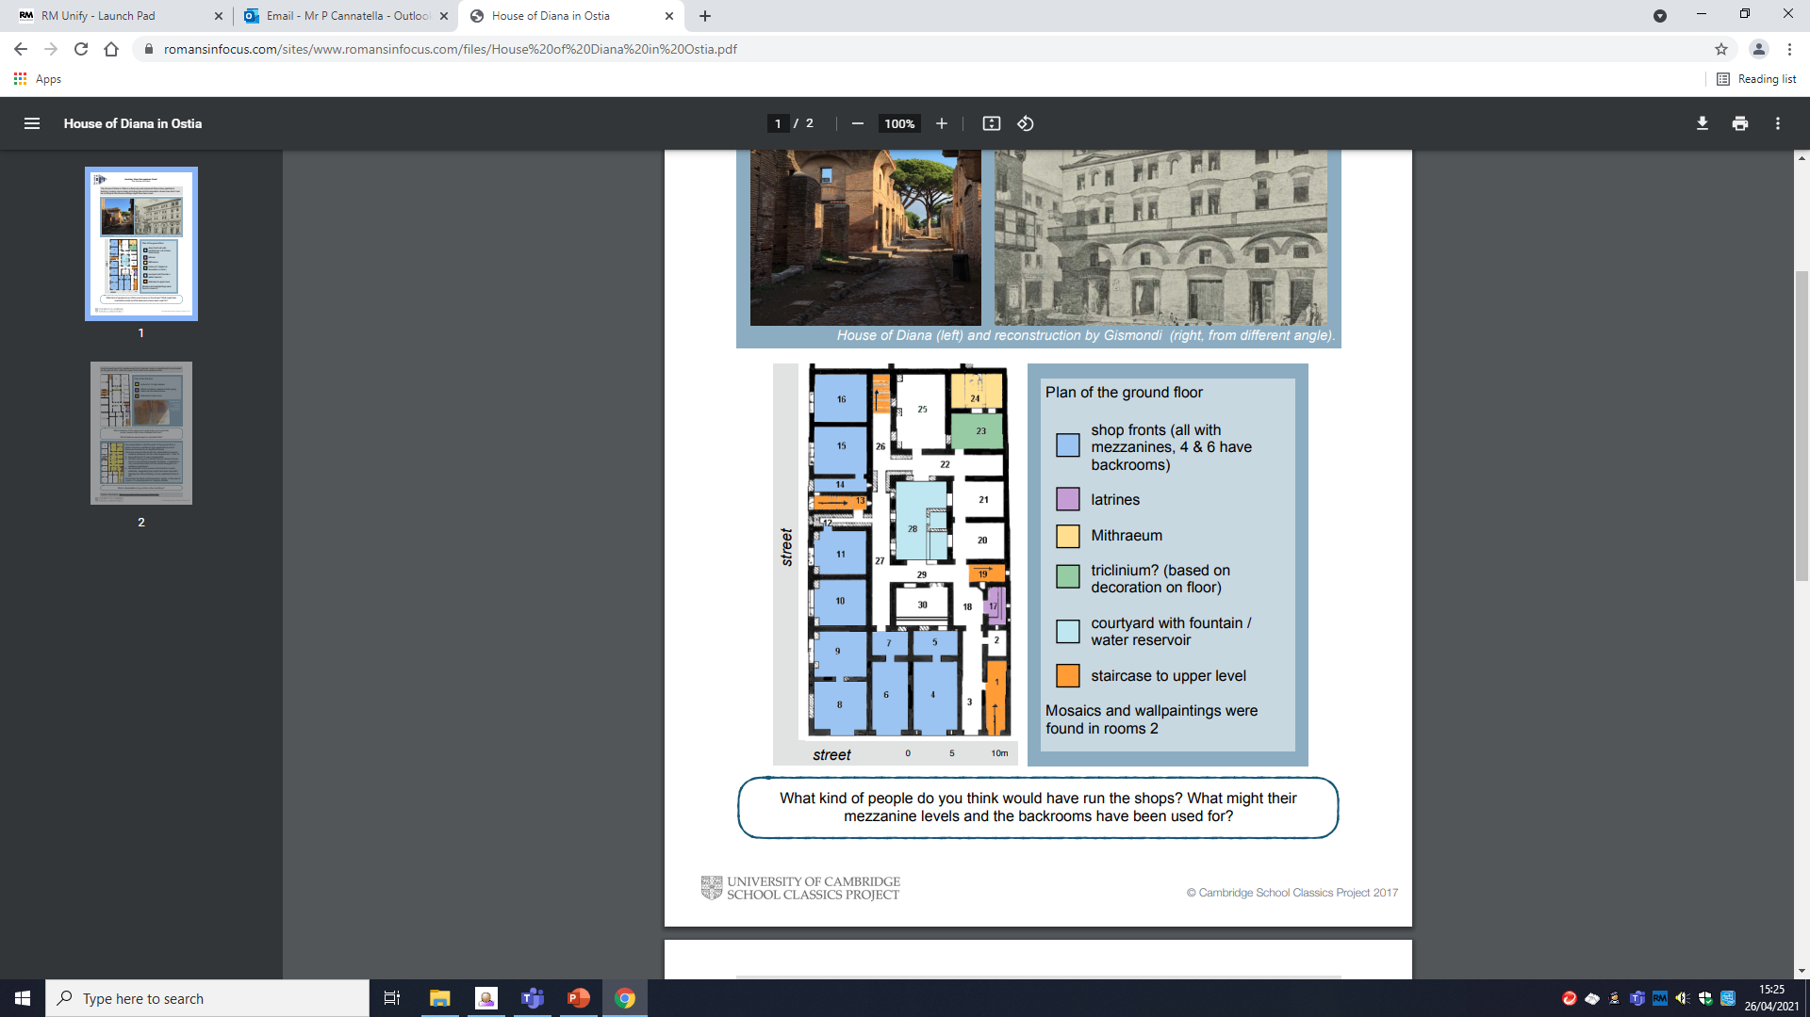
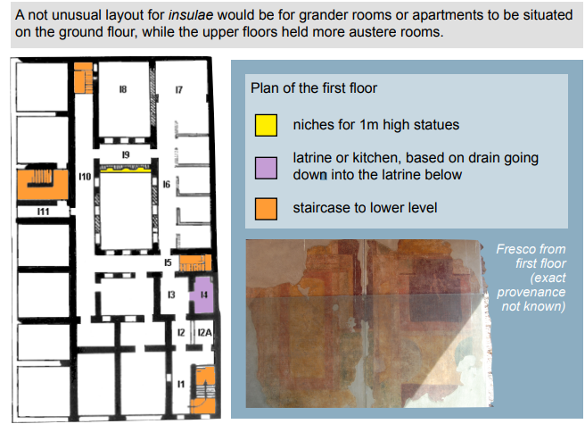
Prescribed Source | Insula of Diana
Location | Ostia
Size | 39x23m 4 storeys
Layout | Ground floor: Shops (thermopolia- hot food shops), courtyard, external and internal staircases. Mezzanines on ground floor could have been used as storage or as sleeping quarters for the shopkeepers. Courtyard in centre. Shrine to Mithras (called a Mithraeum) First floor: Large four-room apartments. Reasonably well-off families probably lived in these. Poorly-lit communal living areas: small rooms and a long corridor. Larger room at the end of this corridor might have housed multiple people at a time. Shared toilet facilities.
Possible Residents | Bigger apartments wealthy families for longer leases (between 6 months and a year) Smaller rooms probably workers for short stays (a number of days)
Owner | Wealthy owner making money from rent
Decoration | Relief sculpture of Diana on courtyard wall Paintings of food in thermopolium Yellow/Red/Green walls in apartments
Special Features | Central courtyard for light Cistern for water supply Relief of Diana on the inner courtyard wall Shrine to the god Mithras (a Mithraeum) located on ground floor

Slide 30
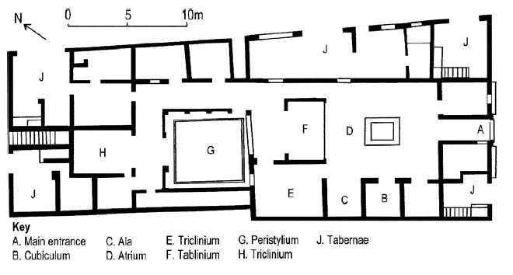
Prescribed Source | House of the Wooden Partition
Location | Herculaneum
Size | c.40m from street to back
Layout | Two storeys Classic atrium – tablinum - peristyle layout Benches for clients on street Steps at back and front to upper storey
Possible Residents | Wealthy individual with family and slaves. Person who ran the shop might have lived above it.
Owner | Wealthy shop owner
Decoration | Red/black/yellow painted panels in atrium Marble display table next to impluvium, fountain in the centre of the impluvium. Wooden partition’s hinges shaped like ships’ figureheads.
Special Features | Wooden partition between tablinum and atrium allowed for privacy when required Other wooden furniture survives Flats above shops

Slide 31
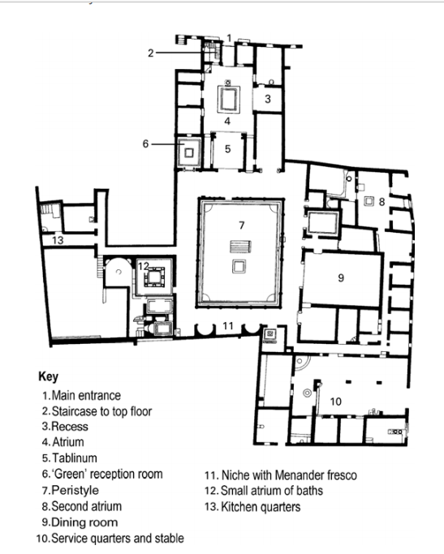
 | House of Menander
Location | Pompeii
Size | One of the largest in Pompeii
Layout | Atrium – tablinum – peristyle, extended many times leading to unconventional layout. Slave quarters and stables at rear. Private baths off peristyle.
Possible residents | Large family plus huge retinue of slaves, wealthy enough to also have a farming estate
Owner | Unclear (named after Greek comic playwright Menander)
Decoration | Paintings of Trojan war in atrium Floor mosaic of River Nile
Special features | Impressive lararium(household shrine) in atrium Private Baths! HUGE dining room

Slide 32
Core | East wing | West wing
Impressive household shrine in atrium Staircase to the upstairs next to the shrine One room to the east in the atrium has three frescos of scenes from the Trojan War Large peristyle Green reception room off to the north-west of the peristyle Baths off to the south-west of the peristyle- a sign of extreme wealth Huge dining room (triclinium) to the east of the peristyle, with a floor mosaic depicting the river Nile Second household shrine (lararium) at the south end of the peristyle, as well as three frescoes. One is of the Greek playwright Menander, which has given the house its name. | Long corridor with multiple small rooms Large stable at the end where a wagon and amphorae were found Small atrium at the other end, where the house’s steward or head slave might have worked Slaves quarters may have been located here | Kitchen Latrine Access to cellars Silver service stored here

Slide 33
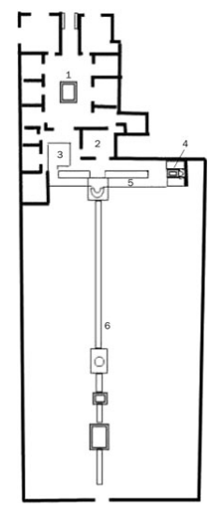
 | House of Octavius Quartio
Location | Pompeii
Size | Very large with a massive garden
Layout | Atrium – tablinum – peristyle, but with a small peristyle and a huge garden stretching out beyond it.
Possible residents | Wealthy family with slaves. Owner might have enjoyed hunting or travelling to the countryside judging by the decorations.
Owner | Unclear, but a man called Octavius Quartio’s ring was found in one of the shops.
Decoration | Huge range of murals (for more details, see the next slide for more details)
Special features | Massive garden with two pergolas, a huge canal, a shrine and even a small temple!

Slide 34
Main house | North side of peristyle | South side of peristyle
Stone seats at front for clients to wait on Two front rooms open onto street as shops- in one Octavius Quartio’s ring was found (this gave the house its name) Rectangular atrium Impluvium with fountain jet Impluvium surrounded by flower boxes- hints at the garden which lays beyond Standard rooms around atrium, leading into a small peristyle, colonnaded on three sides | On fourth side opens onto pergola A narrow canal ran under the pergola, lined with statues and probably home to fish West end of pergola has scenes from the myth of Actium and Diana Reception room (possibly for dining) to the north, with frescoes showing the life of Heracles and the Trojan War North walls of pergola decorated with hunting scenes Dining area east of the pergola with space for only two couches Next to the dining area was a small lararium with paintings of Narcissus and Pyramus and Thisbe next to it | Pergola leads into rest of the garden on a lower level Divided by canal (50m long and decorated with statues, paintings and crossing bridges) and a second, longer pergola Where the two pergolas met, there was a fountain shrine dedicated to Diana and Actaeon Halfway down the pergola was another fountain and a temple

Slide 35
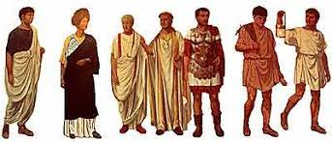
Roman citizenship
Only a man could become a full Roman citizen.
Women only had the same rights as children in Roman law, meaning that they could not vote or hold public office.
Being a Roman citizen gave you a good number of benefits. These included:
  Free access to public games
  Free or very cheap use of public baths
  Being able to vote
  Protection from being punished without a trial
  Poor citizens were given free corn
Roman citizens were born into a number of social classes. Different social classes had different rights and responsibilities to others.

Slide 36
Two tiers of citizens
Patricians
A small number of powerful families. After the fall of the Roman kings, the patrician families became the ruling class of the city. Lost influence over time as plebeians gained additional rights but remained very powerful into the Imperial period. Patrician families would have hoped to become senatorial families. Roman voting system arranged to allow patricians. Although many patrician families tended to have long histories, it became increasingly common for plebeians to be raised to patrician status as old families began to die out.
Plebeians
Everyone else who wasn’t a patrician. Gained power over time. Represented by the tribune of the plebeians, a powerful elected politician with the power to block other politicians’ commands. This office lost power over time, leading to the Roman emperors being given power to control the tribune. Plebeians included people from a huge range of economic backgrounds, from the very rich to the very poor. Extremely wealthy plebeians could become senators. Roman voting system organised to give the plebeians less voting power then the patricians.

Slide 37
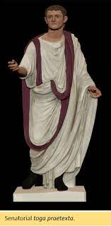
Senators
The highest Roman social class.
Senators sat in the Senate, an extremely influential political body which had the power to choose emperors.
To become a senator:
  Your father had to have been a senator OR the emperor had named you a member of the senatorial class
  Your property had to be worth one million sesterces (possibly about £2.7 million)
  From 17, you could be chosen to become a senator by a magistrate called a censor or the emperor.
  Would normally be expected to have been elected to public office at least once
A senatorial family could lose its rank if it lost its wealth, lacked a male heir or fell out of favour with the emperor. Therefore, the emperor had to raise new families to senatorial rank quite often.
Senators could not make money from trading (though this rule was sometimes ignored) and were not paid for being senators.
Senators could stand every year as magistrates (elected politicians).
A senator could become a consul (one of the two leaders of Rome elected once a year) or a praetor (whose job was to oversee Roman laws).
The emperor might select a senator to command a legion of the army, govern a province, supervise public services or hold an important priesthood.
Senators had their own reserved seating at games and wore a wide purple stripe on their toga.

Slide 38
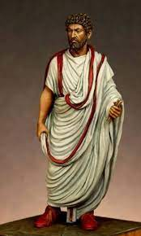
Equestrians
Originally men who could afford to own a horse- their name literally means ‘knights’.
By the 1st century AD, any man with property worth 400,000 sesterces (possibly about £1.1 million) could become an equestrian.
Often successful businessmen who could make money from trade.
Often chosen by the emperor for civil service i.e. managing finances.
Could be governors of small provinces- Pontius Pilate was an equestrian for instance (he was the governor of Judaea).
Each equestrian wore a narrow purple stripe on his toga and a gold ring.
Could be promoted to senatorial class if a position opened up and they had enough money.

Slide 39
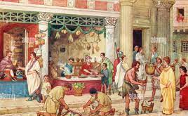
Everybody else!
The ordinary people of Rome.
Generally not wealth off and not educated.
Wealthy enough families could be promoted to equestrian or even patrician statues!
Were involved a huge array of jobs.
Many poorer men chose to serve in the Roman army.

Slide 40
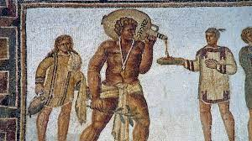
Slaves and masters:
Legally classified as property of their owner
Master had power over their slaves’ lives and deaths (although it eventually became illegal to kill a slave without a good reason)
To stop slaves running away, masters might brand them or put metal collars on them, with the name of their masters written on them
Slaves had no legal protections or rights
Masters could physically and sexually abuse their slaves

Slide 41
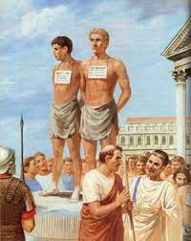
How someone became a slave:
Having a mother who was a slave
Punished for committing a crime by being forced into slavery
Being found exposed as a baby and brought up as a slave
Being sold into slavery at a slave market. Slaves were put on platforms with placards around their necks, stating characteristics such as age, place of origin, level of education and state of health. Big slave markets, like that at Delphi, could sell as many as 10,000 per day. People were sold a after:
  Being captured in war
  Being kidnapped and sold into slavery
  Volunteering to become a slave

Slide 42
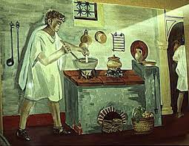
Types of slave:
Domestic
A slave who worked in a private home
Educated Greek slave might have been a tutor
Slave with cooking experience might be a chef
Women might help with cooking, weaving, shopping and childcare. They might help the free women get dressed.
Males worked for paterfamilias, perhaps doing his accounts, going to the baths with him or running errands.
Regarded as part of the family.

Slide 43
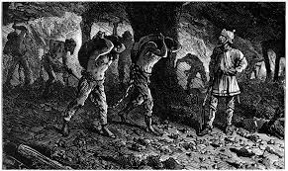
Types of slave:
Industrial
Stronger male slaves
Could have worked in mines, in factories, on large farms or as rowers amongst other industries
Terrible conditions
Life was expected to be short

Slide 44
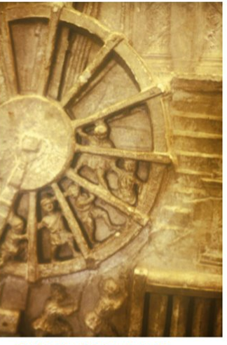
Types of slave:
Public
Owned by the state rather than an individual
Performed a number of roles, such as looking after temples, baths and other public buildings
Might also have worked on public construction or maintenance projects, such as road and aqueducts
  The picture to the right shows slaves running around a giant wheel to operate a crane. This show the building of the Colosseum.
Educated slaves could have worked as scribes for the state

Slide 45
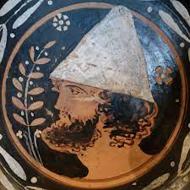
Freedmen
Slaves might be freed if they earned money and bought their own freedom.
A master might release their slaves, for instance if they became too old for work, as a reward for doing something great or, in some cases, to marry them (sometimes if the woman was pregnant with his child).
Freedmen allowed to wear a pileus (a pointed felt hat) to symbolise their freedom.
Freedmen were legally Roman citizens who were unable to run for public office or to become equestrians or senators.
Children of freedmen became full Roman citizens.
A freeman became his former master’s client and would have been expected to work for him for some of the year. Some might have worked full time for their former master.
Freedmen were expected to support their former in politics as shown in this inscription:

Slide 46
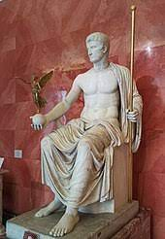
Augustales
The Augustales were a group which existed to preserve the emperor’s honour. Freedmen were allowed to become Augustales.
They were expected to arrange to have building repaired, statues erected and to pay for games. They were therefore probably wealthy.
They played a religious role, possibly in the cult of Augustus.
They were allowed to wear a bordered toga similar to a magistrate’s and very well respected.
By the 1st century AD, most Augustules were descended from slaves and freedmen.

Slide 47
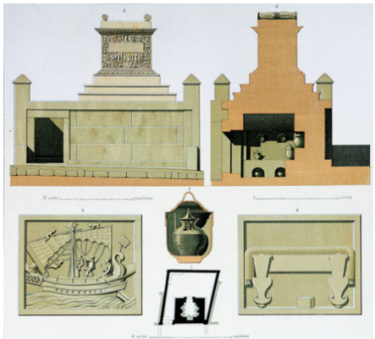
The Tomb of Naevoleia Tyche: Context
In 60s AD, the freedman Gaius Munatius Faustus built himself a tomb outside of Pompeii for himself and Naevoleia Tyche, his wife.
However, after inheriting her husband’s money, Naevoleia Tyche built a much grander tomb on the other side of the city to show off her and her husband’s wealth.
The tomb was made of marble
The tomb was shaped like an altar raised high off the ground.
The front of the tomb had an inscription and an image of Naevoleia Tyche on it.

Slide 48
The Tomb of Naevoleia Tyche
Inscription, picture of a ceremony and portrait of Naevoleia Tyche.
Urns containing the family’s ashes.
Sculpture of a ship showing that Munatius made his money through shipping.
Sculpture of a ceremonial seat and footstool, showing that Munatius was given his own seat (probably at games) for his services to the city.

Slide 49
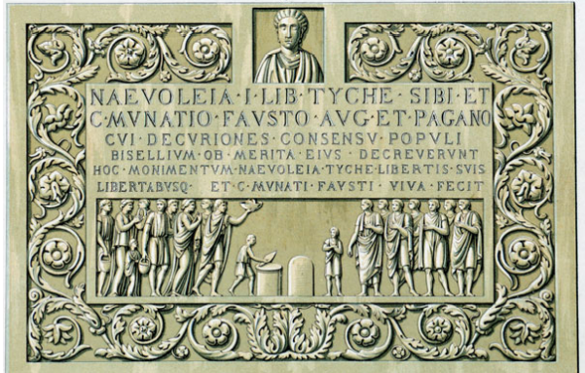
The Tomb of Naevoleia Tyche
Portrait of Naevoleia Tyche. This and the inscription emphasise that it was she, not Munatius, who had the tomb built.
The inscription tells us that:
Naevoleia Tyche was a freedwoman who built the tomb for herself and her husband
That Munatius was an Augustalis who was given a seat for his services to the city.
Naevoleia had the tomb built in her lifetime as a monument for her and her husband’s own freedmen and freedwomen. This shows that they must also have owned slaves.
Relief sculpture of a public ceremony. This may show Munatius giving out food and money to the people of Pompeii.

Slide 50
Paterfamilias (‘father of the family’)
Oldest living male in a Roman family and head of the family.
  Family included slaves and property of the household.
Legal power over the household. In early Roman times, had the power to order the deaths of family members. By the imperial period, he could only order the death of a new-born baby.
  The paterfamilias would inspect new-born babies and order them to be abandoned or exposed (left out to die) if they were unwanted or illegitimate.
Responsible for welfare of the household
Duty to raise children to be good citizens
Could appoint a slave to tutor children and support them in their education
Arranged for his daughters to be married once they reached puberty
Wife expected to be hard-working and loyal
Purchased slaves for the household
The religious head of the family, responsible for leading worship at the lararium, overseeing funerals and making offerings to the gods at important moments (i.e. marriages, births, funerals)
  Responsible for performing the Lemuria

Slide 51
Clients and patrons
A wealthy paterfamilias would be a patron with clients
Patron-client relationships extremely important to Roman society
Clients would attach themselves to wealthy patrons
Clients came to patrons’ houses at dawn every morning. They might accompany him to the baths or to the forum (marketplace).
Clients supported patron in politics, helping to promote him and vote for him in elections.
Clients might get a small amount of money, a gift or business opportunities when visiting their patron.
  Horace met other influential Roman writers by being Maecenas’ client for instance
Clients might receive invitations to dinner parties where they could have a fun time or meet other influential people.
Almost every man had a patron or a client.
Many were both patrons and clients at the same time.

Slide 52

Prescribed Source
Painted on a wall in Pompeii
A patron encourages others to vote for his patron in an election
Interestingly Thalamus identifies himself as a client who didn’t have much choice but to promote his patron. Thalamus clearly wasn’t worried about this making it seem as though he was only support Proculus because he had to.
  Perhaps this suggests that Proculus was actually a good choice for the office since he was popular enough to keep his clients loyal.

Slide 53
Roman Schools
In early Roman times, all children would have been taught by their parents
  Father taught sons about their trades, as well as some basic numeracy and literacy. Mothers taught their daughters about how to manage a household. Children would have also been taught about how to be good citizens.
Eventually, the Romans modelled their education system on the Greeks’.
Afterwards, Roman ‘schools’ became common, with children being educated by a professional teacher wherever he could find space.
  If the teacher could afford it, students would be taught in small rooms which he hired out.
  Teachers also taught in public spaces, especially palaestras in Roman baths.
Although it was quite cheap to pay a teacher, many Romans still could not afford to give their children a full education.
Many Romans would not have been taught to read, although they might have been able to read key words and phrases for their jobs (‘functional literacy’).

Slide 54
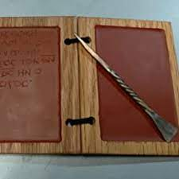
Litterator
Taught boys (and sometimes girls) aged about 7-12.
Taught reading, writing and basic arithmetic
Taught very repetitively
Pupils had to practise writing letters and copying out useful phrases
Pupils would have written on wax tablets with a stilus
Students would write a sentence on the tablet and show it to their teacher. The teacher would correct it and then tell the student to read it aloud to another pupil
Once a student was good enough at writing they were allowed to write on papyrus (paper made out of reeds)
Wealthy families would have a slave accompany a child to school and be his private tutor

Slide 55
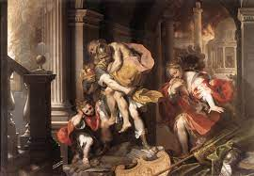
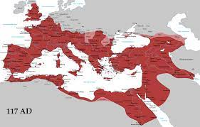
Litterator
Taught children (mostly boys) aged 12-16
Taught Greek and Roman literature
  Roman: Cicero (who wrote philosophy, letters and history), Virgil, Horace and Ovid (who all wrote poetry) would have been taught from 1st century BC. Virgil’s Aeneid was widely taught.
  Greek: Homer (poet), Plato (philosopher), Herodotus (historiographer) and Demosthenes (speech writer) amongst others
Taught to recite passages off by heart and to comment on grammar, figures of speech and a writer’s use of mythology amongst other things
Pupils learned Greek, since most the eastern-half of the Roman empire was Greek-speaking
  If students wanted to work abroad in the empire (i.e. as a governor of a province), they needed to know Greek
Pupils may also have learned about music, astronomy, philosophy and natural science (but these were seen as less important than literature)

Slide 56
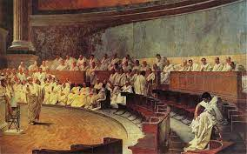
Rhetor
Taught (very privileged) students aged 16
Taught how to write and speak persuasively
  A very important skill if you wanted to be a public figure like a politician or a lawyer
  Pupils taught how to use facial expressions and gestures to persuade an audience
Exercises included debating about an event from history or literature and arguing a legal case from both the prosecution’s and the defence’s sides

Slide 57
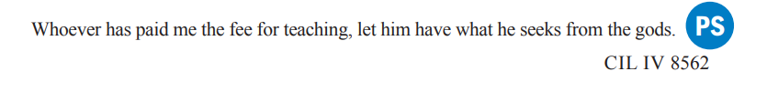
Prescribed source
Teacher is thankful for being paid
Tells us that payments could either be late or never happen.
Found at a palaestra, telling us that schooling happened in palaestras.

Slide 58
Horace’s life
Son of a freedman who became rich by lending people money to buy things from auctions.
His father paid for an education in Rome for his son. After his father died, Horace studied in Athens where he met many young Romans from important families.
In Athens, Horace was recruited to fight for Brutus and Cassius after they had assassinated Caesar. He was given a very high position in their army (which seems to have made some men from important families very jealous, since Horace was the son of a freedman).
After the Battle of Philippi (42 BC), the supporters of Brutus and Cassius were forgiven and allowed to return to Rome. However, Octavian, Antony and Lepidus (who Brutus and Cassius- and therefore Horace- had fought against) took farmland off many farmers living in Italy to give to their soldiers. Horace was one of these people.
In 38 BC he met Maecenas - a close adviser to Octavian and responsible for promoting his regime. Maecenas gave Horace a large villa with farmland. Horace used this villa to write his second book of satires from.

Slide 59
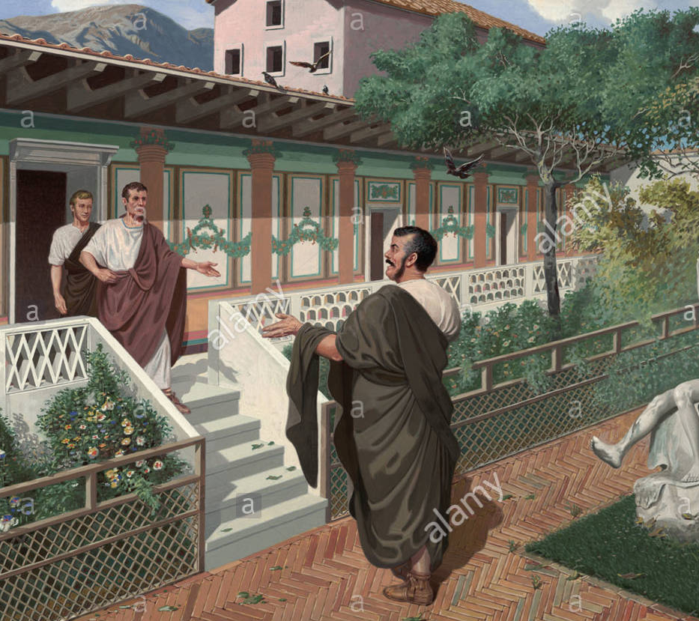
Horace’s writings
Horace does not use the angry tone of Lucilius. He could not afford to criticise the political elite so harshly because of his close ties through his patron, Maecenas.
He is light-hearted and makes fun of himself too. He would often make a point to stress about how he was born in the countryside. He is referred to as the 'smiling satirist'
He addresses the reader directly in a chatty tone. He referred to his own works as 'sermones' - conversations.
He was writing for publication, and his poems would be read by the educated elite on papyrus scrolls. He wanted to gently encourage them to be better people.

Slide 60
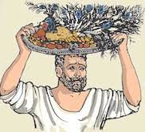
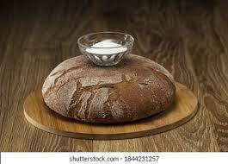
Satire 2.2- Key theme: Simple living
In this poem, Horace stresses the need to live a simple life of moderation. He says that his readers should reject the idea of eating ridiculously fancy and trendy food often, and also rejects the idea that you should only ever eat disgusting foods to make a point about how you are stopping yourself from taking pleasure in food.

Slide 61
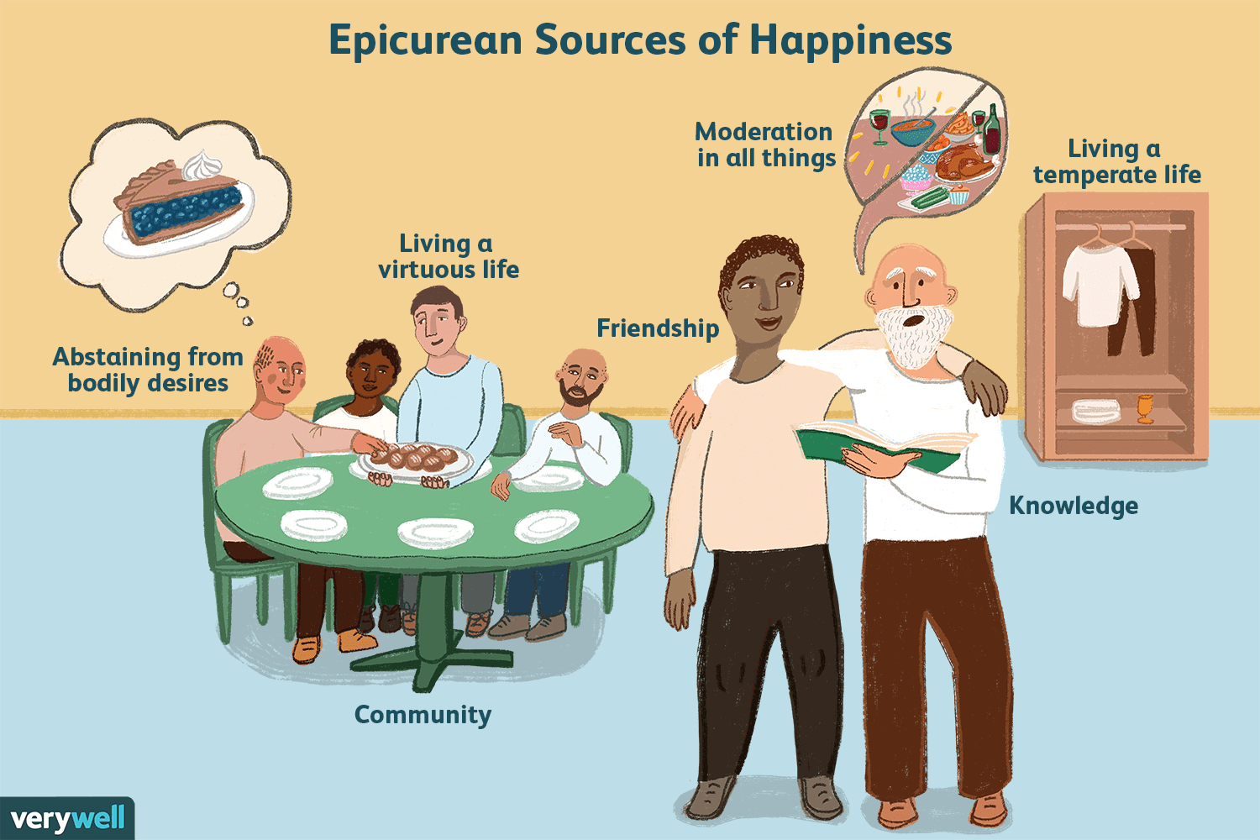
Satire 2.2- Key theme: Epicureanism
Epicureanism is a philosophy which views a life without pain as the perfect life. Epicureans will try to live as simply as possible, believing that simple lives avoid pain and worry. The goal of epicureanism is to remove pain from your life by avoiding extreme behaviours. Epicureans also believe that good friendships are a source of great happiness, and so will make sure to spend plenty of time with friends.

Slide 62
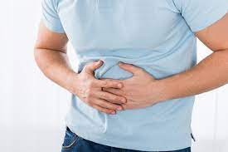
Satire 2.2- Key theme: Food
Horace saw extreme behaviours at Roman banquets, at which hosts tried to outdo one another to serve fancy and fashionable dishes. Horace notes that these sorts of foods do not actually make you happy. He notes that expensive, unusual and fancy foods like those found at Roman dinner parties would sometimes make their eater feel ill, and that even with less unusual food it was common for guests to eat more than their fill, leaving them feeling ill afterwards. Once they felt ill, people would just end up eating bitter, medicinal food to make themselves feel better!

Slide 63
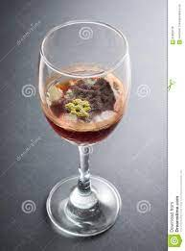
Satire 2.2- Key theme: A good host
Horace suggests that a good host should put out nice (and sometimes fancy) food for their guests and should make them feel welcome. He says you should definitely not deliberately serve disgusting food and drink to your guests just to show off how simple you are!

Slide 64

Satire 2.2- Key theme: The country and the city
Horace talks about how he learned about living simply from a man called Ofellus. Ofellus is a farmer who works on a small amount of land (now renting it, but he was once the owner of it). He is described as an ‘“idiot” savant’- a genius who, because he is from the countryside, is looked down upon by the educated elite (i.e. Horace’s readers). However, Horace tells his readers to listen to the like of Ofellus who, in spite of his simple life and recent bad luck, is happy with his life. Through this poem, we are given some idea about how the city folk of Rome might have looked down on those from the countryside. We should remember also that Horace was originally from the countryside- he therefore appears to be saying that his readers should not write him off either for being from the countryside like Ofellus! Horace seems to want us to realise that living in the countryside naturally means living a simpler and, therefore, happier life.

Slide 65
Satire 2.2: Characters
Horace- Horace is the narrator of the poem and is framed speaking to somebody who he does not name. He appears to be talking before a banquet.
Horace’s listener- There is at least one person who Horace is talking to. We do not here them speak other than when Horace says what he guesses they are thinking.
Ofellus- The small-time farmer who Horace learned about simple living off. Ofellus could be a stand-in for Horace’s father, who did own a farm, or Horace himself, who inherited his father’s farm until he had it confiscated by Octavian, Antony and Lepidus (just as Ofellus lost his land to someone else). It is likely that Ofellus was intended to represent a mixture of both. His name means ‘small mouthful’, highlighting the fact that Ofellus only eats what he needs to.
Avidienus- Horace takes time to tell us about Avidienus, a mean man who only eats five-year old olives and cornels (tiny berries) from the woods and brings sour wine and olive oil which stinks with him to weddings and birthdays. His behaviour is extreme and ridiculous, intended to parody people who deliberately serve food and drink of poor quality to make a point about the fact they are living simply. In reality, Horace suggests, these people aren’t living simply- they are just living a different sort of extreme life.

Slide 66
Satire 2.2: Introduction (lines 1-9)
The poem’s theme is introduced: how good and happy a simple life can be.
We hear about how Ofellus, the ‘‘idiot’ savant’ (i.e. the genius who the Roman elite will refuse to listen to because of where he is from) taught Horace about simple life. Horace is here telling his audience not to ignore his words of advice just because he is from the countryside! He might also be saying that his father, a freedman who lived in the countryside, taught him about simple living (although remember that his father was rich enough to afford to send Horace to school in Rome).
Horace reveals that he is talking to someone at a banquet and wants to talk about simple living before the person he is talking to is distracted by fancy-looking food and ignores his advice.

Slide 67
Satire 2.2: When food tastes best (lines 9-22)
Horace tells us that there is no way that anybody would actually care about eating only fancy food if they were actually hungry.
Horace encourages his readers to exercise before eating, as their hunger afterwards will show them that simple food, like bread and salt, is enough to make them happy. He says that nobody would only demand fancy and trendy food if they were actually hungry.
Horace adds that it is down to the eater to make their food taste good since, if they are hungry after exercising, then even bread and salt will taste delicious.
It is pointed out that, if you have overeaten to the point that you are ‘bloated’ (i.e. filled up with air to the point your belly has swollen, possibly painfully due to the wind being trapped) then you aren’t going to be able to enjoy your food, no matter how expensive or trendy it is.

Slide 68
Satire 2.2: Why expensive food is pointless (lines 23-37)
Horace uses peacock as an example of a food served at banquets for its appearance rather than its taste or whether it will fill you up. Hosts will show the peacock off with its many-coloured tail feathers still in place, but Horace sees no point in this since you can’t eat them! Also, the feathers look nicer on a living peacock anyway!
He moves on to point out that there is no way for a guest to check whether his food comes from the place his host claims. Certain food was regarded as fancier and trendier (and therefore more expensive to buy) if it came from certain places (this idea still exists today), but Horace reminds us that a host could just lie about this, since the food’s taste doesn’t change because of where it has come from.

Slide 69
Satire 2.2: The pointlessness of large portions (lines 38-46)
Horace then points out that people like to eat unusually large portions, such as fish which are bigger than other members of their species. However, Horace asks why you wouldn’t just eat a bigger species of fish if you wanted a larger meal. He also points out that a meal which you have to eat in portions because of its size is pointless.
Horace rounds out this section by stating that expensive foods often make the person eating them feel ill (probably with indigestion). The cure for feeling ill is then to eat bitter leaves and radishes, which people would normally not want to eat. So people who eat this sort of food just end up having to eat stuff which they wouldn’t want to! Horace is asking why you wouldn’t just eat nice food which doesn’t make you ill, like the ‘poor man’s’ olives and eggs which are usually served at banquets alongside the fancier dishes.

Slide 70
Satire 2.2: People would eat anything if it was trendy (lines 47-52)
Horace tells us that, once upon a time, there was a time when nobody bothered eating the foods which are trendy in his day. But now, fashionable people have come along and made people think that they should be eating food which wasn’t that popular all too long ago!
It is stated that the youth of Rome would even eat seagulls if they were told it was fashionable to do so! Horace is reminding us that fancy food are rarely popular because of their taste, but because they are fashionable (and will soon go out of fashion too).

Slide 71
Satire 2.2: The ideal man(lines 53-70)
We are told that Ofellus said that there was a difference between a simple and a mean life.
Horace uses Avidienus as an example of a mean person, somebody who only eats 5 year old grapes, drinks sour wine and brings stinking olive oil with him to weddings and birthdays along with sour vinegar. But we are told the Avidienus wears a clean toga- he is not poor, but is choosing to live in this way. Ofellus (and therefore Horace) sees this as no better than eating fancy food like peacock.
Horace then states that a good man should be fair to his slaves and treat his guests well. He should not be so mean as to serve the horrible things which Avidienus serves to his guests!

Slide 72
Satire 2.2: The health benefits of living simply (lines 71-87)
Those who live simply, Horace says, are healthy. This is because complex food makes a person feel ill and, when you have eaten too much, you feel tired the next day. On the other hand, if you live simply, you will wake the next day with loads of energy.
Horace reminds us that living simply does not mean avoiding fancy and trendy food altogether, but that there is a time and place for these things. He encourages his readers to only eat this way during festivals and when they are old, since then it will feel like a treat and therefore make you happy, even when you are feeling miserable as a result of being elderly.

Slide 73
Satire 2.2: The dangers of living extravagantly(lines 88-110)
Once, Horace said, people would wait before starting their food until all of their guests were present, even if the food didn’t end up tasting as good. Nowadays, he says, people aren’t concerned about making their guests feel welcome, but their reputation.
There is a danger to this though, as, if you seem like a show-off, people will dislike you. And you are risking financial ruin by spending your money in this way! Horace imagines somebody who is driven to suicide, having spent all his money on fancy dinner parties and driven away his family and friends due to showing off too much. However, the man cannot even afford to buy a rope to hang himself with!
Horace argues, there are better things to spend you money on, such as temples and people in need.
In addition, we are reminded that people’s fate can change, and that it is therefore better to get used to living simply now rather than spend your money recklessly and then be miserable when you run out.

Slide 74
Satire 2.2: Ofellus’ story (lines 111-135)
We finally hear more about Ofellus, who we learn that Horace knew when he was growing up.
Ofellus once owned his own farm, but has now had it taken off him. However, he was prepared for this day when it came, as he chose to live a simple life even when he didn’t have to. This meant that he was not miserable.
Ofellus was a good host, but not because he served loads of fancy food. Instead, he served simple but tasty food and entertained his guests well. Ofellus and his guests would also always remember to keep the gods in mind and pray to Ceres for a good harvest after dining. He believed that Ceres was helping him to not feel worried. He paints a very epicurean picture of friends having a great time and living stress-free.
Ofellus ends the poem by reminding Horace’s readers that fate is ever-changing and that nothing stays the same forever. Therefore, when you are living comfortably and doing well, use that to prepare for a day when you might not be doing so well.

Slide 75
Satire 2.6- Key theme: Simple living
Horace paints a picture of the city of Rome as a very stressful place to work in. A simple life can be found in the countryside which cannot be found in Rome! This poem also includes the story of the town mouse and the country mouse. The town mouse loves fancy things and is very rude to the country mouse, refusing to eat his simple food. However, when the town mouse take the country mouse to a house in the city, they are not able to enjoy the trendy food and expensive furniture for long before they are chased away by dogs. Simple living is presented as stress-free, and simple people like the country mouse are actually able to enjoy the things which they have!

Slide 76
Satire 2.6- Key theme: Epicureanism
This poem focuses a lot on the joys of simple living and the importance of friendship. Horace describes his ideal dinner party, one in which everybody (even his slave!) eat and drink the same food and wine and in which people entertain one another by discussing philosophy, rather than by boasting about their possessions. In addition, with the story of the country mouse and the town mouse, Horace wants to remind us that the sort of life which involves eating fancy food and expensive possessions is also very stressful. Horace himself experiences this stress when he goes to Rome! Epicureans believed that they could reach happiness by removing worry from their lives.

Slide 77

Satire 2.6- Key theme: Food
Horace describes his ideal banquet as one in which people eat simple food like beans and cabbages, and all eat and drink the same things as one another. This is important, as Horace does not believe that food and drink should be used to show others’ status. In 2.2, Horace had already argued that food which didn’t fill you up was pointless- food, in Horace’s opinion, should serve one purpose: to stop you from feeling hungry. It should therefore not be used to show that you think you are superior to others.

Slide 78

Satire 2.6- Key theme: A good host
Horace shows himself to be a good host who serves his guests all the same food and wine, and even lets his slaves join in! He entertains his guests by chatting to them about philosophy, something which everybody can engage in, whereas Horace implies that other hosts would prefer to talk their large villas, a topic which not everybody at the dinner party will be able to join in with.

Slide 79

Satire 2.6- Key theme: The country and the city
Horace contrasts the stressfulness of the city with the calmness of the countryside. He says that being a patron of Maecenas is especially stressful, since this has made him famous and somebody who people constantly ask favours of or try to get inside information about the empire from. Indeed, Maecenas never talks about anything all that important with him, but because people think that Horace gets talked to about important matters, they refuse to listen to him when he tells them that this isn’t the case. He therefore highlights how appearance matters hugely to people in Rome. Just as people want to see feathers on a cooked peacock, even though they can’t eat these, so the fact that Horace is seen out and about with Maecenas has made people think that he must be in the know! The contrast between the city and countryside is also explored with the story of the simple country mouse, who enjoys his simple life in peace, and the town mouse, whose fancy dinner parties are easily interrupted.

Slide 80
Satire 2.6: Characters
Horace- Horace is again the narrator of the poem, although this time it takes the form of a prayer to Mercury rather than a conversation.
The people of Rome- The people who Horace meets in Rome are often very rude and nosey, ordering him around and trying to get information about Maecenas from him.
Maecenas- Maecenas appears briefly, and Horace shows him talking about unimportant things to Horace. This contrasts with how the people of Rome believe that Horace is told important secrets by Maecenas.
Cervius- Horace’s neighbour who entertains Horace’s dinner guests with the story of the country mouse and the town mouse.
The country mouse- The country mouse lives simply and gives his guests a warm welcome. However, he lets the town mouse show him what living in the city is life. Although he at first enjoys the banquet that the town mouse puts on for him, after being chased away by a dog he realises that his life in the country might be simple, but it is can be enjoyed without being interrupted by danger.
The town mouse- The town mouse is very rude, refusing to eat the country mouse’s food. He is also shown to be a fool when, after inviting the country mouse for a meal in the city, the fun is cut short when a dog chases the mice away.

Slide 81
Satire 2.6: Horace’s love for the countryside(lines 1-15)
The poem begins with Horace saying that he once prayed to live in a house with garden, a little farmland and a nearby spring. However, the gods have given him so much more now that he is living in his Sabine villa (given to him by Maecenas in 38 BC).
Horace then prays to Mercury, as a god of wealth, that what he has now should be protected, so long as he doesn’t attempt to gain more through harming others, doesn’t want to change the look of the land when he doesn’t need to and doesn’t wish to find more money. In regards to this last point, Horace talks about a farmer who supposedly once found silver and bought the land which he used to rent, a reverse of what we heard happened to Ofellus in 2.2.
Horace finally prays that Mercury protect his current possessions and improve them, rather than help Horace get new ones. In addition, Horace prays that Mercury helps to keep him from becoming arrogant.

Slide 82
Satire 2.6: The proem(lines 16-23)
The next part of the poem parodies a ‘proem’, an introduction at the beginning of a piece of epic poetry. Remember that Horace wrote his poems in hexameters, the meter of epic poetry, so he definitely wanted his readers to draw this comparison. By doing this, Horace compares his struggles in Rome with those of heroes who fight in wars, go on adventures and struggle to return home afterwards. This is both Horace emphasising how tiresome life in Rome is whilst also poking fun at himself: he knows that he doesn’t really have it all that bad, since the only reason he goes to the city is because he is wealthy and the client of one of the most important men in Rome! He is using hyperbole to remind us that, though he might complain, he is grateful for the life which others, such as his father and Maecenas, have helped him to build.
Horace calls his villa his ‘castle in the hills’, a hyperbolic metaphor which reminds us how Horace’s country home is far more than he could ever have dreamed of! Moreover, when he is there, the villa protects him from the outside world of Roman city life.
Horace asks Janus to inspire him. Janus is the god of beginnings, endings and change. Here he represents how Horace’s experience of life changes for the worse when he has to travel to Rome.

Slide 83
Satire 2.6: Horace’s busy life in Rome (lines 23-39)
Horace talks about how he is ‘dragged’ out into the street of Rome to do work for others, even in the dead of winter when it is snowing!
Horace talks about having to ‘barge’ through crowds of people on his way to work. We can assume that he is walking. The wealthiest in Rome would not walk, but would be carried in litters by slaves or take carriages. This is Horace reminding us of his social status, stating that he isn’t quite at the top of the hierarchy. This is a subtle nudge to his readership that he isn’t threatening their position.
Horace talks about how his barging actually hurts some people!
A man is very rude to Horace, calling him an ‘idiot’ as Horace pushes past him. However, the man also says that he recognises him. He doesn’t use Horace’s name, but say that he knows that Horace is going to see Maecenas. Horace admits that he likes being recognised, though he isn’t clear whether he just likes being recognised end of, or if he likes being recognised as a client of Maecenas’.
Horace approaches the Esquiline Hill, which is near to where Maecenas lived. Horace does not mention this fact, since he expects his audience to know where Maecenas lived.
Horace’s good mood at being recognised in the street disappears when he has people bother him with telling him to do things for them. When Horace says that he will ‘try’ to help one of these people, he is told ‘if you want to, you can’. Here we are introduced to the idea that people think that Horace is a lot closer to Maecenas than he actually is, but it also hammers home quite how little Horace gets to do for himself when in Rome.

Slide 84
Satire 2.6: Horace and Maecenas (lines 40-58)
Horace notes that he has been Maecenas’ patron for nearly 8 years at this point. However, although Maecenas allows Horace to ride in his carriage with him, he never discusses anything of any importance with him.
Whilst they are riding, Maecenas will ask Horace for the time, tell him that cold weather is dangerous or else chat to him about gladiators. Horace is not learning anything about the running of the empire from Maecenas.
Horace is aware that people are envious when they see him with Maecenas, especially when he is seen at the Games (presumably on very good seats!) Remember that in 2.2 Horace told us about how being envied can drive a man to lose all of his friends.
Nevertheless, people think that Horace must know all about the inner-workings of the empire and what Augustus is up to. Of course, he doesn’t, since Maecenas doesn’t really tell him anything. But people don’t believe him, since they have started to see him as being closer to being a god than a person (remember that a key part of Augustan propaganda was to connect Augustus with the gods).

Slide 85
Satire 2.6: Horace and Maecenas (lines 40-58)
Horace notes that he has been Maecenas’ patron for nearly 8 years at this point. However, although Maecenas allows Horace to ride in his carriage with him, he never discusses anything of any importance with him.
Whilst they are riding, Maecenas will ask Horace for the time, tell him that cold weather is dangerous or else chat to him about gladiators. Horace is not learning anything about the running of the empire from Maecenas.
Horace is aware that people are envious when they see him with Maecenas, especially when he is seen at the Games (presumably on very good seats!) Remember that in 2.2 Horace told us about how being envied can drive a man to lose all of his friends.
Nevertheless, people think that Horace must know all about the inner-workings of the empire and what Augustus is up to. Of course, he doesn’t, since Maecenas doesn’t really tell him anything. But people don’t believe him, since they have started to see him as being closer to being a god than a person (remember that a key part of Augustan propaganda was to connect Augustus with the gods). Horace doesn’t want to be seen as a god, he just wants to go back to his nice and quiet country villa!

Slide 86
Satire 2.6: Horace and Maecenas (lines 40-58)
Horace notes that he has been Maecenas’ patron for nearly 8 years at this point. However, although Maecenas allows Horace to ride in his carriage with him, he never discusses anything of any importance with him.
Whilst they are riding, Maecenas will ask Horace for the time, tell him that cold weather is dangerous or else chat to him about gladiators. Horace is not learning anything about the running of the empire from Maecenas.
Horace is aware that people are envious when they see him with Maecenas, especially when he is seen at the Games (presumably on very good seats!) Remember that in 2.2 Horace told us about how being envied can drive a man to lose all of his friends.
Nevertheless, people think that Horace must know all about the inner-workings of the empire and what Augustus is up to. Of course, he doesn’t, since Maecenas doesn’t really tell him anything. But people don’t believe him, since they have started to see him as being closer to being a god than a person (remember that a key part of Augustan propaganda was to connect Augustus with the gods). Horace doesn’t want to be seen as a god, he just wants to go back to his nice and quiet country villa!

Slide 87
Satire 2.6: Horace and Maecenas (lines 59-76)
Horace prays to return to his farm, where he can eat simply and host dinner parties at which simple food is served, everybody eats and drinks the same things. At Horace’s parties, he says, even the slaves have the same things as their master, although they do only get the leftovers.
Horace says that he is joined at dinner by the Lar (protector god) of his household.
The idea of the gods eating with humans and there being equality between all people is probably meant to remind us of the Golden Age, during which nobody had to work, all people were free and equal, everybody ate simple food and the gods often spent time with humans. Remember that this was an important reason for the popularity of the Saturnalia, the festival at which nobody worked, a statue of Saturn joined public feasting and at which slaves were supposed to enjoy a bit more freedom and apparently ate the same food as their masters. Horace therefore imagines his villa as a place where he can go to get some experience of the Golden Age.
The guests at the dinner party are entertained by debates about philosophy and a story about two mice told by Horace’s neighbour Cervius. Horace contrasts this with the gossiping and boasting which normally happens at dinner parties. Note that he mentions people complaining about the dancing of a man called Lepos. Lepos was a mime who was a favourite of Augustus’. Horace is criticising the practise of having a mime come in and perform part of a play as a form of entertainment- conversation with your friends is much better (and closer to what Epicureans think will lead to happiness)!

Slide 88
Satire 2.6: The town mouse visits the country mouse (lines 80-98)
A town mouse visits his old friend, a mouse who lives in the countryside. The country mouse lives simply and offers the town mouse a simple but varied spread of food. The town mouse refuses to eat it and instead says that the country mouse would enjoy city life, since in the city he will be surrounded by happiness. Life is short, says the town mouse, so why not spend it happily?
The country mouse is persuaded to go with the town mouse to the city.
The town mouse is very rude to the country mouse, refusing to eat the food which he is offered because he thinks he is too good for it. The variety of food which the country mouse has to offer is meant to highlight a key point in Horace’s philosophy: a simple life does not have to be a boring one, and certainly not one in which you stop yourself from having a good time!
What the town mouse says about the short lives of mortals is ironic. First of all because he is a mouse, and therefore has a much short life than humans. This pokes fun at humans’ short life span being used as an excuse to live an extravagant life- when a mouse, which has a much shorter life than a human, says it, it is still not a good argument. Secondly, as we shall see, the town mouse’s life is a lot more dangerous than the country mouse’s, meaning that he risks shortening his life by living in the city which he praises.

Slide 89
Satire 2.6: The country mouse learns his lesson (line 98-115)
The mice slip into the city when the ‘night occupied the zenith’ (i.e. at midnight). This is language more suitable for epic poetry, which was also written in hexameter. Horace is highlighting how ridiculous the scene ahead is going to be, with the mice acting like humans at dinner, by giving us the impression that the mice think of themselves as heroes like those found in epic. This is a parody of epic, just as the mice parody the behaviour of the Roman elite.
The mice go into a domus and enter the triclinium. They see couches made of ivory with red sheets and the leftovers from a dinner party left in baskets. Clearly, this is a very wealthy person’s home!
The country mouse relaxes whilst the town mouse brings food to him, making sure to taste everything before he gives to the country mouse, as a slave tasting for poison would.
The dinner party is interrupted by a dog barking. The two mice run out of the house and the country mouse says that he has learned the lesson that the city life isn’t for him, since he’d rather the safer country life.
This scene pokes fun at wealthy people’s banquets by having mice play the role of the dinner guests. Horace is pointing out that, whilst the ivory couches, red sheets and fine food are all impressive, the fact that they are as impressive to mice as humans means that they are actually not all that impressive at all.
In addition, Horace highlights the dangers of city life. Whilst he might just be wanting to taste everything which the country mouse is eating, the town mouse looks like a poison-taster to Horace. This is a reminder that it was not unknown for the wealthy and powerful to have enemies who wanted them dead. Remember that earlier Horace commented that people were getting envious of him in Rome, and this reference to poison-tasting maybe tells us that he is worried about making enemies. In addition, the meal is interrupted when a dog starts to bark. It might be a nice meal, but the country mouse would much rather be able to enjoy a simple meal in full without being interrupted by danger, rather than a fancy meal which danger might interrupt. The country mouse, like Horace, wants a relaxing life free from danger.

Slide 90
Satire 2.8- Key theme: Simple living
This satire has the Roman comedian Fundanius telling the story of a disastrous banquet which he was at the night before. His host, Nasidienus, put on a ridiculously over-the-top meal with loads of fancy food which nobody was really able to enjoy properly because of the events which occurred at the party. In fact, the people there ended up enjoying Nasidienus’ misfortune far more than they did the food! We need to contrast this with the peaceful dinner party which Horace imagines in 2.6 to see that he is praising simple living and criticising extravagance in this poem.

Slide 91
Satire 2.8- Key theme: Epicureanism
Nasidienus’ dinner party starts to go wrong when two men start to drink for the purposes of both getting drunk and to get to experience drinking a lot of expensive wine. These are not Nasidienus’ friends and he even tries to stop them from drinking at one point so that they will be able to taste their food better. This should be contrasted with Horace’s presentation of his dinner party in 2.6, in which he allows his guests to drink how they want and everyone respects one another. The poem ends with the guests leaving the dinner, having got bored of Nasidienus and had plenty of fun laughing at him. An important idea in Epicurean philosophy is that you should try hard to keep your friends happy and that having a strong community of people around you is one of the routes to happiness. Nasidienus is so boring, annoying and such a show-off that he hasn’t got any real friends left! His only real friend at the dinner party seems to be Nomentanus, who we get the impression is only Nasidienus’ friend because of the fact that he enjoys the banquets he throws. He does not like Nasidienus for who Nasidienus is, but what he does for other people. This isn’t what the Epicureans would have seen as a good friendship and therefore not the path of a happy life!

Slide 92

Satire 2.8- Key theme: Food
The food at Nasidienus’ dinner party is extremely fancy and Nasidienus takes great pleasure in explaining what each dish and where it has come from. He especially likes to talk about how the time at which the food was prepared changes its taste, something which Horace obviously thinks is ridiculous. He also likes to boast about how he is serving his guests unusual or new recipes which he claims to have thought up himself! Both of these details link 2.8 back to 2.2 and Horace’s warning that mixing flavours together risk making a person feel ill and also his point that hosts can easily lie about where their food comes from to make it seem fancier. Moreover, Nasidienus’ guests find his long descriptions of the food to be really annoying.

Slide 93
Satire 2.8- Key theme: A good host
Nasidienus is an awful host who bores his guests with descriptions of food, boasts about how unique his cooking is and has a friend on hand to interrupt other diners and tell them what they should be eating. He later tries to stop his guests drinking as much wine, something which Horace in 2.6 is clearly against. In addition, his idea of entertainment is to have his slaves dramatically bring in food as though it was an offering to the gods! We have already seen in 2.6 that Horace probably didn’t like mime happening at dinner parties. He definitely wouldn’t like this sort of show!

Slide 94
Satire 2.8- Key theme: The country and the city
Whilst this theme is not a particularly important one in this poem, we should compare this dinner party to the one which Horace described in 2.6. A country dinner party is there made to seem relaxed, enjoyable and something which strengthens friendships, with even the slaves allowed to take part in it. Nasidienus’ dinner party is almost the exact opposite, a chaotic mess which involves people’s conversations being interrupted by the host and Nomentanus’ descriptions of the food and boring table talk. Remember that the country mouse preferred country life because it was calmer with fewer dangers and interruptions. This dinner party is fully of interruptions and the guests fear danger when the wall hanging falls down onto the food. The slaves are made to dress up as though a part of a show. Horace is wanting to make us think that this sort of thing simply wouldn’t happen in the countryside!

Slide 95
Satire 2.8- Key theme: Pretence (acting as if something is greater than it is) and deceit (tricking people into believe something which isn’t true)
Nasidienus’ banquet is full of pretence. The slaves clean up with coloured cloths, which is meant to show that Nasidienus is so wealthy that even his cleaning cloths are expensive! The slaves bring food in as though they are about to perform an offering to the gods, and they are all made to look very smart. Nasidienus tells his guests all about where the food has come from, talks about how he has discovered new recipes, how he knows about the correct time to catch animals or pick fruit and boasts about the different sorts of wines he can offer his guests. But this might not be all that it seems. Fundanius does not believe that picking apples at different times changes their tastes, Nasidienus probably cooked none of the food himself, at one points seems to tell his slaves to pretend to not hear his guests ordering wine and, importantly, might be lying about knowing where all his food has come from. After all, in 2.2 Horace pointed out that there is really no way of checking whether your host is telling the truth about where your food came from! We are left to wonder what else Nasidienus might be hiding. We are perhaps meant to think about Nasidienus as similar to the man Horace describes in 2.2 who spends so much money on expensive dinner parties which annoy his friends and relatives that he ends up without not even enough money to buy a rope to hang himself with! Is Nasidienus really as wealthy as he wants us to think with his coloured cloths, well-presented slaves and expensive wines? We are never told, but we are left to wonder.

Slide 96
Satire 2.8: Characters
Horace- Horace is not the main narrator of the poem, but is present in the poem to chat to Fundanius about Nasidienus’ dinner party.
Fundanius- A comic playwright and the narrator of the story.
Nasidienus- The host of the dinner party. A man who cares far too much about showing off his wealth. He is annoying, constantly talking to his guests about how great his food is, claiming to have made up the recipes (a trained slave chef probably did)
Nomentanius- Nasidienus’ annoying friend who interrupts people’s conversations to tell them about how great the food at the banquet is.
The country mouse- The country mouse lives simply and gives his guests a warm welcome. However, he lets the town mouse show him what living in the city is life. Although he at first enjoys the banquet that the town mouse puts on for him, after being chased away by a dog he realises that his life in the country might be simple, but it is can be enjoyed without being interrupted by danger.
The town mouse- The town mouse is very rude, refusing to eat the country mouse’s food. He is also shown to be a fool when, after inviting the country mouse for a meal in the city, the fun is cut short when a dog chases the mice away.

