Slide 1
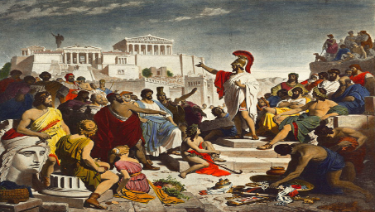
Knowledge organiser: Democracy and political parties
They help ensure politicians work together for the good of the country and can also set standards members have to follow.
They also encourage the public to participate in canvasing and members can choose party leaders
Classical democracy (what we sometimes call direct democracy)
Direct voting on issues by citizens and regular meetings and discussions. All citizens can directly vote on issues and take part in meetings and discussions.
Why are Political parties
Important for democracy?
An organised group of people, People with similar political aims and opinions
Political parties
Parties who are against the UK:
SNP ( Scottish national)
Plaid Cymru (Welsh nationalists)
Sinn Fein ( Northern Ireland)
Representative democracy
A type of democracy in which elected officials represent a group of people. Citizens vote for representatives, who make decisions on their behalf.
People with similar political aims and opinions, People who campaign together to get candidates the most votes at elections.
Labour polices typically involve:
Raising taxes on the wealthy so that government spending. Labour also favour nationalising companies such as energy and transport.
Conservative polices involve: Reducing spending on welfare benefits and public services so that taxes can be cut. Letting private companies run public services.
Key terms:
Democracy
Representative
Classic/direct
Pluralism
Free
Fair
Regular
Secret ballot
Right wing
Left wing
Centre
Labour voters are typically:
Young
Trade Union members
People living in cities,
People working in public service
Conservative voters are typically:
Old
Landowners and business owners
People living in the countryside
People living in the south
Rural areas in the North
Type of democracy | Advantages | Disadvantages
Classical (Direct) Democracy | Gives power to ordinary people Government is more transparent People will more likely follow laws they have had a say in | - People may become apathetic by being asked to continually vote. - People may vote not knowing the full consequences of decisions.
Representative Democracy | - Means citizens do not need to spend a lot of time voting. - Entrusts key law-making to experienced representatives - Having a select number of representatives means they can voice the concerns of the public. | - Representatives can become corrupt due to the power they hold. - Representatives are sometimes more loyal to their party rather than who they represent
Greens
Liberal Democrats
Reform UK
Labour
Centre
Are liberal on social issues but believe in limited government intervention. Believe people should be given what they need to support themselves
Conservatives
Right wing - more traditional and conservative on social issues. Believe in less government intervention and people supporting themselves.
Left wing - More liberal on social issues, believe in governmental help for those who are poor or less able.

Slide 2
Knowledge organiser: Democracy ( voting systems)

