Slide 1
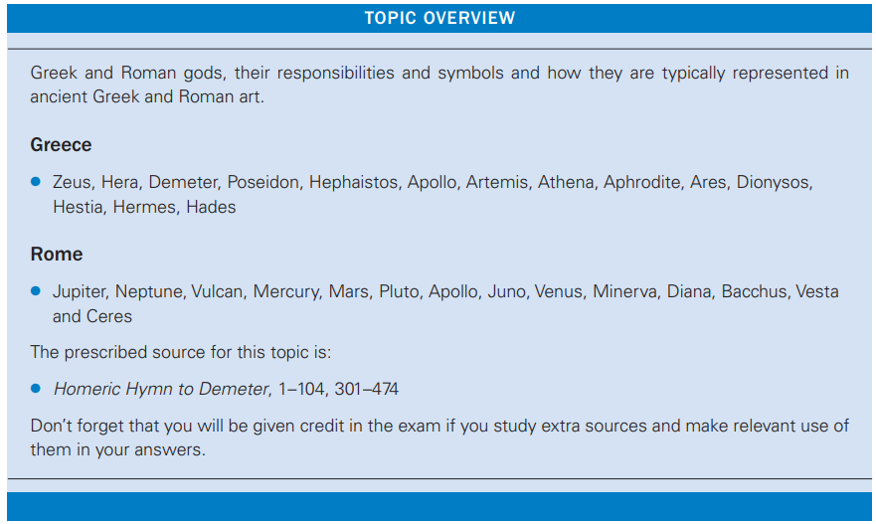
Topic 1.1: The Gods

Slide 2
Key vocabulary
Pantheon- a collective term for a group of gods.
Iconography- the symbols which allow us to recognise a character in a picture.
Polytheism- the belief in many gods.
Anthropomorphism- giving human features to something which isn’t human.
Epithet- a word or phrase added before a person’s name which describes them.
hiera- Greek word meaning religious matters.
religio- Latin word meaning ‘correct worship of state gods’.

Slide 3
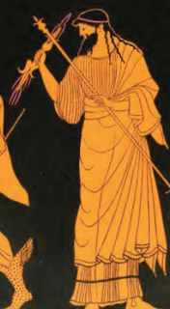
This god’s Greek name is Zeus.
This god’s Roman name is Jupiter.
He is the king of the gods and god of the sky and storms.
Iconography:
His sceptre
A lightning bolt
A throne
An eagle
Other information:
Defeated Cronos/Saturn to become king of the world.
The father of many heroes, including Heracles/Hercules.
Important temples at Olympia (Temple of Zeus at Olympia) and in Rome (the Temple of Jupiter Optimus Maximus on the Capitoline Hill).

Slide 4
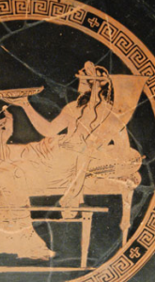
This god’s Greek name is Hades.
This god’s Roman name is Pluto.
He is the god of the underworld.
Iconography:
His cornucopia
His sceptre
Cerberus (three-headed dog)
Persephone/Proserpine (he often appears with a woman).
Other information:
Kidnapped Persephone/Proserpine after asking for Zeus’/Jupiter’s permission to marry her. Although he was given permission to kidnap Persephone/Proserpina, Zeus/Jupiter later demanded that he release Persephone/Proserpine to persuade Demeter/Ceres to call off the famine which was threatening to wipe out all humans. Hades/Pluto tricked her into eating pomegranate seeds in order to force her to stay in the underworld for one-third of the year.
Allowed Heracles/Hercules to take Cerberus to Eurystheus if Heracles/Hercules to capture Cerberus without using any weapons.
Allowed Orpheus to bring Eurydice out of the underworld if Orpheus could make it out of the underworld without looking at her.
Received sacrifices when an animal’s blood was poured onto the ground.
Was rarely spoken about or sacrificed to.
Did not live on Mount Olympus, unlike many of the other gods, but instead lived in the underworld.

Slide 5
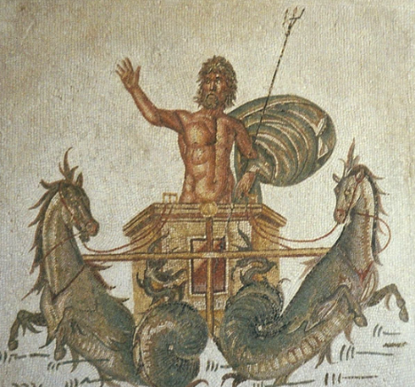
This god’s Greek name is Poseidon.
This god’s Roman name is Neptune.
He is the god of the sea.
Iconography:
His trident
His horses with fish tails (hippokampoi)
Other information:
The father of Theseus.
Competed with Athena for the patronship of Athens by offering the Athenians a salt-water spring.
The Erechtheion (a temple on the Acropolis) might have been dedicated to Poseidon (as well as Athena).

Slide 6
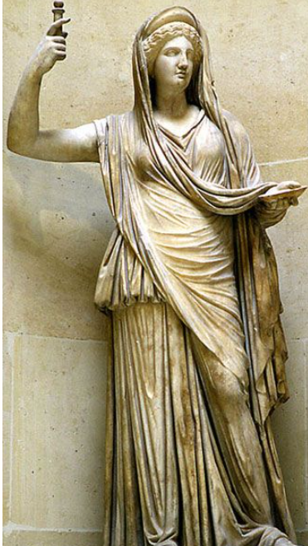
This goddess’ Greek name is Hera.
This goddess’ Roman name is Juno.
She is the goddess of marriage and the queen of the gods.
Iconography:
Her sceptre
Other information:
Wife of Zeus/Jupiter.
Hated Heracles/Hercules for being a child of Zeus’/Jupiter’ cheating and Aeneas for being a Trojan.
Raised the Nemean Lion and the Lerneaean Hydra.
Later spread a rumour that Heracles had fallen out of love with Deianira. This led to Deianira giving Heracles the shirt of Nessus, which caused his death.

Slide 7
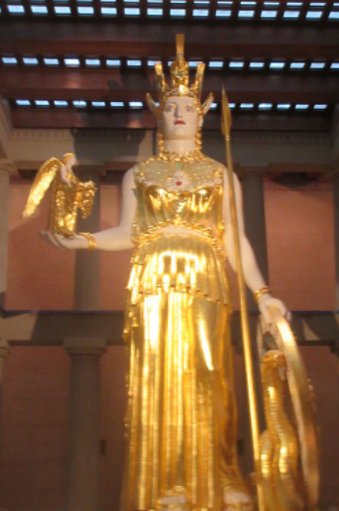
This goddess’ Greek name is Athena.
This goddess’ Roman name is Minerva.
She is the goddess of war, wisdom and strategy.
Iconography:
Her helmet
Her shield
Her spear
The aegis (a cape/robe with a gorgon’s head on it)
Nike (the winged goddess of victory)
Her peplos (dress)
Other information:
Patron goddess of Athens.
Competed with Poseidon/Neptune for the patronage of Athens by offering the Athenians an olive tree.
The Parthenon, a major temple of Athena, is found on the Acropolis of Athens.
Honoured at the Parthenon on the Acropolis.
The Athenians celebrated her birthday every year as part of the Lesser Panathenaia. However, once every four years, the Athenians held the Greater Panathenaia, at which Athena received a new peplos as a birthday present.
After Heracles/Hercules was abandoned by Alcmene due to her fear of Hera/Juno, Athena/Minerva took him up to Olympus where he was rejected by Hera/Juno.
Helped Heracles/Hercules defeat the Nemean Lion by giving him the idea to use its own claw to skin it. Also helped Heracles/Hercules by giving him a rattle made by Hephaistos/Vulcan to help him kill the Stymphalian Birds (in one version of the myth) and later to enter the underworld to bring back Cerberus.

Slide 8
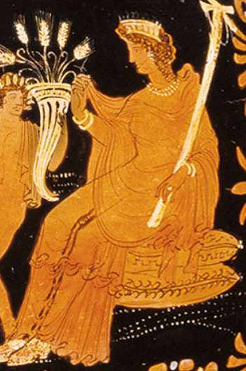
This goddess’ Greek name is Demeter.
This goddess’ Roman name is Ceres.
She is the goddess of the harvest.
Iconography:
A cornucopia
Sheaths of wheat
Other information:
The mother of Persephone/Prosperpine.
Sent a famine which threatened to kill all people when she discovered that Zeus/Jupiter had allowed her daughter to be kidnapped by Hades/Pluto. Although many gods brought her gifts in order to persuade her to call off the famine, she refused to do so until her daughter was returned to her.
The Eleusinian Mysteries were founded in her honour. This was a cult which many Greeks chose to join as they believed that it would guarantee them having a good time in the afterlife.

Slide 9
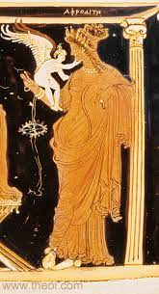
This goddess’ Greek name is Aphrodite.
This goddess’ Roman name is Venus.
She is the goddess of love.
Iconography:
A swan
A conch shell
Eros/Cupid (winged child)
Other information:
The wife of Hephaistos/Vulcan who cheated on him with Ares/Mars. Hephaistos/Vulcan caught them in a net whilst they were in bed together in order to reveal her affair to the other gods.
Forced by Zeus/Jupiter to fall in love with a mortal (since she had made other gods fall in love with mortals). This led to her sleeping with Anchises, a member of the Trojan royal family, and giving birth to Aeneas.
Supported the Trojans during the Trojan War and later helped Aeneas on his journey to Italy.
Caused the death of Theseus’ son Hippolytus (see Artemis/Diana for more information on this).

Slide 10
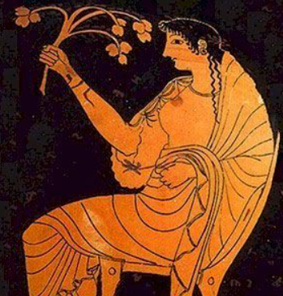
This goddess’ Greek name is Hestia.
This goddess’ Roman name is Vesta.
She is the goddess of the hearth and home.
Iconography:
A flowered branch
Her veil
Other information:
A very important goddess to the Romans. An all-female college of six priestesses known as the Vestal Virgins were in charge of guarding the flame of Vesta, held in the Temple of Vesta. The Vestals were drawn from aristocratic families and swore to abstain from sex for thirty years. Those who broke their vows would be executed by being buried alive. It was believed that, if the flame of Vesta were to go out, Rome would fall. The Vestal Virgins had privileges which other Roman women did not have (such as being allowed to make wills and sit in the front row at certain entertainment venues) and were also responsible with making mola salsa and guarding important documents, including military treaties and the wills of leading Romans. The mother of Romulus, Rhea Silvia, was forced to become a Vestal Virgin to stop her from having children who might challenge the tyrant Amulius for power.

Slide 11
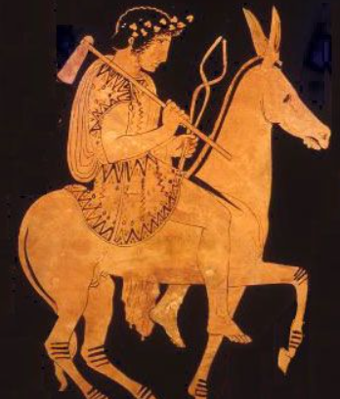
This god’s Greek name is Hephaistos.
This god’s Roman name is Vulcan.
He is the god of the forge and smithing.
Iconography:
His hammer
His tongs
Other information:
The son of Zeus/Jupiter and Hera/Juno.
Walked with a limp. In one myth, this was caused after Zeus/Jupiter threw Hephaistos/Vulcan off Olympus after he defended his mother from his father. In another version, Hera/Juno threw him off Olympus, as she was ashamed of him after she saw that he had been born with a limp.
The father of Cacus, a monster which Heracles/Hercules killed.
Made a rattle which Heracles/Hercules used to help him to kill the Stymphalian Birds (in one version of the myth).

Slide 12
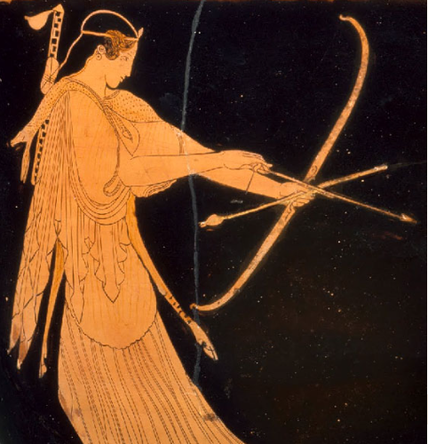
This goddess’ Greek name is Artemis.
This goddess’ Roman name is Diana.
She is the goddess of the moon, hunting and archery.
Iconography:
Bow
Arrows
Hunting dogs
Other information:
The twin sister of Apollo.
Virgin goddess.
Her mother, Leto, gave birth to the twins on the island of Delos.
Killed the dragon Python with her brother.
Had a sacred animal called the Stymphalian (or Golden) Hind which Heracles/Hercules had to capture. Although Artemis/Diana was at first angry that Heracles/Hercules had captured her sacred animal, she forgave him when she realised that he was being forced to do so by Eurystheus and Heracles/Hercules promised to let the Hind go.
One of her favourites was Hippolytus, the son of Theseus and Hippolyta, who swore to remain a virgin forever in her honour. This angered Aphrodite/Venus, who made Theseus’ wife Phaedra fall in love with Hippolytus. When Hippolytus rejected her, Phaedra killed herself and wrote in her suicide note that Hippolytus had raped her. This led to Theseus exile Hippolytus and praying to his father, Poseidon/Neptune, to punish his son. Poseidon/Neptune sent a bull out of the ocean which knock Hippolytus off his chariot.
Was once seen bathing by a hunter called Actaeon. In her anger, she turned Actaeon into a stag and he was ripped apart by his own hunting dogs.

Slide 13
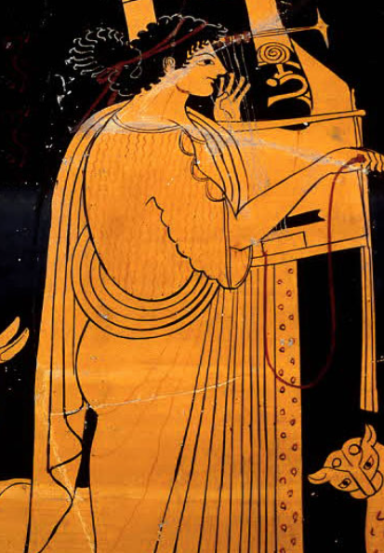
This god’s Greek name is Apollo.
This god’s Roman name is Apollo.
He is the god of music, the sun, poetry, medicine and archery.
Iconography:
Lyre
Bow
Arrows
Other information:
The twin brother of Artemis/Diana.
His mother, Leto, gave birth to the twins on the island of Delos.
Killed the dragon Python with his sister.
Had an oracle (a person who tells the future with the help of the gods) in the town of Delphi.
Had a beautifully sculpted temple in the town of Bassae.
The favourite god of the emperor Augustus, who claimed that he had helped him to win the Battle of Actium.
Not to be mistaken with Helios, the sun god who is encountered by Demeter/Ceres in The Homeric Hymn to Demeter.

Slide 14
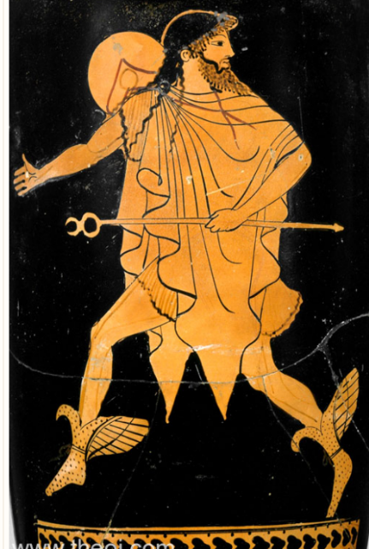
This god’s Greek name is Hermes.
This god’s Roman name is Mercury.
He is the god of messengers and travellers.
Iconography:
Caduceus (his staff).
Winged sandals
Petasos (round hat)
Other information:
The messenger of the gods.
A psychopomp (responsible for guiding the spirits of the dead to the underworld).
Helped to guide Heracles/Hercules to the underworld in so that the hero could bring back Cerberus.
Honoured on the third day of the festival of the Anthesteria in Athens.
Sometimes seen in images with Heracles/Hercules, representing the spread of his fame.
One of the gods worshipped at a lararium (a household shrine in a Roman home) in his role as a god of wealth and good fortune.

Slide 15
Prescribed Source: The Homeric Hymn to Demeter
What is it?
A poem possibly composed in the 7th or 6th century BC. It is similar in style to other poems supposedly composed by a man called Homer, so it is known as a ‘Homeric Hymn’.
What do we learn from it?
It tells the story of Hades’ kidnap of Persephone and her mother Demeter’s misery which turns to anger after she learns that Zeus, Persephone’s father, arranged for Hades to kidnap Persephone. Demeter chooses to punish Zeus by sending a famine which threatens to wipe out all humans and says that she will only stop it if Zeus returns Persephone to her. Persephone is eventually released, but because she at a pomegranate in the underworld she is forced to return there for one third of the year.
What is important about it?
The myth was a way of explaining how the seasons came to be, since winter was believed to be caused by Demeter’s misery at being apart from her daughter. The poem also tells the story of how the Eleusinian Mysteries (a famous cult of Demeter and Persephone which offered its members the chance to have a happy afterlife) came into being. The poem is also interesting, as it explores both the relationship between gods and humans and also the status of women in patriarchal societies.

Slide 16
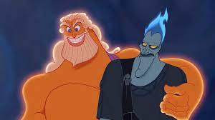
Hades asks Zeus for permission to marry Persephone. Zeus is afraid of Demeter’s anger, so comes up with a plan to allow Hades to kidnap Persephone.

Slide 17
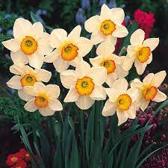
Whilst Persephone is gathering flowers with a group of ocean nymphs, Zeus makes the Earth grow a beautiful narcissus flower.

Slide 18
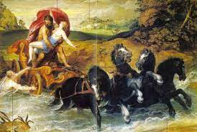
When Persephone goes to pick the narcissus, the ground opens up and Hades, riding out on his chariot, snatches Persephone.

Slide 19
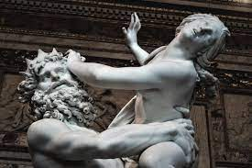
Persephone screams for help, but nobody except Hecate and Helios hear her. Persephone is hopeful that she will escape Hades until the chariot goes back underground again.

Slide 20
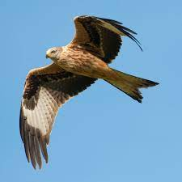
When Demeter discovers that Persephone is missing, she tears off her veil and cloak and wanders the world looking for her daughter, holding a torch in each hand to help her search, ‘like a bird of prey’. Nobody tells her anything about where Persephone is for nine days. In this time, she does not eat or drink or even wash!

Slide 21
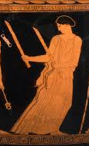
On the tenth day, Demeter meets Hecate. Hecate asks Demeter if she knows who kidnapped Persephone, whose screams she heard. Demeter does not answer her. Hecate, also holding two torches, goes with Demeter to help with the search.

Slide 22
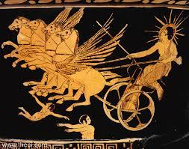
The goddesses go to Helios, who reveals that Zeus gave Hades permission to carry off Persephone. However, Helios says that Demeter should not be angry, and he gives the following reasons for why he thinks that Hades is a suitable husband:
- Hades is Demeter’s own brother
- He rules a third of the world

Slide 23
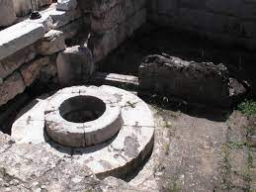
Demeter, furious at Zeus, refuses to return to Olympus and instead wanders the world in disguise. Eventually, she comes to Eleusis, where she sits next to a well, disguised as an old woman. An olive tree grows above her head.

Slide 24
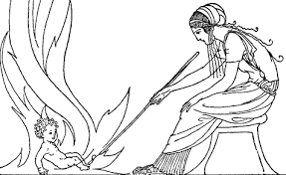
NOTE: YOU WILL NOT BE ASKED ABOUT THIS SECTION IN THE EXAM, BUT IT IS STILL WORTH KNOWING ABOUT
At Eleusis, Demeter becomes the nurse of prince Demephon. To try to make him immortal (possibly as a replacement for Persephone), Demeter puts ambrosia on him during the day and places him in a fire at night (to try to burn away his mortality). However, one night Demophon’s mother, Metanira, spots Demeter placing her baby in the fire and stops her from doing so. Demeter reveals that she is a goddess and demands that a temple and a cult be set up in her honour to make up for interrupting her. This cult is the Eleusinian Mysteries.

Slide 25
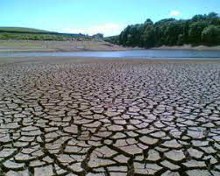
Demeter decides to punish Zeus and the other gods. She causes a year-long famine to occur and this comes close to wiping out all of humanity (and therefore denying the gods gifts from humans), but Zeus notices what is happening.

Slide 26
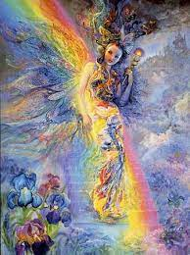
Zeus sends his messenger, Iris, to order Demeter to return to Olympus. Demeter refuses.

Slide 27

Zeus sends the rest of the gods with gifts to try to persuade Demeter to come back to Olympus. Demeter says that she will not return to Olympus until Persephone is returned to her.

Slide 28
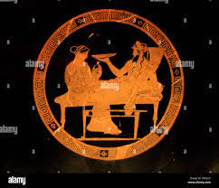
Zeus sends Hermes to order Hades to return Persephone. Hermes finds Hades sitting with Persephone, who is miserable. Hermes tells Hades about Demeter’s plan to wipe out humanity to stop the gods being worshipped.

Slide 29
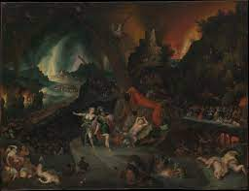
Hades tries to persuade Persephone to stay, using the following arguments:
- He is Zeus’ brother and will therefore be a suitable husband
- Persephone will become the ruler of all living beings if she stays with Hades (since all living things will die one day)
- Persephone will be able to punish any mortal who offends her once they reach the underworld

Slide 30
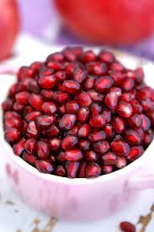
Hades secretly forces Persephone to eat a pomegranate seed, fearing that she will not return to him. He knows that, if she eats in the underworld, then she will be forever bound to the underworld.

Slide 31
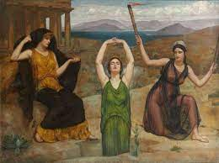
Hades brings Hermes and Persephone back to the surface in his chariot. Demeter and Persephone are reunited. Demeter hugs Persephone, but steps away when she realises that Persephone might have eaten in the underworld. Demeter reveals that, if Persephone has, then she will be forced to live a third of the year (one season) in the underworld. Persephone tells Demeter everything that has happened to her. They spend the day together with Hecate, who has now become Demeter’s close friend.

Slide 32
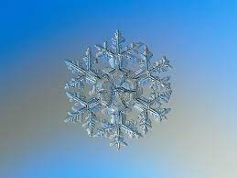
Zeus sends his mother, Rhea, to offer Demeter anything which she wants if she will return to Olympus. Rhea also reports that Zeus has agreed that, because she ate the pomegranate seed, Persephone will spend a third of the year in the underworld. Finally, Rhea tells Demeter to end the famine.

Slide 33
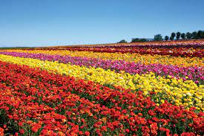
Demeter agrees and calls off the famine. All across the world, flowers burst out of the ground.

Slide 34
Homeric Hymn to Demeter: What you could talk about in the exam.
The poem explains how the season of winter came to be (an aetiological story). Given how important a good harvest was to Greek and Roman society, this story helps to explain why there is a period of the year during which a lot of crops will not grow.

Slide 35
Homeric Hymn to Demeter: What you could talk about in the exam.
The poem explores the relationships between gods and mortals
  The gods only really care about mortals if they can give them gifts.
    Demeter tries to wipe out humanity to punish Zeus. Zeus seems to only be motivated by the idea that he (and the rest of the gods) will no longer receive sacrifices if humans go extinct.
    Hades says that Persephone will be able to punish mortals who do not give her sacrifices if she stays as his wife.
  Demeter reacts to Persephone’s loss in a very human way, and even lives as a human during her time away from Olympus. However, she is still a goddess, able to change her appearance, move across the world with blinding speed and control the harvest. Demeter reminds us that the gods might look and act like humans, but they are still hugely more powerful than humans.
  Similarly, Hades goes to Zeus (as Persephone’s father) to ask his permission to marry her. This mimics real practise in the ancient world. However, the way in which Persephone ends up ‘married’ to Hades is anything but normal. Again, we are reminded that the gods might behave like humans, but they are still gods.

Slide 36
Homeric Hymn to Demeter: What you could talk about in the exam.
Explores the relationships between men and women
  Demeter is not able to have Persephone freed until she threatens to wipe out humanity. She has no other way of forcing Zeus to listen to her.
  Persephone does not get a say in who she marries. As Persephone’s father, Zeus gets the final say. Zeus does not even tell Demeter who her daughter will be married to.
  Persephone, as a young woman, is made to seem utterly powerless throughout the poem.
    She is lured away from her friends by the narcissus flower.
    She is terrified and screams for help when Hades snatches her.
    Even though she is miserable in the underworld, she cannot leave until Hades says that she can.
    She is forced by Hades to eat a pomegranate seed and, therefore, remain in the underworld for some of the year.

Slide 37
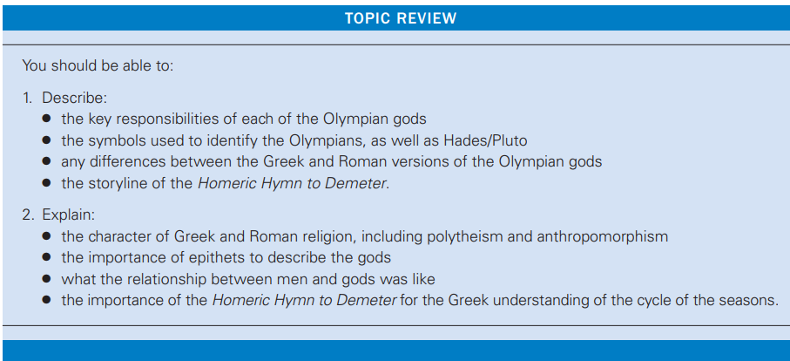
Only move on from this topic once you can do the following.

Slide 38
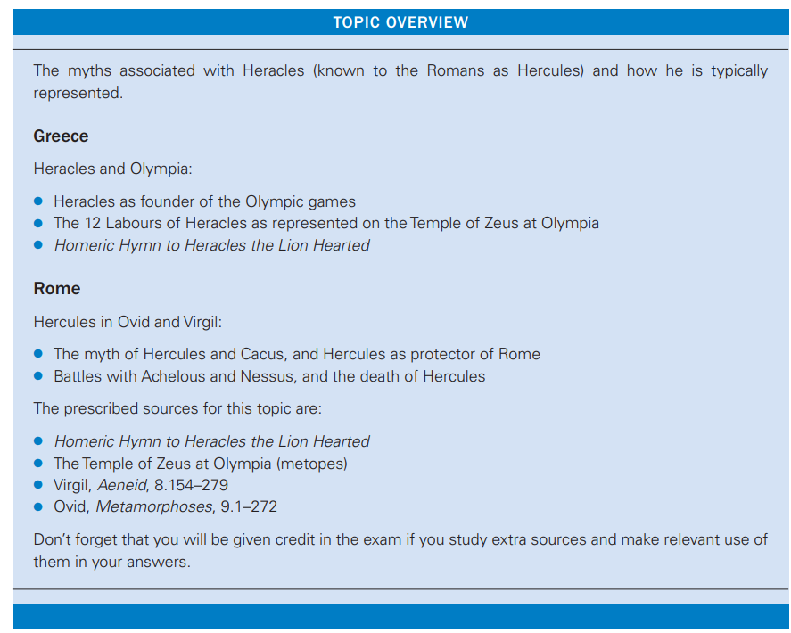
Topic 1.2: The Universal Hero: Heracles/Hercules

Slide 39
Key vocabulary and names
Hero- a person who achieves superhuman deeds, often the child of a god and loved by at least one god.
Alcmene- Heracles’ mother
Amphitryon- Alcmene’s husband
Eileithyia- Hera’s daughter, goddess of childbirth
Eurystheus- Heracles’ cousin, ruler of Mycenae
Mycenae- a powerful Greek city
Thebes- the city which Heracles was born in
Metope- square decorative spaces found on a Doric frieze
Doric frieze- a decorative strip running around the temple beneath its roof which includes metopes
Olympia- a city in Greece at which the Olympic Games occurred
Elis- the region of Greece in which Olympia was located
Exile- to be sent away and banned from entering somewhere
Purify- become clean, especially of a miasma
Miasma- a religious pollution which a person can gain by doing many things, for instance by murdering somebody. Having a miasma prevents a person from entering a religious area for fear of offending the gods.

Slide 40
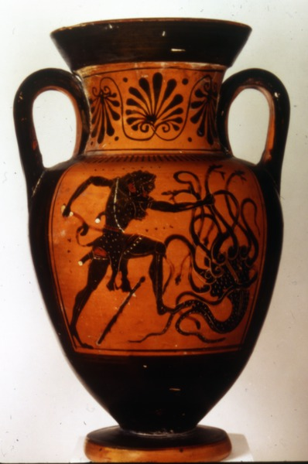
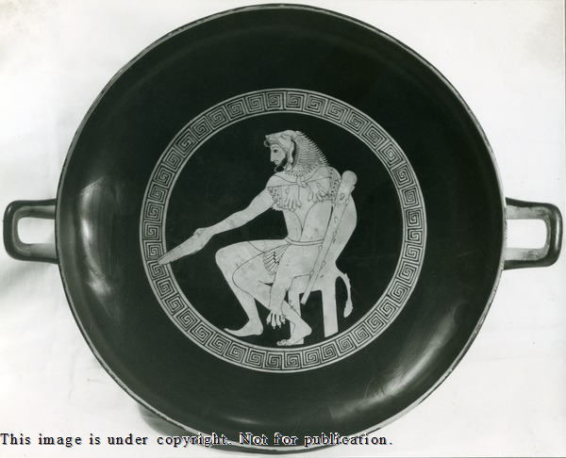
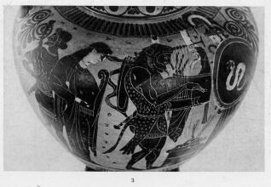
How to recognise Heracles in visual sources: the Nemean Lion’s skin, worn as armour by Heracles.

Slide 41
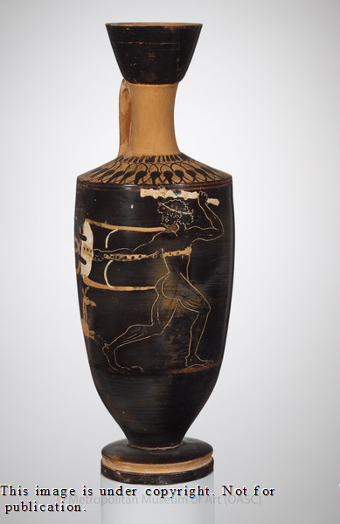
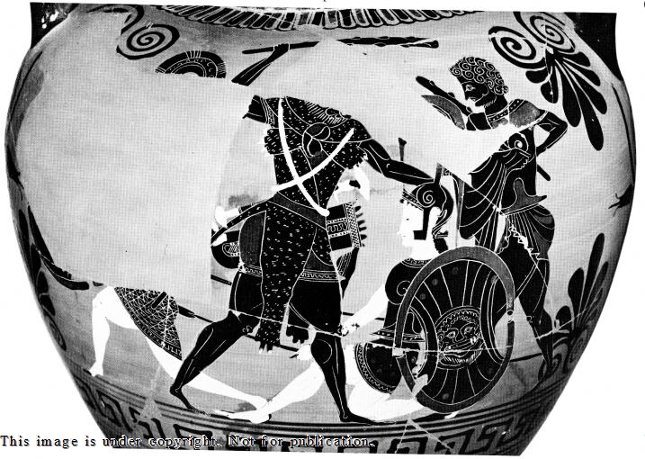
How to recognise Heracles in visual sources: Heracles often is shown holding a club (his weapon of choice).

Slide 42
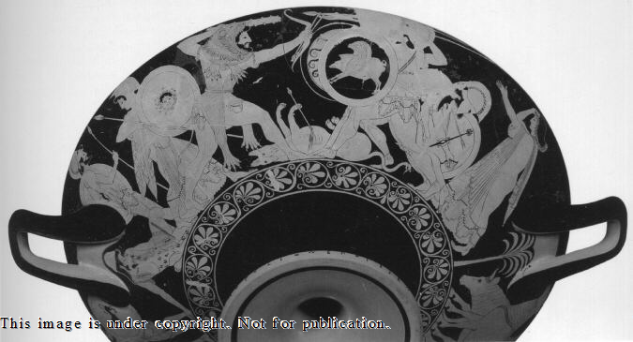
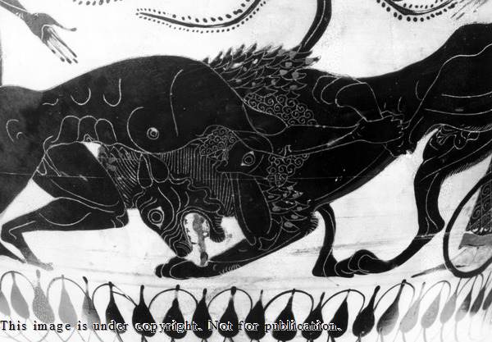
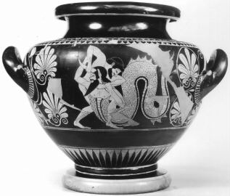
How to recognise Heracles in visual sources: Heracles very often appears completing one of his labours or fighting a well-known enemy.
Heracles kills Hippolyta
Heracles fights Geryon for his cattle
Heracles wrestles the Nemean Lion
Heracles wrestles Achelous
Heracles fights the Lernaean Hydra

Slide 43
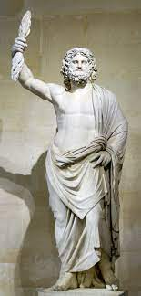
Zeus disguised himself as Amphitryon in order to sleep with Alcmene. Alcmene became pregnant and Zeus boasted to the other gods that his son would match him on earth: whilst Zeus ruled the skies, his son would rule the earth.

Slide 44
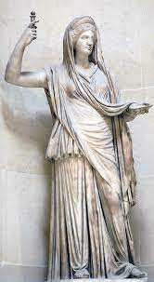
Hera, angered about Zeus cheating on her, made her daughter Eileithyia prolong Alcmene’s labour, hoping that this would kill both her and her unborn son.

Slide 45
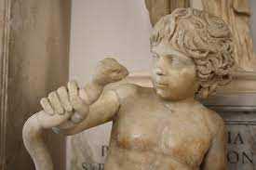
Alcmene’s midwife saved both her and her baby, so Hera sent two snakes to kill Heracles. Heracles killed both of these by strangling them.

Slide 46
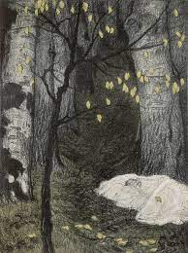
Alcmene was terrified of Hera’s anger and so abandoned Heracles in some woods. He was found by Athena and taken up to Olympus, where Hera rejected him and ordered that Alcmene raise him.

Slide 47
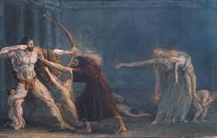
Heracles grew up and married Megara, a princess, but Hera drove him mad. This led Heracles to murder both Megara and his children.

Slide 48
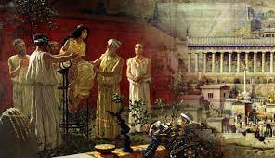
When he realised what he had done, Heracles exiled himself from Thebes and went to Delphi to consult the oracle. Hera made the oracle say that Heracles needed to serve his cousin, King Eurystheus of Mycenae, for ten years to purify himself of his miasma.

Slide 49
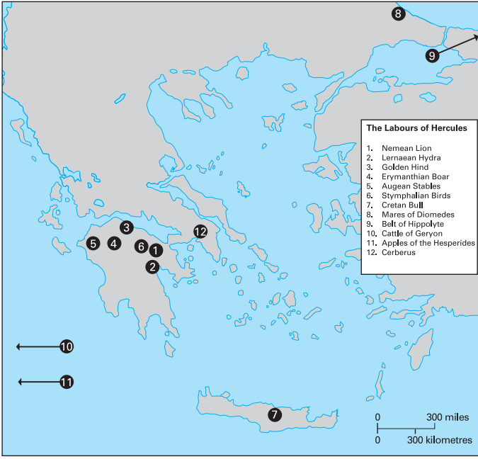
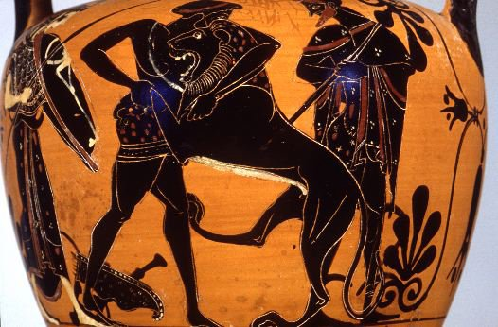
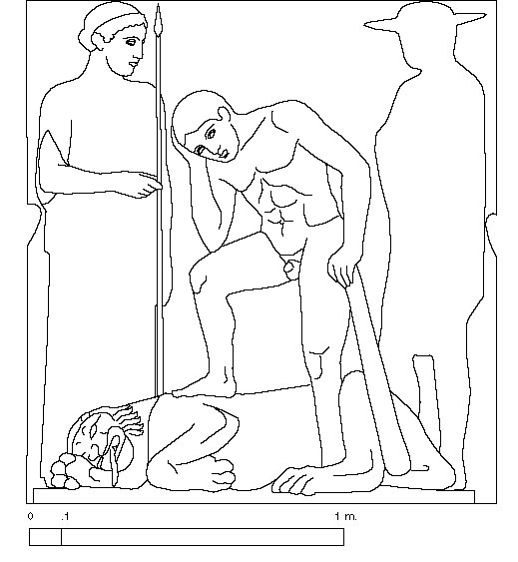
Labour 1
The Nemean Lion
The Challenge: The Nemean Lion had impenetrable skin and Heracles needed to kill it and bring its skin back to Eurystheus.
Location: Nemea in the Peloponnese (southern mainland Greece). See the map to the right for its location.
How Heracles succeeded: Heracles choked the Nemean Lion in its cave. Athena then gave him the idea to skin the lion using its own claw to break through its impenetrable hide.
The metope
Heracles has just killed the Lion, as we can tell from how he is trying to catch his breath. Athena stands to the left, about to give him the idea to skin the Lion with its claw. Hermes stands to the right, ready to spread the word of Heracles’ success amongst the gods. Heracles’ tiredness highlights how difficult the labour was. Plus, it is only the first, inviting us to be impressed with Heracles for managing to complete another eleven!
It should be noted that Heracles is lacking the beard which is found in the other metopes. This tells us that he is meant to be a young man at this point.
Other significant details: Heracles would wear the Lion’s skin as armour throughout the rest of his labours.

Slide 50
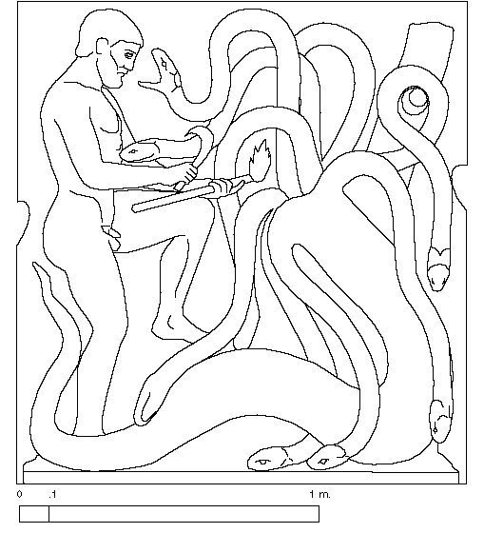
Labour 2
The Lernaean Hydra
The Challenge: The Lernaean Hydra, which had been raised by Hera, had many heads, breathed toxic fumes and had venomous blood. To make matters worse, for every head it lost, two would grow back, and one of its heads was immortal. In addition, Hera assisted the Hydra during Heracles’ battle by sending a crab into battle.
Location: A swamp near to Lake Lerna in in the Peloponnese. See the map to the right for its location.
How Heracles succeeded: Iolaus, Heracles’ cousin, sealed each neck with a torch as Heracles cut each one off. He also crushed the crab under his foot. Heracles then cut off and buried the immortal head under a pile of rocks off.
The metope
Heracles is in the process of killing the Hydra. He holds a sickle in his right hand, and a torch in his left. Iolaus is missing, possibly because there was an alternative version of the myth in which he did not help Heracles. Alternatively, Iolaus might be missing due to a lack of space, meaning that we are meant to imagine him helping Heracles ‘off-screen’.
Other significant details: Heracles dipped his arrow in the Hydra’s blood to make them incredibly deadly.
Because Heracles received help from Iolaus, Eurystheus said that the labour did not count.

Slide 51


Labour 3
The Ceryneian (Golden) Hind
The Challenge: The Ceryneian Hind was a deer which was larger than a bull and was the colour of gold. It was also incredibly fast. Heracles was challenged to capture it and, because it was sacred to Artemis, not harm it.
Location: Heracles tracked the Hind far to the north of Greece before following it back down into the Peloponnese, eventually capturing it near the River Ladon.
How Heracles succeeded: There are a few different versions of this part of the story. Heracles might have used a net, captured it whilst it was asleep, worn it down by chasing it or shot it with an arrow (although he must have done so without causing it a great deal of harm). After capturing the Hind, Heracles met Apollo and Artemis. He explained to Artemis that he had been forced to capture the Hind and would release it after showing it to Eurystheus. Artemis therefore allowed him to continue.
The metope
Heracles is shown wrestling with the Hind, pulling it back by its antlers. We do not see any arrows or a net, so Heracles has either captured it whilst it was asleep or managed to catch up with it after it had become tired.
Other significant details: Although the Golden Hind was not a dangerous monster, Heracles here had to avoid the anger of a goddess other than Hera.
Heracles visits much of mainland Greece during this labour. Given that he was seen as a hero to all Greek people, this is a very important fact.

Slide 52


Labour 4
The Erymanthian Boar
The Challenge: Heracles had to capture the Erymanthian Boar, a huge boar which was terrorising the people of Arcadia.
Location: Heracles captured the Boar near Mount Erymanthos in the northern Peloponnese.
How Heracles succeeded: Heracles chased the Boar into snow, which tired it out. This allowed Heracles to capture it and tie up its legs.
The metope
Heracles holds the Erymanthian Boar above Eurystheus, who hides in a storage jar. This clearly is meant to demonstrate the superior strength and bravery of Heracles compared to those of the man who had enslaved him.
Other significant details: Eurystheus showed his cowardice by hiding in a storage jar when he saw the Erymanthian Boar being carried into his palace.

Slide 53

Labour 5
The Augean Stables
The Challenge: Heracles had to clean the stables of King Augeas, whose enormous number of cattle produced massive amounts of dung, within a single day. Augeas promised that he would pay Heracles if he was able to.
Location: The city of Elis in the Peloponnese.
How Heracles succeeded: Heracles diverted the rivers Alpheius and Peneius through the stables, either by using boulders or by digging trenches.
The metope
Heracles holds what appears to be a shovel. Athena stands by him, which suggests that it is she who is about to give him the idea to divert the rivers through the stables, rather than try to shovel the dung out of the stables.
Other significant details: Augeas refused to pay Heracles. After completing his labours, Heracles raised an army and attacked Elis. He sacked the city and killed Augeas. Heracles then founded the Olympic Games to celebrate his victory (note that this is only one version of the Olympic Games’ foundation story).
Because Heracles agreed to be paid for this labour, Eurystheus said that it did not count.

Slide 54


Labour 6
The Stymphalian Birds
The Challenge: Heracles had to drive away the Stymphalian Birds which were destroying crops and, according to some sources, eating people around the town of Stymphalos.
Location: Near the town of Stymphalos in the Peloponnese.
How Heracles succeeded: Heracles used a rattle to scare the birds into taking flight. In some versions, this rattle was made by Hephaistos and given to Heracles by Athena. In some versions the rattle frightened the birds away, but in others Heracles shot them down with his bow or a sling shot.
The metope
Heracles hands the dead birds to a woman, probably Athena, who sits on a rock. He is holding a bow in his left hand, revealing how he succeeded in killing the birds. Although there is no sign of the rattle, we can assume from her presence that Athena earlier gave him the rattle.
Other significant details: Later sources state that the birds were sacred to Ares, although these writers might have been getting them mixed up with Ares’ other sacred birds.

Slide 55


Labour 7
The Cretan Bull
The Challenge: Heracles had to travel to the island of Crete and bring a rampaging bull from there to Mycenae.
Location: The island of Crete.
How Heracles succeeded: Heracles approached the Cretan Bull from behind, strangled it until it passed out, and then sat on its back whilst it swam back to Greece. In other versions, Heracles allowed the Bull to charge at him before flipping it over.
The metope
Heracles is shown dragging the Cretan Bull by robes, seemingly attached to it. He holds his club in the air, though whether he is going to his the Bull or not with it isn’t clear. This clearly takes place after Heracles has already wrestled and choked the Bull, or else the ropes wouldn’t be attached to it. However, the Bull still appears to be resisting Heracles, though Heracles appears to be winning the struggle.
Other significant details: The Cretan Bull was released by Heracles after he had shown it to Eurystheus and ended up rampaging across the plain of Marathon. It was later captured and killed by Theseus. The Cretan Bull also linked Theseus to Heracles as it was the father of the Minotaur, which Theseus also killed.

Slide 56


Labour 8
The Mares of Diomedes
The Challenge: Heracles had to bring the flesh-eating Mares of Diomedes to Mycenae. This meant stealing them from King Diomedes, who fed visitors to his land to the horses.
Location: Thrace in north-eastern Europe.
How Heracles succeeded: Heracles brought an army and a man called Abderos with him to assist in the labour. After killing the stablemen guarding the horses, Heracles left the horses with Abderos to fight off men who Diomedes sent to get the horses back. After defeating these men, Heracles discovered that the horses had eaten Abderos, so Heracles fed Diomedes to his own horses. This calmed the horses and Heracles took them to Mycenae.
The metope
This metope is actually quite similar to the Cretan Bull’s. Heracles is seen holding onto a rope (not shown in the recreation below) which he is using to drag one of the Mares of Diomedes with him. He is again shown holding up his club. Like the Bull of Marathon metope, this is likely taking place after the Mares were subdued (and Diomedes fed to them), since Heracles is guiding the horse with a rope, but he is still having to struggle with it (and clearly doing very well).
Other significant details: This is a good example of a story in which a ‘civilised’ Greek comes up against a ‘barbaric’ non-Greek character who he overcomes. Eurystheus mistreats his guests horrendously and is later punished for it. I. These stories would become very popular in the 5th century BC after the conclusion of the Persian Wars. It should be noted here that the Greeks believed that Zeus himself protected the right of innocent strangers to not be harmed but to be treated as guests. It is therefore fitting that Zeus’ son is the one to punish Diomedes.

Slide 57

Labour 9
The Belt of Hippolyte
The Challenge: Heracles had to bring the belt of the Amazon queen Hippolyte to Eurystheus’ daughter. It had been given to Hippolyte by her father, Ares. The Amazons were a fierce tribe of warrior women who did not allow men into their territory.
Location: The land of the Amazons, far to the east on the edge of the known world.
How Heracles succeeded: Heracles prepared for battle by bringing an army with him to the Amazons’ land. However, Hippolyte simply gave him her belt as she had heard about Heracles and was impressed by him. However, Hera disguised herself as an Amazon and told the other Amazons that Heracles was planning on kidnapping Hippolyte. This caused the Amazons to attack and Heracles, believing Hippolyte to have tricked him, killed her.
The metope
Hippolyte has fallen to the ground and is helpless as Heracles prepares to kill her with his club. A scene showing a Greek hero about the kill an Amazon was quite commonly found in Greek art. The Amazons in these scenes tend to be positioned lower than the men and helpless to prevent their deaths. These scenes were probably meant to remind Greeks and, and later, Romans of the idea that men were naturally superior to women (a view which was probably quite commonly held).
Other significant details: This is another classic example of a story about Greeks fighting ‘barbarians’.
Heracles’ adventures have been moving away from Greece and here we see him travel to the very edges of the known world. The idea that Heracles’ labours take him all this way further highlights how impressive it is that he overcame these labours.
Hippolyte also met Theseus and had a child with him. This is yet another link between the Heracles and Theseus which the Athenians were keen to stress.

Slide 58


Labour 10
The Cattle of Geryon
The Challenge: Heracles had to travel far to the west to bring back the red-skinned cattle of Geryon, a monster with three bodies. To steal the cattle, Heracles first had to kill both the herdsman Euryton and the two-headed dog Orthrus.
Location: Far to west, near the edge of the known world, on the island of Erytheia. Probably near modern-day Spain and Portugal.
How Heracles succeeded: Heracles travelled through Africa on foot and was gifted a cup to sail in to Erytheia by the sun. Heracles managed to kill both Euryton and Orthrus with his club but had to use a mixture of his bow and club when Geryon attacked. He then had to bring the cattle back east to Greece and ended up passing through Italy, where he killed Cacus, leading to a cult being set up in his honour. When he arrived back at Mycenae, Heracles sacrificed the cattle to Hera.
The metope
Heracles is once again shown in a moment of victory, about to bring his club down on Geryon, who has fallen to the ground. The limp forms of two of bodies can be seen, suggesting that Heracles has perhaps killed these first. Geryon reaches his arm up in defence, further emphasising his weakness compared to Heracles. The scene is very fitting for a metope, since it shows Heracles engaged in close-combat. There are no signs of arrows or his bow.
Other significant details: Once again, Heracles is seen to travel to and from the edges of the known world, this time going west.
It is during this labour that Heracles travels to Italy and frees Pallantium from Cacus. Pallantium is a Greek city which is lived in by a group of Arcadians (Arcadia is a part of the Peloponnese).The Romans used this story to explain both their worship of Hercules and why this worship was performed in a traditionally Greek way.

Slide 59


Labour 11
The Apples of Hesperides
The Challenge: Heracles had to travel to the Garden of the Hesperides and bring back the golden apples which grew there. These had been a wedding present for Zeus and Hera. The apples were guarded both by the Hesperides, Nymphs who were the daughters of the Titan Atlas (punished by Zeus to hold up the sky for siding with Kronos in the Titanomachy) and a dragon called Ladon. However, no mortal knew where the apples could be found.
Location: The Garden of the Hesperides was found in the furthest west part of the world. However, Heracles had to wander through Africa, Asia and, finally, eastern Europe before he learned the location of the Garden.
How Heracles succeeded: Heracles received information about the Garden’s location from Prometheus after Heracles killed the eagle which had been eating his liver and released Prometheus from his chains. Heracles then approached Atlas and told him that he would hold up the sky whilst Atlas retrieved the apples. When Atlas returned, he told Heracles that he would take the apples to Eurystheus, planning not to return and leave Heracles holding up the sky. However, Heracles saw through the trick and said that he would need to get a pillow first. After Atlas took the sky back, Heracles ran away and never returned. Once Eurystheus had seen the apples, Athena returned them to the Garden.
The metope
Heracles is shown holding up the sky, whilst Atlas offers him the Apples of the Hesperides. Athena is see helping Heracles, which explains how Heracles, as a mere mortal, was able to do the job of a Titan. The difference in strength between a god and a mortal is also on how, as Athena effortlessly holds up with one hand what Heracles needs both hands and his shoulders to do. This shouldn’t make us view this scene as critical of Heracles, however. The fact that he has a goddess helping him in this scene would have been a reminder of his heroism to a Greek audience, as the gods normally only helped out particularly impressive people.
Other significant details: Heracles goes one step further and now travels to a place which only the gods know the location of.
In some versions, Heracles learns of the garden’s location from the sea-god Nereus, whilst Prometheus tells him how to get the apples out of it.

Slide 60


Labour 12
Cerberus
The Challenge: Heracles had to travel to the underworld and bring back the three-headed guard dog Cerberus from there. Moreover, although Hades agreed to let Heracles borrow Cerberus, he said that no weapons should be used against the dog.
Location: Heracles first travelled to Eleusis, and then entered the underworld using an entrance in the Peloponnese, exiting the underworld near Troezen.
How Heracles succeeded: Heracles first joined the Eleusinian Mysteries in the hope that this would make Persephone more likely to help him. He then descended to the underworld through an entrance in the Peloponnese, guided by Hermes. Hades agreed to let Heracles take Cerberus, so long as he did not use any weapons against him. Heracles therefore choked Cerberus and, although he was bitten by the huge snake which Cerberus had for a tail. After showing Cerberus to Eurystheus, he let the dog return to the underworld.
The metope
Heracles drags Cerberus behind him. Cerberus is clearly resisting him, meaning that Heracles is having to use all of this strength to pull Cerberus along. This is another scene of Heracles at his moment of triumph: he has already wrestled and strangled Cerberus, which was the most dangerous part of the labour. Hermes watches on, having guided Heracles to the underworld in his role as psychopomp.
Other significant details: Heracles has gone just about as far east and west as he can, so now his labours take him down below the earth into a place which mortals are not meant to go to. He is no longer just passing over geographical boundaries, but the boundary between the living and the dead!
Heracles encounters Theseus and his friend Perithoos trapped in the underworld, having failed to kidnap Persephone. He manages to free Theseus. Once again, this story connects the two heroes.
Hermes is able to help Heracles as he and Dionysus were the only two Olympian gods who were able to travel to the underworld. Hermes did so in his role as psychopomp- the guider of ghosts to the underworld.

Slide 61
Virgil’s Aeneid | Virgil’s Aeneid
What the work is about | Epic poem about the Trojan Aeneas’ journey to Italy and his battle to found the city of Lavinium.
Key characters | Hercules The son of Jupiter who is on his way back from completing his tenth labour. Evander The ruler of the city of Pallantium in Italy, and the narrator of the story. Evander was a legendary figure in Roman history who was said to have brought the worship of the Roman gods to Italy. He is Greek and originally from the region of Arcadia. Cacus A fire-breathing monster living in the Aventine Hill. He is the son of Vulcan. Cacus is evil and cruel, a murderer who nails the heads of his victims to his the doors of his cave. Aeneas A son of Venus who is destined to found a city in Italy and whose descendants will one day found and rule Rome. He flees from Troy, a city in modern-day Turkey, after it is destroyed by a Greek army.
Setting of the passage | Pallantium, a city found on the banks of the River Tiber near the Aventine Hill. This city would eventually become part of Rome after the city was founded.
Context for the passage | Aeneas is visiting Evander during a festival dedicated to Hercules. Evander explains how the Arcadians came to worship Hercules. This story was used by the Romans to explain how the Great Altar of Hercules came to be, and also explained by the Temple of Hercules the Victor had been set up nearby.
Summary of the passage | On his way back to Greece after capturing Geryon’s cattle, Hercules arrived in the region near the Aventine Hill, in which Cacus lived in a cave, terrorising the people of Pallantium. Cacus emerged from his cave and took hold of some of Hercules’ cattle, dragging them backwards to hide them fact that they had been taken. Hercules would not have noticed were it not for the stolen cows returning the lowing of the others as Hercules was preparing to move them on. Cacus, when he saw Hercules coming towards his cave, blocked the entrance with a huge boulder which not even Hercules can move. After circling the Aventine Hill three times, Hercules ripped off the top of the Aventine Hill above Cacus’ cave. Cacus breathed smoke at Hercules, who rained down trees, stones and boulders onto him. Enraged by the smoke, Hercules leaped down into the cave and strangled Cacus to death. Hercules revealed the body to Evander and the Arcadians and they set up an altar and an annual sacrifice in his honour.

Slide 62
Ovid’s Metamorphoses
Name of writer | Ovid
Title of work | Metamorphoses
What the work is about | Epic poem which tells many stories about people changing forms.
Key characters | Hercules The son of Jupiter who wishes to marry Deianira. Thesesus The mythical founder of contemporary Athens. Achelous The god of the River Achelous who wants to marry Deianira. Deianira The princess of the Greek city of Calydon in the region of Aitolia Greeks who Hercules marries. She accidentally causes his death after being tricked into giving him a shirt soaked in Hydra venom by the Centaur Nessus. Nessus A Centaur who Hercules kills after he tries to kidnap Deianira. He gives his shirt, soaked with Hydra venom, to Deianira and tells her to that it is a love charm.
Setting of the passage | The fight happens at Aitoilia in southern Greece. Nessus is killed next to the river Evenus. Hercules dies in Oechalia.
Context for the passage | Theseus (a Greek hero who founded the ‘modern’ city state of Athens) is talking to the river god Achelous about how he came to lose one of his horns whilst they wait for the flooded river Achelous to recede. The story explains where the Cornucopia came from and also tells the story of Hercules apotheosis (becoming a god).
Summary of the passage | Hercules argued that he would be a good husband for Deianira as he was the son of Jupiter and had completed his twelve labours. Achelous said that he would be better match as he was an actual god and also argued that Hercules only had to complete the labours because of his own actions and also claimed that the story of Hercules’ birth was either a lie or a scandal. During the wrestling match which followed, Achelous turned into a snake when Hercules started to get the upper hand. Hercules laughed at this, saying that he had killed snakes as a baby and had killed the Hydra as an adult. Achelous then turned into a bull, and Hercules snapped one of the river god’s horns off before finishing off the match. The horn filled with fruit and became the Cornucopia. On his way home, Hercules was offered help in crossing the river Evenus from the Centaur Nessus. However, Nessus attempted to kidnap Deianira whilst he was pretending to carry her across the river. Hercules shot Nessus in the back, but Nessus smeared his shirt with his blood mixed with Hydra venom and gave it to Deianira, claiming that it was a love charm to be used if Hercules ever stopped loving her. Several years later, Juno got the goddess Rumour to spread lies about Hercules to his wife. Deianira came to believe that Hercules has fallen in love with another woman, and sent him Nessus’ shirt, believing that it would make him love her again. Hercules put it on whilst performing a sacrifice and the heat of the flames caused the venom to activate. The shirt stuck to his skin and melted it away when Hercules tried to remove it. Hercules therefore buillt himself a pyre and bured himself upon it. Jupiter saw his son dying and told the other gods that Hercules should be made a god. As a result, when his body had entirely burned away, Hercules’ spirit went up to Olympus, where he became a god.

Slide 63

Why was Heracles/Hercules important?
Heracles was supposed to have wiped out monsters in Greece, which helped to explain why mythical monsters no longer existed.
Heracles became a god after his death, an idea which showed that there could be a connection between gods and mortals.
Heracles founded the Olympic Games (in one version of their foundation story).
Heracles wandered all across the Greek world, which allowed many Greek settlements to connect themselves to him (and, therefore, one another). The shared belief in heroes such as Heracles helped peoples living in Asia, Africa and Europe understand themselves as Greek.
Hercules was important to the Romans as he connected them to Evander, the man who supposedly introduced, amongst many other things, the Olympian gods and writing to Italy.

Slide 64
Why was Heracles/Hercules impressive/heroic?
Heracles achieved impossible deeds from a young age, surviving Hera’s two attempts to kill him as a baby.
Heracles fought and defeated both monsters and humans who behaved in ways which were offensive to the Greeks.
Heracles was not only the son of Zeus but was supported by his half-sister Athena and also Hermes, showing that he was impressive enough to attract the attention of multiple gods.
Heracles’ labours involved him not only completing impossible tasks, but also wandering to parts of the world which is should be impossible for humans to reach.
Heracles’ successes meant that he was allowed to become a god after he died.
Hercules saved the people of Pallantium from Cacus, marking him out as important to the Romans (Pallantium supposedly became a part of Rome).

Slide 65

Metopes of the Temple of Zeus at Olympia
What you need to know
Show Heracles’ twelve labours
Found on the Temple of Zeus (Heracles’ dad’s temple!)
Augean Stables- after he had completed his labours, Heracles went back to Elis, killed Augeas and founded the Olympic Games (which took place at Olympia!)
  Augeas had agreed to pay Heracles for cleaning his stables if he could it in a day, but had gone back on his promise after Heracles had successfully done this.
What you could write about in an exam:
They bring the story of Heracles to life
  Show Heracles in action during (or just after) the labours- they would have been exciting to look at!
  They have been chosen to show Heracles in particularly heroic moments.
  As they are metopes on a Doric frieze, a person could follow along and have the story of Heracles told in front of their eyes!
They show us the gods
  Which gods helped Heracles (i.e. Athena and Hermes)
  It would have been important for those who believed in the gods to be able to see what they looked like
  They are well sculpted
  Easily recognisable (obvious clues about which labour is which)
  They all make use of space
  There aren’t any obvious mistakes (compare with some of the errors on the Parthenon metopes i.e. the centaur without a neck)
  All show complex images
    Overlapping figures, characters reacting to one another
    Some very complex images: the fight with Geryon is particularly complex
    However…
They only show us Heracles’ labours, not what else he did in his life
You need to already know the story of Heracles to understand what is going on in them.
They were arranged on the east and west sides of the temple (six on each) which meant that the story was actually broken up.

Slide 66
1.3: Religion and the City Key Vocabulary- Temples
Temple- A sacred building, thought to be a home of a god.
Sanctuary- A holy part of a city dedicated to one or more gods. Temples and altars are found in a sanctuary. Those who have a miasma cannot enter a sanctuary.
Miasma- Religious pollution caused by a number of things, such as killing someone, giving birth or being near a dead body.
Pediment: A triangular architectural feature which forms part of the roof of a temple. One is usually found at each end of the temple.
Ionic frieze: A continuous, horizontal strip on which sculpture or paintings can sometimes be found.
Doric frieze: A frieze made out of metopes and triglyphs
Metopes: Square slabs of stone, often with sculpture on them.
Triglyphs: Rectangular pieces of stone with three lines carved onto them. Used to separate metopes on a Doric frieze.
Colonnade: A row of columns
Stylobate: A three-stepped platform on which a Greek temple is found
Plinth: A platform in which a Roman temple is found
Semi-engaged column: A column which is built into a wall. Purely decorative and does not support the temple structure. Found on Roman temples
Naos: The innermost room of a Greek temple where the cult statue was found
Cult statue: The statue of the god which the temple was dedicated to. The grandest were made of chryselephantine.
Chryselephantine: Gold and ivory.
Cella: The innermost room of a Roman temple where the cult statue was found.
Pronaos: A room in front of the naos in a Greek temple.
Opisthodomos: The treasury of a Greek temple.

Slide 67
1.3: Religion and the City Key Vocabulary- Priests and Sacrifices
Blood sacrifice- The killing of another living being in honour of a god.
Hecatomb- The sacrifice of 100 bulls.
Gilding- The covering of a surface with a thin layer of gold.
Lituus- A Roman augur’s staff
Toga- Clothing worn by a Roman citizen
Mola salsa- Mixture of salt and flour made by Vestals and used at Roman blood sacrifices.
Libation- The pouring of wine on the ground as an offering to a god.
Popa- Roman official who struck an animal on the head with a wooden rod.
Cultrarius- A Roman official who slit the throat of an animal at a sacrifice.

Slide 68
Background information
 |  | Parthenon | Zeus at Olympia | Pantheon | Portunus
Date |  | 447-432 BC | 472-456 BC | Original: 27-25 BC (burned down in 80 AD) Rebuilt: 125 AD. | 120-80 BC
Architect |  | Phidias, Iktinos and Kallikrates (commissioned by Pericles, the leading politician of his age) | Libon | N/A (original commissioned by Augustus and built by Marcus Agrippa; current Pantheon commissioned by Hadrian) | N/A
Material |  | Pentellic marble | Local limestone | Marble, brick and concrete | Tufa (local stone). Limestone covered with plaster to create marble effect.
Decoration | Pediment | East: Athena’s birth West: Contest between Athena and Poseidon | East: Oinomaos and Pelops West: Centauromachy | N/A | N/A
 | Ionic Frieze | Panathenaic procession | N/A | Inscription telling us that Marcus Agrippa built it | N/A
 | Doric frieze | Amazonomachy (west), Centauromachy (south), Gigantomachy (east), Trojan War (north) | Labours of Heracles | N/A | N/A
 | Cult statue | Chryselephantine statue of Athena (13m tall) by Phidias | Chryselephantine statue of Zeus by Phidias | Many gods, including Venus and Mars | Portunus, god of harbours.
Important information. |  | Symbolises the power and wealth of Athens. A reminder of Athens’ role in the defeat of the Persian Empire. Built with money from the Delian League. No altar. Final destination of the Panathenaic procession, where a peplos was presented to the statue of Athena. Octostyle (8 columns across the front and back)- most Greek temples were hexastyle (6 columns across the front and back). Both Doric and Ionic elements (Doric: columns and frieze; Ionic: frieze) | Symbolises the importance of Zeus, Heracles and Pelops. Celebrates the Olympic Games. A reminder of the Greek alliance’s victory over the Persian Empire. Was originally near a huge altar dedicated to Zeus (dated to at least 776 BC) which was made of ash and which grew to at least 7m high. Unusually has steps at the front leading up to it. | Unusual architecture includes the rotunda at the rear with an oculus at the top. Oculus creates circle of light which follows the path of the sun. Found in the Campus Martius (Field of Mars), where Roman armies met before campaign, elections took place and where Romans would exercise. Reason for name unknown- possibly because it was dedicated to lots of gods, but also could be because the roof looked like the heavens. | Found in the Forum Borarium (cattle market). Stands next to the Tiber in a place where there was once a harbour. A very typical Roman temple. Found near Temple of Hercules the Victor and the Great Altar of Hercules.
A temple was found in a sanctuary. A sanctuary could contain temples and altars dedicated to many different gods.
A sanctuary was a holy area in a city which could not be entered by those with a miasma. As a result, sanctuaries had fresh water at the entrance to allow people to wash themselves clean.
A temple was dedicated to a god and used to house a cult statue of that god.
A temple was thought to a house of a god when they were away from Olympus.
Only priests could go inside a temple.
Sacrifices took place outside so as not to pollute the temple.
Most temples were rectangular and orientated on an east to west axis
Roman temples were slightly different to Greek ones. They were raised on a plinth, whereas Greek temples were found on a stylobate. This meant that a Roman temple could only be approached from the front, whereas Greek temples could be approached from any direction. A Roman temple also did not have an opisthodomos to act as a treasury.

Slide 69


Myths on the Parthenon’s Pediments
Athena’s birth
Zeus was told that his son would overthrow him, just as he had overthrown his father.
He ate his pregnant wife, Metis, to avoid this from happening.
Metis gave birth in Zeus’ stomach.
Zeus got a horrific headache that was so bad that eventually he had Hephaistos split open his head.
When Zeus’ head was split open, Athena jumped out, fully grown and fully armoured.
On the west pediment, we can recognise Athena by her spear and shield. Nike can be seen to crown her. Zeus is sitting down on his throne, holding his sceptre. Hephaistos stands next to Athena holding the axe which he just used to break open Athena’s head. Poseidon and Hera can also be seen looking on. The other gods stare amazed at what has just happened.
The patronage contest
Athena and Poseidon both wished to become the patron god of Athens, but they arrived at the Acropolis as the same time.
Athena offered the Athenians an olive tree if they selected her as their patron. Olives were extremely useful in the ancient world as a food, but the oil could also be used for cooking or to get washed with. The Athenians claimed, into at least the 5th century BC, that the same olive tree still stood on the Acropolis. Athena, as the goddess of arts, was an appropriate patron for a city which, in the 5th century BC, wanted to position itself as an artistically advanced state.
Poseidon struck the Acropolis with his trident and out came a salt water spring. It was claimed that evidence for this could be found on the Acropolis in the form of some marks on the ground. The support of Poseidon was significant to the Athenians in the 5th century BC (when the Parthenon was built) due to their powerful navy.
On the east pediment, we can recognise Athena by her spear and shield and Poseidon by this trident. The two lean back from one another, as though fighting. The olive tree stands between them as a reminder of how Athena won the contest.

Slide 70




Myths on the Parthenon’s Metopes
These myths were meant to make the viewer think about Athens’ role in the recent victory over the Persian Empire.
North: Trojan War
Aphrodite made Helen of Sparta fall in love with Paris, the prince of Troy. This made her run away with him.
Helen’s husband, Menelaus, persuaded his brother and high king of the Greeks, Agamemnon, to gather an army and attack Troy.
After ten years, Troy was sacked. The most famous story of how this occurred involves Greek soldiers hiding in a wooden horse, which the Trojans brought into their city as an offering to Athena.
This myth was significant to the 5th century Athenians as this was seen as a major Greek victory over an Asian state (i.e. like the Persian Wars).
Interestingly, Aethra appears on this side. Aethra was taken to Troy as a slave, having originally been captured after Helen’s brothers rescued her from Troezen, where Theseus had trapped her. Aethra was rescued from Troy and returned to Greece after the sack.
East: Gigantomachy
A race of beings known as the Giants rose up and tried to overthrow the gods.
Zeus, Athena and Poseidon played major roles in the battle. Heracles joined the battle after the gods were told that they could not win without a god on their side.
They myth continued the theme of Greek civilisations triumphing over ‘barbarians’. It also linked Athens to both Heracles and the gods as a whole.
South: Centauromachy
The king of a Greke people known as the Lapiths, named Pirithous, invited the local Centaurs to his wedding. However, the Centaurs became drunk and tried to kidnap the women there.
Pirithous, Theseus and the other men fought off the Centaurs.
This was another example of a myth which showcased the idea of Greeks triumphing in combat over ‘barbarians’. In addition, this was a battle which Theseus himself participated in.
West: Amazonomachy
Theseus kidnapped the Amazonian queen Antiope, which lead the Amazons to attack Athens, but were crushed by the Athenians.
This myth reinforced the idea of Greek (and, here, Athenian) supremacy. In addition, Amazonomachy scenes were probably used to reinforce the idea of male supremacy over women. It also featured Theseus in a leading role.

Slide 71


Myths on the Temple of Zeus at Olympia’s Pediments
West: Centauromachy
A Greek king named Pirithous invited the local Centaurs to his wedding. However, the Centaurs became drunk and tried to kidnap the women there. Pirithous was a Lapith, and both the Lapiths and the Centaurs claimed that they were descended from Apollo.
Pirithous, Theseus and the other men fought off the Centaurs.
Apollo stands in the centre of the scene, directing the fight. This is a reminder of his being the ancestor of both sides. He points to a Lapith, probably telling us that he is favouring the ‘civilised’ Greeks over the ‘barbarian’ Centaurs. As with the Parthenon, we are meant to be thinking about the Greek victory in the Persian Wars.
East: Oinomaos and Pelops
Pelops was the ruler of the Greek city of Pisa, found near Olympia. He had been told that he would die if his daughter married. As such, he would challenge his daughter’s suitors to chariot races and execute them when they lost.
A man called Pelops challenged Oinomaos to a chariot race, but bribed Oinomaos’ charioteer to swap a linchpin of the chariot out for a wax one. This caused the chariot to crash and Oinomaos to be killed. Pelops then murdered the charioteer.
There is an alternative version in which Pelops was able to win without bribing the charioteer, as his horses were gifts from Poseidon.
Pelops married Hippodamia and set up the Olympic Games as funerary games in honour of Oinomaos.
Zeus, in his role as god of justice, stands in the centre ready to judge the contest. Perhaps we are meant to think that this represents the version of the story which doesn’t involve bribery. Alternatively, this could be a reminder that, because of the murder of the charioteer, Pelops’ descendants were cursed to fight and murder one another.

Slide 72


Differences between Greek and Roman priests
Roman priests not assigned one temple Roman priests veiled their heads (fig. 1) Roman priests organised into colleges
Greek Priests | Length of time served | Duties | Duties | Additional Information
Hiereus (male); hierea (female) | Length of time in the role varied. Some priests served for one festival, some for a year, others for life. | Perform the correct rituals at the correct times, including sacrifices (‘hiereus/hierea’ means ‘one who sacrifices to a god’) Help to look after their temple | Perform the correct rituals at the correct times, including sacrifices (‘hiereus/hierea’ means ‘one who sacrifices to a god’) Help to look after their temple | Gods usually had a male priest Goddesses usually had a female priest Some gods had both male and female priests (i.e. at the temple of Apollo at Delphi) People would have wanted to be a priest in order to show that they were a good citizen Some priests had extra privileges i.e. a priest of Dionysus in Athens was allowed to sit on a throne at the front of the City Dionysia; the Priestess of Demeter at Olympia was the only woman who was allowed to watch the Olympic Games.
Mantis (plural: manteis) | Possibly for life- successful manteis made careers out of their practise. | Look at the entrails (intestines and internal organs) and look for blemishes and imperfections- these were bad omens. Watch the flight of birds to predict the future (augury) Accompany armies and read omens before a battle | Look at the entrails (intestines and internal organs) and look for blemishes and imperfections- these were bad omens. Watch the flight of birds to predict the future (augury) Accompany armies and read omens before a battle | Manteis who regularly make correct predictions would gain a lot of followers.
Roman priests | Length of time served | Number | Duties | Additional information
Pontifiex (plural: pontifices) | Life | Varied throughout time, but most commonly 15 | Protection of temples Regulation of burial and inheritance laws Supervision of religious calendar (this made the pontifices powerful, as they could decide when things could happen in Rome) | Pontifex Maximus: The leader of the pontifices. Pontifex Maximus originally elected from the pontifices, but after Augustus’ election as Pontifex Maximus in 13 BC he was always the current emperor. ‘Pontifex’ means ‘bridge builder’- the pontifices were meant to be the middle-men between humans and gods and maintain the Pax Deorum (‘Peace of the Gods’) The most important college of priests
Augur | Life | Varied over time. Probably originally 3. By the time of Augustus’ rule there were 16. | Take auspices (watch the flights of birds in order to predict the future) Commonly predicted the future before a battle, marriage or business transaction | Often accused of taking bribes or interpreting signs in favour of political allies for personal gain Romulus and Remus took auspices to decide where their new city would be built. When they couldn’t agree on an outcome, they fought and Remus was killed. Carried a curved staff called a lituus (fig. 2)
Vestal Virgin | At least 30 years (most of the girl’s life) | 6 in total, each selected between the ages of six and ten by the Pontifex Maximus. | Protecting the sacred flame for the safety of the state, housed in the Temple of Vesta Making mola salsa to be sprinkled on sacrificial animals in state sacrifices Looked after important state documents such as treaties or wills of important Romans | Only female priesthood in Rome, selected from the most powerful and wealthy Roman families Lived in the House of Vestals in the Roman Forum Allowed front-row seats at some games Permitted to own property, make wills, and vote (unlike all other women, Roman or otherwise) Whipped if the sacred flame went out If they broke their vow of chastity, they would be buried alive while the man involved was whipped to death
Haruspex (plural: haruspices) | Unknown | 60 in the age of Claudius (4th Roman emperor); probably varied over time, | Predict the future at important sacrifices, for instance at battles or festivals Watch how the animal fell Examine smoke and flames whilst animal was burned Read the entrails of an animal, most importantly the liver. | Different parts of a liver meant different things to a haruspex Haruspex would use tools such as a model liver as a guide Haruspex checked for abnormalities, such as blood spots.
Similarities between Greek and Roman priests
Augurs perform the same role. Mantis and haruspex perform the same role Roles in sacrifices largely similar In charge of making sure that rituals are performed in the correct way to keep the gods happy
Fig. 1
Augustus as Pontifex Maximus. Note the veiled head.
Fig. 2
Augur holding a lituus.

Slide 73
Greek Sacrifice
Preparation
Everyone gets clean
Best clothes (possibly leaves and twigs too!)
Prepare animal (gild horns, tie ribbons to tail)
Lead animal to altar with flute playing
Maiden carries a basket of barley and cakes with a knife in it
Participants cleanse themselves with water and a fire is lit below the altar
2. Kill
Priest sprinkle water on animal’s head, then wine, causing it to nod
Participants throw grain into fire
Some of the victim’s hair removed and thrown into the fire
Priest offer a prayer to god
Victim’s neck cut
Women scream to mark the death
3. Sharing
Gods’ portion (thigh bones wrapped in fat) burned
Entrails read for omens then cooked and shared with community
Rest of the meat cooked and shared with community
Animal skin given to the sanctuary

Slide 74
Roman Sacrifice
Preparation
Big ceremony – pontifex
smaller sacrifice- private citizen
Everyone gets clean
Best clothes
Prepare animal (gild horns, tie ribbons to tail)
Lead animal to altar with flute playing
Priest veiled head with toga
2. Kill
Priest sprinkle mola salsa on animal’s head, then wine, causing it to nod
Priest offer a prayer to god
popa struck animal on head with a wooden rod
cultrarius slits neck in a single stroke
3. Sharing
gods receive share of meat
priest would say another prayer to named god and reason for sacrifice
entrails read by haruspex
entrails then cooked and offered to gods
meat cooked and shared with community
Priests ate first, then senate, then other elite citizens

Slide 75


Slide 76


Slide 77


Day 1: Music and rhapsodic contests
What happened?
Rhapsodic contests: Verses recited from poems such as the Iliad and the Odyssey.
Musical contests came in four varieties:
  Singing accompanied by an aulos (see fig. 1)
  Solo aulos performance
  Singing accompanied by a kithara (see fig. 2)
  Solo kithara performance.
Fig. 1
What sorts of skills were needed?
Rhapsodes: had to recite poetry from memory.
Musical: be able to sing and/or play an instrument.
Fig. 2.
What was the significance of this event to the Athenians?
The Athenians wanted to be seen as artistically superior to other Greeks. This event gave them the chance to show why they should be seen as such.
The performances of the Iliad and the Odyssey connected the Athenians to Greek identity more broadly (both were incredibly popular poems across the Greek world).

Slide 78
Days 2 and 3: Athletic events
What happened?
Boys and youths (day 2) and men (day 3) competed in a broad array of athletic events.
  Stadion- a sprint over roughly 180 metres
  Wrestling- competitors covered themselves in oil and had to put their opponent on their back or shoulders without biting, kicking or punching (though tripping was allowed).
  Boxing- no protective head gear and leather strips wrapped around knuckles for protection. Objective was to knock out the opponent.
  Pankration- a mixture of boxing and wrestling with kicking allowed. Competitors forbidden from eye-gouging and biting.
  Pentathlon- Discus, javelin, long-jump (these three happened first), stadion and wrestling. If an athlete won the first three, the stadion and the wrestling would not happen.
What sorts of skills were needed?
Broad range of athletic abilities, including speed and strength. Endurance and fitness also important.
What was the significance of this event to the Athenians?
The Athenians wanted to show off their physical abilities. Not only was this a matter of patriotic pride, but it was also intended to show to other Greeks that the Athenians, as an athletic people, made excellent soldiers. This would have made Athens seem like a powerful state which wasn’t to be messed with.
Wrestling was supposedly introduced to the Athenians by Theseus, who defeated Cercyon of Eleusis in a wrestling match.

Slide 79
Day 4: Equestrian Events
What happened?
Four-horse chariot racing
A contest involving hitting a target with a spear from horseback
What sorts of skills were needed?
Control over horses
The ability to balance whilst on horseback
Throwing accuracy
Bodily strength
What was the significance of this event to the Athenians?
As with the athletic events, to show off the physical qualities of Athenian citizens.
The Athenian army made use of cavalry (soldiers on horseback) to harass enemies with spears. This event was therefore meant to show off that even their light cavalry could be deadly in a war.

Slide 80
Day 5: Tribal Contests
What happened?
Athenians competed in tribal teams (each Athenian belonged to one of ten tribes)
Strength and beauty trials
Pyrrhic dance: war dance accompanied by pipes.
What sorts of skills were needed?
Physical strength
Being able to dance in time with others
What was the significance of this event to the Athenians?
Gave a chance for tribes to compete against one another, creating a sense of camaraderie with other members of the tribe (and, therefore, with other Athenian citizens)
Athenians could again showcase important skills, such as their physical strength. Athenian men could show off how manly they looked (to win the beauty contest an Athenian would have to have been typically masculine-looking)
The Pyrrhic dance was supposedly invented by Athena. Its performance would have given the impression that the Athenians were able to work in synchrony with one another. In close combat, the ability to move in synchrony with your comrades gives you an advantage.

Slide 81
Day 6: All-night celebration, procession and sacrifice
What happened?
Celebration throughout the night including a two-mile race from the Dipylon Gate to the altar on the Acropolis. Each competitor belonged to a different tribe and carried a torch and the winner’s torch lit the altar’s flame during the sacrifice on the following day.
Procession travelled through Athens from the Dipylon Gates to the foot of the Acropolis along the path called the Panathenaic way. Two peploi brought along, the larger of which was used as a sail for a boat which was pushed to the Acropolis. Non-Athenians were not allowed to go any further and the larger peoplos was carried up to the Acropolis and probably presented to the statue of Athena in the Parthenon. The smaller was given to the wooden statue of Athena in the Erechtheion. The procession ended at the altar to Athena Polias, placed between the Parthenon and the Erechtheion.
Up to one hundred oxen and other animals sacrificed. Once Athena had been given her share, the Priestess of Athena and important Athenians would have eaten. Then, the rest of the community would have eaten.
What was the significance of these event to the Athenians?
A chance for the entire Athenian community to get together, creating a sense of patriotism. Even those who weren’t Athenian citizens were allowed to participate as far as the Acropolis, inviting them to feel invested in the city.
The larger peplos being attached to a ship was a reminder of the connection between Athens’ power and her navy.
The sacrifice was intended to show how much the Athenians cared about their patron goddess. They would have hoped that this would have got Athena on their side, but it also allowed the Athenians to show off the wealth of their city trough the size of it.

Slide 82
Day 8: All-night celebration, procession and sacrifice
What happened?
Celebration throughout the night including a two-mile race from the Dipylon Gate to the altar on the Acropolis. Each competitor belonged to a different tribe and carried a torch and the winner’s torch lit the altar’s flame during the sacrifice on the following day.
Procession travelled through Athens from the Dipylon Gates to the foot of the Acropolis along the path called the Panathenaic way. Two peploi brought along, the larger of which was used as a sail for a boat which was pushed to the Acropolis. Non-Athenians were not allowed to go any further and the larger peoplos was carried up to the Acropolis and probably presented to the statue of Athena in the Parthenon. The smaller was given to the wooden statue of Athena in the Erechtheion. The procession ended at the altar to Athena Polias, placed between the Parthenon and the Erechtheion.
Up to one hundred oxen and other animals sacrificed. Once Athena had been given her share, the Priestess of Athena and important Athenians would have eaten. Then, the rest of the community would have eaten.
What was the significance of these event to the Athenians?
A chance for the entire Athenian community to get together, creating a sense of patriotism. Even those who weren’t Athenian citizens were allowed to participate as far as the Acropolis, inviting them to feel invested in the city.
The larger peplos being attached to a ship was a reminder of the connection between Athens’ power and her navy.
The sacrifice was intended to show how much the Athenians cared about their patron goddess. They would have hoped that this would have got Athena on their side, but it also allowed the Athenians to show off the wealth of their city trough the size of it.

Slide 83

Day 7: Boat race and apobates
What happened?
A boat race took place in the Piraeus (Athens’ port).
Men in hoplite armour (fig. 1) would jump off a chariot, running alongside it and jumping back on
What sorts of skills were needed?
Boat race: Skill with piloting a boat
Apobates: Physical strength to carry your armour, speed endurance.
What was the significance of this event to the Athenians?
Gave the Athenians a chance to showcase their sailing talents (very important given that Athens was a naval power).
The apobates involved Athenians dressed in the sort of armour which would have worn into battle. This was meant to therefore send a message about how strong Athenian soldiers were, as well as how quick they could be even when fully dressed in hoplite armour.
Fig. 1

Slide 84

Day 8: Prize giving
What happened?
The winners of the musical contests were given crowns and money
The winners of athletic events were given Panathenaic Amphorae, which showed Athena on one side and the event which had been won on the other (fig. 1).
Fig. 1

Slide 85

Tragedy
  Normally retold well-known myths, sometimes with original endings. Sometimes covered historical events.
  Lots of tragedies survive compared to comedies
  Normally involved a protagonist with high status going through a change in fortune, normally for the worse, and discovering a flaw in their personality through this experience.
  The protagonist has a catharsis - painful or harmful experience that may upset or depress the audience. This often ends with the protagonist dying.
  Tragedies might give audiences a sense of relief that they are not going through what the protagonist is.
  A tragic playwright might attempt to teach the audience an important lesson, such as about what makes a bad ruler or about the power of the gods.
  Tragedy could comment on the current state of Athens or other Greek states.

Slide 86

Comedy
  Comedy developed later than tragedy
  The themes were normally war, politics, or social life – more down-to-earth themes
  Characters would often have reversed roles (eg: masters obeying slaves, women controlling men)
  Politicians were openly mocked
  Comedy gave the people of Athens a chance to laugh at those in power. Comic playwrights could use their plays to make comments on Athenian politics, but also its society.

Slide 87
Satyr Play
Satyr plays used typically tragic and serious characters and myths, but with a comic twist: the chorus members were all satyrs!
The chorus in a Greek tragedy would be used to highlight emotional moments
The chorus was meant to be a stand-in for the audience: ordinary people commenting on the events happening
A chorus of satyrs, therefore, turned this on its head: Satyrs are nature spirits who combine male human traits (beards, hairy bodies, flat noses, and an erect phallus) with the ears and tails of horses.
The satyrs are not serious characters. Instead of highlighting emotional moments, they would act drunk, make rude jokes, carry phallic props around with them and play pranks on the serious tragic characters.
Satyr plays were therefore a form of comic relief following the three tragedies at the City Dionysia. In some ways, it must have felt like the writers of tragedy were making fun of their own work when they wrote satyr plays.
Only one survives: Euripides’ ‘Cyclops’
MAIN FEATURES:
bawdy (rude) satire (made fun of politics)
Choruses of satyrs
Stories from Greek mythology
Mock drunkenness, rude jokes (including phallic props), pranks, generally a sense of the satyrs having fun
A kind of skipping and jumping dance –very silly!

Slide 88

Greek Symbols of Power: The Persian Wars
480 BC: The Persian king Xerxes leads an enormous army and navy drawn from across the Persian Empire to Greece. An alliance of Greek city states is created to resist the Persians, although a number of others declared their support for Persia. The Persians are at first successful and their army makes it to Attica where Athens is sacked and many of the buildings on the Acropolis destroyed. However, the Persian navy is defeated in the Battle of Salamis. Athens provides far more ships to this navy than any other Greek state.
479 BC: The Persian army is finally defeated and pushed out of Greece at the Battle of Plataea. Many Athenians fight at this battle.
The Persian Empire in the 5th century BC

Slide 89

Greek Symbols of Power: The Delian League/Athenian Empire
478 BC: The Delian League is formed. This is an alliance led by Athens with the goal of defending Greeks living near the Persian Empire. Its name comes from the fact that its treasury is set up on the island of Delos.
454 BC: The Athenians move the Delian League’s treasury to Athens, claiming that they will keep it safe from the Persians. It seems that Athens has now converted the Delian League into the Athenian Empire.
447-432 BC: A new Parthenon made of marble is built in place of an older wooden temple which was destroyed in the Persian sack of Athens. The Delian League’s money seems to have been used for building projects such as this on the Acropolis.
The Delian League shown in yellow

Slide 90

Parthenon: Key Facts
Built between 447-432 BC
Commissioned by Pericles (this means that Pericles arranged for it to be built)
Its architects were Phideas, Iktinos, Kallikrates
Dedicated to Athena
Made out of marble (a very expensive stone)
It was both Ionic and Doric style (this means that it had both Ionic and Doric columns- see fig. 1)
It was found on the Acropolis of Athens (the Acropolis of a Greek city was its highest point)
It was both a temple and a treasury.
The Parthenon symbolises the power of Athens
Fig. 1- the main three orders of Greek columns

Slide 91

Recognising the Parthenon:
Pediments: Birth of Athena (east), Athena and Poseidon’s contest (west).
Octostyle: Eight columns along the east and west (i.e. short) sides.
Four columns in opisthodomos, six in the pronaos and thirteen columns in naos. A row of six columns in front of opisthodomos.
Two friezes: one Doric (outermost) and one Ionic (innermost- Parthenon frieze)

Slide 92

Differences
Typical temples: hexastyle (six columns along ‘short’ sides). Parthenon: octostyle.
Normally there were only two columns in the opisthodomos, two in the pronaos and none in the naos. Parthenon has Four columns in opisthodomos, six in the pronaos and thirteen columns in naos. The Parthenon also has extra columns in front of the opisthodomos to support the Parthenon frieze
The Parthenon is larger than a typical Greek temple, hence the extra columns.
The Parthenon is made of marble, an expensive material which many temples would not have been made out of.
Parthenon has two friezes, one Doric, the other Ionic (the Parthenon frieze). The Ionic frieze is located behind the Doric.
The Parthenon
Similarities
Two pediments (normally decorated)
Three steps (stylobate)
Rooms: opisthodomos, naos, pronaos
Colonnade (rows of columns running around the temple)
Orientated east-to-west
‘Typical’ Greek temple

Slide 93
East pediment: Athena’s birth
Athena’s birth
Zeus was told that his son would overthrow him, just as he had overthrown his father.
He ate his pregnant wife, Metis, to avoid this from happening.
Metis gave birth in Zeus’ stomach.
Zeus got a horrific headache that was so bad that eventually he had Hephaistos split open his head.
When Zeus’ head was split open, Athena jumped out, fully grown and fully armoured.
On the east pediment, we can recognise Athena by her spear and shield. Nike can be seen to crown her. Zeus is sitting down on his throne, holding his sceptre. Hephaistos stands next to Athena holding the axe which he just used to break open Athena’s head. Poseidon and Hera can also be seen looking on. The other gods stare amazed at what has just happened.
As a symbol of power
Connects Athens to Zeus through Athena
This appears on the front of the Parthenon, drawing attention to its importance.
The presence of other gods is meant to make us think about just how many other gods Athena can connect Athens to.
The gods are also shown on the east section of the Parthenon Frieze, further highlighting the connection shown here.
Nike crowns Athena- a reminder of Athens’ recent victories in the Persian Wars. Note that Athens was only one state in the alliance, but here the Athenians seem to be trying to take total credit for the defeat of the Persians.

Slide 94
West Pediment: The Patronage Contest
Athena and Poseidon both wished to become the patron god of Athens, but they arrived at the Acropolis as the same time.
Athena offered the Athenians an olive tree if they selected her as their patron. Olives were extremely useful in the ancient world as a food, but the oil could also be used for cooking or to get washed with. The Athenians claimed, into at least the 5th century BC, that the same olive tree still stood on the Acropolis. Athena, as the goddess of arts, was an appropriate patron for a city which, in the 5th century BC, wanted to position itself as an artistically advanced state.
Poseidon struck the Acropolis with his trident and out came a salt water spring. It was claimed that evidence for this could be found on the Acropolis in the form of some marks on the ground. The support of Poseidon was significant to the Athenians in the 5th century BC (when the Parthenon was built) due to their powerful navy.
On the west pediment, we can recognise Athena by her spear and shield and Poseidon by this trident. The two lean back from one another, as though fighting. The olive tree stands between them as a reminder of how Athena won the contest.
As a symbol of power
A reminder of how not just one, but two Olympians competed over Athens’ patronage.
Poseidon’s appearance would have reminded views of Athens’ naval power.
Athena, as the goddess of wisdom, arts and crafts, here represents how the Athenians thought of themselves an artistic and very intelligent people.

Slide 95
Myths on the Parthenon’s Metopes
These myths were meant to make the viewer think about Athens’ role in the recent victory over the Persian Empire.
North: Trojan War
Aphrodite made Helen of Sparta fall in love with Paris, the prince of Troy. This made her run away with him.
Helen’s husband, Menelaus, persuaded his brother and high king of the Greeks, Agamemnon, to gather an army and attack Troy.
After ten years, Troy was sacked. The most famous story of how this occurred involves Greek soldiers hiding in a wooden horse, which the Trojans brought into their city as an offering to Athena.
This myth was significant to the 5th century Athenians as this was seen as a major Greek victory over an Asian state (i.e. like the Persian Wars).
Interestingly, Aethra appears on this side. Aethra was taken to Troy as a slave, having originally been captured after Helen’s brothers rescued her from Troezen, where Theseus had trapped her. Aethra was rescued from Troy and returned to Greece after the sack.
East: Gigantomachy
A race of beings known as the Giants rose up and tried to overthrow the gods.
Zeus, Athena and Poseidon played major roles in the battle. Heracles joined the battle after the gods were told that they could not win without a god on their side.
They myth continued the theme of Greek civilisations triumphing over ‘barbarians’. It also linked Athens to both Heracles and the gods as a whole.
South: Centauromachy
The king of the Greek people known as the Lapiths named Pirithous invited the local Centaurs to his wedding. However, the Lapiths became drunk and tried to kidnap the women there.
Pirithous, Theseus and the other men fought off the Centaurs.
This was another example of a myth which showcased the idea of Greeks triumphing in combat over ‘barbarians’. In addition, this was a battle which Theseus himself participated in.
West: Amazonomachy
Theseus kidnapped the Amazonian queen Antiope, which lead the Amazons to attack Athens, but were crushed by the Athenians.
This myth reinforced the idea of Greek (and, here, Athenian) supremacy. In addition, Amazonomachy scenes were probably used to reinforce the idea of male supremacy over women. It also featured Theseus in a leading role.

Slide 96



Parthenon Frieze
Ionic (one running scene on each side)
Located behind the Doric frieze (the frieze made out of individual metopes)
Represents the Panathenaic Procession (see Greater Panathenaia slides)
Begins on the west side with scenes of horsemen
  Horsemen dressed in a variety of different ways. This might represent some of the different tribes of Athens
Runs in two different directions: east and west.

Slide 97





A variety of different citizens are shown on the Parthenon Frieze:
Chariots- probably apobates and chariot-racing teams
Young men on horses (probably wealthy citizens and contestants in the equestrian contests)
Elderly men
There were two reasons for having this range of citizens:
To celebrate the athletes who competed in the equestrian events
Show of a range of Athenians, a reminder that all Athenians were involved in the Greater Panathenaia. This showed that the Athenians were devoted to their goddess, and also served as a reminder of the Athenians’ pride in their democracy (even though not all of those on the Frieze, such as the women, were allowed to participate in the democracy).
Men leading a bull to sacrifice
Unmarried women carrying bowls to pour wine from for libations during the sacrifice

Slide 98

On the east side Parthenon Frieze we see all of the Olympian gods appear. We know that they are gods because they are bigger than the mortals. Remember that this is the front of the temple.
In the image below are four of the Olympians (more are shown to the left and the right of this section of the Parthenon Frieze). Here is who they are and how we can identify them:
29: Hera: She is a woman sat next to Zeus.
30: Zeus: He has a fancier chair than the other gods
36: Athena: She mirrors Zeus’ position, showing her importance. She is next to the peplos (handled by figures 34 and 35). Remains of snakes found near her wrist (Athena is associated with snakes).
37: Hephaistos: He has a walking stick tucked under his left arm.
The Peplos
Figures 34 and 35 are unfolding the peplos, which is to be given to Athena as part of her birthday celebrations. This is a reflection of a real moment which occurred during the Panathenaic Procession on day 6 of the festival, possibly near to where this scene is sculpted!

Slide 99
How did the Parthenon Frieze work as a symbol of power?
Celebrated Athens and democracy: The wide range of Athenians shown on the Parthenon Frieze was intended to present the Athenians as a unified group.
Showed that the Athenians were respectful towards the gods: We see many sacrificial victims on the Parthenon Frieze, as well as many other items which were used in sacrifices, such as pots for pouring libations and baskets. The number of people participating in this procession before a sacrifice, in addition to the large number of victims, would have made it seem as though the Athenians put a lot of effort into worshipping the gods, especially Athena. This in turn would have presented the Athenians as people who the gods were likely to support.
Presented the Athenians as good soldiers: The chariots are meant to make us think about chariot racing and, more importantly, the apobates. The latter of these was intended to show off strength and endurance of Athenians through athletes competing in a race whilst carrying a heavy hoplite shield and wearing some hoplite armour.
Presented the gods as being on Athens’ side: Not only Athena, but all of the Olympian gods appear on the east side. This would have been intended to communicate the idea that all of the gods supported the Athenians.
Huge and well-sculpted: The quality and size of the Parthenon Frieze suggests that it must have cost a lot of money to make. Remember that this is a frieze which is actually partially hidden behind the Doric frieze- the Athenians are showing themselves to be so rich that they can afford to spend money on sculpture which you can’t even see from afar!

Slide 100
Overview of the Parthenon as a symbol of power:
Size, location and cost: The Parthenon is not only massive, but is positioned higher up than any other temple on the Acropolis. This is especially notable as it does not seem to have been the main temple of Athena. The Athenians therefore sent a message that they could afford to build such a massive temple, made out of the expensive material of marble, with a lot of very detailed art and it still not be their main place of worship.
Sculpture: The sculpture, although varying in quality in places, is nevertheless very fine. Its quality, and the amount of it, was intended to present the Athenians as culturally superior to others, including other Greeks.
Connections to the gods: The gods appear in many places on the Parthenon, meaning that the Athenians probably wanted visitors to think of them as favoured by the gods.
Connections to mythology: The Parthenon metopes all show scenes from mythological stories in which there appear characters linked with Athens. The stories of the Centauromachy and the Amazonomachy both involved Theseus, the Gigantomachy heavily involved Athena and there was supposedly a group of Athenians who fought in the Trojan War (also, Theseus’ mother Aethra makes an appearance on one of the Trojan War metopes).
The Delian League: At the time of the Parthenon being built, the Athenians were transforming the Delian League into their own empire. The Parthenon was probably at least partially funded by money taken from the Delian League’s treasury (which was supposed to be used to help the member states resist future Persian invasions). Such a grand building was therefore meant to represent Athens as being superior to these other Greek states and that, therefore, the Athenians had a right to lead (and rule over) them.

Slide 101
Civilisation versus barbarism:
After the Persian Wars, the Athenians were keen to stress not just how civilised they were, but how Greek they were. The Greeks saw non-Greeks as barbarians and, therefore, uncivilised. The Parthenon was intended to make viewers of it see the Athenians as civilised through:
The amount and quality of the sculpture on the Parthenon: This suggests that the Athenians are highly civilised.
Panhellenic (all-Greek) themes: The Olympian gods appear on the Parthenon, as do scenes from the Trojan War, which involved an alliance of Greek from various states invading and sacking the Asian city of Troy.
The defeat of barbarians: We also scenes showing Greeks fighting the Centaurs and the Amazons, both of whom were thought to be highly uncivilised peoples. We also see the Olympians fighting against the Giants, uncivilised beings who rebelled against the gods.
Reminders of the Persian Wars: The sack of Troy is probably meant to make us think of both the Greek victory in the Persian Wars and later Greek attacks on the Persian Empire in Asia. We are also probably meant to see the other ‘barbarians’ shown on the Parthenon as representing the Persian Empire.

Slide 102


Temple of Apollo at Bassae: Key Facts
Located in Bassae, a town near Olympia.
Building work began in 450 BC.
Designed by Iktinos, who worked on the Parthenon.
A frieze showing the Centauromachy and the Amazonomachy was found in the naos.
In the naos was found a single Corinthian column.
The temple was known for being very well designed. The frieze’s Panhellenic imagery, and its theme of civilisation versus barbarism, was intended to stress how Greek the people of Bassae were. Remember that many Greeks sided with the Persians in the Persian Wars: it was therefore probably important, after the Greek victory, for towns and cities to make it clear that they had been on the Greek side during the wars.

Slide 103
In the exam, you might be asked to assess how good a piece of sculpture is. If you are, explain how well the sculptor:
Created a realistic scene
Filled the space in the scene
Created a recognisable scene

Slide 104


1. Create a realistic scene
The fighters are not 2-d, but parts of their bodies are sculpted so as to pop out of the metope.
The Lapith’s body is twisted as he has been knocked over.
The scene is not 2-d, with lots of layers which overlap one another.
The drapery (i.e. the clothes and the lion skin) are moving realistically.

Slide 105
2. Fill the space
The centaur’s arms would have filled much of the upper half of the scene, as would the animal skin.
The centaur rears up, filling out space across the middle of the metope.
The Lapith lies across the lower half. His body twists to help fill the space underneath the centaur.
Lots of overlap, with the lion’s skin falling behind the man taking up a lot of space behind him.
The two central fighters’ knees are bent, allowing them to be positioned diagonally in a moment of action.

Slide 106
3. Create a recognisable scene
There is very obviously a centaur in this sculpture.
The animal skin over the centaur’s arm is a reminder of his savage nature.
The man is nude, which suggests that he is Greek. Therefore, it can be assumed that he is a Lapith.
The centaur is obviously about to kill the Lapith. The Lapith’s body is twisted and his head is tipped back in pain. The centaur is about to bring his hooves down on the Lapith.
The man is clearly Heracles- he carried a lion skin and is nude, the latter telling us that he is Greek and likely heroic.
The woman must be Hippolyta- she is clearly wearing a belt and, as a woman fighting a man, must be an Amazon.

Slide 107
Augustus’ rise to power
48-44 BC: Julius Caesar serves as dictator in Rome. This makes him the sole ruler of the empire. Although dictators are only supposed to rule for one year in times of emergency, Caesar’s is extended until he eventually declares that he will be dictator for life.
44 BC: Caesar is assassinated by senators who worry that he is becoming a king. The leaders of these assassins are called Brutus and Cassius. In his will, he names his great-nephew, Octavian, as his heir.
43 BC: Octavian helps the senate to defeat Marc Antony, Caesar’s ally, at the Battle of Mutina. Octavian forces the senate to make him consul by marching his army towards Rome.
42 BC: Octavian makes an alliance with both Antony and another powerful man called Lepidus. They form the Second Triumvirate, planning to divide rule of the Roman Empire between them. Their armies defeat Brutus and Cassius’ at the Battle of Philippi. Brutus and Cassius commit suicide.
37 BC: Antony travels to Egypt to fight the Parthian Empire. He is not successful, but his efforts make him hugely popular.
36 BC: Lepidus is exiled from Rome, leaving Antony and Octavian left in control of the Empire.
34 BC: Antony angers Octavian by claiming that Caesar’s heir is not really Octavian. Antony names Caesarion, Caesar and the Egyptian queen Cleopatra’s son, as Caesar’s true heir.
32 BC: Octavian claims that he has learned from Antony’s will that he is planning on giving Rome’s eastern provinces to Cleopatra and her children by Antony. Octavian declares war on Antony.
31 BC: Octavian defeats Antony and Cleopatra and the Battle of Actium.
30 BC: Antony and Cleopatra commit suicide.
27 BC: Octavian claims to return power to the senate. He is given the name by which he is now best known: Augustus.

Slide 108


Augustus’ Artistic Goals:
Recreate the Golden Age of art and architecture
Augustus saw fifth-century Greece as a high point in architectural and sculptural design. He was inspired by buildings like the Parthenon and he sought to recreate these styles in his own sculpture and architecture.

Slide 109

Augustus’ Artistic Goals:
Pax Romana
The Peace of Rome was key to Augustan Rome. Before the Battle of Actium in 31 BC, Rome had been involved in civil wars for much of the 1st century BC (about 60 years). Augustus sought to promote himself as a bringer of peace and to claim that his one-man rule was necessary in order to maintain this peace.

Slide 110



Augustus’ Artistic Goals:
Pax Deorum
The Peace of the Gods was a key concept for Romans. If the gods were appeased Rome would flourish, if they were angered Rome would suffer. Romans believed that priests were able to maintain this peace by performing the correct rituals at the correct time. Augustus wanted to present himself as someone who not only was able to keep the gods happy, but who also had the support of the gods. He wanted people to think that the gods’ support made him a good ruler. Augustus eventually became Pontifex Maximus for life in 12 BC, marking him out as the man whose job it was to maintain the Pax Deorum.

Slide 111

Augustus’ Artistic Goals:
Self and family promotion – kept up the impression of a republic, but also the self-promotion
Although Augustus wanted to promote the idea that Rome remained a republic he still needed to promote himself in order to make himself recognisable and popular amongst the people of Rome. In addition, he needed to promote key messages which would allow him to not be challenged in his rule of Rome. Also, he needed to promote his family with the goal of them taking over the rule of Rome following his death. By promoting his family, Augustus could also promote his supposed links to the gods, since he was not only the adopted son of Caesar (who had been declared to be a god after his death) but also claimed that Romulus and Aeneas were his ancestors, meaning that he could also name himself as a descendant of both Venus and Mars (who also happened to be the son of Jupiter, linking Augustus to the king of the gods himself).

Slide 112

Prima Porta Statue of Augustus
Date: 20BC-15AD (disputed)
Commissioned by: the senate in honour of Augustus
Material: Marble
Location: Livia’s (Augustus wife’s) villa in Prima Porta, 9 miles north of Rome
Significance: excellent example of how Augustus wished to be seen by the Romans

Slide 113

The right arm
Raised
Looks as if he is addressing his army or giving a political speech
Meant to present Augustus as someone who could achieve victories through both military strength and persuasive speech
Points to the horizon- possibly meant to make us think of the concept of imperium sine fine (empire without end), the idea that the Romans would one day rule the world.

Slide 114
The clothing
Breastplate- Augustus is a soldier
Toga- Augustus is a Roman citizen. Note that this is the sort of toga worn by a senator- Augustus would have wanted us to think of him as a very powerful member of the senate and not as a king or dictator (also a reminder that Augustus made a show of handing power back to the senate)
Augustus again presented himself as someone who won victories through both war and diplomacy, as both a warrior and a senator.

Slide 115
The statue of Cupid
Cupid is the son of Venus
He sits on a dolphin, an animal connected to Venus
Augustus wanted people to connect him to Aeneas. This way he could claim that his rule followed on from Aeneas’ family’s (i.e. Romulus).
Connects Augustus to the gods. His connection to Aeneas through Venus also is a reminder that he could claim descent from Romulus, the son of Mars. This is in turn would have connected him to Jupiter. Although he wanted to present himself as a member of the senate, he was trying to make people think that he was superior to his fellow senators because of his connection to the gods.

Slide 116
The feet
Gods and heroes often shown barefoot in Roman art
Augustus wanted people to be reminded of his connection to the gods through Cupid and Caesar, who was deified in 42 BC.
Augustus was known to refer to himself as ‘divi filius’- the son of a god.

Slide 117
The breastplate- Gods
Apollo- supposedly Augustus’ patron god.
Diana- Apollo’s sister.
Tellus- Mother Earth, suggesting that the world herself supports Augustus’ right to rule. Shown with a cornucopia, possibly meant to make us think about Augustus’ rule as a time of abundance.

Slide 118
The breastplate- Standards
The Parthian Empire: Rome’s eastern rival which defeated the Roman generals Crassus (in 53 BC) and Marc Antony (in the 40s BC) and captured their armies’ standards (flags, banners or poles used to identify the group of soldiers fighting near it).
20 BC: Tiberius (Augustus’ stepson and, later, his heir) negotiated the return of the standards peacefully.
A major win for Augustus! It was thought shameful for the standards to be held by an enemy states. Moreover, Augustus managed to get them back without fighting or losing Roman lives.
Augustus made to seem like a man of peace who could influence events without just using the Roman army.
The Roman on the breastplate could be Tiberius. It could also be Mars Ultor (Mars the Avenger).

Slide 119

Ara Pacis
Key facts
Large marble altar, surrounded by enclosure wall, all elaborately sculpted
Commissioned in 13 BC to celebrate Augustus’ return from Gaul and Hispania (modern-day France and Spain). Dedicated (made holy) in 9 BC.
Originally located on Campus Martius (Field of Mars) where Roman armies met before battle, where the Romans voted and where people would go to exercise. Augustus placed many other monuments there too.
Why is it important?
The Ara Pacis can tell us a lot about how Augustus wanted people to view his reign: as one which brought peace to Rome and which was supported by the gods. The detailed sculpture also reminds us that Augustus wanted be known as somebody who brought beautiful art to Rome. The use of marble on the Ara Pacis is important, since marble was an expensive material.

Slide 120

Altar
Scenes relating to sacrifices; semi-nude slaves leading sacrificial animals
East & West friezes
Imagery links Augustus and his family to the founding of Rome and Rome’s gods & goddesses
Fragmentary
North & South friezes
Imagery shows ritual procession to the altar before annual sacrifice
Well preserved; stylistically similar to the Parthenon frieze
NORTH
WEST
EAST
ALTAR
SOUTH

Slide 121



West FRIEZE
There are two interpretations of who the man is in this scene:
Aeneas: A man who supposedly came from Troy to Italy and founded the city of Lavinium. His marriage to the Latin princess Lavinia, and his Trojan companions to other Italians, was supposed to have created the ‘Roman race’ i.e. the ancestors of the Romans living in Augustus’ time.
Numa Pompilius: The second king of Rome who built the Temple of Janus. He is also supposed to have created the position of Pontifex Maximus and ruled over Rome in a time of peace. Because of this peace, Rome was also able to become very rich.
Lupercalia scene
Moment when the shepherd Faustulus discovered Romulus and Remus being suckled by the she-wolf. Augustus claimed to be descended from Romulus. Note the appearance of Mars, a reminder of Augustus’ family links to the gods.

Slide 122
Aeneas or Numa?
Aeneas | Numa
Penates, which were supposedly brought to Italy by Aeneas, visible in the top left-hand corner. The Penates were important as they, along with the Lares and the goddess Vesta, were gods who guarded the household. One of the two boys might be Ascanius (also known as Iulus), Aeneas’ son. A pig is about to be sacrificed. Aeneas sacrificed a white sow and seven piglets when he first arrived in Italy. | Created the Temple of Janus. The Temple of Janus’ doors were supposed to be kept open whenever Rome was at war. Augustus made a point of closing them in 27 BC as a symbol of his bringing an end to the civil wars. Numa created the post of Pontifex Maximus, which Augustus himself held from 12 BC. Numa ruled Rome in a time of peace and prosperity. Augustus would have wanted to promote the idea that his reign would be the same (even though he was trying to not seem like a king!)

Slide 123



The central goddess could be:
Tellus: Also appears on the Prima Porta statue, representing the prosperity of Rome under Augustus. She could represent the same here.
Venus: Aeneas’ mother. This would be a reminder of Augustus’ links to her. A reference to her appears on the Prima Porta statue in the form of Cupid riding a dolphin. Dolphins are one of Venus’ sacred animals, and the others include swans, which appear in this scene.
Pax: Since this is on the Altar of Peace, it might make sense for this to be Pax, the personification of peace.
EAST FRIEZE
This is probably the goddess Roma, the personification of Rome, sitting on the armaments of defeated enemies. This symbolises both that Rome is at peace and also victorious in war. It sends the message that Rome no longer has to go to war, since it has now defeated all of its enemies.

Slide 124


North FRIEZE
This is part of the Ara Pacis’ sculpture which shows a religious procession to the Ara Pacis. It is possibly meant to represent its dedication in 9 BC. This is similar to the Parthenon Frieze, which showed the Panathenaic procession on its way to the Parthenon.
This and the south frieze mainly show us senators & priests- the senators are marked out by their senatorial togas (purple stipes on them which are now not visible but detectable). The priests shown with their heads covered as they would do before performing a sacrifice. Other objects which were used at sacrifices which we can see include:
One carrying jug & incense box
Some carrying laurel leaves
Several with veiled heads

Slide 125



This is the other frieze which shows the procession to the Ara Pacis. This time, the focus is on the Imperial family. Importantly, Augustus himself appears on this frieze.
This frieze was important for the following reasons:
It presents Augustus in the act of leading a sacrifice in order to maintain the Pax Deorum
It shows off Augustus and his family, making them more recognisable and promoting them as the new ruling class of Rome.
Augustus’ celebration of his family was important as he had introduced laws in 18 BC to encourage Romans from powerful families to marry and have large families. Here, he is showing just how large his family is!
South FRIEZE

Slide 126
 | Prima Porta statue | Ara Pacis
Golden Age | Based on the Doryphoros statue (sculpted by Polykleitos) | North and south friezes similar to Parthenon frieze- both show a procession towards the monument the sculptures are found on.
Pax Romana | Augustus is presented as calm and confident. Tellus (Mother Earth) appears with the cornucopia. The world is at peace and therefore there is plenty of food, drink and wealth to go around. The return of the standards was a victory for Augustus which didn’t involve starting another war with the Parthians. No war is depicted on the breastplate. Toga is worn with the breastplate. The breastplate shows that Augustus is a warrior, but the toga shows that he is also a diplomat. | North and south frieze: peaceful procession taking place after Augustus’ return from fighting in Gaul and Hispania. East frieze: Roma is able to sit on the armaments of her enemies now that there is no more fighting to be done. Unidentified goddess is sitting in a peaceful scene. She herself could be Pax, but she could also be Tellus, showing the world at peace. West frieze: Numa Pompilius, who ruled over Rome during a time of peace, might be seen here. Lupercal scene shows Romulus and Remus at a peaceful point in their lives before they rose up against Amulius and then fought each other.
Pax Deorum | Multiple gods appears on the breastplate, reminding the view of their support for Augustus. Cupid is shown riding a dolphin, connecting Augustus to Venus (through Aeneas). Augustus’ bare feet connect him to the gods (possibly a reminder of Caesar being worshipped as a god) | Multiple gods appear, presenting Augustus as being supported by the gods. Two of these may be Mars and Venus, who Augustus claimed to be descended from. Sacrificial procession includes priests with veiled heads holding sacrificial items. This is showing the viewer that the sacrifice is being done the correct way (and will therefore help maintain the Pax Deorum). The Ara Pacis is itself an altar on which sacrifices occurred.
Promotion | A portrait of Augustus showing him standing high above the viewer, clearly in the act of speaking. Breastplate and toga showcase how he was skilled in both war and in politics. Family connections to the gods made clear (see above). Tiberius, Augustus’ stepson, appears at the centre of the breastplate, celebrating a member of Augustus’ family. Some believe that the Prima Porta statue could have been sculpted as late as 13 AD, by which time Tiberius had been adopted by Augustus and named his heir- perhaps this is Augustus promoting the next emperor. | Augustus appears along with his family. This connects him to the maintenance of the Pax Deorum and also paints him as a man with a large family (Augustus passed laws to encourage powerful men to have large families). Augustus joins in with the procession along with the other senators. He almost blends in, but would have still stood out to Roman viewers. This reinforces the idea that he was the ‘first amongst equals’ and not a king or dictator. The appearance of the Imperial family would have helped to raise their profile (and to encourage support of them). The Ara Pacis was made to commemorate Augustus’ return from Gaul and Hispania and stood in the Campus Martius with other Augustan monuments. East frieze: if this is Numa, Augustus is trying to connect himself back to a king who ruled in times of peace and prosperity. In addition, Numa created the role of the Pontifex Maximus, which Augustus himself served. If Aeneas, this is a connection to Augustus’ descent from the gods.

Slide 127
Greek and Roman Funerals
 | Greek | Roman
Immediately after death | Deceased’s eyes and mouth closed Body washed, perfumed and wrapped in long white shroud Coin placed on deceased’s mouth to pay Charon (ferryman who took spirits into the Underworld) | -Deceased kissed after death to ‘catch’ last breath. Deceased’s name called out (could be done later if the person died alone). Body washed and dressed in the deceased’s finest clothes. Coin placed on deceased’s mouth to pay Charon (ferryman who took spirits into the Underworld)
Prosthesis | Lasts 2 days Body placed on display in home Friends and family come to pay final respects Bowl of water placed outside to allow visitors to wash off pollution Women lament after respects are paid (cut hair, dress in shabby black clothes, wail beside the deceased, beat chests, flail arms). | If the family lived in a domus, the body was placed in the atrium for 8 days. Friends and family would be able to come and pay their respects. The women of the house lament and beat their chests.
Ekphora (‘the procession’) | Depending on family’s wealth (and how far away the burial place is), the deceased might be carried on a wagon or carried by pallbearers. Included women, children and men from the family Aulos (a sort of double-headed flute) might be played | Involved a variety of people, including flute and horn players. Deceased’s family, slaves and freedmen attended. Members of the family wore wax funerary masks, symbolising acceptance of the deceased into the afterlife by their ancestors. Wealthy but small families would pay professional mourners to join. Wealthy families would pay for actors to mimic the dead. Funerary club might pay for mourners if the deceased was a member of one.
The burial | Took place outside the city to avoid pollution (and disease) Athens’ main burial ground is now known as the Kerameikos. Body could be buried or cremated. If cremated, the body was burned on a pyre. The ashes were then collected and put into an urn and given to the family. This would then be placed in a shrine or grave. Family brought gifts to grave to help the deceased in the Underworld (normally an item which was important to them or food for the journey). | -Body either buried or cremated outside the city. Wealthy people buried in a family tomb or individual monument. Very wealthy people might have their bodies placed in a sarcophagus in their tomb. Tombs located on roads into the city so that the dead could be remembered by all, including non-family members. If the deceased was a member of a funeral club, they might be buried in a club tomb or burial site. Less wealthy people might have a simple grave stone. If their family could afford it, they might have some information about their life written on it.
After the burial | Very important that the deceased be remembered. If the family could afford it, a stele might be set up. Sacrifice took place. Blood wasn’t poured over an altar, but onto the ground for Hades and Persephone. 30 day mourning period. Family visited grave 3, 9 and 13 days after burial. Family expected to the grave at visit at least once a year afterwards. | -Marble bust made of the deceased and placed in the house so that the dead were honoured correctly. It was believed that the dead became Manes (ghosts) after they died. Manes needed to be fed. Family expected to leave food and wine at the burial site for Manes.

Slide 128

Funeral stele example: Grave stele of Hegeso
Location: Kerameikos, Athens.
Date: Set up around 400 BC.
Hegeso sits down, looking through a jewellery box, probably for a favourite item to take with her to the underworld.
The woman standing is likely a domestic slave who helped Hegeso get ready when she was alive.
Note the size of Hegeso- sitting down she is the same height as the slave. This draws attention to her importance in the scene.
Whilst this isn’t a happy-looking scene, it is certainly not sad. It is a scene of everyday life.

Slide 129

Funeral stele example: Grave stele of an unnamed hoplite (from the Kerameikos in Athens).
Location: Kerameikos, Athens
Date: Around 390 BC.
Shows the deceased as a hoplite (heavy infantryman) in his final moments of glory, about to strike down a fallen enemy. However, the enemy is about to use this as an opportunity to stab the hoplite. The dagger is aimed at the hoplite’s femoral artery: once cut, the hoplite will bleed to death.
The hoplite is armoured for the purposes of presenting a more realistic scene. His enemy is naked in a more typical representation of a warrior. This draws our attention to the deceased and also make his opponent seem helpless against his attack. This is possibly meant to make us think that the deceased as such a fine warrior that he could only be defeated through the cunning of the fallen enemy.
Notes:
Hoplites were the citizen-soldiers of the Greek city states, infantry equipped with a shield, spear and any other armour which they could afford. The hoplite was more than just a soldier to the Athenians, but a representation of the idea of democracy, since any who could afford a spear and a shield could be called up to serve as a hoplite.
The hoplite stands in what is a typically triumphant pose- he faces right (usually the winners of fights are shown facing to the right), his opponent is on the ground and he is raising his spear to deal the killing blow, moving his shield to the side as he does so. But a closer look reveals the tragedy of this scene: his opponent is about to stab him with a dagger now that his shield is out of the way! The enemy appears to be aiming for the top of the hoplite’s thigh: his femoral artery. This will cause the hoplite to bleed to death. It was probably well known by Greek people that a wound to the groin area was fatal.
The scene is therefore the deceased’s final moment of glory, his final kill before he dies. It is also a peaceful moment in spite of the violence, with very little movement actually shown in the scene.
Note that this celebrates the deceased’s fighting ability: his opponent is only able to kill him by cunningly using a dagger.
The deceased is shown fully armoured and not nude as his opponent is. This is probably not meant to imply a lack of heroism on the deceased’s part, but a realistic representation of how he looked in life on the battlefield. The lack of clothes on his opponent also highlights how defenceless he is- even his drapery is positioned behind him, leaving his torso bare and vulnerable.

Slide 130

Stele example: Grave stele of Philoxenos and Philoumene
Date: Around 400 BC
Location: Kerameikos, Athens
A soldier, Philoxenos, clasps the hand of his wife, Philoumene. They are either greeting each other or saying goodbye.
This is an interesting example of a stele, since the meaning of the image would have changed over time. When this stele was first erected (we do not know which of the couple died first) the handshake could have been read as a farewell gesture, or a symbol of the couple continuing to be connected after death. However, once the other member of the couple died, it could then be read as a greeting, with the two finally reuniting in the afterlife.
We should not automatically assume that Philoxenos must have died in battle, and that therefore this is his grave. This is because his representation suggests somebody who wanted to have his status communicated to viewers of the stele. It is entirely possible that this is Philoumene’s grave, and Philoxenos wanted to use this an opportunity to both represent himself as somebody of high status, military success and who took the values of Athens seriously, In doing so, he might have intended to celebrate his wife, who he might have wanted to represent as somebody who shared his ideals.
Notes:
It is tempting to assume that Philoxenos must have died in battle, given that he is dressed in hoplite armour. But it should be noted that the hoplite was more than a soldier to the Athenians, but a symbol of democracy. Philoxenos’ armour is also very ornate, with muscles sculpted onto it, and probably made of bronze. Whilst this sort of armour was worn by Athenian hoplites, it was probably quite rare and expensive and, in my strong opinion, worn as a symbol of status first and foremost since other more comfortable and more effective forms of armour were widely available by the late 5th century BC (note though that we should not overstate how well known the effectiveness of alternative armour was). It is therefore possible to see Polyxenos represented as both a good citizen of Athens and somebody who was of high status. He may have been somebody famous for being a great soldier, but it shouldn’t automatically be assumed that this image represents his death in battle.

Slide 131

Stele example: Grave stele of a family
Location: Athens
Date: Around 360 BC.
The inscriptions which once told us about whose grave this was are missing, so this could have belonged to any member of this group.
This is an interesting representation of a multi-generational picture.
The woman on the far left stands out, since nobody seems to be looking at her. The man looks past her and the women on the right seems to not be looking her in the eye. The child looks out at the viewer.
The women to the left might be a ghost, with the other members unable to see her. Or, she could be mourning her father, who she is looking directly at. Alternatively, the whole family could be dead, with the woman to the left as the sole survivor.
Note the odd-looking child. It is tempting to see this as an error, but note that it was common for Greek artists to show children to look more like tiny adults. This was one of many ways that Greek artists communicated age to the viewer.

Slide 132


Example of a Roman sarcophagus
Date: 200-225 AD
Very well-decorated, therefore likely very expensive.
On the left end we see Cupid waking up Psyche with an arrow. On the right, Cupid and Psyche are hugging.
The story of Cupid and Psyche involved the son of Venus (Cupid) falling love with a mortal woman (Psyche). He is probably shooting her with an arrow in this image in order to cause Psyche to fall in love with him. However, the two were separated by Venus, who did not want her son to love a mortal. Eventually, Zeus allowed Pysche to become immortal, seeing them reunited on Mount Olympus.
This story about loss and reunion was meant to represent how people will be reunited with the loved ones in the afterlife.

Slide 133

Example of a Roman sarcophagus
Date: 200-225 AD
Very well-decorated, therefore likely very expensive.
Again, we see the story of Cupid and Psyche.

Slide 134

Example of Roman tombs
The wealthiest of Romans would be buried in tombs.
These were placed along roads into cities in order to communicate the status of the people buried in them.
This was very different to how some people were buried. Those who were too poor to afford a burial were placed in mass graves, sometimes along with dead animals and general rubbish.

Slide 135


Example of a Roman tomb: The tomb of Naevoleia Tyche
Date: 60s AD
Location: Pompeii
Paid for by a freedwoman called Naevoleia Tyche whose husband, Munatius (who was also a freedman), had already built them a less impressive tomb on the other side of the city.
The new tomb has an inscription which tells us about how Munatius was a member of the Augustales who was awarded a special seat (probably at games) for his services to Pompeii.
A portrait of Naevoleia Tyche is shown above the inscription. Below the inscription is shown Munatius giving out something to a group.
Also seen on the tomb is a picture of a boat (which tells us how Munatius made his money) and a depiction of the special seat which Munatius was awarded!

Slide 136

Example of a Roman grave marker: The grave Tyrannia
This is an example of a stele which would have lain on top of a person’s grave.
It includes an inscription about who the deceased was and who set up the grave. We learn that the woman’s name was Tyrannia and that her husband was the one who set it up.
The holes in the marker would have allowed for the pouring of libations (normally in the form of wine) onto the woman’s ashes. Since it was believed that it was important to provide the Manes of your deceased relatives with food and drink, this must have felt like the people visiting the grave were giving the wine directly to Tyrannia!

Slide 137

Example of a Roman grave stele: The stele of Lucius Duccius Rufus
Location: York
Although it is no longer in the best condition, this grave stele gives us a lot of information about the deceased.
From the image (and inscription) we learn that he was a standard bearer for the Ninth Legion of the Roman army.
The inscription also tells us that he was originally from Vienne, from the Voltinian tribe (every Roman was a member of a group called a tribe) and died at the age of 28. We also learn that his father was called Lucius.
We can assume from the location of the tombstone that he died in or near to Eboracum (modern day York).

Slide 138


Example of a funerary club’s tomb: A columbarium
The columbarii were modelled off the design of family tombs which were usually only used by wealthy people.
They became common following the closure of a huge mass grave (and rubbish pit) in Rome by Augustus.
A burial club would pool their money in order to afford to buy on of these for their members.
Small inscriptions would tell visitors whose ashes (or bodies) were whose.
Busts of the deceased might be placed in order to help honour and identify the deceased.

Slide 139

Example of a Roman mass grave (puticulus)
This is where those who could not afford a burial ended up.
It seems that it was not uncommon for mass graves to also include animal bodies.
These mass graves also doubled as rubbish pits.
It was considered dishonourable to be buried in one of these.
They were still located outside of the city by Roman law.
These are a chilling reminder about why it was thought to be so important to be able to have a proper burial.
The main mass grave in Rome was closed down by Augustus.

Slide 140
Greek (Athenian) festivals.
 | Anthesteria | Genesia
When it happened | Late January over 3 days | One day in late September
Who it honoured | The dead, Hermes and Dionysus | The Athenian’s ancestors
What happened | Day 1: Dead rose believed to rise from the dead. Wine from the previous year opened. Libations poured to Dionysus. Day 2: Drinking contests. Families poured libations on ancestors’ graves. Day 3: Families of the dead made offerings to Hermes. The living weren’t allowed to eat any food as part of these offerings. The dead believed to have left Athens. | The Athenians decorated the tombs of their ancestors with ribbons. The Athenians left food at the graves of their ancestors. The Athenians performed blood sacrifices at the graves of their ancestors.
Why it happened | Dionysus and Hermes honoured as gods who could travel to and from the Underworld. Dionysus honoured with wine (he’s the god of wine!)- drinking parties and libations took place. Libations: pouring wine on the ground in honour of a god. Libations on graves symbolised the sharing of the wine with the deceased so they didn’t feel left out! | - It was believed that the dead needed to be looked after by the living. Being a ghost in the Underworld was meant to be quite miserable for most people. Being remembered and being made offerings to was supposed to have made being a ghost in the Underworld less awful.

Slide 141
 | Roman Festival 1: The Parentalia
When it happened | 9 days between the 13th and 21st February
Who it honoured | Roman families’ ancestors
What happened | Nobody is allowed to get married. Temples are closed. No official business can take place. Days 1-8: Offerings taken to the deceased’s tombs. Day 9: Family meal in the family home. Family members are expected to make up for any wrongs which they have done to one another.
Why it happened | Honoured the Manes (the ghosts of the dead) by making it clear that they were not forgotten. By honouring the Manes, the Romans believed that they were making death more bearable for their ancestors. This was a time for the family to get together and strengthen their bonds. This was a time for family members to make up for bad things which they had done to each other.

Slide 142

 | Roman Festival 2: The Lemuria
When it happened | 9th, 11th and 13th May.
Who it honoured | The Lemuria did not technically honour anybody- it was a festival focused on protecting the home from evil ghosts: the Lemures.
What happened | Nobody was allowed to get married (it was thought that women who married during the Lemuria would be cursed with bad luck). Temples closed. No official business allowed to take place. The paterfamilias performed a ritual at midnight on every night of the festival. The paterfamilias gets up at midnight. The paterfamilias makes ‘the sign with thumb and closed fingers’ to protect him from evil spirits in the night. He washes his hands He takes black beans and throws them over his shoulder without looking back. Whilst throwing the beans, the paterfamilias says the following 9 times: ‘with these beans I redeem myself and my family’. It is believed that this will cause any evil spirits in his home to follow him. The paterfamilias washes his hands again. Finally, he clashes bronze symbols and shouts the following 9 times: ‘Ancestral spirit, depart!’. The paterfamilias then looks behind him and the ritual is complete.
Why it happened | The Romans believed that some people came back as Lares (also known as Larvae) who would haunt homes and cause bad things to happen to the families living in them. The Lemuria was supposed to have been originally thought up by the ghost of Remus who, visiting his adopted parents after their death, told them to go to Romulus and tell him to set up a day in Remus’ honour. Romulus therefore set up a festival called the Remuria, but its name changed over time to become known as the Lemuria. The Romans therefore might have had the murder of Remus in mind when the festival was taking place. This was possibly a time to reflect on Rome’s bloody beginnings and how terrible it is to kill your own family members.

