Slide 1
Year 8 History Homework Booklet
Complete one task after every lesson and submit to Teams. If you have any problems, email your teacher rather than leaving it till the lesson to talk to them!

Slide 2
Autumn Term: Task 1
Purpose: This will help to strengthen your key knowledge from Year 7 to help you to be successful this year.
What can you remember about medieval history or the Middle Ages from your work in Year 7? See if you can describe these events or places in a sentence. If you are stuck, look back at your Year 7 work or do some research! You could even look at Bitesize: https://www.bbc.co.uk/bitesize/subjects/zk26n39
Medieval Baghdad (founded 762) -
Battle of Hastings (1066) –
Murder of Thomas Becket (1170) -
Magna Carta (1215) –
Mali Empire (Medieval Mali) -
Challenge (show your teacher for a house point): What would you say are the main features of the Middle Ages or medieval period? What did people care about? What happened a lot? What were they key developments? Write down 5 ideas.

Slide 3
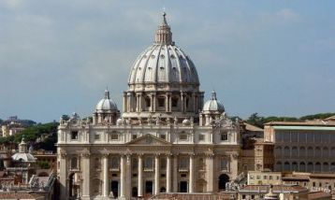
Autumn Term: Task 2
Can you label:
The front - The front or "façade" of the buildings were generally symmetrical.
Columns - They used Roman type columns.
Arches and Domes - Arches and domes were popular. This was again taken from Roman and Greek architecture.
Ceilings - The ceilings of buildings were generally flat.
Square shaped – often buildings were square shaped.
Purpose: this will help you to consolidate your knowledge of the Renaissance and will help you to practice for our first assessment.
In your lesson this week, you learned about the Renaissance, when people were very interested in Ancient Greece and Rome. Renaissance buildings often copied ancient styles. Look at the image below of St Peter’s in Rome. Take a screenshot and label it. Can you find the features below?

Slide 4
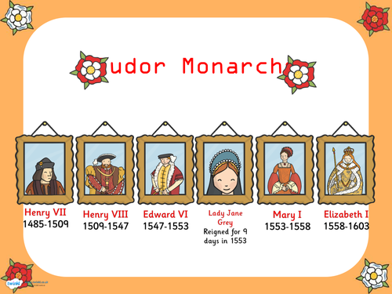
Autumn Term: Task 3
Purpose: this is pre-learning that will help you to be successful over the next few weeks.
Learn the order of the Tudor Monarchs (dates are optional)
Research one monarch you don’t know much about and find out 3 facts about them. You might find this website useful: https://www.bbc.co.uk/teach/how-the-tudor-dynasty-shaped-modern-britain/zrhdbdm

Slide 5
Autumn Term: Task 4
Purpose: This is vocabulary learning that will help you to understand the next few lessons
Learn these key words and their meanings for next lesson. Cover them up and test yourself. Once you have done this, use the Quizlet link or Blooket link below to test yourself and upload a picture of your quiz score to Teams.
https://play.blooket.com/solo?id=684aa17c7d07d828b1a07a06
https://quizlet.com/gb/1053707503/key-concepts-of-the-reformation-and-the-tudors-flash-cards/?i=t6bni&x=1jqt
The Tudors | The royal family on the throne from 1485-1603
The Pope | The head of the (Catholic) Church
The Reformation | When the European Church split into Protestantism and Catholicism (1500s)
The Wars of Religion | The wars in Europe that started due to the Reformation (1500s and 1600s)
Catholics | They wanted the Church to stay the same and they supported the Pope
Protestants | They protested against the Catholic Church and wanted to get rid of the Pope as the head of the Church.
Indulgence | Something you buy from the Church in order to have your sins forgiven.
Mass | Part of the Church service where the congregation shares bread and wine.

Slide 6
Autumn Term: Task 5
Purpose: You will be tested on these dates in your next history assessment and they will help to strengthen your mental timeline
Read them, cover them up and test yourself or ask someone else to test you! Once you have finished, use the Quizlet or Blooket links below to test yourself and post a screenshot to Teams of your final score
https://quizlet.com/gb/1053977439/key-events-in-early-modern-european-history-flash-cards/?i=t6bni&x=1jqt
https://play.blooket.com/solo?id=684bd03a29986cba4771ddaf
When you have finished, use the Quizlet at the bottom to test yourself on the key dates from Year 7 which will also be part of your first assessment.
1485 | The Battle of Bosworth, Henry Tudor becomes King.
1492 | Columbus sails to America
1517 | Martin Luther nails his 95 theses to the door of a German church.
1530s | Henry VIII takes control of the English Church
1588 | The Spanish Armada: Catholic Spain tries to invade Protestant England and fails.
https://quizlet.com/gb/576906520/year-7-history-timeline-flash-cards/?i=t6bni&x=1jqt

Slide 7
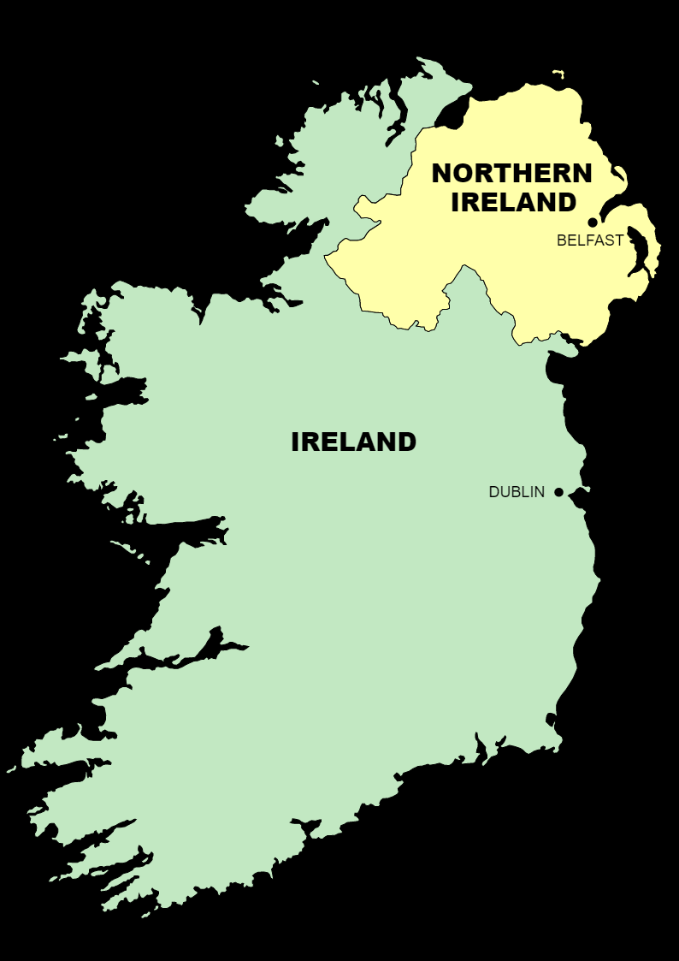
Autumn Term: Task 6
How does the Reformation still affect the world today? Although there is much less conflict between Catholics and Protestants today, the division between Catholics and Protestants is still important in some places.
Task: Read the information on the next page and answer this question: Why is the division between Catholics and Protestants still important in Northern Ireland today?

Slide 8
(Taken from https://passage-new.cappelendamm.no/c453153/artikkel/vis.html?tid=498532)
Why is there so much talk of Catholics and Protestants in the conflict in Northern Ireland?
The Republic of Ireland is historically a Catholic country and a large majority of the Irish are Catholics. Many people in Northern Ireland are descendants of the original population of this region and are also Catholics. However, the majority of the Northern Irish have ancestors who emigrated from England and Scotland and these two countries have been Protestant for almost 500 years. Therefore, we end up with a rather confusing situation with a split population from two different cultural and religious backgrounds.
What do the Catholics and the Protestants want in Northern Ireland?
Many Catholics want to be reunited with the rest of Ireland and to leave the union with England, Scotland and Wales. Many Protestants, on the other hand, wish to remain within the UK because they feel culturally and historically a part of this union since their ancestors emigrated from England and Scotland hundreds of years ago.

Slide 9
Autumn Term: Task 7
Possible sentence starters:
The Reformation mattered to ordinary people because…
The Reformation mattered to Kings and Queens because…
Purpose: This is a practice paragraph for our assessment in two weeks time.
Written Task: Why did the Reformation matter so much to people at the time?
Task: Write a paragraph explaining why the Reformation mattered so much to people at the time. Make sure you support your ideas with knowledge from the past two lessons. How did it affect ordinary people? What problems did it cause? Why were people willing to die for their religion?

Slide 10
Autumn Term: Task 8
Purpose: This is revision for your assessment next lesson
Create three flashcards to revise for your essay “Why did the Reformation matter so much to people at the time?” Create one flashcard on why it mattered to protestant martyrs, one on why it mattered to monarchs, and one on why it mattered to ordinary people. E.g.
2) Revise your key dates again using the Quizlets: https://quizlet.com/gb/1053977439/key-events-in-early-modern-european-history-flash-cards/?i=t6bni&x=1jqt
https://quizlet.com/gb/576906520/year-7-history-timeline-flash-cards/?i=t6bni&x=1jqt
One side of your flashcard:
Why did the Reformation matter so much to protestant martyrs?
The other side of your flashcard:
e.g. Thomas Cranmer was willing to be burned to death rather than become a Catholic.
This was because he thought that…
Use the BBC Bitesize Revision Guide on the Reformation or the knowledge organiser on the next slide if you get stuck:
https://www.bbc.co.uk/bitesize/articles/zgkcr2p#zhvsn9q

Slide 11
Knowledge Organiser: Why did the Reformation matter to people at the time? |  |  | Questions to answer to check your understanding:
Group | Action | Reason
Martyrs (people willing to die for their religion) | Refused to follow the official religion and were willing to die for their beliefs (for example, Latimer and Ridley were burned to death under Mary I). | They believed that the official religion was false (heresy) and needed to protect their own souls so that they would go to heaven. | What is a martyr? What did they do? Why? Why did they care so much about following the true religion?
Monarchs (king or queen) | Took control of the Church, for example Henry VIII introduced their own Bible and Edward VI removed images and statues from churches. Can you find any further examples in your classwork? | It gave them an opportunity to increase their own power, for example Henry VIII was able to take control of the Church and divorce his wife. But they also wanted to protect their own souls and those of their people. | What is a monarch? What did Henry VIII do after taking control of the Church? Why did monarchs want to control the Church?
Ordinary people | Some rebelled against the new changes, for example going on the Pilgrimage of Grace in 1536 against the shutting down of the monasteries. | They were distressed by the attacks on the religion that had been part of their everyday life for centuries. They also relied on monasteries as a place of support and charity. | What was the Pilgrimage of Grace? Why did ordinary people take part? Why would ordinary people have been shocked by the speed of change?

Slide 12
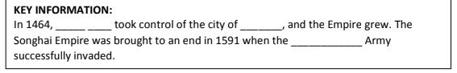
Autumn Term: Task 9
Purpose: This will help you to broaden your knowledge beyond Europe
The Tudor family ruled England...meanwhile, elsewhere the Songhai Empire flourished in West Africa. Use the links below to copy and complete the key information box and to answer the questions.
https://www.ducksters.com/history/africa/songhai_empire.php
https://www.britannica.com/place/Songhai-empire
http://www.blackpast.org/gah/songhai-empire-ca-1375-1591
https://www.youtube.com/watch?v=11XUwCcC9twm
How did the Empire begin?
What religion was the Empire?
How was it governed?

Slide 13
Autumn Term: Task 10
Purpose: This is vocabulary learning to help you to understand the next few lessons.
Learn these key words and their meanings for next lesson. Quiz yourself afterwards using the Quizlet or Blooket link below. Post a screenshot of your score to Teams as evidence.
https://quizlet.com/gb/1053981382/key-concepts-of-the-stuart-period-in-england-flash-cards/?i=t6bni&x=1jqt
https://play.blooket.com/solo?id=684bd67b93c0fc7d3e8ce6a9
The Stuarts | The royal family on the throne from 1603-1714
Divine Right of Kings | The belief that the King’s power came from God and therefore that the King could not be challenged.
Tyranny | When one person has all the power and rules in a cruel or self-interested way.
Puritan | A radical or extreme Protestant.
Parliament | A group of people (MPs) that pass laws and approve taxation.
Archbishop Laud | Archbishop of Canterbury and advisor to the King. He believed in the “beauty of holiness”.
Civil War | A war that happens within a country. In our case, it happened between supporters of the Parliament (Parliamentarians) and the King (Royalists).

Slide 14
Autumn Term: Task 11
Challenge (show your teacher for a House Point): These key events are part of the early modern period. What would you say are the key features of the early modern period and how is it different to the Middle Ages? Write down 5 differences between the Middle Ages and the early modern period.
(Hint: Think about the Church, religion, exploration, power)
Purpose: This is to help you to link your knowledge of the civil war to your previous knowledge to strengthen both.
Looking back at last half term…
Answer these questions in full sentences.
What happened during the English Reformation? (Think back to Henry VIII and the Church…)
How do Charles’s problems and the outbreak of Civil War in Britain link back to the Reformation in England? (Hint: What were Charles’s religious problems?)
If you have forgotten about the Reformation, this site might help: https://www.bbc.co.uk/bitesize/articles/zgkcr2p#zhvsn9q

Slide 15
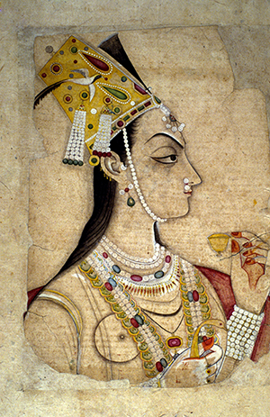
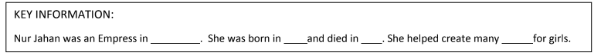
Autumn Term: Task 12
Purpose: This will help you to broaden your knowledge beyond European history.
The Stuarts came to the throne in Britain...meanwhile, elsewhere Nur Jahan fought tigers and helped rule an empire. Use the following slide to copy and complete the key information box and to answer the questions. Use the links below for extra reading about Nur Jahan.
http://www.open.edu/openlearn/history-the-arts/world-changing-women-nur-jahan
https://www.historyofroyalwomen.com/nur-jahan/empress-mughal-india-nur-jahan/
Why was she able to rule instead of her husband?
What were her achievements as a ruler?

Slide 16
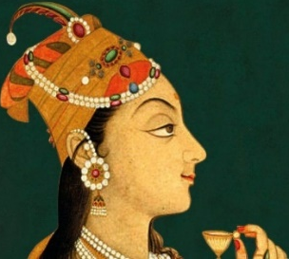
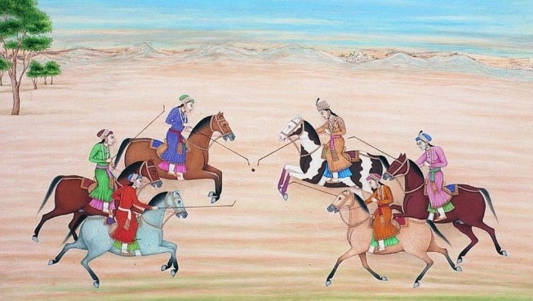
The Mughal Empire - Empress Nur Jahan
Empress Nur Jahan was the most powerful woman in 17th Century India. She played a very important role in running the huge Mughal empire.
Nur Jahan was born in 1577 near Kandahar (in present-day Afghanistan), she was from a Persian family, who had left their home in Iran amid increasing intolerance to seek refuge in the more liberal Mughal empire of India. Nur Jahan was brought to court in 1607, to serve as lady-in-waiting. Reputedly very beautiful, she attracted the attention of the Emperor and they were married in 1611; she would be Jahangir’s twentieth and last wife. During the next ten years, she assumed all the rights of sovereignty and government. Her husband, Jahangir’s addiction to alcohol and opium, and preference for artistic pursuits made him dependent upon her to rule in his name. She controlled all matters of government.
She has been portrayed as a schemer who took advantage of her husband’s addiction to take power. But evidence also points to her physical strength and courage, a talent for administration, and responsibility for the many artistic, architectural, and cultural achievements of Jahangir’s rule. She designed the gardens of Kashmir and Agra and was a patron of poetry. She took a special interest in women’s affairs and provided land for women and opportunities for orphan girls. She was a poet, an expert hunter and an innovative architect. Her design for her parents' tomb in Agra later inspired the construction of the Taj Mahal. One courtier described an incident where she surprised many by appearing in the imperial balcony, which was reserved for men only. This was not her only act of defiance. Be it hunting, issuing imperial orders and coins, designing public buildings, taking measures to support poor women or champion the disadvantaged, Nur lived a life that was unusual among women at the time. She also led an army to save the emperor when he was taken captive. She was also known as a “tiger-slayer” after taking down four tigers with six bullets during a single hunt.
Nur Jahan is shown playing polo with other women
Jahangir’s failure to name an heir before his death in 1627 led to a power struggle amongst his sons. Nur Jahan’s power weakened and she was confined by Jahangir's third son, Shah Jahan. Her imprisonment ended her influence at court, and she spent her final years in exile. She died on 17 December 1645 and is buried in Lahore.

Slide 17
Autumn Term: Task 13
Purpose: This will help you to revise for your assessment next lesson “Why did civil war break out in 1642?”
1) Use your classwork and the knowledge organiser on the next slide to create three flashcards, one for each cause (see boxes below). On the back, include specific evidence you want to include in that paragraph. Use your flashcards at regular intervals to test yourself. You may also find this website useful:
https://www.bbc.co.uk/bitesize/topics/zk4cwmn/articles/zxxgg7h?topicJourney=true#zxv66g83
2) There will also be a timeline quiz in your assessment on key events from Y7 and Y8. Use these Quizlet links below to revise:
https://quizlet.com/gb/1053977439/key-events-in-early-modern-european-history-flash-cards/?i=t6bni&x=1jqt
https://quizlet.com/gb/576906520/year-7-history-timeline-flash-cards/?i=t6bni&x=1jqt
Paragraph 1 (cause 1)
e.g. Conflict over power
Paragraph 2 (cause 2)
e.g. Religious tensions
Paragraph 3 (cause 3) e.g. Money problems

Slide 18
Knowledge Organiser – Why did Civil War break out in 1642?
James I taught his son Charles that God had given him the power to rule alone. This was known as the Divine Right of Kings. | Charles had a Catholic wife, Henrietta Maria. She was unpopular with many in Parliament, especially the Puritans. | In 1629, Charles decided to rule without Parliament for 11 years when it would not give him the taxes he wanted.
In 1633, Charles made Laud Archbishop of Canterbury. Laud didn’t like Puritans, and wanted to make the Church look more beautiful, more like the Catholic Church. | By the 1630s there were many Puritans in Parliament and in parts of England like London. They were angry at Laud who seemed to be making the Church more like the Catholic Church. | In 1635, Charles collected Ship Money from inland counties and it looked like it would become a regular tax. Some people thought Charles shouldn’t have the power to do that.
In the 1630s, Charles needed to come up with ways of getting money which didn’t involve Parliament so he could rule by himself. He introduced unpopular taxes. | In 1639, Scottish rebels who hated Laud’s new prayer book attacked England. This meant that Charles had to call Parliament to raise money to defend England. | When Charles finally called Parliament in 1640, it took the opportunity to criticise him, to demand that he lose some of his power, and to arrest Archbishop Laud, a favourite of Charles.
In October 1641, Irish Catholics rebelled against their Protestant rulers. Rumours spread that Charles was behind the rebellion. Parliament would not allow Charles to lead an army against it. | On 4th January 1642, Charles forced his way into Parliament, but failed to arrest 5 leading MPs. He was angry about Parliament’s demands and their opposition to him leading an army against the Irish rebellion. | Can you sort these into tension or conflict over money, religion, and power? Can you use them to add extra detail to your flashcards?

Slide 19
Autumn Term: Challenge homework – show your teacher for a house point
Purpose: This will help you to see the bigger picture and will strengthen your knowledge from Year 7 and Year 8
Thematic Overview: Power and the monarchy
Using your learning from Year 7 and Year 8, think about how the power of the monarchy (the king/queen) has changed between 1000 and 1700. Complete the following tasks:
Pick one event, development or change from this period (1000-1700) that has increased the power of the monarchy. Explain how it did this.
2) Pick one event, development or change from this period (1000-1700) that has decreased the power of the monarchy. Explain how they did this.

