Slide 1
FINE ART GCSE an overview of homework

Slide 2
FINE ART GCSE HOMEWORK
As ALL of the work that students produce in year 10 and 11 can be submitted for assessment there are no stand alone homework tasks. Every piece of work goes into the sketchbook or portfolio and counts towards the final grade.
Teachers will guide students lesson by lesson setting tasks and homework as appropriate.
Often classwork and homework will overlap so it is not possible to share a week by week list of homework tasks in advance.
Homework will be set weekly on teams and resources shared to support the task. A clear deadline is always given.
We will offer opportunities to complete class and homework after school for any students who find this useful. If a students get behind with class and homework they will have p 7 and 8 added to their timetable as an additional support.
The following slides show a body of work from one student produced over the two year course

Slide 3
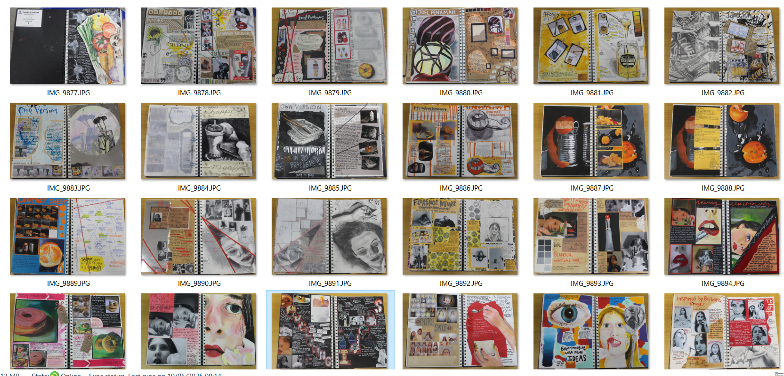
produced from Sept to dec year 11
Work produced from September to December of year 10 .roduced from Sept to dec year 11

Slide 4
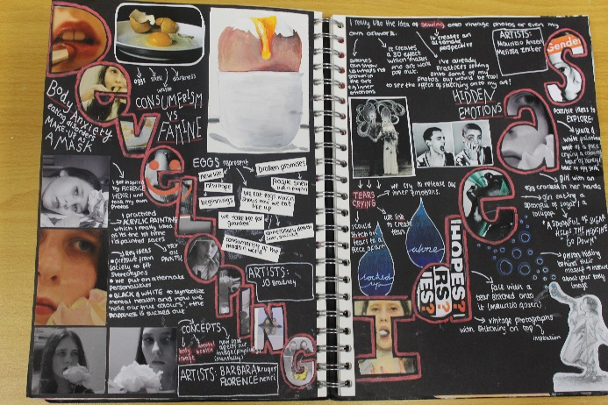
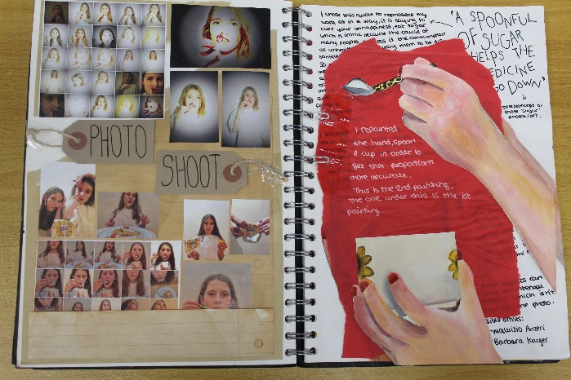
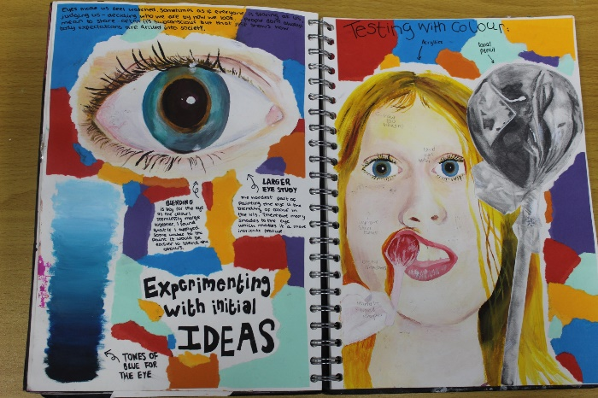
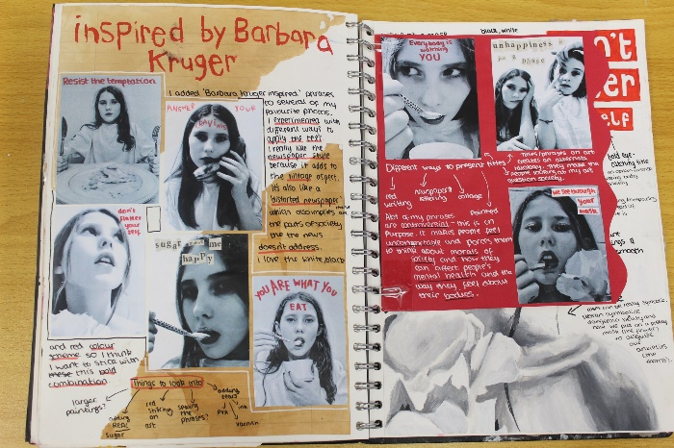
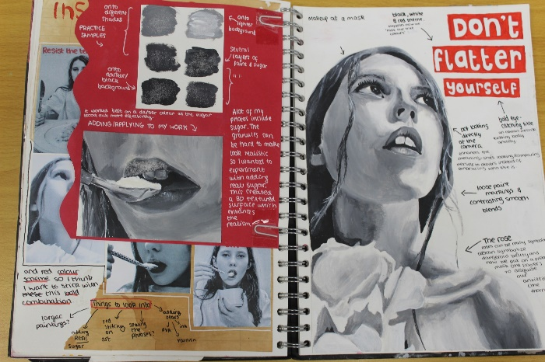
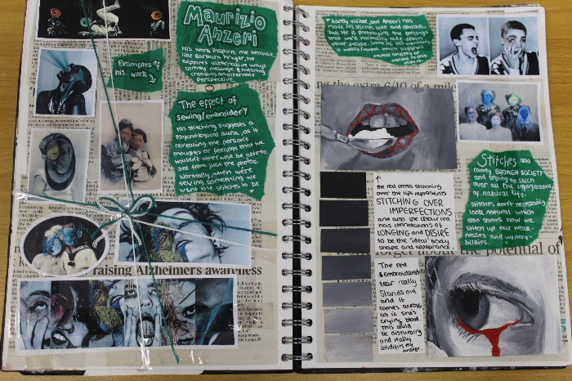
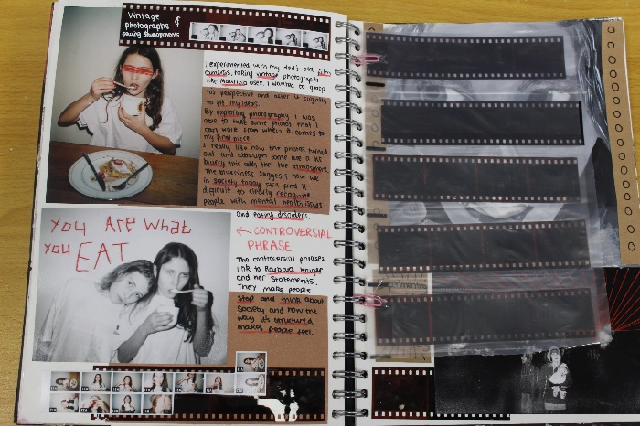
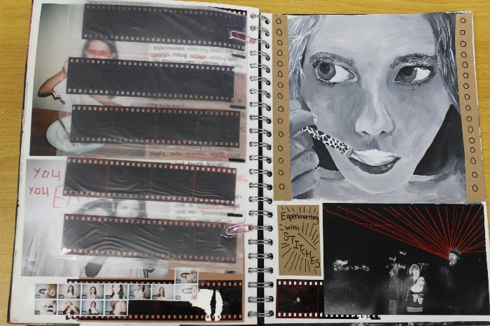
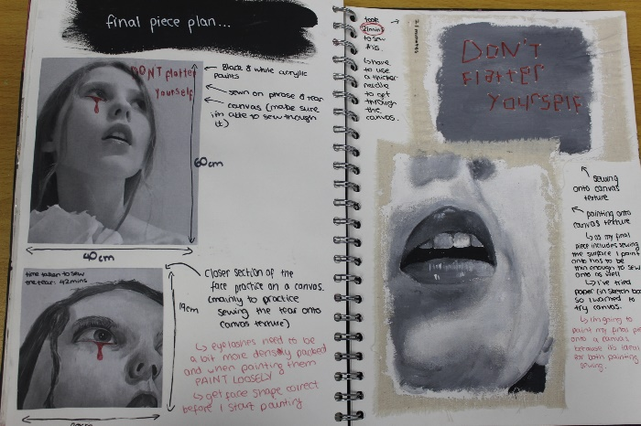
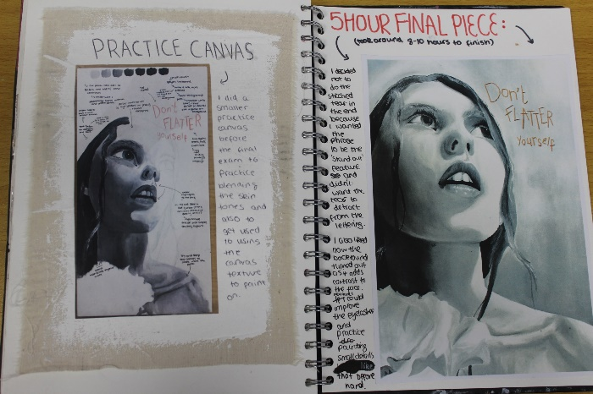
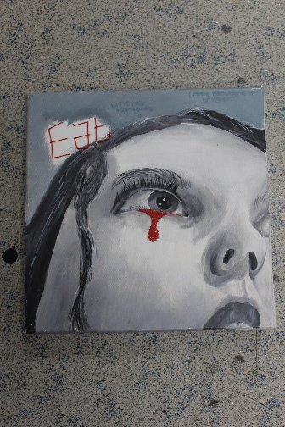
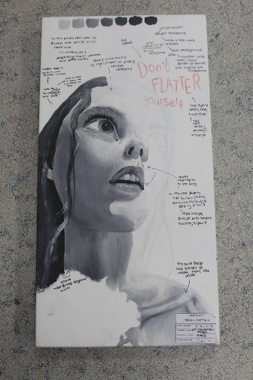
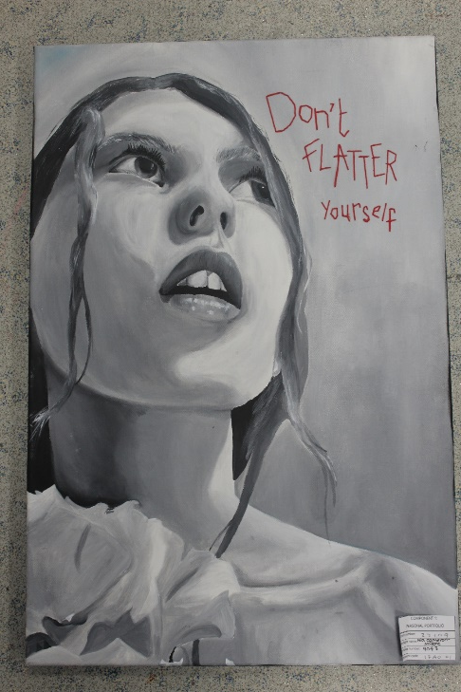
Work produced from January to April year 10

Slide 5
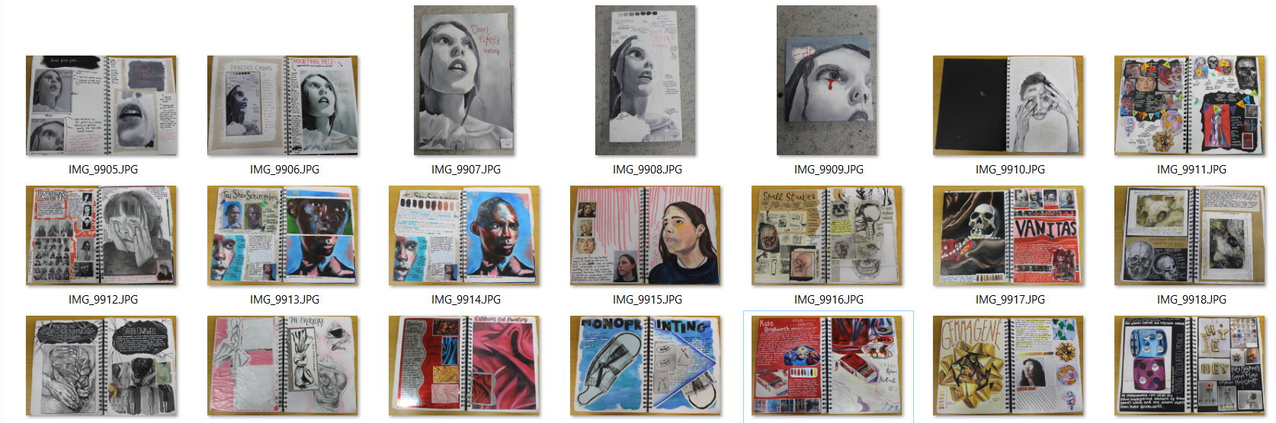
Work produced from April to July year 10

Slide 6
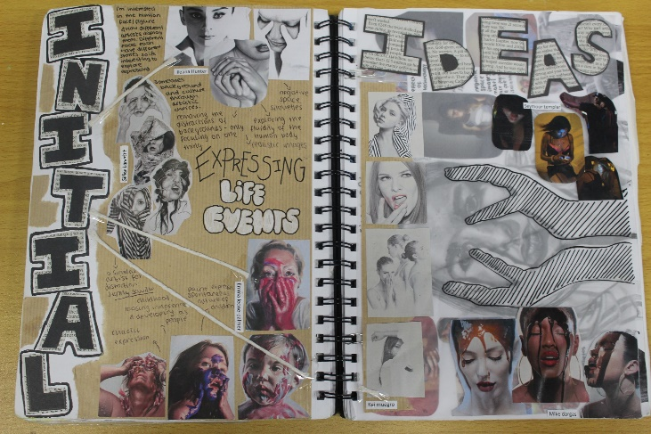
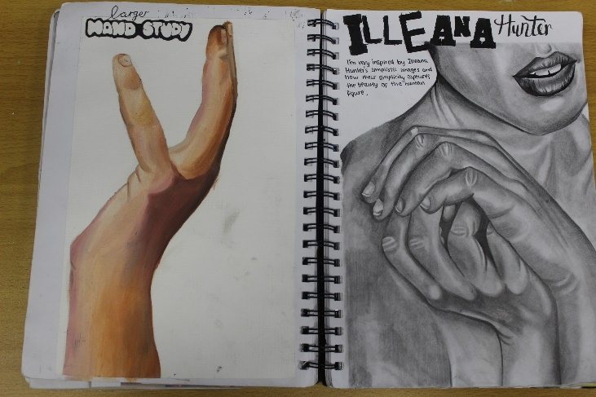
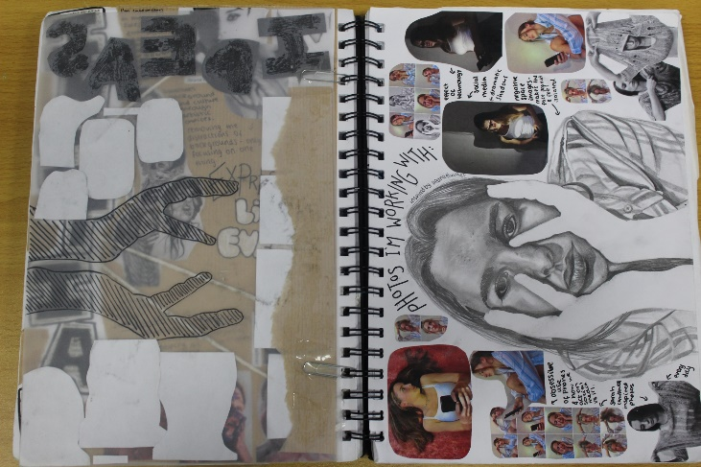
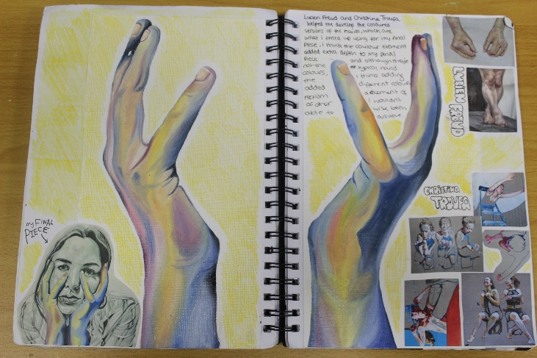
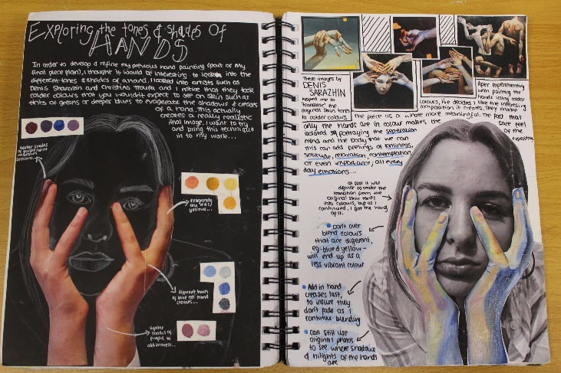
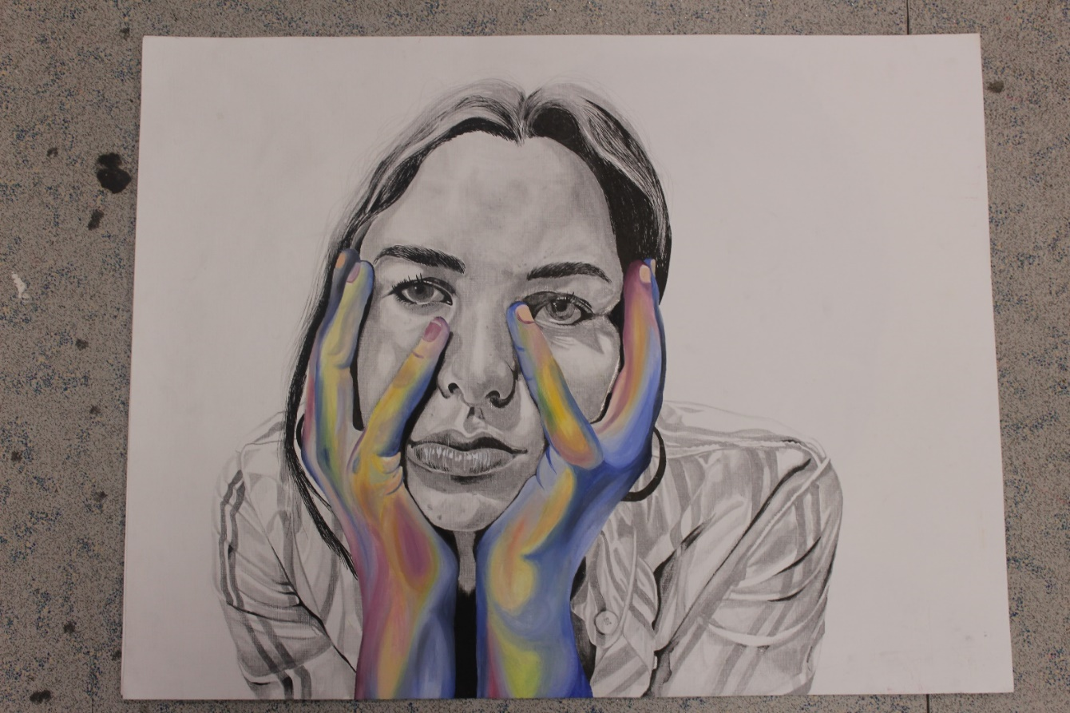
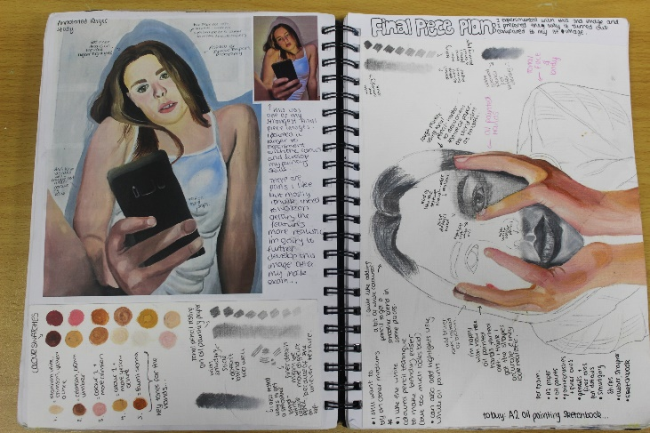
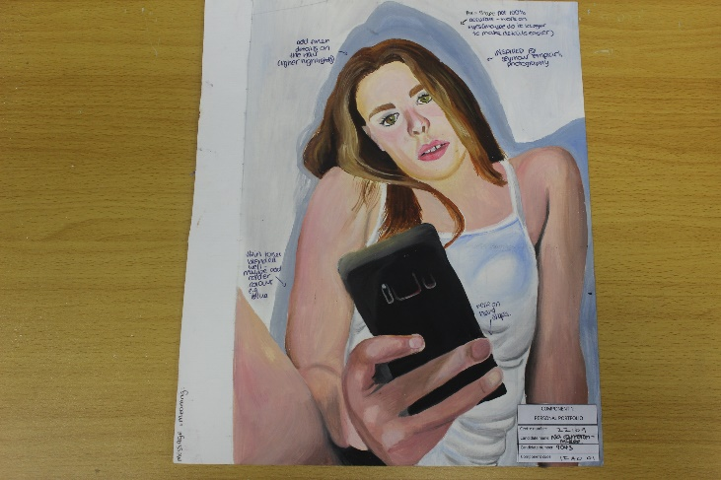
Work produced from Sept to Nov year 11

Slide 7
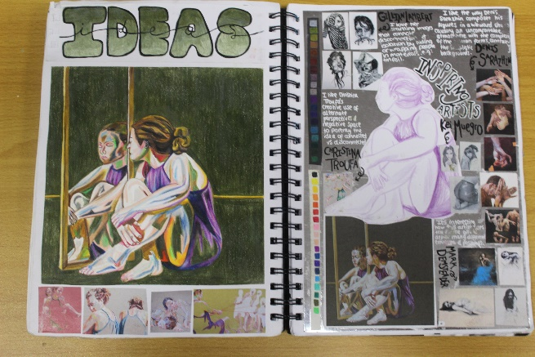
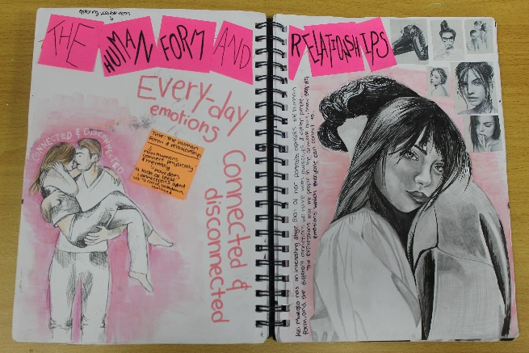
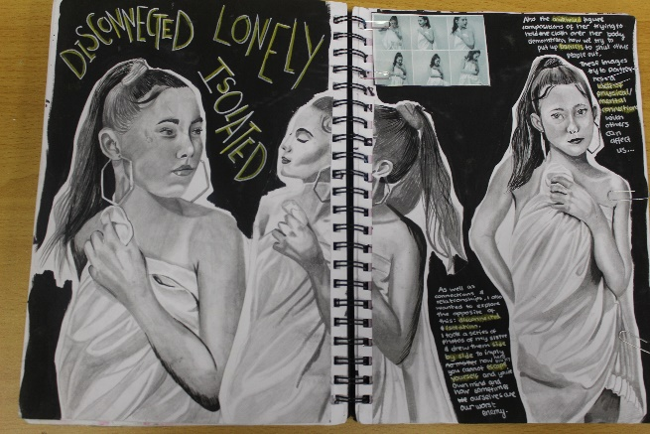
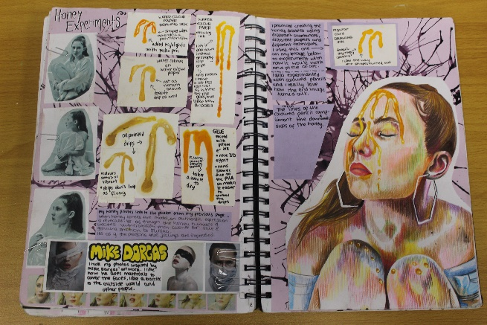
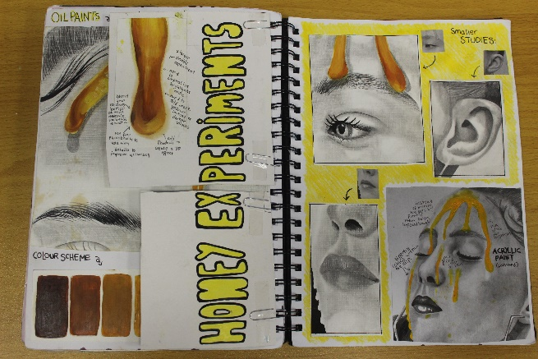
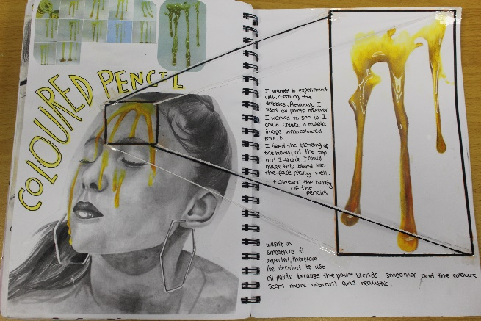
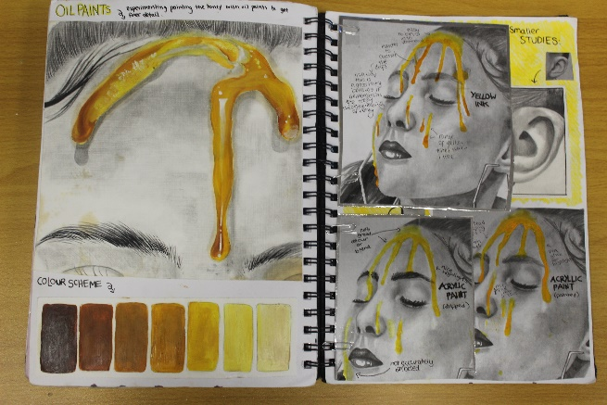
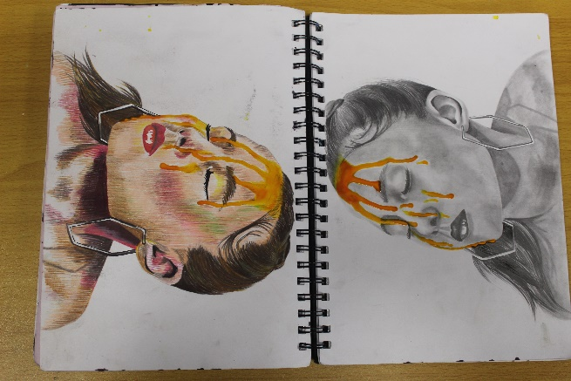
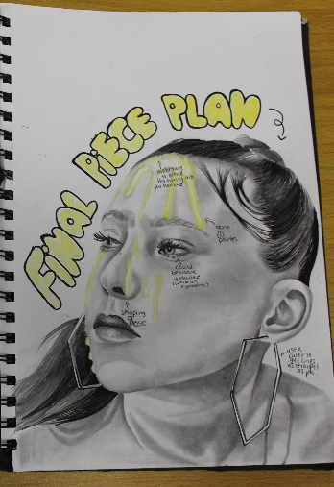
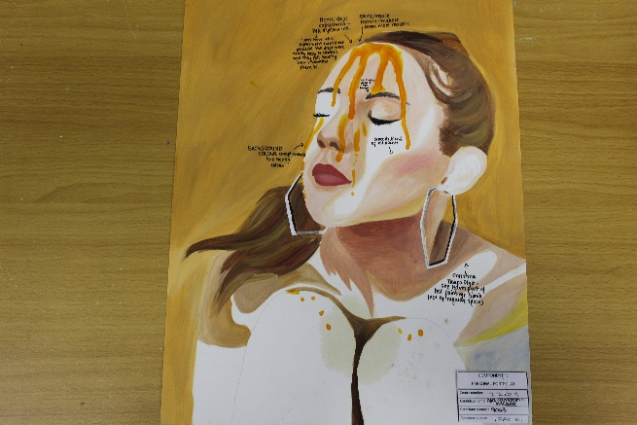
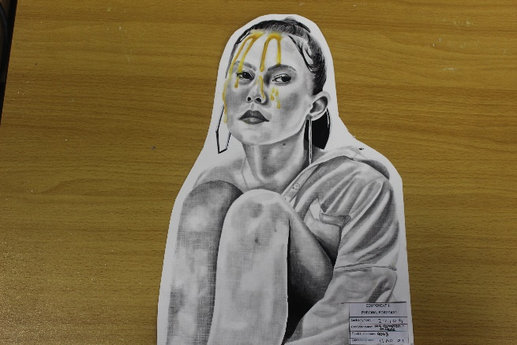
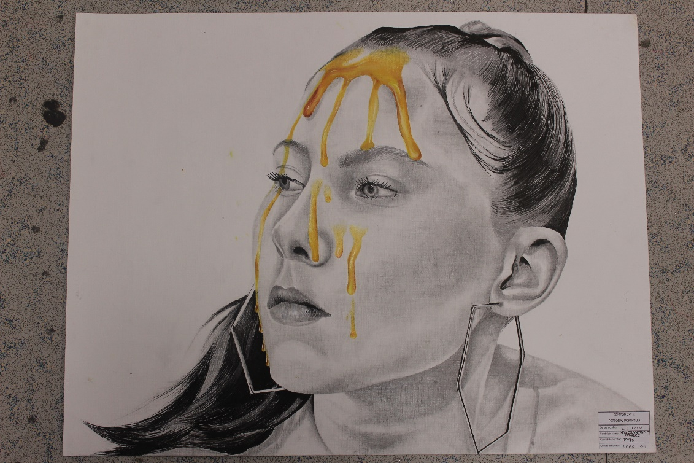
Work produced for the externally set assignment from January to April year 11

Slide 8
With this continuous project approach in mind weekly homework focuses on consolidating taught lessons by practicing skills and presenting developing work in the sketchbook.
Sometimes the tasks will be very explicit such as …

Slide 9
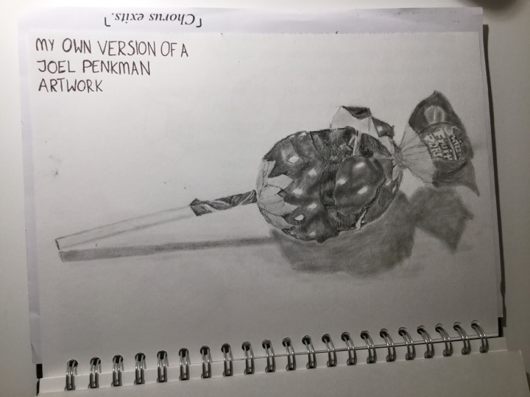
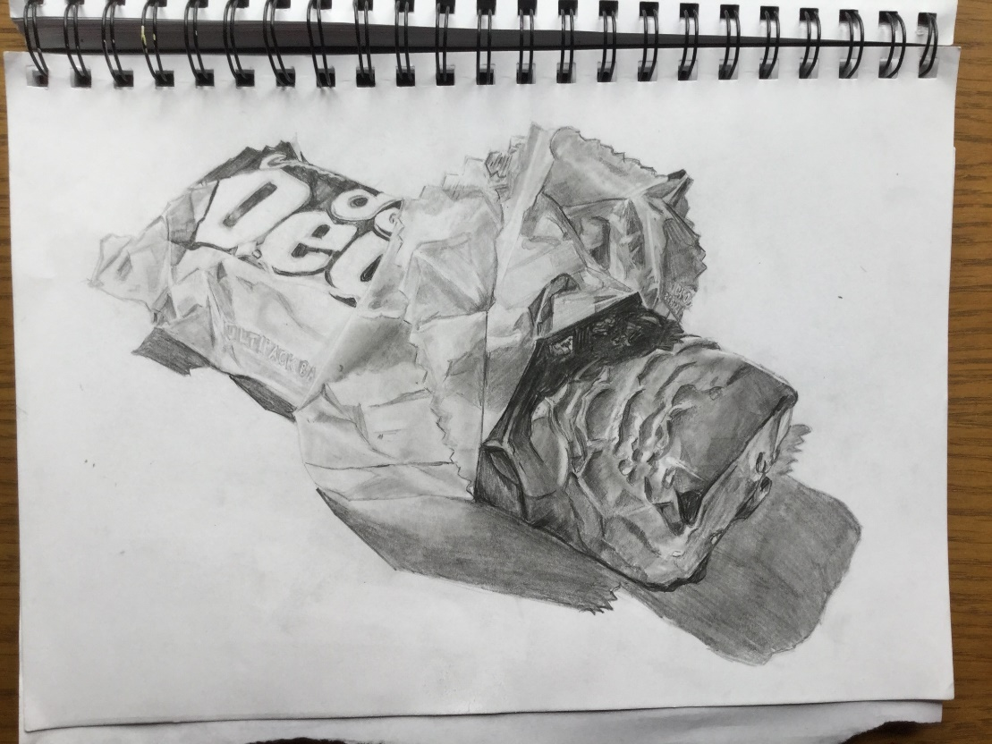
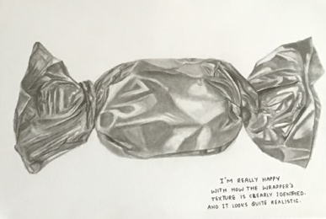
HOMEWORK: Make a drawing from your photoshoot
DUE: Monday 26th September
Please choose any methods and materials to complete the homework. Add to your page presentation or start a new page – work SMART quality over quantity

Slide 10
Often the task will be to present the classwork in the sketchbook.
A clear break down of what is needed on each page will be shared, such as…

Slide 11
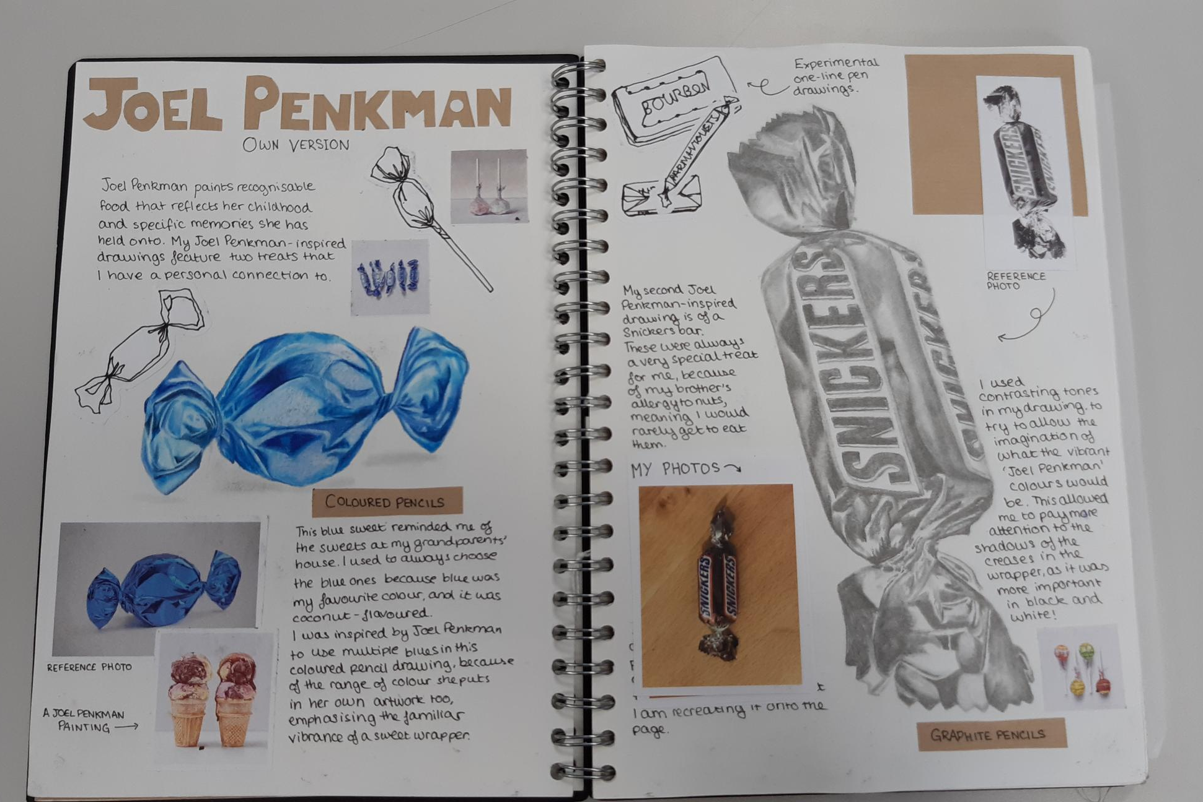
Your tonal drawing of a sweet
Your own photos
Joel Penkman artworks
Bold headings
Notes to explain your reaction to her work and developing ideas
EXTENSION: work in other materials, colour, paint etc.
JOEL PENKMAN PAGE
I am inspired by Joel Penkman’s realistic painting of sweets and food. Her work is inspired by food memories and national identity linking to food items. I am interested in exploring own memories of my favourite childhood sweets such as….

Slide 12
High quality exemplars will be shared...

Slide 13
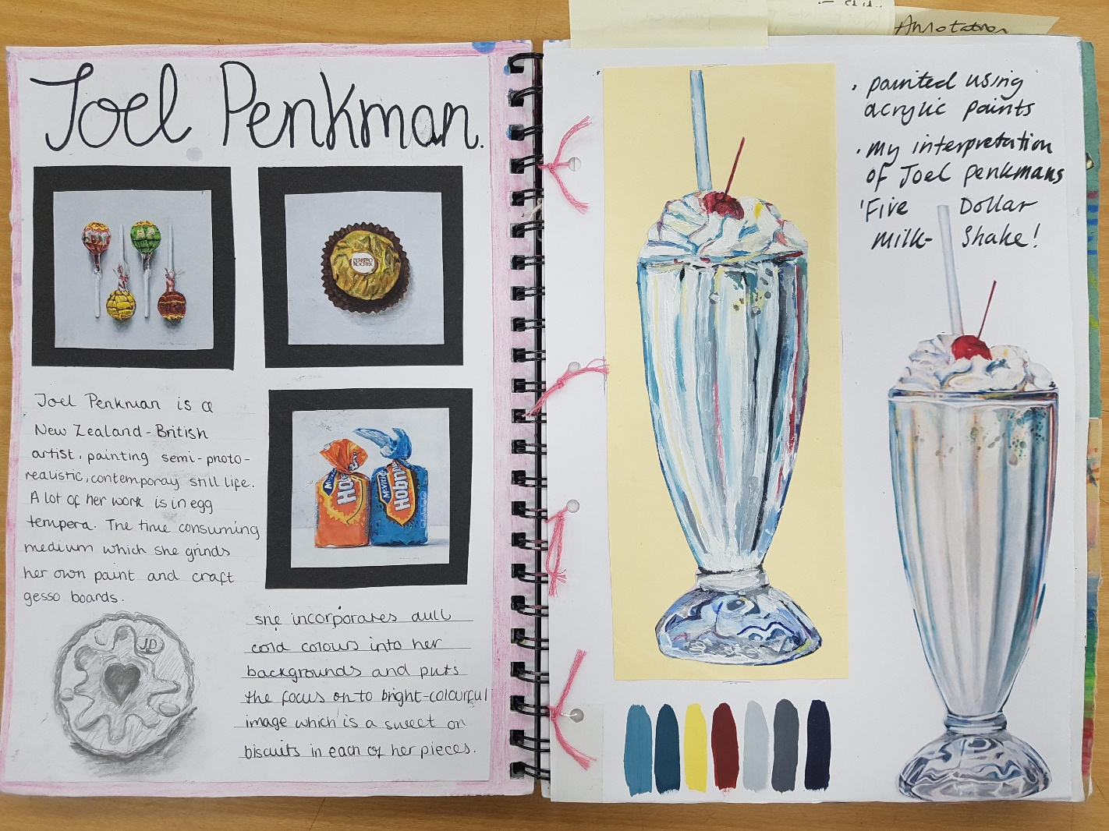

Slide 14
Students will sometime be set personalised tasks such as ‘complete your annotation’, again exemplars will be given...

Slide 15
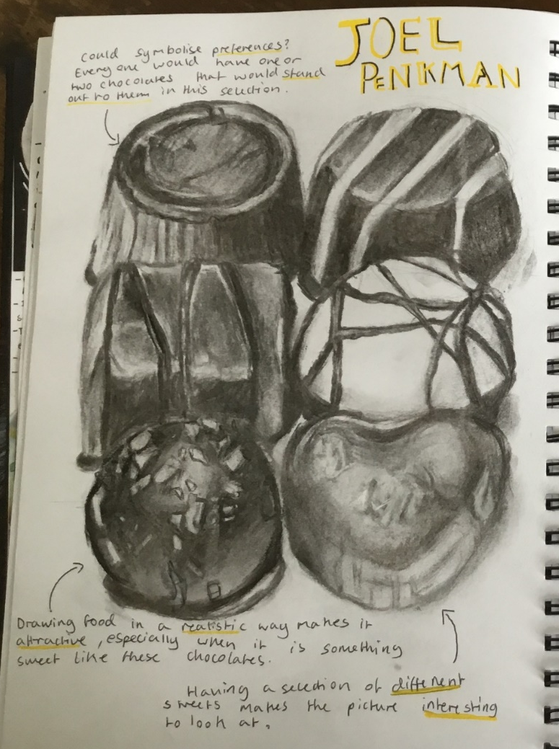

ANNOTATION
Sentence starters
I am inspired by…
I like how…
I am interested in…
MAKE IT PERSONAL: I am inspired by Joel Penkman’s realistic painting of sweets and food. Her work is inspired by food memories and national identity linking to food items. I am interested in exploring own memories of my favourite childhood sweets such as….
Use notes and arrows
Make KEYWORDS stand out

Slide 16
As students develop personal ideas they will be asked to take photos to work from. Sometimes these can be taken in school but often these are more exciting and successful when taken at home or on location…

Slide 17
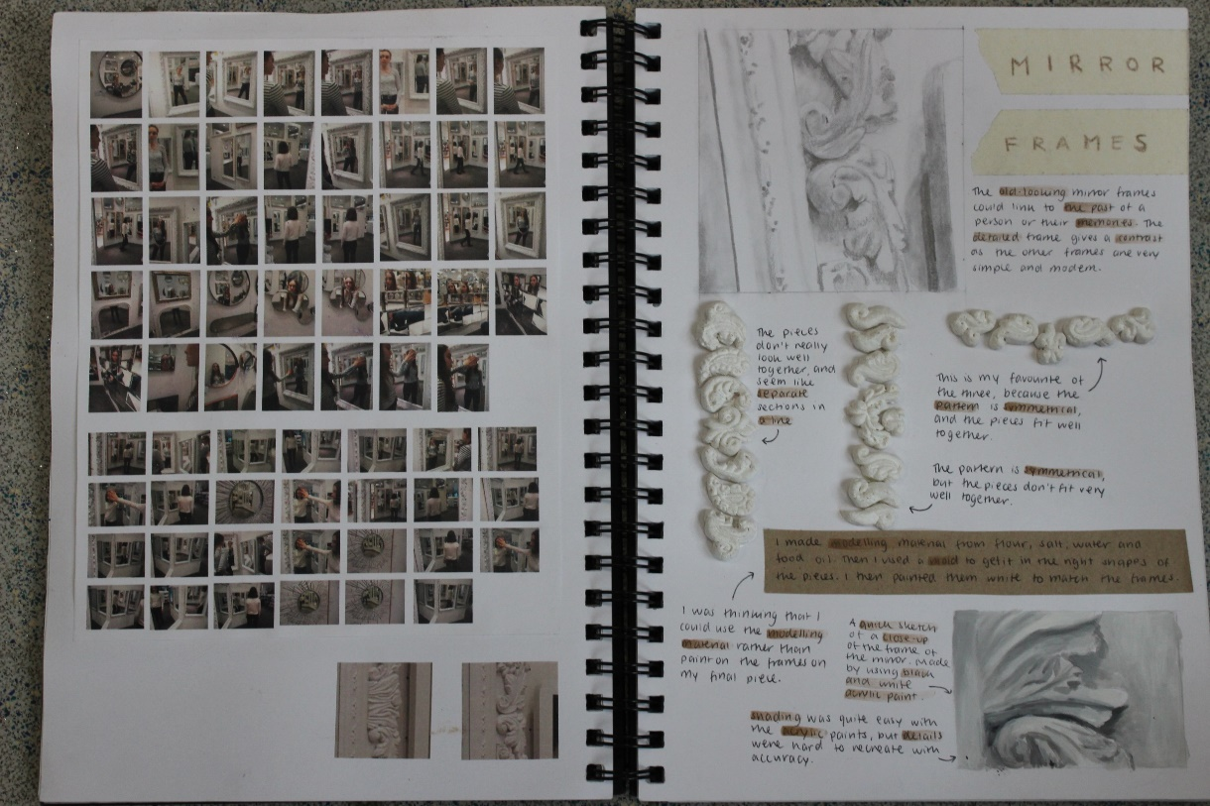
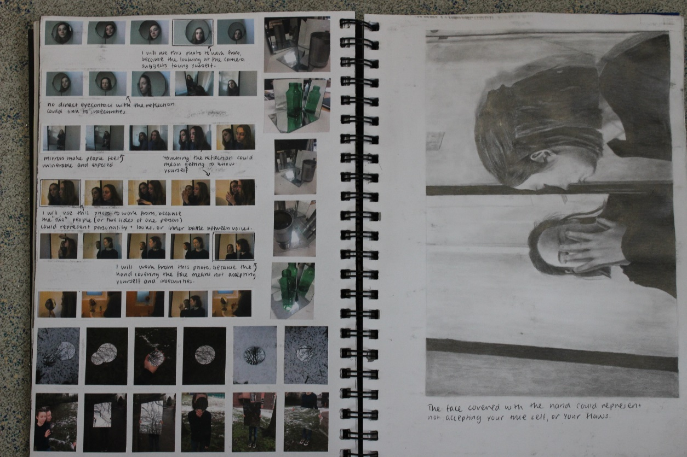
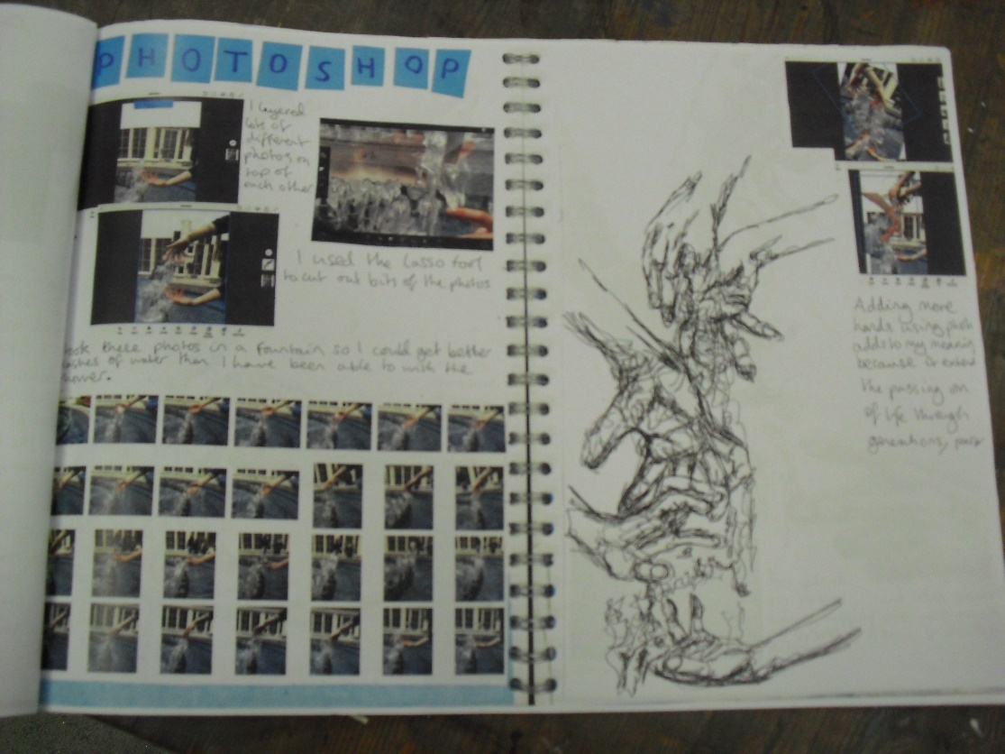
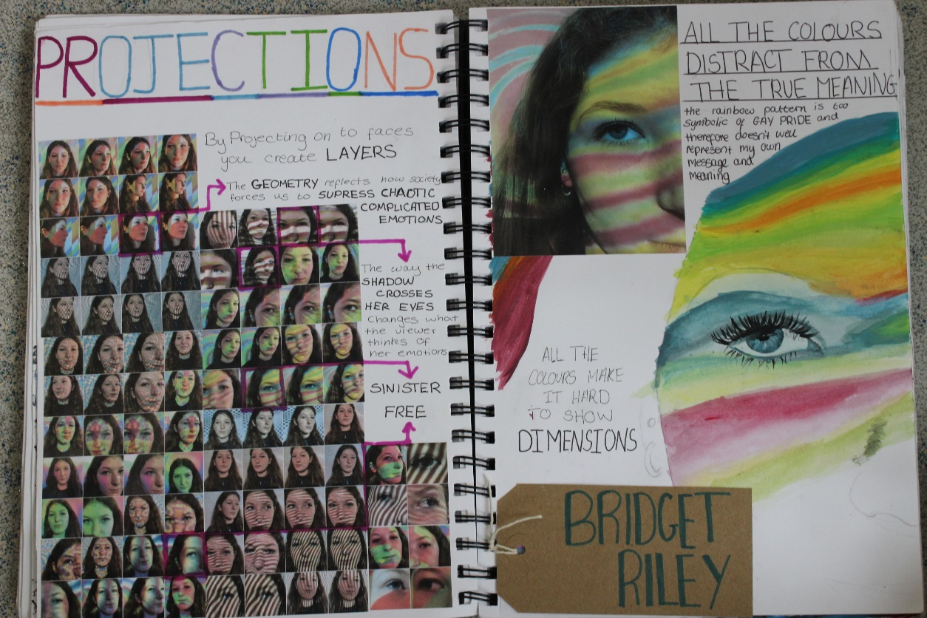
PHOTOSHOOT
Take a series of photos inspired by your developing ideas
Consider:
When, Where, Why, What, Who
Lighting
Background
Location
Props
People
Expressions
Range of ideas
Message and meaning
What next?

Slide 18
Exemplars and checklists will always be shared…

Slide 19
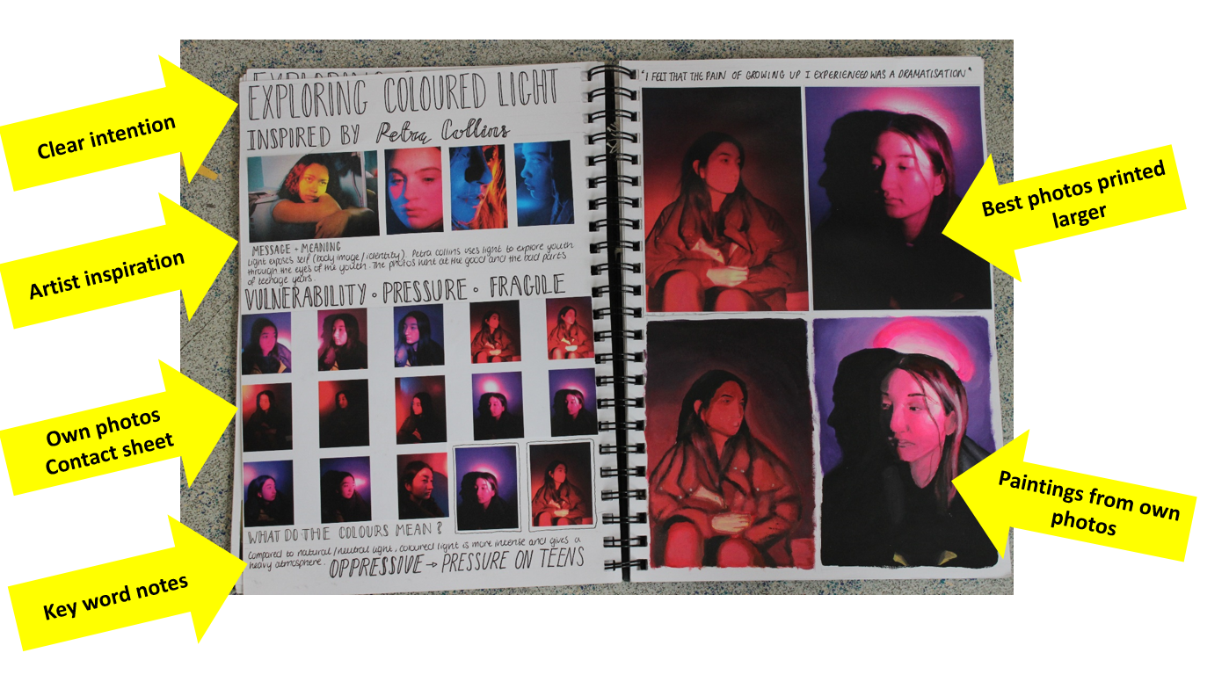
PRESENTING PHOTOSHOOTS
Title: Photoshoot inspired by…
Include artists work to show inspiration
Print a contact sheet and Present in sketchbook, circle and annotate to explain which photo you will use and why.
Add two or three larger photos
Add at least one quality drawing or painting to this page
Add notes to explain developing ideas
Annotation prompts:
How are you inspired, what looks good – why?
What ideas do you have? What possible message and meaning is there? What would you like to do next? What else could you try? What do you need to do?

Slide 20
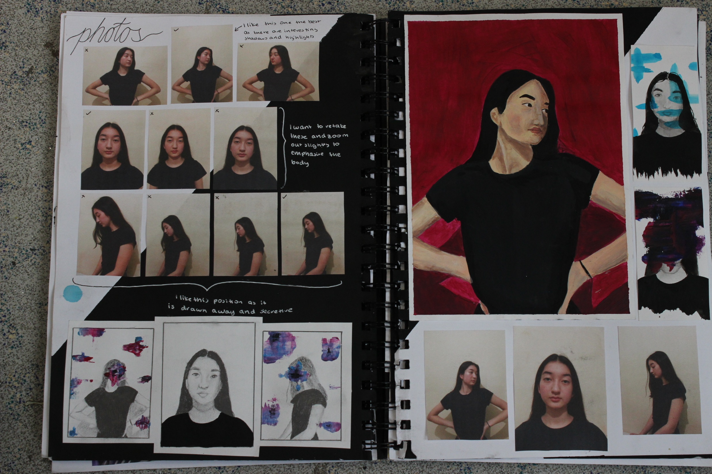
Bold heading
Own photos
Working from own photos
Notes explain developing ideas

Slide 21
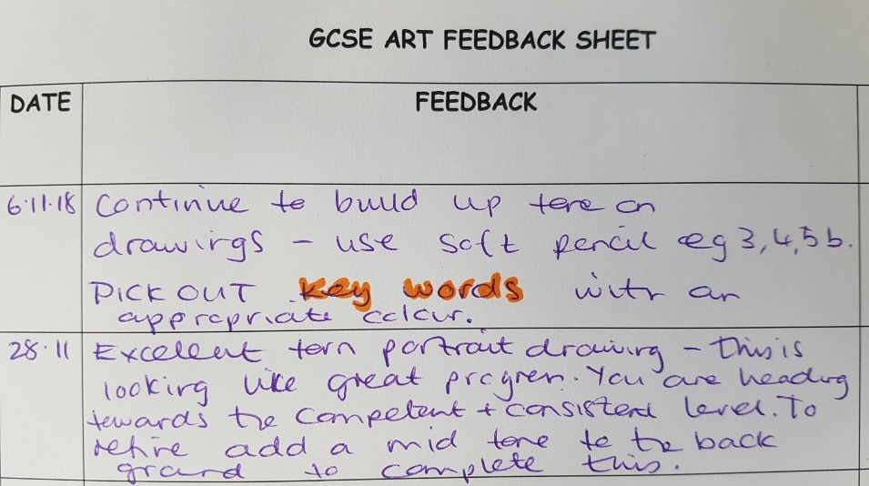
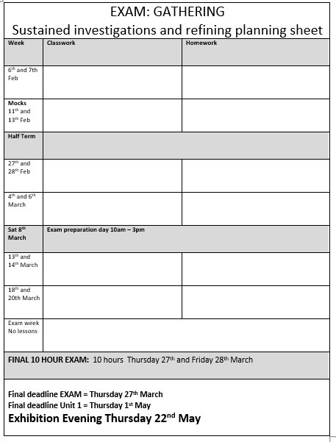
At the start of a project tasks will be more teacher led but as student get into developing their own ideas they might be set personalised feedback tasks or plan their own homework tasks in discussion with their teacher.
Whether classwork or homework the mantra is always ‘quality over quantity’. Please contact us if you have any queries over homework, we are here to help and support your child to manage their time effectively and achieve their potential.

