Slide 1
Year 8 History Homework Booklet
Complete one task after every lesson and submit to Teams. If you have any problems, email your teacher rather than leaving it till the lesson to talk to them!

Slide 2
Autumn Term: Task 1
What can you remember about medieval history from your work in Year 7? See if you can describe these events or places in a sentence. If you are stuck, look back at your Year 7 work or do some research! You could even look at Bitesize: https://www.bbc.co.uk/bitesize/subjects/zk26n39
Medieval Baghdad (founded 762) -
Battle of Hastings (1066) –
Murder of Thomas Becket (1170) -
Magna Carta (1215) –
Mali Empire (Medieval Mali) -

Slide 3
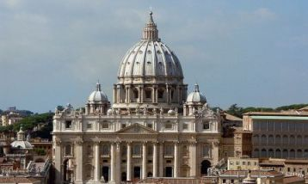
Autumn Term: Task 2
Can you label:
The front - The front or "façade" of the buildings were generally symmetrical.
Columns - They used Roman type columns.
Arches and Domes - Arches and domes were popular. This was again taken from Roman and Greek architecture.
Ceilings - The ceilings of buildings were generally flat.
Square shaped – often buildings were square shaped.
In your lesson this week, you learned about the Renaissance, when people were very interested in Ancient Greece and Rome. Renaissance buildings often copied ancient styles. Look at the image below of St Peter’s in Rome. Take a screenshot and label it. Can you find the features below?

Slide 4
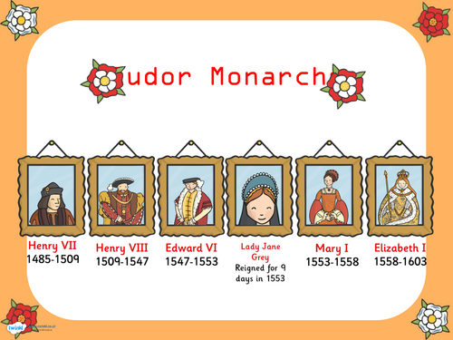
Autumn Term: Task 3
Learn the order of the Tudor Monarchs (dates are optional)
Research one monarch you don’t know much about and find out 3 facts about them. You might find this website useful: https://www.bbc.co.uk/teach/how-the-tudor-dynasty-shaped-modern-britain/zrhdbdm

Slide 5
Autumn Term: Task 4
Vocabulary Learning
Learn these key words and their meanings for next lesson. Cover them up and test yourself or ask someone else to test you!
The Tudors | The royal family on the throne from 1485-1603
The Pope | The head of the (Catholic) Church
The Reformation | When the European Church split into Protestantism and Catholicism (1500s)
The Wars of Religion | The wars in Europe that started due to the Reformation (1500s and 1600s)
Catholics | They wanted the Church to stay the same and they supported the Pope
Protestants | They protested against the Catholic Church and wanted to get rid of the Pope as the head of the Church.
Indulgence | Something you buy from the Church in order to have your sins forgiven.
Mass | Part of the Church service where the congregation shares bread and wine.

Slide 6
Autumn Term: Task 5
Learn these dates:
Cover them up and test yourself or ask someone else to test you!
When you have finished, test yourself on the vocabulary from last week too.
1485 | The Battle of Bosworth, Henry Tudor becomes King.
1517 | Martin Luther nails his 95 theses to the door of a German church.
1530s | Henry VIII takes control of the English Church
1588 | The Spanish Armada: Catholic Spain tries to invade Protestant England and fails.

Slide 7
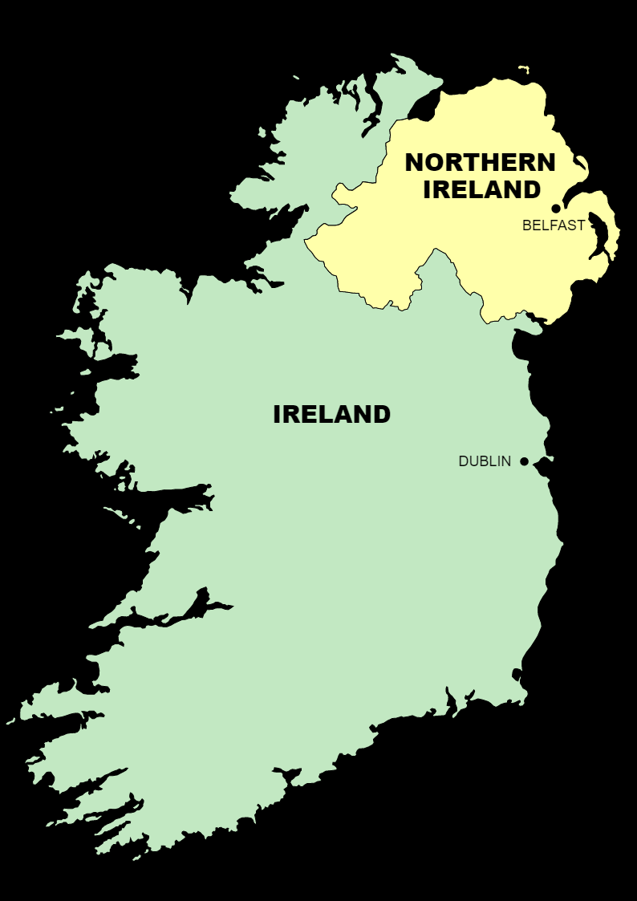
Autumn Term: Task 6
How does the Reformation still affect the world today? Although there is much less conflict between Catholics and Protestants today, the division between Catholics and Protestants is still important in some places.
Task: Read the information on the next page and answer this question: Why is the division between Catholics and Protestants still important in Northern Ireland today?

Slide 8
(Taken from https://passage-new.cappelendamm.no/c453153/artikkel/vis.html?tid=498532)
Why is there so much talk of Catholics and Protestants in the conflict in Northern Ireland?
The Republic of Ireland is historically a Catholic country and a large majority of the Irish are Catholics. Many people in Northern Ireland are descendants of the original population of this region and are also Catholics. However, the majority of the Northern Irish have ancestors who emigrated from England and Scotland and these two countries have been Protestant for almost 500 years. Therefore, we end up with a rather confusing situation with a split population from two different cultural and religious backgrounds.
What do the Catholics and the Protestants want in Northern Ireland?
Many Catholics want to be reunited with the rest of Ireland and to leave the union with England, Scotland and Wales. Many Protestants, on the other hand, wish to remain within the UK because they feel culturally and historically a part of this union since their ancestors emigrated from England and Scotland hundreds of years ago.

Slide 9
Autumn Term: Task 7
Possible sentence starters:
The Reformation mattered to ordinary people because…
The Reformation mattered to Kings and Queens because…
Written Task: Why did the Reformation matter so much to people at the time?
Task: Write a paragraph explaining why the Reformation mattered so much to people at the time. Make sure you support your ideas with knowledge from the past two lessons. How did it affect ordinary people? What problems did it cause? Why were people willing to die for their religion?

Slide 10
Autumn Term: Task 8
Topic overview: Revise for your essay “Why did the Reformation matter so much to people at the time?” You should be able to explain three reasons.
Use the revision checklist and your classwork to create a series of flashcards. Use your flashcards at regular intervals to test yourself.
Here is the BBC Bitesize Revision Guide on the Reformation if you get stuck:
https://www.bbc.co.uk/bitesize/articles/zgkcr2p#zhvsn9q

Slide 11
Autumn Term: Task 9
The Tudor family ruled England...meanwhile, elsewhere the Songhai Empire flourished in West Africa. Use the links below to copy and complete the key information box and to answer the questions.
https://www.ducksters.com/history/africa/songhai_empire.php
https://www.britannica.com/place/Songhai-empire
http://www.blackpast.org/gah/songhai-empire-ca-1375-1591
https://www.youtube.com/watch?v=11XUwCcC9twm
How did the Empire begin?
What religion was the Empire?
How was it governed?

Slide 12
Autumn Term: Task 10
Vocabulary Learning
Learn these key words and their meanings for next lesson. Cover them up and test yourself or ask someone else to test you!
The Stuarts | The royal family on the throne from 1603-1714
Divine Right of Kings | The belief that the King’s power came from God and therefore that the King could not be challenged.
Tyranny | When one person has all the power and rules in a cruel or self-interested way.
Puritan | A radical or extreme Protestant.
Parliament | A group of people (MPs) that pass laws and approve taxation.
Archbishop Laud | Archbishop of Canterbury and advisor to the King. He believed in the “beauty of holiness”.
Civil War | A war that happens within a country. In our case, it happened between supporters of the Parliament (Parliamentarians) and the King (Royalists).

Slide 13
Autumn Term: Task 11
Looking back at last half term…
Answer these questions in full sentences.
What happened during the English Reformation? (Think back to Henry VIII and the Church…)
How do Charles’s problems and the outbreak of Civil War in Britain link back to the Reformation in England? (Hint: What were Charles’s religious problems?)
If you have forgotten about the Reformation, this site might help: https://www.bbc.co.uk/bitesize/articles/zgkcr2p#zhvsn9q

Slide 14
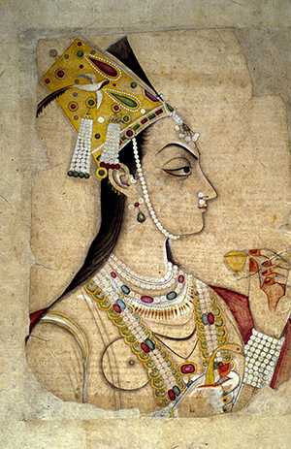
Autumn Term: Task 12
The Stuarts came to the throne in Britain...meanwhile, elsewhere Nur Jahan fought tigers and helped rule an empire. Use the following slide to copy and complete the key information box and to answer the questions. Use the links below for extra reading about Nur Jahan.
http://www.open.edu/openlearn/history-the-arts/world-changing-women-nur-jahan
https://www.historyofroyalwomen.com/nur-jahan/empress-mughal-india-nur-jahan/
Why was she able to rule instead of her husband?
What were her achievements as a ruler?

Slide 15
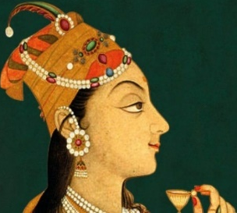
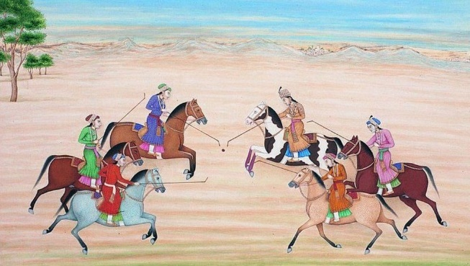
The Mughal Empire - Empress Nur Jahan
Empress Nur Jahan was the most powerful woman in 17th Century India. She played a very important role in running the huge Mughal empire.
Nur Jahan was born in 1577 near Kandahar (in present-day Afghanistan), she was from a Persian family, who had left their home in Iran amid increasing intolerance to seek refuge in the more liberal Mughal empire of India. Nur Jahan was brought to court in 1607, to serve as lady-in-waiting. Reputedly very beautiful, she attracted the attention of the Emperor and they were married in 1611; she would be Jahangir’s twentieth and last wife. During the next ten years, she assumed all the rights of sovereignty and government. Her husband, Jahangir’s addiction to alcohol and opium, and preference for artistic pursuits made him dependent upon her to rule in his name. She controlled all matters of government.
She has been portrayed as a schemer who took advantage of her husband’s addiction to take power. But evidence also points to her physical strength and courage, a talent for administration, and responsibility for the many artistic, architectural, and cultural achievements of Jahangir’s rule. She designed the gardens of Kashmir and Agra and was a patron of poetry. She took a special interest in women’s affairs and provided land for women and opportunities for orphan girls. She was a poet, an expert hunter and an innovative architect. Her design for her parents' tomb in Agra later inspired the construction of the Taj Mahal. One courtier described an incident where she surprised many by appearing in the imperial balcony, which was reserved for men only. This was not her only act of defiance. Be it hunting, issuing imperial orders and coins, designing public buildings, taking measures to support poor women or champion the disadvantaged, Nur lived a life that was unusual among women at the time. She also led an army to save the emperor when he was taken captive. She was also known as a “tiger-slayer” after taking down four tigers with six bullets during a single hunt.
Nur Jahan is shown playing polo with other women
Jahangir’s failure to name an heir before his death in 1627 led to a power struggle amongst his sons. Nur Jahan’s power weakened and she was confined by Jahangir's third son, Shah Jahan. Her imprisonment ended her influence at court, and she spent her final years in exile. She died on 17 December 1645 and is buried in Lahore.

Slide 16
Autumn Term: Task 13
Topic overview: Revise for your assessment “Why did civil war break out in 1642?” Use the revision checklist and your classwork to create three flashcards, one for each cause. On the back, include specific evidence you want to include in that paragraph. Use your flashcards at regular intervals to test yourself. You may find this website useful:
https://www.bbc.co.uk/bitesize/topics/zk4cwmn/articles/zxxgg7h?topicJourney=true#zxv66g83
Paragraph 3 (cause 3) e.g. Money problems
Paragraph 1 (cause 1)
e.g. Conflict over power
Paragraph 2 (cause 2)
e.g. Religious tensions

Slide 17
Autumn Term: Challenge homework
Thematic Overview: Power and the monarchy
Using your learning from Year 7 and Year 8, think about how the power of the monarchy (the king/queen) has changed between 1000 and 1700. Complete the following tasks:
Pick one event, development or change from this period (1000-1700) that has increased the power of the monarchy. Explain how it did this.
2) Pick one event, development or change from this period (1000-1700) that has decreased the power of the monarchy. Explain how they did this.

