Slide 1
Year 11 History Homework Booklet
Autumn 2024
These homework tasks will help you to prepare for your first Year 11 assessment on International Relations, 1919-1939, and then your mock exams. You should do an hour of history homework each week.
When you are asked to create flashcards please make sure you bring them to lesson or show your teacher on your iPad within the lesson. Once you have shown them to your teacher, keep them safe as you will need them to revise for your GCSEs!

Slide 2
Autumn 1
Remember that there are revision resources on the OneDrive folder and on Teams to help you – the ones in the International Relations folder will be especially relevant:
GCSE Revision Materials

Slide 3
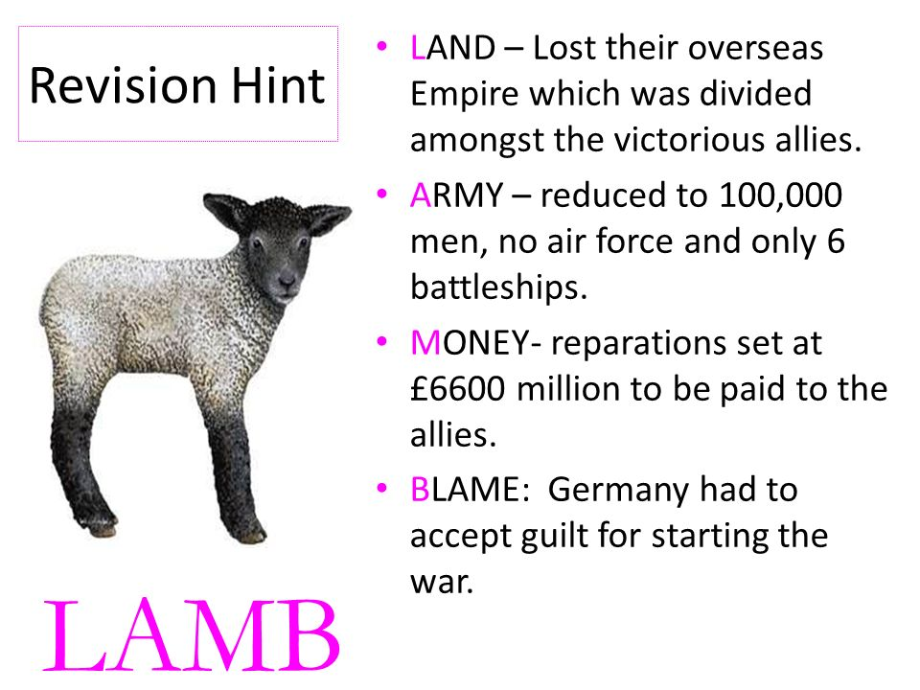
Week 1 – The Treaty of Versailles (1919) and International Agreements of the 1920s
Make sure you complete all the tasks that are part of Week 1 (there are 3)!
Task 1: After the First World War, the Treaty of Versailles punished Germany. Use the revision hint and your work from the Summer Term to create a flashcard or series of flashcards on the terms of the Treaty of Versailles.

Slide 4
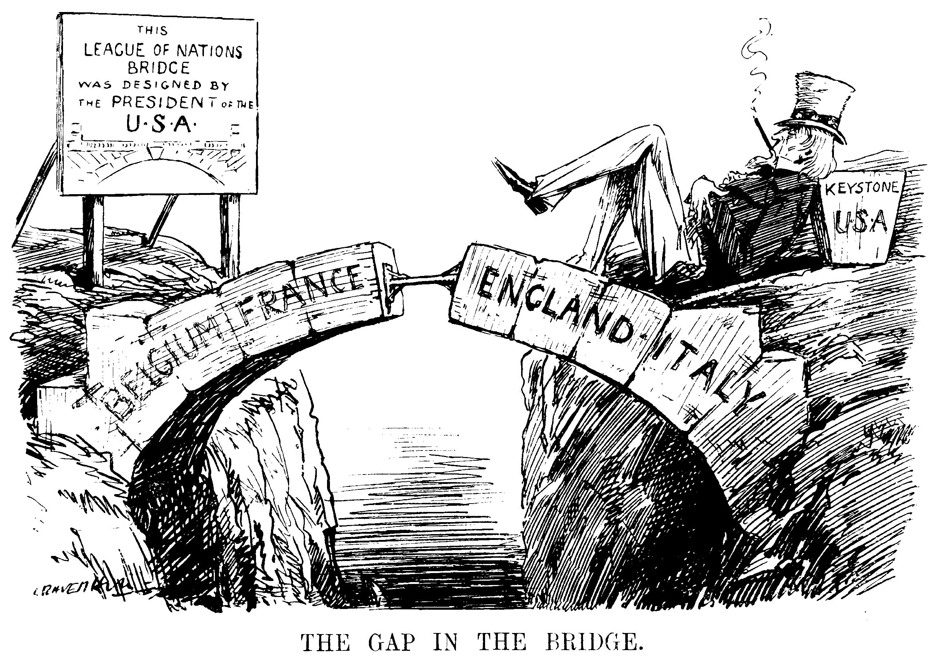
Week 1 – The Treaty of Versailles (1919) and International Agreements of the 1920s
Make sure you complete all the tasks that are part of Week 1 (there are 3)!
Task 2: There were also lots of international agreements in the 1920s to bring about peace. The League of Nations also did its best to solve conflicts between countries. Using your work from the Summer Term, create a flashcard on the following international agreements and crises:
Aaland Islands dispute (1921)
Corfu Crisis (1923)
The Dawes Plan (1924)
The Locarno Treaty (1925)
Kellogg-Briand Pact (1928)
Young Plan (1929)
You could also use the links below and the resources in the revision folder to help you.
https://www.bbc.co.uk/bitesize/guides/zbg4t39/revision/8
https://www.bbc.co.uk/bitesize/guides/zx2knbk/revision/3

Slide 5
Week 1 – The Treaty of Versailles (1919) and International Agreements of the 1920s
Make sure you complete all the tasks that are part of Week 1 (there are 3)!
Task 3: Answer this 5 mark question, using the opening sentence given to you and then adding two examples. Your two examples should be in chronological order.
Outline the purpose of international agreements, 1919-1929 (5 marks).
Opening sentence: “In 1919-1929, lots of international agreements were signed, firstly to punish Germany and then to help Germany recover.”
Example 1 – Give an example of an international agreement and describe the agreement & its purpose.
Example 2 – Give a second example of an international agreement and describe the agreement & its purpose.

Slide 6
Week 2 – Impact of Empire source practice
There is only one task this week. Please make sure you complete & upload it as your teacher will mark it.
Task:
Complete the practice exam question on the next two slides for your teacher to mark. Think about the feedback from your mocks and follow the structure below:
Write a paragraph on each source. In each paragraph explain:
Does the source agree or disagree with the statement (back this up from the source)
Taking into account who wrote it and why, is the source convincing or trustworthy evidence for or against the statement? At the end, summarise what the source convinces or doesn’t convince you of.
At the end, write a conclusion explaining overall whether the sources convince you that the statement is correct.

Slide 7
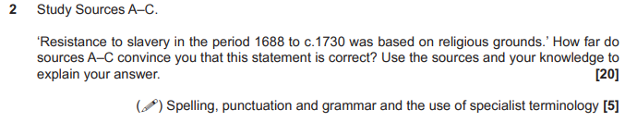
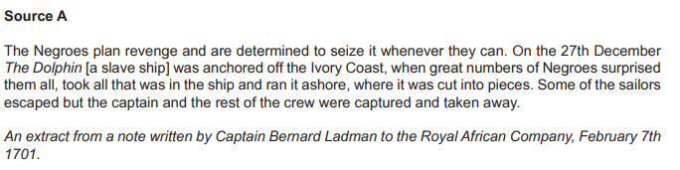
Sources continue on the next slide!

Slide 8
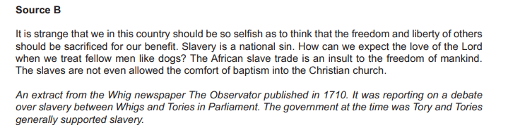
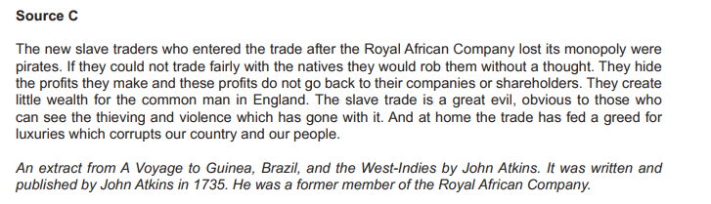

Slide 9

Week 3 – The Wall Street Crash and the Manchurian Crisis
Make sure you complete all the tasks that are part of Week 3 (there are 3)!
Task 1: In 1929 the Wall Street Crash led to a global depression – economies around the world suffered and dictators came to power. Many countries tried to solve their problems by becoming more aggressive and taking over land, including Japan.
Create two flashcards using your work from the Summer:
One on the impact of the Wall Street Crash on international relations
One on the causes, events & consequences of the Manchurian Crisis
You may use these links and the revision videos to help you:
https://www.bbc.co.uk/programmes/p00x5dhm
https://www.bbc.co.uk/programmes/p00x6rwr

Slide 10
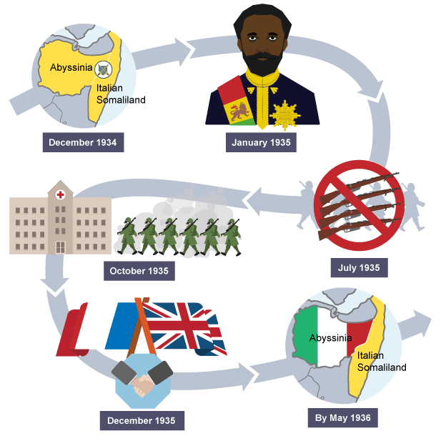
Week 3 – The Wall Street Crash and the Manchurian Crisis
Make sure you complete all the tasks that are part of Week 3 (there are 3)!
Task 2: The Manchurian Crisis had ripple effects which weakened international relations and encouraged other countries, like Italy, to become aggressive too. This led to the Abyssinian Crisis.
Create one or two flashcards on the Abyssinian Crisis: they should cover a summary of the causes/events and consequences of the Abyssinian Crisis.
You may use this link and the revision video to help you:
https://www.bbc.co.uk/programmes/p00x6r7w

Slide 11
Week 3 – The Wall Street Crash and the Manchurian Crisis
Make sure you complete all the tasks that are part of Week 3 (there are 3)!
Task 3: Answer this question – Explain the impact of the Manchurian Crisis on International Relations (10 marks)
You should spend around 10 minutes writing two really good paragraphs. Each paragraph should include some of the detailed information you have revised and should really clearly link back to the question. Why did the Manchurian Crisis cause problems in international relations?

Slide 12

Week 4 – Hitler’s actions and appeasement
Make sure you complete all the tasks that are part of Week 4 (there are 3)!
Task 1: Test yourself, using the flashcards you have created so far. Afterwards, sort them into two piles: ones you knew and ones you didn’t. Revise the ones you didn’t know and then test yourself again.

Slide 13
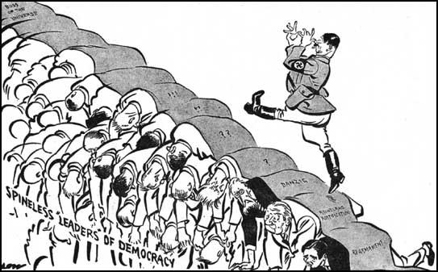
Week 4 – Hitler’s actions and appeasement
Make sure you complete all the tasks that are part of Week 4 (there are 3)!
Task 2: Hitler came to power in 1933. Seeing the weakness of the League of Nations, he embarked on an aggressive foreign policy.
Using your work from the summer term, create three flashcards on Hitler’s actions in the 1930s – e.g. invasion of the Rhineland, Anschluss with Austria. You may use this to help:
https://www.bbc.co.uk/bitesize/guides/z92hw6f/revision/1

Slide 14
Week 4 – Hitler’s actions and appeasement
Task 3: Over time, historians and commentators have come to different conclusions about whether appeasement was the best approach to Hitler. Read the summaries of each interpretation carefully and prepare for a quiz…Remember, you need to know the names and dates of each interpretation.

Slide 15
Week 4 – Interpretations of Appeasement

Slide 16
Week 5 – Overall International Relations Revision
Make sure you complete all the tasks that are part of Week 6 (there are 2)!
Task 2: Answer these questions using the exam guidance to help you. Try to complete them from memory in timed conditions (give yourself 25 minutes max).
Outline the international crises facing the League of Nations, 1930-36. (5 marks)
Outline Hitler’s foreign policy, 1933-39. (5 marks)
Explain why the League of Nations only had moderate successes in the 1920s (10 marks).
Exam guidance:
In a 5 mark question you need an overview sentence at the beginning that summarises the period/ events that you are talking about, then a description of 2 events in chronological order
In a 10 mark question you need 2 well-explained paragraphs

Slide 17
Week 6 – Migration revision - pick at least two questions to answer
Describe laws passed affecting migrants in the 20th century (4 marks).
Explain why migrants arrived in Britain, 1500-1750 (8 marks)
How significant was Commonwealth migration for Britain in the 20th century? (14 marks)
“Migrants struggled for acceptance 1000-1900”. How far do you agree? (24 marks)

Slide 18
Autumn 2

Slide 19
Weeks 1-2: Independent revision for mocks
During the mock period you should be revising independently. I would recommend:
Testing yourself using all the flashcards or quizzes you have created.
Answering practice questions in exam conditions – see some suggestions on the next page.
Creating timelines and mind-maps from memory and then filling in and gaps.
Using all the videos and recorded lessons and lectures in the revision folder.

Slide 20
Suggested practice questions:
Impact of Empire and Spitalfields:
Explain the impact of the slave trade on Britain, 1688-1730 (10 marks).
Explain how the British economy changed, 1688-1730 (10 marks).
Explain the impact of the Spanish War of Succession on Britain (10 marks).
Explain how Spitalfields changed, 1700-1900 (10 marks).
Explain how migration changed Spitalfields’ urban environment, 1900-present day (10 marks).
6. Explain how and why England’s empire expanded, 1688-1730 (10 marks).
7. Explain the impact of empire on British people, 1688-1730 (10 marks).
8. Explain the impact of Huguenot migration on Spitalfields. (10 marks).

Slide 21
Week 3: USA in the 1920s and 1930s
Complete these two essay style questions. Remember, you should aim to summarise your argument at the beginning (a sentence is fine), include a range of paragraphs agreeing and disagreeing (aim for 3 overall) and a strong conclusion where you defend your argument.
We will be doing a practice USA paper in January
“The USA was a place of new opportunities in the 1920s.” How far do you agree? (18 marks)
How successful were the New Deals in achieving their aims? (18 marks)

Slide 22
Week 4: USA in the 1930s and 1940s
Complete these two essay style questions. Remember, you should aim to summarise your argument at the beginning (a sentence is fine), include a range of paragraphs agreeing and disagreeing (aim for 3 overall) and a strong conclusion where you defend your argument.
“The Second World War was the main reason for the end of the economic depression.” How far do you agree? (18 marks)
“The American people were united by the Second World War.” How far do you agree? (18 marks)

Slide 23
Week 5: USA 1918-1948 - flashcards
Look at the exam board summary on the next few slides of everything you need below to know about the USA topic. On which parts are you least confident? Use this time to create a series of flashcards or a quiz on these topics using your classwork.

