Slide 1
Roman Entertainment

Slide 2
 | Circus Maximus | Colosseum | Large Theatre at Pompeii | Central Baths at Herculaneum
Location | Rome | Rome | Pompeii | Herculaneum
Constructed | First built 6th century BC. Rebuilt a number of times, notably in 2nd century AD | Constructed in 70s AD. Opened in 80 AD | 2nd century BC. Renovated in late 1st century BC | Late 1st century BC
No. of seats | 250,000 (by 1st century AD). The largest sporting arena in recorded history. | Around 50,000 | Around 4000 | N/A
Materials | Originally wood. Later rebuilt with brick-faced concrete and marble. Lower tier of seating made of marble, the upper stone. Imperial box built from marble. | Outer wall made of travertine rock Arches made of brick and concrete Stucco (plaster which is easy to paint over) possibly used throughout the building for decoration. Definitely used on two arches which marked VIP entrances. First three storeys of seating made of marble. Top storey made of wood. Metal fence around the arena Sand covered arena | Main seating area made of marble Stage made of wood Front wall made of stone | Variety of materials in different rooms, including marble and stucco
Purpose | Hosted chariot racing | Gladiator fighting Public executions Beast hunts Performances by trained animals Some other extraordinary events, such as sea battles in a flooded arena | Hosted comedies, mimes and pantomimes | People might go to the baths to: Get washed Exercise To be seen and show off their power and status if they were rich men To meet rich and powerful people and try to get dinner invitations Meet friends and relax Hold business meetings Buy snacks and drinks
Important features | Size of track: 600m long, 150m wide Dividing bank down the middle called the spina (spine) Turning points at either end decorated with bronze posts covered with gold called metae 13th century BC red granite obelisk (tall stone monument) on the spina, brought from Egypt by Augustus. Symbols of the gods along the spina Seven large wooden eggs on spina, used to count laps. Later replaced by seven bronze dolphins. Carceres (Starting cages) constructed to stagger the racers as certain starting positions were better than others Three tiers of seating: Lowest: VIPs, state priests, senators and wealthy equites Middle: Anyone, including men, women and children. Top: Possibly standing only Imperial box on one side | Constructed around four concentric circles and a series of archways Four pathways from outer wall to arena with toilets and drinking fountains, Vomitoria: staircases allowing fast exit Eighty entrances with four ornate ones (possibly for VIPs), two of which are decorated (see above) Awning which could be pulled over spectators in event of heat Seating by social class: Ground floor: imperial box, special seats for Vestal Virgins, seating for senators First tier: equites Second tier: ordinary citizens Third tier: women, slaves and the poor Archers stood by arena to shoot animals which threatened spectators Network of tunnels, cages and lifts under the arena. Animals held in these and sent out through trapdoors Underground area linked to a point outside the stadium so that spectators would be surprised by the animals | Renovated by Holconii family with crypt, boxes (above main seating) and theatre seating All seating (except upper section) built into hill in Greek fashion. Seating tiered: Lower tier made of marble: VIPs Second tier: other free citizens Third tier: freedmen, slaves and women Awning to shade spectators Orchestra in front of stage in Greek fashion. Probably used for VIP seating unless a Greek play was happening. Elaborate scaena frons (front scene) behind stage Stage raised on pillars, leaving space below it to move stage machinery and props | Separate areas for both men and women (women’s area was smaller with smaller rooms). Men and women could visit at the same time (baths without both sections would require women to visit in the morning and men in the afternoon). Men and women each had: An entrance An apodyterium (changing room- slaves were probably available to watch people’s possessions) A tepidarium (warm room like a modern saunda) A caldarium (hot room where people would get washed with hot water, have dirt scraped off them with olive oil and strigils and get massaged) The following were only found in the men’s area: A palaestra (exercise ground. Women might have exercised in a corridor next to their apodyterium) A frigidarium (cold room with a plunge pool, used to cool down after caldarium) A man might have visited their rooms in this order: entrance -> apodyterium -> palaestra -> tepidarium -> caldarium -> frigidarium Women would have followed same path, maybe exercising in the corridor next to the apodyterium, though without visiting a frigidarium. Hypocaust system of underground heating used to heat warm rooms.

Slide 3
Why were baths important?
Visiting baths was a daily routine for Romans of all classes.
One source tells us that there were nearly 1000 bath complexes in Rome alone by the 4th century AD.
Some baths were huge. One possibly constructed between 211 and 217 AD could hold 1600 people at any one time.
Bath complexes existed all over the empire. One such well-preserved complex can be found in Bath in England to this very day.
Only the extremely wealth had baths in their own homes. Public baths were therefore extremely important for preventing disease.
Baths were very cheap to visit (possibly less than £1 in modern sterling)
Men visited the baths in the afternoon after they had been working and would sometimes stay there until dinner time. Women visited in the morning if they did not have their own facilities.

Slide 4
What happened at the baths?
People would visit a number of rooms in a bath complex in order to get themselves cleaned.
Bath complexes usually had an exercise ground (palaestra) at which visitors could get their daily exercise by working out or playing games.
Wealthy men arrived with their clients, freedmen and slaves in a show of power and status.
Business meetings likely held at the baths.
Less wealthy people would be able to make contacts with wealthier Romans, possibly with a view to getting invites to dinner parties.
People met friends and relaxed in Roman baths.
Politicians might have used the baths to convince other Romans to support them.
Food could be bought, including nuts, hog’s fat, bread, cutlets and sausages. Drinks could also be bought.
Visitors could receive massages in the baths
At some baths there were even libraries and rooms for poetry reading.
The baths were heated by a hypocaust system (see next slide for details).

Slide 5
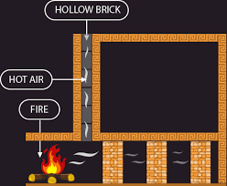
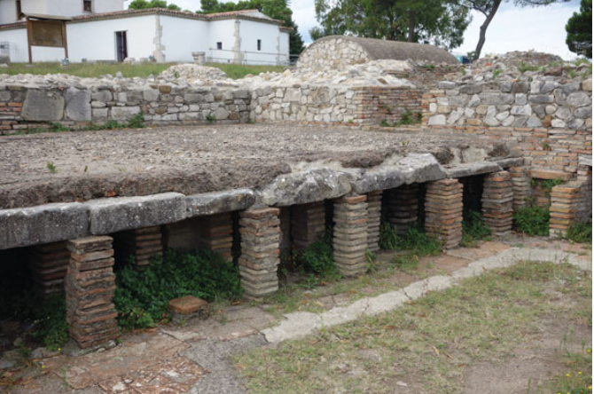
What was a hypocaust system?
Floor raised on pillars
Spaces left inside the walls
Hot air and smoke from a nearby furnace (tended by slaves) could pass under the floor and through the walls, heating up the complex

Slide 6
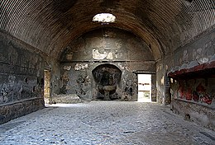
Apodyterium
Changing room
Clothes left in niches along walls
Light clothing kept on for exercising
Slaves used to watch their master’s clothes. Some baths had slaves whose job it was to watch clothes to prevent theft (which might have been quite common).
Sometimes included facilities for people to wash their feet and hands

Slide 7
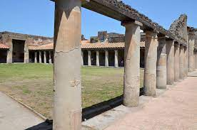
Palaestra
Exercise ground
Visited after getting changed in the apodyterium
Ball games played
‘Harpastum’- essentially piggy-in-the-middle involving a ball stuffed with sand
Fencing against a post
Wrestling
A form of tennis played with the hand
Weight lifting
A number of other types of exercise (i.e. running) could be done here
Roman schools could be held in a palaestrae, since these were easily-accessible areas which often had a shaded colonnade running around the outside which students could sit in.

Slide 8
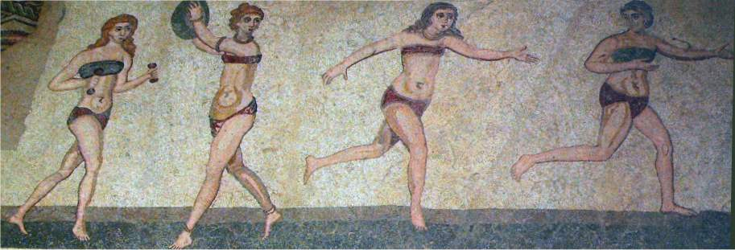
Fresco of women exercising
A reminder that women did exercise, probably in the bath complexes. They may well have used palaestrae, although likely not at the same time as men.

Slide 9
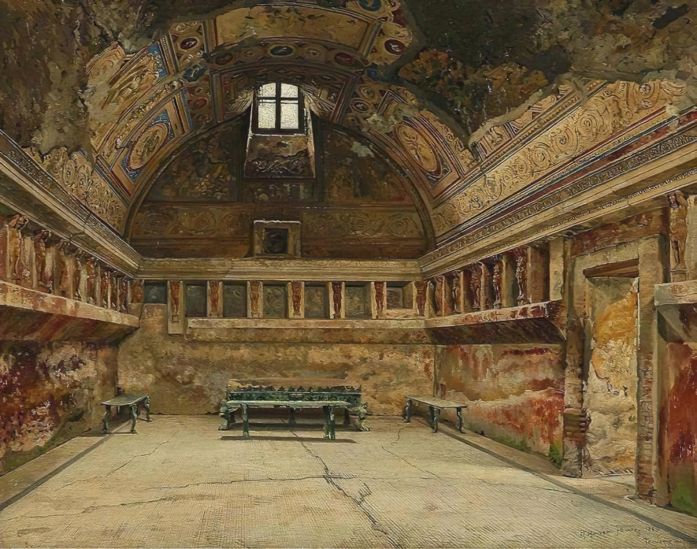
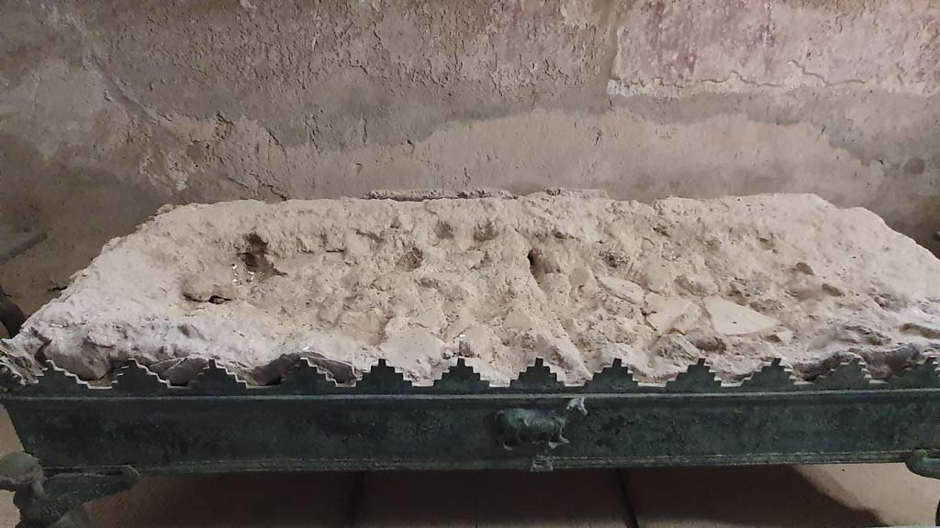
Tepidarium
Warm room
A place to sit and relax in the heat (a bit like a modern sauna, although some Roman baths did have separate rooms which functioned as steam rooms)
Helped visitors to get used to the heat in preparation for going into the hottest room: the caldarium.
Bathers might have also returned here after vising the caldarium in order to help to cool their bodies down
Compartments could be built into the walls to allow people to take off their remaining clothes
Room heated by the hypocaust and sometimes by a brazier
Usually the best-decorated room
Implies that many spent a good amount of time here, likely talking business or just chatting
Curved ceiling prevented build-up of condensation
The brazier which would have heated the tepidarium at a bath at Pompeii. A recreation of this tepidarium is shown in the above image. Note the benches close to the brazier. Those who sat closest to this would have got the sweatiest. Augustus supposedly enjoyed doing exactly this when he was bathing!

Slide 10
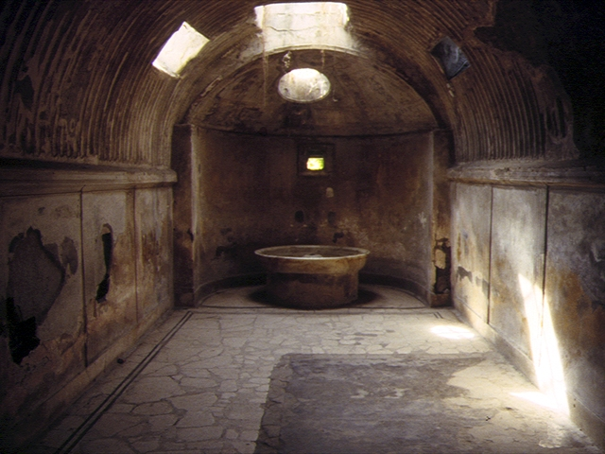
Caldarium
The hot room, closest to the hypocaust system’s furnace
Bathers would clean themselves using olive oil (soap wasn’t known to the Romans) and a strigil, which would be used by a slave (or by the visitor himself) to scrape off the sweat, dirt and olive oil
Note that we do not know when the oil was normally put onto the skin. Some believe that it would have been just after getting changed. It is also possible for the oil to have been put on in caldarium. It should be remembered that the layout of every Roman bath wasn’t the same and that some bathers might have preferred to put the oil on at different times to others.
A caldarium normally had a bath of hot water sunk into the floor, in addition to a basin of cold water and a dry area used for building up a sweat
Curved ceiling prevented build-up of condensation
Though we do not know how hot a caldarium got, it could not have been higher than 50-55 degrees, since bathers would have worn sandals with wooden soles
A caldarium was usually well-decorated.

Slide 11
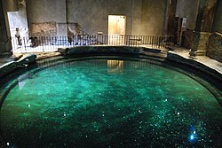
Frigidarium
The cold room, including a plunge pool in which visitors could cool themselves off
This would presumably have been used to wash away additional sweat and to close up pores to prevent further sweating
After a dip in the frigidarium, a visitor might put oils on their skin to give themselves a pleasant smell
These pools could be quite large, as in the case of that found at Bath in England (see the picture to the right)

Slide 12
Which order were the rooms visited in?
There wouldn’t have been one standard order in which to visit the rooms of a Roman bath. The order which an individual visited these rooms in likely came down to personal preference, although all visitors probably visited the apodyterium first. The Roman medical writer Galen recommended the following order:
Palaestra- get daily exercise and build up a sweat
Tepidarium- build up even more of a sweat and open up sweat glands and pores.
Caldarium- continue to sweat
Frigidarium- close up sweat pores
It is worth adding to this that the caldarium would allow visitors to clean themselves with olive oil and a strigil, clearing away dirt dislodged from the body by sweat. Galen’s advice is probably quite sound, even if many of his conclusions are based on scientifically incorrect beliefs.

Slide 13
How hygienic were the baths?
Whilst visiting the baths regularly was important for maintaining a basic level of hygiene, it is worth noting that the baths themselves could present hygiene issues. The communal waters were not necessarily cleaned regularly, meaning that bacteria and waterborne viruses could be transmitted between bathers. At least one ancient writer advised his readers not to visit baths if they had open wounds to avoid infections.

Slide 14
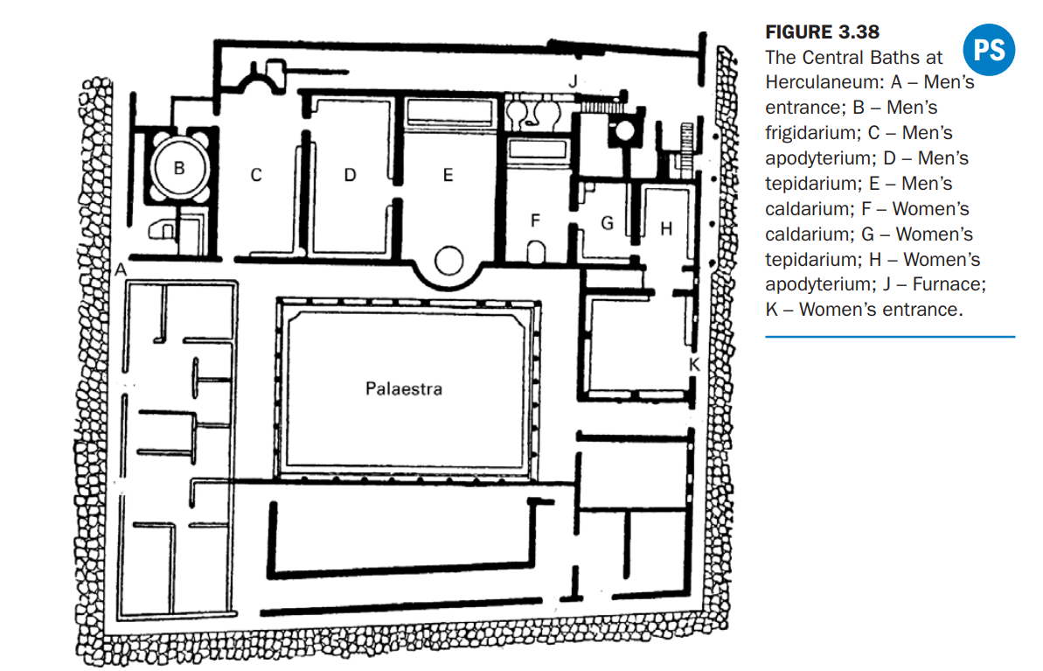
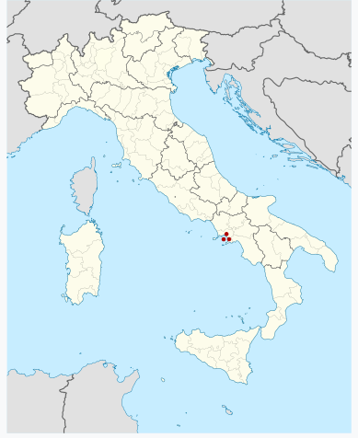
Located in Herculaneum, a town which was destroyed (along with Pompeii) by the eruption of Mount Vesuvius in 79 AD.
Located near the middle of the town
Sometimes also known as the Forum Baths due to possibly being located near Herculaneum’s forum (which hasn’t been discovered)
Opened onto three different streets, meaning that it had a lot of entrances
Male and female facilities, but the men’s were both larger and included more facilities.
Women are missing a frigidarium.
There also does not appear to be access to the palaestra. The women may have exercised indoors at these baths, possibly in a corridor.

Slide 15
Men’s apodyterium
Marble bench along three sides
Niches for storing clothing above the bench
Two basins at one end: one grand marble one for washing hands, the other less impressive one for feet
The second is now lost, but the marble basin can be seen in the picture to the right

Slide 16
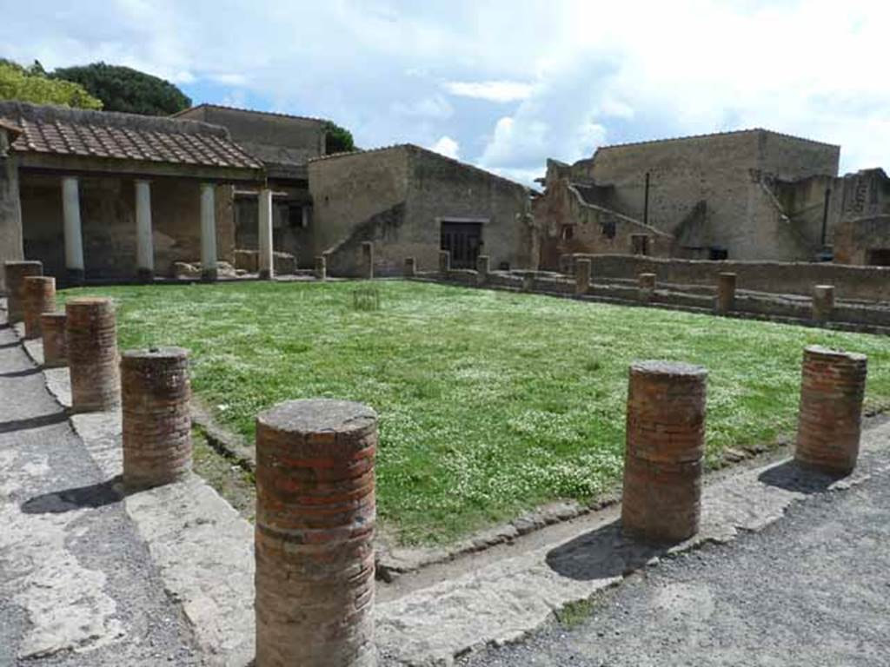
Palaestra
Note the colonnade under which teachers might have held schools.

Slide 17
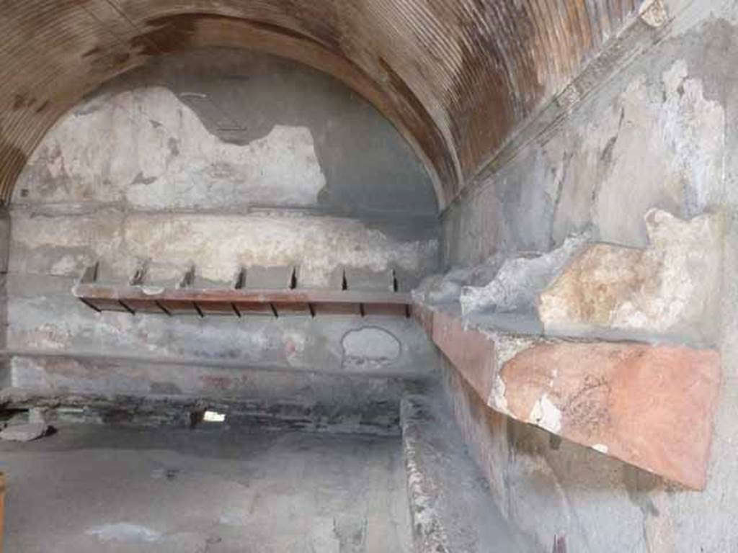
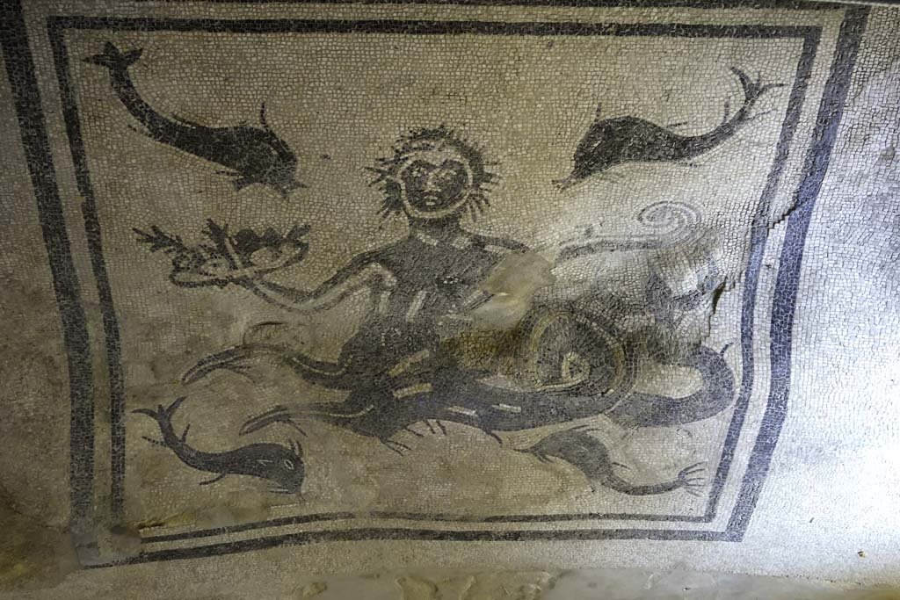
Men’s tepidarium
Marble benches and shelves on all four sides (seen in the picture on the right)
Black mosaic of Triton on the floor (see below)

Slide 18
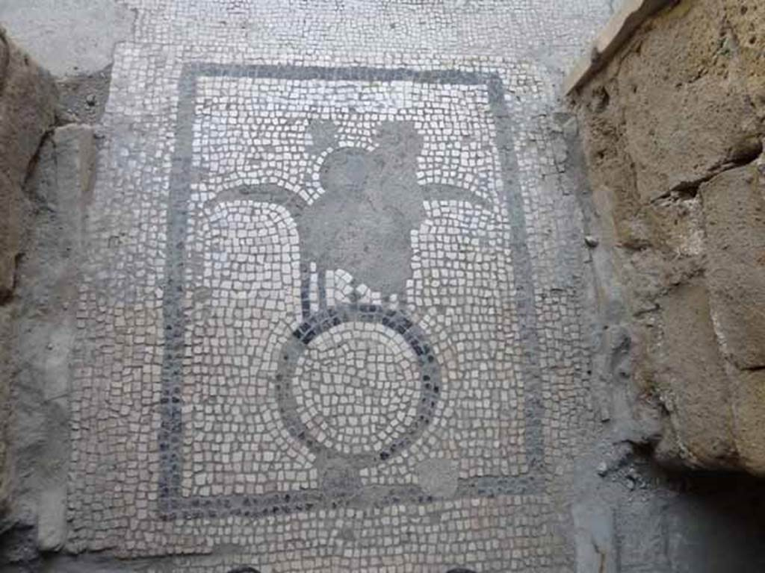
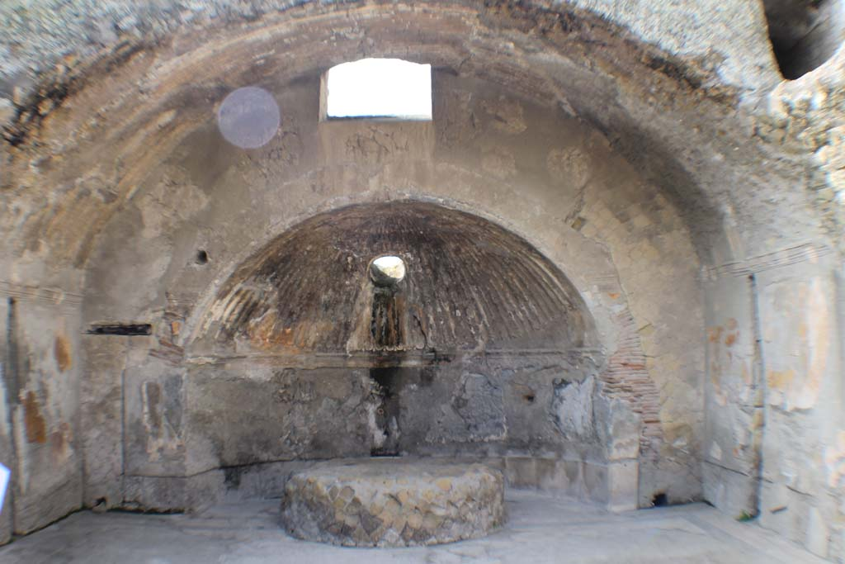
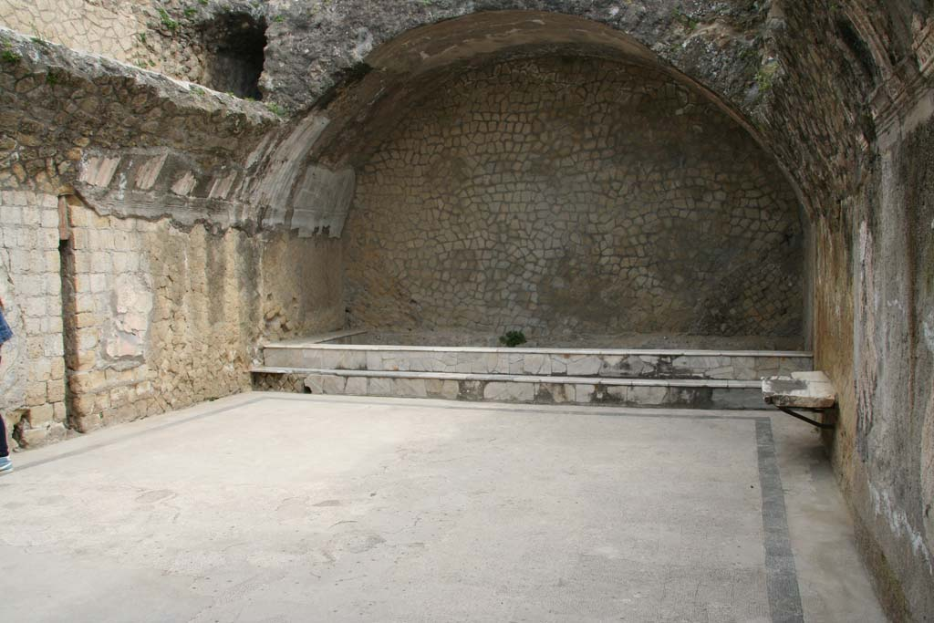
Men’s caldarium
Mosaic on the entrance floor (fig. 1)
Labrum (cold water basin) located on one side of the room mounted on a podium ( see fig. 2 for podium)
Hot bath at the other end (fig. 3)
Individual benches found on walls
Fig.1
Fig.3
Fig.2

Slide 19
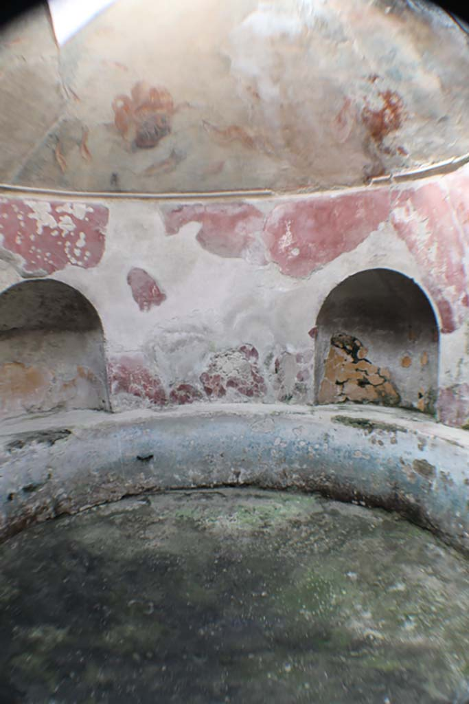
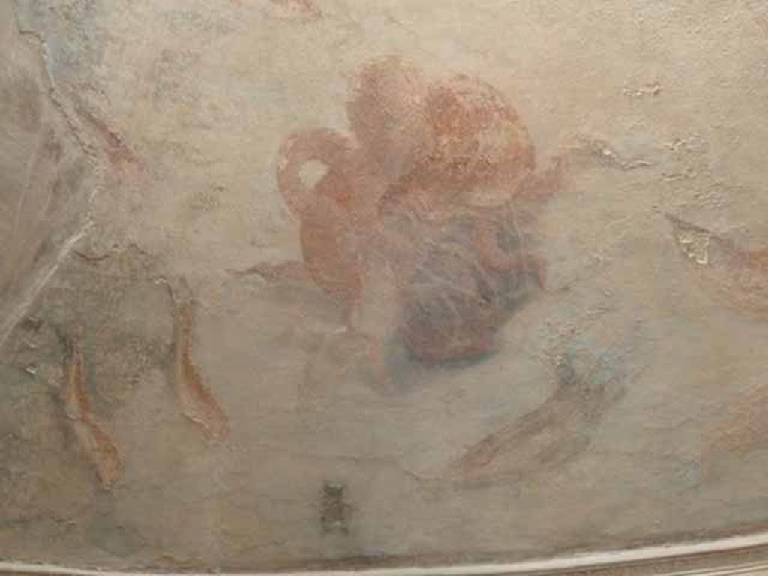
Men’s Frigidarium
Fig.1
Large plunge pool with niches to sit on (fig 1.)
Pictures of sea creatures painted onto the ceiling, including fish, lobsters and an octopus (fig. 2 and next slide)
Fig.2

Slide 20
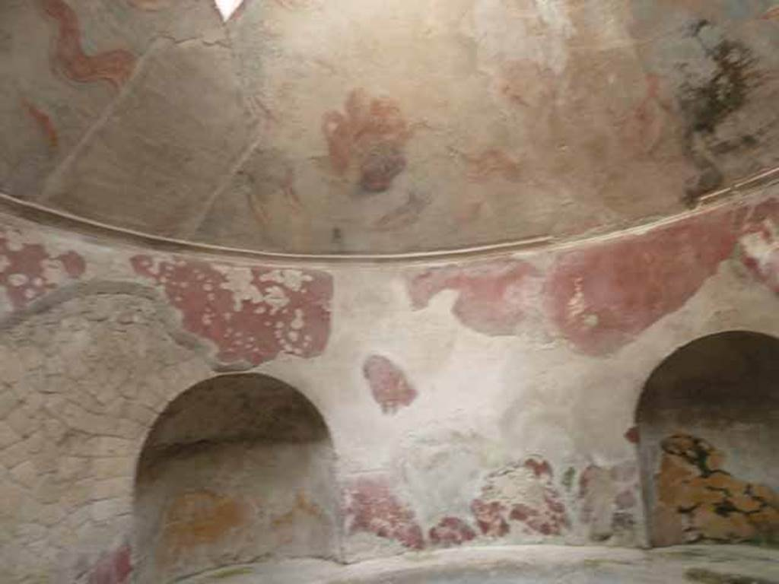
Frigidarium ceiling paintings- note the octopus’ tentacle on the left-hand side of the image.

Slide 21
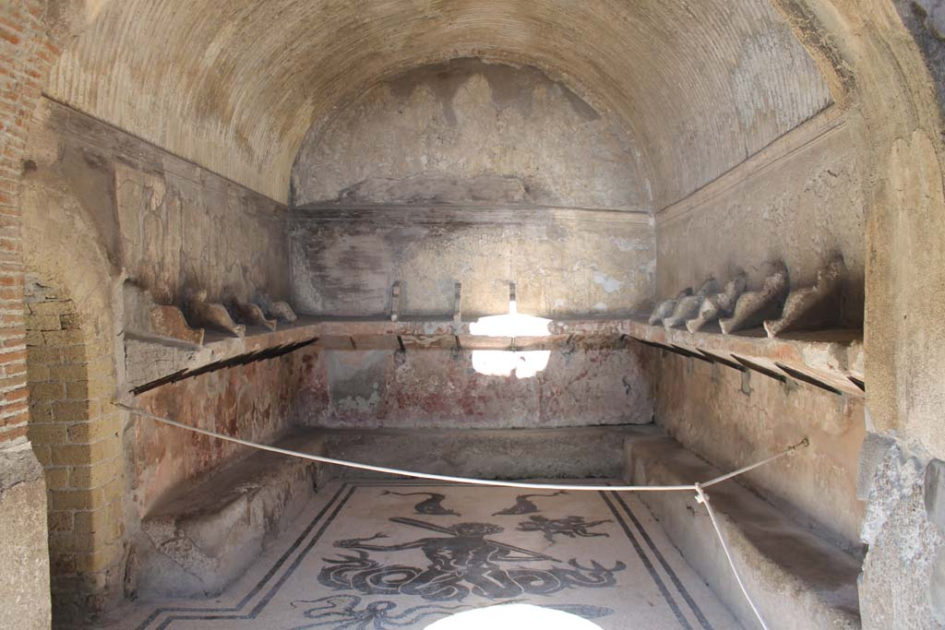
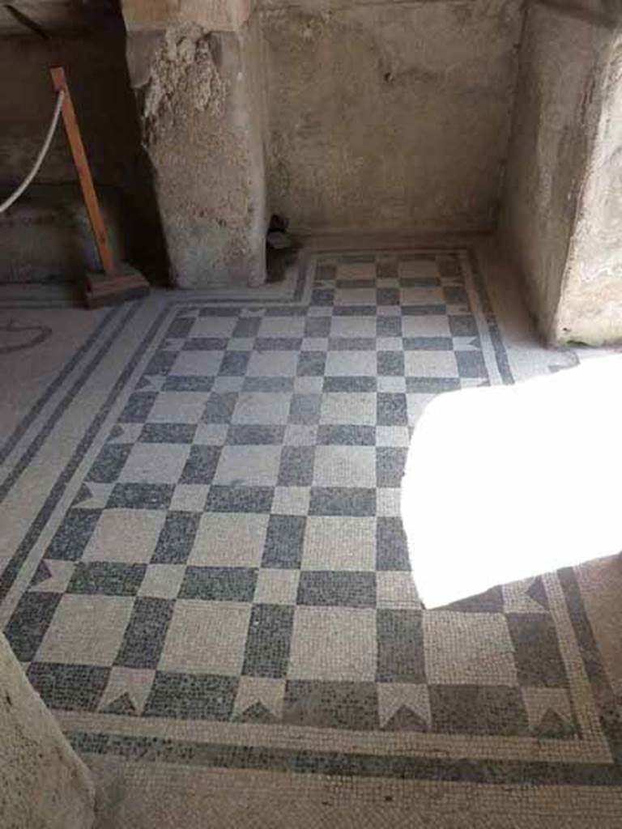
Women’s Apodyterium
Mosaic on entrance floor (fig 1.)
Much smaller than the men’s apodyterium and apparently lacking the basins found within it. Benches run around three walls with shelves above them. Remains of red paint on walls. Mosaic of Triton surrounded by dolphins, an octopus and a squid. Another winged figure can be seen next to Triton, possibly holding snakes. Triton himself holds a fish in one hand. (fig. 2 and next slide for a larger picture)
Corridor south of the apodyterium might have been used to exercise due to the women’s baths not having access to the palaestra (see slide 41)
Fig.2
Fig.1

Slide 22
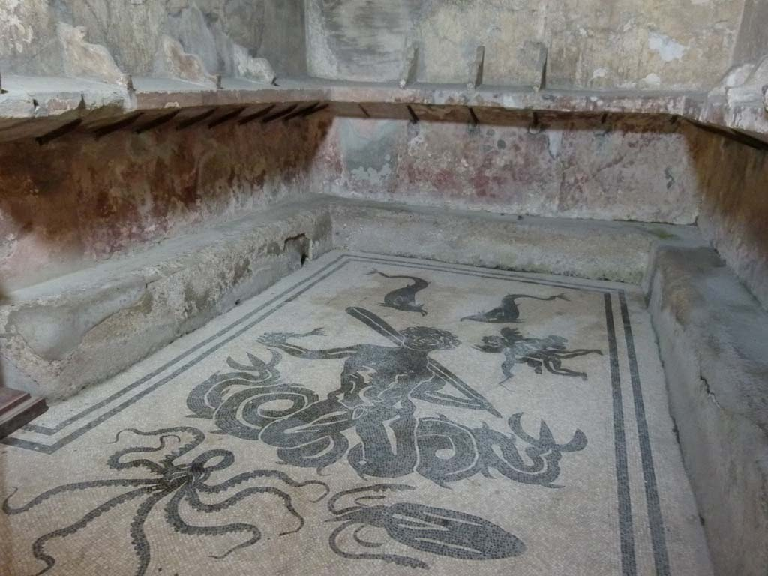
Triton mosaic

Slide 23
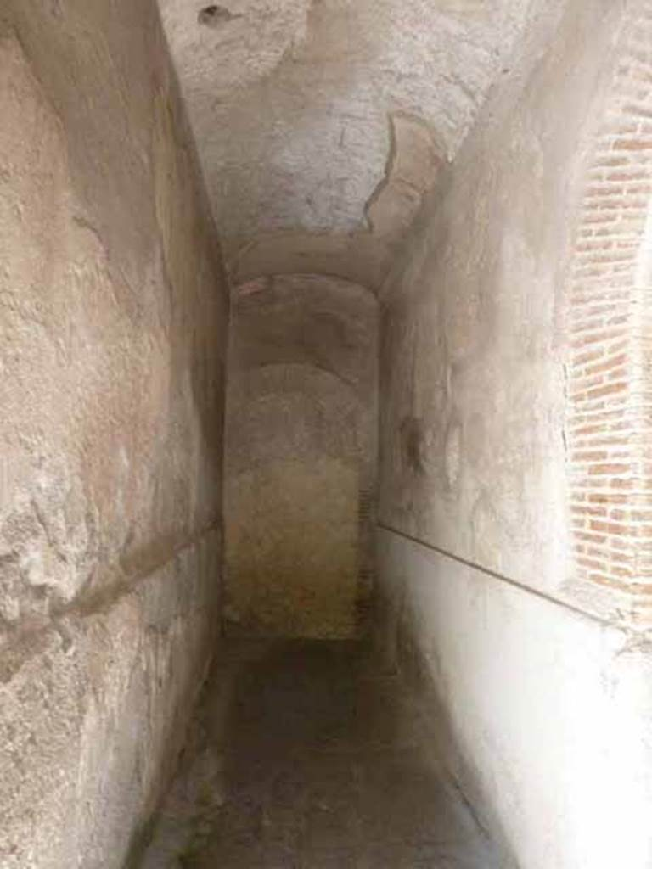
Corridor south of women’s apodyterium which might have been used for exercise

Slide 24
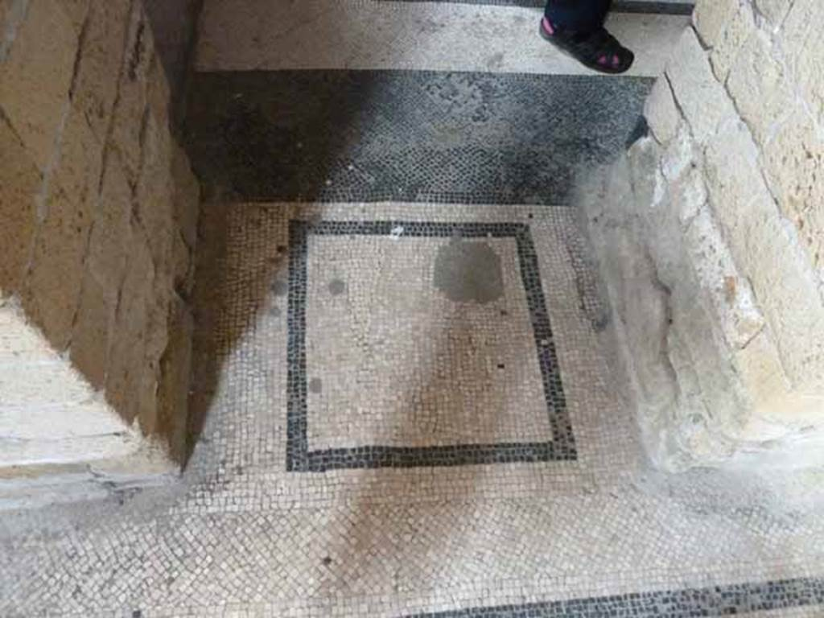
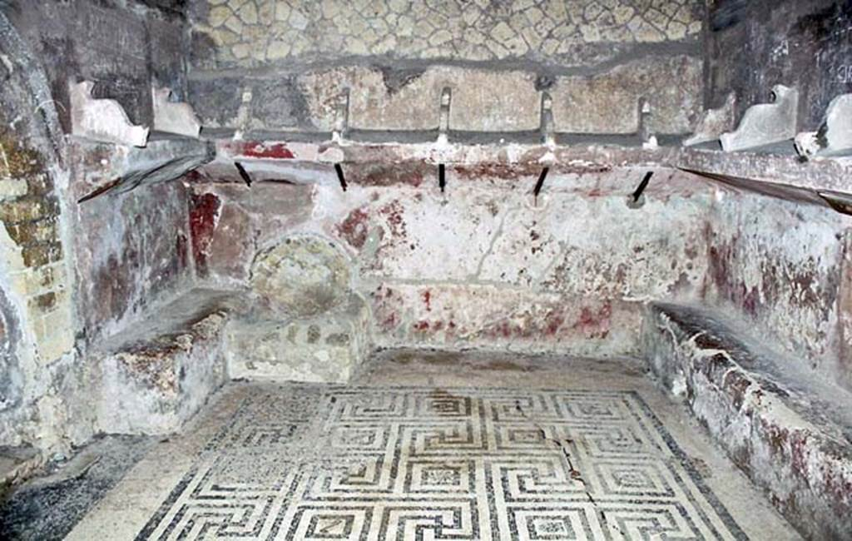
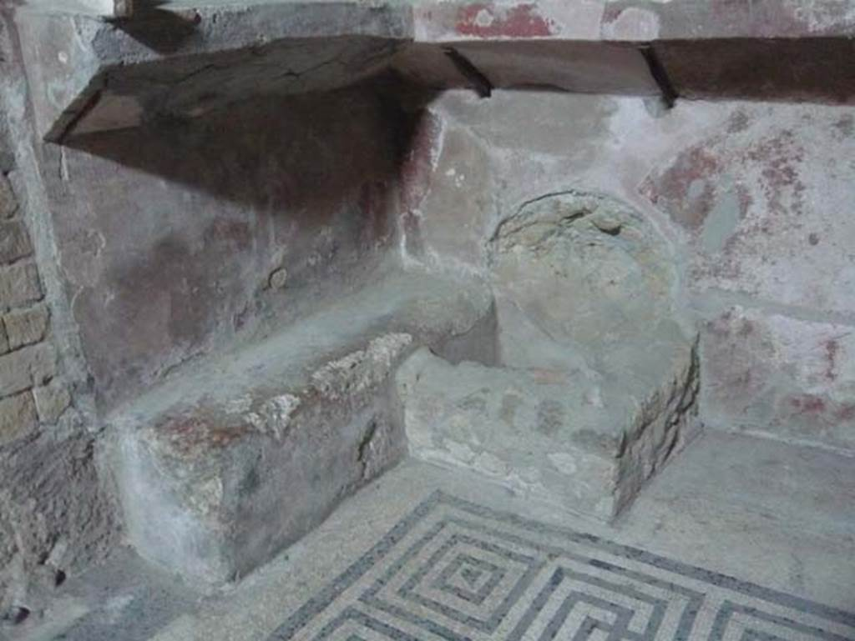
Women’s tepidarium
Mosaic on entrance floor from apodyterium. (fig. 1)
Benches with shelves directly above them for clothes. Geometric meander mosaic on floor. Walls painted red (fig. 2)
Structure in north-west corner which might be a basic, but we cannot know for certain (fig. 3)
Fig.1
Fig.2
Fig.3

Slide 25
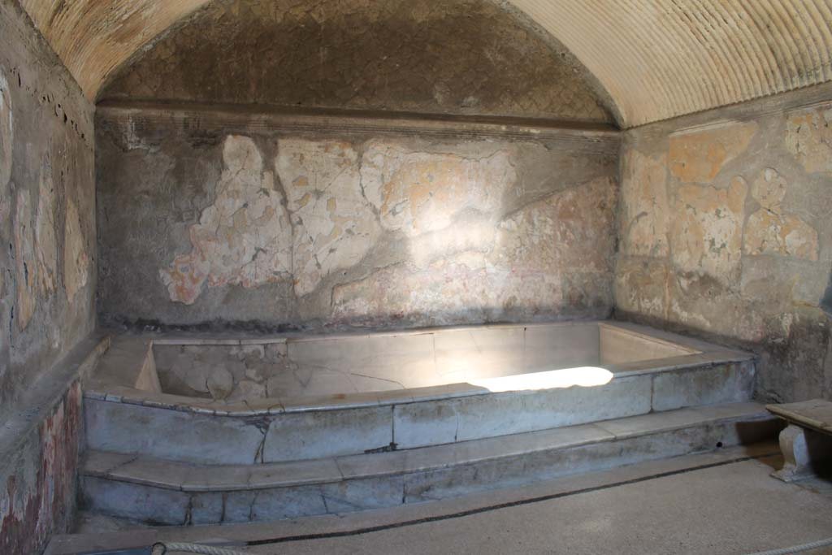
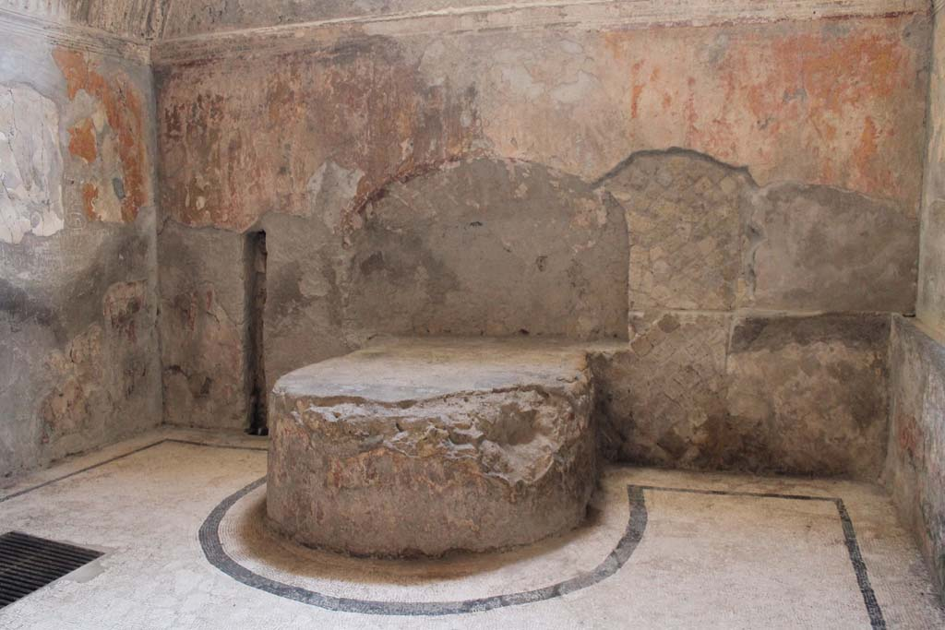
Women’s caldarium
Threshold made of marble
Large marble bath on one side with a bench next to it (fig 1.)
Podium on which a marble or bronze basin for holding cold or warm water would have stood located on the other side (fig. 2)
Note the black mosaic which runs around the room’s floor
Fig.1
Fig.2

Slide 26
Compulsory activities

Slide 27
Written questions The number in the square brackets next to each question tells you the number of marks. This tells you how many points to make.

Slide 28
When were the Central Baths at Herculaneum built? [1]
What is the term for a Roman changing room? [1]
What is the term for a Roman sports ground? [1]
What is the term for the warm room in a Roman bath? [1]
What is the term for the hot room in a Roman bath? [1]
What is the term for the cold room in a Roman bath? [1]
Which room is missing from the women’s half of the Central Baths at Herculaneum? [1]
What did Romans use instead of soap to clean themselves? [1]
What was the purpose of the two basins in the men’s apodyterium at the Central Baths at Herculaneum? [1]
What is the term for a Roman baths’ heating system? [1]
Why might a wealthy politician visit a Roman bath (give two details)? [2]
Why were many of a Roman bath’s ceilings curved? [1]
Who looked after people’s clothes at a Roman bath? [1]
If they didn’t have their own facilities, when did women visit a bath? [1]
What were two of the hygiene issues with Roman baths? [2]
Notes:
XX mins – task
(XX total mins)
Notes
Links

Slide 29
Source questions For each source, create a subtitle (i.e. ‘source 1’, ‘source 2’ etc.) and then answer the questions for each source below this subtitle

Slide 30
Source 1: The women’s apodyterium in the Central Baths at Herculaneum
What was the purpose of this room? [1]
Which god is depicted on the mosaic on the floor? [1]
What are the purposes of the shelves running around the wall? [1]
What isn’t found here which was found in the men’s apodyterium? [1]
Which feature of this room prevented the build-up of condensation? [1]
Notes:
XX mins – task
(XX total mins)
Notes
Links

Slide 31
Source 2: An area of the Central Baths at Herculaneum
What is the term for this area? [1]
What might a visitor do in this area (give three examples)? [3]
What is the connection between this area and children’s education? [1]
Which half of the Central Baths at Herculaneum is not directly connected to this area? [1]
Notes:
XX mins – task
(XX total mins)
Notes
Links

Slide 32
Source 3: A room in the Central Baths at Herculaneum
What is the term for this room? [1]
How are you able to tell? [1]
What provided visitors with access to cooler water in this room? [1]
What might a visitor have used a strigil for in this room? [1]
Which room might visitors have gone to after this one? [1]
Notes:
XX mins – task
(XX total mins)
Notes
Links

Slide 33
Extended writing questions. Complete the 8-marker. As an extension, attempt the 15-marker.
8-marker: ‘The primary purpose of a Roman bath complex was to allow people to clean themselves’. To what extent do you agree with this statement? Use sources 1, 2, and 3 and your own knowledge in your answer. [8]
15-marker: In your opinion, which of these entertainment venues could best be used by the rich and powerful to promote themselves: the Colosseum, the Circus Maximus, the Large Theatre at Pompeii or the Central Baths at Herculaneum?

Slide 34
 | Circus Maximus | Colosseum | Large Theatre at Pompeii | Central Baths at Herculaneum
Location | Rome | Rome | Pompeii | Herculaneum
Constructed | First built 6th century BC. Rebuilt a number of times, notably in 2nd century AD | Constructed in 70s AD. Opened in 80 AD | 2nd century BC. Renovated in late 1st century BC | Late 1st century BC
No. of seats | 250,000 (by 1st century AD). The largest sporting arena in recorded history. | Around 50,000 | Around 4000 | N/A
Materials | Originally wood. Later rebuilt with brick-faced concrete and marble. Lower tier of seating made of marble, the upper stone. Imperial box built from marble. | Outer wall made of travertine rock Arches made of brick and concrete Stucco (plaster which is easy to paint over) possibly used throughout the building for decoration. Definitely used on two arches which marked VIP entrances. First three storeys of seating made of marble. Top storey made of wood. Metal fence around the arena Sand covered arena | Main seating area made of marble Stage made of wood Front wall made of stone | Variety of materials in different rooms, including marble and stucco
Purpose | Hosted chariot racing | Gladiator fighting Public executions Beast hunts Performances by trained animals Some other extraordinary events, such as sea battles in a flooded arena | Hosted comedies, mimes and pantomimes | People might go to the baths to: Get washed Exercise To be seen and show off their power and status if they were rich men To meet rich and powerful people and try to get dinner invitations Meet friends and relax Hold business meetings Buy snacks and drinks
Important features | Size of track: 600m long, 150m wide Dividing bank down the middle called the spina (spine) Turning points at either end decorated with bronze posts covered with gold called metae 13th century BC red granite obelisk (tall stone monument) on the spina, brought from Egypt by Augustus. Symbols of the gods along the spina Seven large wooden eggs on spina, used to count laps. Later replaced by seven bronze dolphins. Carceres (Starting cages) constructed to stagger the racers as certain starting positions were better than others Three tiers of seating: Lowest: VIPs, state priests, senators and wealthy equites Middle: Anyone, including men, women and children. Top: Possibly standing only Imperial box on one side | Constructed around four concentric circles and a series of archways Four pathways from outer wall to arena with toilets and drinking fountains, Vomitoria: staircases allowing fast exit Eighty entrances with four ornate ones (possibly for VIPs), two of which are decorated (see above) Awning which could be pulled over spectators in event of heat Seating by social class: Ground floor: imperial box, special seats for Vestal Virgins, seating for senators First tier: equites Second tier: ordinary citizens Third tier: women, slaves and the poor Archers stood by arena to shoot animals which threatened spectators Network of tunnels, cages and lifts under the arena. Animals held in these and sent out through trapdoors Underground area linked to a point outside the stadium so that spectators would be surprised by the animals | Renovated by Holconii family with crypt, boxes (above main seating) and theatre seating All seating (except upper section) built into hill in Greek fashion. Seating tiered: Lower tier made of marble: VIPs Second tier: other free citizens Third tier: freedmen, slaves and women Awning to shade spectators Orchestra in front of stage in Greek fashion. Probably used for VIP seating unless a Greek play was happening. Elaborate scaena frons (front scene) behind stage Stage raised on pillars, leaving space below it to move stage machinery and props | Separate areas for both men and women (women’s area was smaller with smaller rooms). Men and women could visit at the same time (baths without both sections would require women to visit in the morning and men in the afternoon). Men and women each had: An entrance An apodyterium (changing room- slaves were probably available to watch people’s possessions) A tepidarium (warm room like a modern saunda) A caldarium (hot room where people would get washed with hot water, have dirt scraped off them with olive oil and strigils and get massaged) The following were only found in the men’s area: A palaestra (exercise ground. Women might have exercised in a corridor next to their apodyterium) A frigidarium (cold room with a plunge pool, used to cool down after caldarium) A man might have visited their rooms in this order: entrance -> apodyterium -> palaestra -> tepidarium -> caldarium -> frigidarium Women would have followed same path, maybe exercising in the corridor next to the apodyterium, though without visiting a frigidarium. Hypocaust system of underground heating used to heat warm rooms.

Slide 35
Circus Maximus | Circus Maximus
Location | Rome
Constructed | First built 6th century BC. Rebuilt a number of times, notably in 2nd century AD
No. of seats | 250,000 (by 1st century AD). The largest sporting arena in recorded history.
Materials | Originally wood. Later rebuilt with brick-faced concrete and marble. Lower tier of seating made of marble, the upper stone. Imperial box built from marble.
Purpose | Hosted chariot racing
Important features | Size of track: 600m long, 150m wide Dividing bank down the middle called the spina (spine) Turning points at either end decorated with bronze posts covered with gold called metae 13th century BC red granite obelisk (tall stone monument) on the spina, brought from Egypt by Augustus. Symbols of the gods along the spina Seven large wooden eggs on spina, used to count laps. Later replaced by seven bronze dolphins. Carceres (Starting cages) constructed to stagger the racers as certain starting positions were better than others Three tiers of seating: Lowest: VIPs, state priests, senators and wealthy equites Middle: Anyone, including men, women and children. Top: Possibly standing only Imperial box on one side

Slide 36
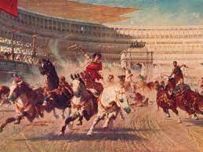
What happened at chariot races?
The races were paid for by the emperor or a senior politician.
There was a parade before the race, led by the sponsor. Behind him came the charioteers and the horses, as well as musicians and soldiers carrying images of the gods and goddesses thought to be present at the races. These were placed in a shrine in the imperial box.
Each races lasted about 10-15 minutes. Each one consisted of seven laps of the track in an anti-clockwise direction.
Normally there were 24 races in a single day.
Chariots normally pulled by 4 horses (though more was possible).
Chariot race started by sponsor dropping a white cloth.
Most accidents happened around the metae (the turning points).
The winner of a race was given a palm branch by the sponsor. Money was given to him and his team at the end of the day.

Slide 37
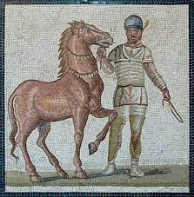
Who were the charioteers?
Usually freedmen or slaves who would hope to buy their freedom with prize money.
Divided into four teams: red, blue, green and white. Each team had an owner who oversaw the team’s stables and staff.
Each wore a tunic (in their team’s colours), a leather helmet, a whip and a knife to cut himself out of the reins wrapped around his wrists in the event of a crash.
Charioteers could be extremely wealthy. Gaius Appuleius Diocles was a chariot racer who would have been a multi-millionaire (perhaps even a billionaire) by today’s standards.

Slide 38
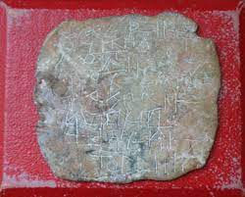
Who were the supporters?
A supporter might have followed a particular team, racer or even a horse. For instance, a successful horse like Victor, who we know won 429 races, might have had a lot of supporters.
It was common for supporters to wear their team’s colours to the races and to bet heavily in favour of them.
Some supporters took chariot racing extremely seriously. We have curse tablets (normally sheets of lead on which were written prayers asking for a curse to put on an enemy- one is shown to the right) which begged the gods to torture and kill rival teams’ racers and horses.
There is one very extreme example of a Red team supporter jumping onto a Red charioteer’s funeral pyre out of grief.
Neptune was a favourite god of Roman chariot racing fans due to his role as the god of horses.

Slide 39
Compulsory activities

Slide 40
Written questions The number in the square brackets next to each question tells you the number of marks. This tells you how many points to make.

Slide 41
How many chariot racing teams were there? [1]
What were the names of these teams? [4]
Who led the procession at the start of a chariot race? [1]
Who was the most successful ever Roman chariot racer? [1]
Who sat on the lowest tier at the Circus Maximus? [4]
How many carceres were there? [1]
What was placed on the spina of the Circus Maximus by Augustus and why did he place it there? [2]
Which god was a favourite amongst chariot racing fans? [1]
How many metae were on either end of the Circus Maximus’ spina? [1]
What was originally used to count laps at the Circus Maximus and what were these replaced with? [2]
Notes:
XX mins – task
(XX total mins)
Notes
Links

Slide 42
Source questions -Put each source as a subtitle (i.e. ‘source 1, source 2 etc.) - Under each, answer the questions

Slide 43
Source 1
Who fears…that their house might collapse, in cool Praeneste, or in Volsinii among the wooded hills, or at unpretentious* Gabii, or the sloping hills of Tibur?
Which literary technique is shown in this quotation?
Write down two words which show us that Umbricius thinks that these country towns are nice to live in.
*Unpretentious = not showing off to seem like something which it isn’t (‘down to earth’)
Notes:
XX mins – task
(XX total mins)
Notes
Links

Slide 44
Source 2
‘We inhabit* a Rome held up by slender props’
Where is the hyperbole in this quotation?
What is Umbricius saying about the houses in Rome with the phrase ‘held up by slender props’?
*Inhabit = living in
Notes:
XX mins – task
(XX total mins)
Notes
Links

Slide 45
Source 3
Cordus had a bed, too small for Procula, and six little jugs of earthenware* to adorn* his sideboard and, underneath it, a little Chiron…made of that very same ‘marble’
How is Cordus made to seem very poor in this passage (give two details)?
‘Adorn’ is a word usually used to describe fancy or expensive decorations. Why has Juvenal chosen to have Umbricius describe Cordus’ earthenware jugs this way?
*Earthenware = a cheap type of clay
*Adorn = decorated
Notes:
XX mins – task
(XX total mins)
Notes
Links

Slide 46
Source 4
And a box somewhat aged now, to hold his Greek library, so the barbarous mice gnawed away at immortal verse.
Why is the use of the word ‘library’ ironic in this passage?
If Cordus owns Greek poetry, what does that tell us about his education?
Since the educated elite (Juvenal’s audience) likely owned and read Greek poetry, what is he trying to tell them by having such a poor man also be able to own copies of and read these poems?
Notes:
XX mins – task
(XX total mins)
Notes
Links

Slide 47
Source 5
Cordus had nothing, who could demur*? Yet, poor man, he lost the whole of that nothing.
How does Juvenal emphasise how little Cordus had in this passage?
How does Juvenal make us feel sorry for Cordus in this passage?
If Cordus’ few possessions were very precious to him, what is Juvenal saying to his audience (the educated elite) when he describes them as ‘nothing’?
*Demur = disagree
Notes:
XX mins – task
(XX total mins)
Notes
Links

Slide 48
Extended writing questions Choose one of the two 8 mark questions (one is shown on each slide) and write a response to it. The source for each is found on the following slide. Extension: Write a response to the other.

Slide 49
How important is food to Horace’s criticisms of the elite of Rome? Use source A as a starting point and your own knowledge in your answer.
Notes:
XX mins – task
(XX total mins)
Notes
Links

Slide 50
Source A
When will they set before me beans, Pythagoras’ kin, And those little cabbages oiled with thick bacon-grease? O heavenly night-time dinners, when I and my friends eat beside my own Lar, and feed jostling servants on left-over offerings. Each guest drinks as he wishes large glasses or small, free from foolish rules, whether he downs the strong stuff, nobly, or wets his whistle In more carefree style. And so the conversation starts. Not about other men’s houses in town, their country Villas, or whether Lepos dances well or not: no, We talk about things one should know, that matter more: Whether it’s wealth or character makes men happier: whether self-interest or virtue make men friends: and the nature of the good, and its highest form. Horace, Satires, 2.6.63-76
Notes:
XX mins – task
(XX total mins)
Notes
Links

Slide 51
‘Juvenal cared more about the poor of Rome than Horace did’. To what extent do you agree with this statement? Use Source B as a starting point and your own knowledge in your answer.
Notes:
XX mins – task
(XX total mins)
Notes
Links

Slide 52
Source B
We inhabit a Rome held up for the most part by slender props; since that’s the way management stop the buildings falling down; once they’ve covered some ancient yawning crack, they’ll tell us to sleep soundly at the edge of ruin. The place to live is far from all these fires, and all these panics in the night. Ucalegon is already summoning a hose, moving his things, and your third floor’s already smoking: you’re unaware; since if the alarm was raised downstairs, the last to burn will be the one a bare tile protects from the rain, up there where gentle doves coo over their eggs Horace, Satires, 2.6.63-76
Notes:
XX mins – task
(XX total mins)
Notes
Links

Slide 53
Compulsory activities

Slide 54
Written questions The number in the square brackets next to each question tells you the number of marks. This tells you how many points to make.

Slide 55
Which genre of poetry did Juvenal write? [1]
Who is the narrator the of Juvenal Satire 3? [1]
What does this man’s name mean? [1]
Were is this man moving from and where is he moving to? [2]
What does the narrator of Juvenal Satire 3 say that Rome’s buildings are held up by? [1]
Who gave Horace his Sabine villa and farm? [1]
Which character in Horace’s poems is given the nickname ‘the Dog’?[1]
What are three things which appeared on the Circus Maximus’ spina? [3]
A theatre in which city was renovated by the Holconii brothers? [1]
The Insula of Diana was originally how many stories tall? [1]
What is a thermopylium? [1]
Which Roman house has a picture of the Nile in one of its rooms?
Which age group did a Grammator teach? [1]
How many sesterces did a Senator’s property have to be worth? [1]
Which sort of slave would have worked in a mine? [1]
Notes:
XX mins – task
(XX total mins)
Notes
Links

Slide 56
Source questions Use the sources on each slide to answer the questions

Slide 57
Source 1
‘Who fears…that their house might collapse, in cool Praeneste, or in Volsinii among the wooded hills, or at unpretentious Gabii, or the sloping hills of Tibur?
We inhabit* a Rome held up by slender props’ –Juvenal Satires
Source 2
We were accompanying him home when, while climbing the Cispian Hill, we saw a tall multi-storey block of flats overrun with flames, and all the neighbouring buildings burning in a great fire ball. Then one of Julianus’ companions said: “The income from urban property is great, but the dangers are far greater. But if some solution could be found to stop houses in Rome from catching fire all the time, by the gods I would sell my country property and buy in the city”. – Aulus Gellius Attic Nights
How do the writers in these passages make life in an insula sound dangerous?
Where do these writers tell us is safer to live in than Rome?
Notes:
XX mins – task
(XX total mins)
Notes
Links

Slide 58
Source 2
We were accompanying him home when, while climbing the Cispian Hill, we saw a tall multi-storey block of flats overrun with flames, and all the neighbouring buildings burning in a great fire ball. Then one of Julianus’ companions said: “The income from urban property is great, but the dangers are far greater. But if some solution could be found to stop houses in Rome from catching fire all the time, by the gods I would sell my country property and buy in the city”. – Aulus Gellius Attic Nights
Source 3
If Assaracus’ great mansion is lost, his mother’s in mourning, the nobles wear black, and the praetor adjourns his hearing. Then we bewail the state of Rome, then we despair of its fires. While it’s still burning, they’re rushing to offer marble, already, To collect donations…Here books and bookcases, a Minerva to set in their midst, there a heap of silver. –Juvenal Satires
3. What do we learn from Source 2 about why insulae are so dangerous to live in?
4. How do Sources 2 and 3 present the rich as caring about wealth?
Notes:
XX mins – task
(XX total mins)
Notes
Links

Slide 59
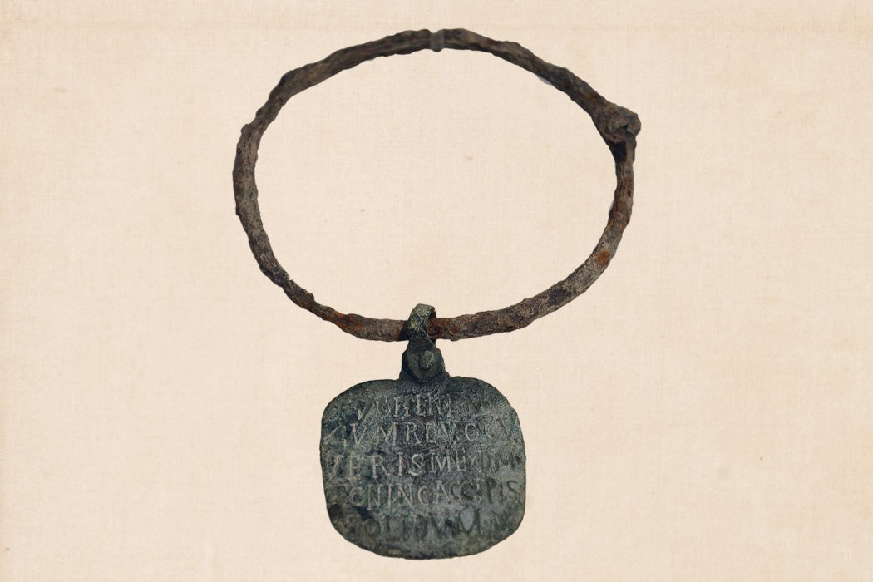
Source 4: A slave collar which reads ‘I have escaped, capture me!’ and promising money to anybody who returns the runaway slave to their master, Zoninus
4. What was the purpose of the item shown in Source 4?
5. What else could masters do to their slaves to prevent them from escaping?
Notes:
XX mins – task
(XX total mins)
Notes
Links

Slide 60
Source 5: A description of the frescos (wall paintings) in the home of Trimalchio, a fictional rich freedman. The frescos show Trimalchio’s rise from slavery to wealthy freedman.
‘There was a slave market depicted with the price tags and Trimalchio himself (with hair) was holding Mercury’s staff and was entering Rome, led by Minerva. After this was how he had learnt accountancy and then how he was made a treasurer. The attentive painter had reproduced everything carefully…Mercury was carrying him off, lifted by the chin, to a lofty tribunal*.’ –Petronius Satyricon
6. What was Mercury the god of which made him appropriate for Petronius to include in this scene?
7. What is Trimalchio trying to suggest about himself by showing the gods helping him become wealthy?
8. What does the character of Trimalchio’s wealth tell us about freedmen?
*A high position in government.
Notes:
XX mins – task
(XX total mins)
Notes
Links

Slide 61
Extended writing questions Choose one of the two 15 mark questions on the following slide. Remember that a 15 marker should be about 4 paragraphs long, including an introduction and a conclusion Extension: Write a response to the other.

Slide 62
9. ‘Roman entertainment was always violent’. To what extent do you agree with this statement? OR 10. ‘Social mobility* was impossible in the city of Rome’. To what extent do you agree with this statement? *Social mobility = poorer people being able to become richer over time

Slide 63
Roman Houses

Slide 64
 | Insula (tower block, literally ‘island’) | Domus (house)
Who would have lived here? | The very poorest in society as well as those who had enough money to rent a flat. | Wealthy people and their slaves
What sort of rooms were there? | Often thermopylia (hot food shops) on the ground floor with space above for the shop workers to sleep (mezzanines). A range of different living spaces. Some single rooms. Some large rooms for multiple people to live in at once. Some flats divided into multiple rooms for better-off families. A few small number had very large flats in them for wealthier people. Communal kitchens and toilet facilities were found in some insulae. | Shops somewhere along the outside, either run by family or rented out. Atrium- main room in which visitors were met. In the centre was an impluvium (rectangular pool to collect rainwater) with a compluvium (an opening to let rainwater fall into the house) in the roof above it. Might contain a lararium (shrine to household gods) and wax masks of ancestors were sometimes kept in Tablinum- a study for the master of the house, usually located between the atrium and the peristyle. Peristyle- A garden with a colonnade running around it. Normally found in an open-air part of the house’s centre. Triclinium- Dining room with three couches for guests to recline on. Bedroom- Normally only big enough for a bed and a chair Kitchen- Small and cramped with a hearth for cooking. Slaves who were cooks may have slept here. Recess- A small room with one side open
How might these be decorated? | Wall decorations quite common. We have evidence for murals (wall paintings) as well as blocks of colour painted onto walls (reds, yellows and browns seem to have been very popular). The outside would have been made of brick-faced concrete, roofs made out of wooden beams covered with terracotta tiles. Some windows may have been glazed. | Wall decorations quite common. Blocks of colours often painted on walls. The most popular colours were reds, oranges, blue-greens. Yellows, purples and black were also popular colours for walls. Atrium might be very well decorated to show off the family’s wealth. Tablinum possibly well-decorated for the same reason. Peristyle would have included flowers and shrubs, possibly an ornate (fancy-looking) fountain and statues. Other rooms likely had murals (wall paintings) appropriate to the room i.e. food on the walls of the tricilinium. Other murals might include scenes of the countryside of scenes from mythology. Slave areas probably not well decorated. The house as a whole probably would have had a lot of furniture in it.
What was life like for people living here? | Varied depending on which part of the building you were living in. Multi-room flats probably not terrible to live in with a decent amount of space. Smaller rooms were probably cramped, especially if multiple people were staying in them. Corridors in the poorer areas generally poorly lit. Wherever you were staying, insulae were not safe buildings. They were often not well built and it seems that it wasn’t uncommon for them to fall down. Fires were a problem with the darker areas needing to be lit by oil lamps. Also, there were no fire escapes- the higher up you were, the greater risk you would die in a fire or be buried under a collapsing insula. | For the free members of the house, probably quite nice. Peristyle would have given them a place to relax, the impluvium somewhere to get water from without leaving the house (on rainy days) and the triclinium would have been nice to eat in. Slaves would have done a lot of the work round the house. The wealthiest of families would have divided time between a house in the city and the house in the countryside. Members of the family would have had to leave home to use baths, unless they were super wealthy and had their own private baths (though they may still have wanted to use the public baths in order to meet people and to be seen out-and-about). The female members of the family would have been less free to come and go from the house as the male members, however. For the slaves, life was hard. Slaves were unlikely to have their own quarters (other than in particularly large houses) and probably slept where they worked. They were expected to wake up before their masters and likely went to bed after them.

Slide 65
Prescribed Source | Insula of Diana
Location | Ostia
Size | 39x23m 4 storeys
Layout | Ground floor: Shops (thermopolia- hot food shops), courtyard, external and internal staircases. Mezzanines on ground floor could have been used as storage or as sleeping quarters for the shopkeepers. Courtyard in centre. Shrine to Mithras (called a Mithraeum) First floor: Large four-room apartments. Reasonably well-off families probably lived in these. Poorly-lit communal living areas: small rooms and a long corridor. Larger room at the end of this corridor might have housed multiple people at a time. Shared toilet facilities.
Possible Residents | Bigger apartments wealthy families for longer leases (between 6 months and a year) Smaller rooms probably workers for short stays (a number of days)
Owner | Wealthy owner making money from rent
Decoration | Relief sculpture of Diana on courtyard wall Paintings of food in thermopolium Yellow/Red/Green walls in apartments
Special Features | Central courtyard for light Cistern for water supply Relief of Diana on the inner courtyard wall Shrine to the god Mithras (a Mithraeum) located on ground floor

Slide 66
Prescribed Source | House of the Wooden Partition
Location | Herculaneum
Size | c.40m from street to back
Layout | Two storeys Classic atrium – tablinum - peristyle layout Benches for clients on street Steps at back and front to upper storey
Possible Residents | Wealthy individual with family and slaves. Person who ran the shop might have lived above it.
Owner | Wealthy shop owner
Decoration | Red/black/yellow painted panels in atrium Marble display table next to impluvium, fountain in the centre of the impluvium. Wooden partition’s hinges shaped like ships’ figureheads.
Special Features | Wooden partition between tablinum and atrium allowed for privacy when required Other wooden furniture survives Flats above shops

Slide 67
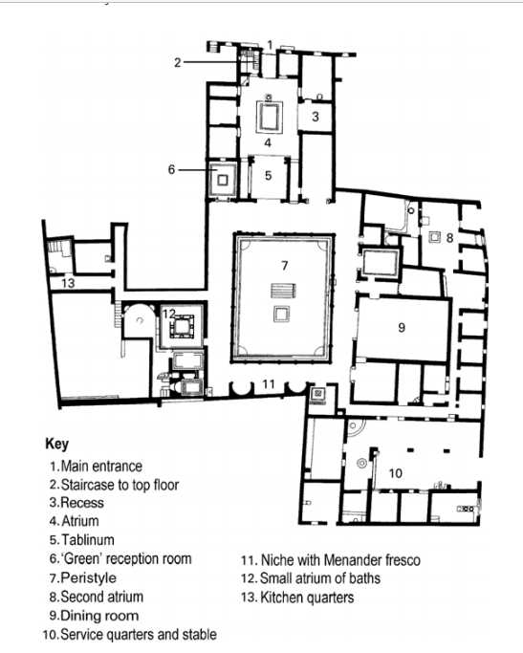
 | House of Menander
Location | Pompeii
Size | One of the largest in Pompeii
Layout | Atrium – tablinum – peristyle, extended many times leading to unconventional layout. Slave quarters and stables at rear. Private baths off peristyle.
Possible residents | Large family plus huge retinue of slaves, wealthy enough to also have a farming estate
Owner | Unclear (named after Greek comic playwright Menander)
Decoration | Paintings of Trojan war in atrium Floor mosaic of River Nile
Special features | Impressive lararium(household shrine) in atrium Private Baths! HUGE dining room

Slide 68
Core | East wing | West wing
Impressive household shrine in atrium Staircase to the upstairs next to the shrine One room to the east in the atrium has three frescos of scenes from the Trojan War Large peristyle Green reception room off to the north-west of the peristyle Baths off to the south-west of the peristyle- a sign of extreme wealth Huge dining room (triclinium) to the east of the peristyle, with a floor mosaic depicting the river Nile Second household shrine (lararium) at the south end of the peristyle, as well as three frescoes. One is of the Greek playwright Menander, which has given the house its name. | Long corridor with multiple small rooms Large stable at the end where a wagon and amphorae were found Small atrium at the other end, where the house’s steward or head slave might have worked Slaves quarters may have been located here | Kitchen Latrine Access to cellars Silver service stored here

Slide 69
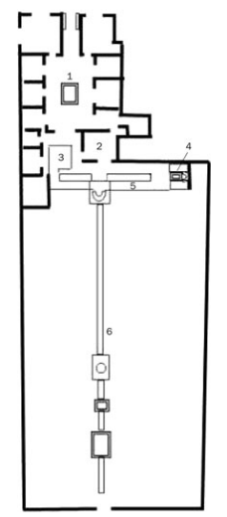
 | House of Octavius Quartio
Location | Pompeii
Size | Very large with a massive garden
Layout | Atrium – tablinum – peristyle, but with a small peristyle and a huge garden stretching out beyond it.
Possible residents | Wealthy family with slaves. Owner might have enjoyed hunting or travelling to the countryside judging by the decorations.
Owner | Unclear, but a man called Octavius Quartio’s ring was found in one of the shops.
Decoration | Huge range of murals (for more details, see the next slide for more details)
Special features | Massive garden with two pergolas, a huge canal, a shrine and even a small temple!

Slide 70
Main house | North side of peristyle | South side of peristyle
Stone seats at front for clients to wait on Two front rooms open onto street as shops- in one Octavius Quartio’s ring was found (this gave the house its name) Rectangular atrium Impluvium with fountain jet Impluvium surrounded by flower boxes- hints at the garden which lays beyond Standard rooms around atrium, leading into a small peristyle, colonnaded on three sides | On fourth side opens onto pergola A narrow canal ran under the pergola, lined with statues and probably home to fish West end of pergola has scenes from the myth of Actium and Diana Reception room (possibly for dining) to the north, with frescoes showing the life of Heracles and the Trojan War North walls of pergola decorated with hunting scenes Dining area east of the pergola with space for only two couches Next to the dining area was a small lararium with paintings of Narcissus and Pyramus and Thisbe next to it | Pergola leads into rest of the garden on a lower level Divided by canal (50m long and decorated with statues, paintings and crossing bridges) and a second, longer pergola Where the two pergolas met, there was a fountain shrine dedicated to Diana and Actaeon Halfway down the pergola was another fountain and a temple

Slide 71
 | Circus Maximus | Colosseum | Large Theatre at Pompeii | Central Baths at Herculaneum
Location | Rome | Rome | Pompeii | Herculaneum
Constructed | First built 6th century BC. Rebuilt a number of times, notably in 2nd century AD | Constructed in 70s AD. Opened in 80 AD | 2nd century BC. Renovated in late 1st century BC | Late 1st century BC
No. of seats | 250,000 (by 1st century AD). The largest sporting arena in recorded history. | Around 50,000 | Around 4000 | N/A
Materials | Originally wood. Later rebuilt with brick-faced concrete and marble. Lower tier of seating made of marble, the upper stone. Imperial box built from marble. | Outer wall made of travertine rock Arches made of brick and concrete Stucco (plaster which is easy to paint over) possibly used throughout the building for decoration. Definitely used on two arches which marked VIP entrances. First three storeys of seating made of marble. Top storey made of wood. Metal fence around the arena Sand covered arena | Main seating area made of marble Stage made of wood Front wall made of stone | Variety of materials in different rooms, including marble and stucco
Purpose | Hosted chariot racing | Gladiator fighting Public executions Beast hunts Performances by trained animals Some other extraordinary events, such as sea battles in a flooded arena | Hosted comedies, mimes and pantomimes | People might go to the baths to: Get washed Exercise To be seen and show off their power and status if they were rich men To meet rich and powerful people and try to get dinner invitations Meet friends and relax Hold business meetings Buy snacks and drinks
Important features | Size of track: 600m long, 150m wide Dividing bank down the middle called the spina (spine) Turning points at either end decorated with bronze posts covered with gold called metae 13th century BC red granite obelisk (tall stone monument) on the spina, brought from Egypt by Augustus. Symbols of the gods along the spina Seven large wooden eggs on spina, used to count laps. Later replaced by seven bronze dolphins. Carceres (Starting cages) constructed to stagger the racers as certain starting positions were better than others Three tiers of seating: Lowest: VIPs, state priests, senators and wealthy equites Middle: Anyone, including men, women and children. Top: Possibly standing only Imperial box on one side | Constructed around four concentric circles and a series of archways Four pathways from outer wall to arena with toilets and drinking fountains, Vomitoria: staircases allowing fast exit Eighty entrances with four ornate ones (possibly for VIPs), two of which are decorated (see above) Awning which could be pulled over spectators in event of heat Seating by social class: Ground floor: imperial box, special seats for Vestal Virgins, seating for senators First tier: equites Second tier: ordinary citizens Third tier: women, slaves and the poor Archers stood by arena to shoot animals which threatened spectators Network of tunnels, cages and lifts under the arena. Animals held in these and sent out through trapdoors Underground area linked to a point outside the stadium so that spectators would be surprised by the animals | Renovated by Holconii family with crypt, boxes (above main seating) and theatre seating All seating (except upper section) built into hill in Greek fashion. Seating tiered: Lower tier made of marble: VIPs Second tier: other free citizens Third tier: freedmen, slaves and women Awning to shade spectators Orchestra in front of stage in Greek fashion. Probably used for VIP seating unless a Greek play was happening. Elaborate scaena frons (front scene) behind stage Stage raised on pillars, leaving space below it to move stage machinery and props | Separate areas for both men and women (women’s area was smaller with smaller rooms). Men and women could visit at the same time (baths without both sections would require women to visit in the morning and men in the afternoon). Men and women each had: An entrance An apodyterium (changing room- slaves were probably available to watch people’s possessions) A tepidarium (warm room like a modern saunda) A caldarium (hot room where people would get washed with hot water, have dirt scraped off them with olive oil and strigils and get massaged) The following were only found in the men’s area: A palaestra (exercise ground. Women might have exercised in a corridor next to their apodyterium) A frigidarium (cold room with a plunge pool, used to cool down after caldarium) A man might have visited their rooms in this order: entrance -> apodyterium -> palaestra -> tepidarium -> caldarium -> frigidarium Women would have followed same path, maybe exercising in the corridor next to the apodyterium, though without visiting a frigidarium. Hypocaust system of underground heating used to heat warm rooms.

Slide 72
Circus Maximus | Circus Maximus
Location | Rome
Constructed | First built 6th century BC. Rebuilt a number of times, notably in 2nd century AD
No. of seats | 250,000 (by 1st century AD). The largest sporting arena in recorded history.
Materials | Originally wood. Later rebuilt with brick-faced concrete and marble. Lower tier of seating made of marble, the upper stone. Imperial box built from marble.
Purpose | Hosted chariot racing
Important features | Size of track: 600m long, 150m wide Dividing bank down the middle called the spina (spine) Turning points at either end decorated with bronze posts covered with gold called metae 13th century BC red granite obelisk (tall stone monument) on the spina, brought from Egypt by Augustus. Symbols of the gods along the spina Seven large wooden eggs on spina, used to count laps. Later replaced by seven bronze dolphins. Carceres (Starting cages) constructed to stagger the racers as certain starting positions were better than others Three tiers of seating: Lowest: VIPs, state priests, senators and wealthy equites Middle: Anyone, including men, women and children. Top: Possibly standing only Imperial box on one side

Slide 73
What happened at chariot races?
The races were paid for by the emperor or a senior politician.
There was a parade before the race, led by the sponsor. Behind him came the charioteers and the horses, as well as musicians and soldiers carrying images of the gods and goddesses thought to be present at the races. These were placed in a shrine in the imperial box.
Each races lasted about 10-15 minutes. Each one consisted of seven laps of the track in an anti-clockwise direction.
Normally there were 24 races in a single day.
Chariots normally pulled by 4 horses (though more was possible).
Chariot race started by sponsor dropping a white cloth.
Most accidents happened around the metae (the turning points).
The winner of a race was given a palm branch by the sponsor. Money was given to him and his team at the end of the day.

Slide 74
Who were the charioteers?
Usually freedmen or slaves who would hope to buy their freedom with prize money.
Divided into four teams: red, blue, green and white. Each team had an owner who oversaw the team’s stables and staff.
Each wore a tunic (in their team’s colours), a leather helmet, a whip and a knife to cut himself out of the reins wrapped around his wrists in the event of a crash.
Charioteers could be extremely wealthy. Gaius Appuleius Diocles was a chariot racer who would have been a multi-millionaire (perhaps even a billionaire) by today’s standards.

Slide 75
Who were the supporters?
A supporter might have followed a particular team, racer or even a horse. For instance, a successful horse like Victor, who we know won 429 races, might have had a lot of supporters.
It was common for supporters to wear their team’s colours to the races and to bet heavily in favour of them.
Some supporters took chariot racing extremely seriously. We have curse tablets (normally sheets of lead on which were written prayers asking for a curse to put on an enemy- one is shown to the right) which begged the gods to torture and kill rival teams’ racers and horses.
There is one very extreme example of a Red team supporter jumping onto a Red charioteer’s funeral pyre out of grief.

Slide 76
Colosseum | Colosseum
Location | Rome
Constructed | Constructed in 70s AD. Opened in 80 AD
No. of seats | Around 50,000
Materials | Outer wall made of travertine rock Arches made of brick and concrete Stucco (plaster which is easy to paint over) possibly used throughout the building for decoration. Definitely used on two arches which marked VIP entrances. First three storeys of seating made of marble. Top storey made of wood. Metal fence around the arena Sand covered arena
Purpose | Gladiator fighting Public executions Beast hunts Performances by trained animals Some other extraordinary events, such as sea battles in a flooded arena
Important features | Constructed around four concentric circles and a series of archways Four pathways from outer wall to arena with toilets and drinking fountains, Vomitoria: staircases allowing fast exit Eighty entrances with four ornate ones (possibly for VIPs), two of which are decorated (see above) Awning which could be pulled over spectators in event of heat Seating by social class: Ground floor: imperial box, special seats for Vestal Virgins, seating for senators First tier: equites Second tier: ordinary citizens Third tier: women, slaves and the poor Archers stood by arena to shoot animals which threatened spectators Network of tunnels, cages and lifts under the arena. Animals held in these and sent out through trapdoors Underground area linked to a point outside the stadium so that spectators would be surprised by the animals

Slide 77
How were the games at an amphitheatre funded?
Emperors and other wealthy men sponsored games in amphitheatres as a way to win support from the general public (politicians, especially before the reign of Augustus, would promise spectacular games as a way of persuading people to vote for them). Over time the emperors passed laws so to stop anyone other than themselves putting in particularly extraordinary shows in Rome.
Outside of Rome, wealthy politicians continued to use the promise of great spectacles in games in order to persuade people to vote for them.
Prescribed source
In cities outside of Rome, the two most powerful politicians were the aediles. This message was painted on the outside wall of a building in the forum at Pompeii. The forum was the central marketplace of a Roman town which many people would probably have visited on almost a daily basis. Aulus clearly wanted his message to be seen by as many people as possible in order to gain their support in future elections.

Slide 78
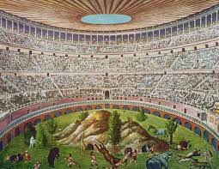
Wild animal shows
When they happened
Probably in the morning.
What they involved
Animals might perform tricks, like panthers who pulled chariots or elephants bowing to the emperor. The animals might be made to fight each other, or a bestiarius (a trained animal fighter) might fight a vicious animal or hunt them through a recreation of the wilderness (similar to the scene to the right).
What the point of them was
By bringing into the Colosseum animals taken from far away places, the size (and therefore the power) of the Roman Empire could be shown off. These included elephants, crocodiles, giraffes and hippos. Most spectators would never see such animals outside of the games. The shows were also meant to give the spectators the idea that the empire (and therefore the Emperor) had control over both humans and nature.

Slide 79
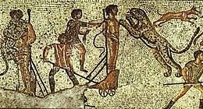
Executions
When they happened
Probably in midday.
What they involved
Criminals were killed in brutal or disgustingly creative ways. They were usually killed by wild animals, either after being tied to a stake or being made to fight them. Criminals were also made to fight to the death in a mock gladiator fight. In addition, we hear of crucifixions and people even being burned alive. Some of the more creative methods of execution might involve a criminal being forced to play the role of a mythological character in a recreation of their death scene.
What the point of them was
These were probably meant to be a warning against going against the emperor’s laws. The presence of the wild animals would have had an effect similar to that of the wild animal shows.

Slide 80
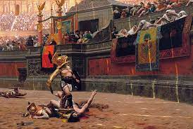
Gladiatorial fights
When they happened
Probably in the afternoon.
What they involved
A procession, accompanied by music, would have started the gladiator fights, followed by an inspection of the gladiator’s weapons. Most bouts involved two gladiators, but some could involve more. A bout lasted about 15-20 minutes, and ended when one fighter surrendered by lifting up his finger. At this point, the emperor, after listening to the crowd’s response, use his thumb to give the order to either spare or kill the defeated gladiator (we do not have records about what his signal looked like). Usually gladiators were not killed, but those who were would be trained to not flinch or beg for mercy. After his death, a gladiator’s head would be hit by a mallet from an attendant, whilst another dressed as Mercury would prod the corpse with a hot rod. The body was then removed, the man’s throat cut and the sand rake over to hide the blood. Some gladiatorial fights involved marginalised groups, such as women or dwarfs, as gladiators.
What the point of them was
Not only were these entertaining, but gladiator fights allowed the emperor to not only be seen as paying attention to the will of the crowd when he voted on whether to kill or spare a defeated gladiator, but it also allowed him to present himself as somebody who had power over life and death. The appearance of an attendant dressed as Mercury represented the spirit of the gladiator being taken down into the underworld.
The usage of marginalised people would have provided the audience with variety, but would have also been a cruel way of mocking these people.

Slide 81
Large Theatre at Pompeii | Colosseum
Location | Pompeii
Constructed | 2nd century BC. Renovated in late 1st century BC
No. of seats | Around 4000
Materials | Main seating area made of marble Stage made of wood Front wall made of stone
Purpose | Hosted comedies, mimes and pantomimes
Important features | Renovated by Holconii family with crypt, boxes (above main seating) and theatre seating All seating (except upper section) built into hill in Greek fashion. Seating tiered: Lower tier made of marble: VIPs Second tier: other free citizens Third tier: freedmen, slaves and women Awning to shade spectators Orchestra in front of stage in Greek fashion. Probably used for VIP seating unless a Greek play was happening. Elaborate scaena frons (front scene) behind stage Stage raised on pillars, leaving space below it to move stage machinery and props

Slide 82
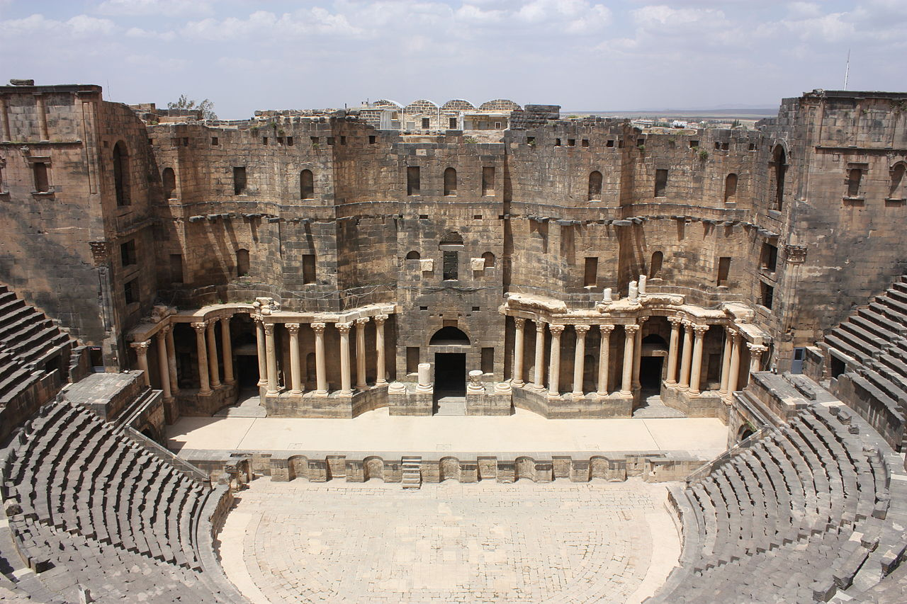
awning
Slave Seating
Scaenae frons
vomitoria
Pillars
Orchestra
Double doors
VIP seating
Stage

Slide 83
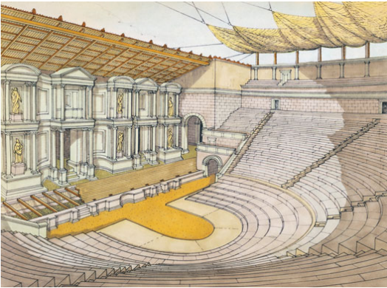
Overview
Roman drama developed from Greek drama
Like the Greeks, Romans often put on plays during religious festivals
Plays were usually paid for partly out of public funds and partly by politicians who ran the festivals, hoping that this would get them support in elections
Wealthy people would also pay for theatres to be built or renovated (i.e. the Holconii in Pompeii)
A theatre might have had a semi-circular seating area and a semi-circular space in the centre called the orchestra. This was probably only used for Greek plays and otherwise likely used for VIP seating.

Slide 84
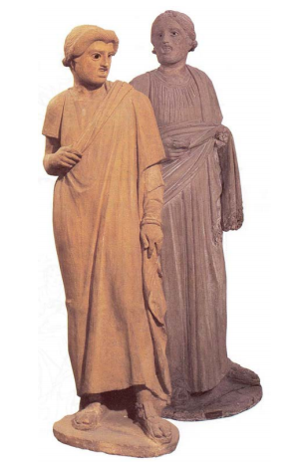
Roman actors
Considered infamis (few legal rights)
Tended to be slaves or people with little money to begin with.
To be an actor, a person needed to be able to sing and play a vast number of roles.
Could become very rich due to having huge numbers of passionate fans
Groups of actors formed troupes, each under the leadership of a troupe leader.
Competition was fierce between troupes, as prizes were awarded to troupes or individual actors at the end of festivals. Troupes might have supporters placed in the audience in order to clap or cheer at the right moments.

Slide 85
Costumes, props and masks
For male roles, a cloak and tunic would be worn,
For female roles, a dress and a cloak would be worn for female roles
Props would be use to tell an audience about a character’s role in the play- an old man might carry a walking stick, a cook might hold a knife and a slave dealer usually held a money-bag. These sorts of costumes all originated in Greek theatre.
The theatrical mask originated in Greek theatre and allowed a single actor to play multiple roles with each one designed to indicate a specific kind of character. For instance, masks made for female characters would have pale skin, whilst masks made for male characters would have brown skin. They were made out of linen and plaster, making them very light.

Slide 86
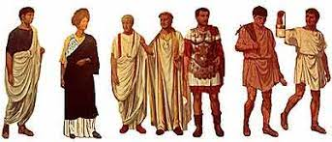
Roman citizenship
Only a man could become a full Roman citizen.
Women only had the same rights as children in Roman law, meaning that they could not vote or hold public office.
Being a Roman citizen gave you a good number of benefits. These included:
Free access to public games
Free or very cheap use of public baths
Being able to vote
Protection from being punished without a trial
Poor citizens were given free corn
Roman citizens were born into a number of social classes. Different social classes had different rights and responsibilities to others.

Slide 87
Two tiers of citizens
Patricians
A small number of powerful families. After the fall of the Roman kings, the patrician families became the ruling class of the city. Lost influence over time as plebeians gained additional rights but remained very powerful into the Imperial period. Patrician families would have hoped to become senatorial families. Roman voting system arranged to allow patricians. Although many patrician families tended to have long histories, it became increasingly common for plebeians to be raised to patrician status as old families began to die out.
Plebeians
Everyone else who wasn’t a patrician. Gained power over time. Represented by the tribune of the plebeians, a powerful elected politician with the power to block other politicians’ commands. This office lost power over time, leading to the Roman emperors being given power to control the tribune. Plebeians included people from a huge range of economic backgrounds, from the very rich to the very poor. Extremely wealthy plebeians could become senators. Roman voting system organised to give the plebeians less voting power then the patricians.

Slide 88
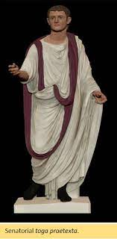
Senators
The highest Roman social class.
Senators sat in the Senate, an extremely influential political body which had the power to choose emperors.
To become a senator:
Your father had to have been a senator OR the emperor had named you a member of the senatorial class
Your property had to be worth one million sesterces (possibly about £2.7 million)
From 17, you could be chosen to become a senator by a magistrate called a censor or the emperor.
Would normally be expected to have been elected to public office at least once
A senatorial family could lose its rank if it lost its wealth, lacked a male heir or fell out of favour with the emperor. Therefore, the emperor had to raise new families to senatorial rank quite often.
Senators could not make money from trading (though this rule was sometimes ignored) and were not paid for being senators.
Senators could stand every year as magistrates (elected politicians).
A senator could become a consul (one of the two leaders of Rome elected once a year) or a praetor (whose job was to oversee Roman laws).
The emperor might select a senator to command a legion of the army, govern a province, supervise public services or hold an important priesthood.
Senators had their own reserved seating at games and wore a wide purple stripe on their toga.

Slide 89
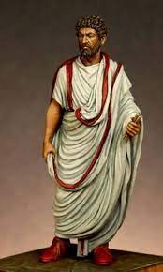
Equestrians
Originally men who could afford to own a horse- their name literally means ‘knights’.
By the 1st century AD, any man with property worth 400,000 sesterces (possibly about £1.1 million) could become an equestrian.
Often successful businessmen who could make money from trade.
Often chosen by the emperor for civil service i.e. managing finances.
Could be governors of small provinces- Pontius Pilate was an equestrian for instance (he was the governor of Judaea).
Each equestrian wore a narrow purple stripe on his toga and a gold ring.
Could be promoted to senatorial class if a position opened up and they had enough money.

Slide 90
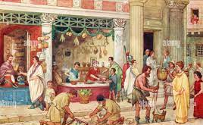
Everybody else!
The ordinary people of Rome.
Generally not wealth off and not educated.
Wealthy enough families could be promoted to equestrian or even patrician statues!
Were involved a huge array of jobs.
Many poorer men chose to serve in the Roman army.

Slide 91
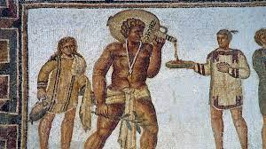
Slaves and masters:
Legally classified as property of their owner
Master had power over their slaves’ lives and deaths (although it eventually became illegal to kill a slave without a good reason)
To stop slaves running away, masters might brand them or put metal collars on them, with the name of their masters written on them
Slaves had no legal protections or rights
Masters could physically and sexually abuse their slaves

Slide 92
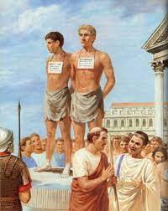
How someone became a slave:
Having a mother who was a slave
Punished for committing a crime by being forced into slavery
Being found exposed as a baby and brought up as a slave
Being sold into slavery at a slave market. Slaves were put on platforms with placards around their necks, stating characteristics such as age, place of origin, level of education and state of health. Big slave markets, like that at Delphi, could sell as many as 10,000 per day. People were sold a after:
Being captured in war
Being kidnapped and sold into slavery
Volunteering to become a slave

Slide 93
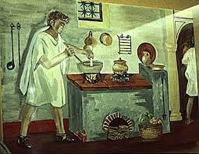
Types of slave:
Domestic
A slave who worked in a private home
Educated Greek slave might have been a tutor
Slave with cooking experience might be a chef
Women might help with cooking, weaving, shopping and childcare. They might help the free women get dressed.
Males worked for paterfamilias, perhaps doing his accounts, going to the baths with him or running errands.
Regarded as part of the family.

Slide 94
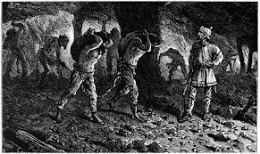
Types of slave:
Industrial
Stronger male slaves
Could have worked in mines, in factories, on large farms or as rowers amongst other industries
Terrible conditions
Life was expected to be short

Slide 95
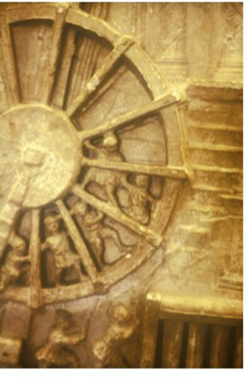
Types of slave:
Public
Owned by the state rather than an individual
Performed a number of roles, such as looking after temples, baths and other public buildings
Might also have worked on public construction or maintenance projects, such as road and aqueducts
The picture to the right shows slaves running around a giant wheel to operate a crane. This show the building of the Colosseum.
Educated slaves could have worked as scribes for the state

Slide 96
Freedmen
Slaves might be freed if they earned money and bought their own freedom.
A master might release their slaves, for instance if they became too old for work, as a reward for doing something great or, in some cases, to marry them (sometimes if the woman was pregnant with his child).
Freedmen allowed to wear a pileus (a pointed felt hat) to symbolise their freedom.
Freedmen were legally Roman citizens who were unable to run for public office or to become equestrians or senators.
Children of freedmen became full Roman citizens.
A freeman became his former master’s client and would have been expected to work for him for some of the year. Some might have worked full time for their former master.
Freedmen were expected to support their former in politics as shown in this inscription:

Slide 97
Augustales
The Augustales were a group which existed to preserve the emperor’s honour. Freedmen were allowed to become Augustales.
They were expected to arrange to have building repaired, statues erected and to pay for games. They were therefore probably wealthy.
They played a religious role, possibly in the cult of Augustus.
They were allowed to wear a bordered toga similar to a magistrate’s and very well respected.
By the 1st century AD, most Augustules were descended from slaves and freedmen.

Slide 98
The Tomb of Naevoleia Tyche: Context
In 60s AD, the freedman Gaius Munatius Faustus built himself a tomb outside of Pompeii for himself and Naevoleia Tyche, his wife.
However, after inheriting her husband’s money, Naevoleia Tyche built a much grander tomb on the other side of the city to show off her and her husband’s wealth.
The tomb was made of marble
The tomb was shaped like an altar raised high off the ground.
The front of the tomb had an inscription and an image of Naevoleia Tyche on it.

Slide 99
The Tomb of Naevoleia Tyche
Inscription, picture of a ceremony and portrait of Naevoleia Tyche.
Urns containing the family’s ashes.
Sculpture of a ship showing that Munatius made his money through shipping.
Sculpture of a ceremonial seat and footstool, showing that Munatius was given his own seat (probably at games) for his services to the city.

Slide 100
The Tomb of Naevoleia Tyche
Portrait of Naevoleia Tyche. This and the inscription emphasise that it was she, not Munatius, who had the tomb built.
The inscription tells us that:
Naevoleia Tyche was a freedwoman who built the tomb for herself and her husband
That Munatius was an Augustalis who was given a seat for his services to the city.
Naevoleia had the tomb built in her lifetime as a monument for her and her husband’s own freedmen and freedwomen. This shows that they must also have owned slaves.
Relief sculpture of a public ceremony. This may show Munatius giving out food and money to the people of Pompeii.

Slide 101
Literature

Slide 102
 | Life | Goals of writing | Style of writing | Extra details
Horace | - Lived between 65 and 27 BC Wrote second book of satires in late 30s BC Son of wealthy freedman who made money as an auctioneer. Educated in Rome. After father’s death finish his education in Athens. May have learned about Epicurean philosophy in Athens. Fought against Triumvirs (Octavian, Antony, Lepidus) at the Battle of Philippi in 42 BC. After defeat at Philippi, returned to Italy. Farm inherited from father confiscated and given to the Triumvirate’s soldiers. Became a patron of Octavian’s friend Maecenas who, in the mid-30s BC, gave Horace a villa and farm in the Sabine Hills Maecenas promoted Horace and introduced him to many other Roman writers | Wanted to gently criticise the educated elite to get them to change their ways Wanted people to live simpler, more relaxed and happier lives | Gentle criticisms Makes fun of the elite, but not in an angry way Parodies extravagant behaviour of the elite (i.e. with the story of the city mouse and the town mouse) Doesn’t write about real people to criticise them. Creates characters to represent the behaviour of the elite (i.e. Nasidienus, who annoys his dinner guests by describing in detail where the food has come from) Background as the son of a freedman who had fought against Octavian meant he couldn’t appear too angry towards the elite. Didn’t want to seem a threat, so like to remind his readers of his background. Wanted to spread an Epicurean message about how to live your life | Influenced by Epicureanism, a philosophy of living simply, enjoying the company of friends and avoiding stress in order to be happy. Wrote a lot about how he preferred the countryside to the city. Was writing his second book of Satires whilst living at the Sabine farm. Though a patron of Maecenas, he was worried about people being jealous of him because of this. Nicknamed the ‘Smiling Satirist’ because of his way of criticising the elite by gently mocking them.
Juvenal | -Lived in Rome between roughly 55 and 130 AD. -Writing between 110 and 130 AD. - May have been the son of rich freedman. -We do not know much about his life. Clearly well-educated since he was able to wite effective poetry Studied rhetoric meaning that he or his family had the money to pay for a complete education Is said to have been the son of a rich freedman | Wanted his audience (the educated elite) to change their ways Saw the wealthy as hypocrites who behaved immorally Driven by ‘indignation’ at the state of Rome- he believed that the people of Rome could and should do better | Angry and nasty in places Does not write about anybody still alive Mocks the elite by depicting them doing ridiculous things | Similar to Lucilius (early Roman satirist who wrote very angry poems) in style Wrote after the death of the Emperor Domitian, who was known for showing off his wealth. Writes a lot of criticisms of Domitian after his assassination. Spent some time in exile from Rome, supposedly for insulting an emperor’s favourite actor.

Slide 103
Juvenal Satire 3
Key themes
How hard life is for the poor in Rome- nobody cares for the poor, the wealthy are safer than the poor.
Rome is so busy that it is hard to even get sleep. The streets are so packed that you get hurt every time you go outside.
Rome is a dangerous place with poorly-built homes, thieves and heavy things being carried around the streets.
The countryside is nicer, with cheaper, better built homes where you can enjoy peace and quiet.

Slide 104
Narrators
Juvenal
Narrates the very beginning of the poem.
Umbricius
Almost certainly a fictional character
Described as a poorer friend of Juvenal’s who narrates most of the poem
Moving out of Rome because it is hard to make a living if you are an honest person
Doesn’t like how many non-Romans are living in Rome.
Juvenal might use the character of Umbricius to give the concerns of the poor a voice
Umbricius’ name means ‘shady’, so perhaps Juvenal is making fun of the poor with his character. He might be a parody of a poor person.
Notes:
XX mins – task
(XX total mins)
Notes
Links

Slide 105
Umbricius’ complaints from non-prescribed lines
Complaints about how difficult it is to make a living in Rome.
Rome is no longer a place for an honest man
Rome is full of foreign people, mainly Greeks and Scythians (Scythian people who mainly came from settlements around the west and north coasts of the Black Sea, including Crimea)
They have brought their cultures to Rome
They are taking Roman jobs from Roman people
Roman law protects the rich and ignores the poor
Poor men kicked out of theatre seats and cannot find women to marry
Notes:
XX mins – task
(XX total mins)
Notes
Links

Slide 106
A fire in an insula (lines 190-211)
Houses in the city are more likely to collapse than those in the countryside
In insulae, those living on the lower floors escape a fire and can save their possessions. Those on the upper floors will not even notice there is a fire.
Cordus: a man living in an insula who has a bed so small that Procula (a dwarf) wouldn’t fit in it! He has six clay jugs, a clay statue of Chiron (a centaur who trained heroes in mythology), a sideboard and a box of Greek poems.
Cordus survives, but loses his belongings and is homeless and has no possessions, not even clothes! Nobody offers him even a crust of bread to help him!
Notes:
XX mins – task
(XX total mins)
Notes
Links

Slide 107
Compulsory activities

Slide 108
Written questions The number in the square brackets next to each question tells you the number of marks. This tells you how many points to make.

Slide 109
Which Roman writer is nicknamed the ‘Smiling Satirist’? [1]
In Horace Satires 2.2, who is described as an ‘idiot ‘savant’’? [1]
Which bird does Horace say tastes no nicer than chicken despite being more expensive? [1]
What falls on the food at Nasidienus’ dinner party in Horace Satires 2.8 [1]
Who were the audiences of both Horace and Juvenal’s satires? [1]
What did Juvenal say inspired him to write his satires? [1]
Who narrates most of Juvenal Satire 3? [1]
Why is this man moving out of Rome (give two reasons)? [2]
Where does the narrator say you can find safer housing? [1]
What can those living on the lower floors of an insula save from a fire? [1]
Where does Cordus live? [2]
What does Cordus own? [5]
What don’t people do for Cordus after the fire? [1]
Notes:
XX mins – task
(XX total mins)
Notes
Links

Slide 110
Source questions -Put each source as a subtitle (i.e. ‘source 1, source 2 etc.) - Under each, answer the questions

Slide 111
Source 1
Who fears…that their house might collapse, in cool Praeneste, or in Volsinii among the wooded hills, or at unpretentious* Gabii, or the sloping hills of Tibur?
Which literary technique is shown in this quotation?
Write down two words which show us that Umbricius thinks that these country towns are nice to live in.
*Unpretentious = not showing off to seem like something which it isn’t (‘down to earth’)
Notes:
XX mins – task
(XX total mins)
Notes
Links

Slide 112
Source 2
‘We inhabit* a Rome held up by slender props’
Where is the hyperbole in this quotation?
What is Umbricius saying about the houses in Rome with the phrase ‘held up by slender props’?
*Inhabit = living in
Notes:
XX mins – task
(XX total mins)
Notes
Links

Slide 113
Source 3
Cordus had a bed, too small for Procula, and six little jugs of earthenware* to adorn* his sideboard and, underneath it, a little Chiron…made of that very same ‘marble’
How is Cordus made to seem very poor in this passage (give two details)?
‘Adorn’ is a word usually used to describe fancy or expensive decorations. Why has Juvenal chosen to have Umbricius describe Cordus’ earthenware jugs this way?
*Earthenware = a cheap type of clay
*Adorn = decorated
Notes:
XX mins – task
(XX total mins)
Notes
Links

Slide 114
Source 4
And a box somewhat aged now, to hold his Greek library, so the barbarous mice gnawed away at immortal verse.
Why is the use of the word ‘library’ ironic in this passage?
If Cordus owns Greek poetry, what does that tell us about his education?
Since the educated elite (Juvenal’s audience) likely owned and read Greek poetry, what is he trying to tell them by having such a poor man also be able to own copies of and read these poems?
Notes:
XX mins – task
(XX total mins)
Notes
Links

Slide 115
Source 5
Cordus had nothing, who could demur*? Yet, poor man, he lost the whole of that nothing.
How does Juvenal emphasise how little Cordus had in this passage?
How does Juvenal make us feel sorry for Cordus in this passage?
If Cordus’ few possessions were very precious to him, what is Juvenal saying to his audience (the educated elite) when he describes them as ‘nothing’?
*Demur = disagree
Notes:
XX mins – task
(XX total mins)
Notes
Links

Slide 116
Extended writing questions Choose one of the two 8 mark questions (one is shown on each slide) and write a response to it. The source for each is found on the following slide. Extension: Write a response to the other.

Slide 117
How important is food to Horace’s criticisms of the elite of Rome? Use source A as a starting point and your own knowledge in your answer.
Notes:
XX mins – task
(XX total mins)
Notes
Links

Slide 118
Source A
When will they set before me beans, Pythagoras’ kin, And those little cabbages oiled with thick bacon-grease? O heavenly night-time dinners, when I and my friends eat beside my own Lar, and feed jostling servants on left-over offerings. Each guest drinks as he wishes large glasses or small, free from foolish rules, whether he downs the strong stuff, nobly, or wets his whistle In more carefree style. And so the conversation starts. Not about other men’s houses in town, their country Villas, or whether Lepos dances well or not: no, We talk about things one should know, that matter more: Whether it’s wealth or character makes men happier: whether self-interest or virtue make men friends: and the nature of the good, and its highest form. Horace, Satires, 2.6.63-76
Notes:
XX mins – task
(XX total mins)
Notes
Links

Slide 119
‘Juvenal cared more about the poor of Rome than Horace did’. To what extent do you agree with this statement? Use Source B as a starting point and your own knowledge in your answer.
Notes:
XX mins – task
(XX total mins)
Notes
Links

Slide 120
Source B
We inhabit a Rome held up for the most part by slender props; since that’s the way management stop the buildings falling down; once they’ve covered some ancient yawning crack, they’ll tell us to sleep soundly at the edge of ruin. The place to live is far from all these fires, and all these panics in the night. Ucalegon is already summoning a hose, moving his things, and your third floor’s already smoking: you’re unaware; since if the alarm was raised downstairs, the last to burn will be the one a bare tile protects from the rain, up there where gentle doves coo over their eggs Horace, Satires, 2.6.63-76
Notes:
XX mins – task
(XX total mins)
Notes
Links

Slide 121
Starter questions Write each question’s number followed by the correct answer

Slide 122
What was the title of Petronius’ job under the emperor Nero?
How do we know that Petronius was writing for quite a wide audience?
How does Encolpius react to seeing a guard dog on the fresco?
How does Trimalchio try to make himself appear heroic through his fresco?
Whilst washing the guests, what do Trimalchio’s slaves do?
What are the eggs served during the main course made of?
Who is Trimalchio’s wife?
Where has Trimalchio imported bees from?
The stuffing of Trimalchio’s cushions are which two colours?
Why does Trimalchio have his cook stripped?
How does Trimalchio demonstrate his lack of knowledge about Roman history?
Notes:
XX mins – task
(XX total mins)
Notes
Links

Slide 123
Source questions -Put each source as a subtitle (i.e. ‘source 1, source 2 etc.) - Under each subtitle, answer the questions.

Slide 124
Source 1
Which detail about the spoons is used to show Trimalchio’s wealth?
A. Which detail shows us that Encolpius is foolish? B. How does this detail show us that he is foolish?
How is Trimalchio using food to entertain his guests?
Notes:
XX mins – task
(XX total mins)
Notes
Links

Slide 125
Source 2
Who is ‘this shrew’?
A: ‘she…is like a magpie’. Which literary technique is this an example of? B: What does this quotation tell us about the woman?
What is an example of hyperbole in this passage which tells us about Trimalchio’s wealth?
‘More silver lies in the storeroom of that man’s doorkeeper than anyone else has in his whole fortune’. What does this quotation suggest about how usual Roman social customs are treated in Trimalchio’s home?
Notes:
XX mins – task
(XX total mins)
Notes
Links

Slide 126
Source 3
Why is it ironic that here Trimalchio is trying to convince people that he isn’t stupid?
Where was Corinthian bronze actually from?
Where else in the novel do we hear of a reference to the Trojan War in Trimalchio’s home?
Notes:
XX mins – task
(XX total mins)
Notes
Links

Slide 127
Extended writing questions Choose one of the two 15 mark questions (one is shown on each slide) and write a response to it. Extension: Write a response to the other.

Slide 128
‘Juvenal is more successful at critiquing the rich than Petronius.’ To what extent do you agree with this statement? [15]
2. ‘Horace does a better job of pointing out the absurdity of the wealthy’s dinner party than Petronius’. To what extent do you agree with this statement? [15]
Notes:
XX mins – task
(XX total mins)
Notes
Links

Slide 129
Starter questions Write each question’s number followed by the correct answer

Slide 130
What did Juvenal work as?
Who is the narrator of Juvenal Satire 3?
What happens to Cordus’ possessions?
How does the response of Asturicus’ patrons and friends highlight the hypocrisy of the rich?
Which Roman emperor does Juvenal say would struggle to sleep in Rome?
Why are the people crushed by falling marble not able to get into the underworld?
Why might Rome soon run out of iron?
How do thieves see the city of Rome?
Why is it ironic that the rich of Rome do not have to worry about drunk people attacking them?
Notes:
XX mins – task
(XX total mins)
Notes
Links

Slide 131
Source questions For each source, write a subtitle (i.e. Source 1; Source 2 etc.) Read through the source and then answer the questions beneath your subtitle

Slide 132
Source 1
4. Pick out two examples of hyperbole in this passage.
1. What is keeping Juvenal in Rome?
2. How is life in Rome made to seem expensive in this passage?
5. What would Juvenal live off whilst living in the countryside?
3. What is the advantage of owning a private well?
6. Why might this passage have been written to mock the poor?
Notes:
XX mins – task
(XX total mins)
Notes
Links

Slide 133
Source 2
1. What kills the people in the crowd in this passage?
4. Pick out three details which describe how busy the kitchen is.
5. What is Juvenal expecting the answer to the rhetorical questions in this passage to be?
2. Why will it not be possible for families to bury their dead after this accident?
6. Pick out one example of hyperbole in this passage.
3. Pick out two details which show a contrast between the heat of the kitchen and the cold of the underworld.
Notes:
XX mins – task
(XX total mins)
Notes
Links

Slide 134
Source 3
1. How is the drunk man’s desire for a fight made to seem hyperbolic?
4. What does a wealthy man use to light his way through Rome?
5. Why is ironic that the drunk man attacks Umbricius but not a wealthy man?
2. Why does the drunk man not want to attack a rich person?
3. What does Umbricius use to light his way through Rome?
6. How does Umbricius make himself seem poor in this passage?
Notes:
XX mins – task
(XX total mins)
Notes
Links

Slide 135
Source 4
1. Why is the description of Rome as a game preserve [hunting ground] for thieves so effective? Make two points
2. Pick out two examples of hyperbole in this passage and explain why these are effective in making Rome seem like an unpleasant place to live in?
3. What are the final two lines meant to remind the reader about?
Notes:
XX mins – task
(XX total mins)
Notes
Links

Slide 136
Extension: Who is more successful in their representation of Rome as an unpleasant place to live, Horace or Juvenal? [15]

