Slide 1
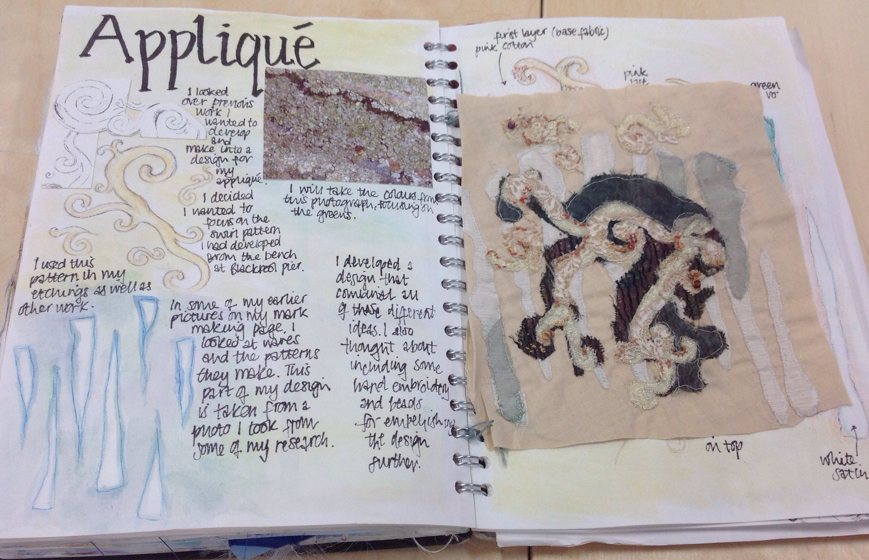
GCSE TEXTILES HOMEWORK a visual guide for students and parents.
Over the course of the GCSE students will be set a weekly homework task.
These will form part of their coursework, which is 60% of students final grade.
These will include
Artists research and investigation.
Specific drawing tasks.
Visual research, taking photos and recording primary. resources
Researching and investigating textile techniques.
Undertaking practical textile skills. Making samples.
Annotating work
Developing design ideas
Page presentation
Personalized feedback tasks
Finishing practical work .
Some tasks will be set for groups as a whole but others will be specific to individual students depending on the direction of their work and development of their coursework

Slide 2
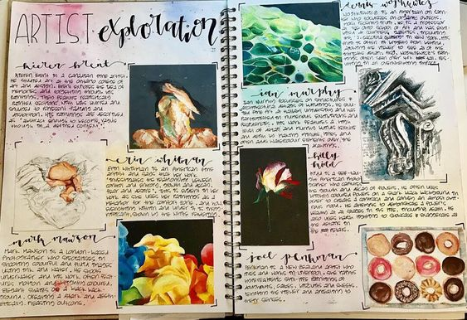
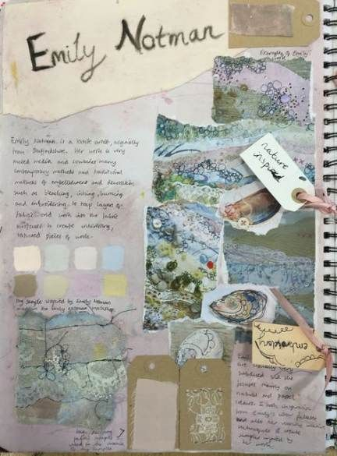
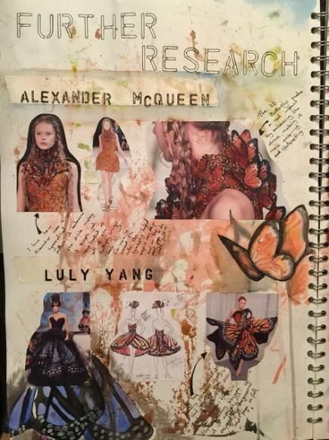
EXAMPLE OF AN ARTIST INVESTIGATION HOMEWORK
PAGES SHOULD INCLUDE ;
Critical analysis showing an understanding of the sources.
Message and meaning in the artists work.
Analysis of techniques and materials and visual elements.
An understanding of the context of the work.
A personal response

Slide 3
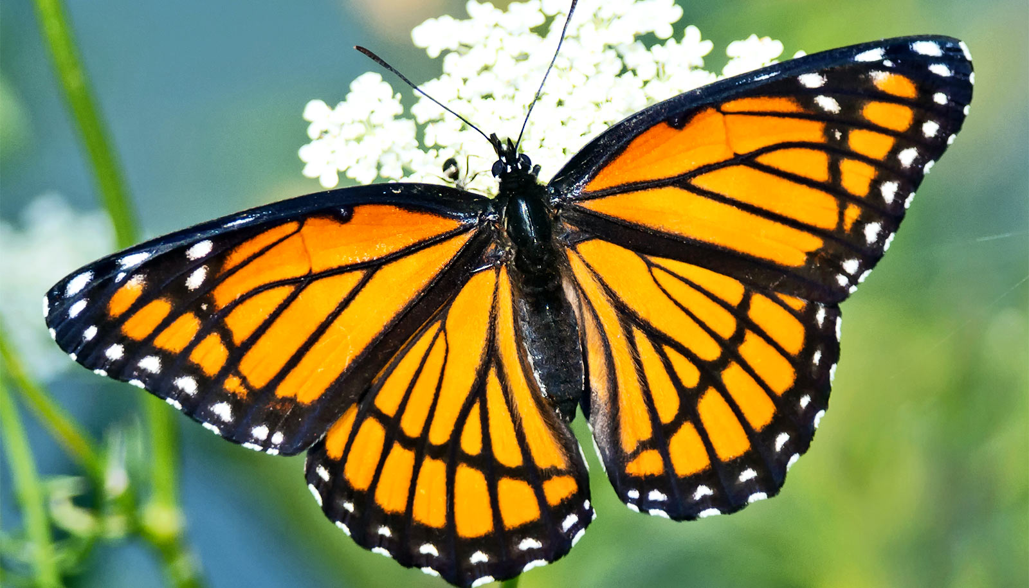
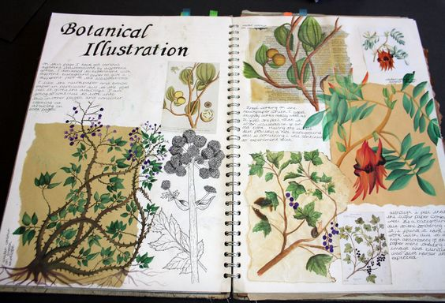
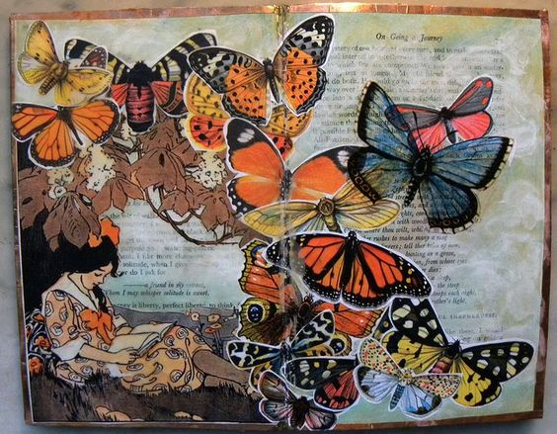
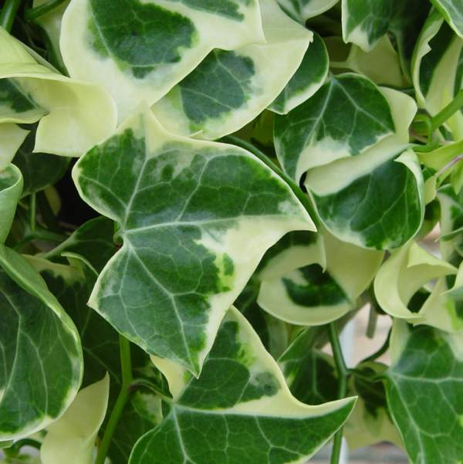
DRAWING TASKS. These will relate to the students’ artist research and will be used as inspiration for the development of textile design ideas.
Observational studies . Working from primary resources. Exploring media and techniques.

Slide 4
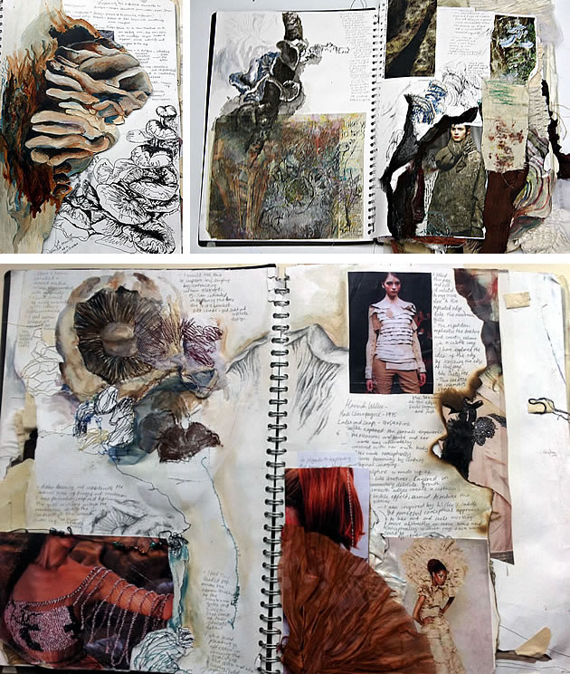
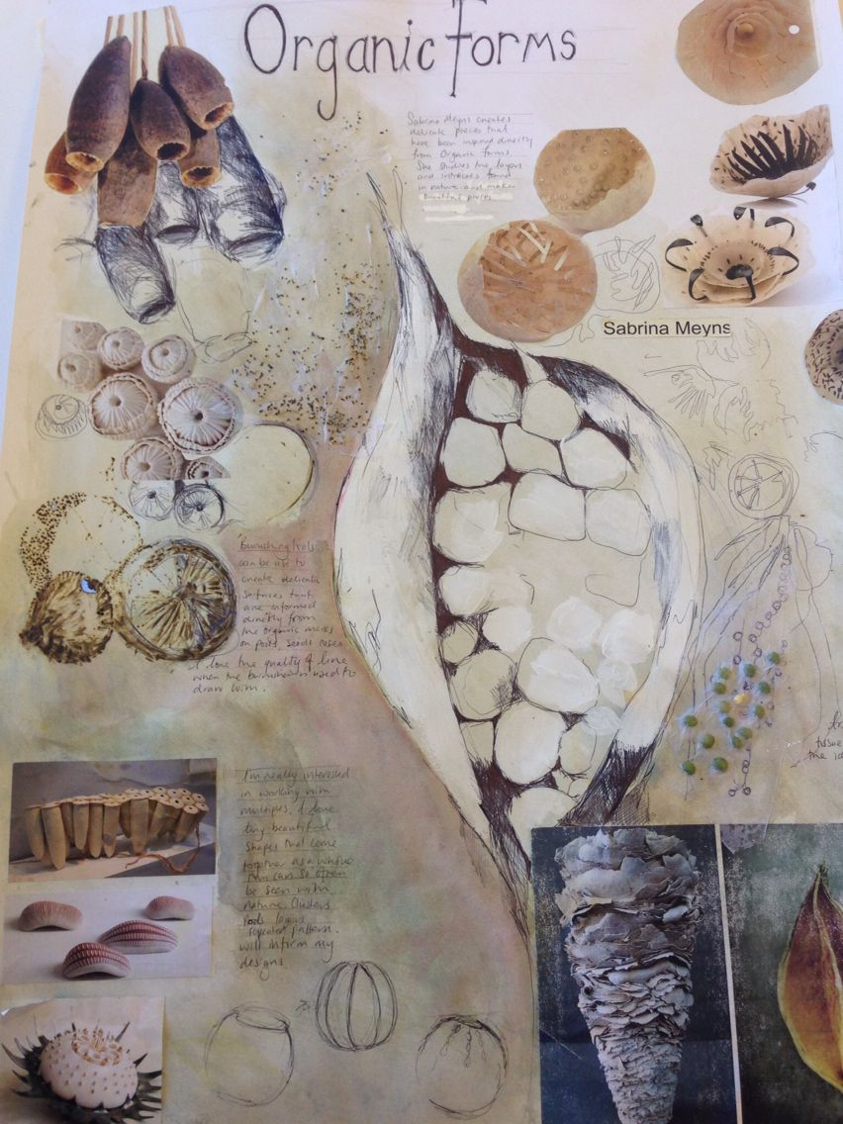
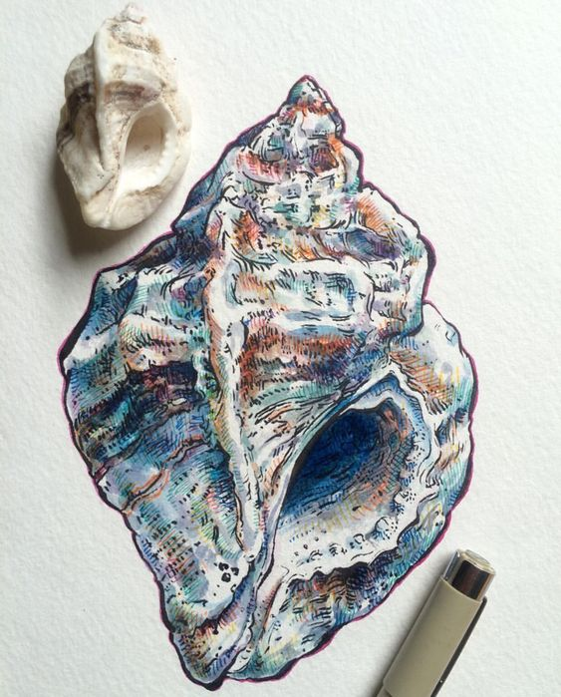
Drawing from observation
Observational drawings link to artists research
And are a source of inspiration for designing.

Slide 5
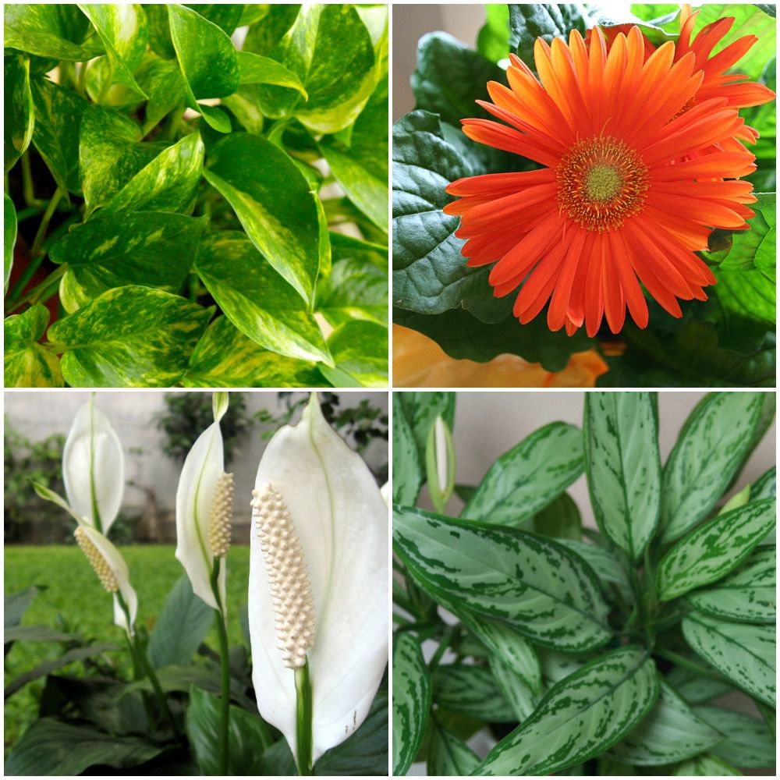
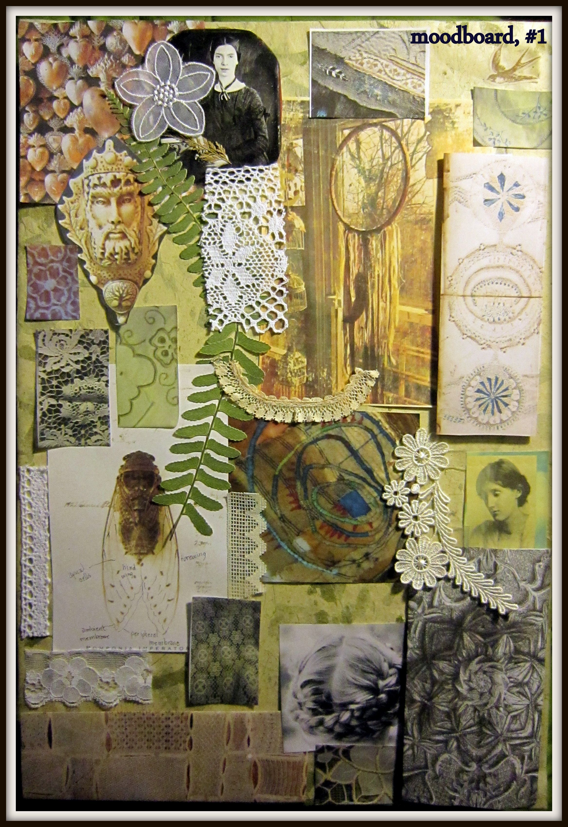

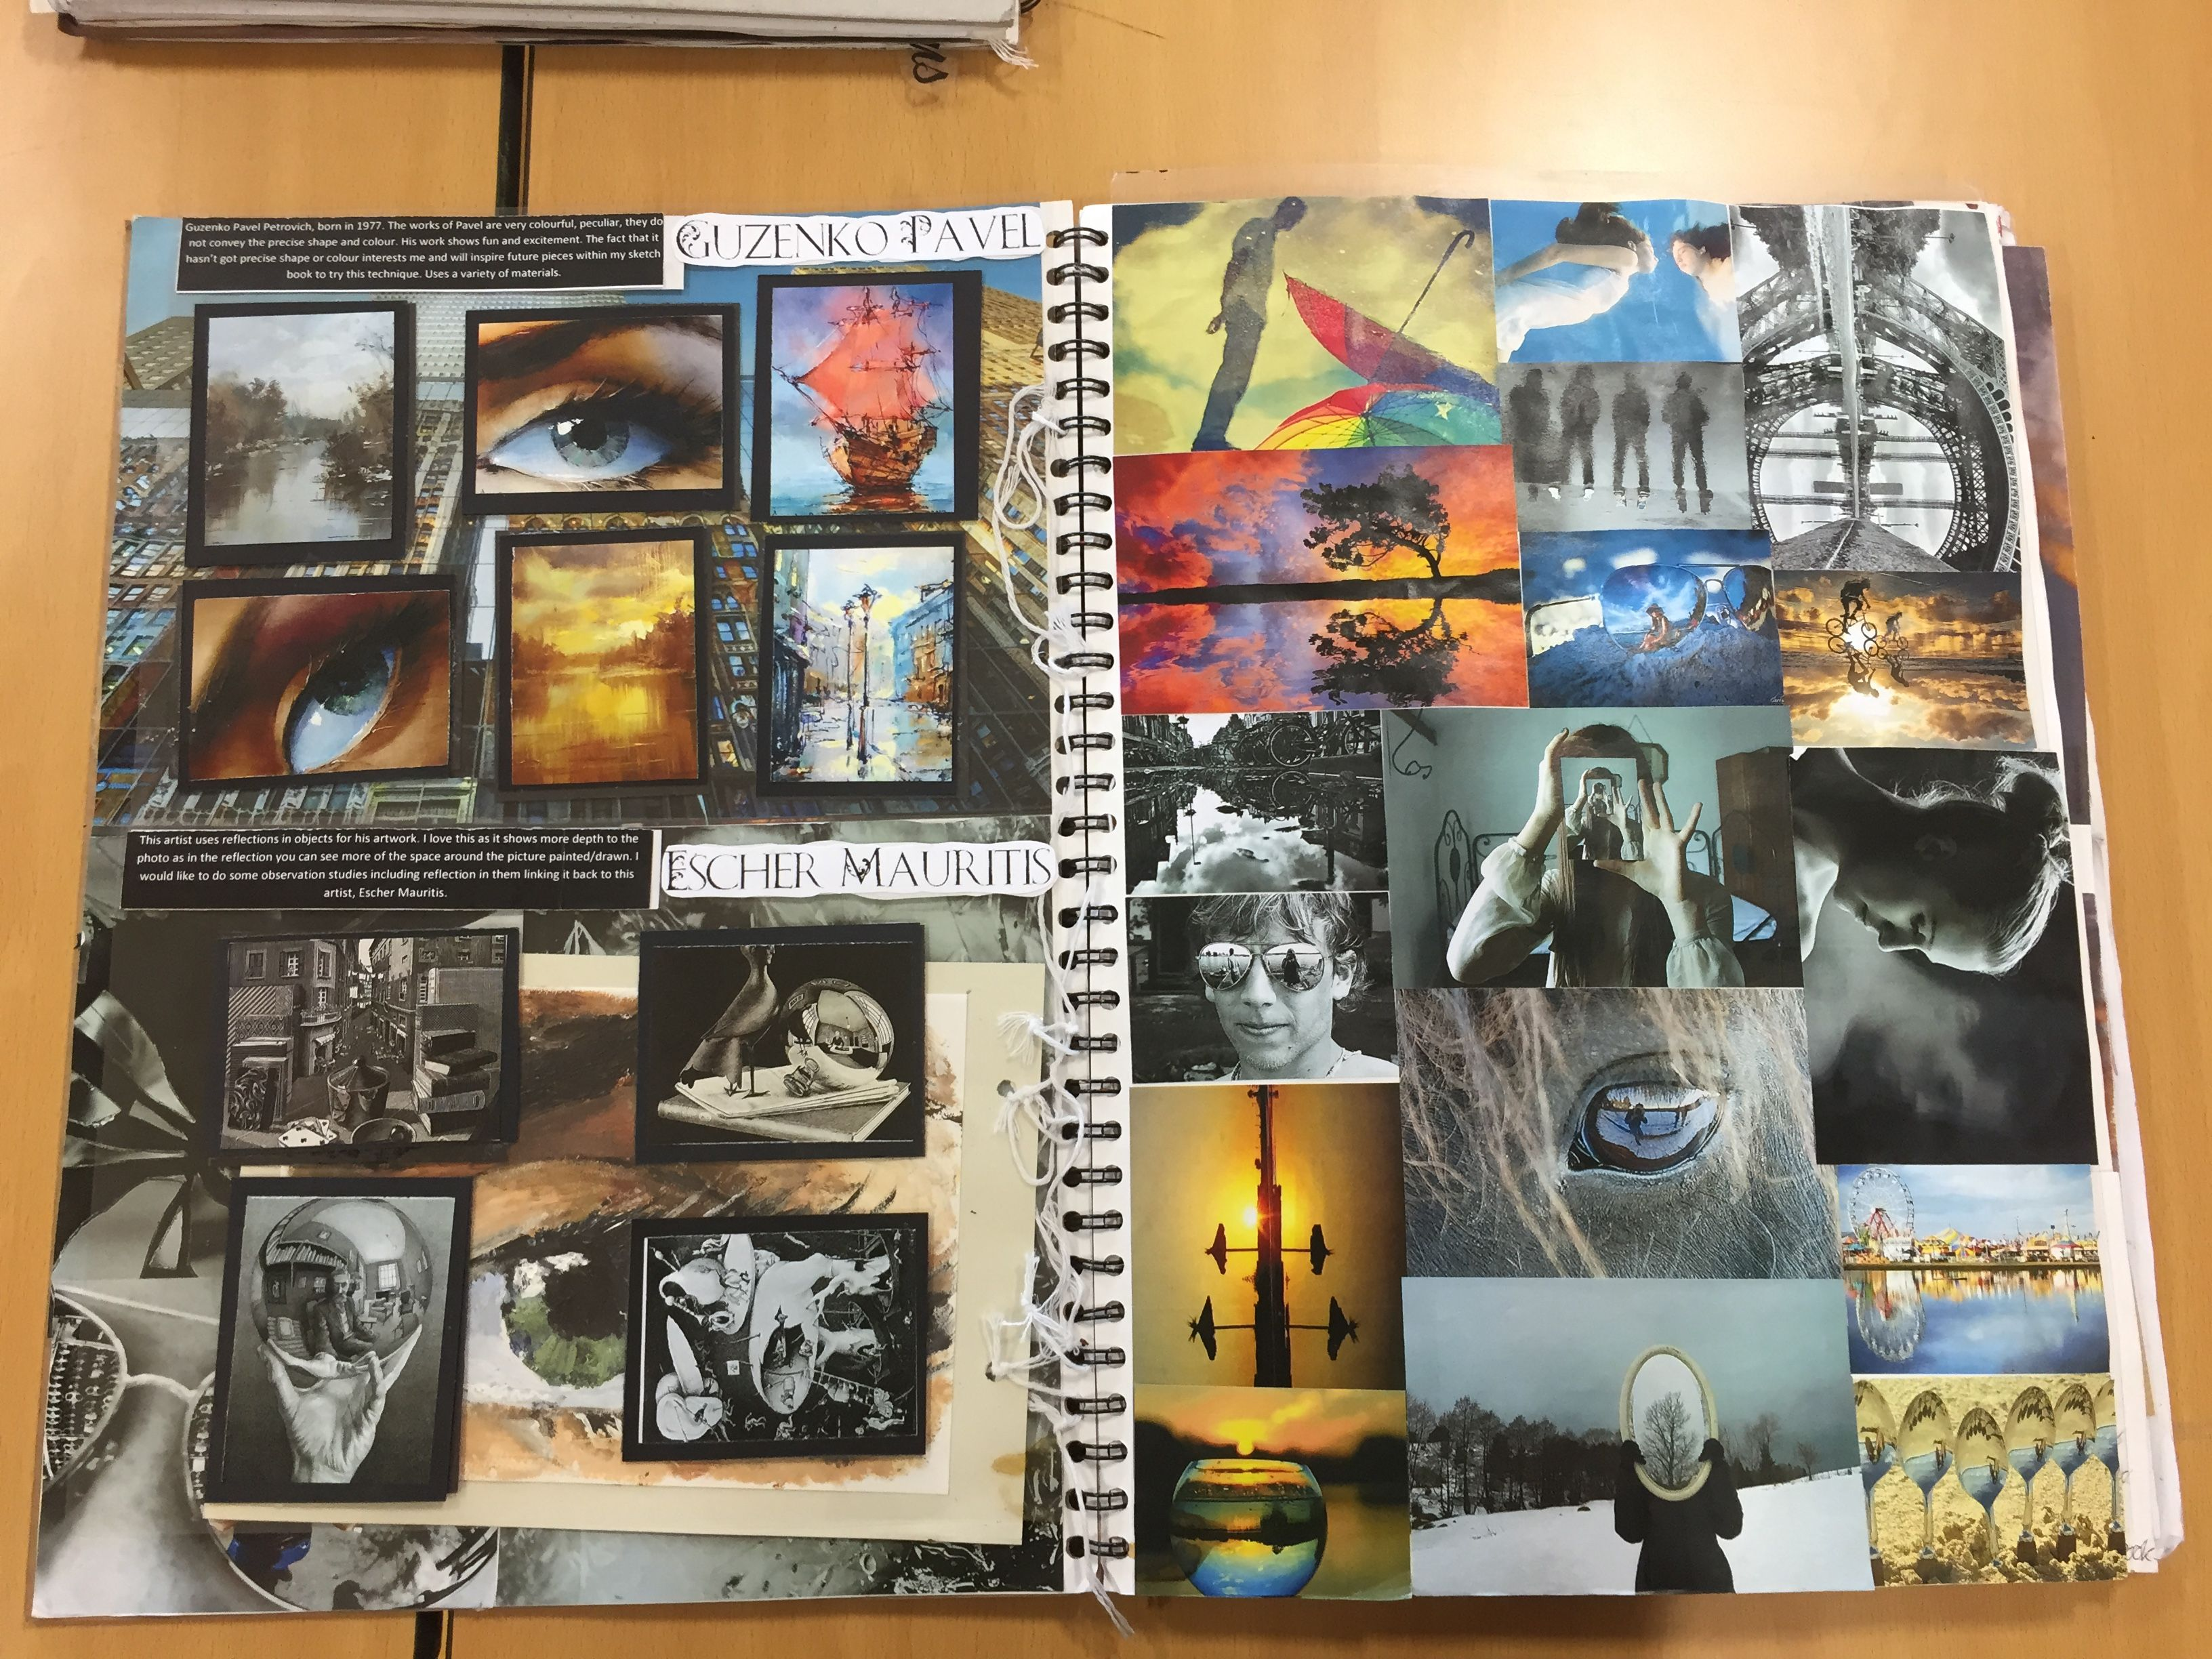
Visual research, taking photos and recording Using primary resources

Slide 6
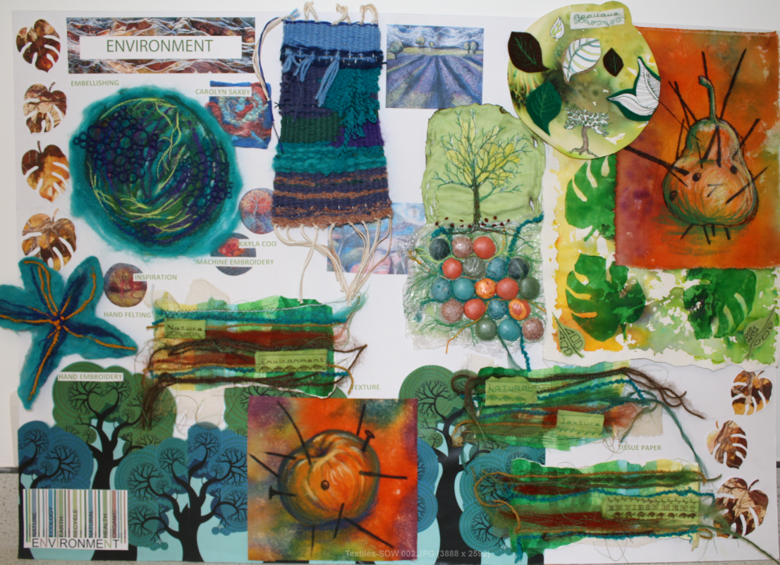
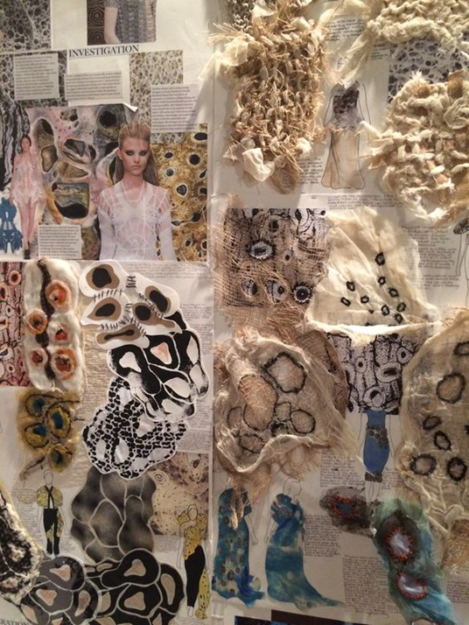
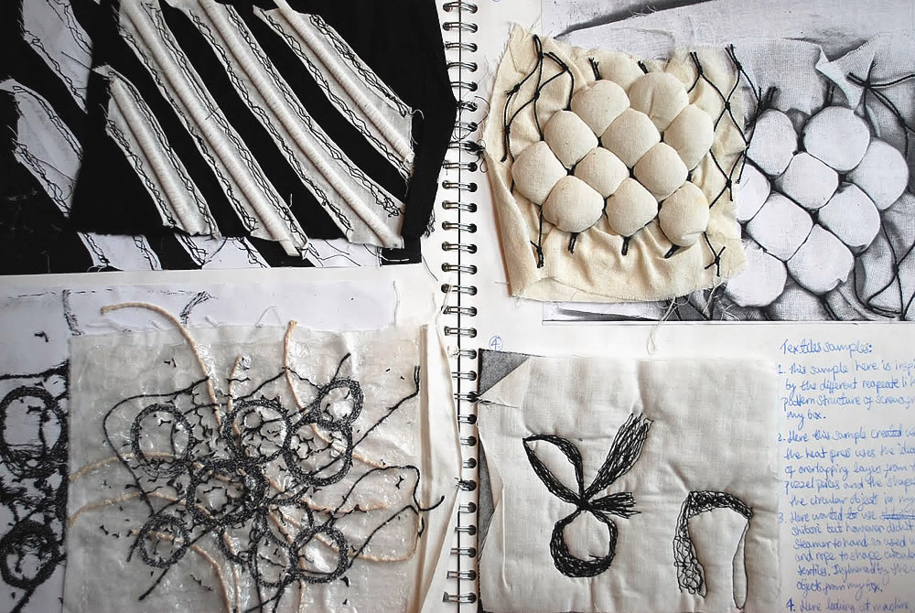
Undertaking practical textile skills. Making samples exploring techniques,
Refining and developing
Exploring techniques;
Experimenting with fabrics
Materials
Colours
Textures
Patterns
Fabrics

Slide 7
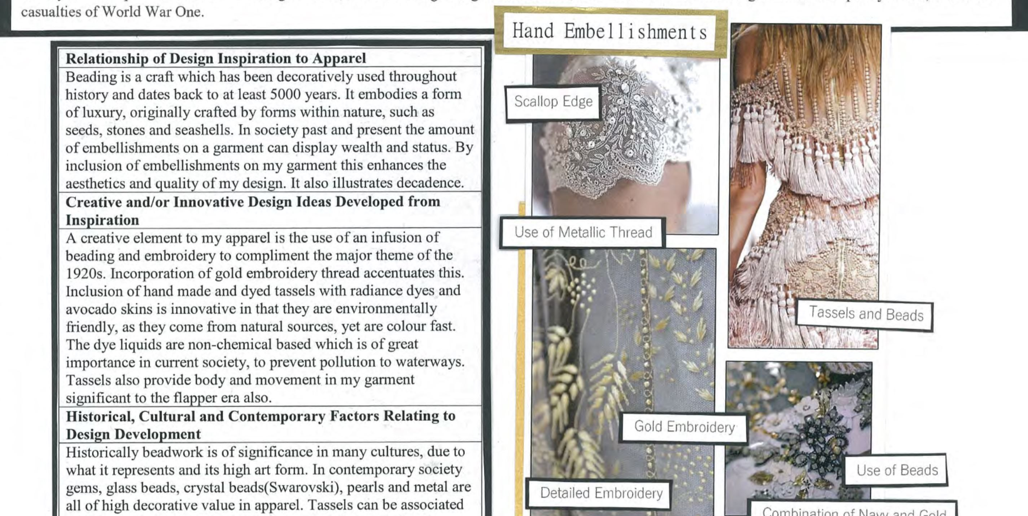
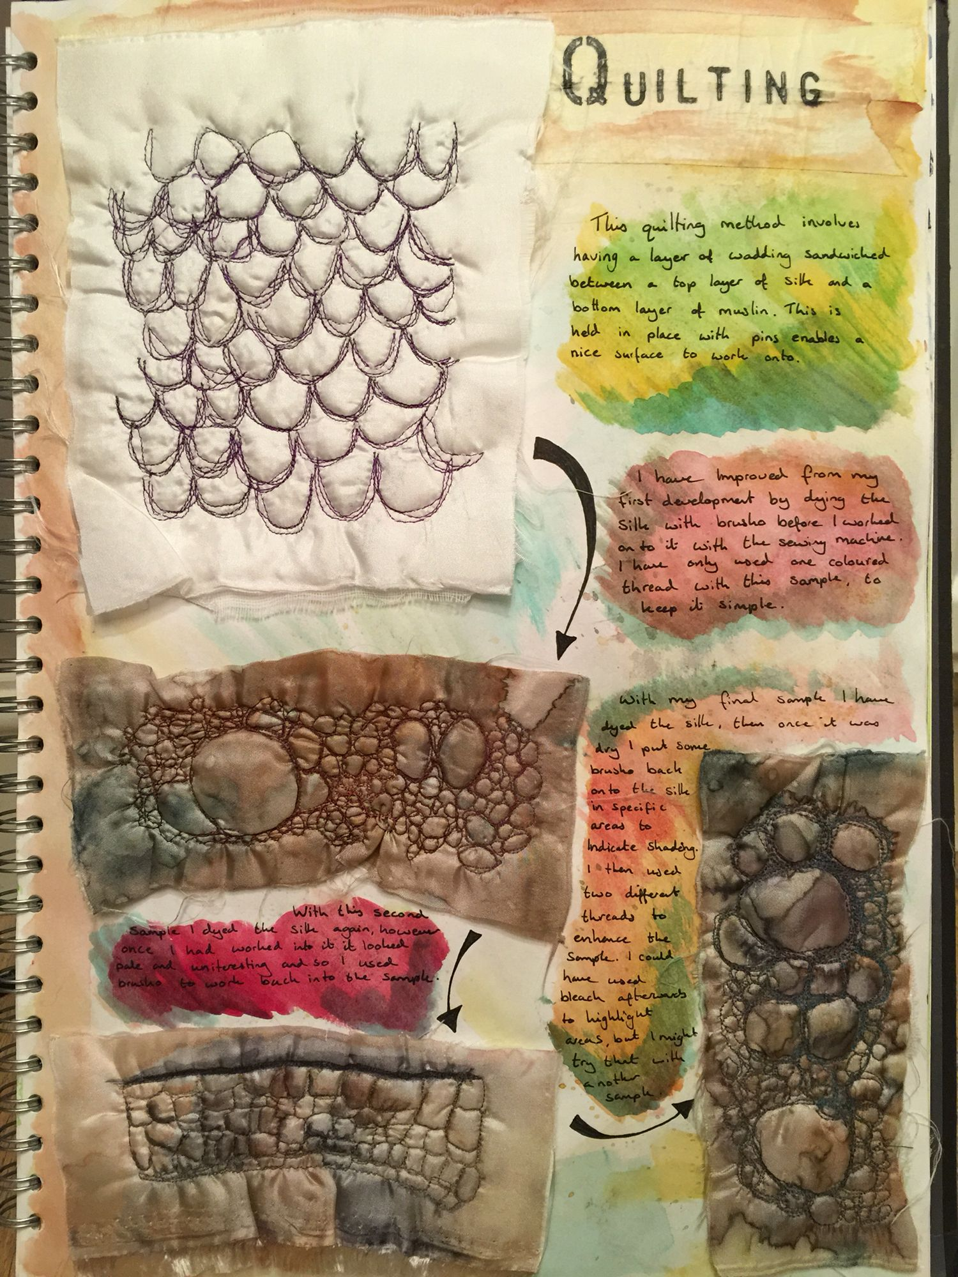
Annotating work and textile samples
Reviewing and evaluating work as it evolves
Recording insight and explaining intentions.
Explaining the development of ideas and techniques
Review and evaluate

Slide 8
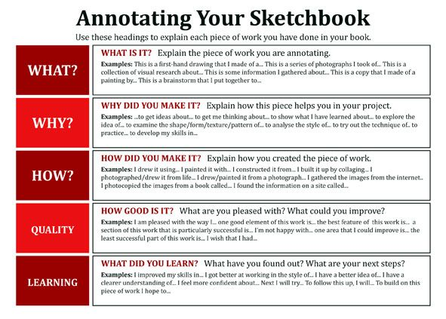

Slide 9
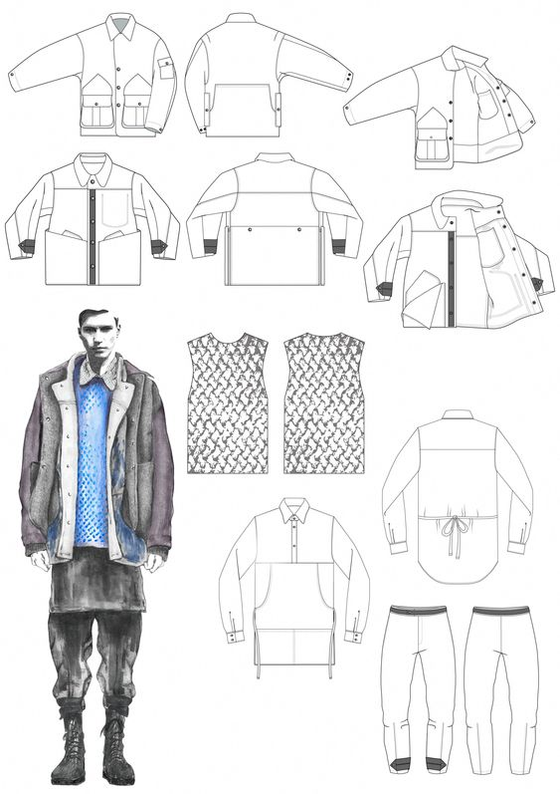
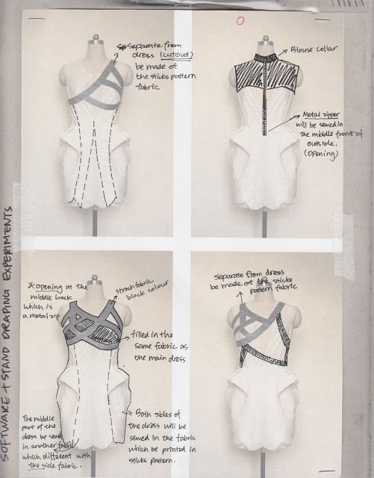
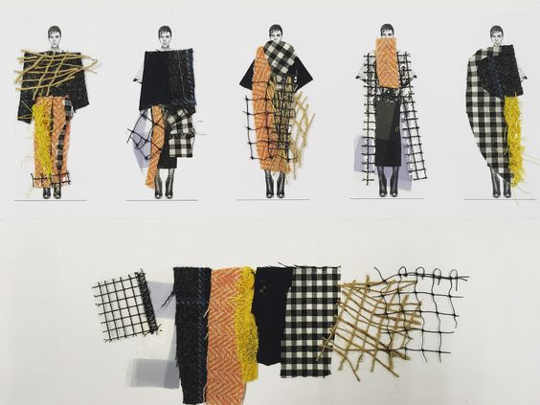
REFINING AND DEVELOPING DESIGN IDEAS
Thorough development of ideas through exploring media materials techniques
.

Slide 10
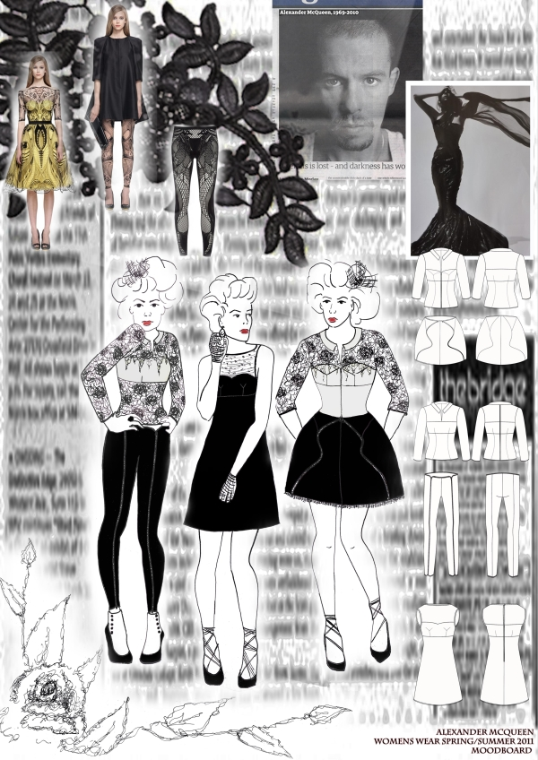
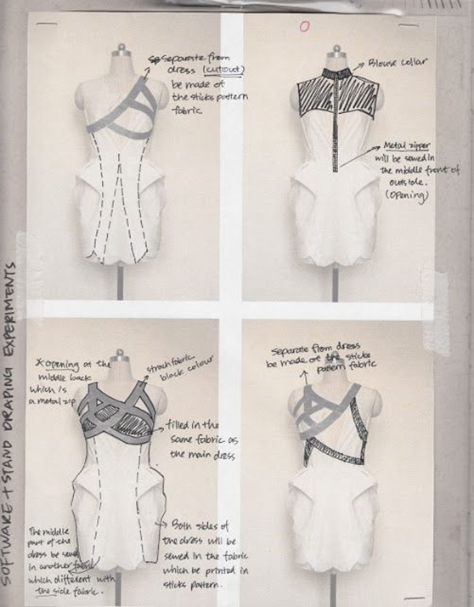
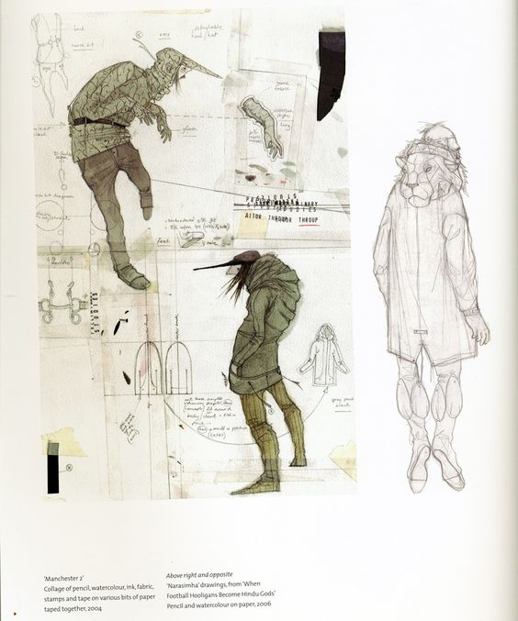
Developing design ideas
Exploring ideas.
Creative experimentation
Reflecting on work as it develops.

Slide 11

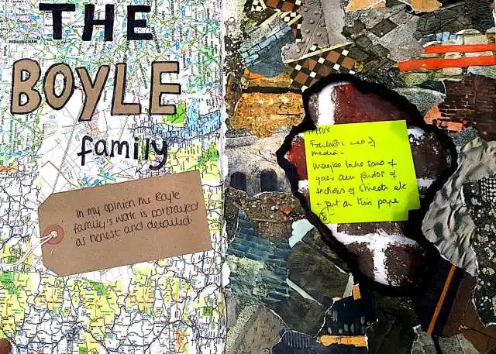
Personalized feedback tasks
Responding to Teacher and peer feedback

Slide 12
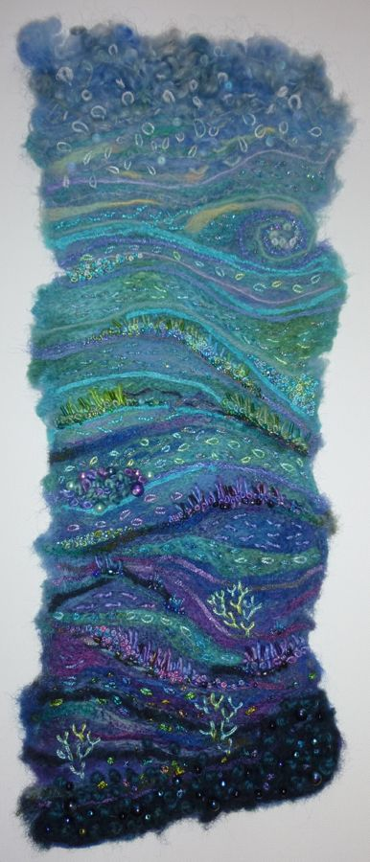
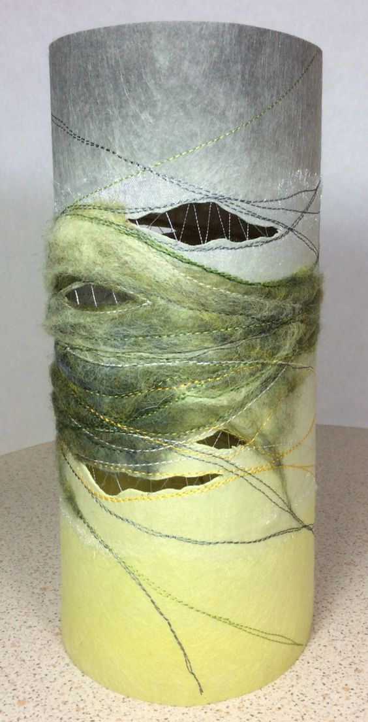
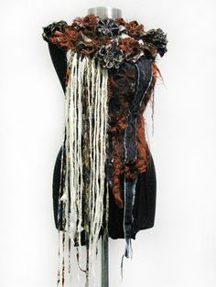
Finishing practical work .
PRESENTING A PURPOSEFUL AND MEANINGFUL RESPONSE

