Slide 1
GCSE PHOTOGRAPHY HOMEWORK a visual guide for students and parents
Over the course of the GCSE Photography students will be set weekly homework tasks and should take at least 1 hour.
Often students will be asked to:
finish writing up a photoshoot, editing or analysis pages which has been started in a lesson. The lesson powerpoints will be on Teams for them to refer to as a reminder of the sketch book layout and detail they need to include in their pages.
They may also be asked to:
Gather research
Page presentation
Independent photo shoots
Personalised feedback tasks
When asked to complete personalised feedback tasks students will have instructions on their feedback sheets which are stuck in the back of their sketch books and/or they will have post-it notes on the specific pages to work on.
Homework tasks will be posted on Teams and edulink.
Please find next a visual guide to a Grade 5+ Photography sketch book to help with understanding of sketch book expectations.

Slide 2
Inspiration Pages

Slide 3
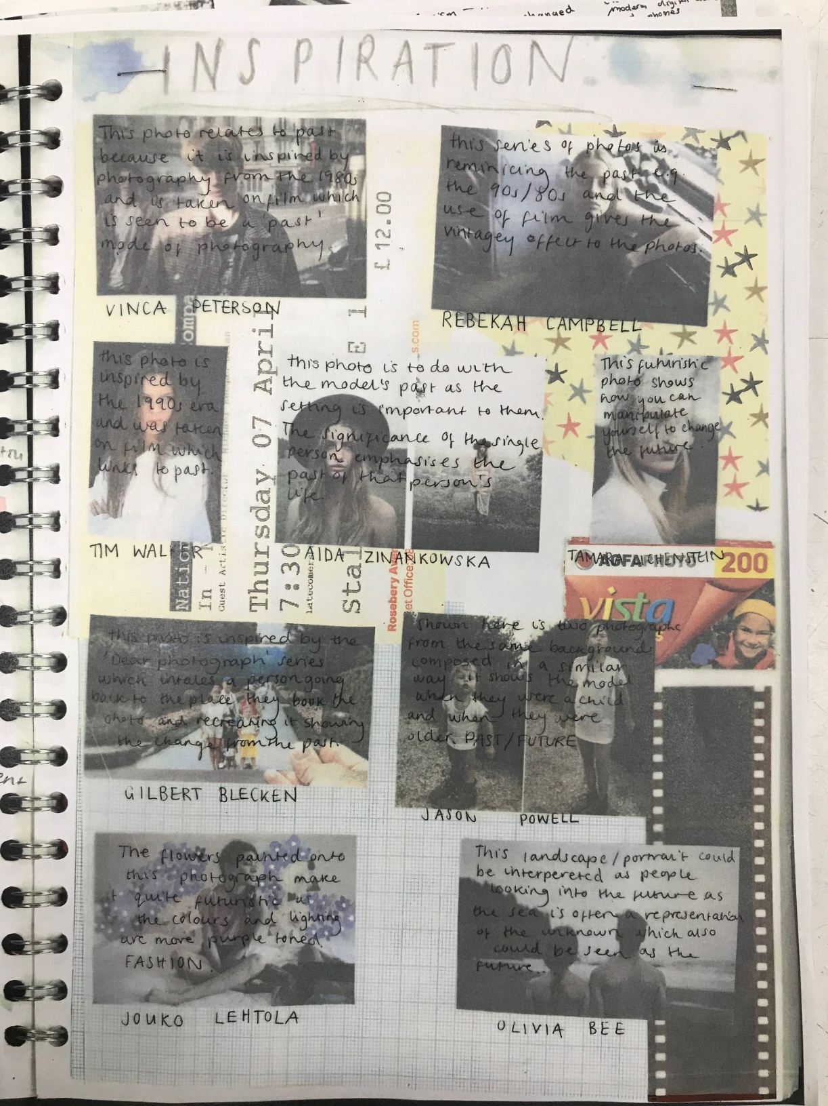
Clear Title
Simple decoration that suits theme
Similar style of photographs / nothing TOO different
No BOLD key words
Clear photographer names
Do not necessarily need this much writing

Slide 4
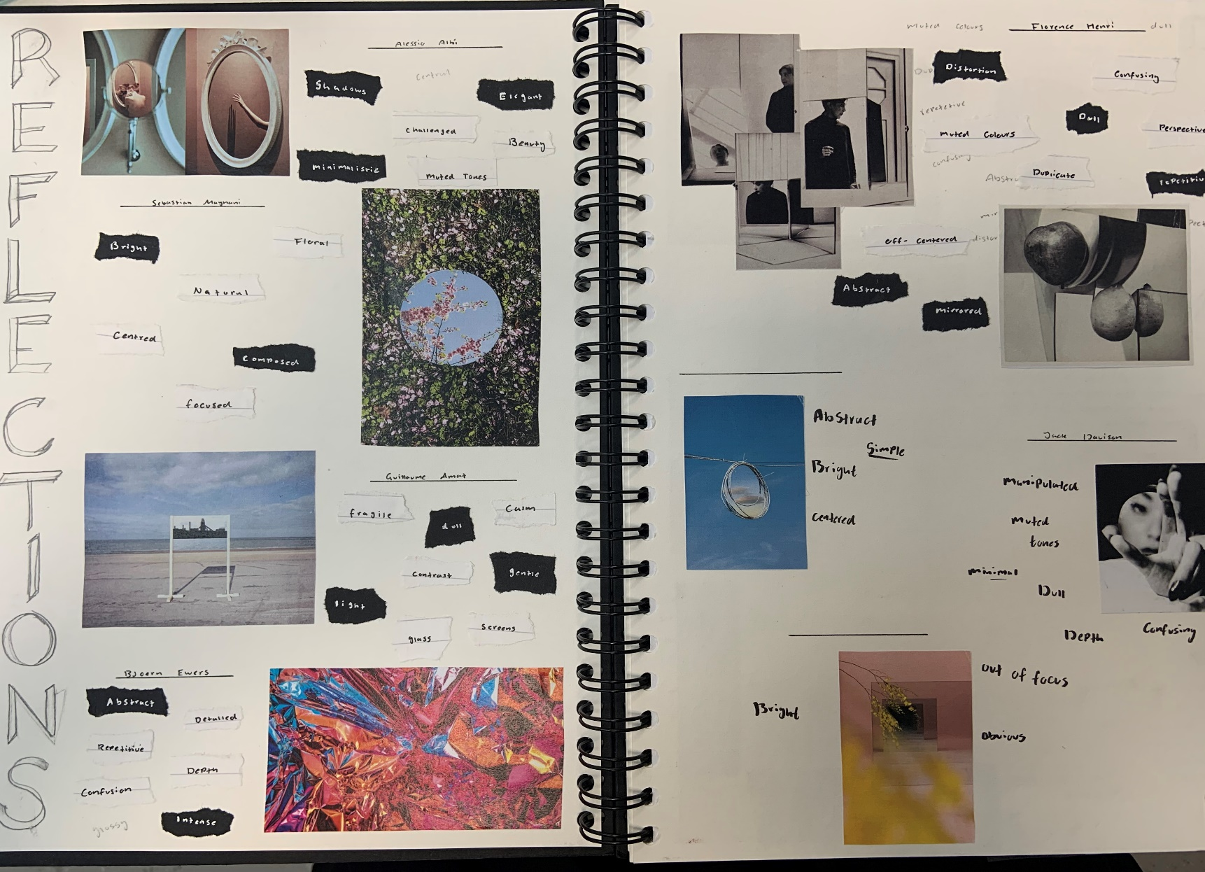
Key / Bold key words to describe style of work
BOLD title
Simple presentation
Photographer name

Slide 5
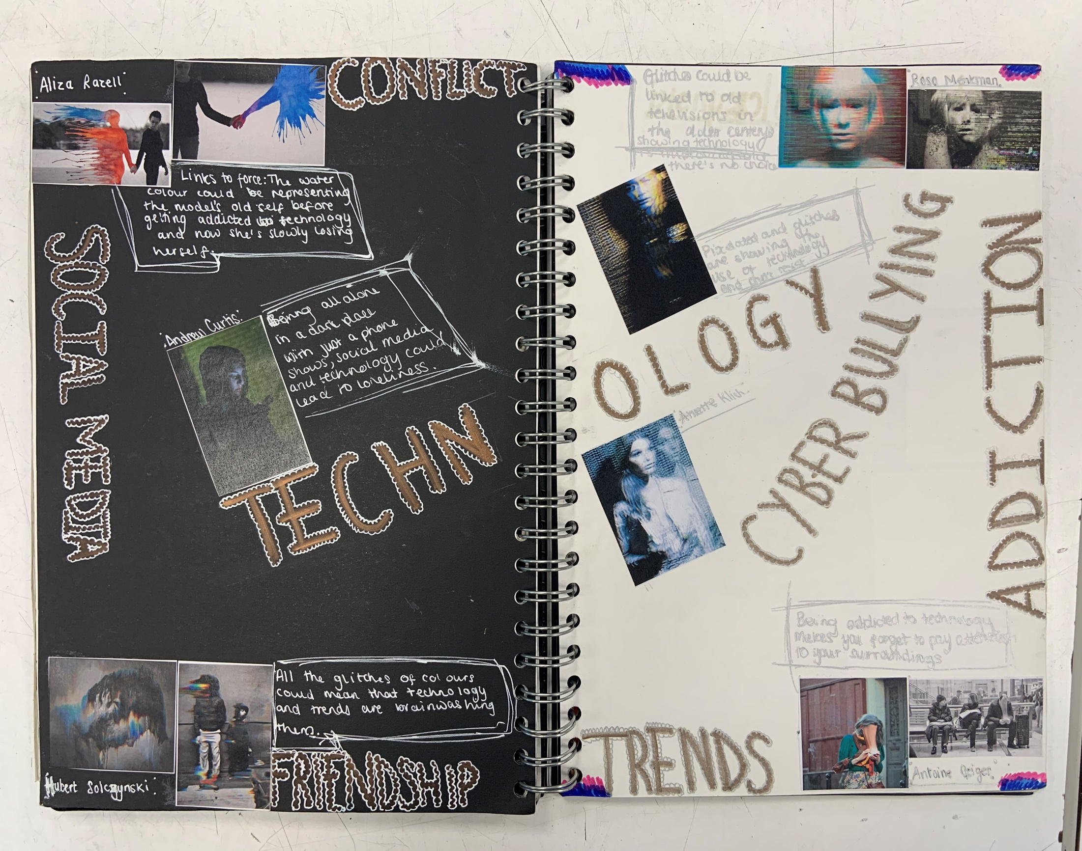
Words related to theme
Clear Title
Clear photographer names

Slide 6
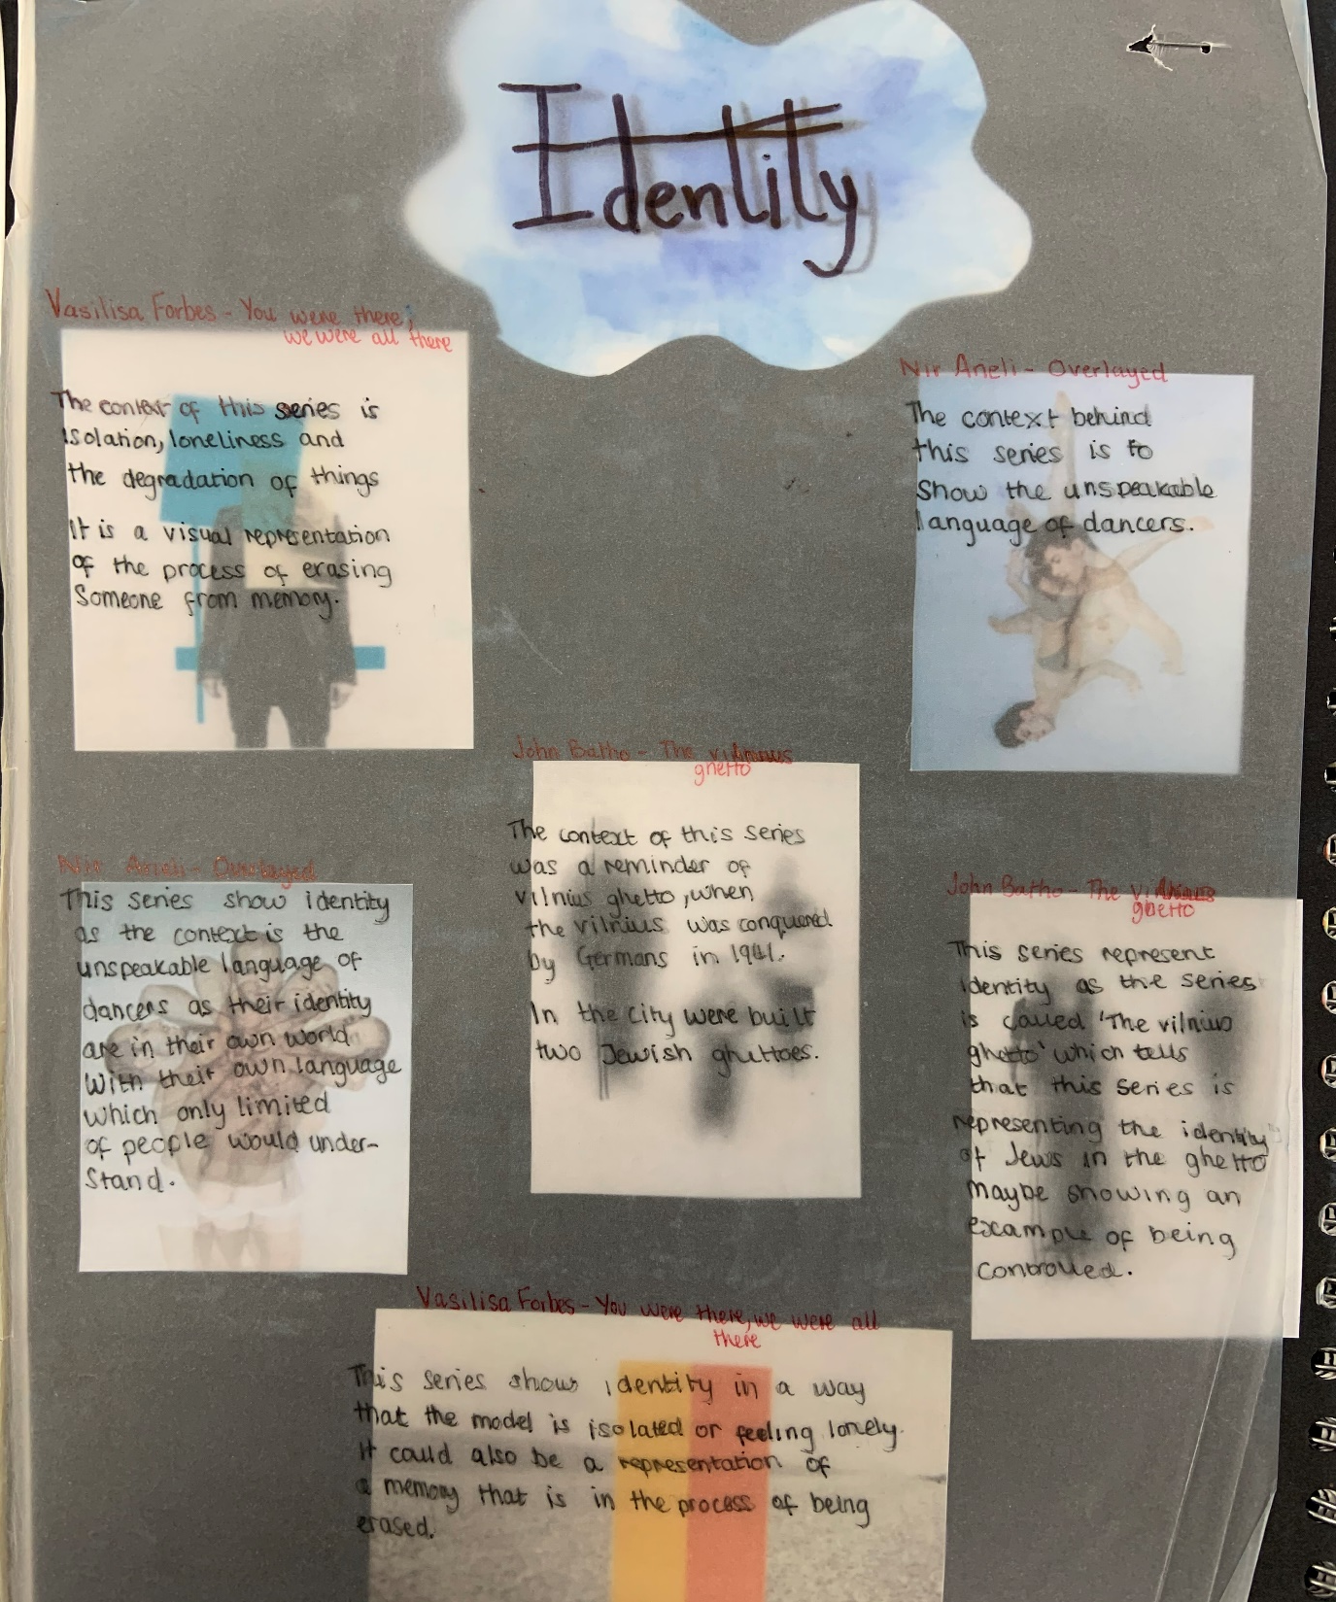
BOLD title
Simple presentation
No BOLD key words
Clear photographer names
Do not necessarily need this much writing

Slide 7
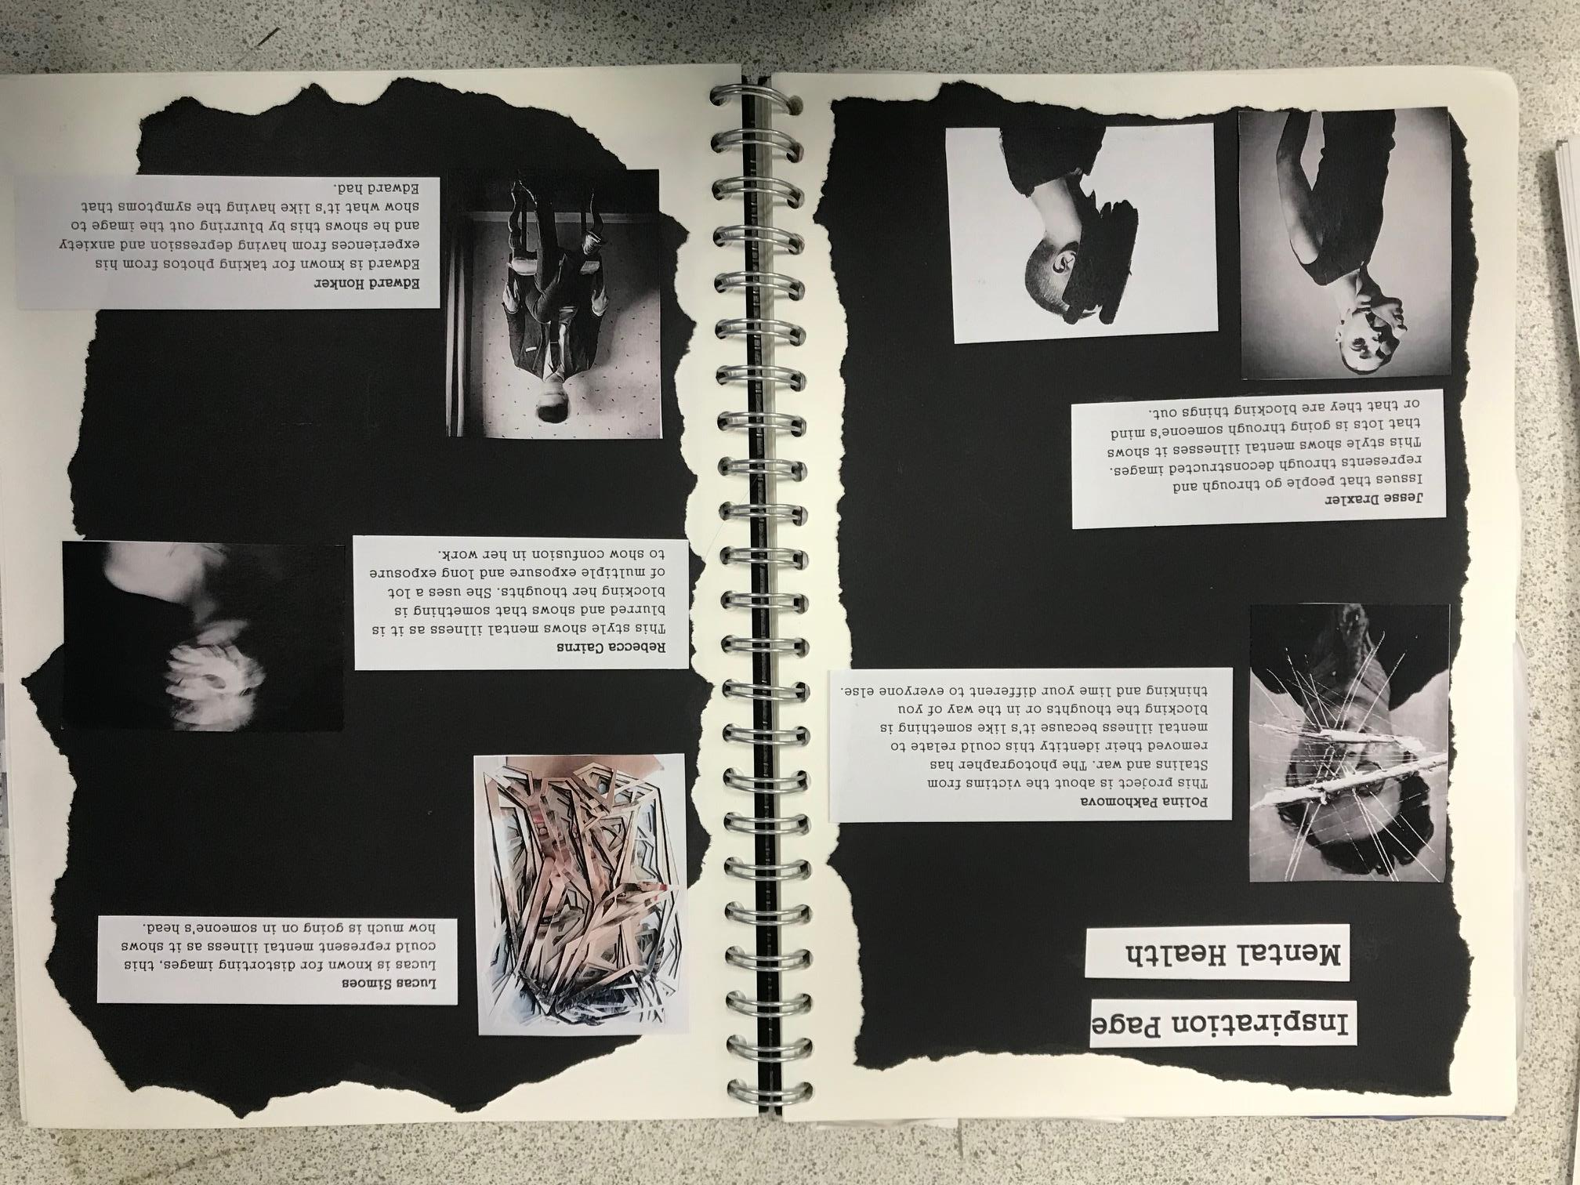
Clear message from the start
Simple decoration that suits theme
No BOLD key words
Small info on their message
Clear photographer names

Slide 8
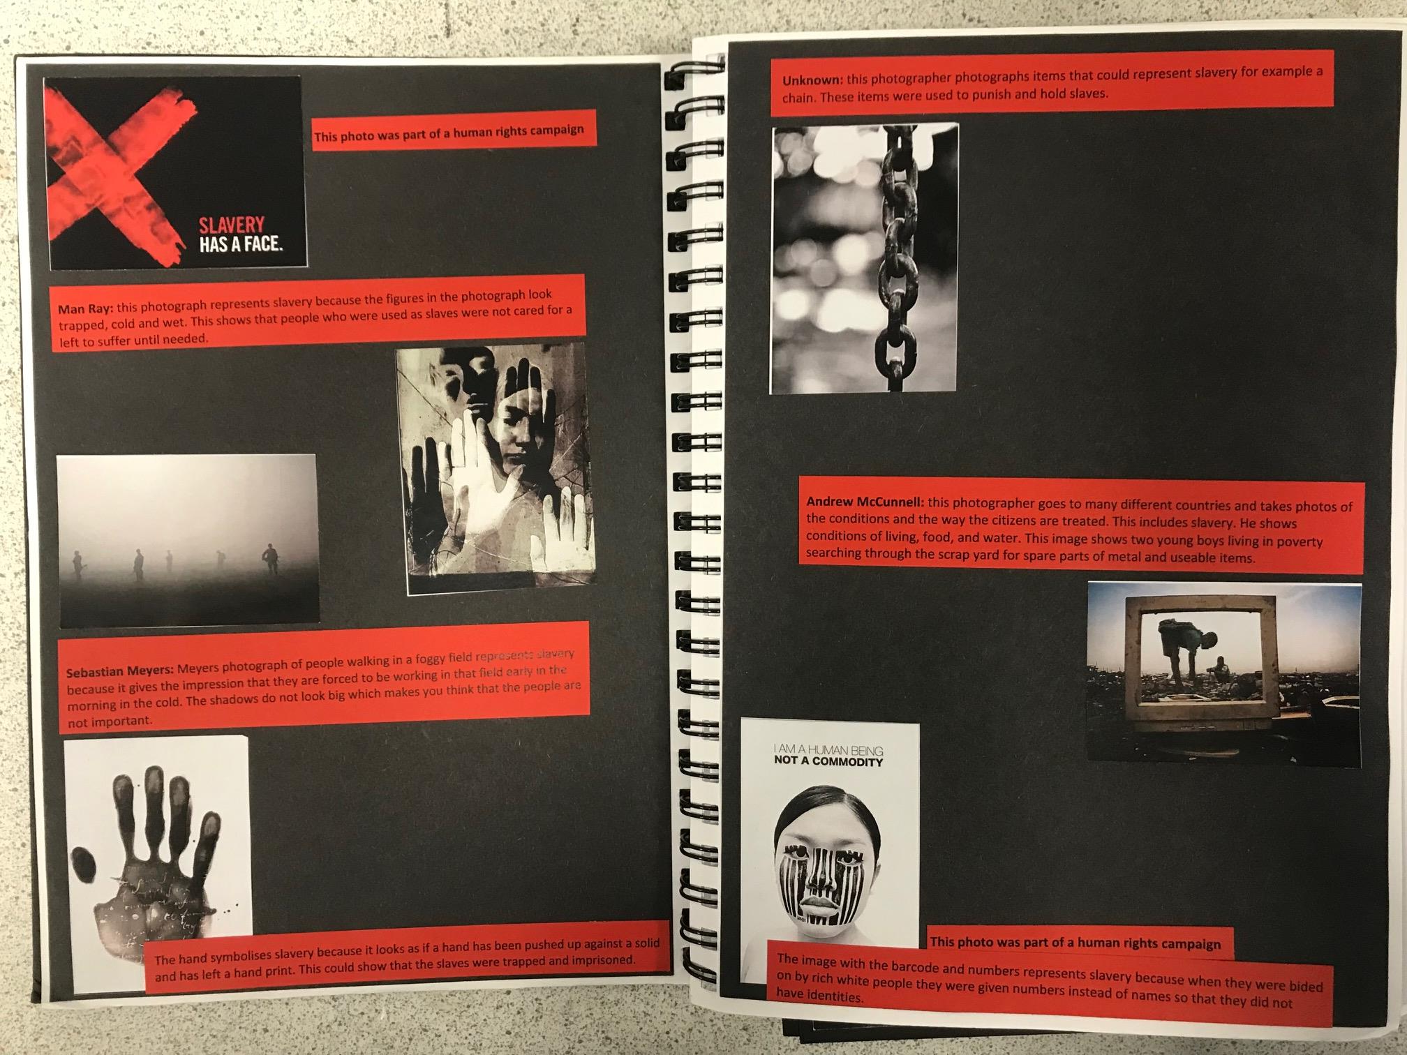
Other imagery and not just photographs
Clear photographer names
Simple colours that suits theme

Slide 9
In the Style Pages

Slide 10
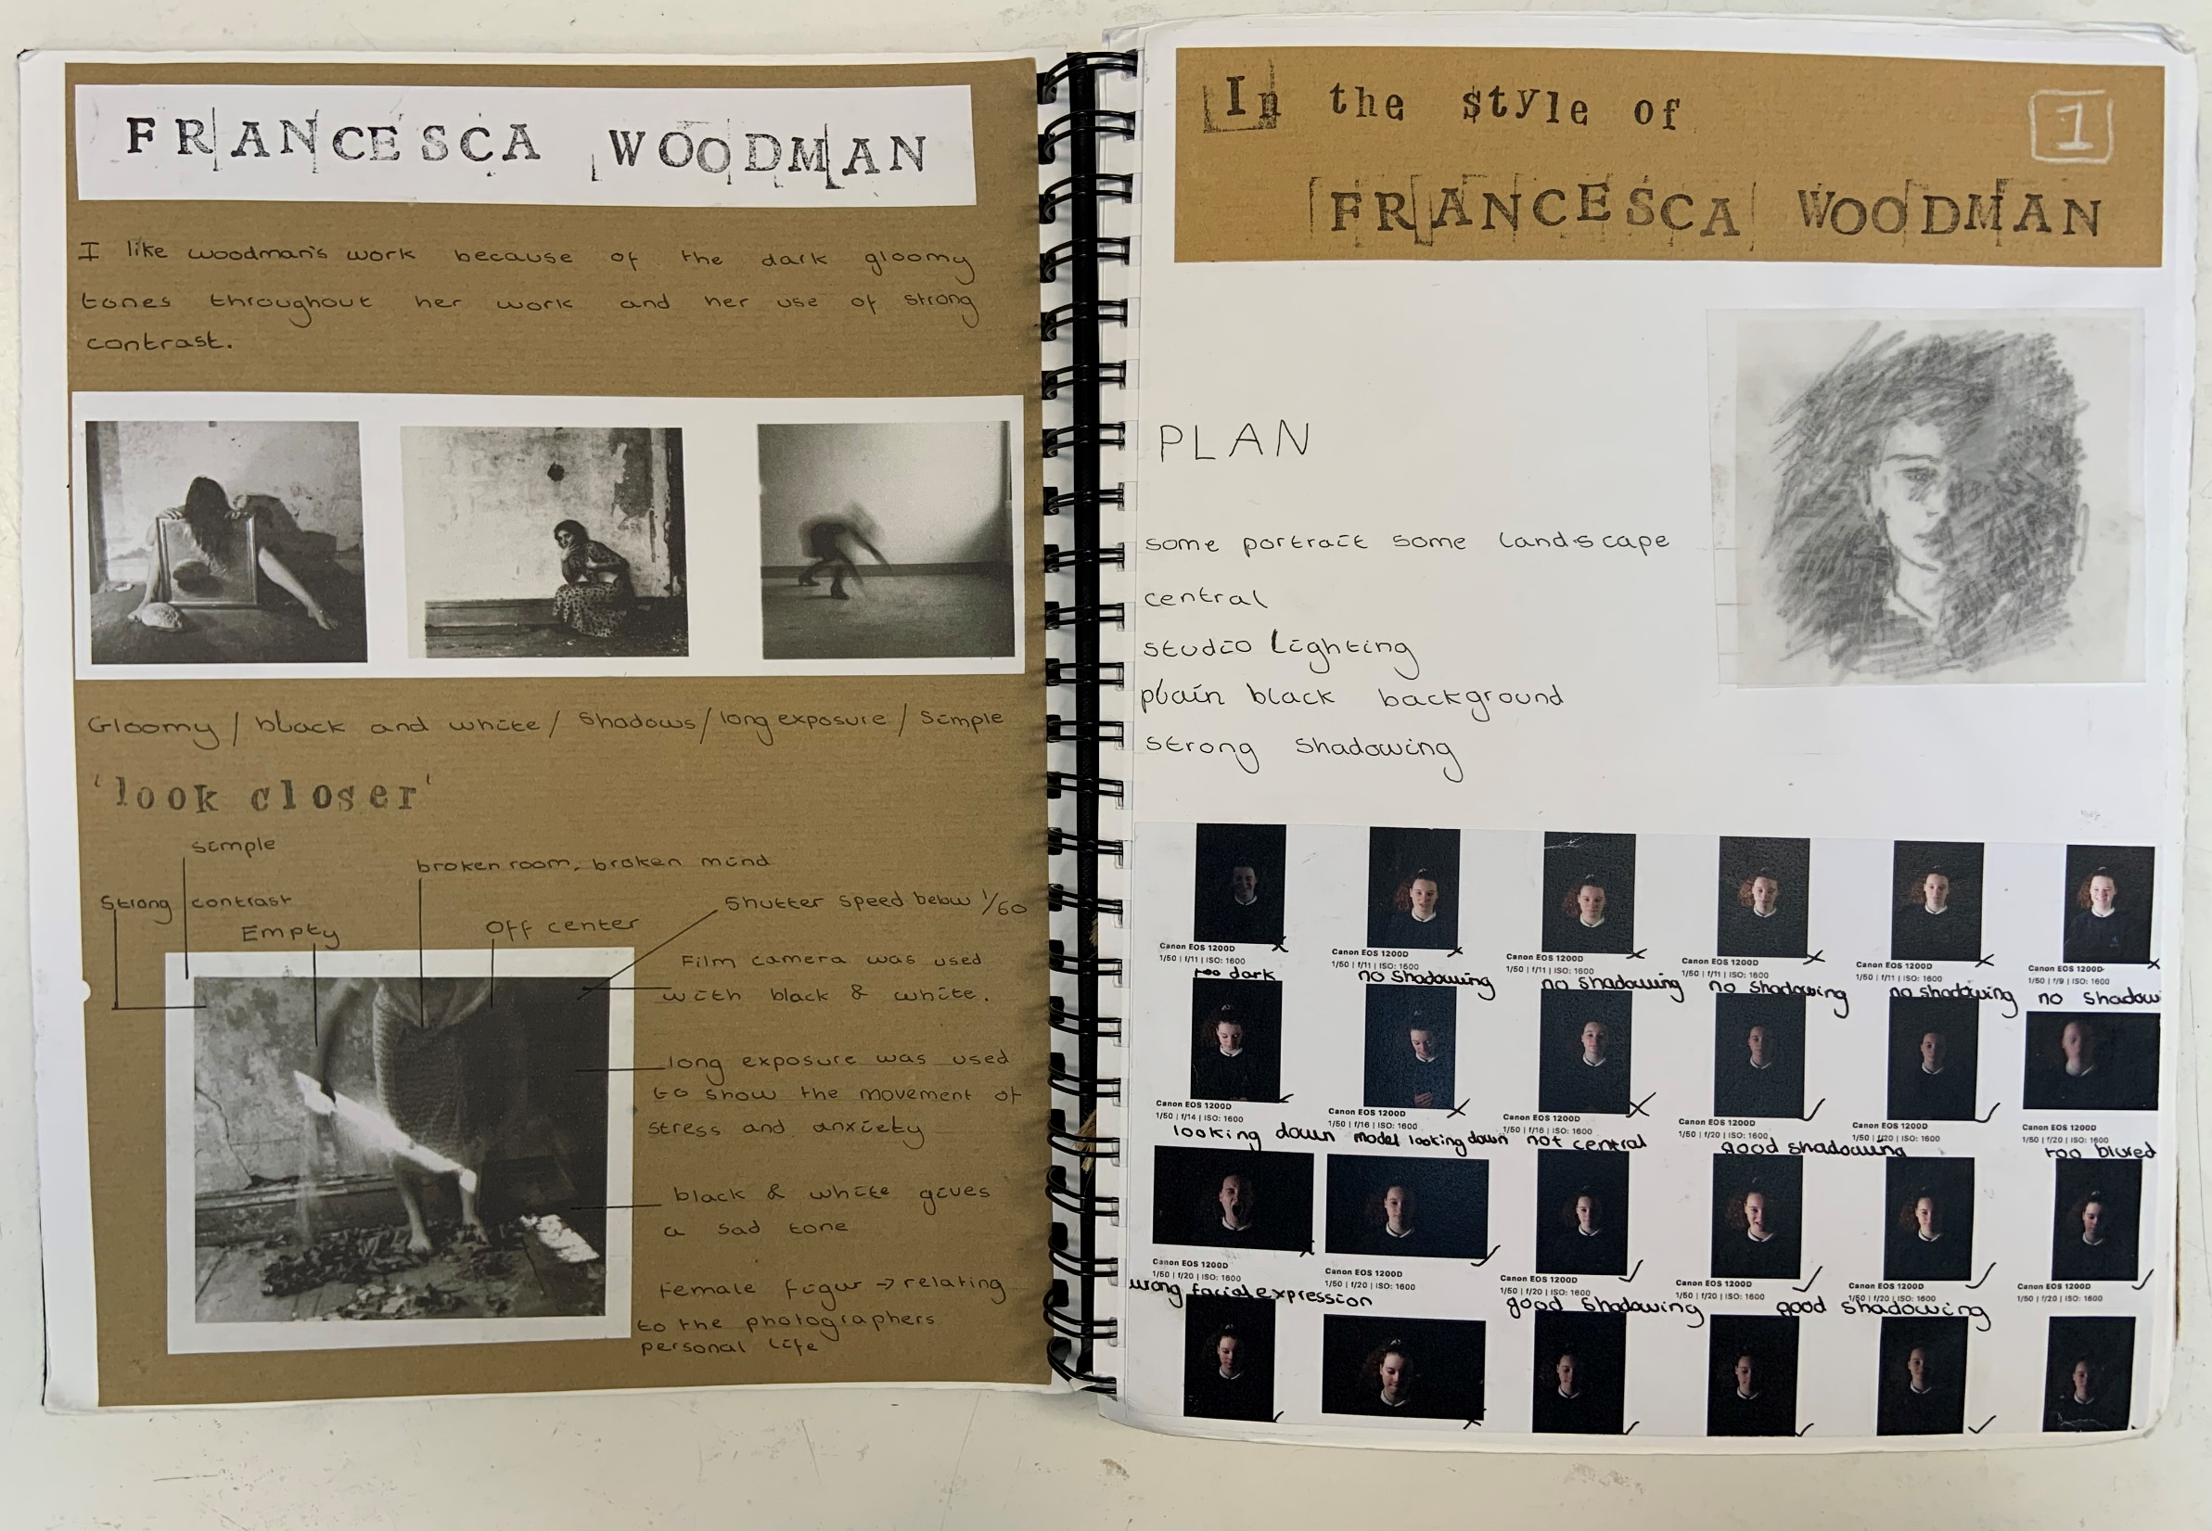
Clear title
Full sentence
Shoot plan above contact sheet.
Study and analysis page
Bold words to describe style
Annotated contact sheets with key words

Slide 11
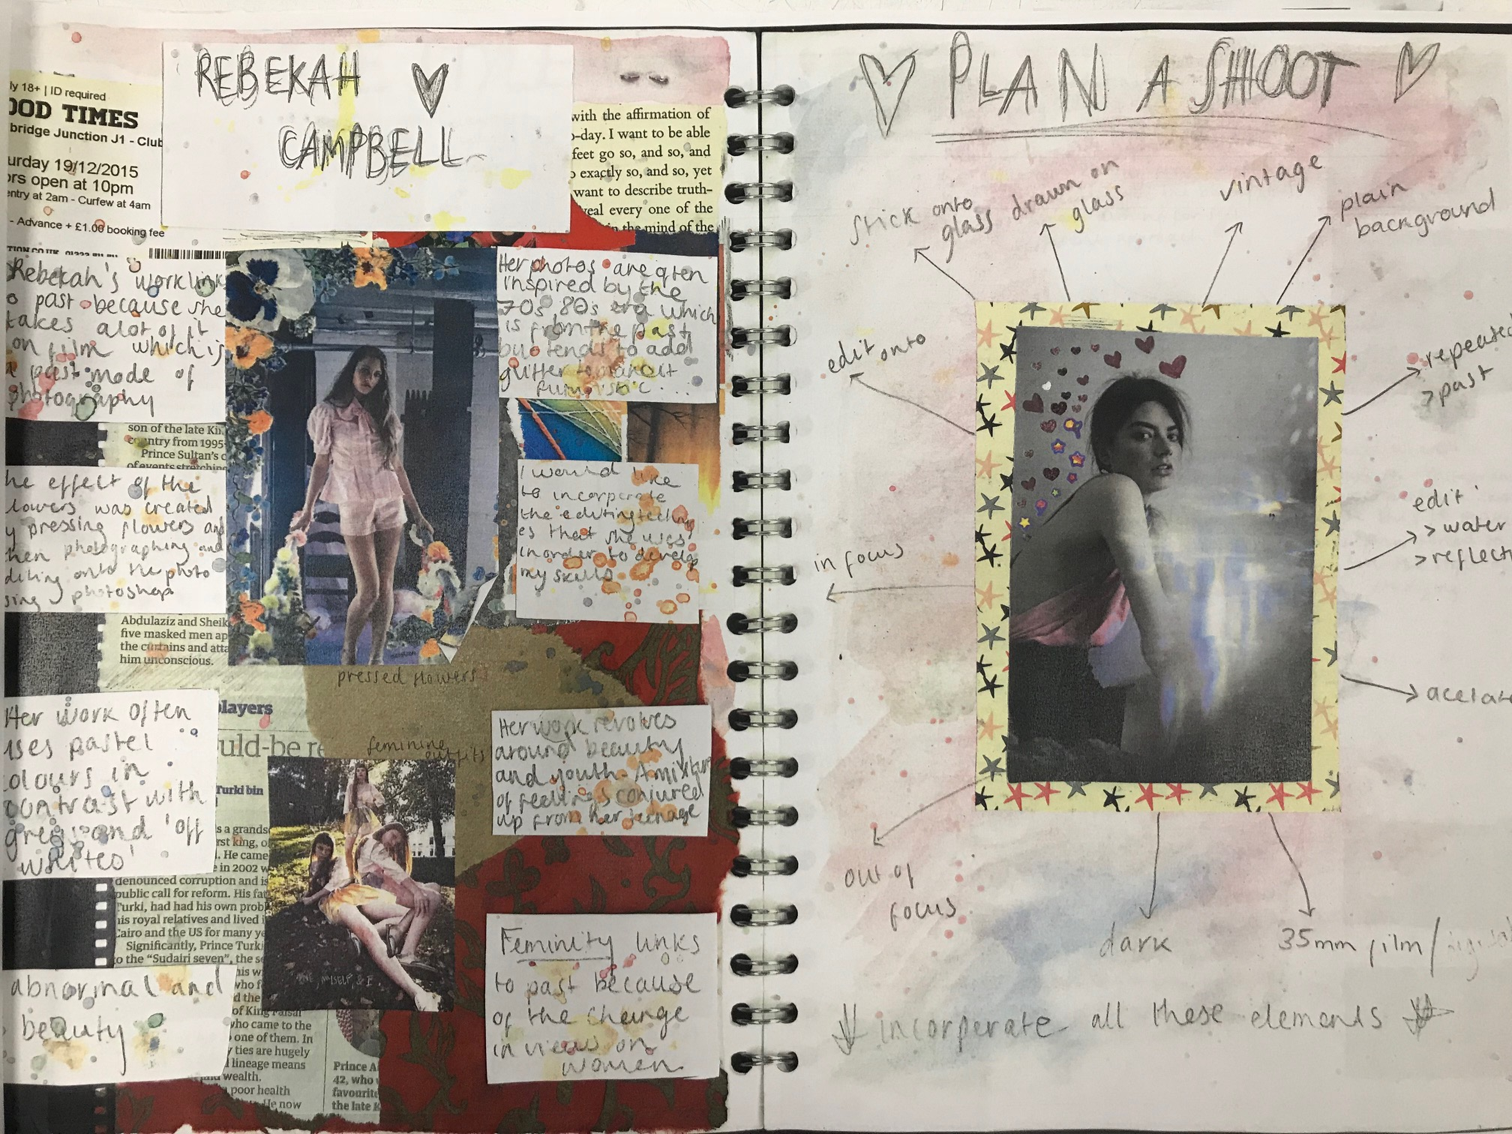
Clear Titles
Presentation consistent and suits theme
More than one image
Key words
Double Page
Annotating shoot plan rather than a list
Limited notes (study and analysis)

Slide 12
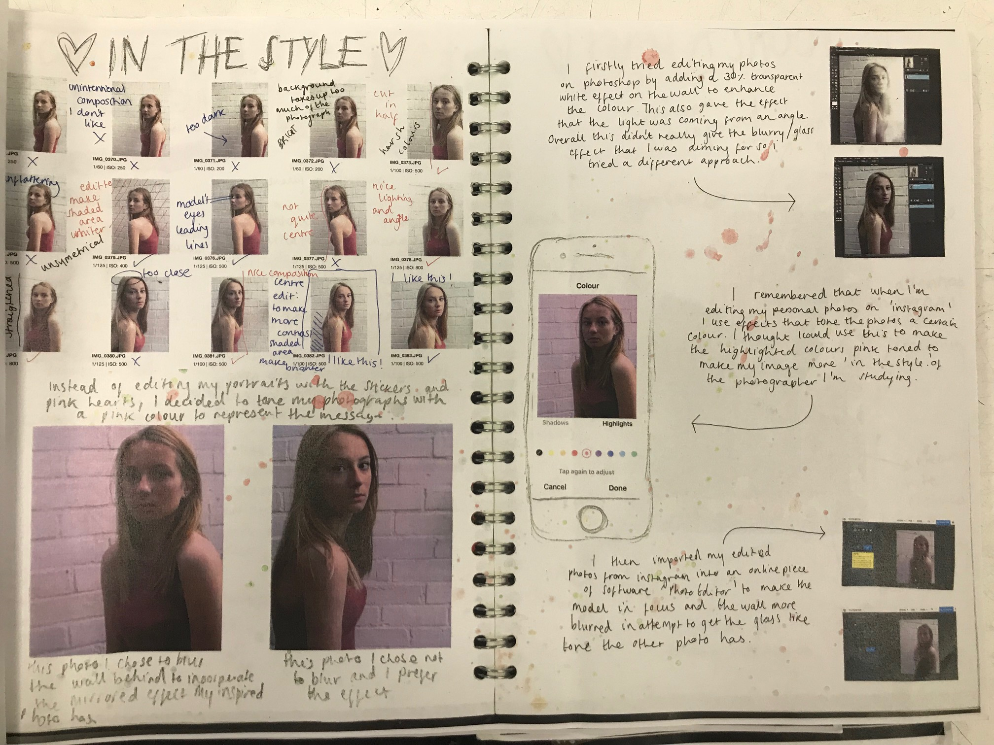
Screen shots with annotations
Presentation consistent and suits theme
Annotated contact sheets with key words
Larger final edits

Slide 13
Clear title
Shoot plan above contact sheet.
Full sentence
Study and analysis page
Bold words around study images
Annotated contact sheets with key words

Slide 14
Clear title
Full sentence
Shoot plan above contact sheet.
Bold words around study images
Annotated contact sheets with key words
Study and analysis page

Slide 15
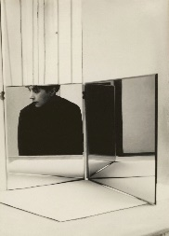
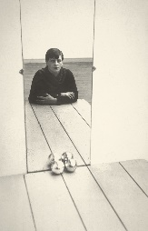
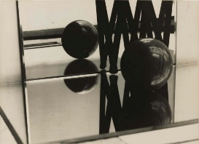
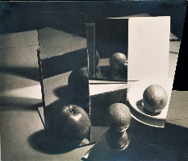
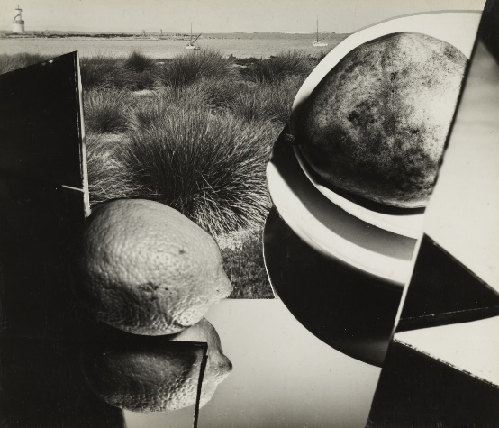
S T U D Y A N D A N A L Y S I S P A G E
FLORENCE HENRI
Double Page
Title: NAME
One sentence – why you like their work
Multiple images
Bold words around page that link Photographer to theme
I LIKE HENRI’S WORK BECAUSE OF HER USE OF MIRRORS AND DISTORTED OBJECTS…
MIRRORS
PORTRAITS
DISTORTED
FRAGMENTS
ABSTRACT
OBJECTS
OBSCURE

Slide 16
S T U D Y A N D A N A L Y S I S P A G E
FLORENCE HENRI
Analyse your chosen image by annotating:
What composition is used and why?
What is the main colour? Why?
What is the REAL message (research!)?
How has it been edited?
What lighting has been used? Is it harsh, soft, gentle, creates shadows?
How does it relate to theme?
[Have any techniques been used?]
I LIKE HENRI’S WORK BECAUSE OF HER USE OF MIRRORS AND DISTORTED OBJECTS…
Bullet point your plans
Composition?
Angles?
Orientation?
Location / props?
Techniques?
Light
Blah Blah Blah
MIRRORS
PORTRAITS
DISTORTED
FRAGMENTS
ABSTRACT
OBJECTS
OBSCURE
Contact sheet –ANNOTATED.
NO paragraphs.
WWW
EBI
Composition, light etc

Slide 17
S T U D Y A N D A N A L Y S I S P A G E
FLORENCE HENRI
Shoot plan in bullet points
Image from photographer by plan
Contact sheet printed from macs with settings
Annotated contact sheets – ticks and crosses, WWW, EBI
I LIKE HENRI’S WORK BECAUSE OF HER USE OF MIRRORS AND DISTORTED OBJECTS…
Bullet point your plans
Composition?
Angles?
Orientation?
Location / props?
Techniques?
Light
Blah Blah Blah
MIRRORS
PORTRAITS
DISTORTED
FRAGMENTS
ABSTRACT
OBJECTS
OBSCURE
Contact sheet –ANNOTATED.
NO paragraphs.
WWW
EBI
Composition, light etc

Slide 18
E D I T I N G P A G E S
IN THE STYLE OF FLORENCE HENRI
Double Page
Title: IN THE STYLE
Examples of their work
SCREEN SHOTS annotated to explain tools used
At least 2 BIG final edits
Annotated final edits
Visual analysis – not paragraphs
How has their work inspired your final edits?
ANNOTATED
Label that this is their work!!!!
FINAL EDITS
ANNOTATED
WWW WITH EDITING
EBI WITH EDITING
SCREEN
SHOTS
HOW INSPIRED?
FINAL EDITS
ANNOTATED
WHAT TOOLS
NOT TOO SMALL
WWW WITH EDITING
EBI WITH EDITING
WHAT TOOLS
ANNOTATED

Slide 19
Writing up Independent Shoots

Slide 20
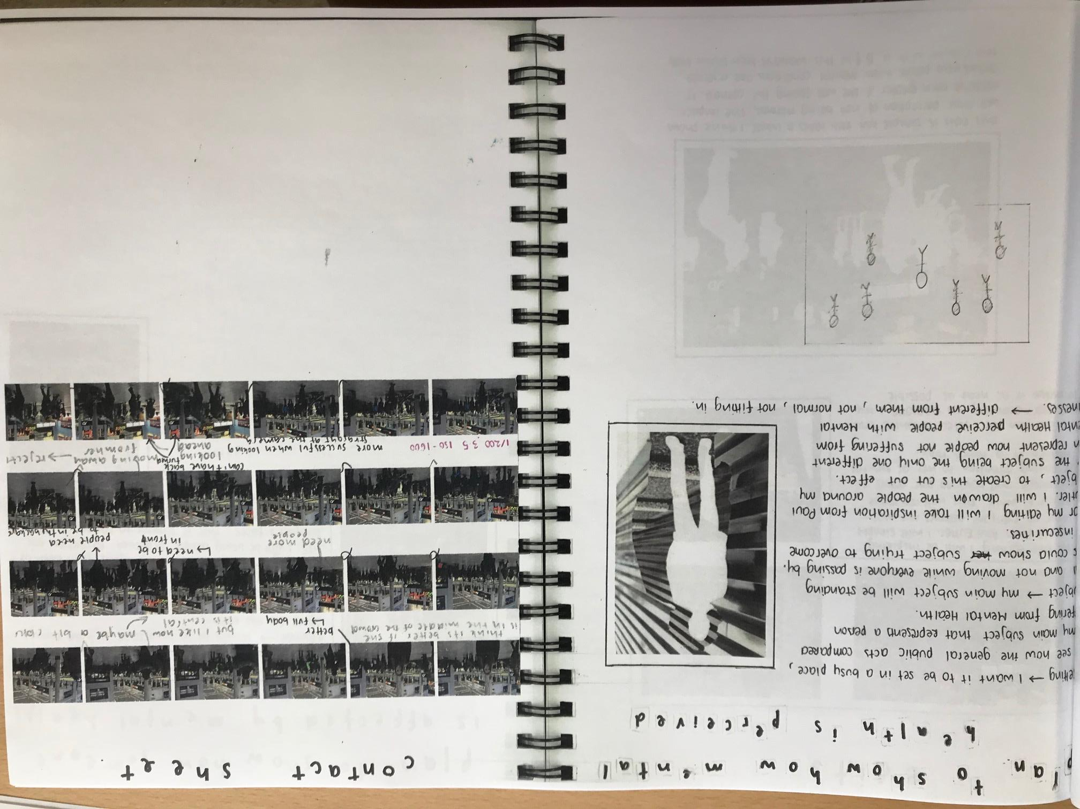
Title related to message
Visual reference to how you will edit / who inspired shoot
Annotated contact sheets with key words
Sketches are optional

Slide 21
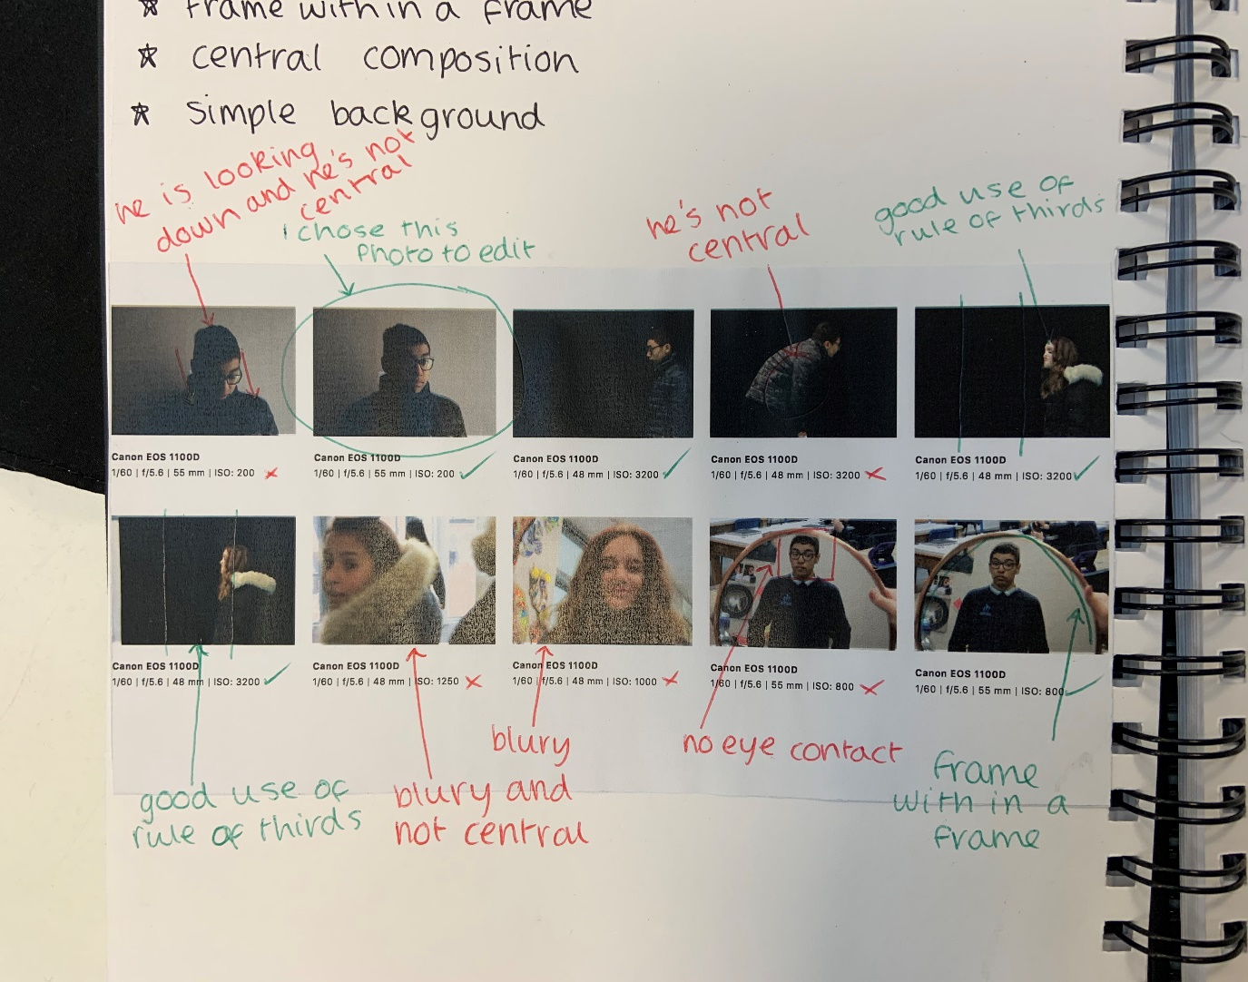
Annotated contact sheets with key words
Edited image circled
All ticked or crossed
Green / Red to make annotation clear

Slide 22
Clear title – student is experimenting in this independent shoot
Plan above contact sheet
All ticked or crossed
No editing? Clear ‘best’ images with annotation

Slide 23
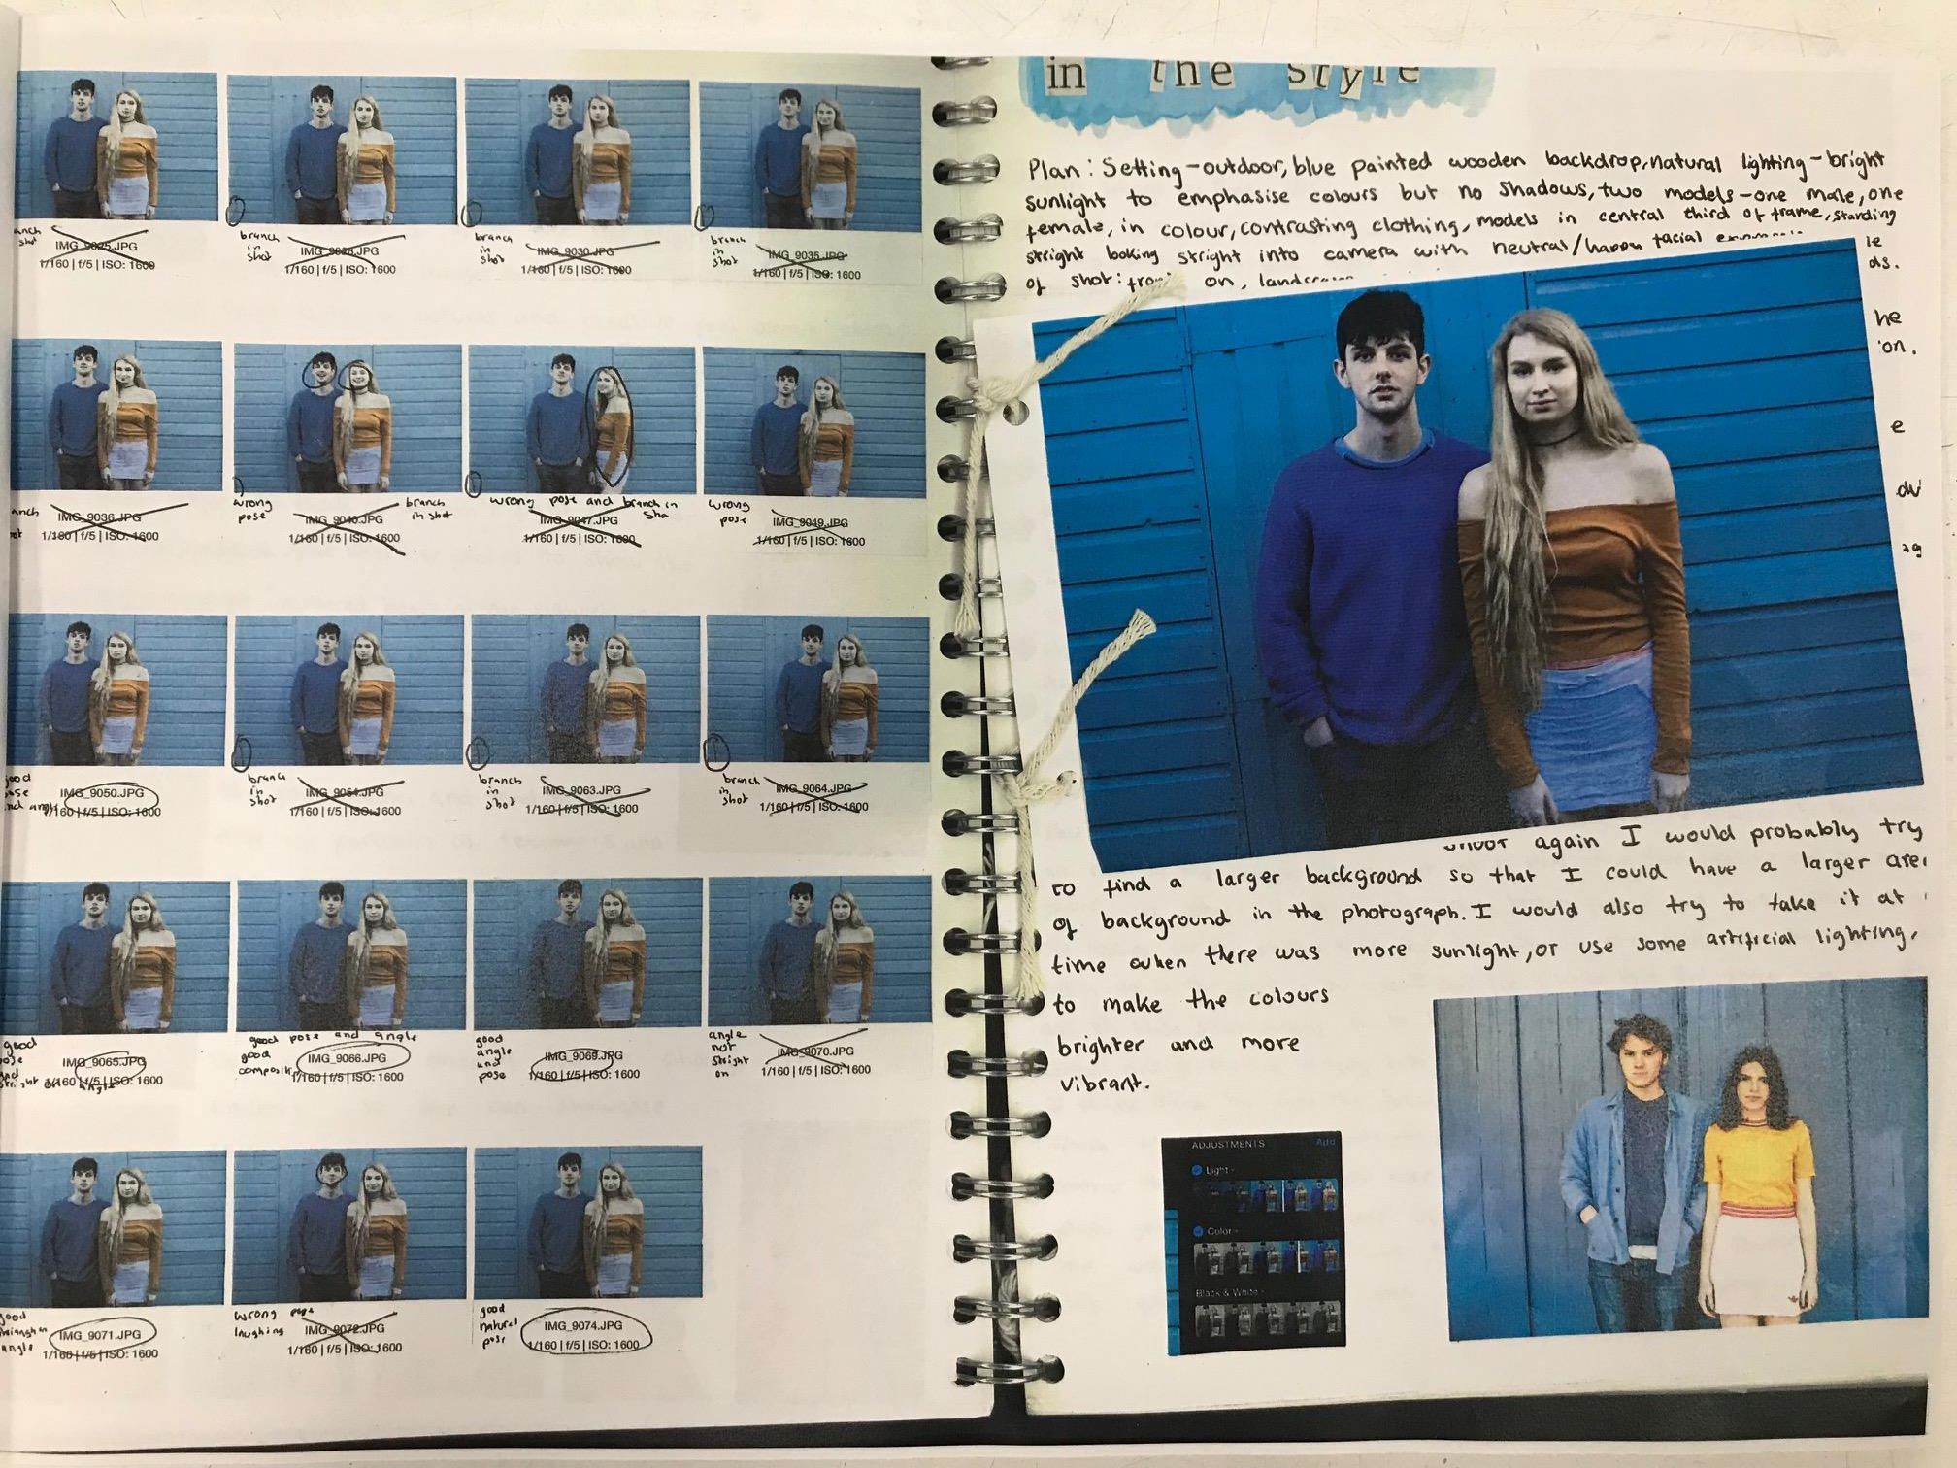
Presentation consistent and suits style (blue)
Larger final edits
Annotated contact sheets with key words
Visual reference to how you will edit / who inspired shoot
Screen shots

Slide 24
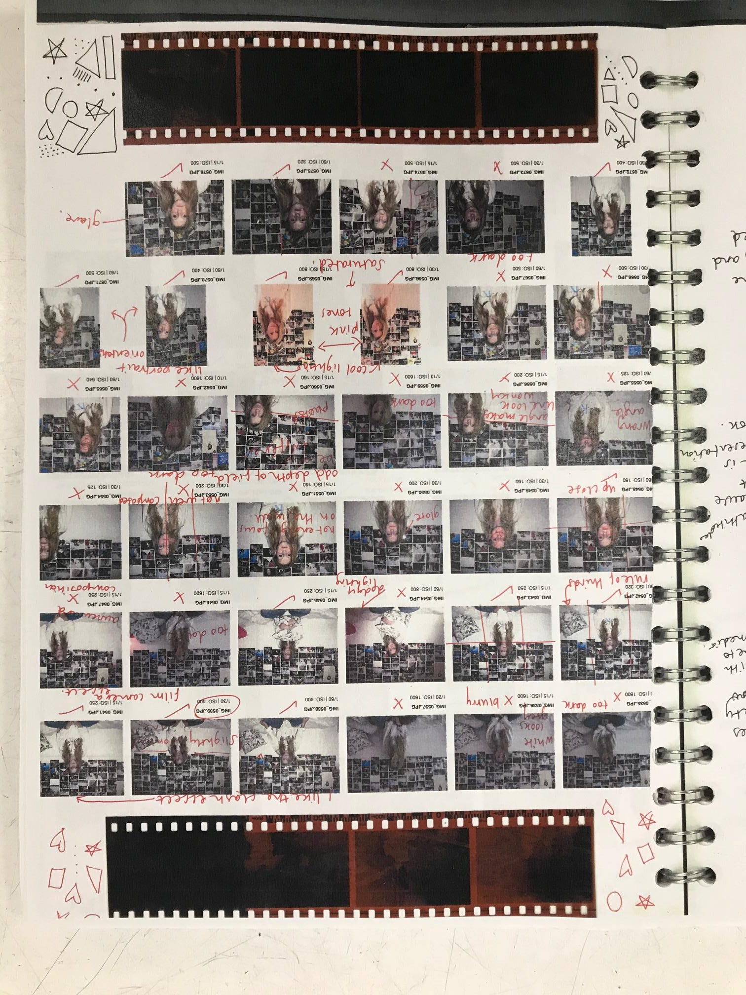
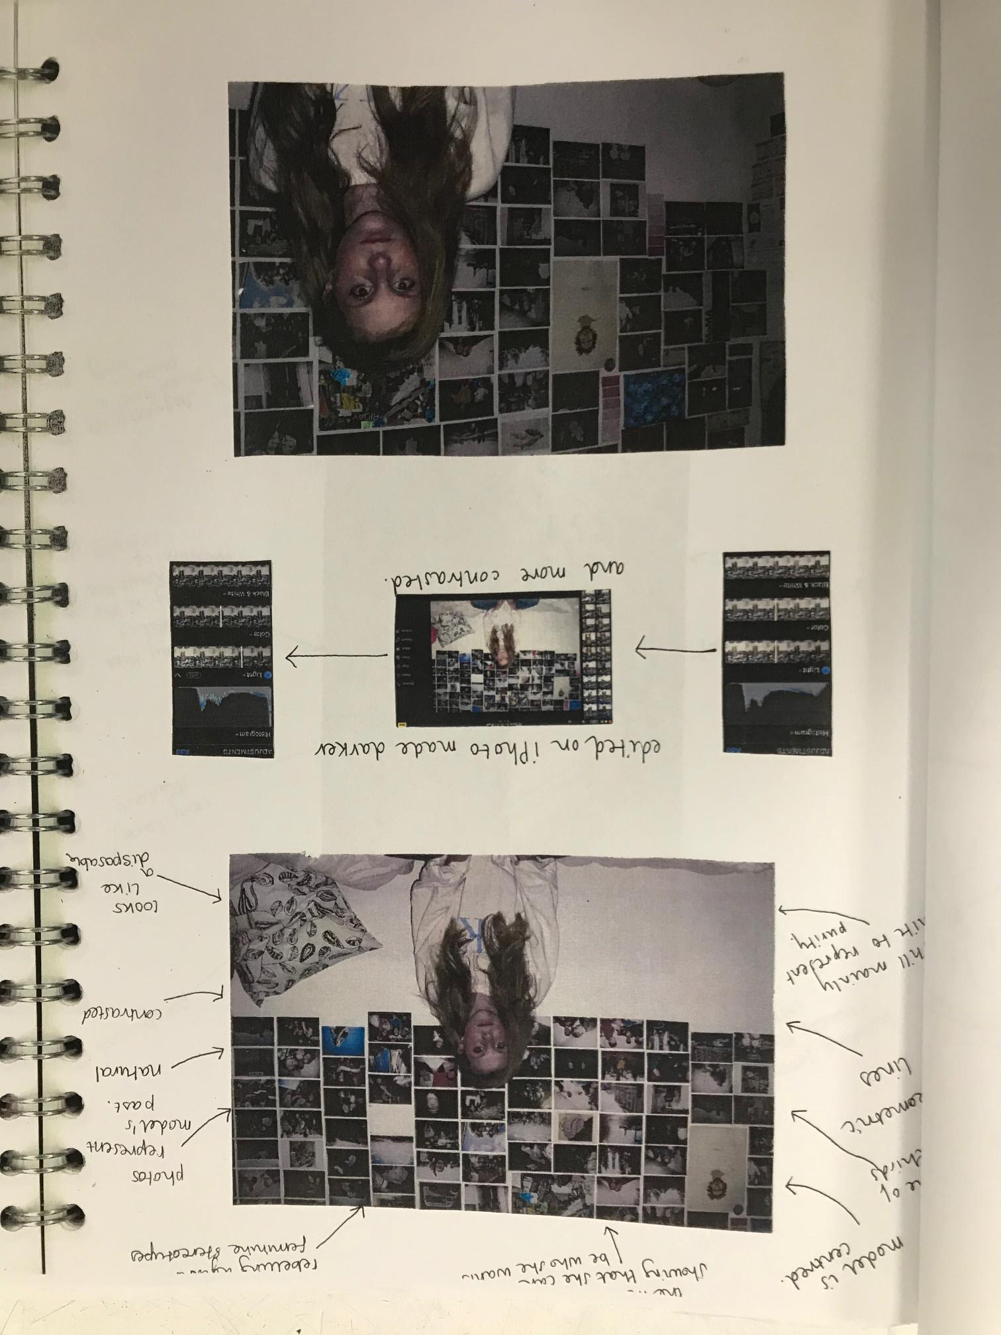
Annotated contact sheets with key words
Annotating to analyse own work
Reference to message
Screen shots
Larger final edits

Slide 25
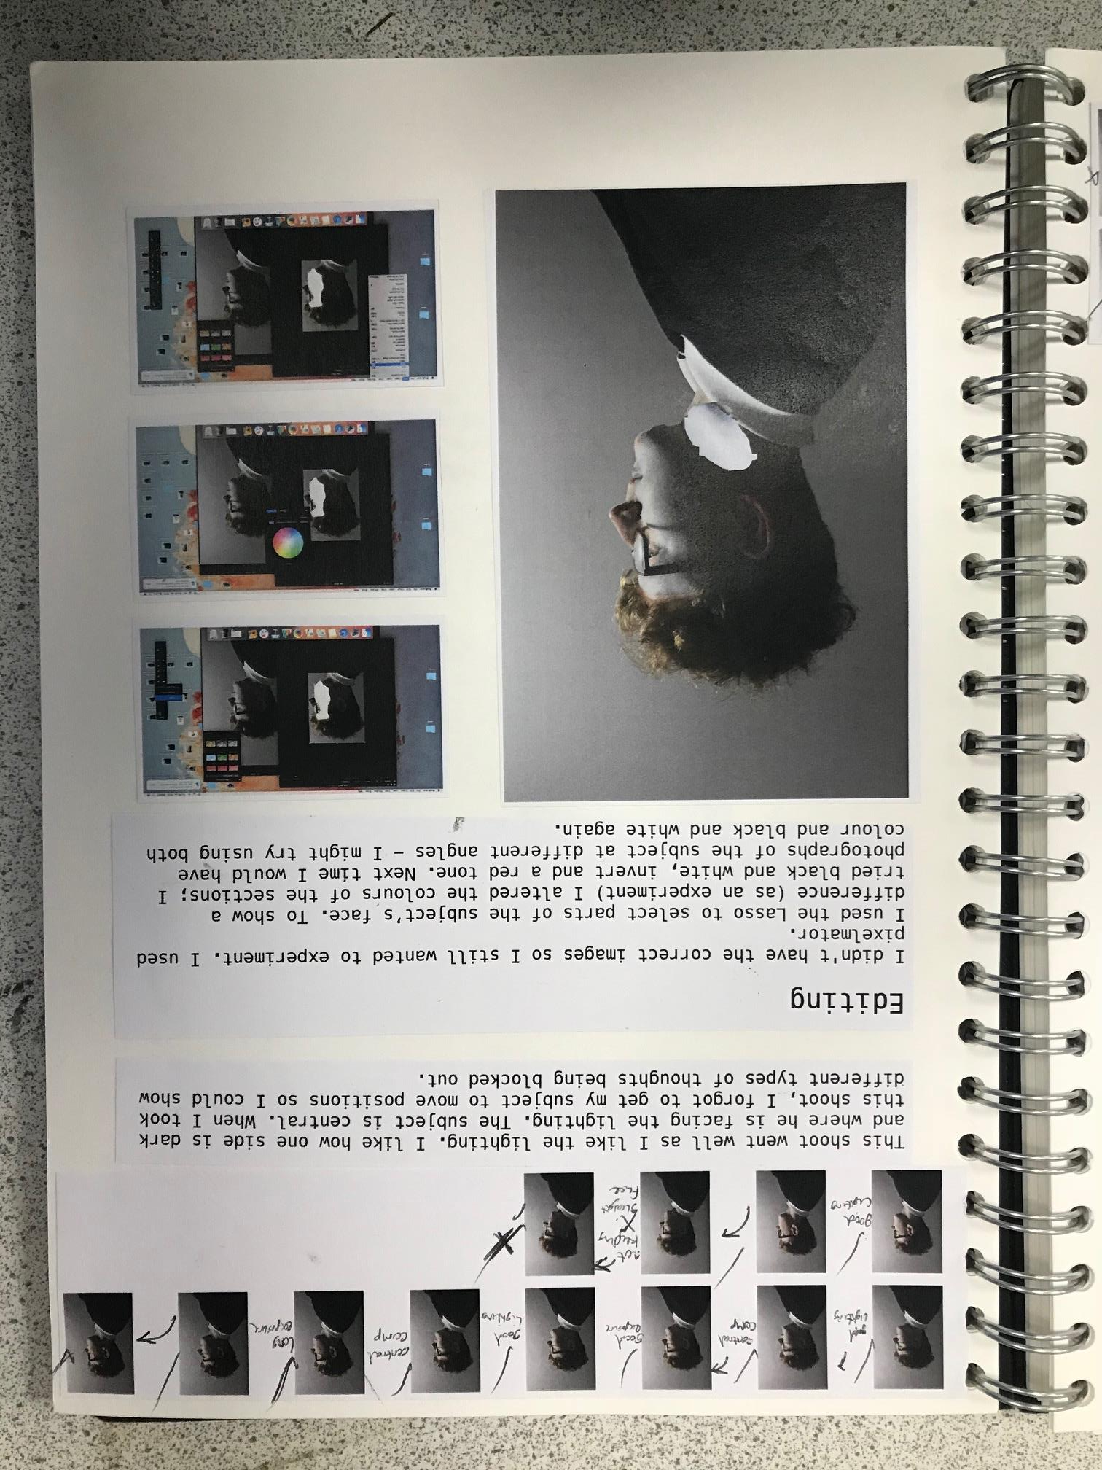
Annotated contact sheet
Clear screen shots
LARGE final edit photo

Slide 26
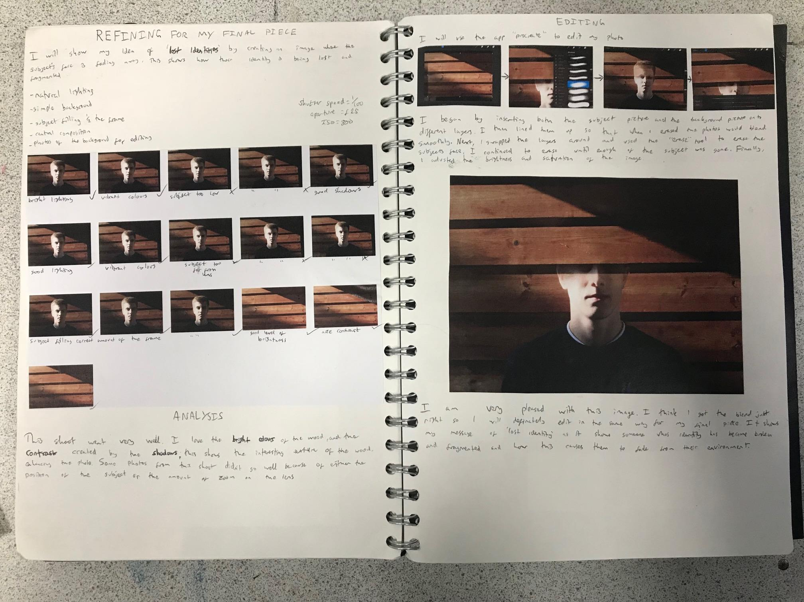
Screen shots,
tools annotated
Reference to message (could be bolder!)
Annotated contact sheets with key words
Large final edit,
Annotated www…ebi…

Slide 27
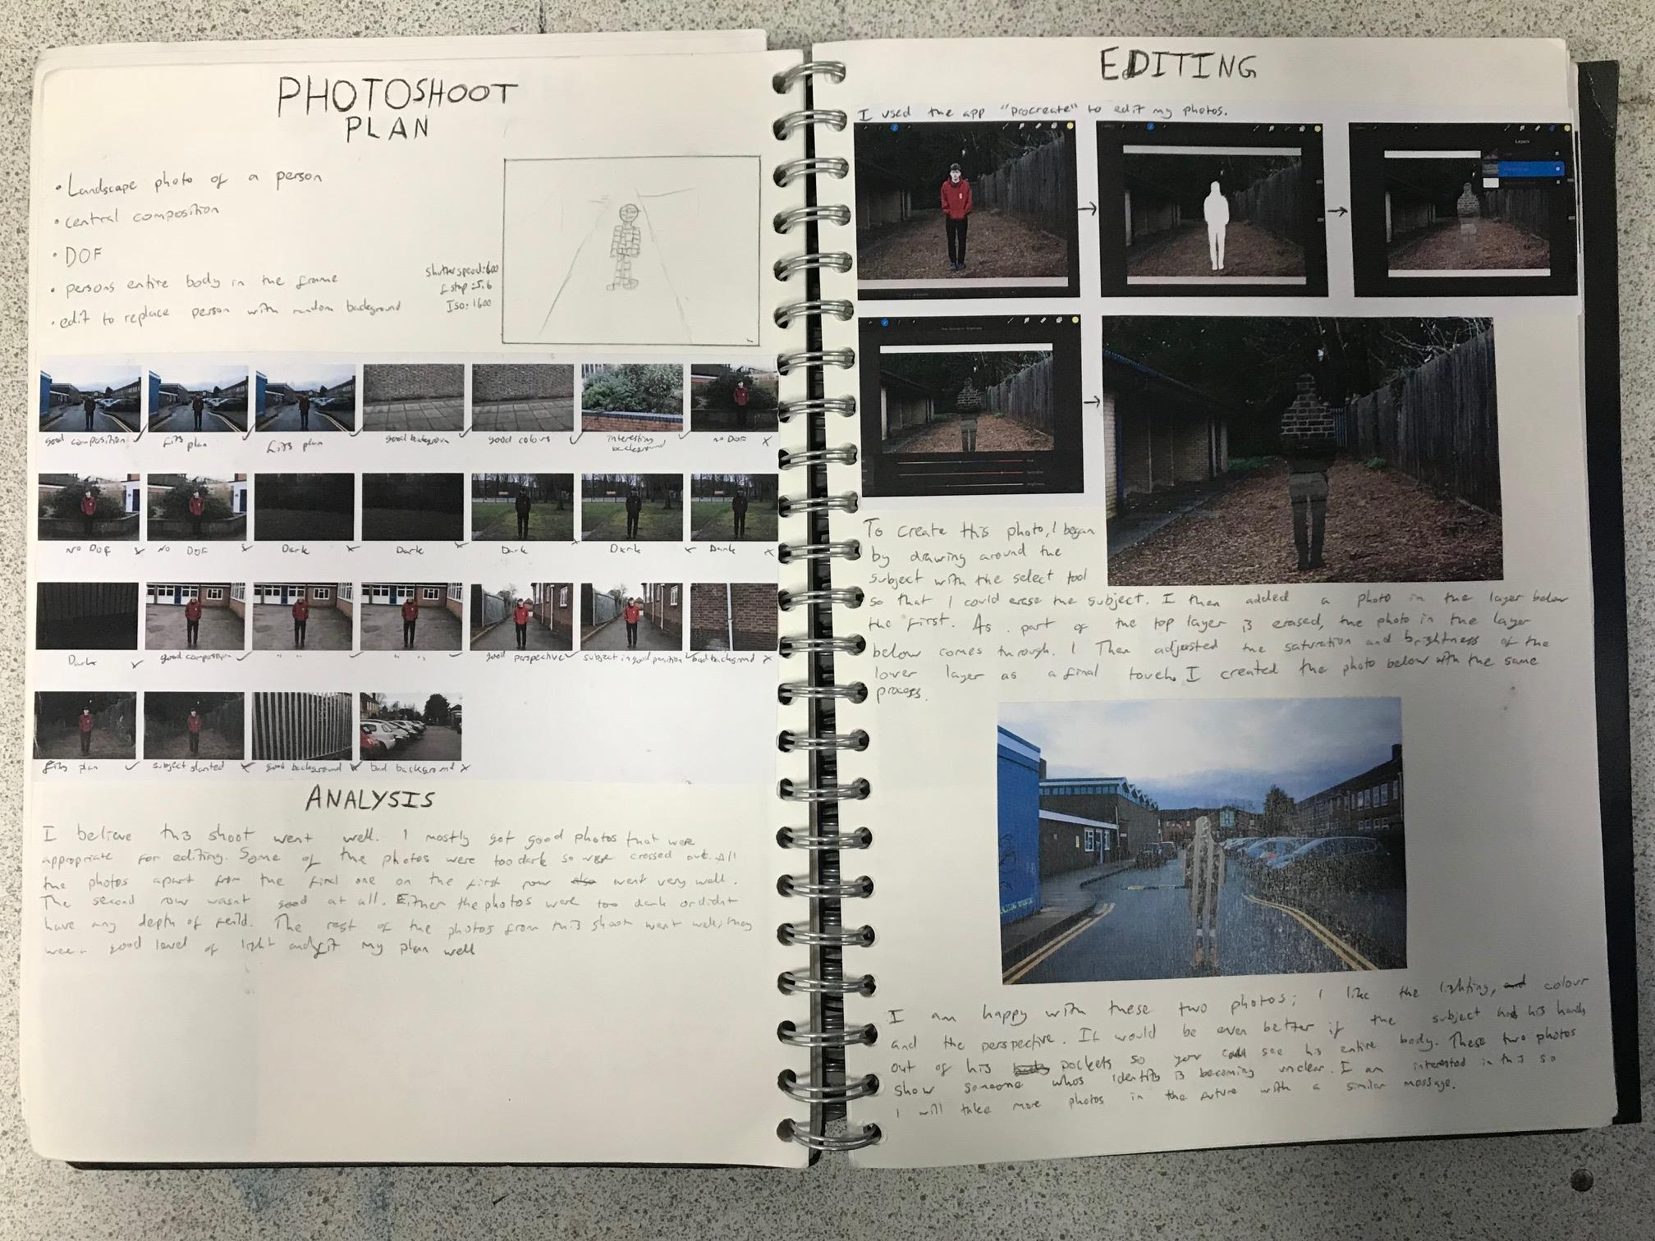
Screen shots
Reference to message (could be bolder!)
Larger final edits

Slide 28
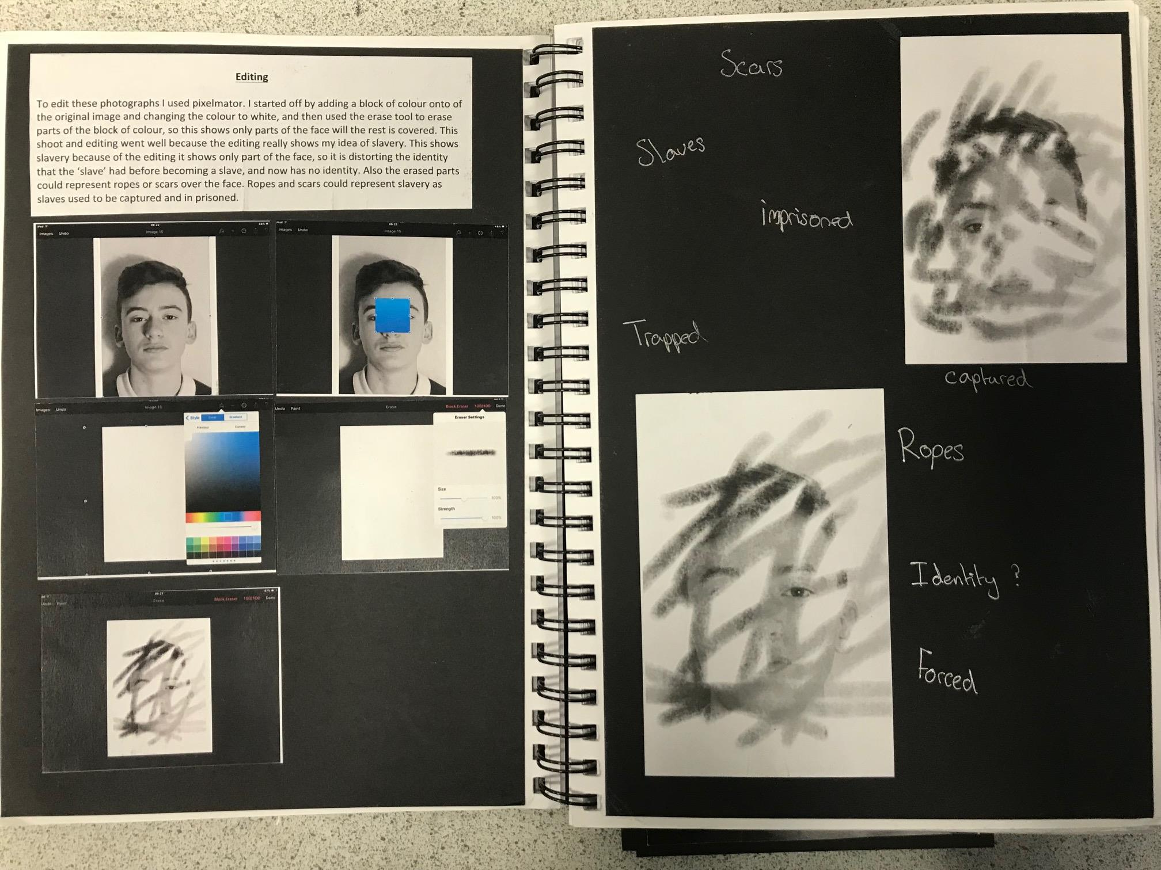
Large final edit
Clear screen shots
BOLD words linking edits to theme

Slide 29
Clear screen shots
Clear journey of editing
Steps annotated

Slide 30
Visual Analysis

Slide 31
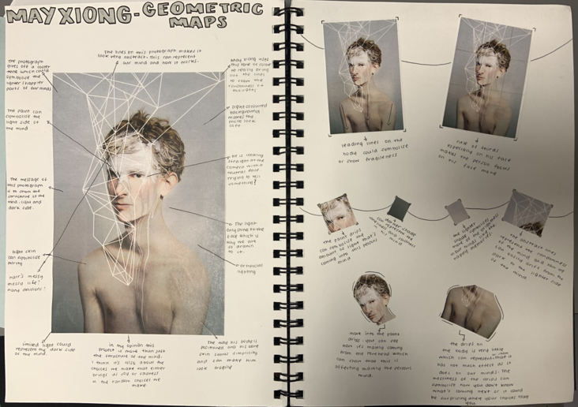

Slide 32
Simple presentation clearly linked to image (grey).
Composition lines drawn on top of image
Arrows to areas discussing
Image cut apart to emphasise your points

Slide 33
Message Pages

Slide 34
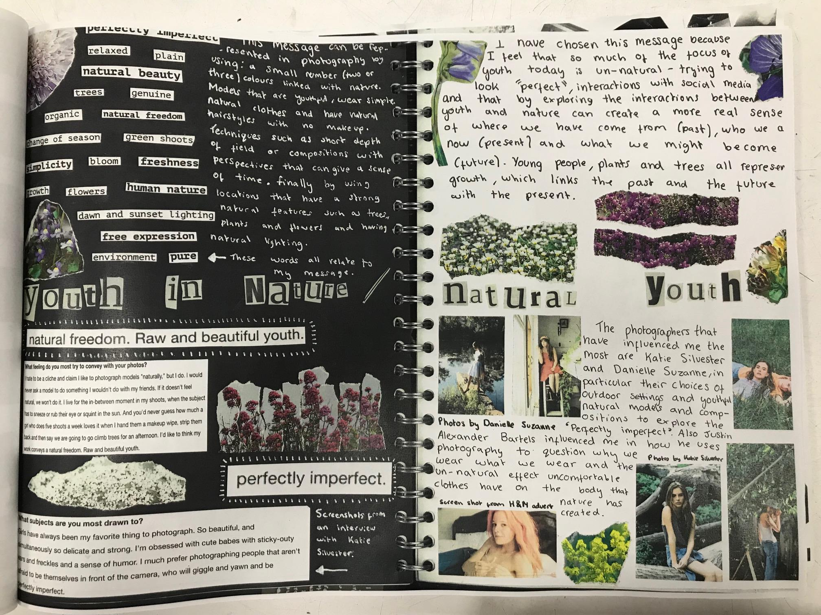
Simple presentation clearly linked to theme
Clear message
Deeper information on message – facts / quotes from context of photographers
Photographers that have inspired you

Slide 35
Photographers that have inspired you
Future ideas (list)
How they have inspired
Clear message
Why chosen message
How linked to theme
Key words and ideas linked the message

Slide 36
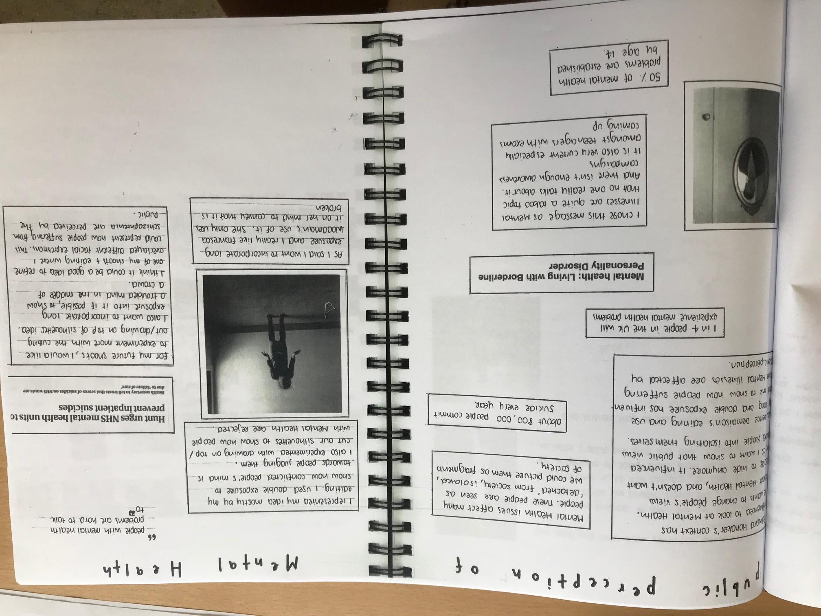
Quotes / Links to theme
Clear message
Future ideas (list)
Visual links
Quotes / Links to theme

Slide 37
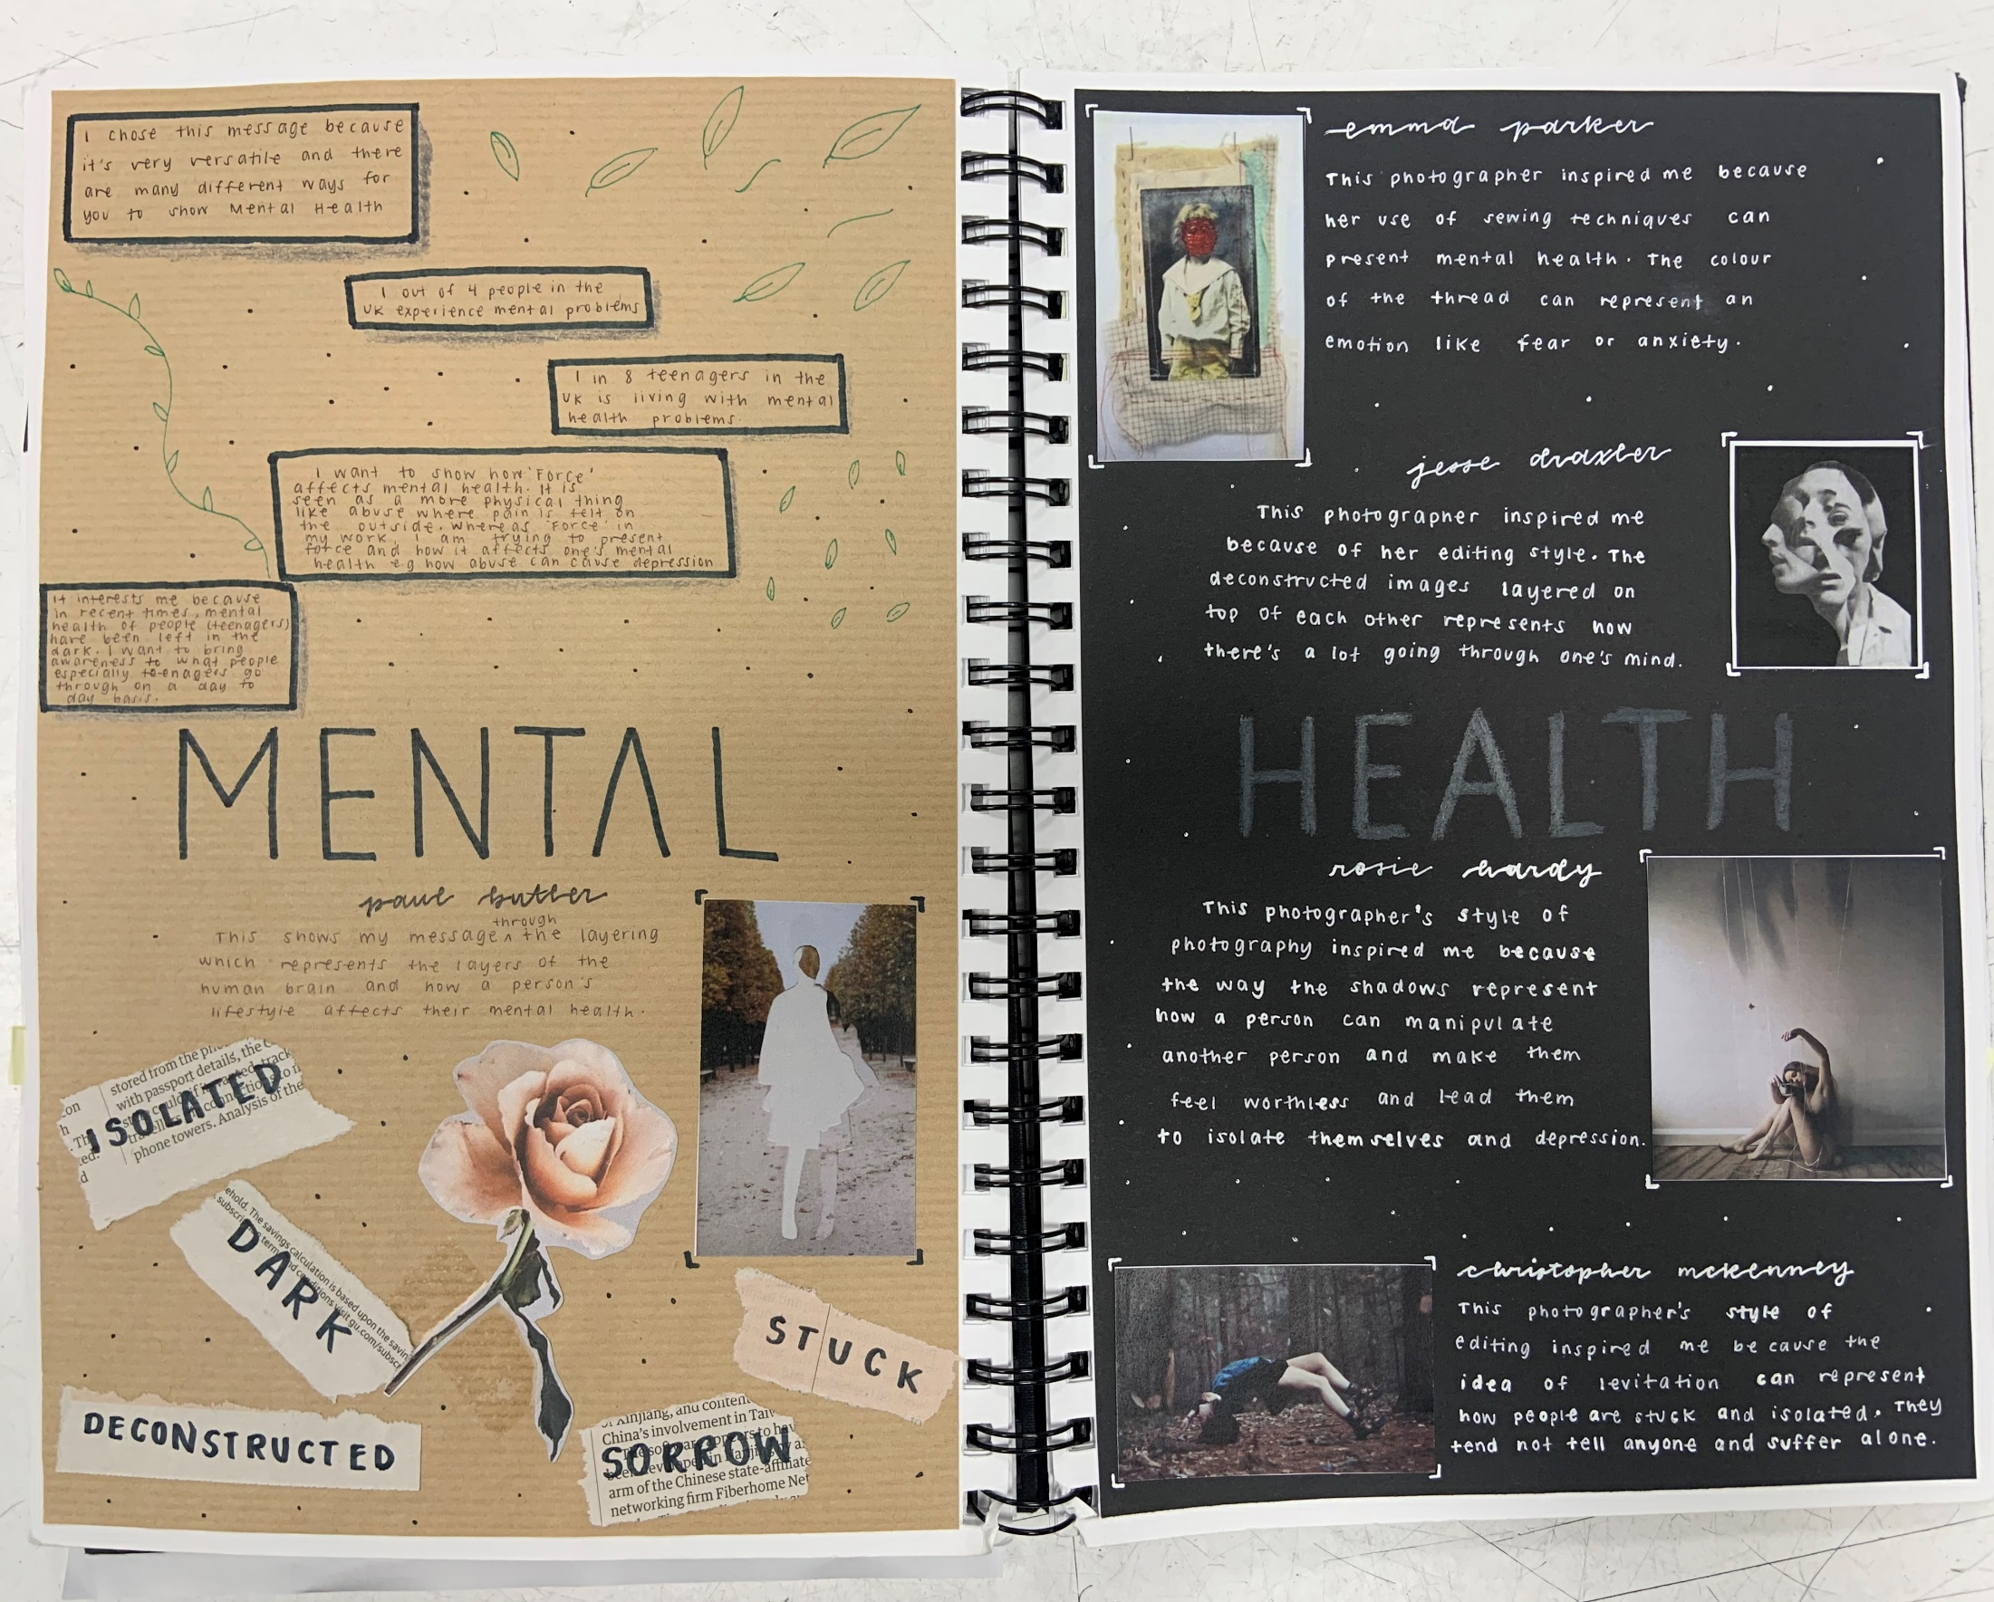
Quotes / Links / facts to theme
Photographers that have inspired
Clear message
How linked to theme
Key words linked to message

Slide 38
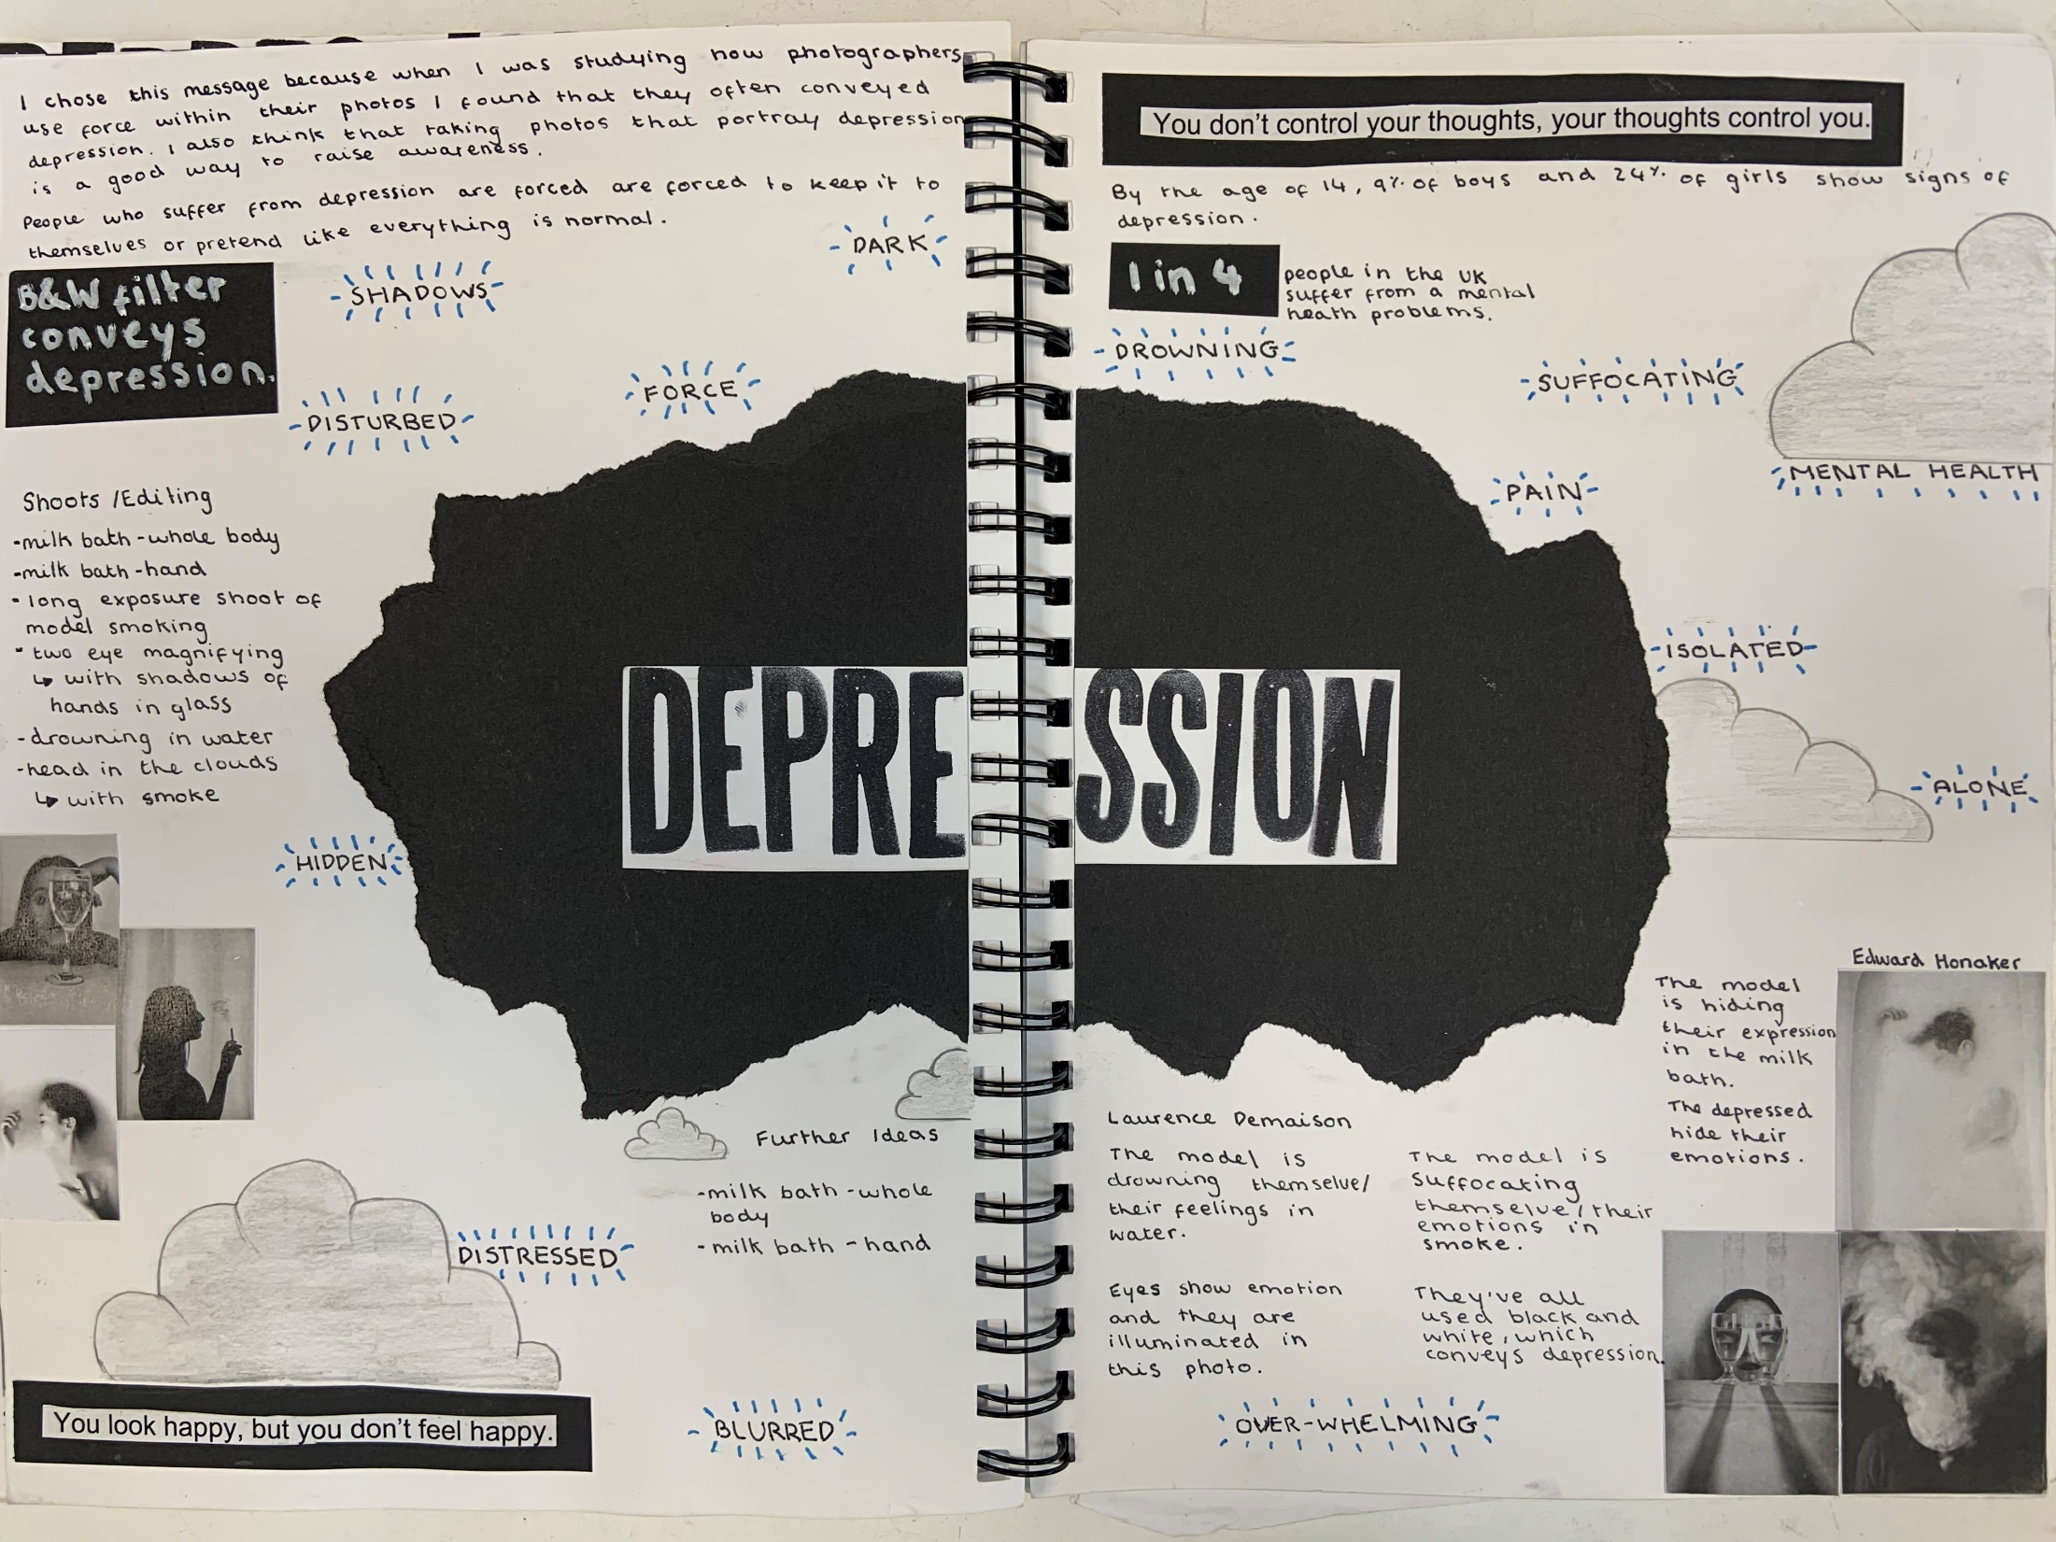
Facts and quotes linked to theme
Visual links
Photographers that have inspired
Clear message
Examples of OWN work
Key words linked to message

Slide 39
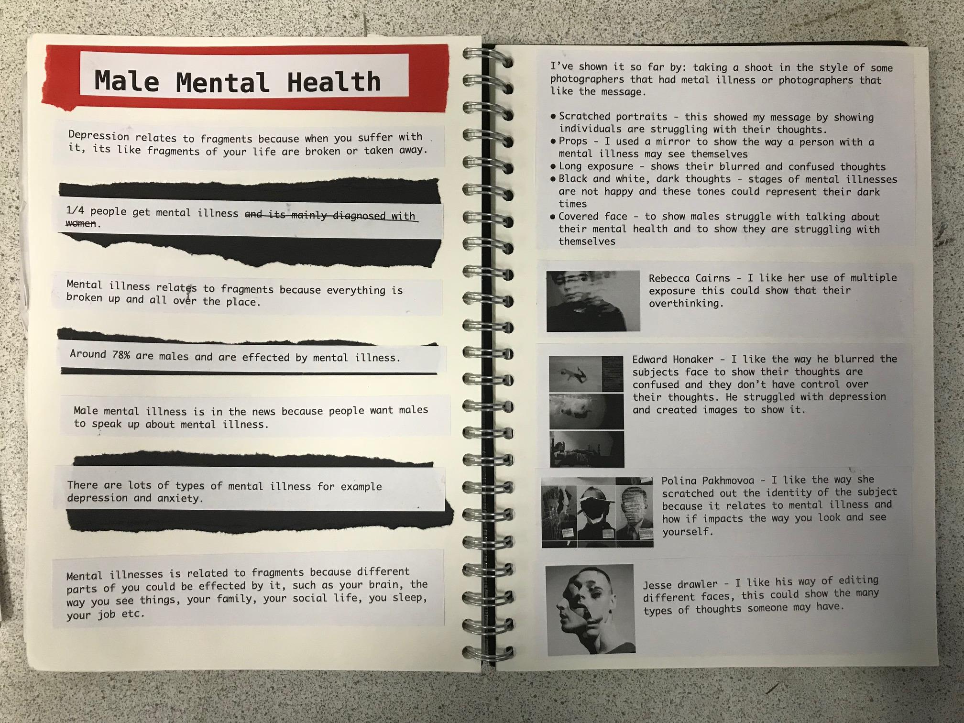
Clear message
FACTS
FACTS
Photographers that have inspired
FACTS
Visual links

Slide 40
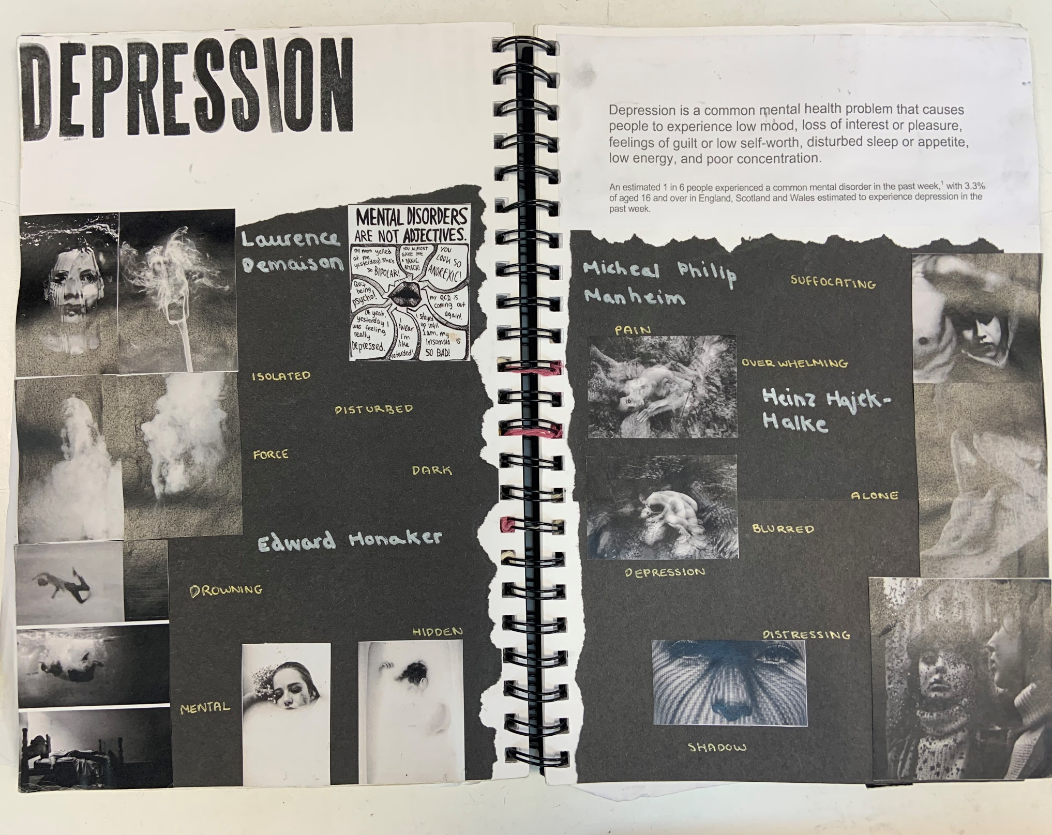
Clear message
Facts and quotes linked to theme
Photographers that have inspired

Slide 41
Hand Manipulation

Slide 42
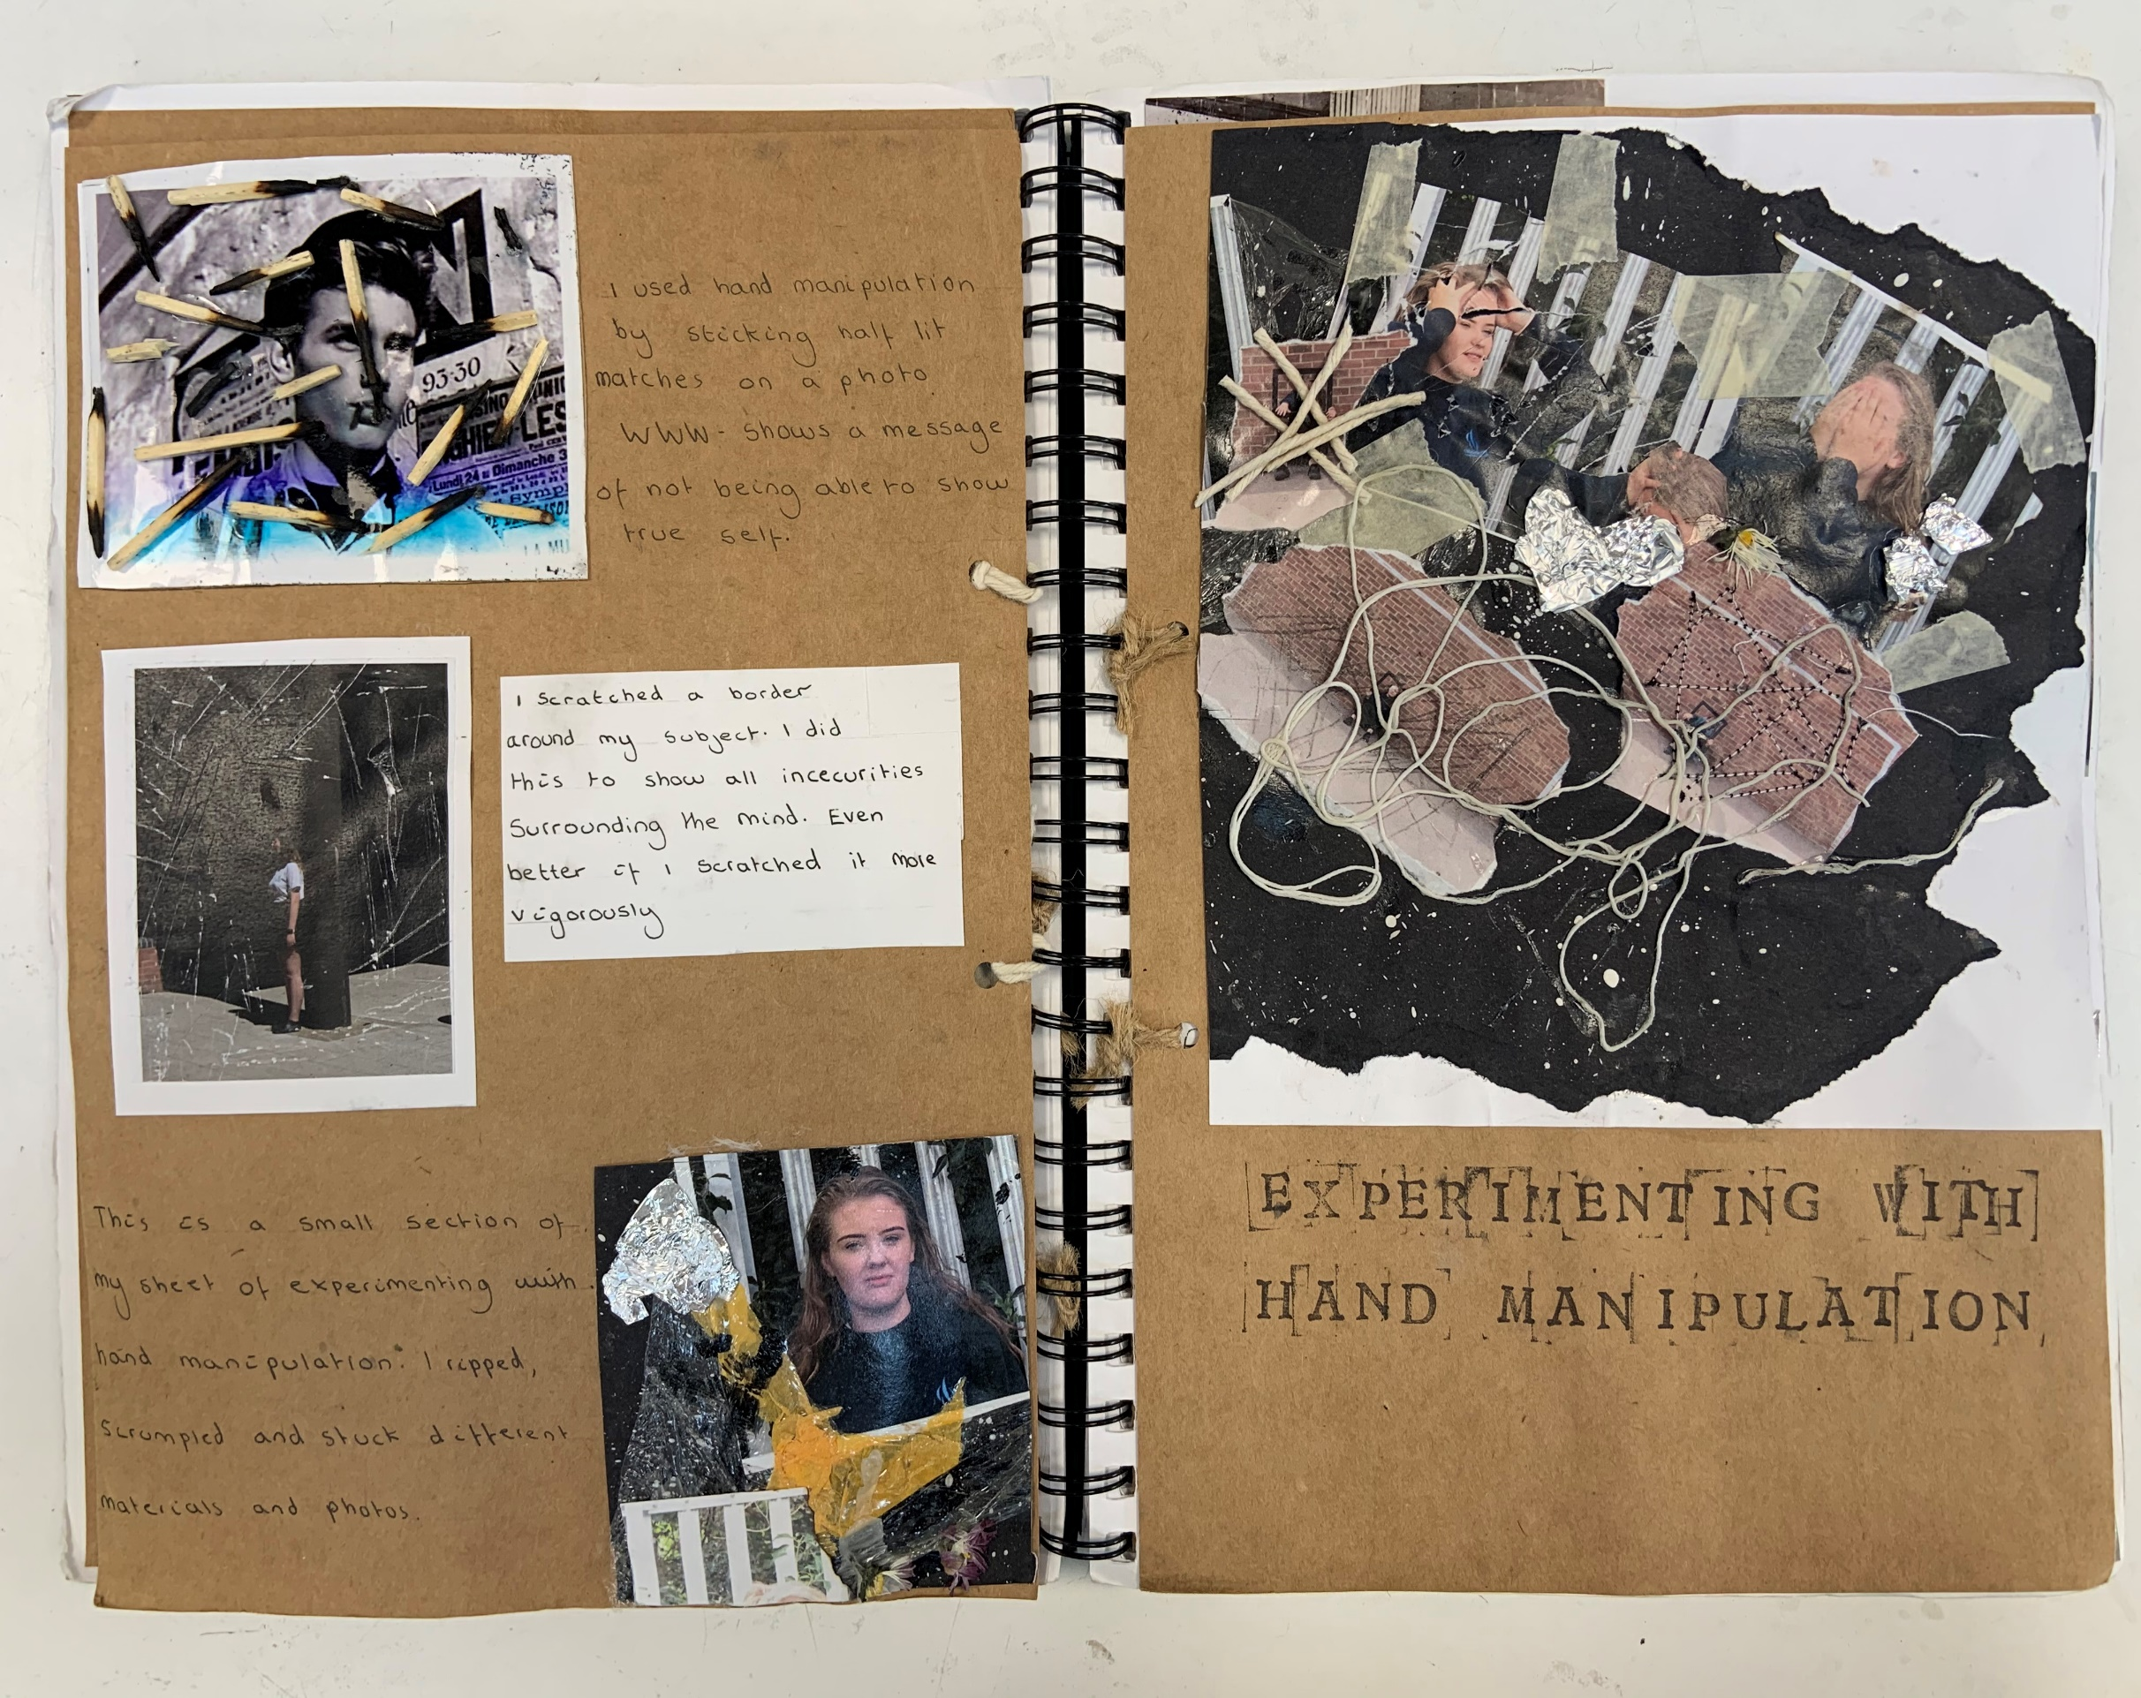
Clear title and layout

Slide 43
Clear title
Key point (www) bold
Small bits of wood stuck into book and annotated

Slide 44
Clear title
How these manipulations link to message
Explanation
Further experiments with the same image
WWW EBI

Slide 45
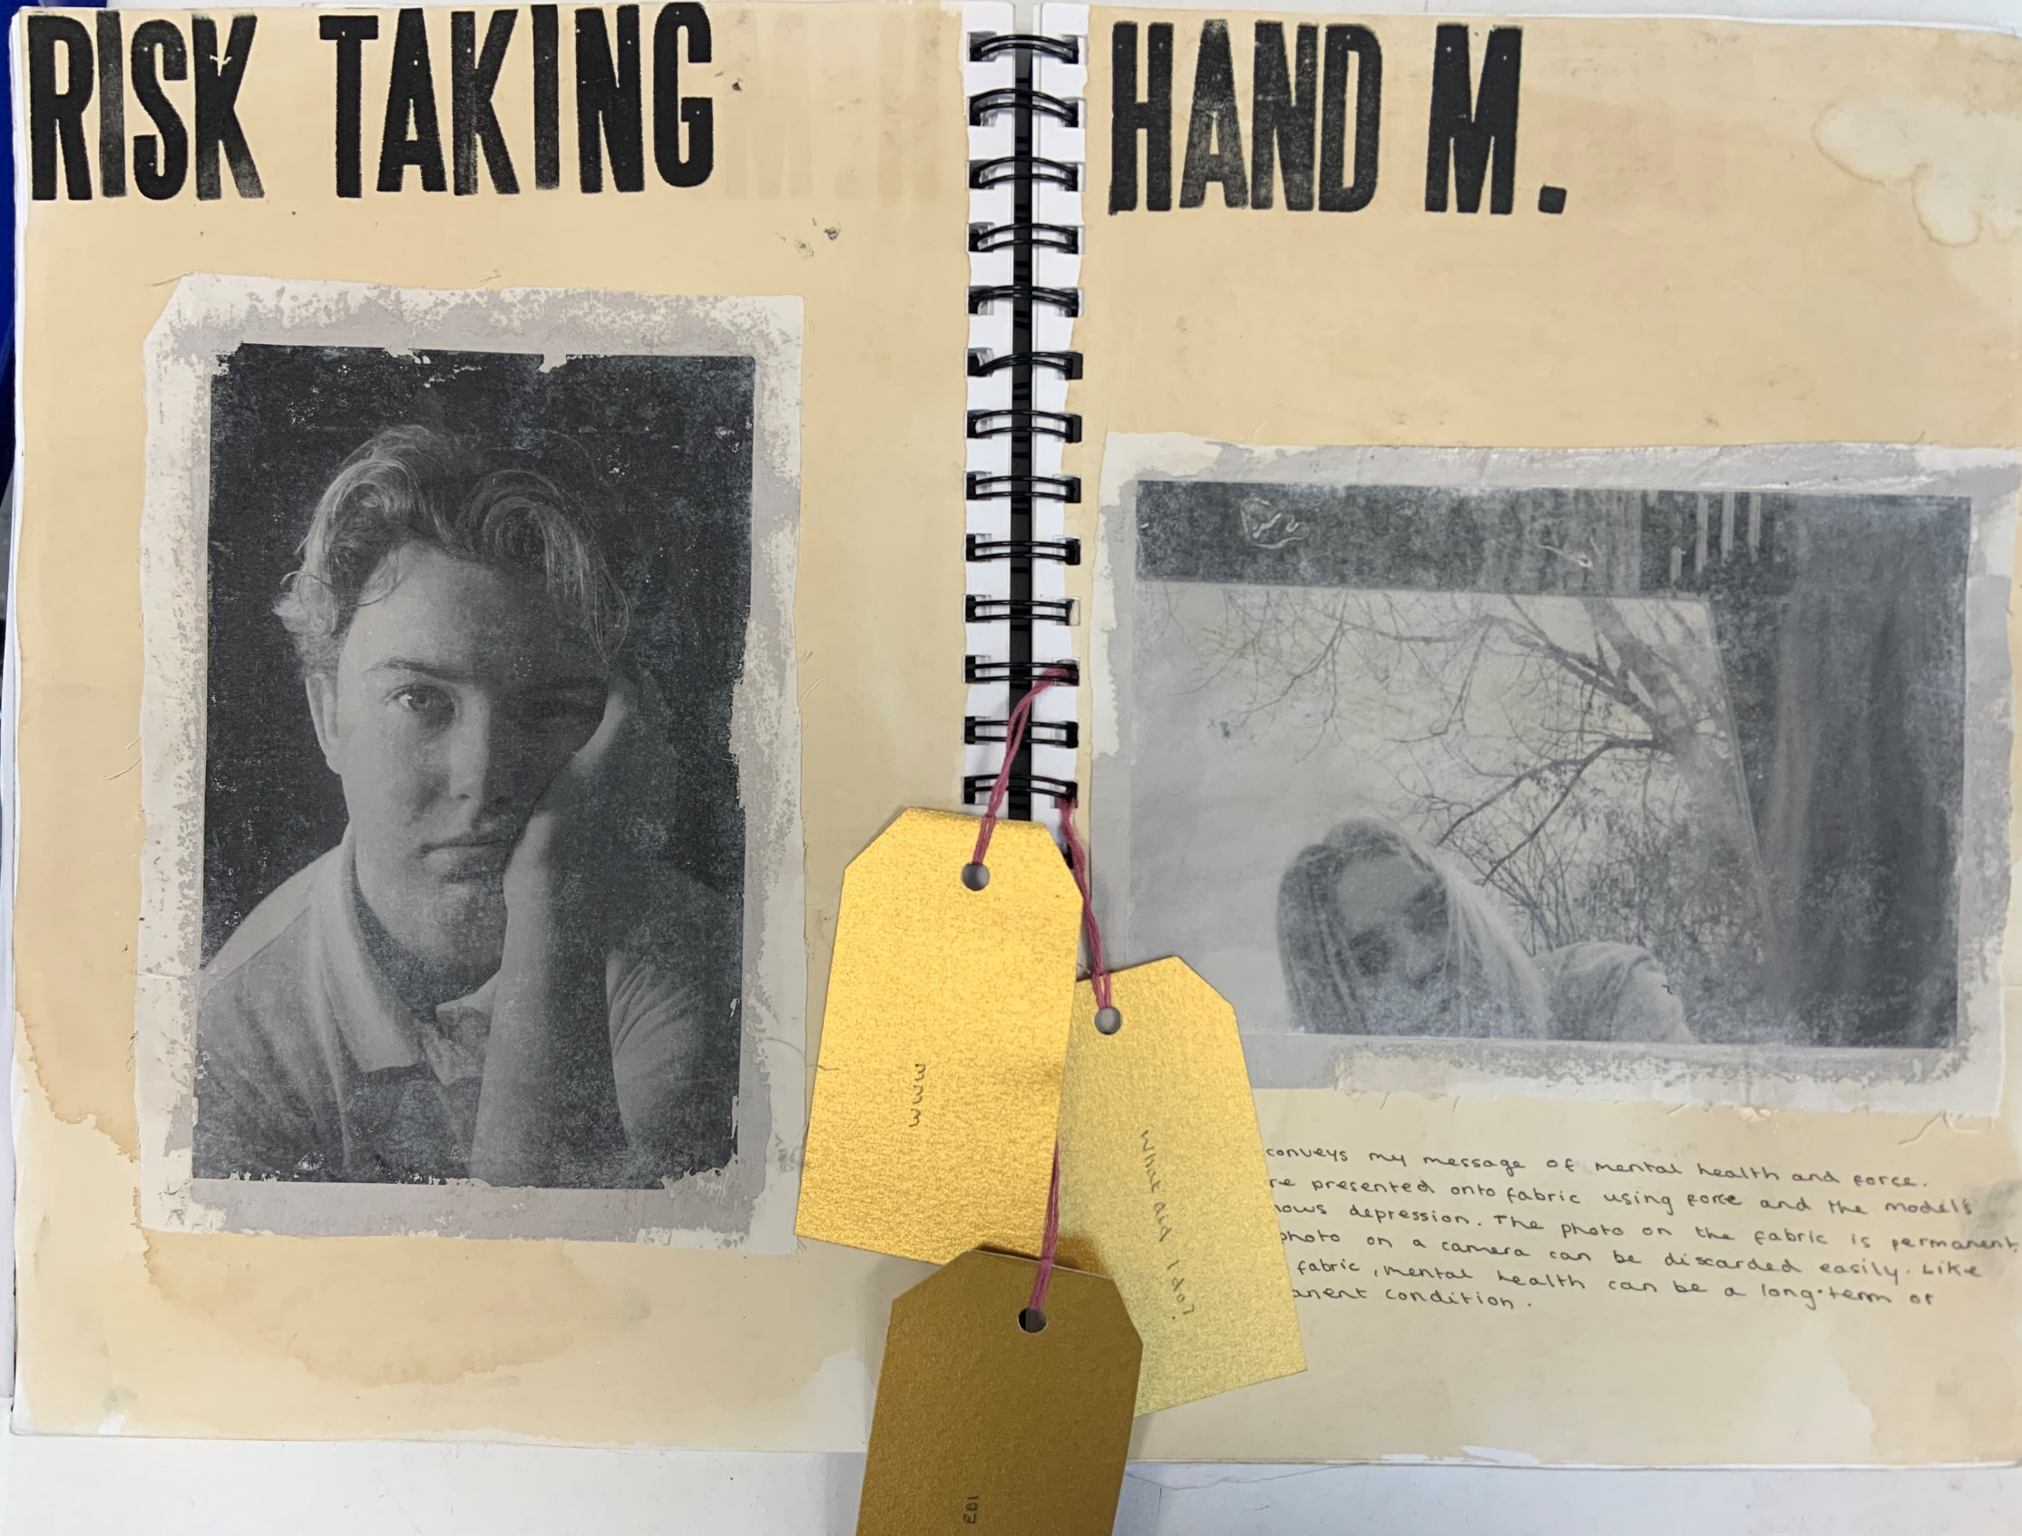
Clear title
WWW EBI – can’t see them!

Slide 46
Final Piece Plan

Slide 47
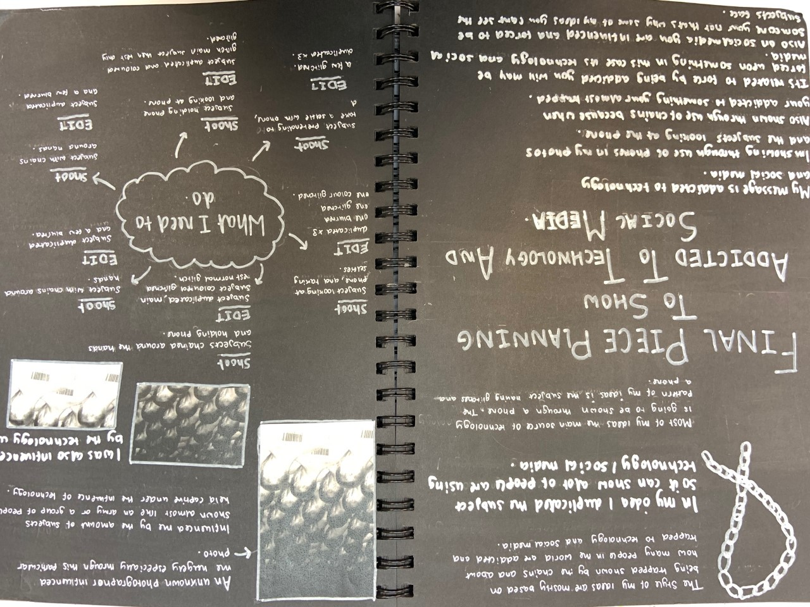
Main ideas in BOLD
Clear final piece title
Visual links
What do you need to do to get to the exam?! E.g. tick list, mindmap of shoots and edits.
Linked to message AND detail on message

Slide 48
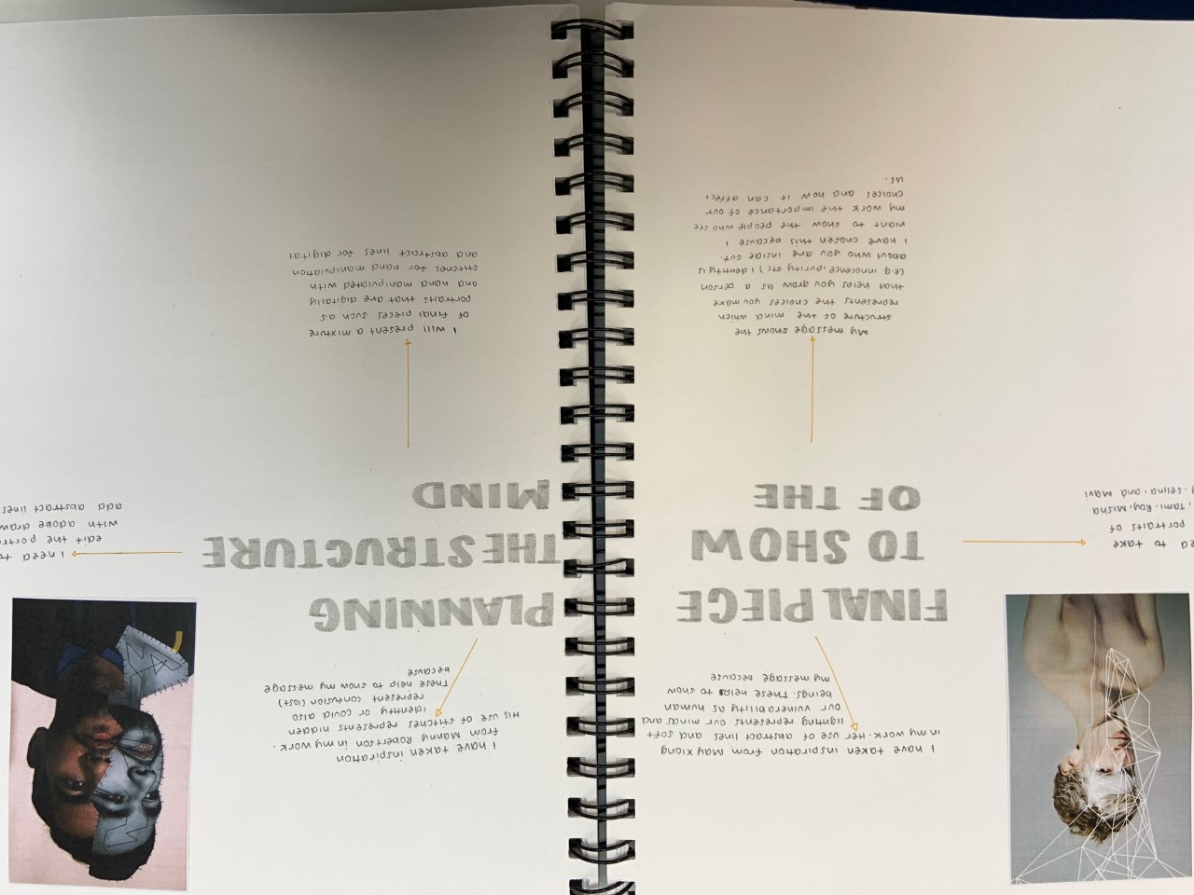
Visual links
Clear final piece title
Linked to message AND detail on message

Slide 49
VISTING EXHIBITIONS

