Slide 1
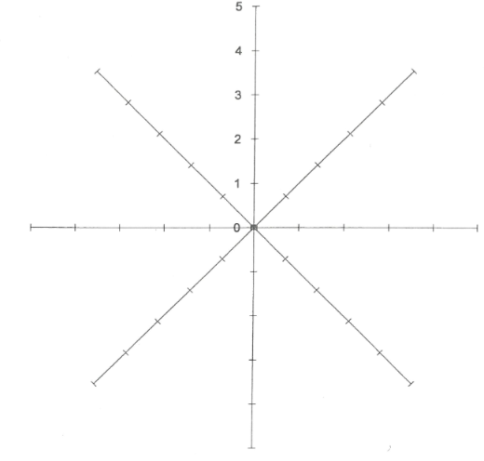
Name ________________________________ |  | Date | __________________
Product made _______________________________________
What client group would this dish suit? (circle/highlight) | Sensory analysis
Babies / toddlers / children / teenagers / young adults / adults / older adults Why? ________________________________________________________________________________________________________________________________________________________________________________________________________________________________ | Appearance Taste Aroma Texture
What nutrients are in this dish? (circle/highlight)
Macros: Protein / fats / carbohydrates Micros: Vitamins / Minerals Water / Fibre Function in body? ________________________________________________________________________________________________________________________________________________________________________________________________________________________________
Preparation techniques (circle/highlight)
blending* beating* grating* hydrating* juicing* marinating* mashing* melting* proving* shredding* sieving* tenderising* zesting* creaming** dehydrating** folding** kneading** measuring** mixing** puréeing** rub-in** rolling ** skinning** toasting(nuts/seeds) ** weighing** crimping*** laminating (pastry)*** melting using bain-marie*** piping*** shaping*** unmoulding*** whisking(aeration)***
Knife skills (circle/highlight)
chopping* peeling* trimming* bâton** chiffonade** dicing** slicing** deseeding** spatchcock** brunoise*** julienne*** mincing*** deboning*** filleting*** segmenting**
Cooking techniques (circle/highlight)
basting* boiling* chilling* cooling* dehydrating* freezing* skimming* toasting* baking** blanching** braising** griddling** deglazing** frying**griddling** pickling** reduction** roasting** sautéing** steaming** water-bath (sous-vide)** stir-frying** setting** baking blind*** caramelising*** deep fat frying*** emulsifying*** poaching*** tempering***

Slide 2
Personal performance review (use target questions)
________________________________________________________________________________________________________________________________________________________________________________________________________________________________________________________________________________________________________________________________________________________________________________________________________________________________________________________________________________________________________________________________________________________________________________________________________________________________________________________________________________________________________________________________________________________________________________________________________________________________________________________________________________________________________________________________________________________________________________________________________________________________________________________________________________________________________________________________________________________________________________________________________________________________________________________________________________________________________________________________________
Commentary of learner performance Level of skills demonstrated I.e., high (well executed) Medium (some precision) basic (basic).
In preparation well executed some precision basic
In cooking well executed some precision basic
In presentation well executed some precision basic
Quality checks well executed some precision basic
Quality of final outcomes high medium low
Health and safety considerations high medium low
Level of guidance provided low medium high
Feedback/Target to improve

Slide 3
Target questions
T1: Explain how you resolved a problem during this practical
For example: When cooking the oil became too hot, which is a health and safety hazard. To resolve this I briefly turned off the heat and allowed the oil to cool slightly before continuing to cook.
T2: Give 3 examples of how you followed health, safety and hygiene during this practical
For example: I worked healthily and safely during this practical by wearing an apron, washing my hands before and after handling food as well as using colour coded chopping boards to prevent cross-contamination.
T3: Provide an example of how you used equipment safely during this practical
For example: I used a chef's knife safely during this task by consistently applying the bridge method and claw grip. This ensured my fingers were out of the way when dicing so that I did not cut myself.
T4: List 2 ingredients, where you stored them prior to this practical, and why.
For example: I stored raw chicken in the fridge, on the bottom shelf. Raw chicken is a high risk ingredient and must be on the bottom shelf to avoid dripping onto other foods. I stored my dry ingredients, e.g. Flour, in an airtight container in the cupboard so that moisture could not get in and cause mould to grow.
T5: Suggest how you could use any food waste as a result of your practical
For example: I could use the bones and vegetables scraps from this dish to make a gravy.
T6: Suggest 1 accompaniment that would pair well with this dish
For example: This dish would pair well with a roasted garlic mayonnaise. This dish would pair well with a pistachio creme. This dish would pair well with steamed, seasonal vegetables.
T7: Name 3 ingredients, list their nutritional content and explain how those nutrients function in the body
For example: The tofu in this dish contains protein, protein is essential for the body to grow and repair.
The cheese in this dish contains calcium, essential for building strong bones and teeth
The spinach in this dish is a source of vitamin K. Vitamin K assists with blood clotting.
T8: In your opinion, which specific group is this dish suitable for, and why?
E.g. In my opinion, this dish is most suitable for young children as it contains healthy sources of carbohydrate, calcium and vitamin D. Young children require a lot of carbohydrates due to their energy requirements, e.g. very active! They are also growing rapidly so require calcium and Vitamin D.

