Slide 1
History A Level Taster Session
Starter question: Why have you chosen History A Level?

Slide 2
What will I be studying?
Year 12:
Germany and West Germany, 1918 – 1989
The Rise and Fall of Fascism in Italy, c. 1911 – 1946
Introduction to coursework
Year 13:
Protest, Agitation and Parliamentary Reform, c. 1780 – 1928
Coursework

Slide 3
What might you already know?
TASK: Work in pairs
Write out the titles of each course unit on a different desk.
Then, sort the cards into the correct module.
CHALLENGE: What additional information can you branch off from your cards?

Slide 4
Protest, Agitation and Parliamentary Reform
The Great Reform Act of 1832 extended the franchise (who could vote) to include middle class industrialists. | Emmeline and Christabel Pankhurst founded the Women’s Social and Political Union.
The Peterloo Massacre resulted in the deaths of 10-20 people following a peaceful protest in St Peter’s Field, Manchester. | This paper consists of three questions: one depth, one breadth and one source analysis.
A series of reforms in the 19th century led to equal voting rights in the 20th century. | William Gladstone and Benjamin Disraeli had a well-known political feud in the 19th century.
The Contagious Diseases Acts targeted women, despite being an Act to prevent disease spreading amongst men. | Rotten boroughs and potwalloper boroughs meant that election fraud was rife in the late 18th and early 19th centuries.
Henry Hunt was imprisoned for seditious conspiracy (speaking out against the state). | The General Strike was ultimately defeated by the government.

Slide 5
Germany and West Germany
Chancellor Adenauer sought to rebuild the country after the Second World War. | Women’s status changed considerably throughout this course, but perhaps not as significantly as it appears on the surface.
The country was split in two following the Second World War, with East and West under the influence of different ideologies. | The Korean War ensured that this country was able to build its economy.
The Weimar government was unpopular with many, with many associating them with the ‘November criminals.’ | This paper consists of three questions: one depth, one breadth and one comparison of interpretations of the beginning of the Second World War.
‘Guest workers’ were invited to this country for a short amount of time, particularly between 1955 and 1973. | This country’s rebirth as a global economic power after the devastation of the Second World War is known as the ‘economic miracle.’
This country’s leaders wanted it to rely less on the USA and more on its European neighbours. | The government faced uprisings from the right and left, such as the Spartacist uprising and the Kapp Putsch.

Slide 6
Rise and Fall of Fascism in Italy
The country took decades to unify in the 19th century. | Mussolini changed his political allegiances from socialism to fascism.
The Grand Council voted for their dictator to resign; he was imprisoned for 10 days in 1943. | The relationship between the Catholic church and the government was a significant political issue.
This paper consists of two questions: one depth, one source question utilising two sources from the period. | This country had a particular colonial interest in modern-day Ethiopia.
This country remained neutral for some of the First and Second World War. | Much of this course unit centres around the cult of Il Duce.
The questione meridionale was problematic as the north was industrialised and wealthier than then agricultural and poorer south. | One of the first leaders you’ll meet is Giovanni Giolitti, a statesman and five-times prime minister.

Slide 7
Comparing sources
We’ll study two sources together. Both are connected to Hitler’s early days in power in 1933.
Before we study the sources, discuss: what do you already know about this topic?
As we read, you should:
Highlight anything that gives you a greater understanding of Hitler’s early days in power.
Annotate your highlighted sections with a brief explanation of what that section shows you.

Slide 8
Comparing sources
Now, we need to consider the points of comparisons:
What are the two sources showing us?
What are the similarities?
What are the differences?
Is one source ‘correct’ and the other ‘incorrect’?
How might we use the sources together to build a picture of Hitler’s early days in power?

Slide 9
Source 1: Lord Rothermere, writing in the British newspaper, The Daily Mail (10th July, 1933). Lord Rothermore was the owner of the newspaper and a supporter of the Nazi regime.
I urge all British young men and women to study closely the progress of the Nazi regime in Germany. They must not be misled by the misrepresentations of its opponents. The most spiteful distracters of the Nazis are to be found in precisely the same sections of the British public and press as are most vehement in their praises of the Soviet regime in Russia.
They have started a clamorous campaign of denunciation against what they call "Nazi atrocities" which, as anyone who visits Germany quickly discovers for himself, consists merely of a few isolated acts of violence such as are inevitable among a nation half as big again as ours, but which have been generalized, multiplied and exaggerated to give the impression that Nazi rule is a bloodthirsty tyranny.
The German nation, moreover, was rapidly falling under the control of its alien elements. In the last days of the pre-Hitler regime there were twenty times as many Jewish Government officials in Germany as had existed before the war. Israelites of international attachments were insinuating themselves into key positions in the German administrative machine. Three German Ministers only had direct relations with the Press, but in each case the official responsible for conveying news and interpreting policy to the public was a Jew.

Slide 10
Source 2: Extract from an article in The Cleveland Press, March 25th, 1933. The Cleveland Press was a daily American newspaper published in Cleveland, Ohio.
Hitler’s atrocities against Jews and political opponents in Germany have provoked great waves of protest in virtually all civilized countries.
There is nothing much our government or any foreign government can do, except to insist on the protection of its own citizens unlucky enough to be caught in Germany at such a time. That is the convention of international law -- one government does not interfere, as a rule, with another sovereign government in the treatment of the latter's subjects.
This rule, however heartless it may appear at first glance, has in general worked for peace between nations; otherwise, nations would constantly be in danger of drifting into war over domestic disputes.
But this does not mean that effective action is impossible. the kind of mass protest now arising against the terror is apt to be more effective in the long run than foreign governmental action. When Americans cancel their sailings on German ships, when the English boycott German goods, as they are now doing, the pressure becomes very acute even on a Hitler. Even those German business interests which have helped to raise him to power may realize their folly.

Slide 11
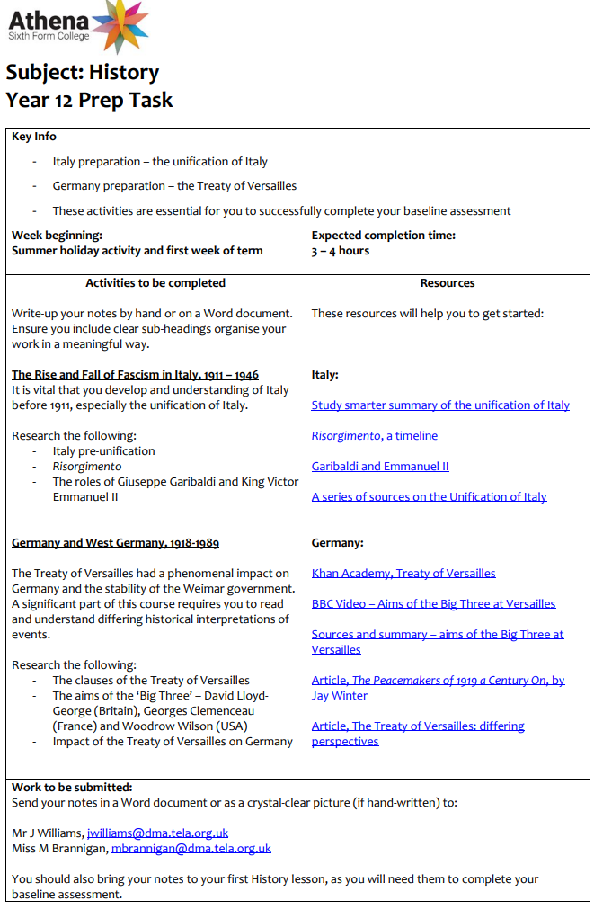
Summer preparation
During the first week of Year 12, you will sit baseline assessments. They are:
Designed to give your new teachers and understanding of your current level;
Provide you with an immediate understanding of the differences between GCSE and A-Level;
Give you something tangible to improve on.
Click here to access the pdf document

Slide 12
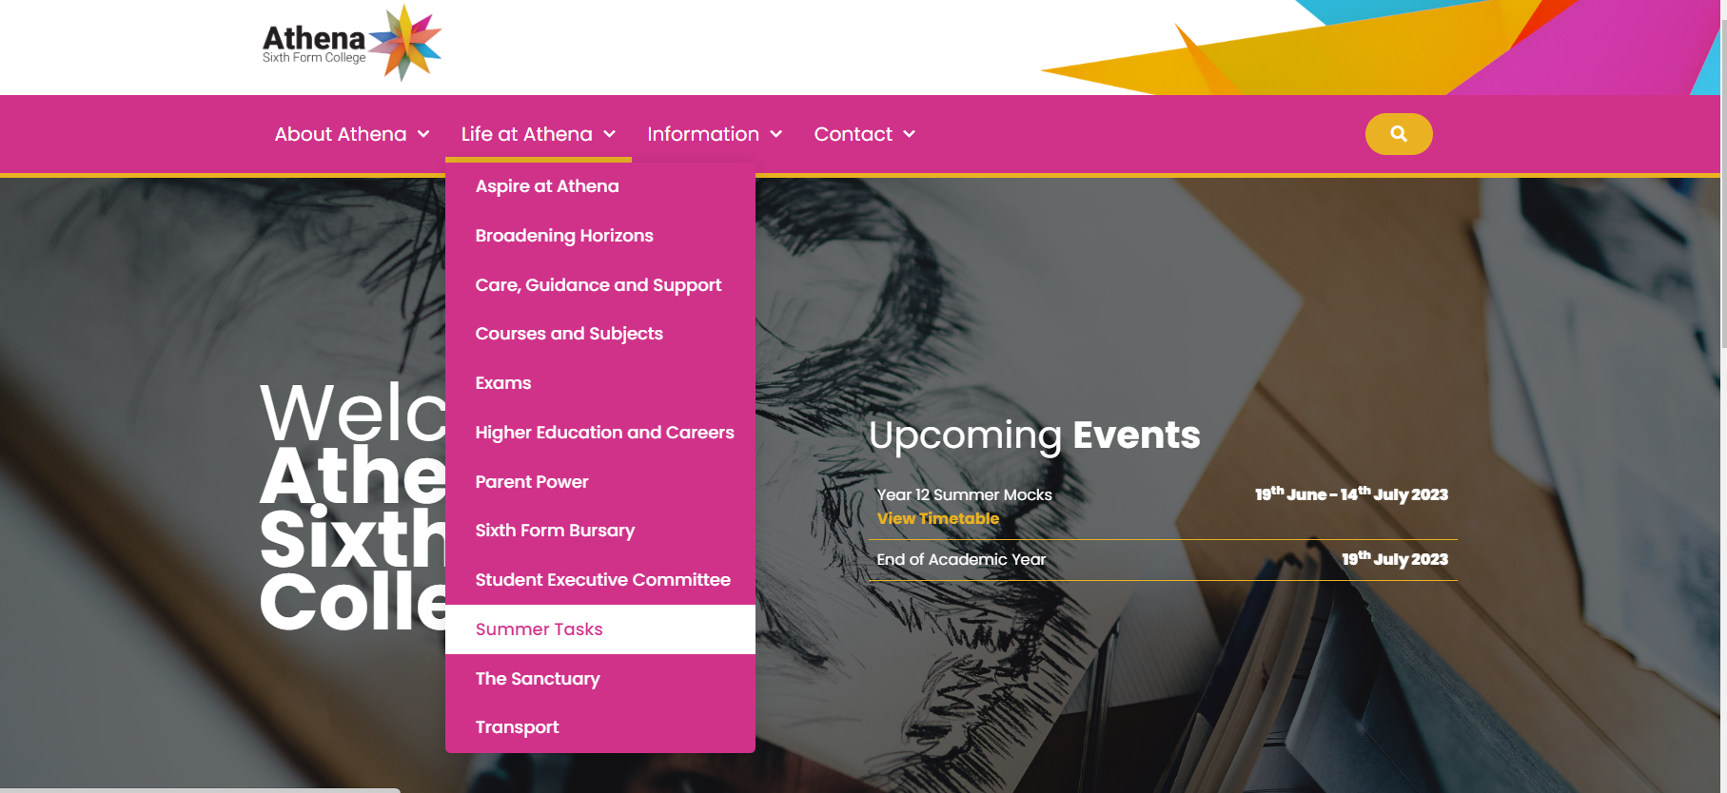
Where are the summer tasks?

